Slide 1
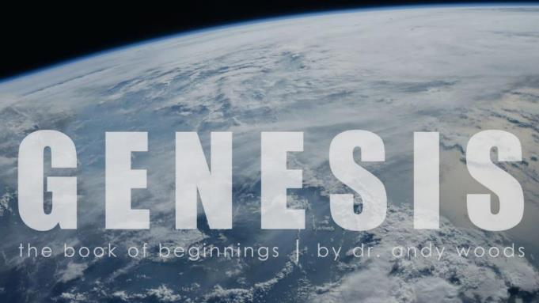
Genesis 12‒50
Israel’s Birth & Preservation

Slide 2
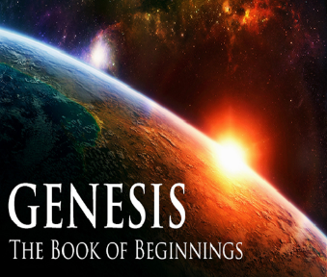
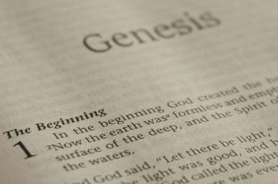
GENESIS STRUCTURE
Beginning of the Human race (Gen. 1‒11)
Beginning of the Hebrew race (Gen. 12‒50)

Slide 3
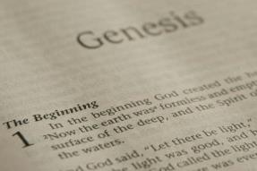
GENESIS STRUCTURE
Genesis 1-11 (four events)
Creation (1-2)
Fall (3-5)
Flood (6-9)
National dispersion (10-11)

Slide 4
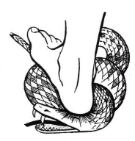
Genesis 3:15
“And I will put enmity Between you and the woman, And between your seed and her seed; He shall bruise you on the head, And you shall bruise him on the heel.”

Slide 5
GENESIS STRUCTURE
Beginning of the Human race (Gen. 1‒11)
Beginning of the Hebrew race (Gen. 12‒50)

Slide 6
GENESIS STRUCTURE
Genesis 12-50 (four people)
Abraham (12:1–25:11)
Isaac (25:12–26:35)
Jacob (27–36)
Joseph (37–50)

Slide 7
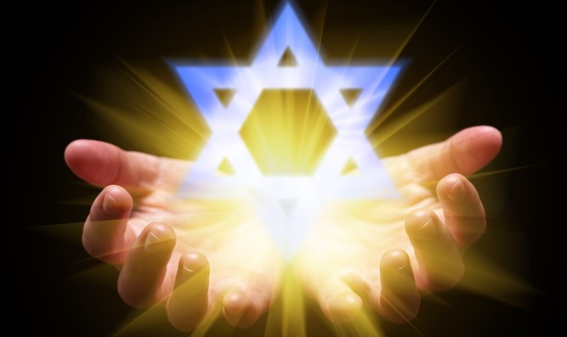
Isaiah 43:1
“But now, thus says the Lord, your Creator, O Jacob, And He who formed you, O Israel, 'Do not fear, for I have redeemed you; I have called you by name; you are Mine!'”

Slide 8
GENESIS STRUCTURE
Genesis 12-50 (four people)
Abraham (12:1–25:11)
Isaac (25:12–26:35)
Jacob (27–36)
Joseph (37–50)

Slide 9
Genesis 12‒19 Abram’s Early Journeys
Unconditional promises (Gen. 12:1-3)
From Haran to Canaan (Gen. 12:4-5)
In Canaan (Gen. 12:6-9)
In Egypt (Gen. 12:10-20)
Abram and Lot Separate (Gen. 13:1-13)
Reaffirmation of Abram’s promises (Gen. 13:14-18)
Abram Rescues Lot (14:1-24)
Abrahamic Covenant (15:1-21)
Hagar & Ishmael (16:1-16)
Circumcision (Gen. 17:1-27)
Sodom & Gomorrah (Gen. 18‒19)

Slide 10
Genesis 18‒19 Sodom & Gomorrah
Visitation (18:1-15)
Prediction (18:16-33)
Destruction (19:1-38)

Slide 11
Genesis 18‒19 Sodom & Gomorrah
Visitation (18:1-15)
Prediction (18:16-33)
Destruction (19:1-38)

Slide 12
Visitation Genesis 18:1-15
Hosting (1-8)
Promise of Isaac (9-15)

Slide 13
Visitation Genesis 18:1-15
Hosting (1-8)
Promise of Isaac (9-15)

Slide 14
Hosting Genesis 18:1-8
The appearance (1)
The invitation (2-5a)
The acceptance (5b)
The hospitality (6-8)

Slide 15
Visitation Genesis 18:1-15
Hosting (1-8)
Promise of Isaac (9-15)

Slide 16
Promise of Isaac Genesis 18:9-15
Focus on Sarah (9)
Promise (10a)
Sarah’s unbelief (10b-12)
Promise reaffirmed (13-14)
Sarah’s response (15a)
God’s response (15b)

Slide 17
Promise of Isaac Genesis 18:9-15
Focus on Sarah (9)
Promise (10a)
Sarah’s unbelief (10b-12)
Promise reaffirmed (13-14)
Sarah’s response (15a)
God’s response (15b)

Slide 18
Promise of Isaac Genesis 18:9-15
Focus on Sarah (9)
Promise (10a)
Sarah’s unbelief (10b-12)
Promise reaffirmed (13-14)
Sarah’s response (15a)
God’s response (15b)

Slide 19
Promise of Isaac Genesis 18:9-15
Focus on Sarah (9)
Promise (10a)
Sarah’s unbelief (10b-12)
Promise reaffirmed (13-14)
Sarah’s response (15a)
God’s response (15b)

Slide 20
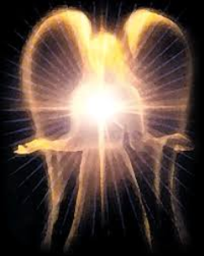
Satan’s Original State and First Sin
Isaiah 14:12-15
5 “I will” statements
Ascend to heaven (13)
Raise my throne above the stars of God (13)
Sit enthroned on the Mt. of the Assembly (13)
Ascend above the tops of the clouds (14)
Make myself like the Most High (14)

Slide 21
Promise of Isaac Genesis 18:9-15
Focus on Sarah (9)
Promise (10a)
Sarah’s unbelief (10b-12)
Promise reaffirmed (13-14)
Sarah’s response (15a)
God’s response (15b)

Slide 22
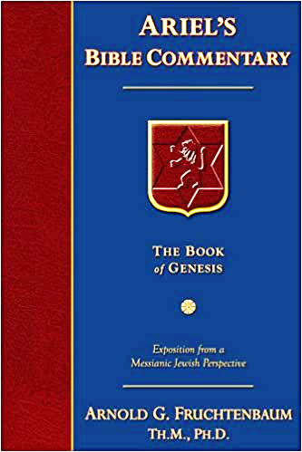
Dr. Arnold G. Fruchtenbaum
The Book of Genesis, 313
“So, the question in verse 14a was: Is anything too hard for Jehovah? The Hebrew word for hard is pele, which means ‘wonderful,’ ‘extraordinary,’ ‘surpassing.’ It is one of those Hebrew words that is only used of God, never of man (Judg. 13:18; Ps. 139:6; Isa. 9:6, 28:29). Literally: ‘Is anything too ‘wonderful’ for God to do?’”

Slide 23
John 13:19; 14:29
“^{13:19} From now on I am telling you before it comes to pass, so that when it does occur, you may believe that I am He… ^{14:29} Now I have told you before it happens, so that when it happens, you may believe.”

Slide 24
What Happened to Christ’s Disciples?
Disciple | Place | Martyrdom
James the Son of Alpheus | Jerusalem | Clubbed to death
Simon the Zealot | Jerusalem | Martyred
James the Son of Zebedee | Judea (Acts 12:2) | Executed
Thaddeus | Mesopotamia | Beaten to death
Peter | Babylon, Rome | Crucified upside down
Matthew | Parthia (Tehran) | Beheaded
Notes:
109 prophecies…
Peter Stoner – SCIENCE SPEAKS, An Evaluation of Certain Christian Evidences
To fulfill just 8 prophecies =1 X 10 to the twenty-eighth power!
Can we visualize this with an illustration? Suppose we took an atheistic professor, blindfolded him and covered the state of Texas two feet deep with silver dollars. Then we put a check on one of those silver dollars and mixed them up. The odds of one person fulfilling just these eight prophecies would be the same as this atheistic professor selecting the silver dollar upon which we have placed a check, in his first try.
https://www.bereanpublishers.com/the-odds-of-eight-messianic-prophecies-coming-true/

Slide 25
What Happened to Christ’s Disciples?
Disciple | Place | Martyrdom
John | Asia Minor, Patmos, Ephesus | Fried in boiling oil
Philip | E. Turkey | Tortured & crucified
Thomas | India | Speared
Bartholomew | India | Flayed & crucified
Andrew | Ukraine, Russia, Greece | Hanged
Notes:
109 prophecies…
Peter Stoner – SCIENCE SPEAKS, An Evaluation of Certain Christian Evidences
To fulfill just 8 prophecies =1 X 10 to the twenty-eighth power!
Can we visualize this with an illustration? Suppose we took an atheistic professor, blindfolded him and covered the state of Texas two feet deep with silver dollars. Then we put a check on one of those silver dollars and mixed them up. The odds of one person fulfilling just these eight prophecies would be the same as this atheistic professor selecting the silver dollar upon which we have placed a check, in his first try.
https://www.bereanpublishers.com/the-odds-of-eight-messianic-prophecies-coming-true/

Slide 27
Promise of Isaac Genesis 18:9-15
Focus on Sarah (9)
Promise (10a)
Sarah’s unbelief (10b-12)
Promise reaffirmed (13-14)
Sarah’s response (15a)
God’s response (15b)

Slide 28
Promise of Isaac Genesis 18:9-15
Focus on Sarah (9)
Promise (10a)
Sarah’s unbelief (10b-12)
Promise reaffirmed (13-14)
Sarah’s response (15a)
God’s response (15b)

Slide 29
Conclusion

Slide 30
Genesis 18‒19 Sodom & Gomorrah
Visitation (18:1-15)
Prediction (18:16-33)
Destruction (19:1-38)

Slide 31
Visitation Genesis 18:1-15
Hosting (1-8)
Promise of Isaac (9-15)

Slide 32
Promise of Isaac Genesis 18:9-15
Focus on Sarah (9)
Promise (10a)
Sarah’s unbelief (10b-12)
Promise reaffirmed (13-14)
Sarah’s response (15a)
God’s response (15b)

Slide 33
Genesis 18‒19 Sodom & Gomorrah
Visitation (18:1-15)
Prediction (18:16-33)
Destruction (19:1-38)

Slide 34
“The Lord bless you and keep you; the Lord make his face shine on you and be gracious to you; the Lord turn his face toward you and give you peace.” (NIV)

