Slide 1
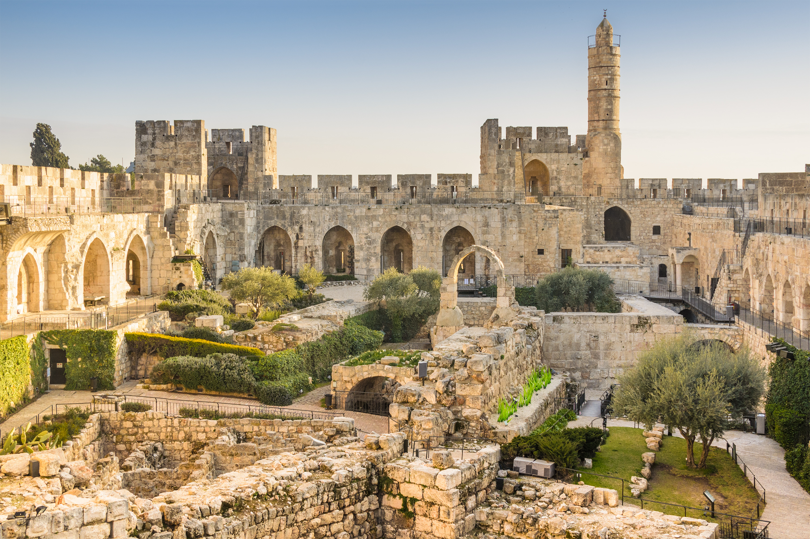
Paul J. Scharf, M.Div. Church Ministries Representative foi.org/scharf pscharf@foi.org
A Burden for God’s People Nehemiah 1:1--2:8

Slide 3
Our mission is focused: The Friends of Israel is a worldwide evangelical ministry proclaiming Biblical truth about Israel and the Messiah, while bringing physical and spiritual comfort to the Jewish people.

Slide 4
foi.org

Slide 5
foi.org/blog

Slide 6
Sharper Iron.org

Slide 7
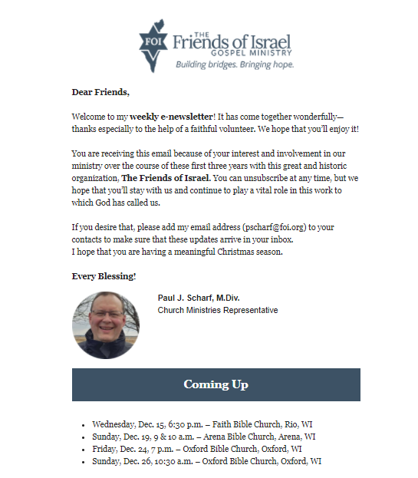
Weekly E-newsletter
Launches!

Slide 8
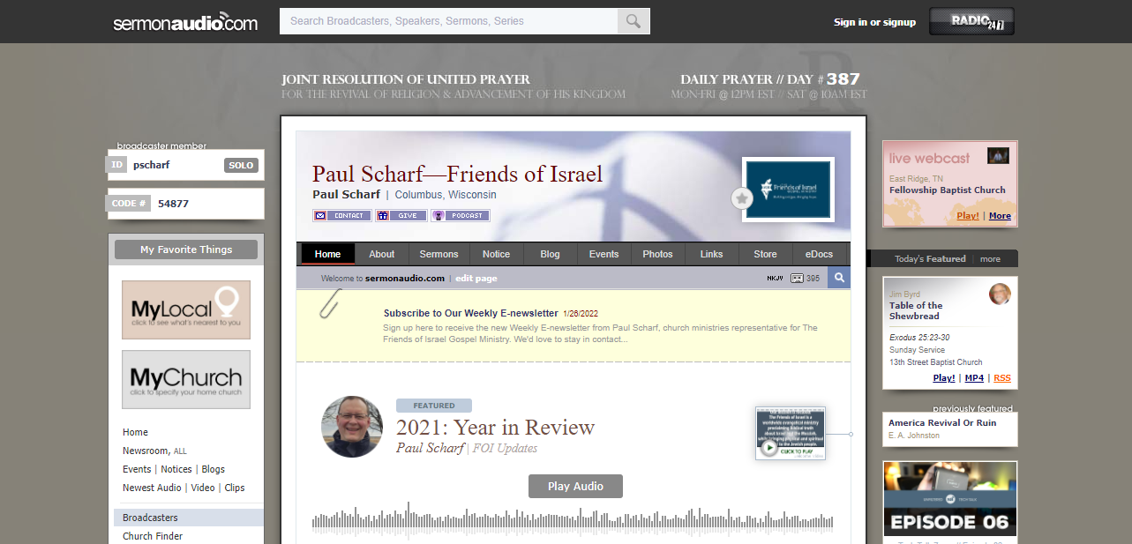
sermonaudio.com/pscharf

Slide 9
Paul J. Scharf, M.Div. Church Ministries Representative foi.org/scharf pscharf@foi.org
A Burden for God’s People Nehemiah 1:1--2:8
Scripture taken from the New King James Version®. Copyright © 1982 by Thomas Nelson. Used by permission. All rights reserved.

Slide 10
Do you have a burden for the people of God?

Slide 11
“Jerusalem will be trampled by Gentiles until the times of the Gentiles are fulfilled.”
Luke 21:24, NKJV

Slide 12
Three Waves of Captivity
605 B.C. – Daniel
597 B.C. – Ezekiel
586 B.C. – Jerusalem, Temple

Slide 14
Three Waves of Return
538 B.C. – Zerubbabel
458 B.C. – Ezra
444 B.C. – Nehemiah

Slide 16
Building the Second Temple
536 B.C. – Work Begins
520 B.C. – Work Resumes
516 B.C. – Work Completed

Slide 17
Three Post-Exilic Prophets
520 B.C. – Haggai
520 B.C. – Zechariah
433 B.C. – Malachi

Slide 18
Three Waves of Return
538 B.C. – Zerubbabel
458 B.C. – Ezra
444 B.C. – Nehemiah

Slide 20
“If I forget you, O Jerusalem, Let my right hand forget its skill !”
Psalm 137:5, NKJV

Slide 21
“… its gates are burned with fire” (Neh. 1:3)

Slide 22
“… its gates are burned with fire” (Neh. 1:3)
Prov. 24:31

Slide 23
“… its gates are burned with fire” (Neh. 1:3)
Prov. 24:31
Prov. 25:28

Slide 24
“So it was, when I heard these words, that I sat down and wept, and mourned for many days….”
Nehemiah 1:4a, NKJV

Slide 25
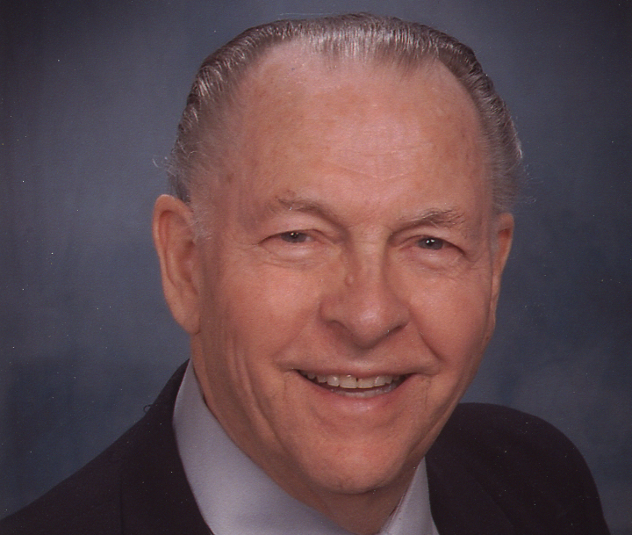
The message absolutely electrified him! It completely devastated him!
Dr. John C. Whitcomb “Nehemiah: The Crisis and the Commission”
(Indianapolis: Whitcomb Ministries).

Slide 26
“In the days of Artaxerxes also….”
Ezra 4:7, NKJV

Slide 27
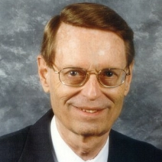
Vv. 6-23 form a parenthesis tracing the history of opposition.
Ryrie Study Bible KJV, Expanded Edition, Note on Ezra 4:24, p. 739
(Chicago: Moody Publishers, 1994).

Slide 28
The Enemies of Israel
“Rehum … Shimshai … and the rest….” (Ezra 4:9)

Slide 29
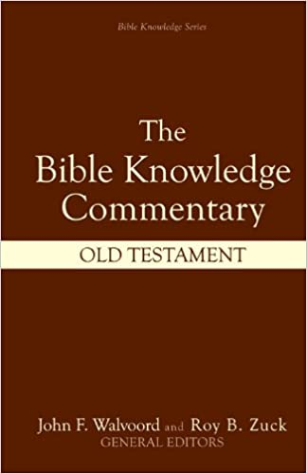
… Rehum, the commanding officer … may have been a Persian responsible to Artaxerxes (Ezra 4:17-23).
Bible Knowledge Commentary Gene A. Getz, “Nehemiah,” p. 674
The Bible Knowledge Commentary: Old Testament (Wheaton, IL: Victor Books, 1985).

Slide 30
“Rebellious and Evil City”—Ezra 4:12
“they will not pay tax, tribute, or custom” (v. 13)
“not proper for us to see the king’s dishonor” (v. 14)
“they have incited sedition” (v. 15)
“you will have no dominion” (v. 16)
Source: “Adversaries Hinder Work,” ESV Study Bible (Wheaton, IL: Crossway, 2008), p. 809

Slide 31
The precise occasion of this action against the community is not known, but it presupposed that the people had made an attempt to rebuild the city walls
ESV Study Bible Note on Ezra 4:7-8, p. 809
(Wheaton, IL: Crossway, 2008).

Slide 32
sometime before the mission of Nehemiah, who arrived in 445 B.C....
ESV Study Bible Note on Ezra 4:7-8, p. 809
(Wheaton, IL: Crossway, 2008).

Slide 34
There was no decree—and thus no authority—to rebuild the city walls, either when Zerubbabel returned in 538 B.C., or when Ezra returned in 458 B.C.

Slide 35
These letters to and from Artaxerxes are out of place chronologically, but they follow here logically to show that the opposition Ezra had begun
Bible Knowledge Commentary John A. Martin, “Ezra,” p. 660
The Bible Knowledge Commentary: Old Testament (Wheaton, IL: Victor Books, 1985).

Slide 36
to describe … continued on for many years.... Thus the letters may have been written at the time of Ezra’s return (458 B.C.).
Bible Knowledge Commentary John A. Martin, “Ezra,” p. 660
The Bible Knowledge Commentary: Old Testament (Wheaton, IL: Victor Books, 1985).

Slide 37
The enemies of the Jews used that … stop-work decree as an excuse to destroy the walls and the gates that had already been partly built.
Dr. John C. Whitcomb “Nehemiah: The Crisis and the Commission”
(Indianapolis: Whitcomb Ministries).

Slide 40
“… I was fasting and praying before the God of heaven.”
Nehemiah 1:4b, NKJV

Slide 42
Nehemiah based his prayer on the precedent of 2 Chron. 7:14, and on the examples found in Dan. 9 and Ezra 9.

Slide 43
“If My people who are called by My name will humble themselves, and pray and seek My face….”
2 Chronicles 7:14, NKJV

Slide 44
Nehemiah based his prayer on the precedent of 2 Chron. 7:14, and on the examples found in Dan. 9 and Ezra 9.

Slide 45
Nehemiah based his prayer on the precedent of 2 Chron. 7:14, and on the examples found in Dan. 9 and Ezra 9.
His prayer of confession is saturated with the words of the Hebrew Bible.

Slide 48
He prayed with knowledge, basing his prayer on the blessings and cursings sections of the Law (Lev. 26 & Deut. 28).

Slide 50
Nehemiah is also asking God to forgive and bless His people —and to revive the people and restore their land, based on His unconditional covenants (Gen. 12:1-3 & Deut. 30:1-10).

Slide 51
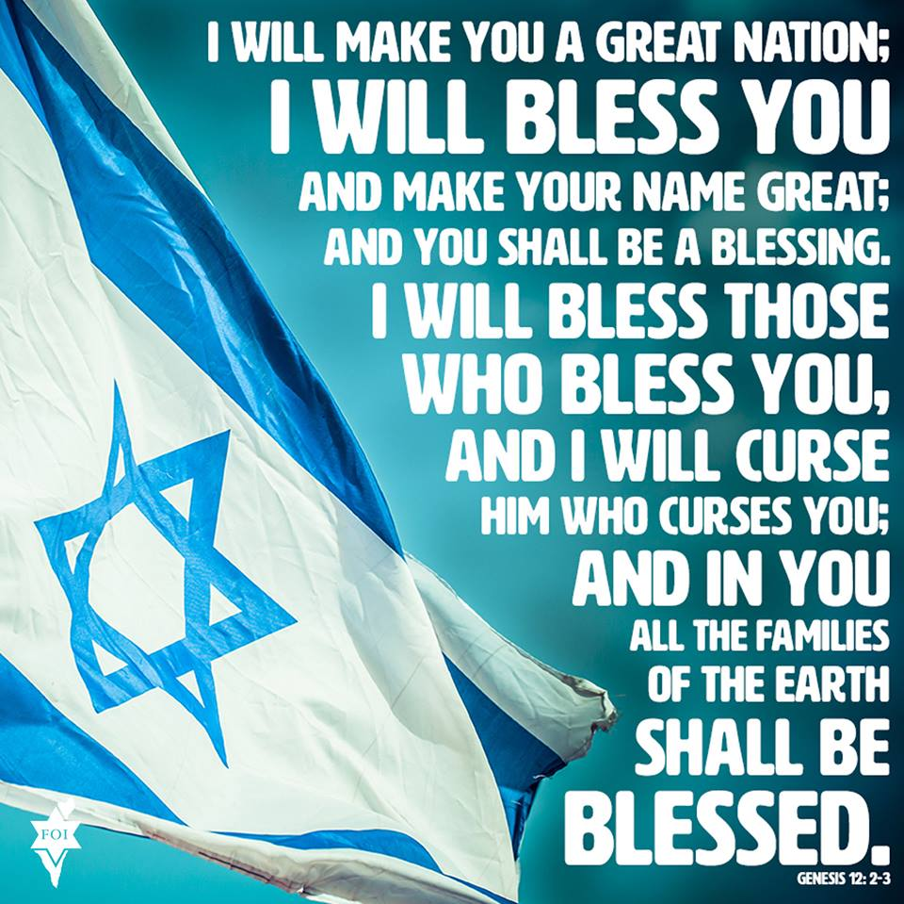

Slide 52
“… let Your servant prosper this day, I pray, and grant him mercy in the sight of this man.”
Nehemiah 1:11b, NKJV

Slide 53
“For I was the king’s cupbearer.”
Nehemiah 1:11c, NKJV

Slide 54
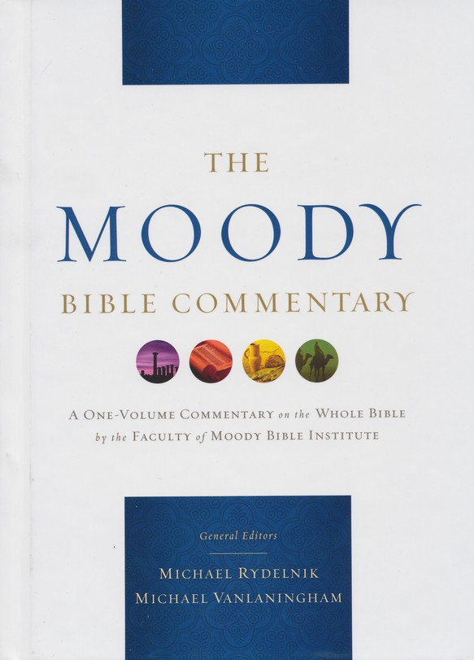
… not a waiter, but a highly trusted servant. … he did more than protect —he also served as companion
Moody Bible Commentary Bryan O’Neal, “Nehemiah,” p. 657
The Moody Bible Commentary (Chicago: Moody Publishers, 2014).

Slide 55
and confidant to the king, much like a modern “counsel to the president.”
Moody Bible Commentary Bryan O’Neal, “Nehemiah,” p. 657
The Moody Bible Commentary (Chicago: Moody Publishers, 2014).

Slide 56
This important position in the king’s court gives insight into Nehemiah’s life and character.
Bible Knowledge Commentary Gene A. Getz, “Nehemiah,” p. 674
The Bible Knowledge Commentary: Old Testament (Wheaton, IL: Victor Books, 1985).

Slide 57
A mighty monarch such as the king of Persia would select for that position a man who was wise and discreet, and consistently honest and trustworthy.
Bible Knowledge Commentary Gene A. Getz, “Nehemiah,” p. 674
The Bible Knowledge Commentary: Old Testament (Wheaton, IL: Victor Books, 1985).

Slide 58
Nehemiah’s position alone reveals much about his intellectual capabilities, his emotional maturity, and his spiritual status.
Bible Knowledge Commentary Gene A. Getz, “Nehemiah,” p. 674
The Bible Knowledge Commentary: Old Testament (Wheaton, IL: Victor Books, 1985).

Slide 59
He sat down and wept (Neh. 1:4), knelt down and prayed, and then stood up and worked....
Dr. Warren W. Wiersbe Be Determined, p. 21
(Colorado Springs, CO: Victor Books, 1992).

Slide 60
“Then the king said to me, ‘What do you request?’ So I prayed to the God of heaven.”
Nehemiah 2:4, NKJV

Slide 61
“Then the king said to me (the queen also sitting beside him)….”
Nehemiah 2:6, NKJV

Slide 62
“And the king granted them to me according to the good hand of my God upon me.”
Nehemiah 2:8b, NKJV

Slide 63
“The street shall be built again, and the wall, Even in troublesome times.”
Daniel 9:25b, NKJV

Slide 64
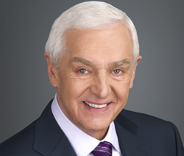
He returned to Jerusalem to rebuild a charred and blasted city, and to convince a disheartened, faithless remnant of Jewish refugees
The Jeremiah Study Bible NKJV, “Book Introduction,” p. 621
David Jeremiah (Franklin, TN: Worthy Publishing, 2013).

Slide 65
that the God of Abraham, Isaac, and Jacob still wanted to be their God.
The Jeremiah Study Bible NKJV, “Book Introduction,” p. 621
David Jeremiah (Franklin, TN: Worthy Publishing, 2013).

Slide 67
“For even the Son of Man did not come to be served, but to serve, and to give His life a ransom for many.”
Mark 10:45, NKJV

Slide 68
Do you have a burden for the people of God?

Slide 69
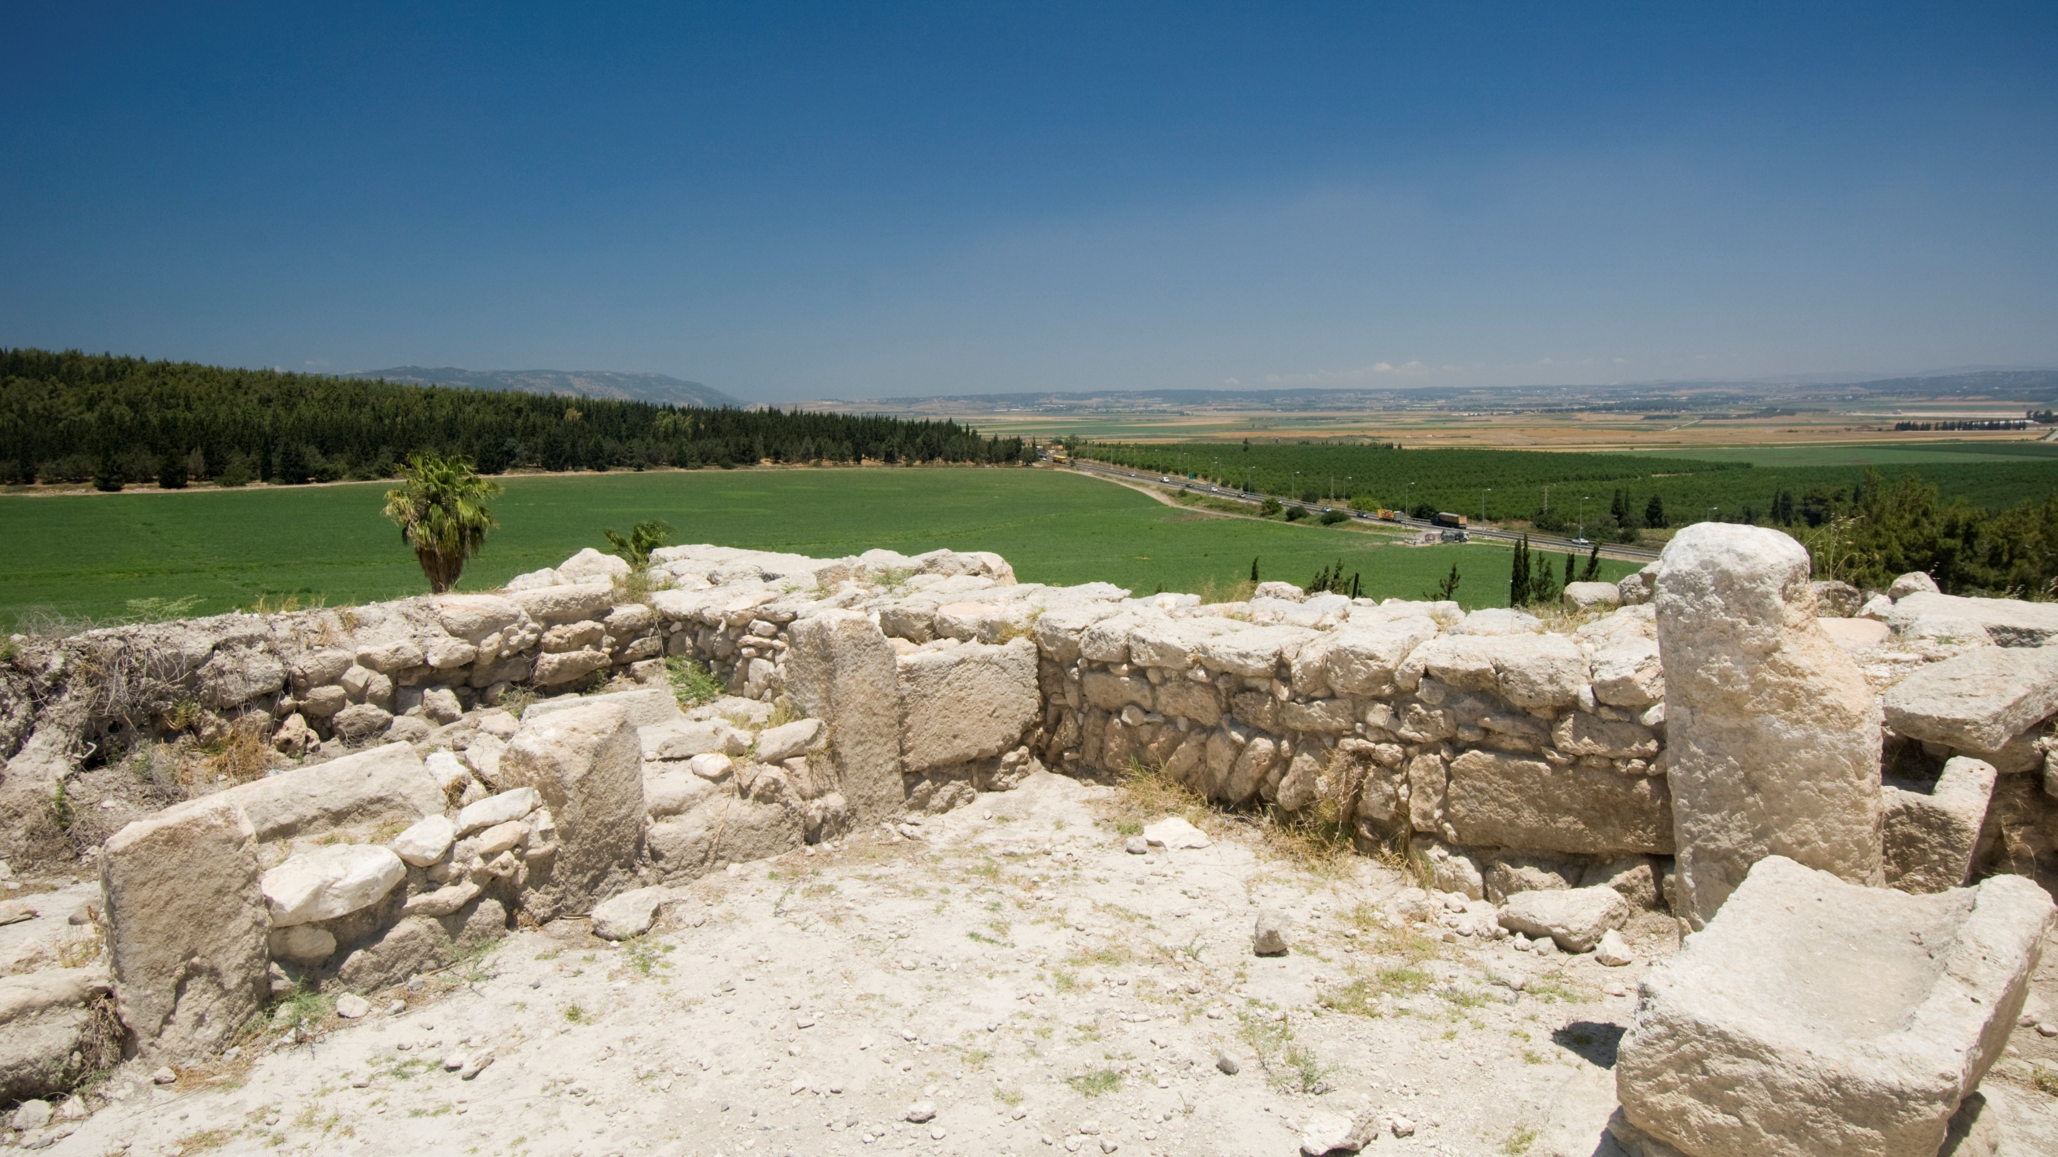
Paul J. Scharf, M.Div. Church Ministries Representative foi.org/scharf pscharf@foi.org
A Burden for God’s Work Nehemiah 2:9--3:32

Slide 70
Paul J. Scharf, M.Div. Church Ministries Representative foi.org/scharf pscharf@foi.org
A Burden for God’s People Nehemiah 1:1--2:8

