Slide 1
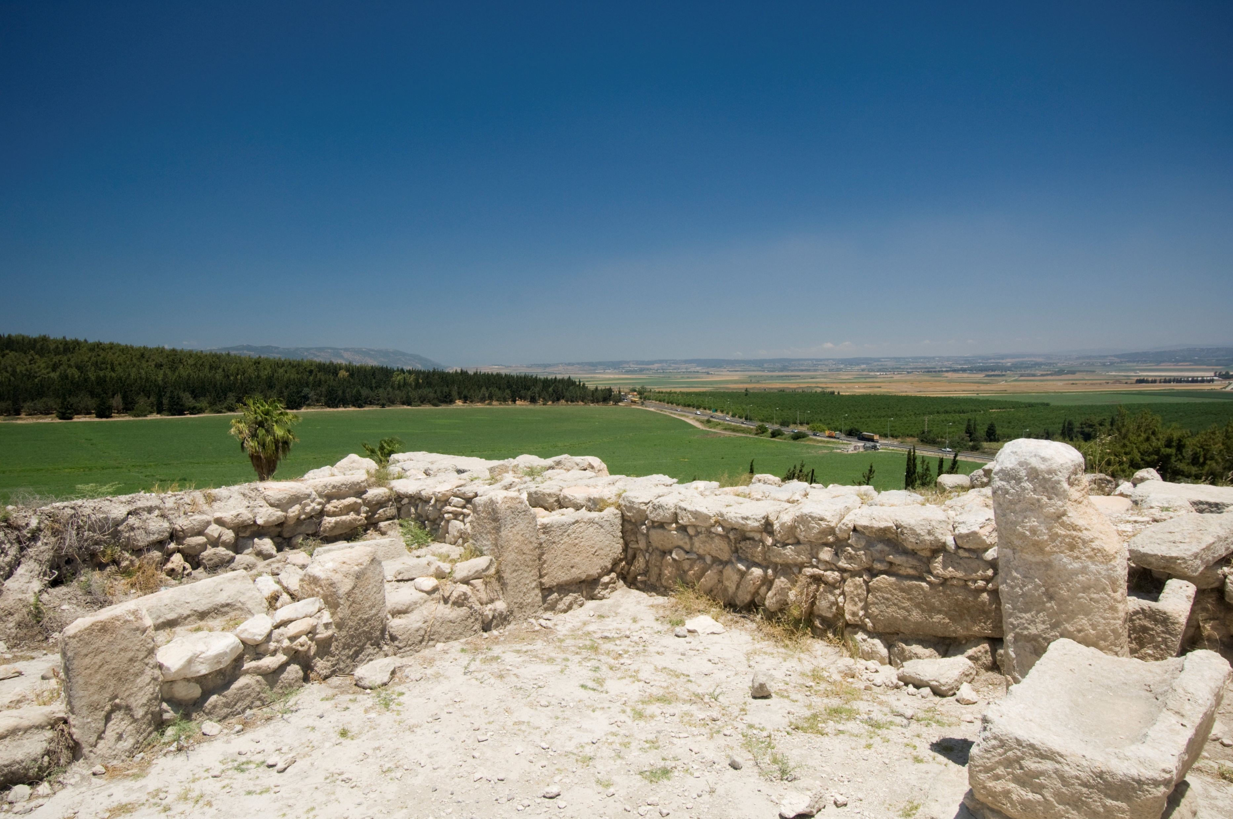
Paul J. Scharf, M.Div. Church Ministries Representative foi.org/scharf pscharf@foi.org
A Burden for God’s Work Nehemiah 2:9--3:32

Slide 3
Our mission is focused: The Friends of Israel is a worldwide evangelical ministry proclaiming Biblical truth about Israel and the Messiah, while bringing physical and spiritual comfort to the Jewish people.

Slide 4
foi.org

Slide 5
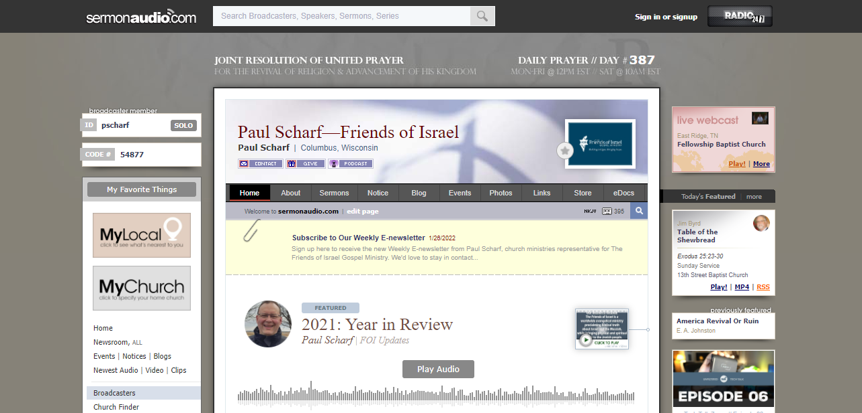
sermonaudio.com/pscharf

Slide 6
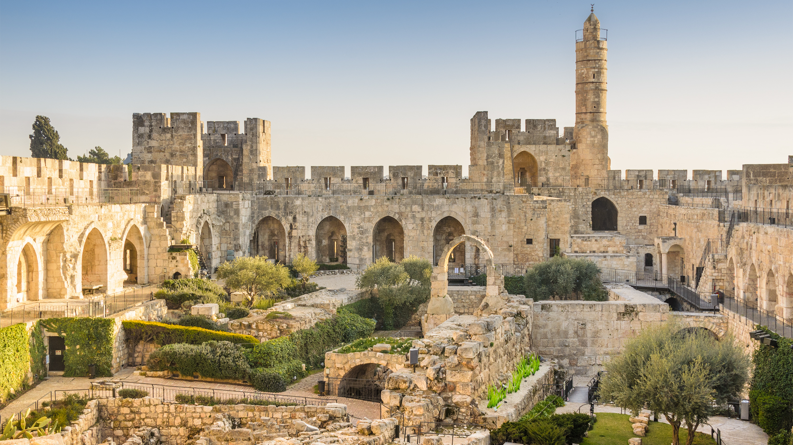
Paul J. Scharf, M.Div. Church Ministries Representative foi.org/scharf pscharf@foi.org
A Burden for God’s People Nehemiah 1:1--2:8

Slide 7
Paul J. Scharf, M.Div. Church Ministries Representative foi.org/scharf pscharf@foi.org
A Burden for God’s Work Nehemiah 2:9--3:32
Scripture taken from the New King James Version®. Copyright © 1982 by Thomas Nelson. Used by permission. All rights reserved.

Slide 8
Do you have a burden for the work of God?

Slide 9
“Jerusalem will be trampled by Gentiles until the times of the Gentiles are fulfilled.”
Luke 21:24, NKJV

Slide 10
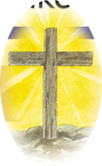
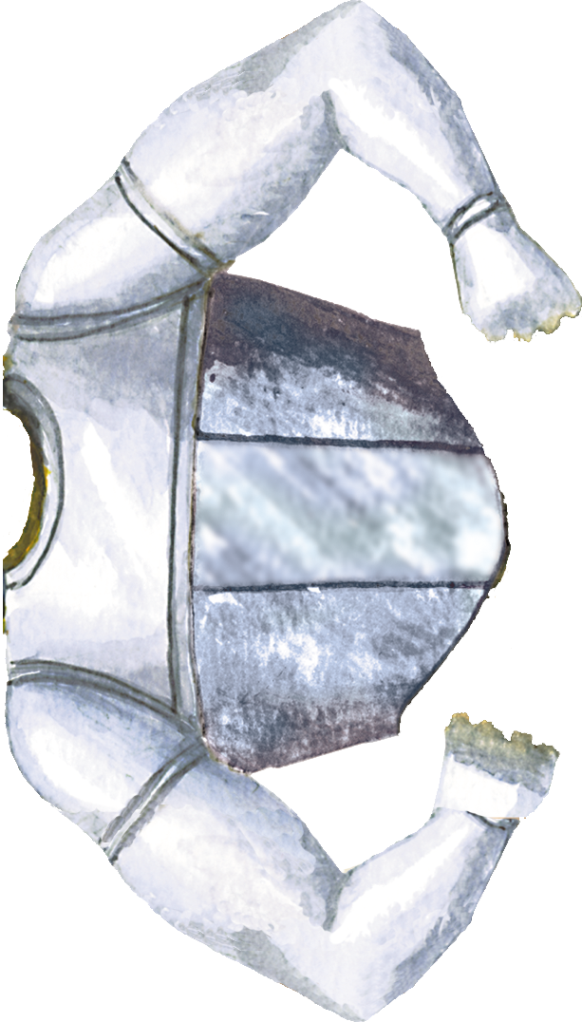
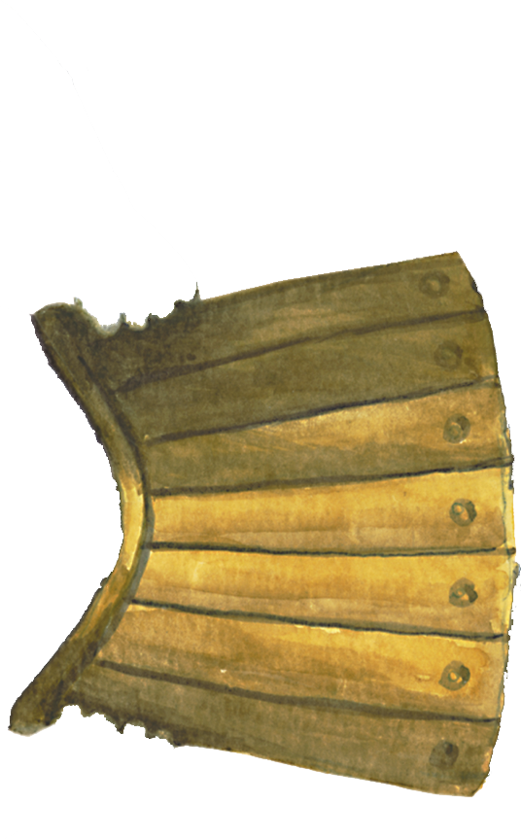
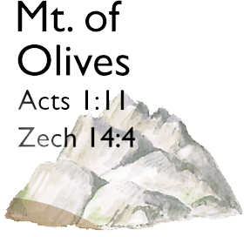
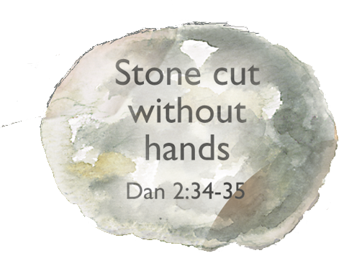
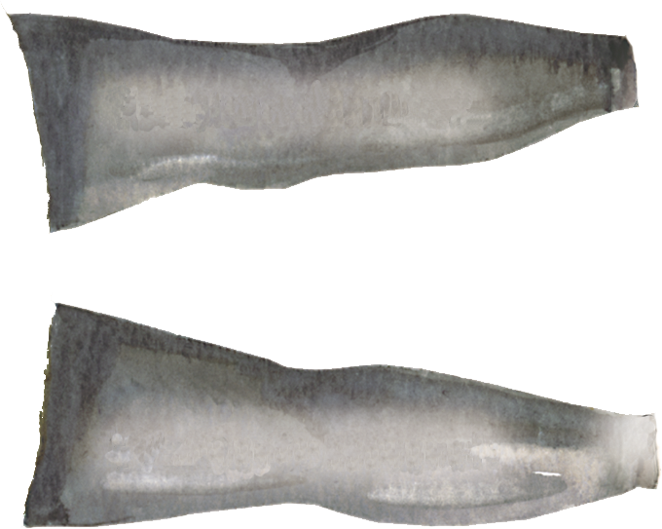
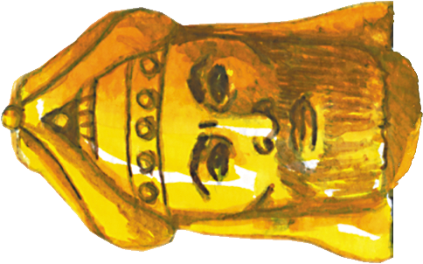
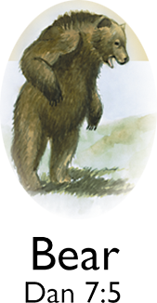
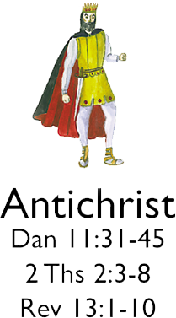
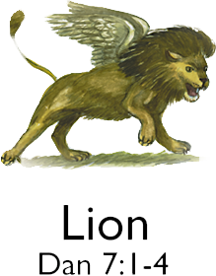
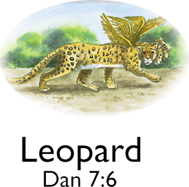
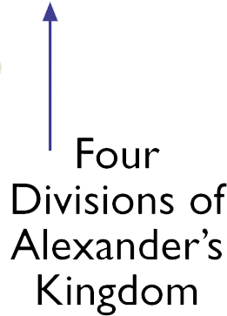
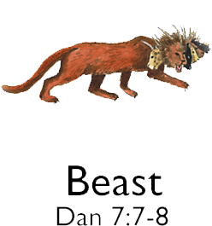
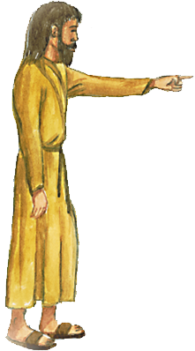
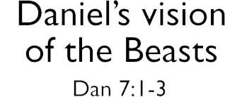
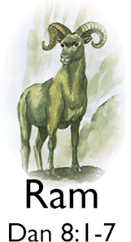
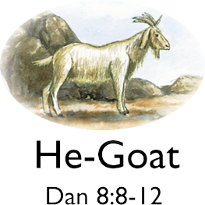

Slide 12
“And the king granted them to me according to the good hand of my God upon me.”
Nehemiah 2:8b, NKJV

Slide 13
Three Waves of Return
538 B.C. – Zerubbabel
458 B.C. – Ezra
444 B.C. – Nehemiah

Slide 15
“The street shall be built again, and the wall, Even in troublesome times.”
Daniel 9:25b, NKJV

Slide 16
“… I will build My church, and the gates of Hades shall not prevail against it.”
Matthew 16:18, NKJV

Slide 17
“For we are God’s fellow workers; you are God’s field, you are God’s building.”
1 Corinthians 3:9, NKJV

Slide 18
“We then, as workers together with Him....”
2 Corinthians 6:1, NKJV

Slide 19
The Enemies of Israel
“Rehum … Shimshai … and the rest….” (Ezra 4:9)
Sanballat and Tobiah (Neh. 2:10)
Geshem (Neh. 2:19)
Noadiah (Neh. 6:14)

Slide 22
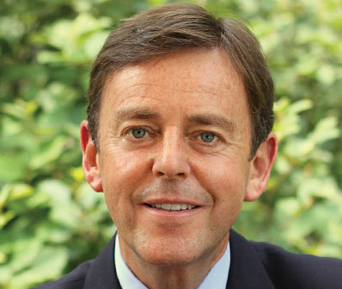
There is a time for silence. There is a time for reconnaissance. There is a time for prayerful examination.
Alistair Begg “Nov. 5, 2010: Planting the Vision”
Truth for Life; sermonaudio.com/sermon/11510110037570; Internet; accessed 12 March 2022.

Slide 24
Nehemiah saw more at night than the residents saw in the daylight, for he saw the potential as well as the problems.
Dr. Warren W. Wiersbe Be Determined, p. 32
(Colorado Springs, CO: Victor Books, 1992).

Slide 25
“Come and let us build the wall of Jerusalem, that we may no longer be a reproach.”
Nehemiah 2:17, NKJV

Slide 26
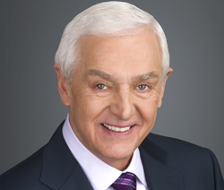
Nehemiah’s ability to rally the people to the cause is a testament to his leadership and strength of character.
The Jeremiah Study Bible NKJV, “Book Introduction,” p. 622
David Jeremiah (Franklin, TN: Worthy Publishing, 2013).

Slide 27
“He came to His own....”
John 1:11a, NKJV

Slide 28
“… He is not ashamed to call them brethren....”
Hebrews 2:11b, NKJV

Slide 29
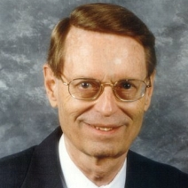
The work began Aug. 1, 444 B.C.
Ryrie Study Bible KJV, Expanded Edition, Note on Ezra 2:18, p. 753
(Chicago: Moody Publishers, 1994).

Slide 31
Ch. 3 is the heart of the book!

Slide 32
Ch. 3 is the heart of the book!
Ch. 4-6 take place during the rebuilding described here.

Slide 33
Chapters 4 to 6 describe at least nine different tactics that the enemy used to try to stop the work on the walls.
Dr. Warren W. Wiersbe Be Determined, p. 50
(Colorado Springs, CO: Victor Books, 1992).

Slide 34
Ridicule (4:1-6)
Plots of war (4:7-9)
Discouragement (4:10)
Fear (4:11-23)
Selfishness (5:1-19)
Compromise (6:1-4)
Slander (6:5-9)
Threats (6:10-14)
Intrigue (6:17-19)
Warren W. Wiersbe, Be Determined (Colorado Springs, CO: Victor Books, 1992), p. 50.

Slide 35
Seven Adversarial Attacks
Based on “Seven Attempts to Stop Nehemiah’s Work.” John MacArthur, MacArthur Study Bible, 2nd Edition, ESV (Nashville, TN: Thomas Nelson, 2021), p. 591.

Slide 36
Seven Adversarial Attacks
“they laughed at us and despised us” – 2:19
Based on “Seven Attempts to Stop Nehemiah’s Work.” John MacArthur, MacArthur Study Bible, 2nd Edition, ESV (Nashville, TN: Thomas Nelson, 2021), p. 591.

Slide 37
Seven Adversarial Attacks
“they laughed at us and despised us” – 2:19
“Sanballat … mocked the Jews” – 4:1
Based on “Seven Attempts to Stop Nehemiah’s Work.” John MacArthur, MacArthur Study Bible, 2nd Edition, ESV (Nashville, TN: Thomas Nelson, 2021), p. 591.

Slide 38
Seven Adversarial Attacks
Based on “Seven Attempts to Stop Nehemiah’s Work.” John MacArthur, MacArthur Study Bible, 2nd Edition, ESV (Nashville, TN: Thomas Nelson, 2021), p. 591.

Slide 39
Seven Adversarial Attacks
“conspired ... to ... attack Jerusalem” – 4:8
Based on “Seven Attempts to Stop Nehemiah’s Work.” John MacArthur, MacArthur Study Bible, 2nd Edition, ESV (Nashville, TN: Thomas Nelson, 2021), p. 591.

Slide 40
Seven Adversarial Attacks
“conspired ... to ... attack Jerusalem” – 4:8
“let us meet together” – 6:2
Based on “Seven Attempts to Stop Nehemiah’s Work.” John MacArthur, MacArthur Study Bible, 2nd Edition, ESV (Nashville, TN: Thomas Nelson, 2021), p. 591.

Slide 41
Seven Adversarial Attacks
Based on “Seven Attempts to Stop Nehemiah’s Work.” John MacArthur, MacArthur Study Bible, 2nd Edition, ESV (Nashville, TN: Thomas Nelson, 2021), p. 591.

Slide 42
Seven Adversarial Attacks
“an open letter” – 6:5
Based on “Seven Attempts to Stop Nehemiah’s Work.” John MacArthur, MacArthur Study Bible, 2nd Edition, ESV (Nashville, TN: Thomas Nelson, 2021), p. 591.

Slide 43
Seven Adversarial Attacks
“an open letter” – 6:5
“prophecy against me” – 6:12
Based on “Seven Attempts to Stop Nehemiah’s Work.” John MacArthur, MacArthur Study Bible, 2nd Edition, ESV (Nashville, TN: Thomas Nelson, 2021), p. 591.

Slide 44
Seven Adversarial Attacks
Based on “Seven Attempts to Stop Nehemiah’s Work.” John MacArthur, MacArthur Study Bible, 2nd Edition, ESV (Nashville, TN: Thomas Nelson, 2021), p. 591.

Slide 45
Seven Adversarial Attacks
“Tobiah sent letters to frighten me” – 6:19
Based on “Seven Attempts to Stop Nehemiah’s Work.” John MacArthur, MacArthur Study Bible, 2nd Edition, ESV (Nashville, TN: Thomas Nelson, 2021), p. 591.

Slide 46
Ch. 3 is the heart of the book!
Ch. 4-6 take place during the rebuilding described here.

Slide 47
Ch. 3 is the heart of the book!
Ch. 4-6 take place during the rebuilding described here.
Ch. 7-13 take place within the rebuilt city.

Slide 49
Ch. 3 tells the story of rebuilding up to 2.5 miles of wall, surrounding 220 acres of the city.*
*Edwin Yamauchi, Expositor’s Bible Commentary, Vol. 4, p. 692

Slide 50
Ch. 3 tells the story of rebuilding up to 2.5 miles of wall, surrounding 220 acres of the city.*
Vv. 1-5 are the northern walls
Vv. 6-13 are the western walls
Vv. 14-16 are the southern walls
Vv. 17-32 are the eastern walls
*Edwin Yamauchi, Expositor’s Bible Commentary, Vol. 4, p. 692

Slide 52
Ch. 3 tells the story of rebuilding up to 2.5 miles of wall, surrounding 220 acres of the city.*
Vv. 1-5 are the northern walls
Vv. 6-13 are the western walls
Vv. 14-16 are the southern walls
Vv. 17-32 are the eastern walls
*Edwin Yamauchi, Expositor’s Bible Commentary, Vol. 4, p. 692

Slide 54
Ch. 3 mentions 38 individuals, representing 42 different groups.

Slide 55
The work is sometimes “building” and sometimes “repairing,” suggesting that the parts of the walls were in various states of dilapidation.
ESV Study Bible Note on Nehemiah 3:4, p. 827
(Wheaton, IL: Crossway, 2008).

Slide 56
In most cases, these would have been massive double doorways designed to accommodate the anticipated size and flow of traffic.
The Jeremiah Study Bible NKJV, “A Gated Community,” p. 626
David Jeremiah (Franklin, TN: Worthy Publishing, 2013).

Slide 57
Fully loaded camels would pass through, and the traffic at the gates was often two-way.
The Jeremiah Study Bible NKJV, “A Gated Community,” p. 626
David Jeremiah (Franklin, TN: Worthy Publishing, 2013).

Slide 58
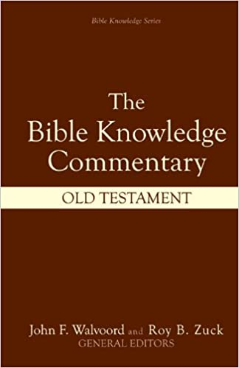
A task so enormous as rebuilding the walls of Jerusalem, especially under adverse conditions, called for unusual organizational effort.
Bible Knowledge Commentary Gene A. Getz, “Nehemiah,” p. 678
The Bible Knowledge Commentary: Old Testament (Wheaton, IL: Victor Books, 1985).

Slide 59
The uniqueness of Nehemiah’s plan is evident in this chapter.
Bible Knowledge Commentary Gene A. Getz, “Nehemiah,” p. 678
The Bible Knowledge Commentary: Old Testament (Wheaton, IL: Victor Books, 1985).

Slide 61
Working Together – Nehemiah 3

Slide 62
Working Together – Nehemiah 3
Close to Home – vv. 1, 10, 17, 23, 28-30

Slide 63
“… the high priest rose up with his brethren the priests and built the Sheep Gate....”
Nehemiah 3:1, NKJV

Slide 64
Working Together – Nehemiah 3
Close to Home – vv. 1, 10, 17, 23, 28-30

Slide 65
Working Together – Nehemiah 3
Close to Home – vv. 1, 10, 17, 23, 28-30
“Next to …” = 16 times

Slide 66
“And next to them....”
Nehemiah 3:4, NKJV

Slide 67
Working Together – Nehemiah 3
Close to Home – vv. 1, 10, 17, 23, 28-30
“Next to …” = 16 times

Slide 68
“… joined and knit together by what every joint supplies, according to the effective working by which every part does its share....”
Ephesians 4:16, NKJV

Slide 69
Working Together – Nehemiah 3
Close to Home – vv. 1, 10, 17, 23, 28-30
“Next to …” = 16 times

Slide 70
Working Together – Nehemiah 3
Close to Home – vv. 1, 10, 17, 23, 28-30
“Next to …” = 16 times
Notable Nobles – vv. 1, 4, 8, 9, 12, 16-19, 22, 28, 31, 32

Slide 71
Working Together – Nehemiah 3
Close to Home – vv. 1, 10, 17, 23, 28-30
“Next to …” = 16 times
Notable Nobles – vv. 1, 4, 8, 9, 12, 16-19, 22, 28, 31, 32
Women at Work – vv. 12

Slide 72
Working Together – Nehemiah 3

Slide 73
Working Together – Nehemiah 3
A Bad Report – v. 5 – See v. 27

Slide 74
Working Together – Nehemiah 3
A Bad Report – v. 5 – See v. 27
Extra Effort – v. 11, 19, 20, 21, 24, 27, 30

Slide 75
Working Together – Nehemiah 3
A Bad Report – v. 5 – See v. 27
Extra Effort – v. 11, 19, 20, 21, 24, 27, 30
The End Result – 4:1-6; 6:15-16

Slide 76
“So we built the wall, and the entire wall was joined together up to half its height, for the people had a mind to work.”
Nehemiah 4:6, NKJV

Slide 77
Working Together – Nehemiah 3
A Bad Report – v. 5 – See v. 27
Extra Effort – v. 11, 19, 20, 21, 24, 27, 30
The End Result – 4:1-6; 6:15-16

Slide 78
In only 52 days, the wall around the city was whole again —restored and rebuilt (6:15).
The Jeremiah Study Bible NKJV, “Book Introduction,” p. 622
David Jeremiah (Franklin, TN: Worthy Publishing, 2013).

Slide 79
“So the wall was finished … in fifty-two days.”
Nehemiah 6:15, NKJV

Slide 80
The wall was completed on Sept. 21, 444 B.C.
Ryrie Study Bible KJV, Expanded Edition, Note on Ezra 6:15, p. 759
(Chicago: Moody Publishers, 1994).

Slide 81
It is time to build up the work of God!

Slide 82
“Be ready in season and out of season.”
2 Timothy 4:2, NKJV

Slide 83
Working Together – Nehemiah 3
A Bad Report – V. 5 – See v. 27
Extra Effort – V. 11, 19, 20, 21, 24, 27, 30
The End Result – 4:1-6; 6:15-16

Slide 84
Working Together – Nehemiah 3
A Bad Report – V. 5 – See v. 27
Extra Effort – V. 11, 19, 20, 21, 24, 27, 30
The End Result – 4:1-6; 6:15-16
One Missing Name

Slide 85
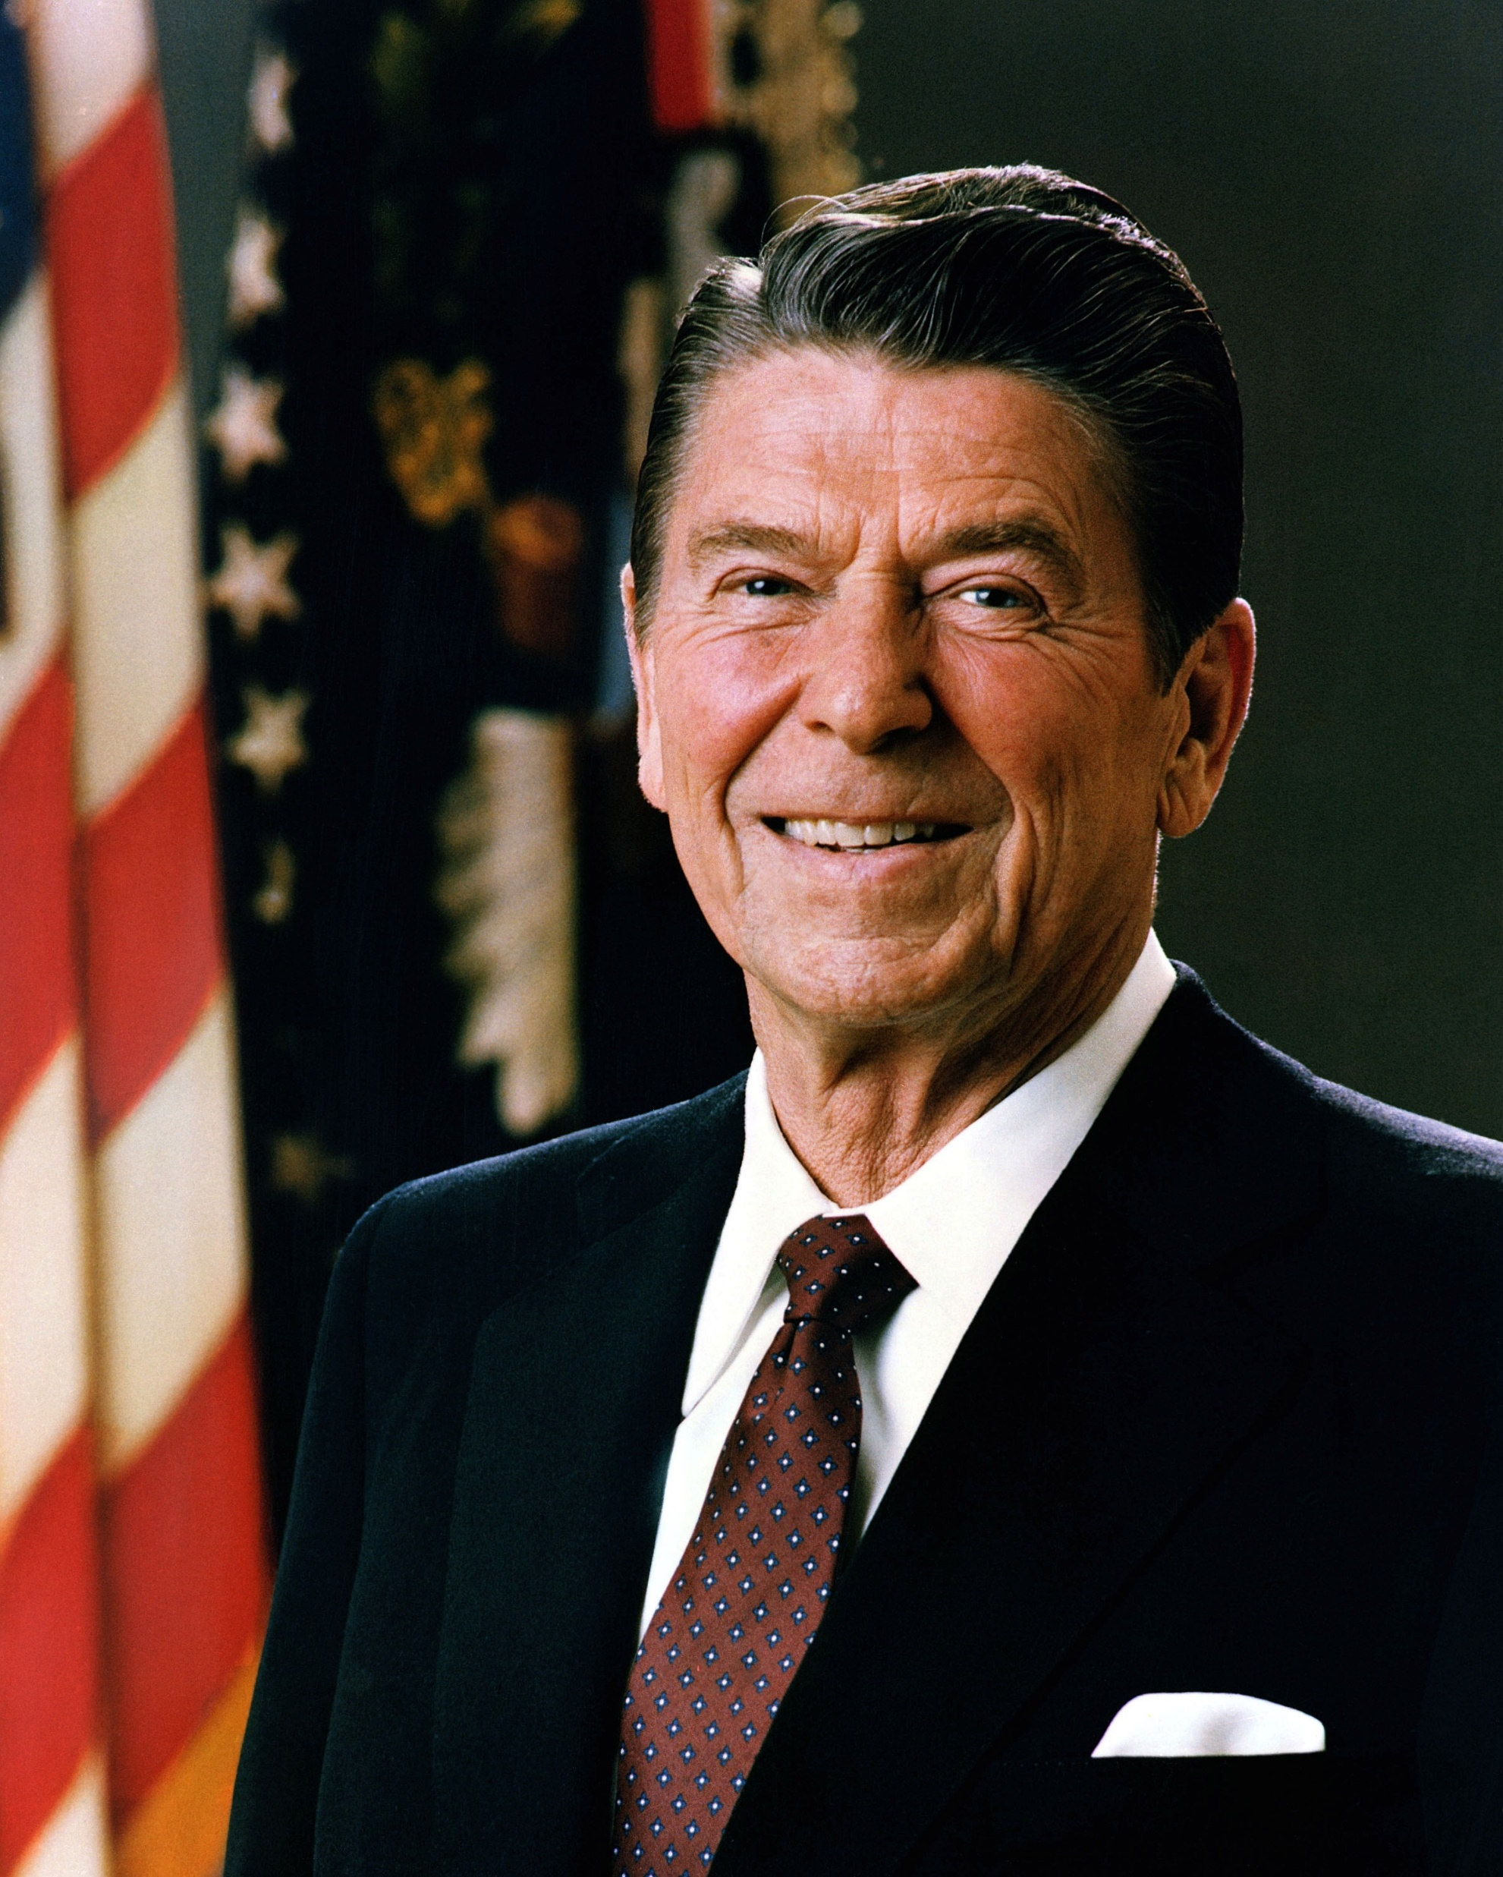
“On my desk in the Oval Office, I have a little sign that says: There is no limit to what a man can do or where he can go if he doesn’t mind who gets the credit.”
40th President Ronald Reagan
Jan. 29, 1988; Source: Ronald Reagan Presidential Library and Museum, Simi Valley, CA.

Slide 86
“Remember me, my God, for good, according to all that I have done for this people.”
Nehemiah 5:19, NKJV

Slide 87
“For God is not unjust to forget your work and labor of love which you have shown
Hebrews 6:10, NKJV

Slide 88
toward His name, in that you have ministered to the saints, and do minister.”
Hebrews 6:10, NKJV

Slide 89
“… And I will write on him My new name.”
Revelation 3:12, NKJV

Slide 90
Do you have a burden for the work of God?

Slide 91
Paul J. Scharf, M.Div. Church Ministries Representative foi.org/scharf pscharf@foi.org
A Burden for God’s Work Nehemiah 2:9--3:32

