Slide 1
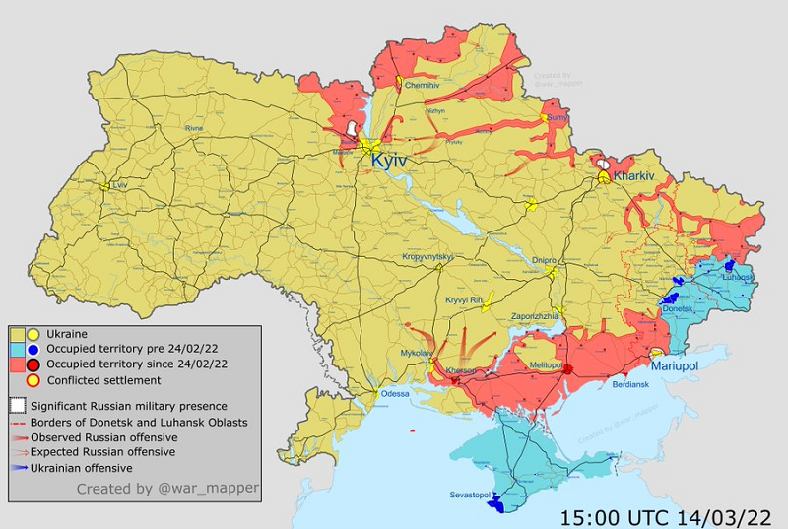

Slide 2
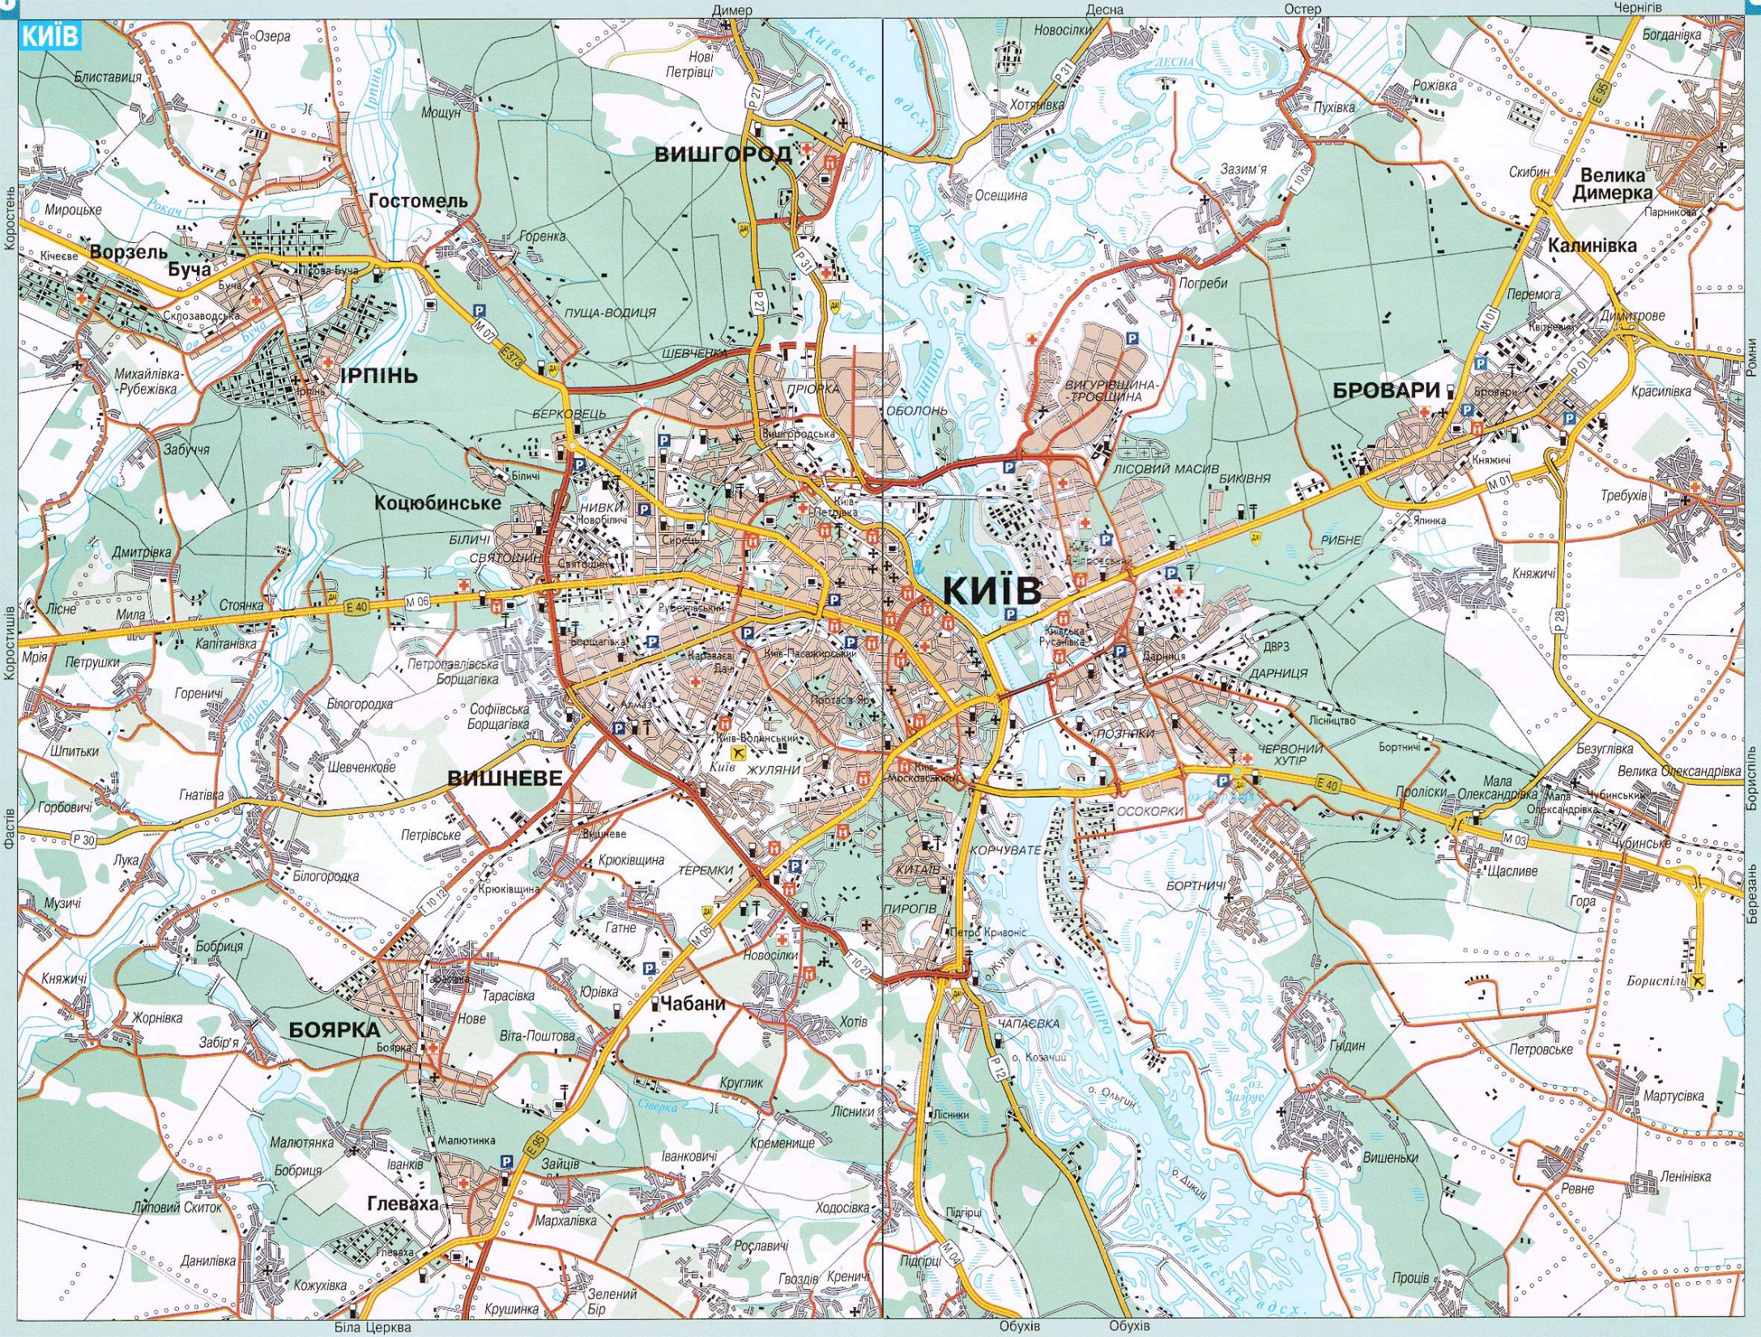

Slide 3
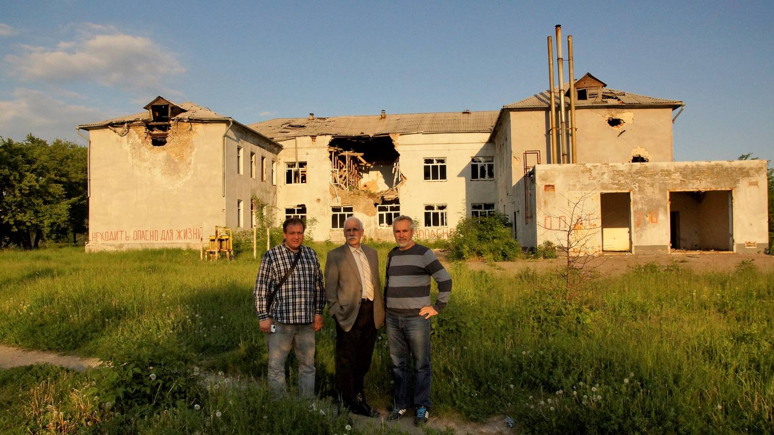

Slide 4
Exceedingly Great and Precious Promises

Slide 5
^{NKJ} 2 Peter 1:1 Simon Peter, a bondservant and apostle of Jesus Christ, To those who have obtained like precious faith with us by the righteousness of our God and Savior Jesus Christ:
² Grace and peace be multiplied to you in the knowledge of God and of Jesus our Lord,

Slide 6
³ as His divine power has given to us all things that pertain to life and godliness, through the knowledge of Him who called us by glory and virtue,
⁴ by which have been given to us exceedingly great and precious promises, that through these you may be partakers of the divine nature, having escaped the corruption that is in the world through lust.

Slide 7
⁵ But also for this very reason, giving all diligence, add to your faith virtue, to virtue knowledge,
⁶ to knowledge self-control, to self-control perseverance, to perseverance godliness,

Slide 8
⁷ to godliness brotherly kindness, and to brotherly kindness love.
⁸ For if these things are yours and abound, you will be neither barren nor unfruitful in the knowledge of our Lord Jesus Christ.

Slide 9
⁹ For he who lacks these things is shortsighted, even to blindness, and has forgotten that he was cleansed from his old sins.
¹⁰ Therefore, brethren, be even more diligent to make your call and election sure, for if you do these things you will never stumble;

Slide 10
¹¹ for so an entrance will be supplied to you abundantly into the everlasting kingdom of our Lord and Savior Jesus Christ.

Slide 12
^{NKJ} 2 Peter 1:1 Simon Peter, a bondservant and apostle of Jesus Christ, To those who have obtained like precious faith with us by the righteousness of our God and Savior Jesus Christ:
² Grace and peace be multiplied to you in the knowledge of God and of Jesus our Lord,

Slide 13
³ as His divine power has given to us all things that pertain to life and godliness, through the knowledge of Him who called us by glory and virtue,
⁴ by which have been given to us exceedingly great and precious promises, that through these you may be partakers of the divine nature, having escaped the corruption that is in the world through lust.

Slide 15
1. God is omniscient: He knows all the knowable. He has always known everything. No difficulty, heartache, trauma, adversity, or attack against you is a surprise to Him.

Slide 16
2. We mix our faith with the principles of God's Word.

Slide 17
3. We apply doctrinal rationales and doctrinal conclusions to the circumstances of life. If God solved the greatest problem I will ever face, God can solve any problem I face.

Slide 18
2. God has an eternal plan, included in that plan is a plan for your life. In that plan God saw every situation you would ever face, every need you would ever have. He made provision for you to fulfill His plan (not yours!)

Slide 19
3. Therefore God's Word and grace are more than sufficient to handle the problems.

Slide 20
4. To claim a promise you must first know it. The more promises you know, the better equipped you are to face the difficulties of life.

Slide 21
5. Consider the theology behind the promise, i.e, the character of God. God cannot lie, therefore His promises are sure. God is all powerful; therefore He is able to keep His promises.

Slide 22
Precious Promises

Slide 25
Precious Promises

Slide 26
This is the day which the Lord has made, we will rejoice and be glad in it. Psa. 118:24

Slide 27
Blessed be the Lord who daily bears our burden, the God who is our salvation; God is to us a God of salvation. Psa. 68:19

Slide 28
Fear thou not for I am with thee; be not dismayed for I am thy God: I will strengthen thee; yea I will help thee; yea I will uphold thee with the right hand of my righteousness. Isa. 41:10

Slide 29
Cast thy burden upon the Lord, and he shall sustain thee; he shall never suffer the righteous to be moved. Psa. 55:22

Slide 30
Thou wilt keep him in perfect peace, whose mind is stayed on thee, because he trusteth in thee. Trust ye in the Lord forever, for in the Lord Jehovah is everlasting strength. Isa. 26:3-4

Slide 31
But they that wait upon the Lord shall renew their strength; they shall mount up with wings as eagles; they shall run and not be weary; and they shall walk and not faint. Isa. 40:31

Slide 32
For with God nothing shall be impossible. Luke 1:37

Slide 33
He that spared not his own son, but delivered him up for us all, how shall he not with him also freely give us all things? Rom. 8:32

Slide 34
And we know that all things work together for good to them that love God, to them who are the called according to his purpose. Rom. 8:28

Slide 35
Who shall separate us from the love of Christ? Shall tribulation, or distress, or persecution, or famine, or nakedness, or peril, or the sword? Rom. 8:35

Slide 36
No, in all these things we are more than conquerors through him that loved us. Rom. 8:37

Slide 37
For I am persuaded that neither death, nor life, nor angels, nor principalities, nor powers, not things present, nor things to come, nor height, nor depth, nor any other creature shall be able to separate us from the love of God which is in Christ Jesus our Lord. Ro. 8:38-39

Slide 38
Delight thyself also in the Lord, and he shall give thee the desires of thine heart. Commit thy way unto the Lord, trust also in him, and he shall bring it to pass. Psa. 37:4-5

Slide 39
Casting all your cares on him, for he careth for you. 1 Pet 5:7

Slide 40
Stop worrying about anything, but in everything by prayer and supplication, with thanksgiving, let your requests be made known unto God, and the peace of God which passeth all understanding shall guard your hearts and minds through Christ Jesus. Phil. 4:6-7

Slide 41
For from him and through him and to him are all things: to whom be glory forever and ever. Amen. Rom. 11:36

Slide 42
Amen.

