Slide 1


Zechariah
God Remembers!

Slide 2

Structure
Introductory call to repentance (1:1-6)
Eight-night visions (1:7–6:15)
Question and answers about fasting (7–8)
Two burdens (9–14)

Slide 3
Structure
Introductory call to repentance (1:1-6)
Eight-night visions (1:7–6:15)
Question and answers about fasting (7–8)
Two burdens (9–14)

Slide 4
ZECHARIAH’S EIGHT NIGHT VISIONS
Vision | Reference | Meaning
The Red-horse Rider among the Myrtles | 1:7-17 | God’s anger against the nations & blessing on restored Israel.
The Four Horns & the Four Craftsmen | 1:18-21 | God’s judgment on the nations that afflict Israel.
The Surveyor with a Measuring Line | Chapter 2 | God’s future blessing on restored Israel.
The Cleansing & Crowning of Joshua the Hight Priest. | Chapter 3 | Israel’s future cleansing from sin & reinstatement as a priestly nation.
The Golden Lampstand & the Two Olive Trees | Chapter 4 | Israel as the light to the nations under Messiah, the King-Priest.
The Flying Scroll | 5:1-4 | The severity & totality of divine judgment on individual Israelites.
The Woman in the Ephah | 5:5-11 | The removal of national Israel’s sin of rebellion against God.
The Four Chariots | 6:1-8 | Divine judgment on Gentile nations.

Slide 5
II. Eight Night Visions
(1:7‒6:15)
  Riders & horses among the myrtle trees (1:7-17)
  Four horns & four craftsmen (1:18-21)
  Man with the measuring line (2)
  Cleansing of the High Priest Joshua (3)
  Lampstand & olive tree (4)
  Flying scroll (5:1-4)
  Woman in the basket (5:5-11)
  Four chariots (6:1-8)
  Conclusion: crowning of Joshua (6:9-15)

Slide 6
Structure
Introductory call to repentance (1:1-6)
Eight-night visions (1:7–6:15)
Question and answers about fasting (7–8)
Two burdens (9–14)

Slide 7
III. Questions & Answers Concerning Fasting
(7‒8)
  Question (7:1-3)
  Four divine answers (7:4‒8:23)
    Condemnation of empty ritualism (7:4-7)
    Condemnation of past covenant failure (7:8-14)
    Prediction of Jerusalem’s restoration (8:1-17)
    Prediction of future blessing (8:18-23)

Slide 8
Structure
Introductory call to repentance (1:1-6)
Eight-night visions (1:7–6:15)
Question and answers about fasting (7–8)
Two burdens (9–14)

Slide 9
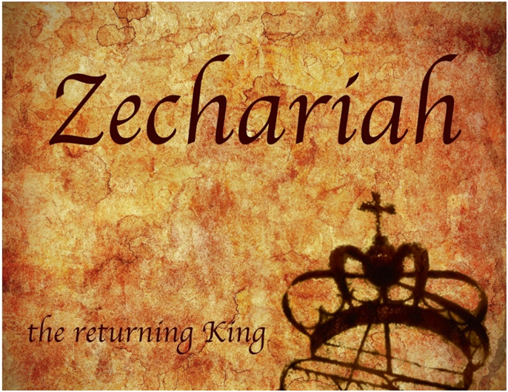
IV. Two Burdens
(9‒14)
  Israel’s postponed deliverance due to her rejection of her Messiah (9‒11)
  Israel’s future deliverance due to her acceptance of her Messiah (12‒14)

Slide 10
IV. Two Burdens
(9‒14)
  Israel’s postponed deliverance due to her rejection of her Messiah (9‒11)
  Israel’s future deliverance due to her acceptance of her Messiah (12‒14)

Slide 11

First Burden Outline
(9‒11)
    Divine warrior hymn (9)
    True shepherd (10)
    False shepherd (11)

Slide 12
First Burden Outline
(9‒11)
    Divine warrior hymn (9)
    True shepherd (10)
    False shepherd (11)

Slide 13
Divine Warrior Hymn
(9:1-17)
Judgment on the oppressing nations (1-8)
Messiah (9-10)
Covenant protection (11-17)

Slide 14
Divine Warrior Hymn
(9:1-17)
Judgment on the oppressing nations (1-8)
Messiah (9-10)
Covenant protection (11-17)

Slide 15
Judgment on the Oppressing Nations
(9:1-8)
    Hadrach (1a)
    Damascus (1b)
    Hamath (2a)
    Tyre & Sidon (2b-4)
    Philistines (5-7)
    Jerusalem (8)

Slide 16
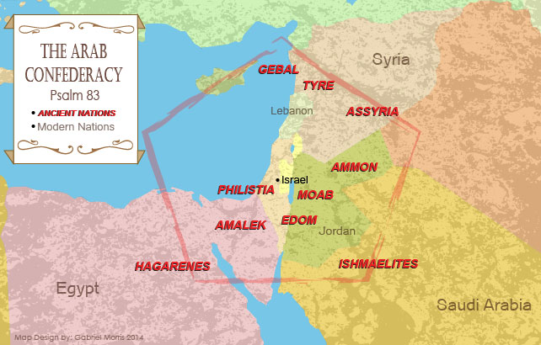

Slide 17
Kenneth L. Barker
Barker, Kenneth L. "Zechariah." In Daniel-Minor Prophets. Vol. 7 of The Expositor's Bible Commentary. 12 vols. Edited by Frank E. Gaebelein and Richard P. Polcyn. Grand Rapids: Zondervan Publishing House, 1985. p. 657.
“As history shows, the agent of the Lord's judgment was Alexander the Great. After defeating the Persians (333 B.C.), Alexander moved swiftly toward Egypt. On his march he toppled the cities in the Aramean (Syrian) interior, as well as those on the Mediterranean coast. Yet, on coming to Jerusalem, he refused to destroy it.”

Slide 18
Divine Warrior Hymn
(9:1-17)
Judgment on the oppressing nations (1-8)
Messiah (9-10)
Covenant protection (11-17)

Slide 19
Messiah
(9:9-10
    First advent (9)
    Second advent (10)

Slide 20
Messiah
(9:9-10
    First advent (9)
    Second advent (10)

Slide 21
Messiah
(9:9-10
    First advent (9)
    Second advent (10)

Slide 22

Zechariah 9:9-10
⁹ Rejoice greatly, O daughter of Zion! Shout in triumph, O daughter of Jerusalem! Behold, your king is coming to you; He is just and endowed with salvation, Humble, and mounted on a donkey, Even on a colt, the foal of a donkey.¹⁰ I will cut off the chariot from Ephraim And the horse from Jerusalem; And the bow of war will be cut off. And He will speak peace to the nations; And His dominion will be from sea to sea, And from the River to the ends of the earth.

Slide 23
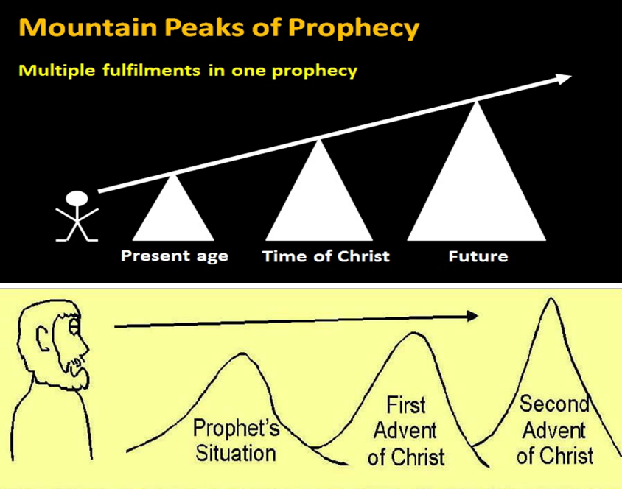

Slide 24
Warren Wiersbe
Wiersbe, Warren W. "Zechariah." In The Bible Exposition Commentary/Prophets, pp. 447-76. Colorado Springs, Colo.: Cook Communications Ministries; and Eastbourne, England: Kingsway Communications Ltd., 2002. p. 467.
“The entire age of the church fits between Zechariah 9:9 and 9:10, just as it does between Isaiah 9:6 and 7 and after the comma in Isaiah 61:2.”

Slide 25
Divine Warrior Hymn
(9:1-17)
Judgment on the oppressing nations (1-8)
Messiah (9-10)
Covenant protection (11-17)

Slide 26
Covenant Protection
(9:11-17)
    Blood covenant (11a)
    Prisoners liberated (11b-12)
    Victories (13-17)

Slide 27
Covenant Protection
(9:11-17)
    Blood covenant (11a)
    Prisoners liberated (11b-12)
    Victories (13-17)

Slide 28


Slide 29
Covenant Protection
(9:11-17)
    Blood covenant (11a)
    Prisoners liberated (11b-12)
    Victories (13-17)

Slide 30
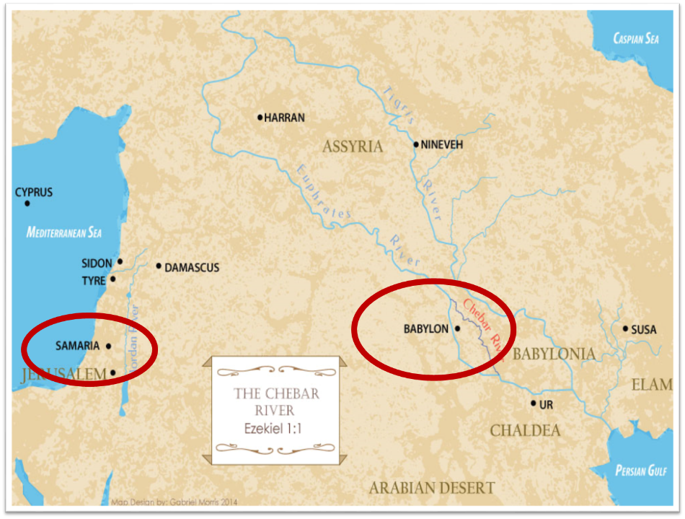

Slide 31
Three Returns
 | DATE | DURATION | PERSIAN KING | JEWISH LEADER | SCRIPTURE | PURPOSE | NUMBER OF RETURNEES
1st return | 538–515 B.C. | 23 years | Cyrus (Isa. 44:28‒45:1) | Zerubbabel | Ezra 1–6; Isaiah 44:28 | Rebuilding the temple | 50,000
2nd return | 458–457 B.C. | 2 years | Artaxerxes | Ezra | Ezra 7–10 | Adorning of the temple and reforming the people | 2,000
3rd return | 444–432 B.C. | 8 years | Artaxerxes | Nehemiah | Nehemiah | Rebuilding the wall

Slide 32
Covenant Protection
(9:11-17)
    Blood covenant (11a)
    Prisoners liberated (11b-12)
    Victories (13-17)

Slide 33

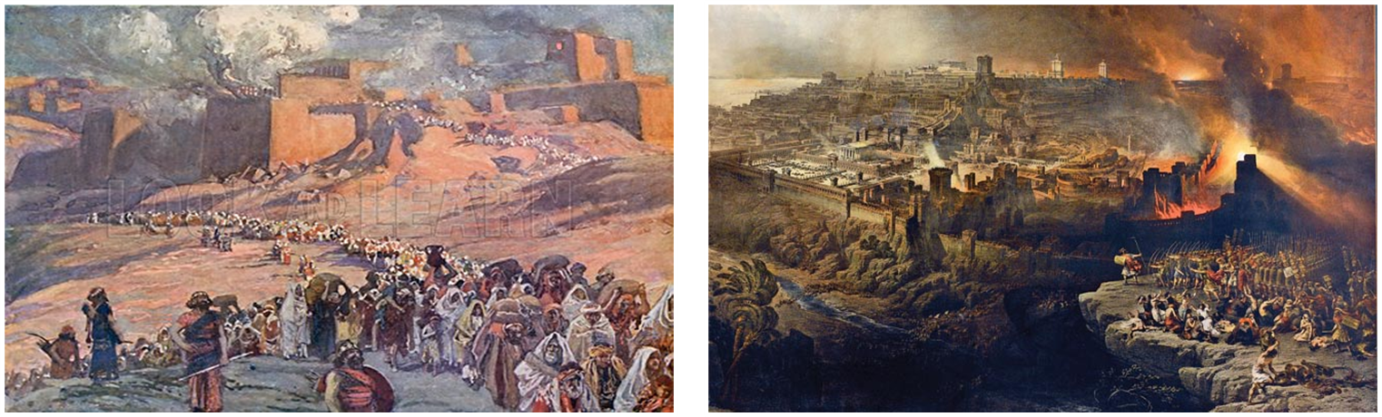
Charles Ryrie
The Ryrie Study Bible
“Zechariah 9:13-17 (RSB:NASB1995U): 9:13-17 These verses predict the defeat of Greece (particularly of Antiochus Epiphanes) by the Jewish people during the Maccabean era (second century b.c.).

Slide 34

HANUKKAH
The Maccabean revolt
December 25th 164 BC, the temple is liberated and rededicated
1 & 2 Maccabees (Non-canonical)
The miracle of the lamp oil
Hanukkah “Feast of Dedication” (festival of lights).
Christmas / Jewish Holiday
John 10:22-24

Slide 35
7 Levitical Feasts (Leviticus 23)
Feast | Season | Purpose | Type
Passover | Spring | Redemption | 1 Cor 5:7
Unleavened Bread | Spring | Separation | John 6:35
1st fruits | Spring | Praise for initial crop | 1 Cor. 15:20
Pentecost | Spring | Praise for full crop | Acts 2:1-4
Trumpets | Fall | New Year | Matt. 24:31
Atonement | Fall | Lev. 16 | Zech. 12:10
Booths | Fall | Wilderness provision | Zech. 14:16-18

Slide 36


Slide 37


Slide 38
Six Parts of a Suzerain-Vassal Treaty in Deuteronomy
Preamble (1:1-5)
Prologue (1:6–4:40)
Covenant obligations (5–26)
Storage and reading instructions (27:2-3; 31:9, 24, 26)
Witnesses (32:1)
Blessings and curses (28)

Slide 39
Thomas McComiskey
McComiskey, Thomas Edward. "Zechariah." In The Minor Prophets: An Exegetical and Expositional Commentary, 3:1003-1244. 3 vols. Edited by Thomas Edward McComiskey. Grand Rapids: Baker Books, 1992, 1993, and 1998. Page 1174
“The citizens of Christ's kingdom as well as God's ancient people are a landed people. Hebrews 3 and 5 make this clear, affirming the believer's landedness in the gospel—'at- homeness in Christ.' Today, the fruit of the land that causes its citizens to flourish is the fruit of salvation.”

Slide 40
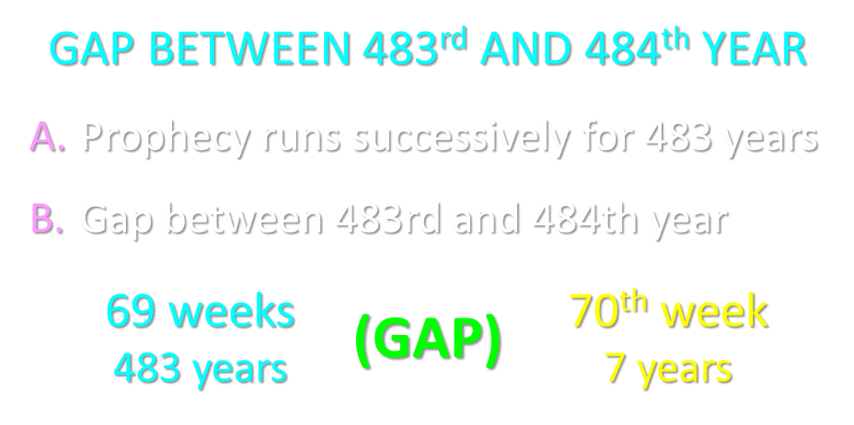

Slide 41
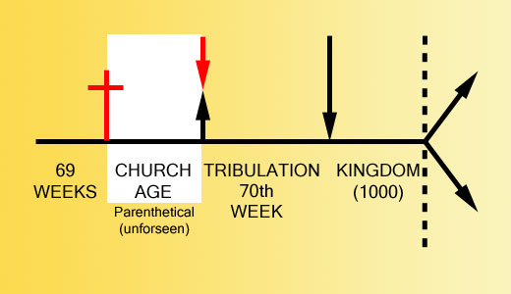

Slide 42
First Burden Outline
(9‒11)
    Divine warrior hymn (9)
    True shepherd (10)
    False shepherd (11)

Slide 43
True Shepherd
(10:1-12)
Messianic prosperity (1-3)
Restoration of the Northern & Southern kingdoms (4-7)
Messianic regathering (8-12)

Slide 44
True Shepherd
(10:1-12)
Messianic prosperity (1-3)
Restoration of the Northern & Southern kingdoms (4-7)
Messianic regathering (8-12)

Slide 45
Messianic Prosperity
(10:1-3)
    Challenge (1)
    Idols inhibiting prosperity (2)
    True shepherd to judge the false shepherds (3)

Slide 46
Messianic Prosperity
(10:1-3)
    Challenge (1)
    Idols inhibiting prosperity (2)
    True shepherd to judge the false shepherds (3)

Slide 47
Six Parts of a Suzerain-Vassal Treaty in Deuteronomy
Preamble (1:1-5)
Prologue (1:6–4:40)
Covenant obligations (5–26)
Storage and reading instructions (27:2-3; 31:9, 24, 26)
Witnesses (32:1)
Blessings and curses (28)

Slide 48
Messianic Prosperity
(10:1-3)
    Challenge (1)
    Idols inhibiting prosperity (2)
    True shepherd to judge the false shepherds (3)

Slide 49
Joyce Baldwin
Baldwin, Joyce G. Haggai, Zechariah, Malachi: An Introduction and Commentary. Tyndale Old Testament Commentaries series. Leicester, Eng., and Downers Grove, Ill.: Inter-Varsity Press, 1972. Page 171.
“A modern parallel is the renewed interest in magic, spiritism and other survivals of primitive times. The more widespread modern equivalent is to ignore God altogether and tacitly to assume that no problem is beyond man's unaided power to solve.”

Slide 50
Messianic Prosperity
(10:1-3)
    Challenge (1)
    Idols inhibiting prosperity (2)
    True shepherd to judge the false shepherds (3)

Slide 51
True Shepherd
(10:1-12)
Messianic prosperity (1-3)
Restoration of the Northern & Southern kingdoms (4-7)
Messianic regathering (8-12)

Slide 52
Restoration of the N & S Kingdoms
(10:4-7)
    The king (4-5)
    The kingdoms (6-7)

Slide 53
Restoration of the N & S Kingdoms
(10:4-7)
    The king (4-5)
    The kingdoms (6-7)

Slide 54
Merrill F. Unger
Unger, Merrill F. Zechariah. Grand Rapids: Zondervan Publishing House, 1963. p. 180.
“"The scene is that of the strengthening of the Jews in Palestine at the time of the invasion from the North under 'the beast' (Dan. 7:8) in conjunction with the events of Armageddon (Rev. 16:14; 19:17-20).”

Slide 55
Restoration of the N & S Kingdoms
(10:4-7)
    The king (4-5)
    The kingdoms (6-7)

Slide 56
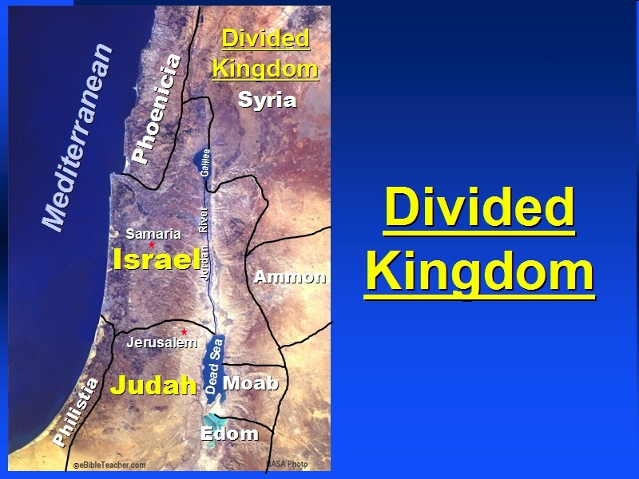

Slide 57
Six Parts of a Suzerain-Vassal Treaty in Deuteronomy
Preamble (1:1-5)
Prologue (1:6–4:40)
Covenant obligations (5–26)
Storage and reading instructions (27:2-3; 31:9, 24, 26)
Witnesses (32:1)
Blessings and curses (28)

Slide 58
Israel's Judgments
Division of the kingdom in 931 B.C. (1 Kgs. 12)
Assyrian judgment in 722 B.C. (2 Kgs. 17)
Babylonian captivity in 586 B.C. (2 Kgs. 25)
Rome Diaspora in A.D. 70 (Luke 19:41-44)

Slide 59
Ezekiel 37
Vision: Valley of the Dry Bones (1-14)
  Vision (1-10)
  Interpretation (11-14)
Sign: Two Sticks (15-28)
  Sign (15-17)
  Interpretation (18-28)

Slide 60
Israel's Judgments
Division of the kingdom in 931 B.C. (1 Kgs. 12)
Assyrian judgment in 722 B.C. (2 Kgs. 17)
Babylonian captivity in 586 B.C. (2 Kgs. 25)
Rome Diaspora in A.D. 70 (Luke 19:41-44)

Slide 61
True Shepherd
(10:1-12)
Messianic prosperity (1-3)
Restoration of the Northern & Southern kingdoms (4-7)
Messianic regathering (8-12)

Slide 62
Messianic Regathering
(10:8-12)
    The regathering (8-9)
    The geography (10-11)
    The strengthening (12)

Slide 63
Messianic Regathering
(10:8-12)
    The regathering (8-9)
    The geography (10-11)
    The strengthening (12)

Slide 65
Messianic Regathering
(10:8-12)
    The regathering (8-9)
    The geography (10-11)
    The strengthening (12)

Slide 66


Slide 71

VI. 8 New Promises
Genesis 12:1-3
    Land (Gen. 12:1b)
    Great nation (Gen. 12:2a)
    Personal blessing (Gen. 12:2b)
    Great name (Gen. 12:2c)
    Blessing to others (Gen. 12:2d)
    Blessing to blessers (Gen. 12:3a)
    Cursing to cursers (Gen. 12:3b)
    Blessing to the world (Gen. 12:3c)

Slide 72


Genesis 12:3
“And I will bless those who bless you, And the one who curses you I will curse. And in you all the families of the earth will be blessed.”

Slide 73
Messianic Regathering
(10:8-12)
    The regathering (8-9)
    The geography (10-11)
    The strengthening (12)

Slide 74
Conclusion

Slide 75
First Burden Outline
(9‒11)
    Divine warrior hymn (9)
    True shepherd (10)
    False shepherd (11)

Slide 76
True Shepherd
(10:1-12)
Messianic prosperity (1-3)
Restoration of the Northern & Southern kingdoms (4-7)
Messianic regathering (11-17)

Slide 77
First Burden Outline
(9‒11)
    Divine warrior hymn (9)
    True shepherd (10)
    False shepherd (11)

