Slide 1
Law and Grace: An Overview Jim McGowan, Th.D. Sugar Land Bible Church 03-20-2022
…but grace and truth were realized through Jesus Christ - John 1:17
For the Law was given through Moses…
Special thanks to Dr. Vern Peterman for access to his insights and resources.

Slide 2
Session 31 Outline
Review
Purpose, Aim, and Objective
Session 30 – Matthew 5:21-42
The Law True and Deep – Part 3
Matthew 5:43-48
Concluding Observations

Slide 3
OUR PURPOSE, AIM AND OBJECTIVE
Law and Grace
…is to Compare and Contrast Law and Grace so as to properly understand these two important themes and how they are related to the life of the New Testament Believer.

Slide 4
C. I. Scofield, D. D.
The Grace of God, The Fundamentals Vol. 3, Chapter VII, p. 98
We have, most of us, been reared and now live under the influence of Galatianism. Protestant theology, alas, is for the most part, thoroughly Galatianized, in that neither law nor grace are given their distinct and separated places, as in the counsels of God, but are mingled together in one incoherent system.
The law is no longer, as in the Divine intent, a ministration of death (2 Cor. 3:7), of cursing (Gal. 3:10), of conviction (Rom. 3:19), because we are taught that we must try to keep it, and that by Divine help we may.
Nor, on the other hand, does grace bring us blessed deliverance from the dominion of sin, for we are kept under the law as a rule of life despite the plain declaration, “Sin shall not have dominion over you: for ye are not under the law, but under grace” (Rom. 6:14). (emphasis mine)

Slide 5
William R. Newell
Romans Verse-by-Verse (p. 274).
Grand Rapids, MI: Christian Classics Ethereal Library.
It is because Reformed theology has kept us Gentiles under the Law,—if not as a means of righteousness, then as “a rule of life,” that all the trouble has arisen. The Law is no more a rule of life than it is a means of righteousness. Walking in the Spirit has now taken the place of walking by ordinances. God has another principle under which He has put his saints: “Ye are not under law, but, under grace! (Rom. 6:14)” (italics mine)
PDF Download Here: https://archive.org/details/Romans_Verse_By_Verse-NewellWR

Slide 6
Henry Ironside
The Continual Burnt Offering: Daily Meditations on the Word of God (p. 265). Neptune, NJ: Loizeaux Brothers.
In Romans 7 we have a man renewed by the Spirit of God, but struggling under law, hoping thereby to subdue or find deliverance from the power of the old Adamic nature. In chapter 8 we have God’s way of deliverance through the death and resurrection of Christ with which the believer is identified before God. The chapter begins with “no condemnation” and ends with “no separation.” All who are in Christ Jesus are accepted in the Beloved and as free from every charge of guilt as He is Himself. He paid our penalty on the cross. Now we are linked up with Him in resurrection, not under law but under grace.

Slide 7
Matthew’s 3-Fold Purpose
Law and Grace: Review The SOM – Matthew 5:1–8:1 (Luke 6:17–49)
To explain:
that Jesus in whom they had believed was the long-awaited Jewish Messiah
why the kingdom had been postponed despite the fact that the king had arrived
the interim program of God during the kingdom’s absence

Slide 8
Matthew and the Kingdom
Law and Grace: Review The SOM – Matthew 5:1–8:1 (Luke 6:17–49)
 | offered
 | rejected
 | postponed Interim program
 | ultimately accepted

Slide 9
Matthew’s Message
Law and Grace: Review The SOM – Matthew 5:1–8:1 (Luke 6:17–49)
Jesus is the predicted Jewish king who ushered in an interim program by building the sons of the kingdom into the Church in between Israel’s past rejection and future acceptance of her king.

Slide 10
Session 31 Outline
Review
Purpose, Aim, and Objective
Session 30 – Matthew 5:21-42
The Law True and Deep – Part 3
Matthew 5:43-48
Concluding Observations

Slide 11
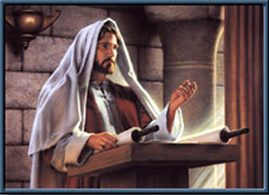
Law and Grace: Review The SOM – Matthew 5:1–8:1 (Luke 6:17–49)
Jesus contrasted with the Scribes & Pharisees
Matthew 5:20-48
Jesus made the Law of Moses apply to the whole person, all the way from the heart and thoughts, to all of the outward expressions and even in the relationships between Jews, and with God.
True Righteousness vs. Pharisaical Righteousness

Slide 12
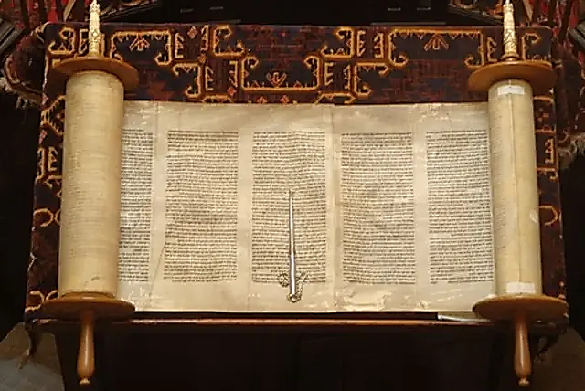
Law and Grace: Review The SOM – Matthew 5:1–8:1 (Luke 6:17–49)
Two Primary Patterns in Jesus’ Statements
Matthew 5:21-48
Jesus will quote Old Testament passages and include those laws that require full heart-level and relationship compliance when appropriate.

Slide 13
Law and Grace: Review The SOM – Matthew 5:1–8:1 (Luke 6:17–49)
Two Primary Patterns in Jesus’ Statements
Matthew 5:21-48
Jesus will quote Old Testament passages along with one of the traditions that have been added to the Law of Moses, and then correct the tradition by taking the application deeper and/or back to the original intent of the Law of Moses.

Slide 14
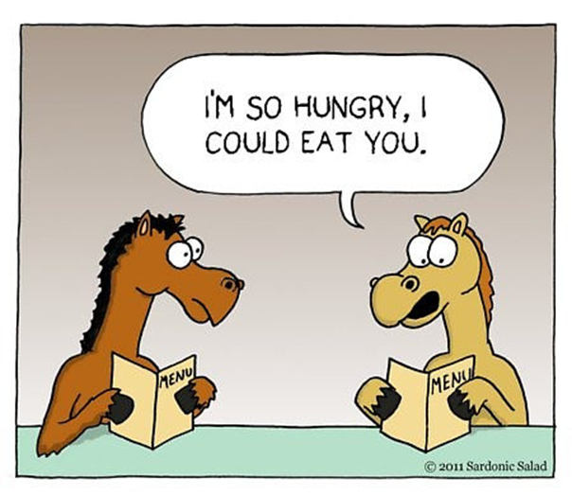
Law and Grace: Review The SOM – Matthew 5:1–8:1 (Luke 6:17–49)
Jesus Used Hyperbole
Matthew 5:21-26
Jesus sometimes uses *hyperbole in the Sermon on the Mount, for the sake of emphasis and as an aid to memory.
* hyperbole an obvious and intentional exaggeration used for stress or emphasis; not intended to be taken literally…i.e. I’m so hungry, I could eat a horse.

Slide 15
Law and Grace: Review The SOM – Matthew 5:1–8:1 (Luke 6:17–49)
From The Inside Out – What We Covered Previously
Matthew 5:21-48
In Matt. 5:21-48, Jesus contrasts Pharisaic Righteousness and True Righteousness regarding 7 topics (we covered 1-6 previously):
Murder (21-22) | Oaths (33-37)
Reconciliation (23-26) | Non-resistance (38-42)
Adultery (27-30) | Love (43-48).
Divorce (31-32)

Slide 16
We’ll Continue With Our Compare and Contrast Approach
Law and Grace: Review The SOM – Matthew 5:1–8:1 (Luke 6:17–49)
COMPARE AND CONTRAST
PEOPLE GROUP | RULING PRINCIPLE
Nation of Israel | OT / Gospels / Acts 1 THE LAW OF MOSES | 1000 Reign of Christ KINGDOM LAW
Church | Acts 2 – Rapture GRACE | -----
‘Similar ≠ Same’

Slide 17
Context, Context, Context Matthew 5:21-48
Law and Grace: Review The SOM – Matthew 5:1–8:1 (Luke 6:17–49)
The Sermon on the Mount was directed to Israelites, living in Israel, who were all under the Law of Moses.

Slide 18
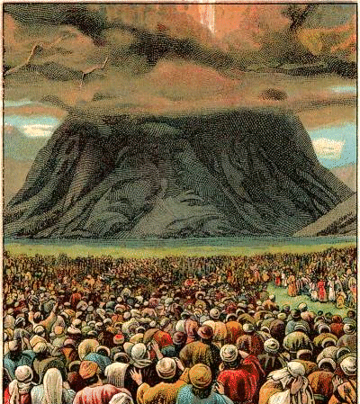
Context, Context, Context Matthew 5:21-48
Law and Grace: Review The SOM – Matthew 5:1–8:1 (Luke 6:17–49)
To understand what Christ says we should keep in mind that: proper interpretation requires identifying the cultural context.

Slide 19
Yes, Yes or No, No! Matthew 5:33-37
Law and Grace: Review The SOM – Matthew 5:1–8:1 (Luke 6:17–49)
The Law of Moses required that the people of Israel simply keep their vows, whether to the Lord or to another person (Numbers 30:1-2).

Slide 20
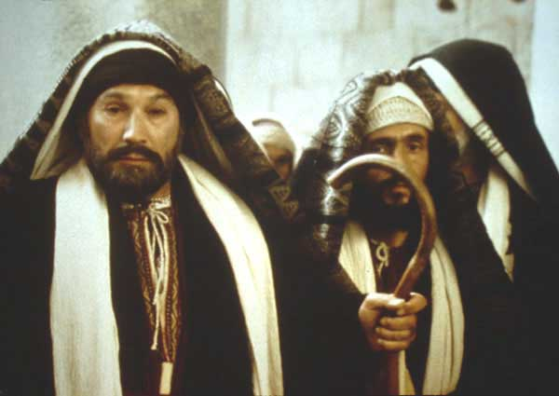
Yes, Yes or No, No! Matthew 5:33-37
Law and Grace: Review The SOM – Matthew 5:1–8:1 (Luke 6:17–49)
But by the time of Christ, the rabbis had developed a complex set of rules for when an oath is binding and when it is not a binding promise.
Making an oath by heaven, by earth, or by Jerusalem were all non-binding.
Only oaths invoking God’s name were binding.

Slide 21
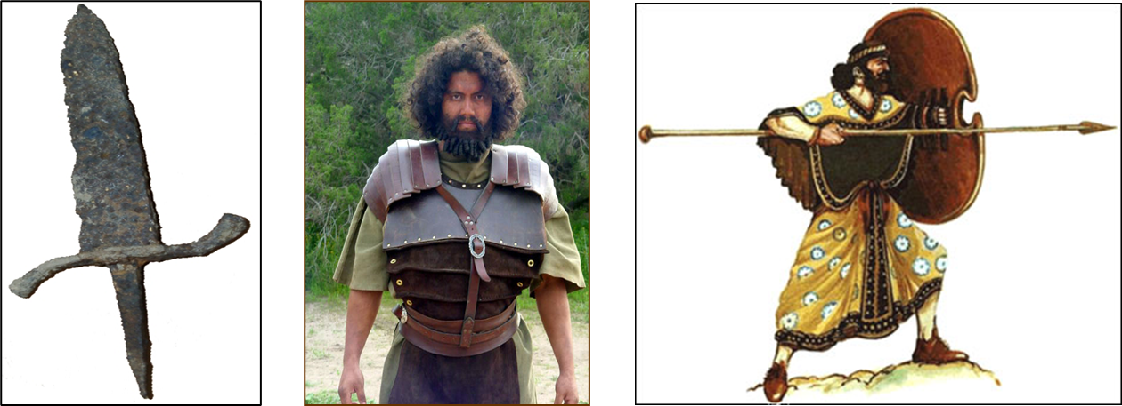
“An eye for an eye and a tooth for a tooth” Matthew 5:38-42
Law and Grace: Review The SOM – Matthew 5:1–8:1 (Luke 6:17–49)
Israel was in the midst of cultures that practiced an escalating revenge, carried out privately, even to the point of ‘honor killings’.

Slide 22
“An eye for an eye and a tooth for a tooth” Matthew 5:38-42
Law and Grace: Review The SOM – Matthew 5:1–8:1 (Luke 6:17–49)
The principle in the Law of Moses, ‘an eye for an eye, and a tooth for a tooth’ stopped escalating revenge and kept justice a public issue.
Israelite society was thus kept from escalating violence and the family’s ‘duty’ to carry out revenge.

Slide 23
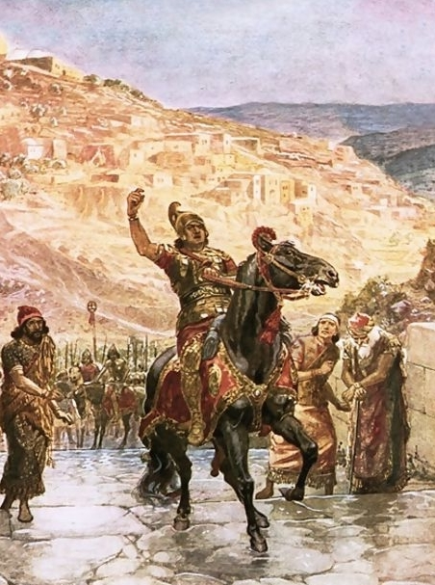
“Vengeance is mine”, says the Lord” Matthew 5:38-42
Law and Grace: Review The SOM – Matthew 5:1–8:1 (Luke 6:17–49)
The Old Testament taught that Israelites were to leave room for God to take His vengeance for them (cf. Lev. 19:17-18; Deut. 32:35; Psa. 94:1; Prov. 20:22; 24:29).
The same principle applies to us who are in the Body of Christ (Romans 12:19; Hebrews 10:30)

Slide 24
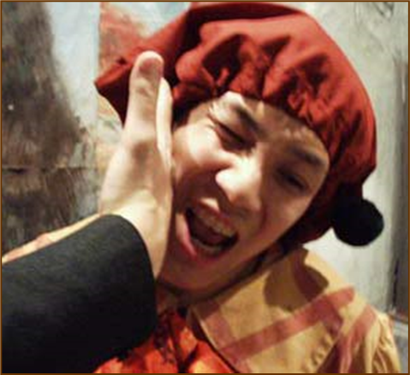
“Vengeance is mine”, says the Lord” Matthew 5:38-42
Law and Grace: Review The SOM – Matthew 5:1–8:1 (Luke 6:17–49)
A backhanded slap on the cheek was not an injurious physical threat, but an insult.
Both in the Gospels and the Epistles to the Church, one is not to respond in kind to an attack only intended to damage one’s emotions or reputation.

Slide 25
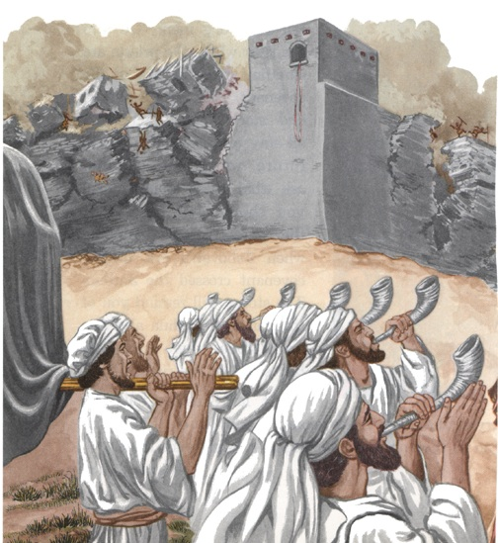
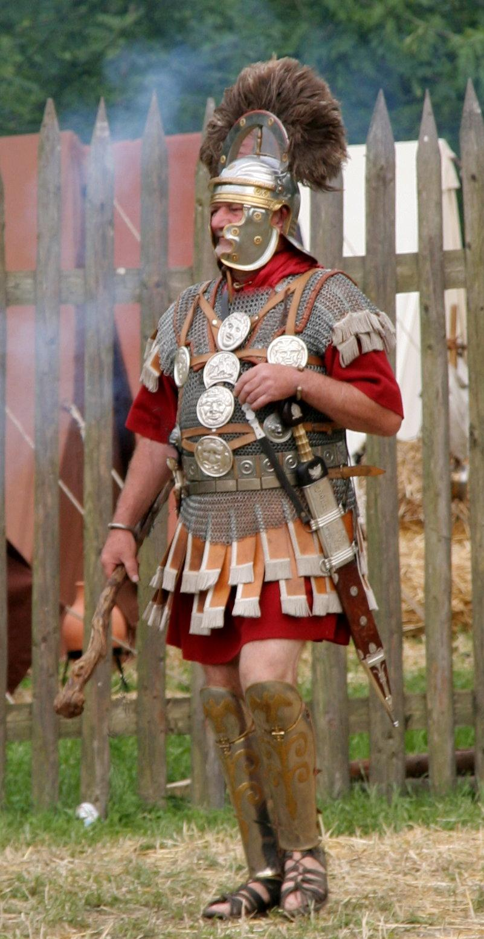
Some Reasons Why Total Pacifism Is Not Biblically Supported Matthew 5:38-42
Law and Grace: Review The SOM – Matthew 5:1–8:1 (Luke 6:17–49)
Israel was to have a military, both initially and as a continuing force, and this was not incompatible with God fighting for them (cf. Ex 14:14; Deut 1:30; 3:22; Josh 23:3; 2 Chr 20:29; Neh 4:20)
In the Gospels and in the Book of Acts Roman officers are all shown in a favorable light, and neither Jesus or the apostles said to quit the military.

Slide 26
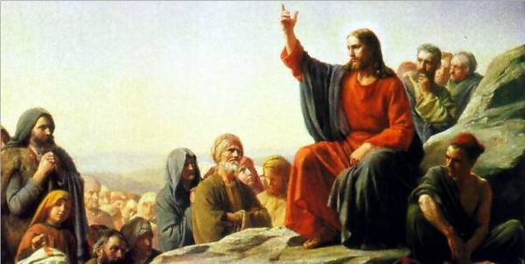
Some Reasons Why Total Pacifism Is Not Biblically Supported Matthew 5:38-42
Law and Grace: Review The SOM – Matthew 5:1–8:1 (Luke 6:17–49)
In anticipation of the church (Acts 1-2) Christ tells the disciples to arm for self-defense. (cf. Luke 22:35-36).

Slide 27
“let him have your coat also” Matthew 5:38-42
Law and Grace: Review The SOM – Matthew 5:1–8:1 (Luke 6:17–49)
Jesus was using hyperbole here.
This must be taken in its specific ‘cultural context’. The Israelites, under the Mosaic Law, in the land of Israel, were already commanded to lend to any and all of their Jewish brethren with an open hand.

Slide 28
“Give to him who asks of you...” Matthew 5:38-42
Law and Grace: Review The SOM – Matthew 5:1–8:1 (Luke 6:17–49)
Every 7th year in Israel all debts to all Israelites were to be forgiven, and no Israelite was to diminish their lending because they anticipated that year of forgiveness of debts.

Slide 29
“Whoever forces you to go one mile, go with him two.” Matthew 5:38-42
Law and Grace: Review The SOM – Matthew 5:1–8:1 (Luke 6:17–49)
A Roman soldier could compel anyone else by law, to carry his military equipment for one mile (cf. Matthew 27:32).
Jesus told the Israelites to carry the soldier’s equipment for another mile beyond what was required by Roman law.

Slide 30
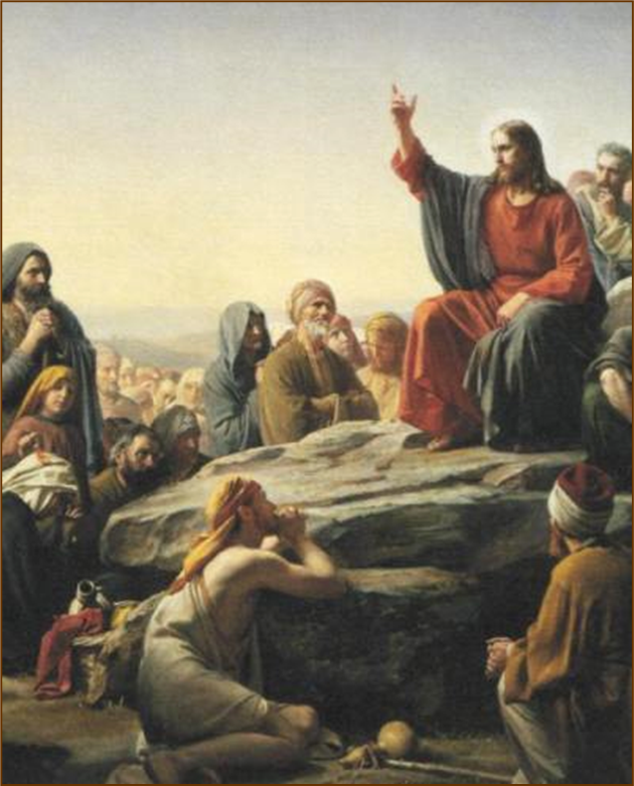
In each case in this passage… Matthew 5:38-42
Law and Grace: Review The SOM – Matthew 5:1–8:1 (Luke 6:17–49)
In each case, Jesus says “be gracious, full of mercy and generous from the heart’ – go beyond the mere requirement of the Law of Moses.
By so doing, Jesus endorses and promotes True Righteousness while also condemning and reproving Pharisaic Righteousness.

Slide 31
In each case in this passage… Matthew 5:38-42
Law and Grace: Review The SOM – Matthew 5:1–8:1 (Luke 6:17–49)
The Body of Christ, the Church, is not under the Law of Moses, however, being gracious and merciful is still what God has in mind for you and me because grace and mercy are basic to God’s character.

Slide 32
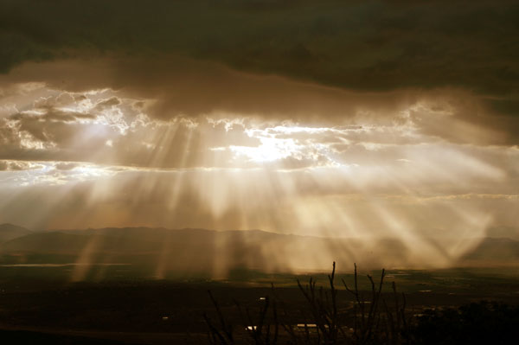
Ephesians 2:4–7
⁴ But God, being rich in mercy, because of His great love with which He loved us, ⁵ even when we were dead in our transgressions, made us alive together with Christ (by grace you have been saved), ⁶ and raised us up with Him, and seated us with Him in the heavenly places in Christ Jesus, ⁷ so that in the ages to come He might show the surpassing (ὑπερβάλλω) riches of His grace in kindness toward us in Christ Jesus.

Slide 33
In each case in this passage… Matthew 5:38-42
Law and Grace: Review The SOM – Matthew 5:1–8:1 (Luke 6:17–49)
Grace and mercy, basic to God’s character, are to be lived out in and through us by the life of Christ.

Slide 34
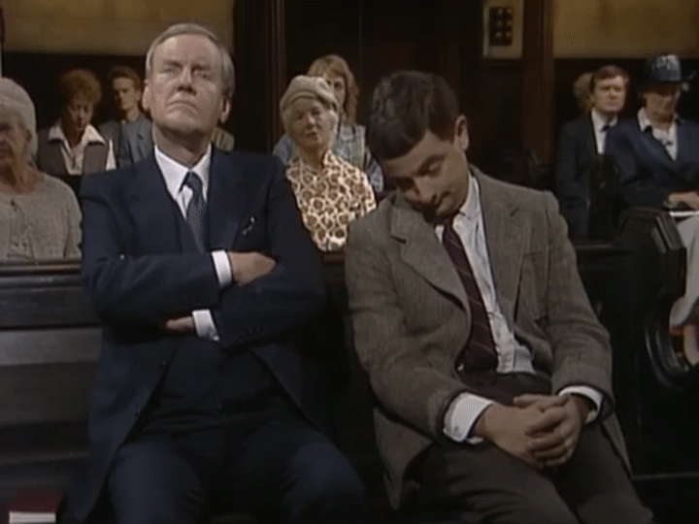
Law and Grace: Review The SOM – Matthew 5:1–8:1 (Luke 6:17–49)

Slide 35
Session 31 Outline
Review
Purpose, Aim, and Objective
Session 30 – Matthew 5:21-42
The Law True and Deep – Part 3
Matthew 5:43-48
Concluding Observations

Slide 36
Law and Grace: Session 31 The SOM – Matthew 5:1–8:1 (Luke 6:17–49)
From The Inside Out – What We’ll Cover in this Session
Matthew 5:21-48
In Matt. 5:21-48, Jesus contrasts Pharisaic Righteousness and True Righteousness regarding 7 topics:
Murder (21-22) | Oaths (33-37)
Reconciliation (23-26) | Non-resistance (38-42)
Adultery (27-30) | Love (43-48).
Divorce (31-32)

Slide 37
Matthew 5:43–47
⁴³ “You have heard that it was said, ‘You shall love your neighbor and hate your enemy.’ ⁴⁴ “But I say to you, love your enemies and pray for those who persecute you, ⁴⁵ so that you may be sons of your Father who is in heaven; for He causes His sun to rise on the evil and the good, and sends rain on the righteous and the unrighteous. ⁴⁶ “For if you love those who love you, what reward do you have? Do not even the tax collectors do the same? ⁴⁷ “If you greet only your brothers, what more are you doing than others? Do not even the Gentiles do the same?

Slide 38
“Love Your Neighbor” Matthew 5:43-47
Law and Grace: Session 31 The SOM – Matthew 5:1–8:1 (Luke 6:17–49)
Love your neighbor was definitely a message from the Law of Moses (Leviticus 19:18)…

Slide 39
“Love Your Neighbor” Matthew 5:43-47
Law and Grace: Session 31 The SOM – Matthew 5:1–8:1 (Luke 6:17–49)
…but hating your enemy was primarily taught among the Essenes, who considered the Pharisees, the, Sadducees, and everyone else, enemies.

Slide 40
“Hate Your Enemy”
Law and Grace: Session 31 The SOM – Matthew 5:1–8:1 (Luke 6:17–49)
The Essenes became famous for their displays of justified indignation….But that was putting it mildly. The Qumran Community Rule scroll actually encouraged its Essene readers to show anger and hatred for all outside their sect (1QS 1.4, 5, 9–11; 4Q258 9.16, 22). In fact, it actually states that all those “chosen” by God (that is, the Essenes) should “hate all that He [God] has rejected” (1QS 1.4, 5), that is, everyone else.…According to the Community Rule, all Essenes were even expected to pledge together “Everlasting hatred in a spirit of secrecy for the men of perdition!” (4Q258 9.22). In fact, at Qumran, the Essenes prided themselves so fiercely on hating outsiders that they even composed a War Scroll. This scroll set down guidelines that Essene members were expected to honour when taking on the Romans and the rest of the world in the final eschatological battles between good and evil, light and darkness.
Qumran's "Righteous Teacher“ by Daryn Graham,
https://www.hopechannel.com/au/read/qumrans-righteous-teacher, accessed online 09-08-2021

Slide 41
“Love Your Neighbor” Matthew 5:43-47
Law and Grace: Session 31 The SOM – Matthew 5:1–8:1 (Luke 6:17–49)
Many no doubt, would have wondered where Jesus stood in the midst of these conflicting messages.

Slide 42
Matthew 5:43–47
⁴³ “You have heard that it was said, ‘You shall love your neighbor and hate your enemy.’ ⁴⁴ “But I say to you, love your enemies and pray for those who persecute you, ⁴⁵ so that you may be sons of your Father who is in heaven; for He causes His sun to rise on the evil and the good, and sends rain on the righteous and the unrighteous. ⁴⁶ “For if you love those who love you, what reward do you have? Do not even the tax collectors do the same? ⁴⁷ “If you greet only your brothers, what more are you doing than others? Do not even the Gentiles do the same?

Slide 43
Matthew 5:43–47
⁴³ “You have heard that it was said, ‘You shall love your neighbor and hate your enemy.’ ⁴⁴ “But I say to you, love your enemies and pray for those who persecute you, ⁴⁵ so that you may be sons of your Father who is in heaven; for He causes His sun to rise on the evil and the good, and sends rain on the righteous and the unrighteous. ⁴⁶ “For if you love those who love you, what reward do you have? Do not even the tax collectors do the same? ⁴⁷ “If you greet only your brothers, what more are you doing than others? Do not even the Gentiles do the same?

Slide 44
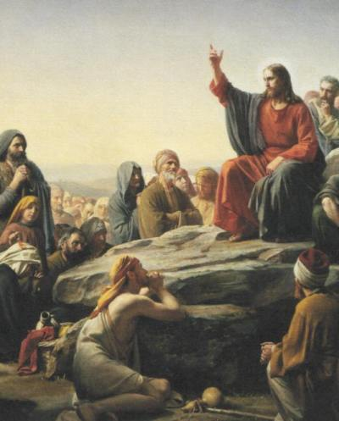
Law and Grace: Session 31 The SOM – Matthew 5:1–8:1 (Luke 6:17–49)
“Love Your Neighbor” Matthew 5:43-47
In sharp contrast to the spirit and behavior of those who would make themselves their enemies, Jesus said to love them in return. This is consistent also with what the Apostles taught.

Slide 45
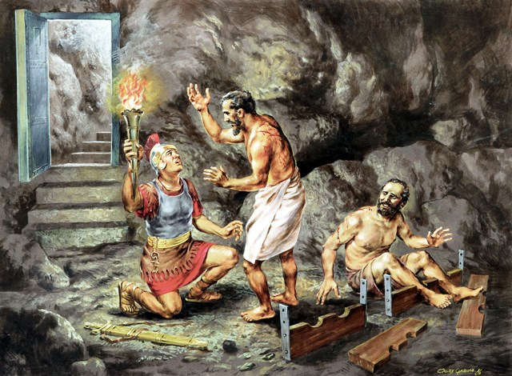
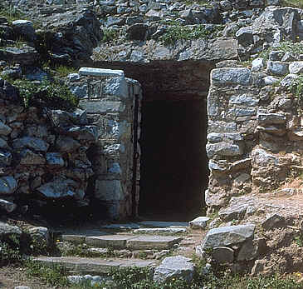
Law and Grace: Session 31 The SOM – Matthew 5:1–8:1 (Luke 6:17–49)
“Love Your Neighbor” Matthew 5:43-47
When Paul and Silas were in stocks in the worst part of the jail in Philippi, they sang songs in praise to God.
They shared the true gospel to the jailer rather than run away.

Slide 46
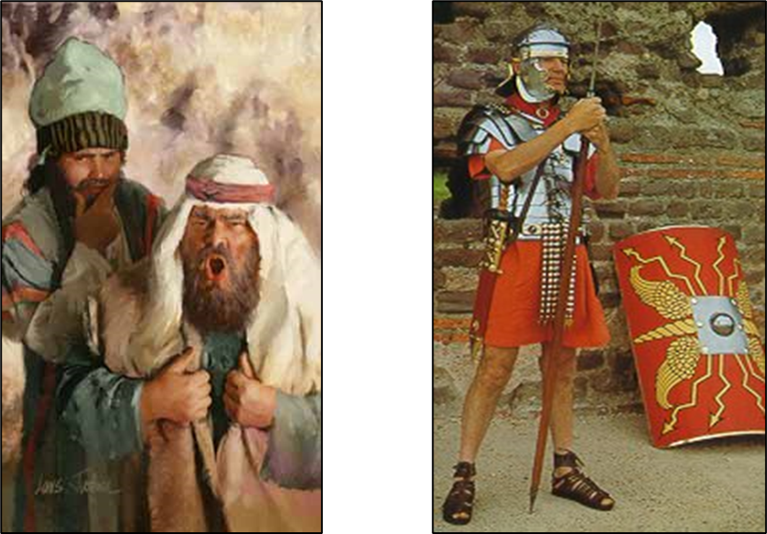
And speaking of persecutors…
Law and Grace: Session 31 The SOM – Matthew 5:1–8:1 (Luke 6:17–49)
“Love Your Neighbor” Matthew 5:43-47

Slide 47
Law and Grace: Session 31 The SOM – Matthew 5:1–8:1 (Luke 6:17–49)
“Love Your Neighbor” Matthew 5:43-47
So, whether under Law or Grace, true righteousness consists of our not responding in kind to persecutors but responding in His love!

Slide 48
Matthew 5:43–47
⁴³ “You have heard that it was said, ‘You shall love your neighbor and hate your enemy.’ ⁴⁴ “But I say to you, love your enemies and pray for those who persecute you, ⁴⁵ so that you may be sons of your Father who is in heaven; for He causes His sun to rise on the evil and the good, and sends rain on the righteous and the unrighteous. ⁴⁶ “For if you love those who love you, what reward do you have? Do not even the tax collectors do the same? ⁴⁷ “If you greet only your brothers, what more are you doing than others? Do not even the Gentiles do the same?

Slide 49
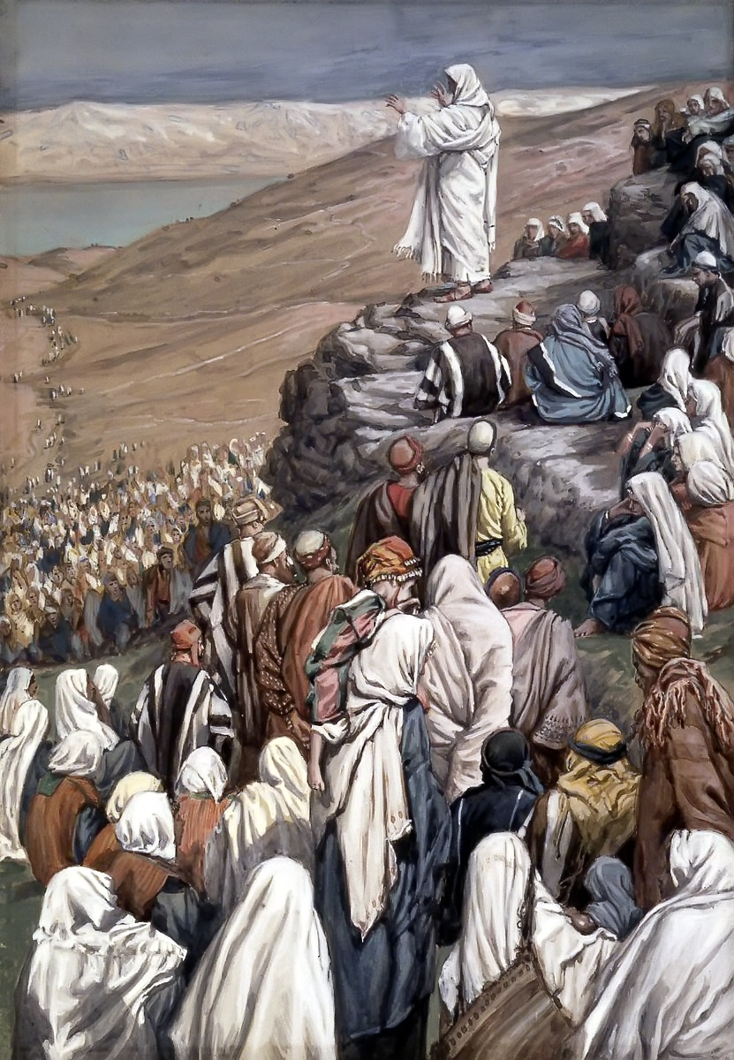
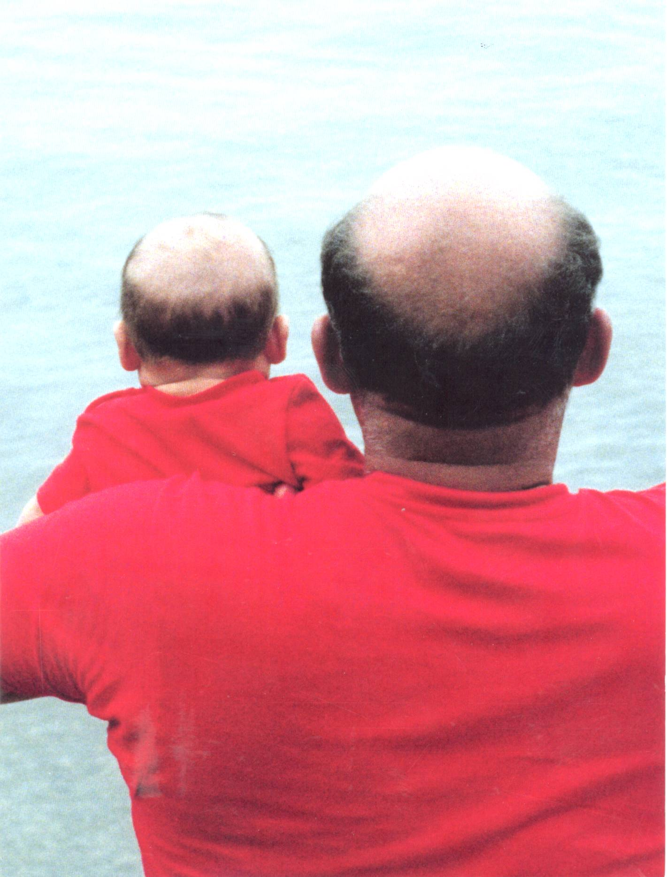
Law and Grace: Session 31 The SOM – Matthew 5:1–8:1 (Luke 6:17–49)
“Sons of your Father” Matthew 5:43-47
Jesus uses the term ‘sons of’, (‘children of’) which means:
like in character and/or
close in relationship to.
Jesus said that loving persecutors in return is ‘sonlike’.

Slide 50
Matthew 5:43–47
⁴³ “You have heard that it was said, ‘You shall love your neighbor and hate your enemy.’ ⁴⁴ “But I say to you, love your enemies and pray for those who persecute you, ⁴⁵ so that you may be sons of your Father who is in heaven; for He causes His sun to rise on the evil and the good, and sends rain on the righteous and the unrighteous. ⁴⁶ “For if you love those who love you, what reward do you have? Do not even the tax collectors do the same? ⁴⁷ “If you greet only your brothers, what more are you doing than others? Do not even the Gentiles do the same?

Slide 51
Law and Grace: Session 31 The SOM – Matthew 5:1–8:1 (Luke 6:17–49)
“Sons of your Father” Matthew 5:43-47
Jesus then tells them that God does make material blessing and provision available to all, whether they are righteous or unrighteous.
So, loving regardless of behavior is, in that way, ‘son-like’.

Slide 52
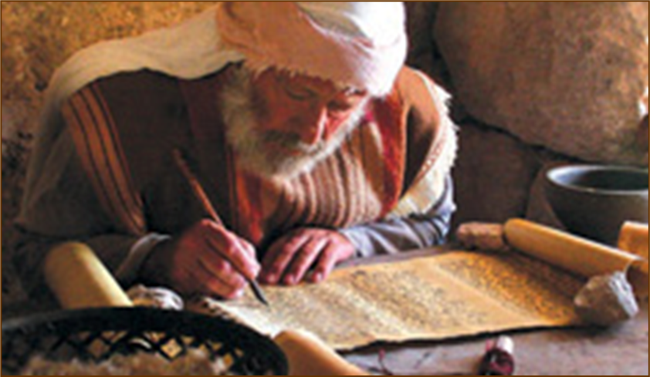
Matthew 5:48
“Therefore you are to be perfect, as your heavenly Father is perfect.

Slide 53
Law and Grace: Session 31 The SOM – Matthew 5:1–8:1 (Luke 6:17–49)
“Be Perfect…” Matthew 5:48
The Law of Moses demanded from the Israelites a holy heart that would lead to good, righteous, and holy behavior, because it’s intent, which was true righteousness as opposed to Pharisaic righteousness, perfectly expressed the very character of God (Leviticus 20:26). But the Law of Moses offered no provision for the enablement to meet its righteous demands.

Slide 54
Matthew 5:48
“Therefore you are to be perfect, as your heavenly Father is perfect.

Slide 55
Colossians 1:28; 4:12
^{1:28} We proclaim Him, admonishing every man and teaching every man with all wisdom, so that we may present every man complete in Christ…. ^{4:12} Epaphras, who is one of your number, a bondslave of Jesus Christ, sends you his greetings, always laboring earnestly for you in his prayers, that you may stand perfect and fully assured in all the will of God.
James 1:4; 3:2
⁴ And let endurance have its perfect result, so that you may be perfect and complete, lacking in nothing….^{3:2} For we all stumble in many ways. If anyone does not stumble in what he says, he is a perfect man, able to bridle the whole body as well.

Slide 56
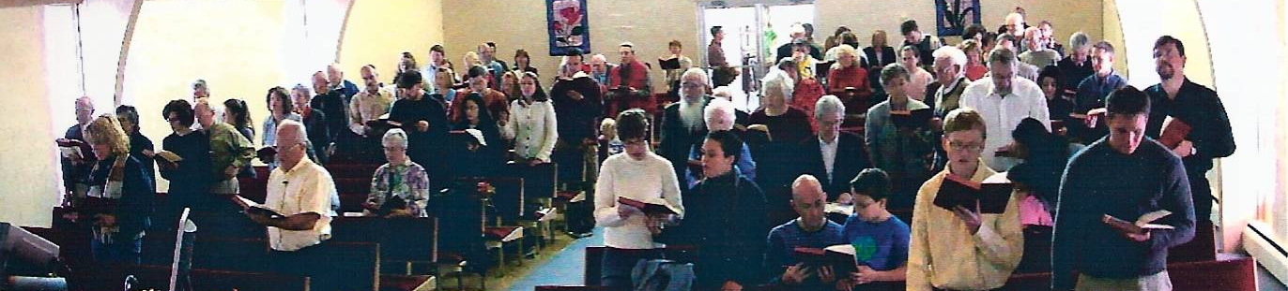
Law and Grace: Session 31 The SOM – Matthew 5:1–8:1 (Luke 6:17–49)
“Be Perfect…” Matthew 5:48
However, for believers living under Grace, the righteous demands of the Law are ALREADY FULFILLED in us, through our identification ‘with Christ’, and will be fully realized experientially once we are glorified.

Slide 57
Session 31 Outline
Review
Purpose, Aim, and Objective
Session 30 – Matthew 5:21-42
The Law True and Deep – Part 2
Matthew 5:43-48
Concluding Observations

Slide 58
Law and Grace: Session 31 The SOM – Matthew 5:1–8:1 (Luke 6:17–49)
“Be Perfect…” Matthew 5:48
In the meantime, God’s design and desire is that we be conformed, transformed, and growing into who we already are ‘in Christ’, daily!

Slide 59
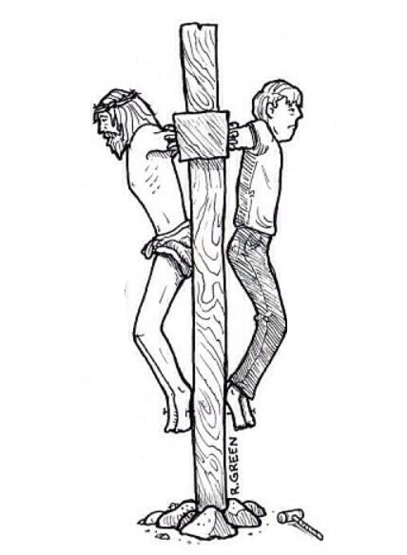
Law and Grace: Session 31 The SOM – Matthew 5:1–8:1 (Luke 6:17–49)
Our Identification ‘In Christ’
1) Crucified …………………..................................................
2) Buried …………………......................................................
3) Risen …………………........................................................
4) A New Position of Life ……………………..........................
5) A New Nature of Righteousness ………….....................
6) Ascended & Seated ………............................................
7) A New Walk of Fruitfulness ……………..........................

Slide 60
Law and Grace: An Overview Jim McGowan, Th.D. Sugar Land Bible Church 03-20-2022
…but grace and truth were realized through Jesus Christ - John 1:17
For the Law was given through Moses…
Special thanks to Dr. Vern Peterman for access to his insights and resources.

