Slide 1


Zechariah
God Remembers!

Slide 2

Structure
Introductory call to repentance (1:1-6)
Eight-night visions (1:7–6:15)
Question and answers about fasting (7–8)
Two burdens (9–14)

Slide 3
Structure
Introductory call to repentance (1:1-6)
Eight-night visions (1:7–6:15)
Question and answers about fasting (7–8)
Two burdens (9–14)

Slide 4
ZECHARIAH’S EIGHT NIGHT VISIONS
Vision | Reference | Meaning
The Red-horse Rider among the Myrtles | 1:7-17 | God’s anger against the nations & blessing on restored Israel.
The Four Horns & the Four Craftsmen | 1:18-21 | God’s judgment on the nations that afflict Israel.
The Surveyor with a Measuring Line | Chapter 2 | God’s future blessing on restored Israel.
The Cleansing & Crowning of Joshua the Hight Priest. | Chapter 3 | Israel’s future cleansing from sin & reinstatement as a priestly nation.
The Golden Lampstand & the Two Olive Trees | Chapter 4 | Israel as the light to the nations under Messiah, the King-Priest.
The Flying Scroll | 5:1-4 | The severity & totality of divine judgment on individual Israelites.
The Woman in the Ephah | 5:5-11 | The removal of national Israel’s sin of rebellion against God.
The Four Chariots | 6:1-8 | Divine judgment on Gentile nations.

Slide 5
II. Eight Night Visions
(1:7‒6:15)
  Riders & horses among the myrtle trees (1:7-17)
  Four horns & four craftsmen (1:18-21)
  Man with the measuring line (2)
  Cleansing of the High Priest Joshua (3)
  Lampstand & olive tree (4)
  Flying scroll (5:1-4)
  Woman in the basket (5:5-11)
  Four chariots (6:1-8)
  Conclusion: crowning of Joshua (6:9-15)

Slide 6
Structure
Introductory call to repentance (1:1-6)
Eight-night visions (1:7–6:15)
Question and answers about fasting (7–8)
Two burdens (9–14)

Slide 7

III. Questions & Answers Concerning Fasting
(7‒8)
  Question (7:1-3)
  Four divine answers (7:4‒8:23)
    Condemnation of empty ritualism (7:4-7)
    Condemnation of past covenant failure (7:8-14)
    Prediction of Jerusalem’s restoration (8:1-17)
    Prediction of future blessing (8:18-23)

Slide 8
Structure
Introductory call to repentance (1:1-6)
Eight-night visions (1:7–6:15)
Question and answers about fasting (7–8)
Two burdens (9–14)

Slide 9
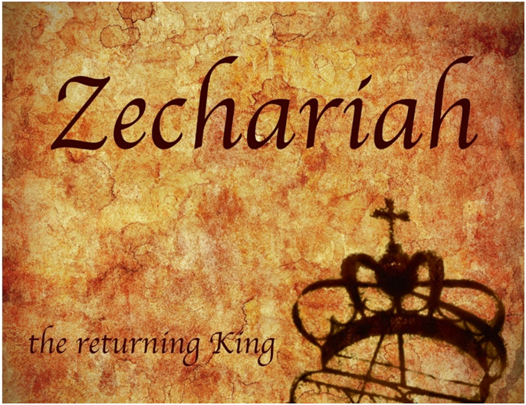
IV. Two Burdens
(9‒14)
  Israel’s postponed deliverance due to her rejection of her Messiah (9‒11)
  Israel’s future deliverance due to her acceptance of her Messiah (12‒14)

Slide 10
IV. Two Burdens
(9‒14)
  Israel’s postponed deliverance due to her rejection of her Messiah (9‒11)
  Israel’s future deliverance due to her acceptance of her Messiah (12‒14)

Slide 11
First Burden Outline
(9‒11)
    Divine warrior hymn (9)
    True shepherd (10)
    False shepherd (11)

Slide 12
First Burden Outline
(9‒11)
    Divine warrior hymn (9)
    True shepherd (10)
    False shepherd (11)

Slide 13
Divine Warrior Hymn
(9:1-17)
Judgment on the oppressing nations (1-8)
Messiah (9-10)
Covenant protection (11-17)

Slide 14
Divine Warrior Hymn
(9:1-17)
Judgment on the oppressing nations (1-8)
Messiah (9-10)
Covenant protection (11-17)

Slide 15
Judgment on the Oppressing Nations
(9:1-8)
    Hadrach (1a)
    Damascus (1b)
    Hamath (2a)
    Tyre & Sidon (2b-4)
    Philistines (5-7)
    Jerusalem (8)

Slide 16
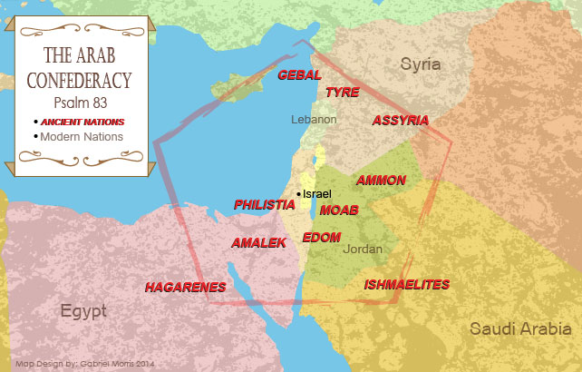

Slide 17
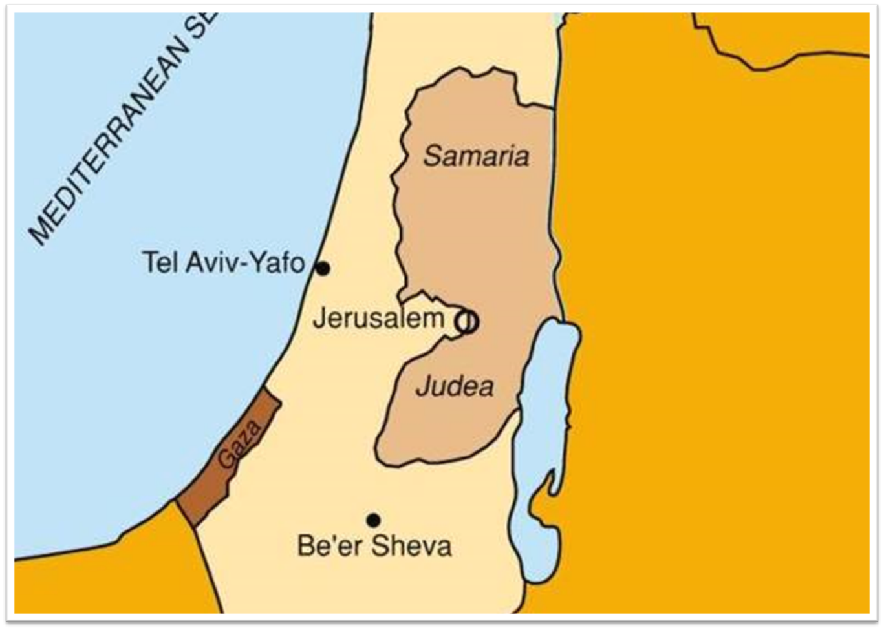

Slide 18
Kenneth L. Barker
Barker, Kenneth L. "Zechariah." In Daniel-Minor Prophets. Vol. 7 of The Expositor's Bible Commentary. 12 vols. Edited by Frank E. Gaebelein and Richard P. Polcyn. Grand Rapids: Zondervan Publishing House, 1985. p. 657.
“As history shows, the agent of the Lord's judgment was Alexander the Great. After defeating the Persians (333 B.C.), Alexander moved swiftly toward Egypt. On his march he toppled the cities in the Aramean (Syrian) interior, as well as those on the Mediterranean coast. Yet, on coming to Jerusalem, he refused to destroy it.”

Slide 19
Divine Warrior Hymn
(9:1-17)
Judgment on the oppressing nations (1-8)
Messiah (9-10)
Covenant protection (11-17)

Slide 20
Messiah
(9:9-10
    First advent (9)
    Second advent (10)

Slide 21
Messiah
(9:9-10
    First advent (9)
    Second advent (10)

Slide 22
Messiah
(9:9-10
    First advent (9)
    Second advent (10)

Slide 23

Zechariah 9:9-10
⁹ Rejoice greatly, O daughter of Zion! Shout in triumph, O daughter of Jerusalem! Behold, your king is coming to you; He is just and endowed with salvation, Humble, and mounted on a donkey, Even on a colt, the foal of a donkey.¹⁰ I will cut off the chariot from Ephraim And the horse from Jerusalem; And the bow of war will be cut off. And He will speak peace to the nations; And His dominion will be from sea to sea, And from the River to the ends of the earth.

Slide 24
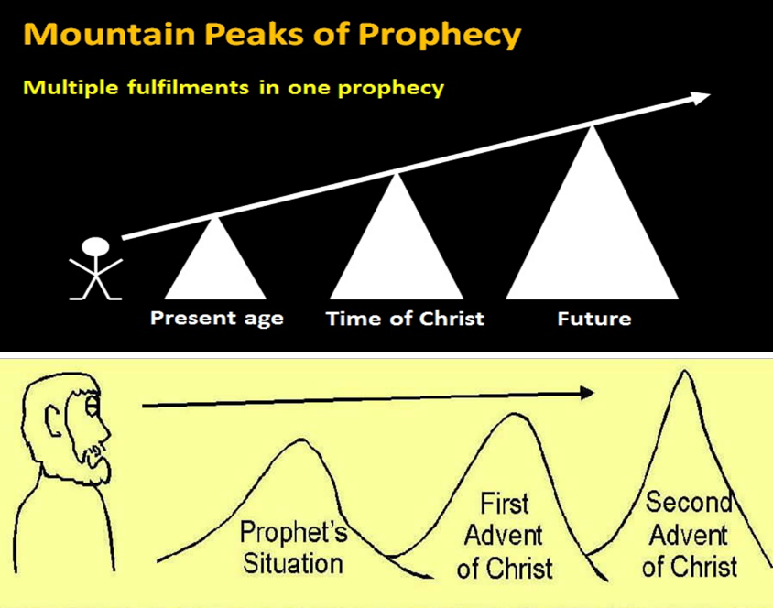

Slide 25
Warren Wiersbe
Wiersbe, Warren W. "Zechariah." In The Bible Exposition Commentary/Prophets, pp. 447-76. Colorado Springs, Colo.: Cook Communications Ministries; and Eastbourne, England: Kingsway Communications Ltd., 2002. p. 467.
“The entire age of the church fits between Zechariah 9:9 and 9:10, just as it does between Isaiah 9:6 and 7 and after the comma in Isaiah 61:2.”

Slide 26

Isaiah 9:6-7
^{6 “}For a child will be born to us, a son will be given to us; |And the government will rest on His shoulders; And His name will be called Wonderful Counselor, Mighty God, Eternal Father, Prince of Peace.⁷ There will be no end to the increase of His government or of peace, The zeal of the Lord of hosts will accomplish this. On the throne of David and over his kingdom, To establish it and to uphold it with justice and righteousness From then on and forevermore.”

Slide 27
Divine Warrior Hymn
(9:1-17)
Judgment on the oppressing nations (1-8)
Messiah (9-10)
Covenant protection (11-17)

Slide 28
Covenant Protection
(9:11-17)
    Blood covenant (11a)
    Prisoners liberated (11b-12)
    Victories (13-17)

Slide 29
Covenant Protection
(9:11-17)
    Blood covenant (11a)
    Prisoners liberated (11b-12)
    Victories (13-17)

Slide 30


Slide 31

Charles Ryrie
The Ryrie Study Bible
“Zechariah 9:11-12 (RSB:NASB1995U): 9:11-12 Restoration and blessing for those still in Babylon is promised. Blood of My covenant. Probably the Abrahamic covenant, which was ratified with a blood sacrifice (Gen. 15:9–10), though possibly the Mosaic, which required many blood sacrifices. Waterless pit. Cistern used as a dungeon.

Slide 32


Slide 33

Exodus 2:24
“So God heard their groaning; and God remembered His covenant with Abraham, Isaac, and Jacob.”

Slide 34
Ezekiel 36:22
“Therefore, say to the house of Israel, ‘This is what the Lord God says: “It is not for your sake, house of Israel, that I am about to act, but for My holy name, which you have profaned among the nations where you went.”

Slide 35
Covenant Protection
(9:11-17)
    Blood covenant (11a)
    Prisoners liberated (11b-12)
    Victories (13-17)

Slide 36
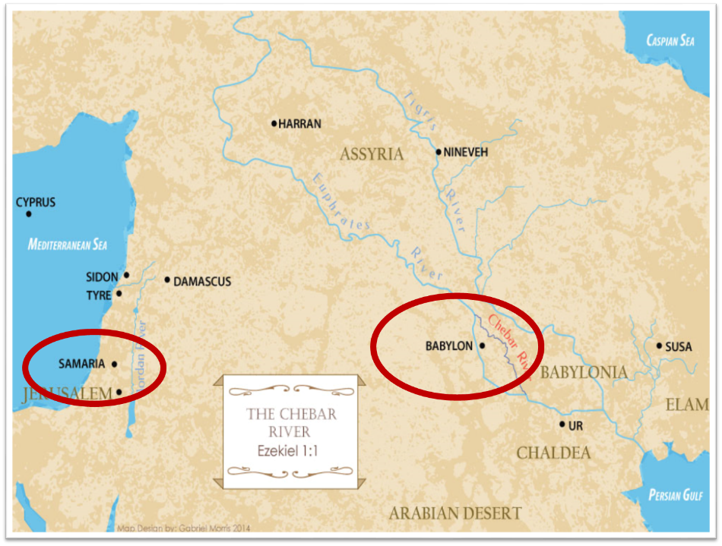

Slide 37
Three Returns
 | DATE | DURATION | PERSIAN KING | JEWISH LEADER | SCRIPTURE | PURPOSE | NUMBER OF RETURNEES
1st return | 538–515 B.C. | 23 years | Cyrus (Isa. 44:28‒45:1) | Zerubbabel | Ezra 1–6; Isaiah 44:28 | Rebuilding the temple | 50,000
2nd return | 458–457 B.C. | 2 years | Artaxerxes | Ezra | Ezra 7–10 | Adorning of the temple and reforming the people | 2,000
3rd return | 444–432 B.C. | 8 years | Artaxerxes | Nehemiah | Nehemiah | Rebuilding the wall

Slide 38
Charles Ryrie
The Ryrie Study Bible
“Zechariah 9:11-12 (RSB:NASB1995U): 9:11-12 Restoration and blessing for those still in Babylon is promised. Blood of My covenant. Probably the Abrahamic covenant, which was ratified with a blood sacrifice (Gen. 15:9–10), though possibly the Mosaic, which required many blood sacrifices. Waterless pit. Cistern used as a dungeon.

Slide 39
Covenant Protection
(9:11-17)
    Blood covenant (11a)
    Prisoners liberated (11b-12)
    Victories (13-17)

Slide 40
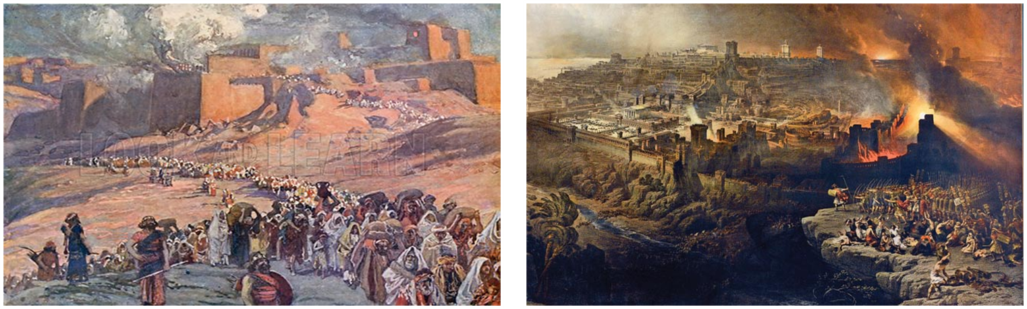
Charles Ryrie
The Ryrie Study Bible
“Zechariah 9:13-17 (RSB:NASB1995U): 9:13-17 These verses predict the defeat of Greece (particularly of Antiochus Epiphanes) by the Jewish people during the Maccabean era (second century b.c.).

Slide 41

HANUKKAH
The Maccabean revolt
December 25th 164 BC, the temple is liberated and rededicated
1 & 2 Maccabees
The miracle of the lamp oil
Hanukkah “Feast of Dedication” (festival of lights).
Christmas / Jewish Holiday
John 10:22-24

Slide 42
Charles Ryrie
The Ryrie Study Bible
“Zechariah 9:1 (RSB:NASB1995U): 9:1 Some hold that chaps. 9–14 are not to be ascribed to Zechariah. However, many similarities exist between chaps. 1–8 and 9–14, and difference of style is never a conclusive argument for different authorship. The reference to Greece as a future dominant power (9:13) is no problem if one accepts the validity of predictive prophecy.

Slide 43
Unique Characteristics
  Interpreting angel
  Longest minor prophet
  Messianic prophecies
  Multiplicity of literary styles
  Times of the Gentiles
  Israel’s Eschatology
  Two burdens focused upon in the passion narratives
  Third most alluded to book in the Apocalypse
  Imputation (3:1-5)
  Summation of prophetic themes

Slide 44
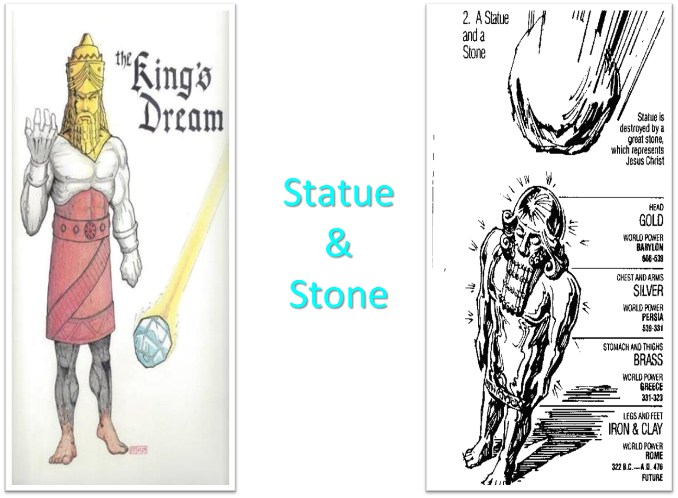

Slide 45


Slide 46
7 Levitical Feasts (Leviticus 23)
Feast | Season | Purpose | Type
Passover | Spring | Redemption | 1 Cor 5:7
Unleavened Bread | Spring | Separation | John 6:35
1st fruits | Spring | Praise for initial crop | 1 Cor. 15:20
Pentecost | Spring | Praise for full crop | Acts 2:1-4
Trumpets | Fall | New Year | Matt. 24:31
Atonement | Fall | Lev. 16 | Zech. 12:10
Booths | Fall | Wilderness provision | Zech. 14:16-18

Slide 47


Slide 49
Six Parts of a Suzerain-Vassal Treaty in Deuteronomy
Preamble (1:1-5)
Prologue (1:6–4:40)
Covenant obligations (5–26)
Storage and reading instructions (27:2-3; 31:9, 24, 26)
Witnesses (32:1)
Blessings and curses (28)

Slide 50
Thomas McComiskey
McComiskey, Thomas Edward. "Zechariah." In The Minor Prophets: An Exegetical and Expositional Commentary, 3:1003-1244. 3 vols. Edited by Thomas Edward McComiskey. Grand Rapids: Baker Books, 1992, 1993, and 1998. Page 1174
“The citizens of Christ's kingdom as well as God's ancient people are a landed people. Hebrews 3 and 5 make this clear, affirming the believer's landedness in the gospel—'at- homeness in Christ.' Today, the fruit of the land that causes its citizens to flourish is the fruit of salvation.”

Slide 51
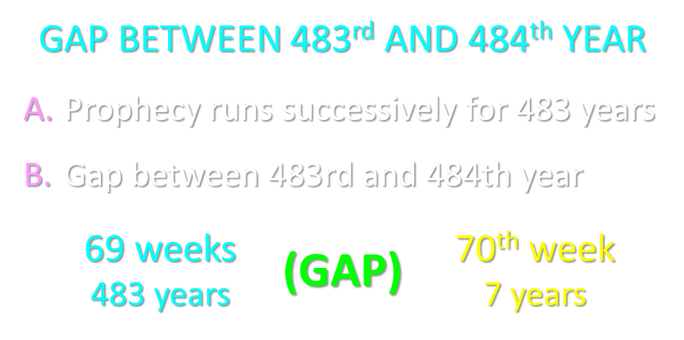

Slide 52
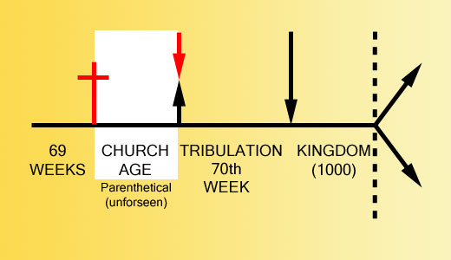

Slide 53
Conclusion

Slide 54
First Burden Outline
(9‒11)
    Divine warrior hymn (9)
    True shepherd (10)
    False shepherd (11)

Slide 55
Divine Warrior Hymn
(9:1-17)
Judgment on the oppressing nations (1-8)
Messiah (9-10)
Covenant protection (11-17)

Slide 56
First Burden Outline
(9‒11)
    Divine warrior hymn (9)
    True shepherd (10)
    False shepherd (11)

Slide 57
First Burden Outline
(9‒11)
    Divine warrior hymn (9)
    True shepherd (10)
    False shepherd (11)

