Slide 1


Genesis 12‒50
Israel’s Birth & Preservation

Slide 2


GENESIS STRUCTURE
  Beginning of the Human race (Gen. 1‒11)
  Beginning of the Hebrew race (Gen. 12‒50)

Slide 3

GENESIS STRUCTURE
  Genesis 1-11 (four events)
    Creation (1-2)
    Fall (3-5)
    Flood (6-9)
    National dispersion (10-11)

Slide 4


Genesis 3:15
“And I will put enmity Between you and the woman, And between your seed and her seed; He shall bruise you on the head, And you shall bruise him on the heel.”

Slide 5
GENESIS STRUCTURE
  Beginning of the Human race (Gen. 1‒11)
  Beginning of the Hebrew race (Gen. 12‒50)

Slide 6

GENESIS STRUCTURE
  Genesis 12-50 (four people)
    Abraham (12:1–25:11)
    Isaac (25:12–26:35)
    Jacob (27–36)
    Joseph (37–50)

Slide 7


Isaiah 43:1
“But now, thus says the Lord, your Creator, O Jacob, And He who formed you, O Israel, 'Do not fear, for I have redeemed you; I have called you by name; you are Mine!'”

Slide 8
GENESIS STRUCTURE
  Genesis 12-50 (four people)
    Abraham (12:1–25:11)
    Isaac (25:12–26:35)
    Jacob (27–36)
    Joseph (37–50)

Slide 9
Genesis 12‒19
Abram’s Early Journeys
  Unconditional promises (Gen. 12:1-3)
  From Haran to Canaan (Gen. 12:4-5)
  In Canaan (Gen. 12:6-9)
  In Egypt (Gen. 12:10-20)
  Abram and Lot Separate (Gen. 13:1-13)
  Reaffirmation of Abram’s promises (Gen. 13:14-18)
  Abram Rescues Lot (14:1-24)
  Abrahamic Covenant (15:1-21)
  Hagar & Ishmael (16:1-16)
  Circumcision (Gen. 17:1-27)
  Sodom & Gomorrah (Gen. 18‒19)

Slide 10
Genesis 18‒19
Sodom & Gomorrah
    Visitation (18:1-15)
    Prediction (18:16-33)
    Destruction (19:1-38)

Slide 11
Genesis 18‒19
Sodom & Gomorrah
    Visitation (18:1-15)
    Prediction (18:16-33)
    Destruction (19:1-38)

Slide 12
Visitation
Genesis 18:1-15
    Hosting (1-8)
    Promise of Isaac (9-15)

Slide 13
Visitation
Genesis 18:1-15
    Hosting (1-8)
    Promise of Isaac (9-15)

Slide 14
1. Hosting
Genesis 18:1-8
    The appearance (1)
    The invitation (2-5a)
    The acceptance (5b)
    The hospitality (6-8)

Slide 15
1. Hosting
Genesis 18:1-8
    The appearance (1)
    The invitation (2-5a)
    The acceptance (5b)
    The hospitality (6-8)

Slide 16


Dr. Arnold G. Fruchtenbaum
The Book of Genesis, 240
“This is the first of seven times that Abraham receives a direct revelation from God. In 12:1–3 is God’s initial call to Abram outside the Land of Canaan; in 12:7 is the first appearance to Abraham in the Land; in 13:14–17, Abraham encounters God after the separation of Lot; in 15:1–21, God signs and seals the Abrahamic Covenant; in 17:1–21, Abraham receives the token of the covenant; in 18:1–33, God speaks to him in conjunction with the destruction of Sodom; and in 22:1–2 and 22:11–18, God directs Abraham to offer Isaac.”

Slide 17
1. Hosting
Genesis 18:1-8
    The appearance (1)
    The invitation (2-5a)
    The acceptance (5b)
    The hospitality (6-8)

Slide 18
1. Hosting
Genesis 18:1-8
    The appearance (1)
    The invitation (2-5a)
    The acceptance (5b)
    The hospitality (6-8)

Slide 19

Genesis 1:27
God created man in His own image, in the image of God He created him; male and female He created them.

Slide 20


Genesis 9:6
“Whoever sheds man’s blood, By man his blood shall be shed, For in the image of God He made man.”

Slide 21
1. Hosting
Genesis 18:1-8
    The appearance (1)
    The invitation (2-5a)
    The acceptance (5b)
    The hospitality (6-8)

Slide 22

Genesis 6:1-4
“¹ Now it came about, when men began to multiply on the face of the land, and daughters were born to them, ² that the sons of God saw that the daughters of men were beautiful; and they took wives for themselves, whomever they chose. ³ Then the Lord said, ‘My Spirit shall not strive with man forever, because he also is flesh; nevertheless his days shall be one hundred and twenty years.’ ⁴ The Nephilim were on the earth in those days, and also afterward, when the . . .

Slide 23
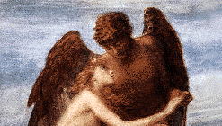
Genesis 6:1-4
. . . sons of God came in to the daughters of men, and they bore children to them. Those were the mighty men who were of old, men of renown.”

Slide 24
DOES NOT REFER TO ANGELS | DOES REFER TO ANGELS
Millard Erickson | John MacArthur
J. Sidlow Baxter | Henry Morris
Warren Wiersbe | Arnold Fruchtenbaum
Paul Enns | Robert Lightner
Gleason Archer | D. Edmond Hiebert
John Sailhammer | James Boice
Wayne Grudem | Robert Morey
Meredith Kline | M. R. DeHann
Leupold | Charles Ryrie
Williamson, unpublished paper, DTS

Slide 25
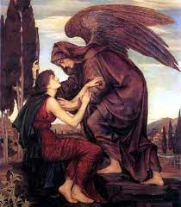
Objections to the Angel View
Angels do not marry? (Matt. 22:30)
Angels are spirits (Heb. 1:14)

Slide 26
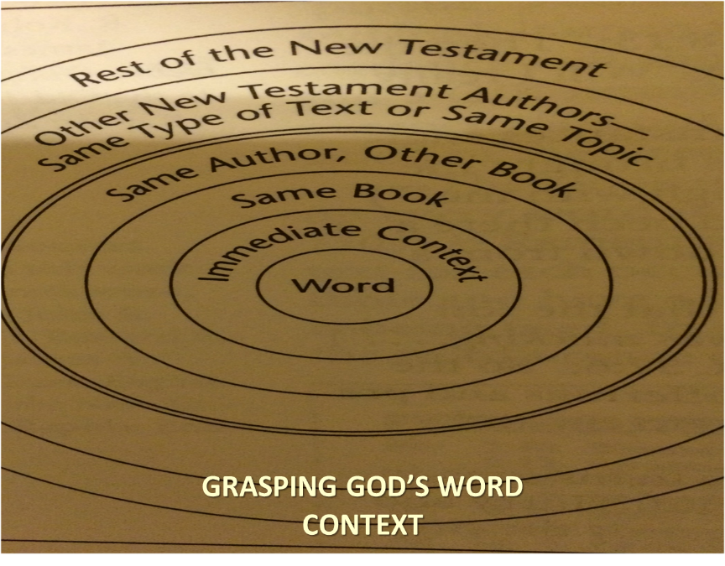

Slide 27


Slide 28

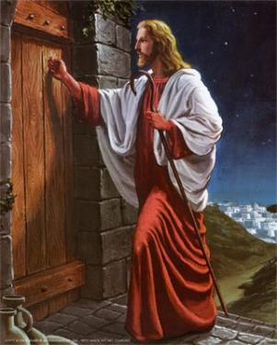
Revelation 3:20
“Behold, I stand at the door and knock; if anyone hears My voice and opens the door, I will come in to him and will dine with him, and he with Me.”

Slide 29
Visitation
Genesis 18:1-15
    Hosting (1-8)
    Promise of Isaac (9-15)

Slide 30
2. Promise of Isaac
Genesis 18:9-15
    Focus on Sarah (9)
    Promise (10a)
    Sarah’s unbelief (10b-12)
    Promise reaffirmed (13-14)
    Sarah’s response (15a)
    God’s response (15b)

Slide 31
2. Promise of Isaac
Genesis 18:9-15
    Focus on Sarah (9)
    Promise (10a)
    Sarah’s unbelief (10b-12)
    Promise reaffirmed (13-14)
    Sarah’s response (15a)
    God’s response (15b)

Slide 32
2. Promise of Isaac
Genesis 18:9-15
    Focus on Sarah (9)
    Promise (10a)
    Sarah’s unbelief (10b-12)
    Promise reaffirmed (13-14)
    Sarah’s response (15a)
    God’s response (15b)

Slide 33
2. Promise of Isaac
Genesis 18:9-15
    Focus on Sarah (9)
    Promise (10a)
    Sarah’s unbelief (10b-12)
    Promise reaffirmed (13-14)
    Sarah’s response (15a)
    God’s response (15b)

Slide 34
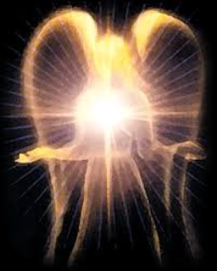
Satan’s Original State and First Sin
Isaiah 14:12-15
  5 “I will” statements
    Ascend to heaven (13)
    Raise my throne above the stars of God (13)
    Sit enthroned on the Mt. of the Assembly (13)
    Ascend above the tops of the clouds (14)
    Make myself like the Most High (14)

Slide 35
2. Promise of Isaac
Genesis 18:9-15
    Focus on Sarah (9)
    Promise (10a)
    Sarah’s unbelief (10b-12)
    Promise reaffirmed (13-14)
    Sarah’s response (15a)
    God’s response (15b)

Slide 36


John 13:19; 14:29
“^{13:19} From now on I am telling you before it comes to pass, so that when it does occur, you may believe that I am He… ^{14:29} Now I have told you before it happens, so that when it happens, you may believe.”

Slide 37


Slide 38
2. Promise of Isaac
Genesis 18:9-15
    Focus on Sarah (9)
    Promise (10a)
    Sarah’s unbelief (10b-12)
    Promise reaffirmed (13-14)
    Sarah’s response (15a)
    God’s response (15b)

Slide 39
2. Promise of Isaac
Genesis 18:9-15
    Focus on Sarah (9)
    Promise (10a)
    Sarah’s unbelief (10b-12)
    Promise reaffirmed (13-14)
    Sarah’s response (15a)
    God’s response (15b)

Slide 40
Conclusion

Slide 41
Genesis 18‒19
Sodom & Gomorrah
    Visitation (18:1-15)
    Prediction (18:16-33)
    Destruction (19:1-38)

Slide 42
Visitation
Genesis 18:1-15
    Hosting (1-8)
    Promise of Isaac (9-15)

Slide 43

“The Lord bless you and keep you; the Lord make his face shine on you and be gracious to you; the Lord turn his face toward you and give you peace.” (NIV)

