Slide 1

Ezekiel 36‒39
The Middle East Meltdown 2022
Dr. Andy Woods
Senior Pastor – Sugar Land Bible Church
President – Chafer Theological Seminary

Slide 2
Ezekiel 33‒48
Ezekiel recommissioned (33)
False shepherds removed (34)
Edom destroyed (35)
Israel’s restoration: physical & spiritual (36)
Israel’s restoration illustrated (37)
Means of restoration: Northern invasion (38)
Results of the Northern invasion: conversion (39)
Millennial Temple (40‒46)
Tribal land allotment (47‒48)

Slide 3
Ezekiel 36
Israel to prosper again (1-15)
Israel’s sins inhibiting prosperity (16-21)
Israel to be restored: physically & spiritually (22-38)

Slide 4
Ezekiel 33‒48
Ezekiel recommissioned (33)
False shepherds removed (34)
Edom destroyed (35)
Israel’s restoration: physical & spiritual (36)
Israel’s restoration illustrated (37)
Means of restoration: Northern invasion (38)
Results of the Northern invasion: conversion (39)
Millennial Temple (40‒46)
Tribal land allotment (47‒48)

Slide 5
Ezekiel 37
Vision: Valley of the Dry Bones (1-14)
  Vision (1-10)
  Interpretation (11-14)
Sign: Two Sticks (15-28)
  Sign (15-17)
  Interpretation (18-28)

Slide 6
Ezekiel 33‒48
Ezekiel recommissioned (33)
False shepherds removed (34)
Edom destroyed (35)
Israel’s restoration: physical & spiritual (36)
Israel’s restoration illustrated (37)
Means of restoration: Northern invasion (38)
Results of the Northern invasion: conversion (39)
Millennial Temple (40‒46)
Tribal land allotment (47‒48)

Slide 7
Ezekiel 38‒39
Invasion planned (38:1-13)
Invasion executed (38:14-16)
Invasion defeated (38:17‒39:20)
Invasion’s results (39:21-29)

Slide 8
Ezekiel 38‒39
Invasion planned (38:1-13)
Invasion executed (38:14-16)
Invasion defeated (38:17‒39:20)
Invasion’s results (39:21-29)

Slide 9
I. Invasion Planned (Ezekiel 38:1-13)
  God’s intention (1-9)
  Gog’s intention (10-13)

Slide 10
I. Invasion Planned (Ezekiel 38:1-13)
  God’s intention (1-9)
  Gog’s intention (10-13)

Slide 11


Slide 12

Ancient Names From Ezekiel 38:1-9
Magog (Central Asia), Rosh (Russia), Meshec (Turkey), Tubal (Turkey), Persia (Iran), Put (Libya), Cush (Sudan), Gomer (Turkey), | Togarmah (Turkey) Sheba (Saudi Arabia) Dedan (Saudi Arabia or Yemen) Tarshish (Spain) Merchants of Tarshish (Conglomeration of Western powers including Europe) Israel

Slide 13
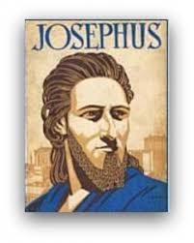
Josephus
Josephus, Antiquities, 1.6.1.
"Magog founded those that from him were named Magogites, but who are by the Greeks called Scythians."

Slide 15
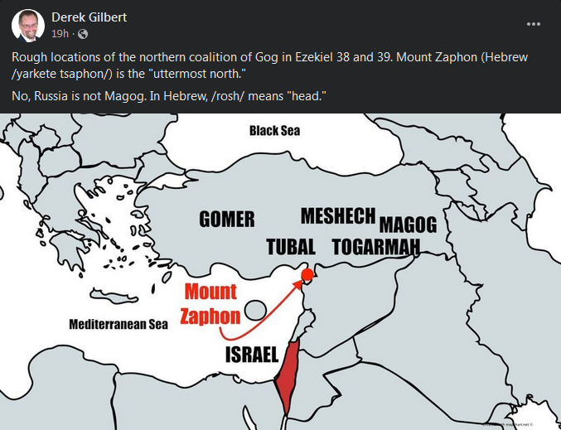

Slide 16

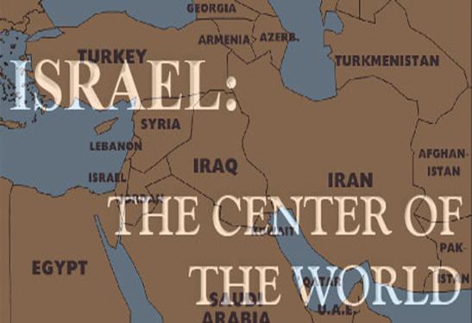
Ezekiel 38:2 (KJV)
“Son of man, set thy face against Gog, the land of Magog, the chief prince of Meshech and Tubal, and prophesy against him.”

Slide 17
Ezekiel 38:2 (NASB/NASB95)
“Son of man, set your face toward Gog of the land of Magog, the prince of Rosh, Meshech and Tubal, and prophesy against him.”

Slide 18
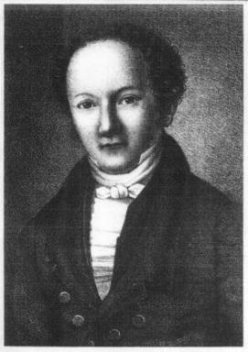
Wilhelm Gesenius
Gesenius' Hebrew and Chaldee Lexicon (Samuel Bagster and Sons, 1847; reprint, Grand Rapids: Baker, 1987), 752.
"pr. n. of a northern nation, mentioned with Tubal and Meshech; undoubtedly the Russians, who are mentioned by the Byzantine writers of the tenth century, under the name the Ros, dwelling to the north of Taurus . . .as dwelling on the river Rha (Wolga)."

Slide 19
Clyde Billington
Clyde E. Billington Jr., “The Rosh People in History and Prophecy (Part Two)” Michigan Theological Journal 3 (1992): 59, 61.
“Historical, ethnological, and archaeological evidence all favor the conclusion that the Rosh people of Ezekiel 38–39 were the ancestors of the Rus/Ros people of Europe and Asia. . . . Those Rosh people who lived to the north of the Black Sea in ancient and medieval times were called the Rus/Ros/Rox/Aorsi from very early times. . . . The Rosh people of the area north of the Black Sea formed the people known today as the Russians.”

Slide 20
Wilhelm Gesenius
Gesenius' Hebrew and Chaldee Lexicon (Samuel Bagster and Sons, 1847; reprint, Grand Rapids: Baker, 1987), 752.
"pr. n. of a northern nation, mentioned with Tubal and Meshech; undoubtedly the Russians, who are mentioned by the Byzantine writers of the tenth century, under the name the Ros, dwelling to the north of Taurus . . .as dwelling on the river Rha (Wolga)."

Slide 21

Ezekiel 5:5
“Thus says the Lord God, ‘This is Jerusalem; I have set her at the center of the nations, with lands around her.'”

Slide 22
Ezekiel 38:12
“to capture spoil and to seize plunder, to turn your hand against the waste places which are now inhabited, and against the people who are gathered from the nations, who have acquired cattle and goods, who live at the center of the world.”

Slide 24
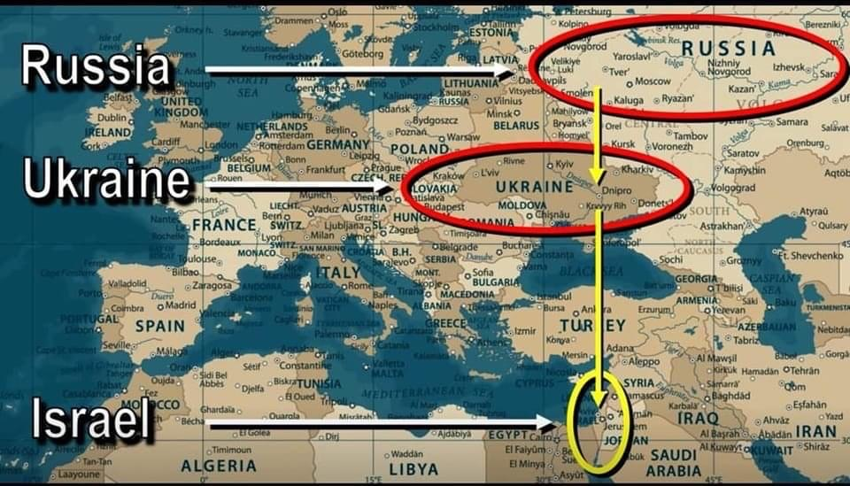

Slide 25
Josephus
Josephus, Antiquities, 1.6.1.
"..and the Mosocheni were founded by Mosoch; now they are Cappadocians."

Slide 26

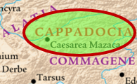
1 Peter 1:1
Peter, an apostle of Jesus Christ, To those who reside as aliens, scattered throughout Pontus, Galatia, Cappadocia, Asia, and Bithynia, who are chosen…

Slide 27
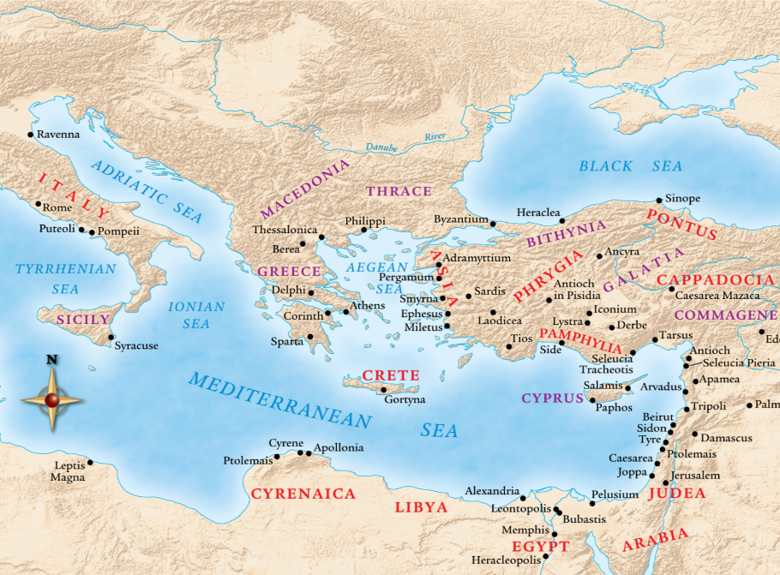

Slide 28

Herodotus, Histories, 3:93-94 (450 B.C.)
“The twelfth, the Bactrians as far as the land of the Aegli; these paid three hundred and sixty. The thirteenth, the Pactyic country and Armenia and the lands adjoining as far as the Euxine sea; these paid four hundred…The Moschi, Tibareni, Macrones, Mossynoeci, and Mares, the nineteenth province, were ordered to pay three hundred. The Indians made up the twentieth province. These are more in number than any nation of which we know, and they paid a greater tribute than any other province, namely three hundred and sixty talents of gold dust.”

Slide 30
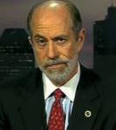
Frank Gaffney
War Footing (Annapolis: Naval Institute Press, 2006), 164. Cited in Rhodes, 177.
According to Frank Gaffney, President of the Center for Security Policy, Turkey is transitioning from “a secular democracy with a Muslim society into a state governed by a radical Islamic ideology hostile to Western values and freedoms.”

Slide 31
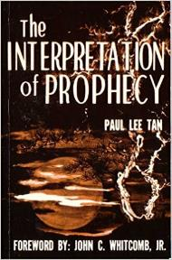
Paul Lee Tan
The Interpretation of Prophecy, 223-24
“Interestingly, these prophesied military instruments though centuries old have not been made obsolete. The horse, for instance, is still used in warfare on certain kinds of terrain.”

Slide 32

Charles L. Feinberg
The Prophecy of Ezekiel: The Glory of the Lord, Paperback ed. (Chicago: Moody, 1969; reprint, Chicago: Moody, 1984), 221.
“Some have found great difficulty in the references to armor, buckler, shield, sword and helmet, but even in our day of advanced weapons of warfare it is interesting to learn that in some parts of the world conflict is going on with primitive weapons. (And how else could an ancient writer have described warfare? He knew nothing of planes and guns.).”

Slide 33

Ezekiel 39:2, 4
“² and I will turn you around, drive you on, take you up from the remotest parts of the north and bring you against the mountains of Israel…⁴You will fall on the mountains of Israel, you and all your troops and the peoples who are with you; I will give you as food to every kind of predatory bird and beast of the field.”

Slide 34
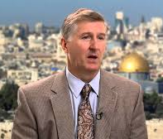
Mountains of Israel?
Mark Hitchcock, The Amazing Claims of Bible Prophecy: What You Need to Know in These Uncertain Times (Harvest House: Eugene, OR, 2010), 211.
“According to Ezekiel 39:2, 4, Israel must possess the ‘mountains of Israel’ when this invasion occurs...The famous Six Day war in Israel in 1967 helped set the stage for this to be fulfilled. Before the Six Day War, all the mountains of Israel, with the exception of a small strip of west Jerusalem, were in the hands of the Jordanian Arabs. Only since 1967 have the mountains of Israel been in Israel, thus setting the stage for the fulfillment of this prophecy.”

Slide 35


Dr. Arnold G. Fruchtenbaum
THE MODERN STATE OF ISRAEL IN BIBLE PROPHECY
Paper presented to the PTSG on 12-7-21, pps. 18-19
“But where in the Land of Israel will the invading armies be destroyed? The exact location is revealed in Ezekiel 39:2 and 4a: ‘and I will turn you about, and will lead you on, and will cause you to come up from the uttermost parts of the north; and I will bring you upon the mountains of Israel…you shall fall upon the mountains of Israel.’ The phrase ‘the mountains of Israel’ refers to the central mountain range that makes up the backbone of the country. In the Hebrew Scriptures, these mountains were known as the Hill Country of Ephraim and the Hill Country of Judah. Some of the famous biblical cities that lie within these mountains include Dothan, Shechem, Samaria, Shiloh, Bethel, Ai, Ramah, Bethlehem, Hebron, Debir, and most importantly, Jerusalem, which seems to be the target of the invading army. However, from 1948 until the Six-Day War in 1967, these mountains were not in Israel, but in Jordan.”

Slide 36
Dr. Arnold G. Fruchtenbaum
THE MODERN STATE OF ISRAEL IN BIBLE PROPHECY
Paper presented to the PTSG on 12-7-21, pps. 18-19
“They are now referred to politically as the West Bank. In 1948, Jordanian forces took over these mountains and annexed them as part of Jordan. All Israel had was a small corridor leading west to Jerusalem. The border between Israel and Jordan ran down the foot of these mountains, then cut into the mountains, dividing Jerusalem in two, and then went out again and continued along the foot of these mountains. Israel had maybe five percent or less of the mountains, while the rest belonged to Jordan. Only since 1967 have the mountains of Israel been in Israel. Besides the Temple compound falling into Jewish hands, another by-product of the Six-Day War was that these mountains also fell under Israeli sovereignty. Therefore, not only could this prophecy not have been fulfilled before 1948, but it could also not have been fulfilled before 1967.”

Slide 37
Dr. Arnold G. Fruchtenbaum
THE MODERN STATE OF ISRAEL IN BIBLE PROPHECY
Paper presented to the PTSG on 12-7-21, pps. 18-19
“The mountains of Israel (the West Bank) are yet to have a very important and relevant role in Bible prophecy. As for the present State of Israel, they became part of Israel in 1967. This is yet another way the modern Jewish State fits within Bible prophecy.”

Slide 38
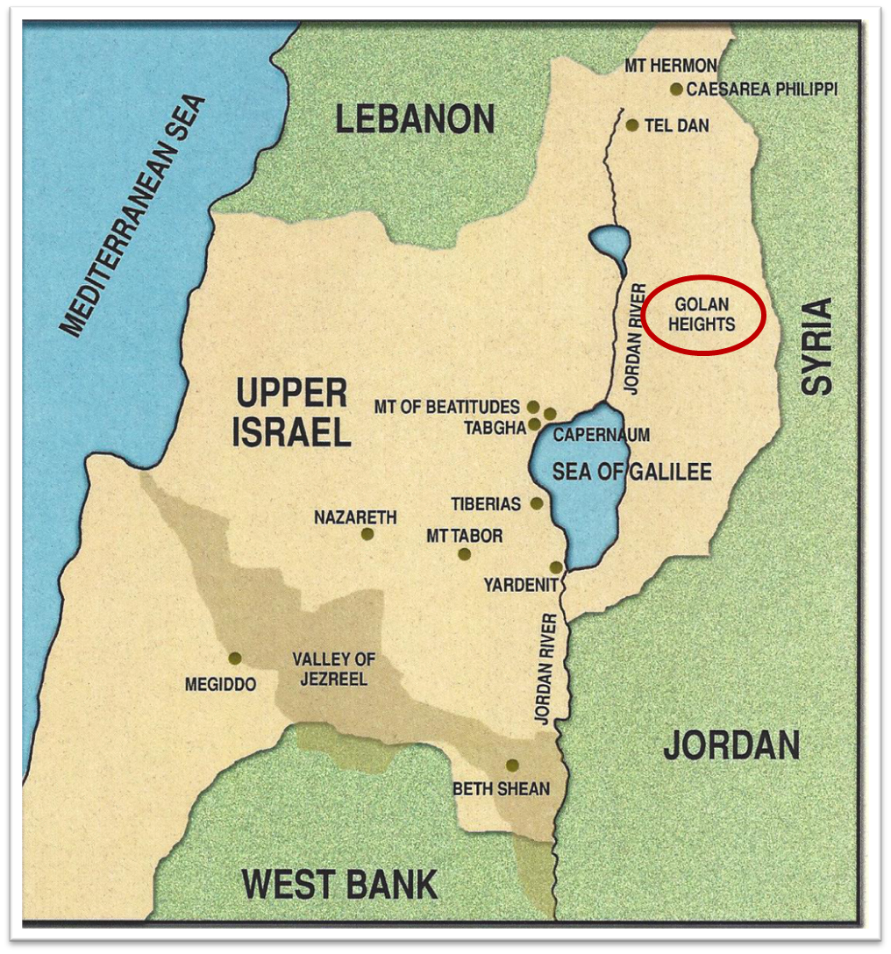

Slide 39
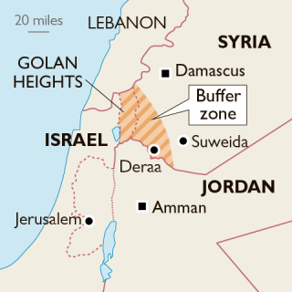

Slide 40


Slide 41
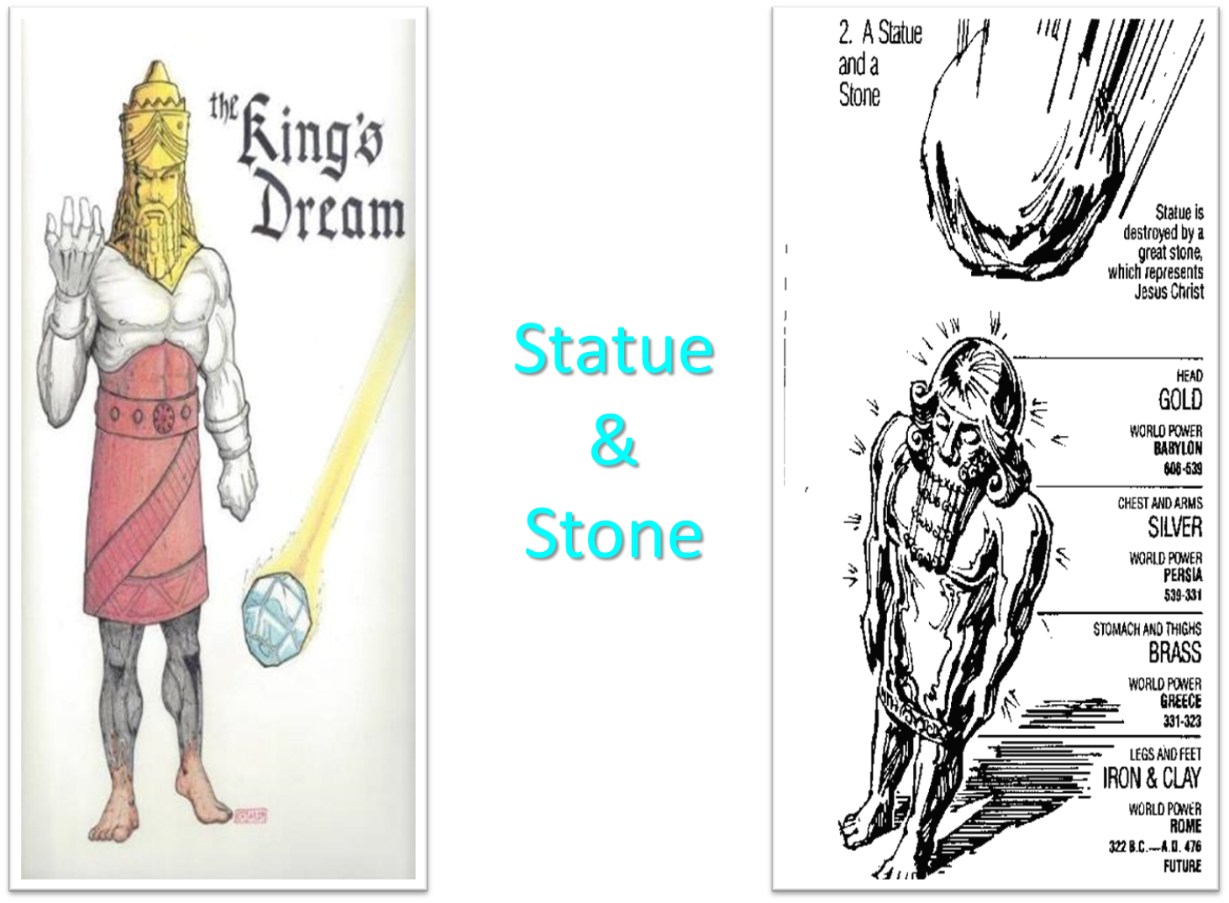

Slide 42
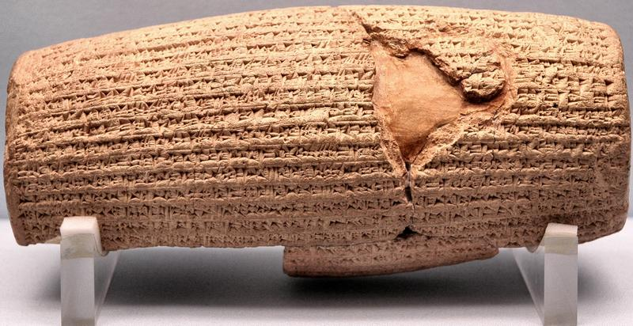
Cyrus Cylinder

Slide 43
Three Returns
 | DATE | DURATION | PERSIAN KING | JEWISH LEADER | SCRIPTURE | PURPOSE | NUMBER OF RETURNEES
1st return | 538–515 B.C. | 23 years | Cyrus (Isa 44:28‒45:1) | Zerubbabel | Ezra 1–6; Isaiah 44:28 | Rebuilding the temple | 50,000
2nd return | 458–457 B.C. | 2 years | Artaxerxes | Ezra | Ezra 7–10 | Adorning of the temple and reforming the people | 2,000
3rd return | 444–432 B.C. | 8 years | Artaxerxes | Nehemiah | Nehemiah | Rebuilding the wall

Slide 45
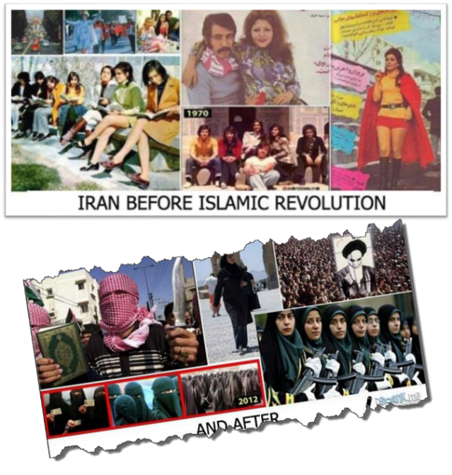

Slide 46
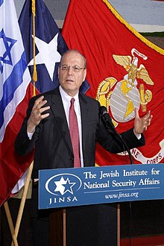
Yoram Ettinger
“Iran's School Textbooks‒Can Congress Afford to Ignore It?,” online: http://theettingerreport.com/Iran-and-MidEast/Iran-s-School-Textbooks-%E2%80%93-can-Congress-afford-to-i.aspx, May 29, 2015, accessed 30 May 2015.
“Iranian school textbooks, such as The Qur'an and Life (Grade 12, p. 125) prepare Iranian children for the Ayatollahs' sublime goal: the apocalyptic, horrifying, millenarian, military battle against the USA and other "arrogant oppressors of the world," which are ostensibly led by "idolatrous devils." While the "savior" – the infallible, immortal, divinely ordained and eventual global leader, the Mahdi – has not surfaced yet, Iranian children are taught that the battle is already raging throughout the world, awaiting their sacrifice. School . . .

Slide 47
Yoram Ettinger
“Iran's School Textbooks‒Can Congress Afford to Ignore It?,” online: http://theettingerreport.com/Iran-and-MidEast/Iran-s-School-Textbooks-%E2%80%93-can-Congress-afford-to-i.aspx, May 29, 2015, accessed 30 May 2015.
. . .textbooks of Western democracies are the most authentic reflection of peoples' values and worldview. School textbooks of tyrannies are the most authentic reflection of the nature and mission of the regimes. Iranian school textbooks reflect the strategy and tactics of the Ayatollahs, much more authentically than speeches, interviews, diplomatic statements and conversations conducted by President Rouhani and Foreign Minister Zarif.”

Slide 48
Josephus
Josephus, Antiquities, 1.6.2.
"For of the four sons of Ham, time has not at all hurt the name of Cush; for the Ethiopians, over whom he reigned, are even at this day, both by themselves and by all men in Asia, called Cushites."

Slide 49
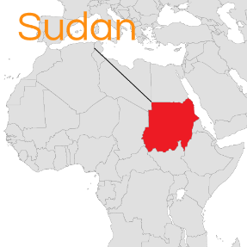
Cush = Sudan
Philip C. Johnson, “Cush,” in Wycliffe Bible Encyclopedia, ed. Howard F. Vos, Charles F. Pfeiffer, John Rea (Chicago: Moody, 1975), p. 1.411.
"The designation, Ethiopia, is misleading for it did not refer to the modern state of Ethiopia...Cush... bordered Egypt on the South,...or modern Sudan."

Slide 51

Renald Showers
Renald Showers, The Coming Apocalypse: A Study of Replacement Theology Vs. God’s Faithfulness in the End Times (Bellmawr, NJ: Friends of Israel, 2009), p. 92.
“﻿Sudan is dominated by a brutal Arab Islamic fundamentalist government that murderers, rapes, and enslaves Christians and animists and is slaughtering the black Muslims in Darfur in an attempt to establish a pure Islamic state.”

Slide 52
Josephus
Josephus, Antiquities, 1.6.2.
"Phut also was the founder of Libya, and called the inhabitants Phutites, from himself: there is also a river in the country of Moors which bears that name; whence it is that we may see the greatest part of the Grecian historiographers mention that river and the adjoining country by the apellation of Phut: but the name it has now has been by change given it from one of the sons of Mesraim, who was called Lybyos."

Slide 54
Gaddafi
http://en.wikipedia.org/wiki/1986_Berlin_discotheque_bombing>; Internet; accessed 27 May 2015.
“﻿On April 5, 1986 three people were killed and around 230 injured when La Belle discothèque was bombed in West Berlin. The entertainment venue was commonly frequented by United States soldiers, and two of the dead and 79 of the injured were American servicemen... Libya was accused of sponsoring the bombing by the US government, and US President Ronald Reagan ordered retaliatory strikes on Tripoli and Benghazi in Libya ten days later. The strikes reportedly killed at least 15 people, including Colonel Gaddafi’s adopted daughter. A 2001 trial in the US found that the bombing had been ‘planned by the Libyan secret service and the Libyan Embassy.”

Slide 55
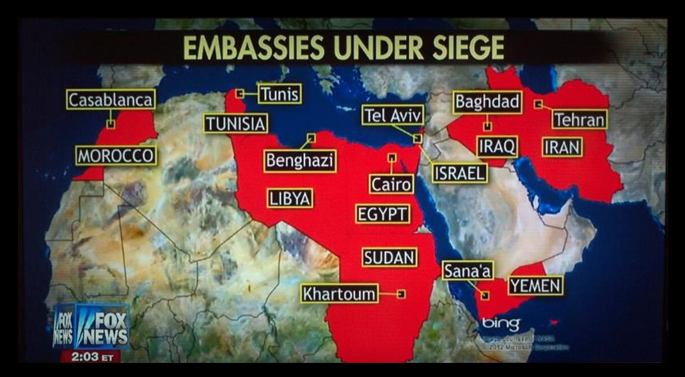

Slide 56
Josephus
Josephus, Antiquities, 1.6.1.
"For Gomer founded those whom the Greeks now call Galatians, [Galls,] but were then called Gomerites.”

Slide 59
Josephus
Josephus, Antiquities, 1.6.1.
"...Thrugramma the Thrugrammeans, who, as the Greeks resolved, were named Phrygians.”

Slide 60
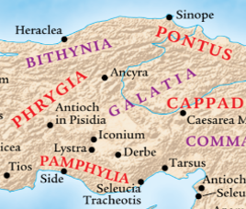
Acts 16:6
“ They passed through the Phrygian and Galatian region, having been forbidden by the Holy Spirit to speak the word in Asia.”

Slide 63
Frank Gaffney
War Footing (Annapolis: Naval Institute Press, 2006), 164. Cited in Rhodes, 177.
According to Frank Gaffney, President of the Center for Security Policy, Turkey is transitioning from “a secular democracy with a Muslim society into a state governed by a radical Islamic ideology hostile to Western values and freedoms.”

Slide 64
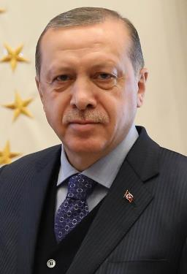
Turkish President Assumes New Sweeping Powers
http://www.israelislamandendtimes.com/turkish-president-and-pm-we-will-gather-together-all-of-the-muslim-world-and-invade-jerusalem/, July 09, 2018, accessed 01 August 2018.
“Turkish President Recep Tayyip Erdogan has assumed sweeping new powers as the country transitions to an executive presidency… Erdogan's new presidential powers are considerable. He can issue decrees with the enforcement of the law and appoint ministers who directly report to him. Erdogan also chooses nine of the 12 constitutional court charges. Under the new system, the post of prime minister is abolished.”

Slide 65
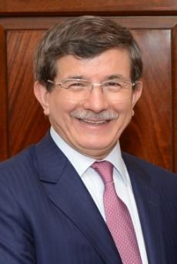
Turkish President and PM:
'We Will Gather Together All Of The Muslim World and Invade Jerusalem,’”
http://www.israelislamandendtimes.com/turkish-president-and-pm-we-will-gather-together-all-of-the-muslim-world-and-invade-jerusalem/, May 30, 2015, accessed 30 May 2015.
“By Allah’s will, Jerusalem belongs to the Kurds, the Turks, the Arabs, and to all Muslims. And as our forefathers fought side by side at Gallipoli, and just as our forefathers went together to liberate Jerusalem with Saladin, we will march together on the same path [to liberate Jerusalem].”

Slide 66

Laura Mowat
The Express, online: https://www.express.co.uk/news/world/853497/EU-State-of-the-union-jean-claude-juncker-turkey-membership. September 13, 2017 , accessed 12 December 2017.
“‘They’ve pulled up the draw bridge’ Juncker RULES OUT Turkey joining the EU. THE President of the European Commission Jean-Claude Juncker has said Turkey will not be joining the European Union (EU) in the foreseeable future in a flagship speech.”

Slide 67
Ezekiel 38:12
“to capture spoil and to seize plunder, to turn your hand against the waste places which are now inhabited, and against the people who are gathered from the nations, who have acquired cattle and goods, who live at the center of the world.”
67

Slide 68
Ezekiel 5:5
“Thus says the Lord God, ‘This is Jerusalem; I have set her at the center of the nations, with lands around her.'”
68

Slide 70
Charles L. Feinberg
The Prophecy of Ezekiel: The Glory of the Lord, Paperback ed. (Chicago: Moody, 1969; reprint, Chicago: Moody, 1984), 224.
“The area of origin was stated as out of the uttermost parts, the farthest reaches, of the north. It is well known who has been dominant in this region of the world ever since the end of the last global conflict, an area which has actually kept the entire world in turmoil constantly. Russia is a power that must be reckoned with now, and surely will figure largely in the events that lie head, especially when the church is raptured to her risen Lord.”

Slide 71
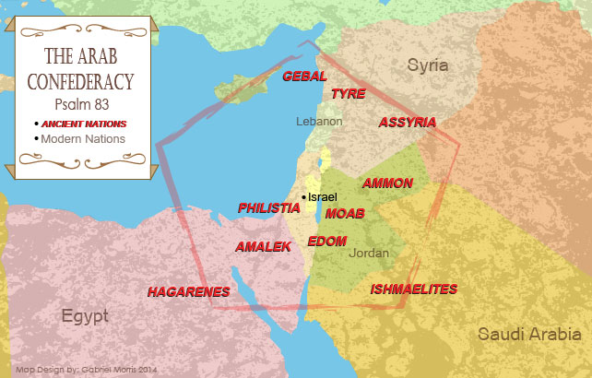

Slide 72
Ancient Names From Ezekiel 38:1-9
Magog (Central Asia), Rosh (Russia), Meshec (Turkey), Tubal (Turkey), Persia (Iran), Put (Libya), Cush (Sudan), Gomer (Turkey), | Togarmah (Turkey) Sheba (Saudi Arabia) Dedan (Saudi Arabia or Yemen) Tarshish (Spain) Merchants of Tarshish (Conglomeration of Western powers including Europe) Israel

Slide 74

Mikhail Metzel
TASS Russian News Agency, online: http://tass.com/politics/932980. February 27, 2017 , accessed 12 December 2017.
“Putin: Russia's military base in Tajikistan to ensure security of border with Afghanistan. Russian President Vladimir Putin has expressed his readiness to consider the proposals made by his Tajik counterpart Emomali Rahmon, aimed at boosting bilateral educational cooperation.”

Slide 75

John C. K. Daly
Eurasia Daily Monitor, online: https://jamestown.org/program/russia-and-uzbekistan-hold-first-joint-military-exercise-in-12-years-plan-further-cooperation/. October 3, 2017 , accessed 12 December 2017.
“Russia and Uzbekistan Hold First Joint Military Exercise in 12 Years, Plan Further Cooperation.”

Slide 76
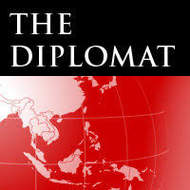
Catherine Putz
The Diplomat, online: https://thediplomat.com/2017/06/on-trip-to-russia-kyrgyz-president-atambayev-sings-putins-praises. November 29, 2017 , accessed 12 December 2017.
“Checking in With Moscow: New Kyrgyz President Makes First International Trip to Russia. President Sooronbai Jeenbekov made a working visit to Moscow less than a week after taking office. Five days after being inaugurated as Kyrgyzstan’s new president on November 24, Sooronbai Jeenbekov touched down in Moscow for a working visit.”

Slide 77

AFP News
online: http://www.dailymail.co.uk/wires/afp/article-5111291/In-Russia-Sudans-Bashir-asks-Putin-protection-US.html/. November 23, 2017 , accessed 12 December 2017.
“Putin meets with Sudanese President Omar al-Bashir. Sudanese President Omar al-Bashir, who is wanted by the International Criminal Court for genocide and war crimes, asks Russia's Vladimir Putin to protect his country from the United States.”

Slide 78
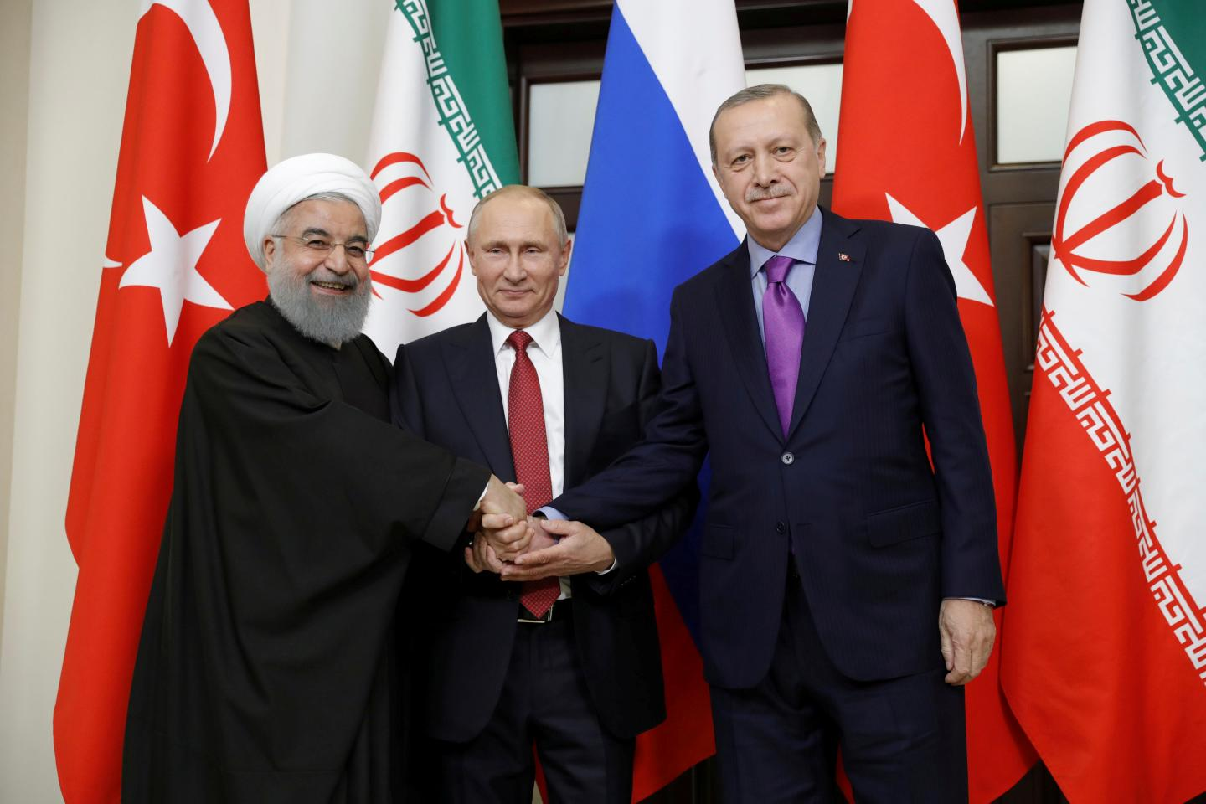

Slide 79
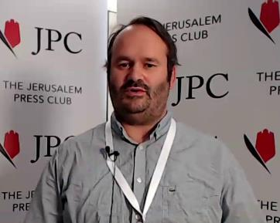
Seth J. Frantzman
The Jerusalem Post, online: http://www.jpost.com/Middle-East/Iran-News/Analysis-Russia-Iran-Turkey-meeting-is-message-to-US-514581. November 19, 2017 , accessed 12 December 2017.
“Analysis: Russia-Iran-Turkey meeting is message to US. Moscow, Turkey and Iran are all sending symbolic messages to Washington that the Americans are out in the cold and the post-ISIS era may well be dictated by regional powers.”

Slide 80

Schams Elwazer
Milena Veselinovic and Hilary McGann. CNN, online: http://www.cnn.com/2017/11/22/world/syria-russia-turkey-iran-talks/index.html. November 22, 2017 , accessed 12 December 2017.
“Russia, Iran, Turkey agree to hold Syrian 'congress' to talk peace. Russian President Vladimir Putin, center, addresses reporters with Iranian President Hassan Rouhani, left, and Turkish President Recep Tayyip Erdogan after a meeting on Syria in Sochi, Russia, on Wednesday.”

Slide 81

Daily Sabah
online: https://www.dailysabah.com/diplomacy/2017/08/07/turkey-iran-russia-to-hold-syria-talks-in-tehran-aug-8-9. August 07, 2017, accessed 12 December 2017.
“Turkey, Iran, Russia to hold Syria talks in Tehran Aug. 8-9. Iranian Foreign Minister Javad Zarif (L), Russian Foreign Minister Sergey Lavrov (C), and Turkish Foreign Minister Mevlüt Çavuşoğlu attend a joint press conference after talks in Moscow, Russia, December 20, 2016. Turkish, Iranian and Russian officials will hold talks concerning war-torn Syria in Tehran on August 8-9, Russian Foreign Minister Sergey Lavrov said Sunday.”

Slide 82

Ezekiel 38:8
“After many days you will be summoned; in the latter years you will come into the land that is restored from the sword, whose inhabitants have been gathered from many nations to the mountains of Israel which had been a continual waste; but its people were brought out from the nations, and they are living securely, all of them.”

Slide 83
Ezekiel 38:8
“After many days you will be summoned; in the latter years you will come into the land that is restored from the sword, whose inhabitants have been gathered from many nations to the mountains of Israel which had been a continual waste; but its people were brought out from the nations, and they are living securely, all of them.”

Slide 84
6 Timing Clues
Restoration section (33-48)
Latter times (38:8a)
Last days (38:16)
After Israel’s regathering in unbelief but before her final restoration (38:8b; 39:22, 29)
During God’s wrath (Ezek. 38:18-19)
While Israel is living securely and peacefully (38:8c, 11)

Slide 85
6 Timing Clues
Restoration section (33-48)
Latter times (38:8a)
Last days (38:16)
After Israel’s regathering in unbelief but before her final restoration (38:8b; 39:22, 29)
During God’s wrath (Ezek. 38:18-19)
While Israel is living securely and peacefully (38:8c, 11)

Slide 86
Ezekiel 38:8
“After many days you will be summoned; in the latter years you will come into the land that is restored from the sword, whose inhabitants have been gathered from many nations to the mountains of Israel which had been a continual waste; but its people were brought out from the nations, and they are living securely, all of them.”

Slide 87


Slide 88
Six Parts of a Suzerain-Vassal Treaty in Deuteronomy
Preamble (1:1-5)
Prologue (1:6–4:40)
Covenant obligations (5–26)
Storage and reading instructions (27:2-3; 31:9, 24, 26)
Witnesses (32:1)
Blessings and curses (28)

Slide 89
Israel's Judgments
Division of the kingdom in 931 B.C. (1 Kgs. 12)
Assyrian judgment in 722 B.C. (2 Kgs. 17)
Babylonian captivity in 586 B.C. (2 Kgs. 25)
Rome Diaspora in A.D. 70 (Luke 19:41-44)

Slide 90
Ezekiel 38:8
“After many days you will be summoned; in the latter years you will come into the land that is restored from the sword, whose inhabitants have been gathered from many nations to the mountains of Israel which had been a continual waste; but its people were brought out from the nations, and they are living securely, all of them.”

Slide 91
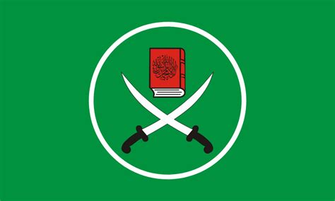

Slide 92
Quran Surah (or chapter) 24:55
“Allah has promised those who have believed among you and done righteous deeds that He will surely grant them succession [Caliphate] upon the earth just as He granted it to those before them and that He will surely establish for them [therein] their religion which He has preferred for them and that He will surely substitute for them, after their fear, security, [for] they worship Me, not associating anything with Me. But whoever disbelieves after that - then those are the defiantly disobedient.”

Slide 93
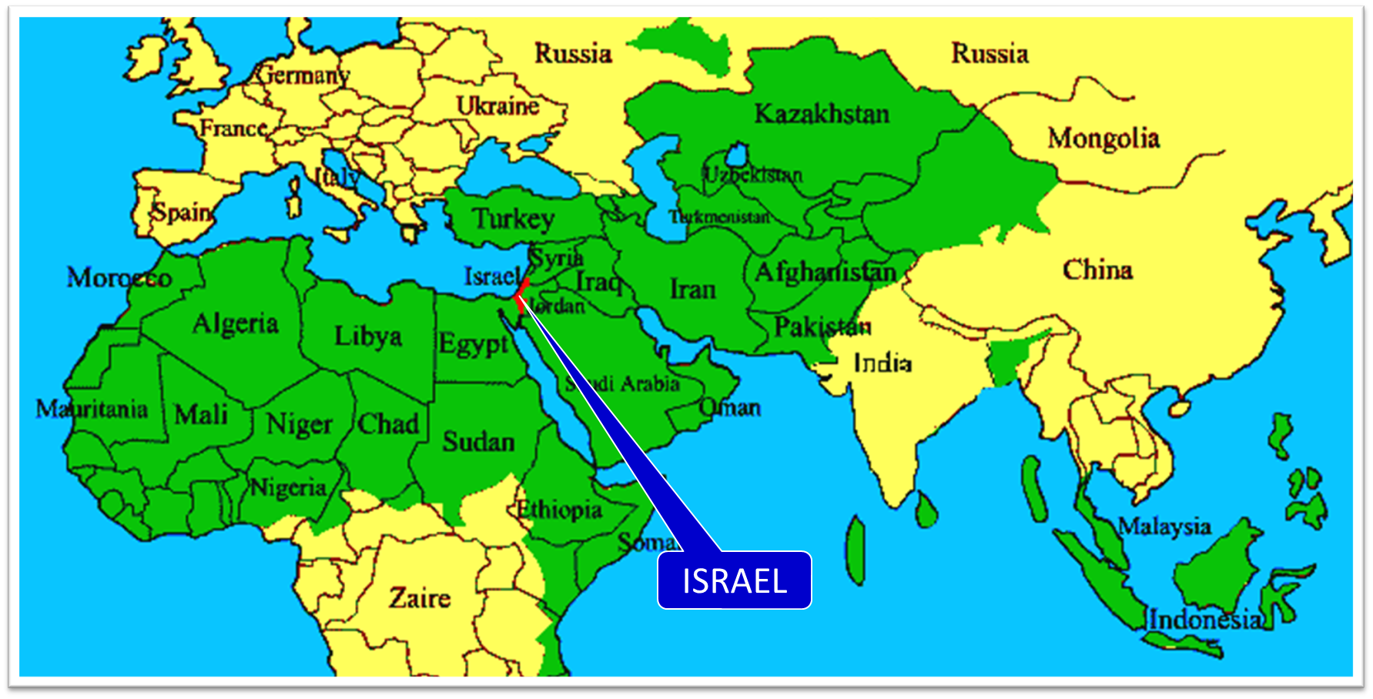

Slide 94
Ezekiel 38:8
“After many days you will be summoned; in the latter years you will come into the land that is restored from the sword, whose inhabitants have been gathered from many nations to the mountains of Israel which had been a continual waste; but its people were brought out from the nations, and they are living securely, all of them.”

Slide 95
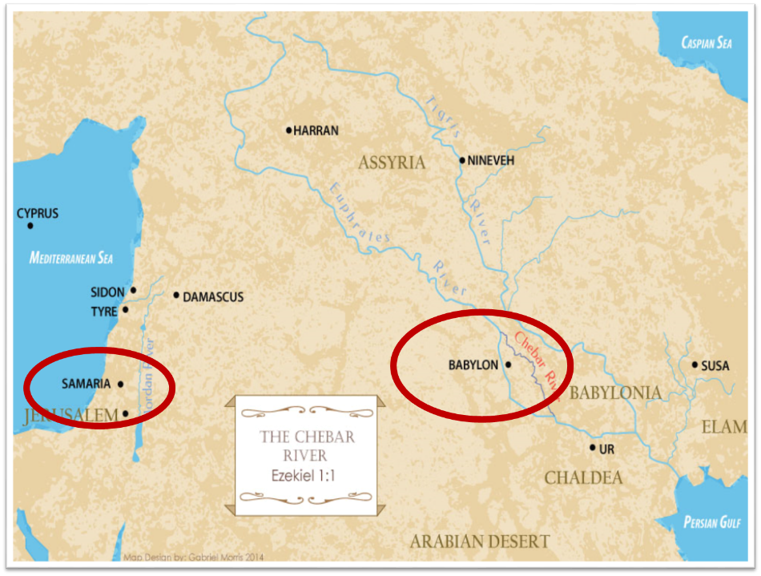

Slide 96
Ezekiel 38:8
“After many days you will be summoned; in the latter years you will come into the land that is restored from the sword, whose inhabitants have been gathered from many nations to the mountains of Israel which had been a continual waste; but its people were brought out from the nations, and they are living securely, all of them.”

Slide 97
Ezekiel 39:2, 4
“² and I will turn you around, drive you on, take you up from the remotest parts of the north and bring you against the mountains of Israel…⁴You will fall on the mountains of Israel, you and all your troops and the peoples who are with you; I will give you as food to every kind of predatory bird and beast of the field.”

Slide 98
Mountains of Israel?
Mark Hitchcock, The Amazing Claims of Bible Prophecy: What You Need to Know in These Uncertain Times (Harvest House: Eugene, OR, 2010), 211.
“According to Ezekiel 39:2, 4, Israel must possess the ‘mountains of Israel’ when this invasion occurs...The famous Six Day war in Israel in 1967 helped set the stage for this to be fulfilled. Before the Six Day War, all the mountains of Israel, with the exception of a small strip of west Jerusalem, were in the hands of the Jordanian Arabs. Only since 1967 have the mountains of Israel been in Israel, thus setting the stage for the fulfillment of this prophecy.”

Slide 99
Dr. Arnold G. Fruchtenbaum
THE MODERN STATE OF ISRAEL IN BIBLE PROPHECY
Paper presented to the PTSG on 12-7-21, pps. 18-19
“But where in the Land of Israel will the invading armies be destroyed? The exact location is revealed in Ezekiel 39:2 and 4a: ‘and I will turn you about, and will lead you on, and will cause you to come up from the uttermost parts of the north; and I will bring you upon the mountains of Israel…you shall fall upon the mountains of Israel.’ The phrase ‘the mountains of Israel’ refers to the central mountain range that makes up the backbone of the country. In the Hebrew Scriptures, these mountains were known as the Hill Country of Ephraim and the Hill Country of Judah. Some of the famous biblical cities that lie within these mountains include Dothan, Shechem, Samaria, Shiloh, Bethel, Ai, Ramah, Bethlehem, Hebron, Debir, and most importantly, Jerusalem, which seems to be the target of the invading army. However, from 1948 until the Six-Day War in 1967, these mountains were not in Israel, but in Jordan.”

Slide 100
Dr. Arnold G. Fruchtenbaum
THE MODERN STATE OF ISRAEL IN BIBLE PROPHECY
Paper presented to the PTSG on 12-7-21, pps. 18-19
“They are now referred to politically as the West Bank. In 1948, Jordanian forces took over these mountains and annexed them as part of Jordan. All Israel had was a small corridor leading west to Jerusalem. The border between Israel and Jordan ran down the foot of these mountains, then cut into the mountains, dividing Jerusalem in two, and then went out again and continued along the foot of these mountains. Israel had maybe five percent or less of the mountains, while the rest belonged to Jordan. Only since 1967 have the mountains of Israel been in Israel. Besides the Temple compound falling into Jewish hands, another by-product of the Six-Day War was that these mountains also fell under Israeli sovereignty. Therefore, not only could this prophecy not have been fulfilled before 1948, but it could also not have been fulfilled before 1967.”

Slide 101
Dr. Arnold G. Fruchtenbaum
THE MODERN STATE OF ISRAEL IN BIBLE PROPHECY
Paper presented to the PTSG on 12-7-21, pps. 18-19
“The mountains of Israel (the West Bank) are yet to have a very important and relevant role in Bible prophecy. As for the present State of Israel, they became part of Israel in 1967. This is yet another way the modern Jewish State fits within Bible prophecy.”

Slide 104
Ezekiel 38:8
“After many days you will be summoned; in the latter years you will come into the land that is restored from the sword, whose inhabitants have been gathered from many nations to the mountains of Israel which had been a continual waste; but its people were brought out from the nations, and they are living securely, all of them.”

Slide 105
Leviticus 26:43
“For the land will be abandoned by them, and will make up for its sabbaths while it is made desolate without them. They, meanwhile, will be making amends for their iniquity, because they rejected My ordinances and their soul abhorred My statutes.”

Slide 106
Ezekiel 38:8
“After many days you will be summoned; in the latter years you will come into the land that is restored from the sword, whose inhabitants have been gathered from many nations to the mountains of Israel which had been a continual waste; but its people were brought out from the nations, and they are living securely, all of them.”

Slide 107
Daniel 9:27
And he will make a firm covenant with the many for one week, but in the middle of the week he will put a stop to sacrifice and grain offering; and on the wing of abominations will come one who makes desolate, even until a complete destruction, one that is decreed, is poured out on the one who makes desolate.

Slide 108


Slide 109


Slide 110
Isaiah 28:15, 18
“¹⁵ Because you have said, “We have made a covenant with death, And with Sheol we have made a pact. The overwhelming scourge will not reach us when it passes by, For we have made falsehood our refuge and we have concealed ourselves with deception.”… ¹⁸ Your covenant with death will be canceled, And your pact with Sheol will not stand; When the overwhelming scourge passes through, Then you become its trampling place.”

Slide 112
CONCLUSION

Slide 113
I. Invasion Planned (Ezekiel 38:1-13)
  God’s intention (1-9)
  Gog’s intention (10-13)

Slide 114
Ezekiel 38‒39
Invasion planned (38:1-13)
Invasion executed (38:14-16)
Invasion defeated (38:17‒39:20)
Invasion’s results (39:21-29)

