Slide 1

Ezekiel 36‒39
The Middle East Meltdown 2022
Dr. Andy Woods
Senior Pastor – Sugar Land Bible Church
President – Chafer Theological Seminary

Slide 2
Ezekiel 33‒48
Ezekiel recommissioned (33)
False shepherds removed (34)
Edom destroyed (35)
Israel’s restoration: physical & spiritual (36)
Israel’s restoration illustrated (37)
Means of restoration: Northern invasion (38)
Results of the Northern invasion: conversion (39)
Millennial Temple (40‒46)
Tribal land allotment (47‒48)

Slide 3
Ezekiel 36
Israel to prosper again (1-15)
Israel’s sins inhibiting prosperity (16-21)
Israel to be restored: physically & spiritually (22-38)

Slide 4
Ezekiel 33‒48
Ezekiel recommissioned (33)
False shepherds removed (34)
Edom destroyed (35)
Israel’s restoration: physical & spiritual (36)
Israel’s restoration illustrated (37)
Means of restoration: Northern invasion (38)
Results of the Northern invasion: conversion (39)
Millennial Temple (40‒46)
Tribal land allotment (47‒48)

Slide 5
Ezekiel 37
Vision: Valley of the Dry Bones (1-14)
  Vision (1-10)
  Interpretation (11-14)
Sign: Two Sticks (15-28)
  Sign (15-17)
  Interpretation (18-28)

Slide 6
The Millennial David
Hosea 3:5; Jer. 30:9; Ezek. 34:23; 37:24
Root of Jesse
Branch of David
Son of David
Seed of David

Slide 7
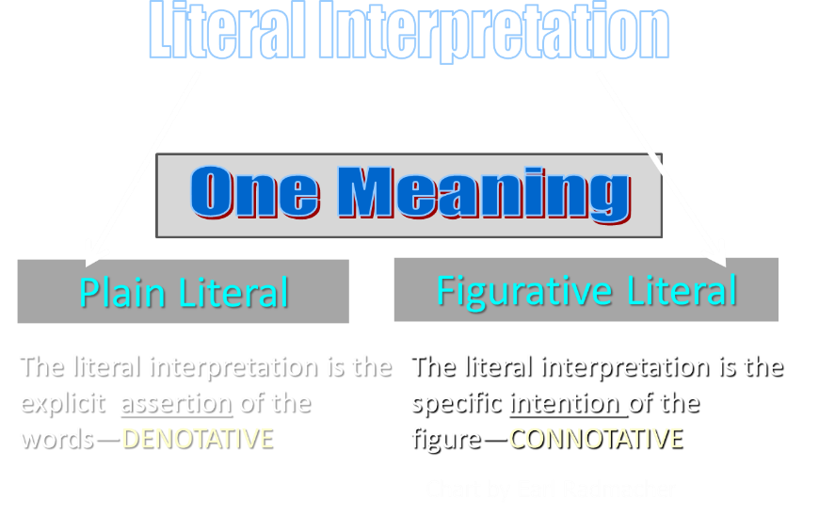

Slide 8
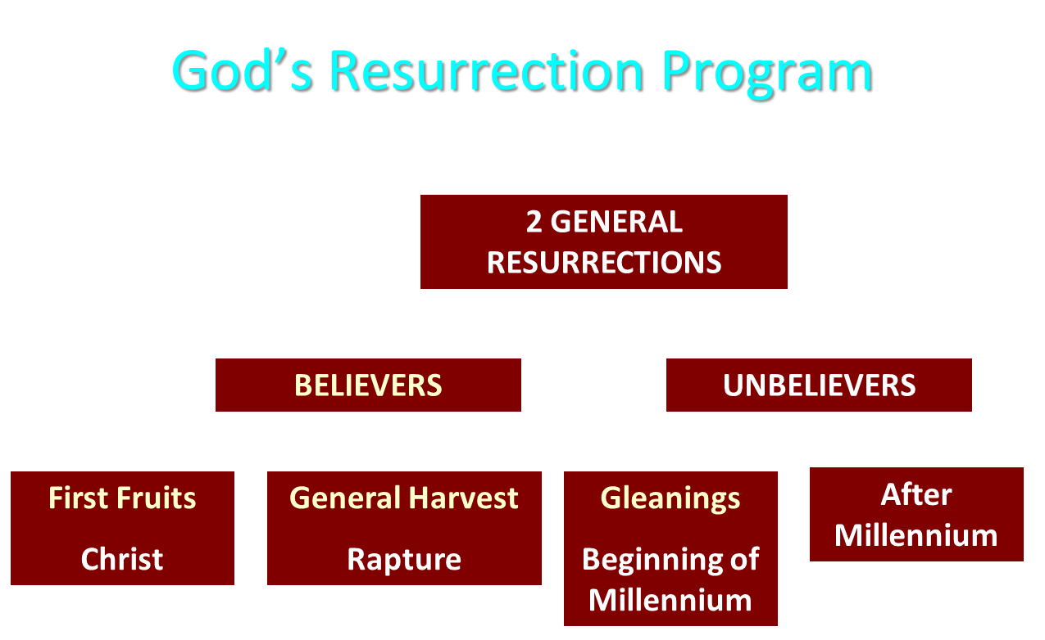

Slide 9
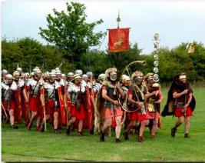
Order or Tagma (1 Cor. 15:23)
General: Christ’s resurrection (1 Cor 15:23)
Officer: Rapture (1 Thess 4:13-18)
Soldiers: OT saints & Tribulation martyrs (Rev 20:4)
Captives: Unsaved of all ages (Rev 20:5)

Slide 10


Slide 11


Dr. Arnold G. Fruchtenbaum
Footsteps of the Messiah, 389
“Nothing in the text indicates that David is to be taken symbolically. If the prophets wanted to refer to the messiah in connection with David, they used terms such as ‘Root of Jesse,’ ‘Branch of David,’ ‘Son of David,’ or ‘Seed of David.’ None of these expressions are used here. The text simply states, David. In keeping with literal interpretation, it is best to take the text as it reads, meaning the literal David, who, in his resurrected form, will function as the king over Israel and as a prince in subjection to the King of the world.”

Slide 12

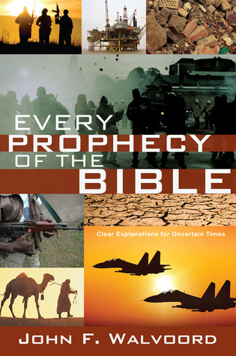
Dr. John Walvoord
Every Prophecy in the Bible, 187
“Though some have attempted to take this prophecy in less than its literal meaning, the clear statement is that David, who is now dead and whose body is in his tomb in Jerusalem (Acts 2:29), will be resurrected.”

Slide 13
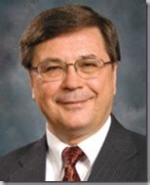
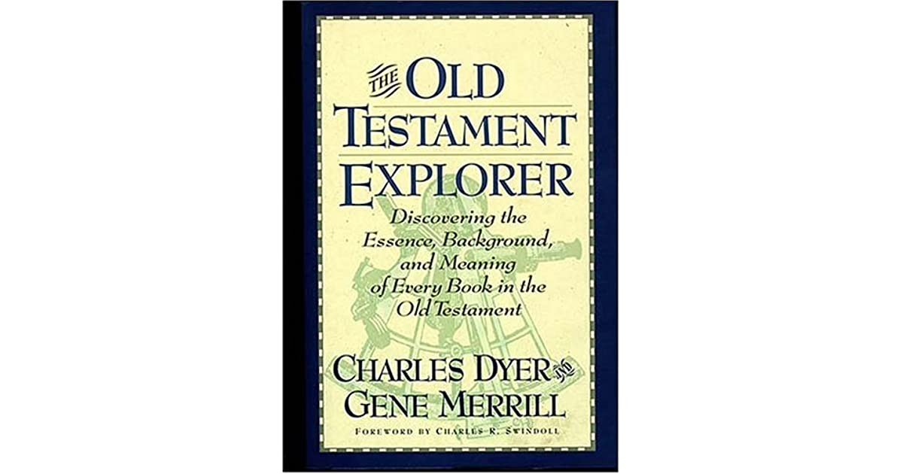
Charles H. Dyer
Bible Knowledge Commentary p. 1295.
“After judging the individual sheep, God will exercise His leadership by appointing a new shepherd (vv. 23–24). This shepherd, God stated, will be His servant David. Many see this as an allusion to Christ, the Good Shepherd (cf. John 10:11–18), who descended from the line of David to be the King of Israel (cf. Matt. 1:1). However, nothing in Ezekiel 34:23 demands that Ezekiel was not referring to the literal King David who will be resurrected to serve as Israel’s righteous prince.”

Slide 14
Charles H. Dyer
Bible Knowledge Commentary p. 1295.
“David is referred to by name elsewhere in passages that look to the future restoration of Israel (cf. Jer. 30:9; Ezek. 37:24–25; Hosea 3:5). Also Ezekiel indicated that David will be the prince (nāśî’) of the restored people (Ezek. 34:24; 37:25). This same ‘prince’ will then offer sin offerings for himself during the millennial period (45:22; 46:4). Such actions would hardly be appropriate for the sinless Son of God, but they would be for David. So it seems this is a literal reference to a resurrected David.”

Slide 15
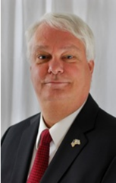
Thomas Ice
Tim LaHaye, ed., Tim LaHaye Prophecy Study Bible (Chattanooga, TN: AMG Publishers, 2001), 875.
"While Jesus, the Messiah, will reign over the entire earth, David will be resurrected to reign with Christ as vice regent over the nation of Israel."

Slide 16


Slide 17


Slide 18

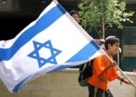
Charles L. Feinberg
The Prophecy of Ezekiel: The Glory of the Lord, Paperback ed. (Chicago: Moody, 1969; reprint, Chicago: Moody, 1984), 216.
“Many have denied that this refers to a physical building in sanctuary, but this seems pointless in view of the last nine chapters of the book, which are treated at length. Just as it pleases God to dwell in a tabernacle when Israel departed from Egypt, so He will tabernacle among them in their converted condition (cf. Exodus 25:8).”

Slide 19
ISRAEL’S FOUR TEMPLES
Solomon’s pre-exilic temple (Kings and Chronicles)
Zerubbabel’s post exilic temple (Ezra 1-6; John 2:20)
Antichrist's temple (Dan. 9:27; Matt. 24:15; 2 Thess. 2:4; Rev. 11:1-2)
Millennial temple (Ezek. 40-48)

Slide 20
ISRAEL’S FOUR TEMPLES
Solomon’s pre-exilic temple (Kings and Chronicles)
Zerubbabel’s post exilic temple (Ezra 1-6; John 2:20)
Antichrist's temple (Dan. 9:27; Matt. 24:15; 2 Thess. 2:4; Rev. 11:1-2)
Millennial temple (Ezek. 40-48)

Slide 21


Slide 22


Slide 23
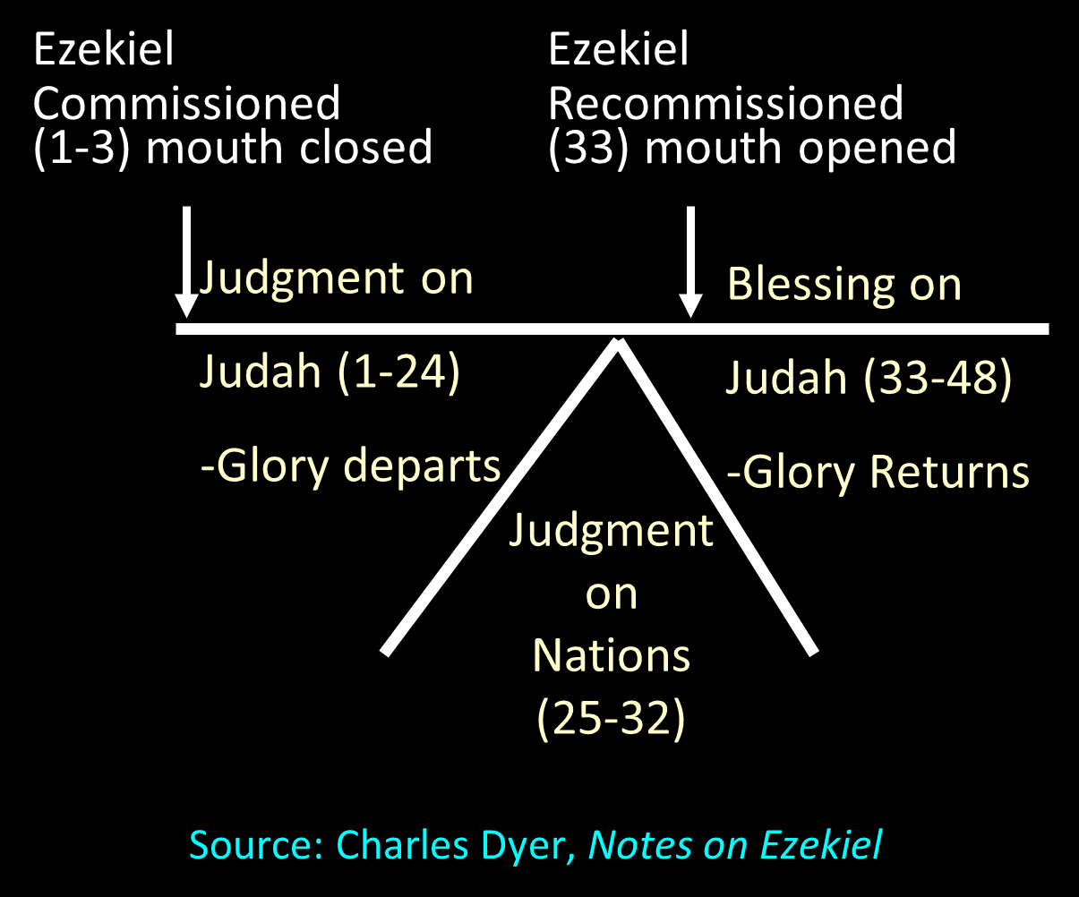

Slide 25
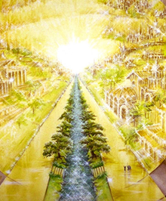
Eternal State is Future
No Satan (Rev 20:10)
No sea (Rev 21:1)
No death, crying, or pain (Rev 21:4)
No Sun (Rev 22:5)
No Moon (Rev 21:23)
No temple (Rev. 21:22)
No night (Rev 21:25)
No evil (Rev 21:27)
No curse (Rev 22:3)

Slide 26

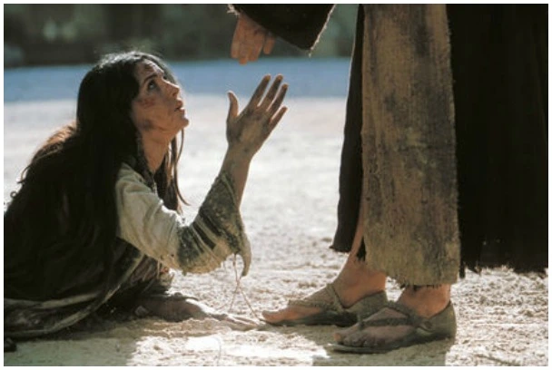
Revelation 21:4
“and He will wipe away every tear from their eyes; and there will no longer be any death; there will no longer be any mourning, or crying, or pain; the first things have passed away.”

Slide 27
Ezekiel 37
Vision: Valley of the Dry Bones (1-14)
  Vision (1-10)
  Interpretation (11-14)
Sign: Two Sticks (15-28)
  Sign (15-17)
  Interpretation (18-28)

Slide 28
Ezekiel 33‒48
Ezekiel recommissioned (33)
False shepherds removed (34)
Edom destroyed (35)
Israel’s restoration: physical & spiritual (36)
Israel’s restoration illustrated (37)
Means of restoration: Northern invasion (38)
Results of the Northern invasion: conversion (39)
Millennial Temple (40‒46)
Tribal land allotment (47‒48)

Slide 29
Ezekiel 38‒39
Invasion planned (38:1-13)
Invasion executed (38:14-16)
Invasion defeated (38:17‒39:20)
Invasion’s results (39:21-29)

Slide 30
Ezekiel 38‒39
Invasion planned (38:1-13)
Invasion executed (38:14-16)
Invasion defeated (38:17‒39:20)
Invasion’s results (39:21-29)

Slide 31
I. Invasion Planned (Ezekiel 38:1-13)
  God’s intention (1-9)
  Gog’s intention (10-13)

Slide 32
I. Invasion Planned (Ezekiel 38:1-13)
  God’s intention (1-9)
  Gog’s intention (10-13)

Slide 33


Slide 34

Ancient Names From Ezekiel 38:1-9
Magog (Central Asia), Rosh (Russia), Meshec (Turkey), Tubal (Turkey), Persia (Iran), Put (Libya), Cush (Sudan), Gomer (Turkey), | Togarmah (Turkey) Sheba (Saudi Arabia) Dedan (Saudi Arabia or Yemen) Tarshish (Spain) Merchants of Tarshish (Conglomeration of Western powers including Europe) Israel

Slide 35
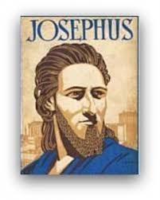
Josephus
Josephus, Antiquities, 1.6.1.
"Magog founded those that from him were named Magogites, but who are by the Greeks called Scythians."

Slide 37
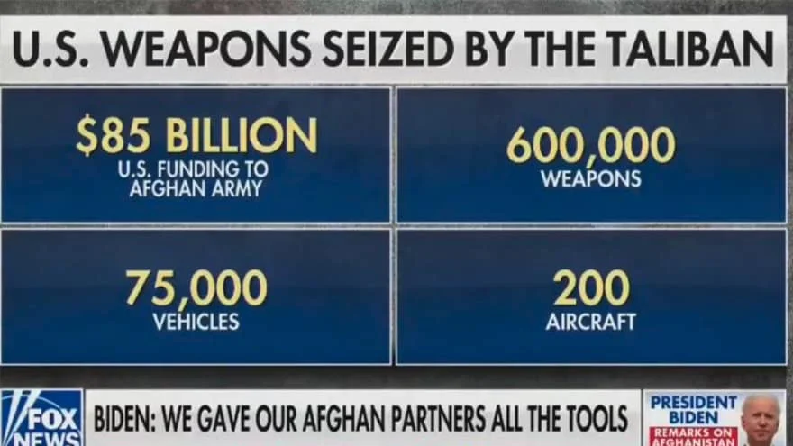

Slide 38

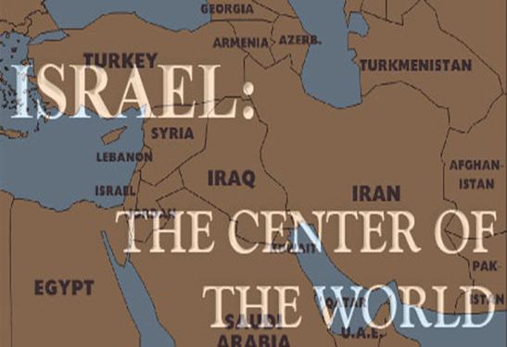
Ezekiel 38:2 (KJV)
“Son of man, set thy face against Gog, the land of Magog, the chief prince of Meshech and Tubal, and prophesy against him.”

Slide 39
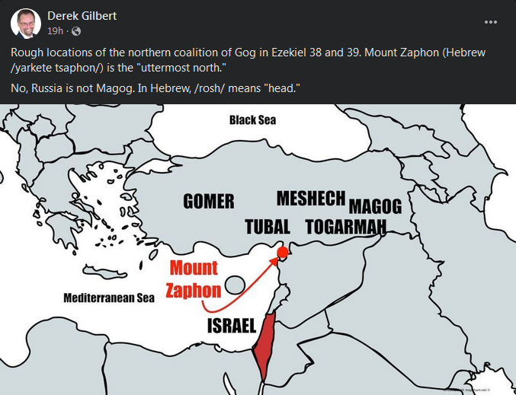

Slide 40
Ezekiel 38:2
“Son of man, set your face toward Gog of the land of Magog, the prince of Rosh, Meshech and Tubal, and prophesy against him.”

Slide 41
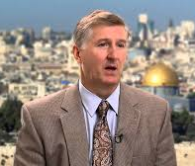
Is Rosh Russia?
The End, Page 295
“The weight of evidence favors translating Rosh in Ezekiel 38–39 as a proper name. Five arguments support this view. First, the eminent Hebrew scholars C. F. Keil and Wilhelm Gesenius both hold that a proper noun is the better translation of Rosh in Ezekiel 38:2-3 and 39:1, referring to a specific geographical location. Second, the Greek translation of the Old Testament, the Septuagint, translates Rosh as the proper name Ros. This translation is especially significant since the Septuagint was translated only three centuries after Ezekiel was written—obviously much closer to the original than any modern translation.”

Slide 42
Is Rosh Russia?
The End, Page 295
“The modern translations of Rosh as an adjective can be traced to the Latin Vulgate of Jerome. Third, in their articles on Rosh, many Bible dictionaries and encyclopedias (New Bible Dictionary, Wycliffe Bible Dictionary, and International Standard Bible Encyclopedia) support taking it as a proper name in Ezekiel 38. Fourth, Rosh is mentioned the first time in Ezekiel 38:2 and then repeated in Ezekiel 38:3 and 39:1. If Rosh were simply a title, it would be dropped in these two places, because when titles are repeated in Hebrew, they are generally abbreviated.”

Slide 43
Is Rosh Russia?
The End, Page 295
“Fifth, the most impressive evidence in favor of taking Rosh as a proper name is simply that this translation in this context is the most natural. G. A. Cooke translates Ezekiel 38:2, ‘the chief of Rosh, Meshech and Tubal.’ He calls this ‘the most natural way of rendering the Hebrew.’ The compelling evidence of biblical scholarship indicates that Rosh be understood as a proper name—the name of a specific geographic area.”

Slide 44
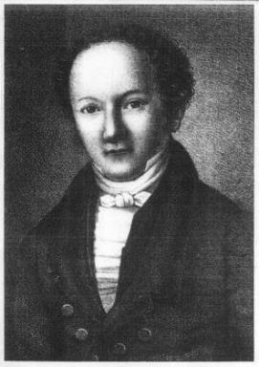
Wilhelm Gesenius
Gesenius' Hebrew and Chaldee Lexicon (Samuel Bagster and Sons, 1847; reprint, Grand Rapids: Baker, 1987), 752.
"pr. n. of a northern nation, mentioned with Tubal and Meshech; undoubtedly the Russians, who are mentioned by the Byzantine writers of the tenth century, under the name the Ros, dwelling to the north of Taurus . . .as dwelling on the river Rha (Wolga)."

Slide 45
Is Rosh Russia?
The End, Page 296
“First, linguistically and historically, there is substantial evidence that in Ezekiel’s day there was a group of people known variously as Rash, Reshu, or Ros who lived in what today is southern Russia. Egyptian inscriptions as early as 2600 BC identify a place called Rosh (Rash). A later Egyptian inscription from about 1500 BC refers to a land called Reshu that was located to the north of Egypt. Other ancient documents include a place named Rosh or its equivalent in various languages.”

Slide 46
Is Rosh Russia?
The End, Page 296
“The word appears three times in the Septuagint (LXX), ten times in Sargon’s inscriptions, once in Ashurbanipal’s cylinder, once in Sennacherib’s annals, and five times in Ugaritic tablets. While the word has a variety of forms and spellings, it is clear that the same people are in view. Rosh was apparently a well-known place in Ezekiel’s day.”

Slide 47
Clyde Billington
Clyde E. Billington Jr., “The Rosh People in History and Prophecy (Part Two)” Michigan Theological Journal 3 (1992): 59, 61.
“Historical, ethnological, and archaeological evidence all favor the conclusion that the Rosh people of Ezekiel 38–39 were the ancestors of the Rus/Ros people of Europe and Asia. . . . Those Rosh people who lived to the north of the Black Sea in ancient and medieval times were called the Rus/Ros/Rox/Aorsi from very early times. . . . The Rosh people of the area north of the Black Sea formed the people known today as the Russians.”

Slide 48
Wilhelm Gesenius
Gesenius' Hebrew and Chaldee Lexicon (Samuel Bagster and Sons, 1847; reprint, Grand Rapids: Baker, 1987), 752.
"pr. n. of a northern nation, mentioned with Tubal and Meshech; undoubtedly the Russians, who are mentioned by the Byzantine writers of the tenth century, under the name the Ros, dwelling to the north of Taurus . . .as dwelling on the river Rha (Wolga)."

Slide 49
Ezekiel 38:12
“to capture spoil and to seize plunder, to turn your hand against the waste places which are now inhabited, and against the people who are gathered from the nations, who have acquired cattle and goods, who live at the center of the world.”

Slide 50

Ezekiel 5:5
“Thus says the Lord God, ‘This is Jerusalem; I have set her at the center of the nations, with lands around her.'”

Slide 52
Josephus
Josephus, Antiquities, 1.6.1.
"..and the Mosocheni were founded by Mosoch; now they are Cappadocians."

Slide 53

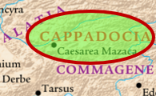
1 Peter 1:1
Peter, an apostle of Jesus Christ, To those who reside as aliens, scattered throughout Pontus, Galatia, Cappadocia, Asia, and Bithynia, who are chosen…

Slide 54
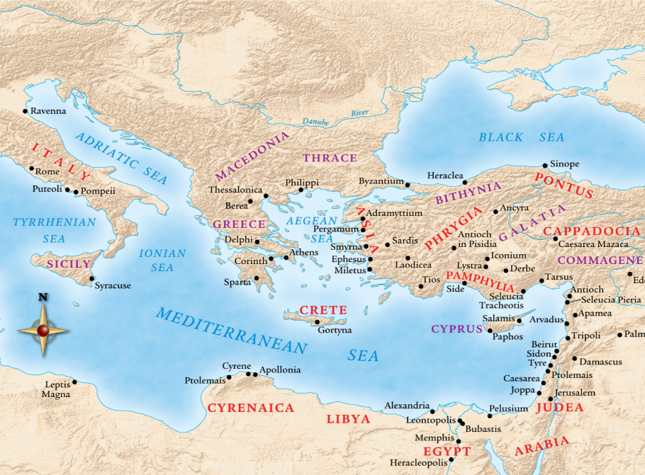

Slide 55

Herodotus, Histories, 3:93-94 (450 B.C.)
“The twelfth, the Bactrians as far as the land of the Aegli; these paid three hundred and sixty. The thirteenth, the Pactyic country and Armenia and the lands adjoining as far as the Euxine sea; these paid four hundred…The Moschi, Tibareni, Macrones, Mossynoeci, and Mares, the nineteenth province, were ordered to pay three hundred. The Indians made up the twentieth province. These are more in number than any nation of which we know, and they paid a greater tribute than any other province, namely three hundred and sixty talents of gold dust.”

Slide 56
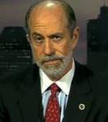
Frank Gaffney
War Footing (Annapolis: Naval Institute Press, 2006), 164. Cited in Rhodes, 177.
According to Frank Gaffney, President of the Center for Security Policy, Turkey is transitioning from “a secular democracy with a Muslim society into a state governed by a radical Islamic ideology hostile to Western values and freedoms.”

Slide 57
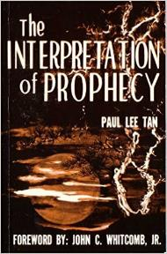
Paul Lee Tan
The Interpretation of Prophecy, 223-24
“Interestingly, these prophesied military instruments though centuries old have not been made obsolete. The horse, for instance, is still used in warfare on certain kinds of terrain.”

Slide 58
Charles L. Feinberg
The Prophecy of Ezekiel: The Glory of the Lord, Paperback ed. (Chicago: Moody, 1969; reprint, Chicago: Moody, 1984), 221.
“Some have found great difficulty in the references to armor, buckler, shield, sword and helmet, but even in our day of advanced weapons of warfare it is interesting to learn that in some parts of the world conflict is going on with primitive weapons. (And how else could an ancient writer have described warfare? He knew nothing of planes and guns.).”

Slide 59
CONCLUSION

Slide 60
Ezekiel 38‒39
Invasion planned (38:1-13)
Invasion executed (38:14-16)
Invasion defeated (38:17‒39:20)
Invasion’s results (39:21-29)

Slide 61
I. Invasion Planned (Ezekiel 38:1-13)
  God’s intention (1-9)
  Gog’s intention (10-13)

