Slide 1
Genesis 12‒50
Israel’s Birth & Preservation

Slide 2
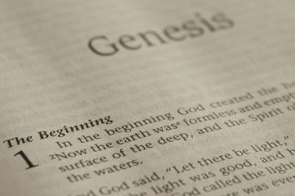
GENESIS STRUCTURE
Beginning of the Human race (Gen. 1‒11)
Beginning of the Hebrew race (Gen. 12‒50)

Slide 3
GENESIS STRUCTURE
Genesis 1-11 (four events)
Creation (1-2)
Fall (3-5)
Flood (6-9)
National dispersion (10-11)

Slide 4
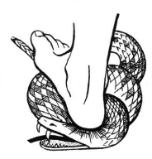
Genesis 3:15
“And I will put enmity Between you and the woman, And between your seed and her seed; He shall bruise you on the head, And you shall bruise him on the heel.”

Slide 5
GENESIS STRUCTURE
Beginning of the Human race (Gen. 1‒11)
Beginning of the Hebrew race (Gen. 12‒50)

Slide 6
GENESIS STRUCTURE
Genesis 12-50 (four people)
Abraham (12:1–25:11)
Isaac (25:12–26:35)
Jacob (27–36)
Joseph (37–50)

Slide 7
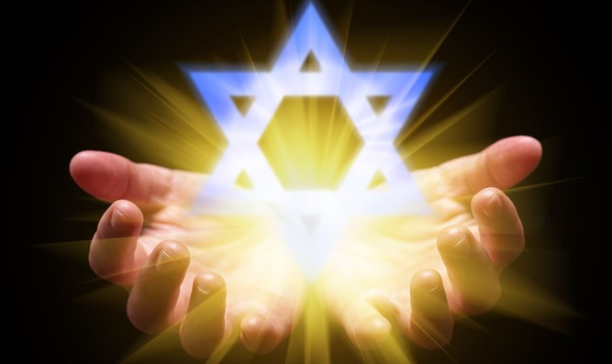
Isaiah 43:1
“But now, thus says the Lord, your Creator, O Jacob, And He who formed you, O Israel, 'Do not fear, for I have redeemed you; I have called you by name; you are Mine!'”

Slide 8
GENESIS STRUCTURE
Genesis 12-50 (four people)
Abraham (12:1–25:11)
Isaac (25:12–26:35)
Jacob (27–36)
Joseph (37–50)

Slide 9
Genesis 12‒17 Abram’s Early Journeys
Unconditional promises (Gen. 12:1-3)
From Haran to Canaan (Gen. 12:4-5)
In Canaan (Gen. 12:6-9)
In Egypt (Gen. 12:10-20)
Abram and Lot Separate (Gen. 13:1-13)
Reaffirmation of Abram’s promises (Gen. 13:14-18)
Abram Rescues Lot (14:1-24)
Abrahamic Covenant (15:1-21)
Hagar & Ishmael (16:1-16)
Circumcision (Gen. 17:1-27)

Slide 10
Genesis 17:1‒27 Circumcision
Covenant Restated (17:1-8)
Covenant Token (17:9-14)
Sarah’s Role (17:15-21)
Abraham’s Obedience (17:22-27)

Slide 11
Genesis 17:1‒27 Circumcision
Covenant Restated (17:1-8)
Covenant Token (17:9-14)
Sarah’s Role (17:15-21)
Abraham’s Obedience (17:22-27)

Slide 12
Covenant Restated Genesis 17:1-8
Timing (1a)
Divine disclosure (1b-2)
Abram’s response (3a)
Amplification of promises (3b-8)

Slide 13
Genesis 17:1‒27 Circumcision
Covenant Restated (17:1-8)
Covenant Token (17:9-14)
Sarah’s Role (17:15-21)
Abraham’s Obedience (17:22-27)

Slide 14
Covenant Token Genesis 17:9-14
The obligation (9)
The token (10-11)
The inclusions (12-13a)
The duration (13b)
The penalty (14)

Slide 15
Genesis 17:1‒27 Circumcision
Covenant Restated (17:1-8)
Covenant Token (17:9-14)
Sarah’s Role (17:15-21)
Abraham’s Obedience (17:22-27)

Slide 16
Sarah’s Role Genesis 17:15-21
Sarah’s name change (15)
Sarah’s blessings (16)
Abraham’s response (17)
Abraham’s misunderstanding (18)
God’s response: Isaac (19)
God’s response: Ishmael (20)
Concluding remarks: Isaac (21)

Slide 17
Sarah’s Role Genesis 17:15-21
Sarah’s name change (15)
Sarah’s blessings (16)
Abraham’s response (17)
Abraham’s misunderstanding (18)
God’s response: Isaac (19)
God’s response: Ishmael (20)
Concluding remarks: Isaac (21)

Slide 18
Matthew 16:18
I also say to you that you are Peter, and upon this rock I will build [oikodomeō] My church; and the gates of Hades will not overpower it.

Slide 19
Sarah’s Role Genesis 17:15-21
Sarah’s name change (15)
Sarah’s blessings (16)
Abraham’s response (17)
Abraham’s misunderstanding (18)
God’s response: Isaac (19)
God’s response: Ishmael (20)
Concluding remarks: Isaac (21)

Slide 20
Sarah’s Blessings Genesis 17:16
Blessings (16a)
Son (16b)
Nations (16c)
Kings (16d)

Slide 21
Sarah’s Blessings Genesis 17:16
Blessings (16a)
Son (16b)
Nations (16c)
Kings (16d)

Slide 22
Genesis 1:26-28
²⁶ Then God said, “Let Us make man in Our image, according to Our likeness; and let them rule over the fish of the sea and over the birds of the sky and over the cattle and over all the earth, and over every creeping thing that creeps on the earth.” ²⁷ God created man in His own image, in the image of God He created him; male and female He created them. ²⁸ God blessed them; and ...

Slide 23
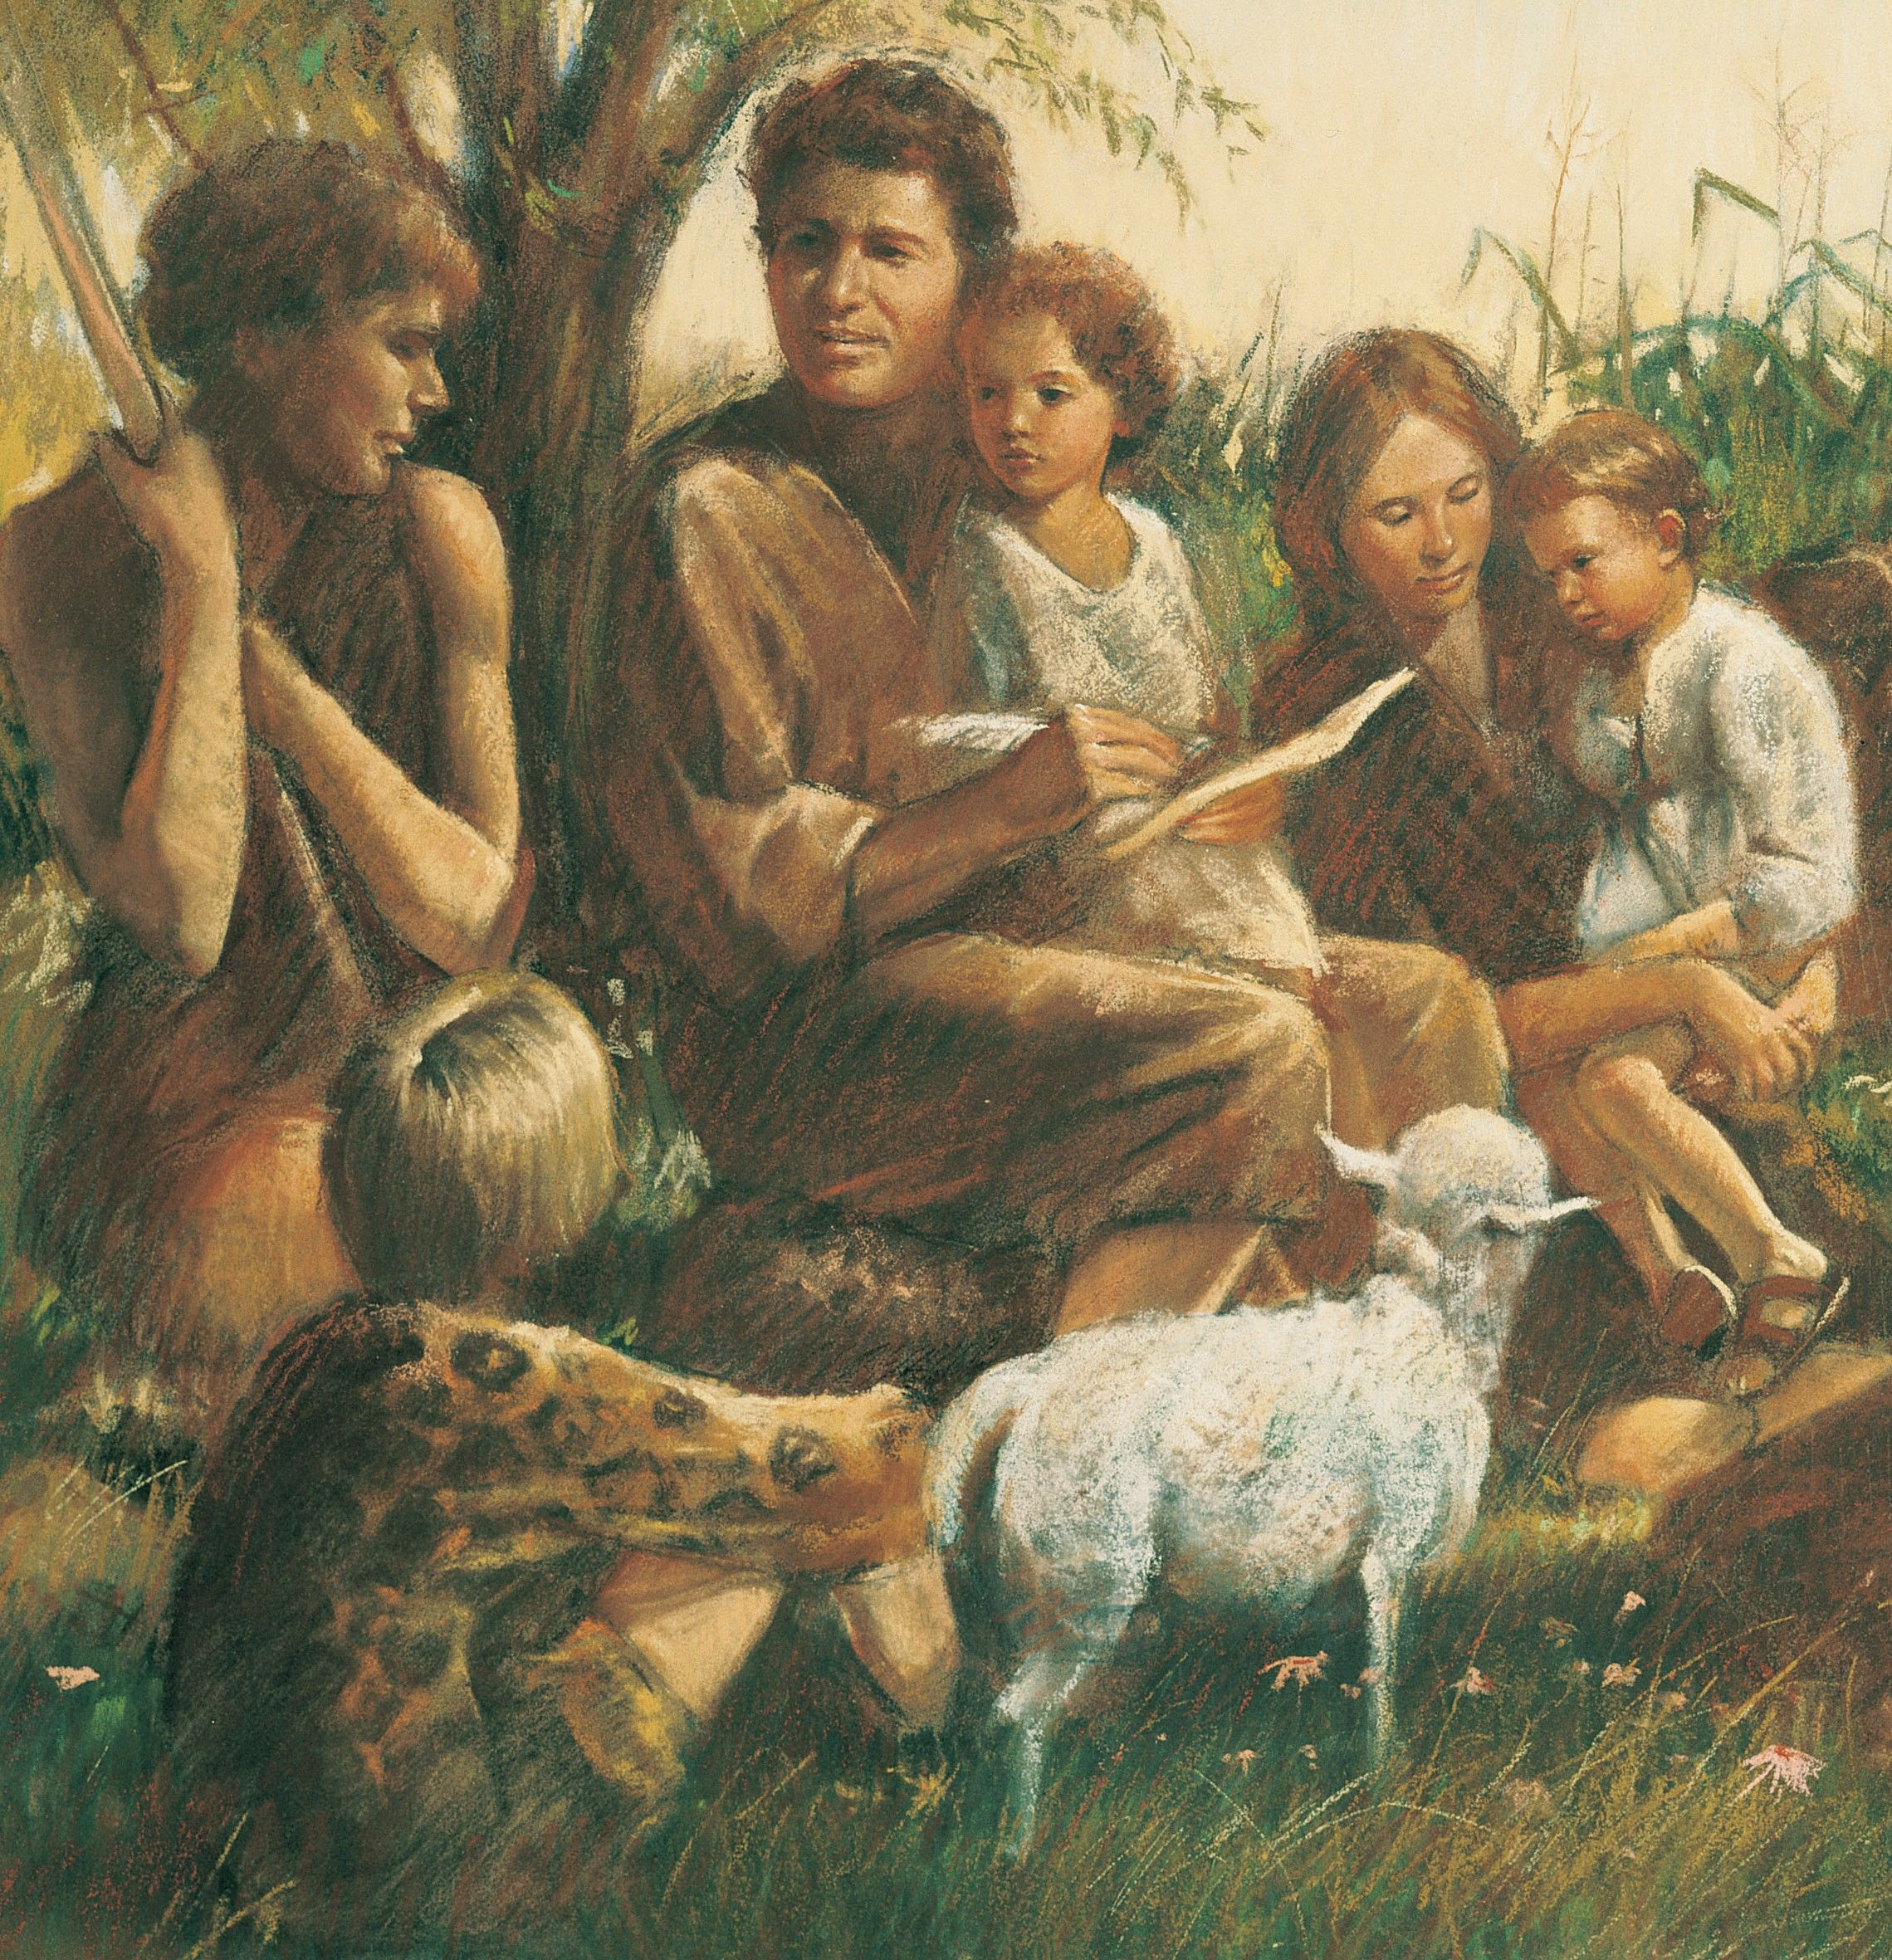
Genesis 1:26-28
. . . God said to them, “Be fruitful and multiply, and fill the earth, and subdue it; and rule over the fish of the sea and over the birds of the sky and over every living thing that moves on the earth.”

Slide 24
Sarah’s Blessings Genesis 17:16
Blessings (16a)
Son (16b)
Nations (16c)
Kings (16d)

Slide 25
Sarah’s Blessings Genesis 17:16
Blessings (16a)
Son (16b)
Nations (16c)
Kings (16d)

Slide 27
Sarah’s Blessings Genesis 17:16
Blessings (16a)
Son (16b)
Nations (16c)
Kings (16d)

Slide 29
Sarah’s Role Genesis 17:15-21
Sarah’s name change (15)
Sarah’s blessings (16)
Abraham’s response (17)
Abraham’s misunderstanding (18)
God’s response: Isaac (19)
God’s response: Ishmael (20)
Concluding remarks: Isaac (21)

Slide 30
Abraham’s Response Genesis 17:17
Physical response (17a)
Emotional response (17b)
Heart-felt response (17c)

Slide 31
Abraham’s Response Genesis 17:17
Physical response (17a)
Emotional response (17b)
Heart-felt response (17c)

Slide 32
Abraham’s Response Genesis 17:17
Physical response (17a)
Emotional response (17b)
Heart-felt response (17c)

Slide 33
Abraham’s Response Genesis 17:17
Physical response (17a)
Emotional response (17b)
Heart-felt response (17c)

Slide 34
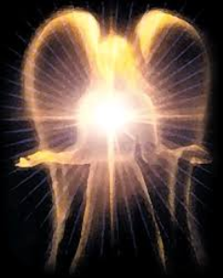
Satan’s Original State and First Sin
Isaiah 14:12-15
5 “I will” statements
Ascend to heaven (13)
Raise my throne above the stars of God (13)
Sit enthroned on the Mt. of the Assembly (13)
Ascend above the tops of the clouds (14)
Make myself like the Most High (14)

Slide 35
Sarah’s Role Genesis 17:15-21
Sarah’s name change (15)
Sarah’s blessings (16)
Abraham’s response (17)
Abraham’s misunderstanding (18)
God’s response: Isaac (19)
God’s response: Ishmael (20)
Concluding remarks: Isaac (21)

Slide 36
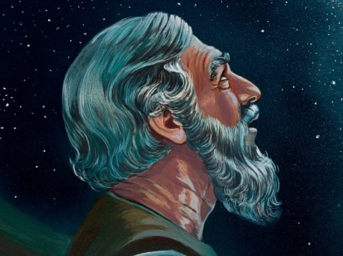
Genesis 15:4-5
Then behold, the word of the Lord came to him, saying, “This man will not be your heir; but one who will come forth from your own body, he shall be your heir.” ⁵ And He took him outside and said, “Now look toward the heavens, and count the stars, if you are able to count them.” And He said to him, “So shall your descendants be.”

Slide 37
Sarah’s Role Genesis 17:15-21
Sarah’s name change (15)
Sarah’s blessings (16)
Abraham’s response (17)
Abraham’s misunderstanding (18)
God’s response: Isaac (19)
God’s response: Ishmael (20)
Concluding remarks: Isaac (21)

Slide 38
God’s Response: Isaac Genesis 17:19
Seed-son through Sarah (19a)
Name: Isaac (19b)
Abrahamic Covenant through Isaac (19c)

Slide 39
God’s Response: Isaac Genesis 17:19
Seed-son through Sarah (19a)
Name: Isaac (19b)
Abrahamic Covenant through Isaac (19c)

Slide 40
God’s Response: Isaac Genesis 17:19
Seed-son through Sarah (19a)
Name: Isaac (19b)
Abrahamic Covenant through Isaac (19c)

Slide 41
God’s Response: Isaac Genesis 17:19
Seed-son through Sarah (19a)
Name: Isaac (19b)
Abrahamic Covenant through Isaac (19c)

Slide 42
Dr. Arnold G. Fruchtenbaum
The Book of Genesis, 306
“Normally, the Hebrew would read, ‘to cut a covenant’; but here it states He is going to establish a covenant, which involves the maintaining of an existing covenant. Therefore, God did not make a brand new covenant with Isaac; He was establishing with Isaac a preexisting covenant, which is the Abrahamic Covenant.”

Slide 43
Evidence of Abrahamic Covenant’s Unconditional Nature
ANE covenant ratification ceremony (Gen 15)
Lack of stated conditions for Israel’s obedience (Gen 15)
Covenant's eternality (Gen 17:7, 13, 19; Ps. 90:2)
Covenant's immutability (Heb 6:13-18; Mal. 3:6)
Trans-generational reaffirmation despite perpetual national disobedience (Jer 31:35-37)
Walvoord, The Millennial Kingdom, 149-52

Slide 44
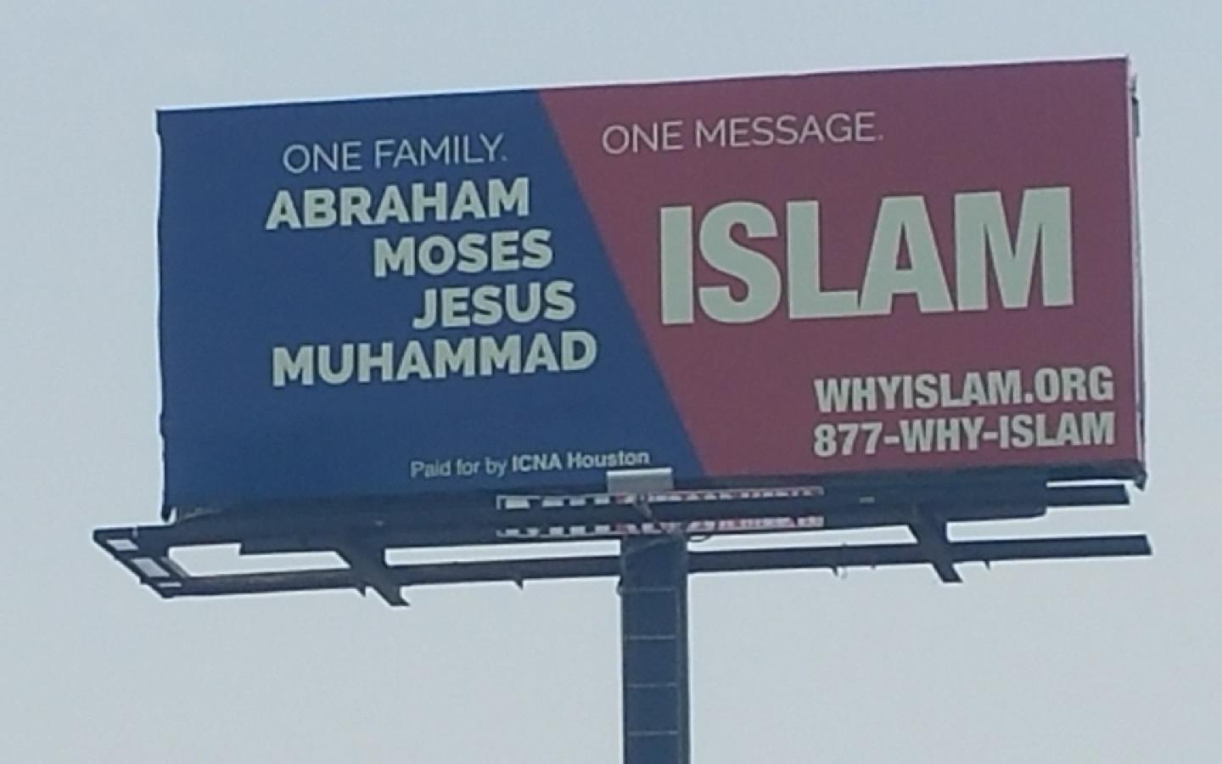

Slide 45
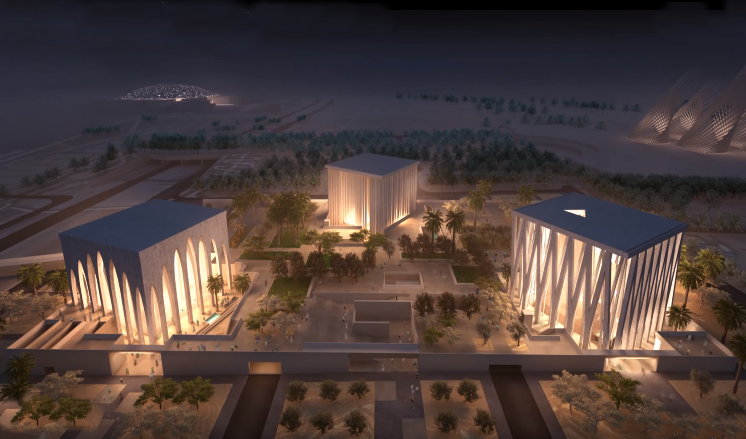
45

Slide 46
46

Slide 47
Seyyid Qutb
The Muslim Brotherhood’s senior theoretician, Seyyid Qutb, was transparent in the true agenda behind Islamic participation in interfaith dialogue, when he wrote, “The chasm between Islam and the Jahiliyyah [the society of unbelievers] is great, and a bridge is not to be built across it so that the people on the two sides may mix with each other, but only so that the people of the Jahiliyyah [the society of unbelievers] may come over to Islam."
Sayyid Qutb, Milestones, Salimiah (Kuwait: International Islamic Federation of Student Organizations, 1978 [written 1966]), 263.

Slide 48
Sarah’s Role Genesis 17:15-21
Sarah’s name change (15)
Sarah’s blessings (16)
Abraham’s response (17)
Abraham’s misunderstanding (18)
God’s response: Isaac (19)
God’s response: Ishmael (20)
Concluding remarks: Isaac (21)

Slide 49
God’s Response: Ishmael Genesis 17:20
Blessing (20a)
Multiplication (20b)
Beget twelve princes (20c)
Great nation (20d)

Slide 50
God’s Response: Ishmael Genesis 17:20
Blessing (20a)
Multiplication (20b)
Beget twelve princes (20c)
Great nation (20d)

Slide 51
God’s Response: Ishmael Genesis 17:20
Blessing (20a)
Multiplication (20b)
Beget twelve princes (20c)
Great nation (20d)

Slide 52
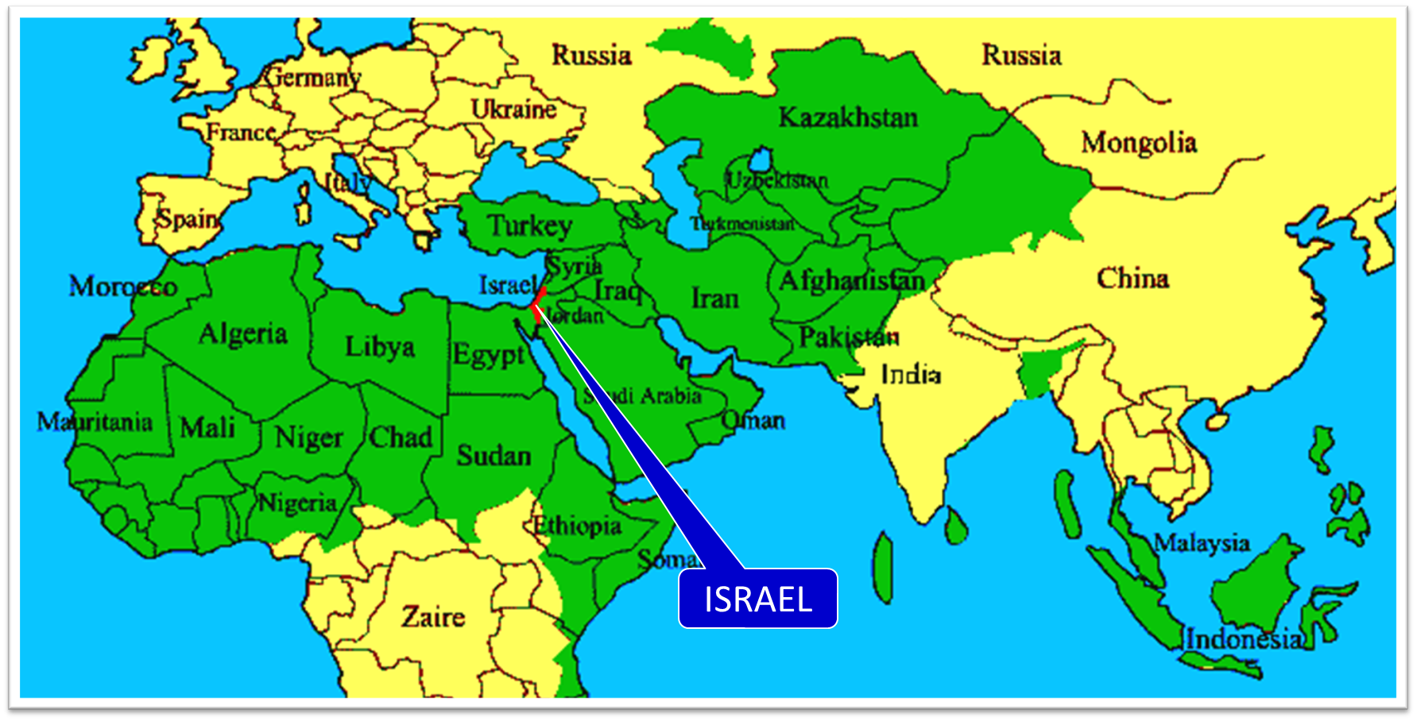

Slide 53
God’s Response: Ishmael Genesis 17:20
Blessing (20a)
Multiplication (20b)
Beget twelve princes (20c)
Great nation (20d)

Slide 54
God’s Response: Ishmael Genesis 17:20
Blessing (20a)
Multiplication (20b)
Beget twelve princes (20c)
Great nation (20d)

Slide 56
Sarah’s Role Genesis 17:15-21
Sarah’s name change (15)
Sarah’s blessings (16)
Abraham’s response (17)
Abraham’s misunderstanding (18)
God’s response: Isaac (19)
God’s response: Ishmael (20)
Concluding remarks: Isaac (21)

Slide 57
Concluding Remarks: Isaac Genesis 17:21
Abrahamic Covenant: Isaac (21a)
Sarah: mother of seed-son (21b)
Isaac to be born in a year (21c)

Slide 58
Concluding Remarks: Isaac Genesis 17:21
Abrahamic Covenant: Isaac (21a)
Sarah: mother of seed-son (21b)
Isaac to be born in a year (21c)

Slide 59
Concluding Remarks: Isaac Genesis 17:21
Abrahamic Covenant: Isaac (21a)
Sarah: mother of seed-son (21b)
Isaac to be born in a year (21c)

Slide 60
Concluding Remarks: Isaac Genesis 17:21
Abrahamic Covenant: Isaac (21a)
Sarah: mother of seed-son (21b)
Isaac to be born in a year (21c)

Slide 61
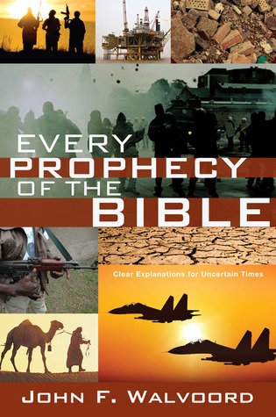

Slide 62
John 13:19; 14:29
“^{13:19} From now on I am telling you before it comes to pass, so that when it does occur, you may believe that I am He… ^{14:29} Now I have told you before it happens, so that when it happens, you may believe.”

Slide 63
Sarah’s Role Genesis 17:15-21
Sarah’s name change (15)
Sarah’s blessings (16)
Abraham’s response (17)
Abraham’s misunderstanding (18)
God’s response: Isaac (19)
God’s response: Ishmael (20)
Concluding remarks: Isaac (21)

Slide 64
Genesis 17:1‒27 Circumcision
Covenant Restated (17:1-8)
Covenant Token (17:9-14)
Sarah’s Role (17:15-21)
Abraham’s Obedience (17:22-27)

Slide 65
Abraham’s Obedience Genesis 17:22-27
Cessation (22)
Circumcision (23)
Abraham’s age (24)
Ishmael’s age (25)
Timing (26)
Abraham's house (27)

Slide 66
Abraham’s Obedience Genesis 17:22-27
Cessation (22)
Circumcision (23)
Abraham’s age (24)
Ishmael’s age (25)
Timing (26)
Abraham's house (27)

Slide 67
Dr. Arnold G. Fruchtenbaum
The Book of Genesis, 240
“This is the first of seven times that Abraham receives a direct revelation from God. In 12:1–3 is God’s initial call to Abram outside the Land of Canaan; in 12:7 is the first appearance to Abraham in the Land; in 13:14–17, Abraham encounters God after the separation of Lot; in 15:1–21, God signs and seals the Abrahamic Covenant; in 17:1–21, Abraham receives the token of the covenant; in 18:1–33, God speaks to him in conjunction with the destruction of Sodom; and in 22:1–2 and 22:11–18, God directs Abraham to offer Isaac.”

Slide 68
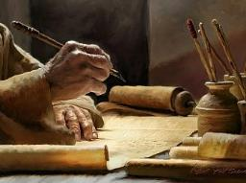
2 Timothy 3:16-17
“All Scripture is inspired by God [theopneustos] and profitable for teaching, for reproof, for correction, for training in righteousness; so that the man of God may be adequate, equipped for every good work.”

Slide 69
2 Peter 1:3-4
“³ Seeing that His divine power has granted to us everything pertaining to life and godliness, through the true knowledge of Him who called us by His own glory and excellence. ⁴For by these He has granted to us His precious and magnificent promises, so that by them you may become partakers of the divine nature, having escaped the corruption that is in the world by lust.”

Slide 70
Abraham’s Obedience Genesis 17:22-27
Cessation (22)
Circumcision (23)
Abraham’s age (24)
Ishmael’s age (25)
Timing (26)
Abraham's house (27)

Slide 71
Abraham’s Obedience Genesis 17:22-27
Cessation (22)
Circumcision (23)
Abraham’s age (24)
Ishmael’s age (25)
Timing (26)
Abraham's house (27)

Slide 72
Abraham’s Obedience Genesis 17:22-27
Cessation (22)
Circumcision (23)
Abraham’s age (24)
Ishmael’s age (25)
Timing (26)
Abraham's house (27)

Slide 73
Abraham’s Obedience Genesis 17:22-27
Cessation (22)
Circumcision (23)
Abraham’s age (24)
Ishmael’s age (25)
Timing (26)
Abraham's house (27)

Slide 74
Abraham’s Obedience Genesis 17:22-27
Cessation (22)
Circumcision (23)
Abraham’s age (24)
Ishmael’s age (25)
Timing (26)
Abraham's house (27)

Slide 75
Concluding Thoughts Circumcision
Sign of the Abrahamic Covenant
Does not give salvation
A circumcised heart

Slide 76
Concluding Thoughts Circumcision
Sign of the Abrahamic Covenant
Does not give salvation
A circumcised heart

Slide 77
Covenant Signs
Noahic Covenant: Rainbow (Gen 9)
Abrahamic Covenant: Circumcision (Gen 17)
Mosaic Covenant: Sabbath (Exod 20; Lev 25: Jer 25:11; 29:10; 2 Chron 36:21)
New Covenant: Communion (Luke 22)

Slide 78
Concluding Thoughts Circumcision
Sign of the Abrahamic Covenant
Does not give salvation
A circumcised heart

Slide 79
Concluding Thoughts Circumcision
Sign of the Abrahamic Covenant
Does not give salvation
A circumcised heart

Slide 80
Conclusion

Slide 81
Genesis 17:1‒27 Circumcision
Covenant Restated (17:1-8)
Covenant Token (17:9-14)
Sarah’s Role (17:15-21)
Abraham’s Obedience (17:22-27)

Slide 82
“The Lord bless you and keep you; the Lord make his face shine on you and be gracious to you; the Lord turn his face toward you and give you peace.” (NIV)

