Slide 1

Ezekiel 36‒39
The Middle East Meltdown 2022
Dr. Andy Woods
Senior Pastor – Sugar Land Bible Church
President – Chafer Theological Seminary

Slide 2
Ezekiel 33‒48
Ezekiel recommissioned (33)
False shepherds removed (34)
Edom destroyed (35)
Israel’s restoration: physical & spiritual (36)
Israel’s restoration illustrated (37)
Means of restoration: Northern invasion (38)
Results of the Northern invasion: conversion (39)
Millennial Temple (40‒46)
Tribal land allotment (47‒48)

Slide 3
Ezekiel 36
Israel to prosper again (1-15)
Israel’s sins inhibiting prosperity (16-21)
Israel to be restored: physically & spiritually (22-38)

Slide 4
Ezekiel 33‒48
Ezekiel recommissioned (33)
False shepherds removed (34)
Edom destroyed (35)
Israel’s restoration: physical & spiritual (36)
Israel’s restoration illustrated (37)
Means of restoration: Northern invasion (38)
Results of the Northern invasion: conversion (39)
Millennial Temple (40‒46)
Tribal land allotment (47‒48)

Slide 5
Ezekiel 37
Vision: Valley of the Dry Bones (1-14)
  Vision (1-10)
  Interpretation (11-14)
Sign: Two Sticks (15-28)
  Sign (15-17)
  Interpretation (18-28)

Slide 6
Ezekiel 37
Vision: Valley of the Dry Bones (1-14)
  Vision (1-10)
  Interpretation (11-14)
Sign: Two Sticks (15-28)
  Sign (15-17)
  Interpretation (18-28)

Slide 7
Ezekiel 37
Vision: Valley of the Dry Bones (1-14)
  Vision (1-10)
  Interpretation (11-14)
Sign: Two Sticks (15-28)
  Sign (15-17)
  Interpretation (18-28)

Slide 8
Ezekiel 37
Vision: Valley of the Dry Bones (1-14)
  Vision (1-10)
  Interpretation (11-14)
Sign: Two Sticks (15-28)
  Sign (15-17)
  Interpretation (18-28)

Slide 9
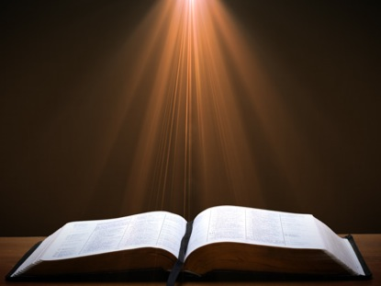

John 13:19; 14:29
“^{13:19} From now on I am telling you before it comes to pass, so that when it does occur, you may believe that I am He… ^{14:29} Now I have told you before it happens, so that when it happens, you may believe.”

Slide 10
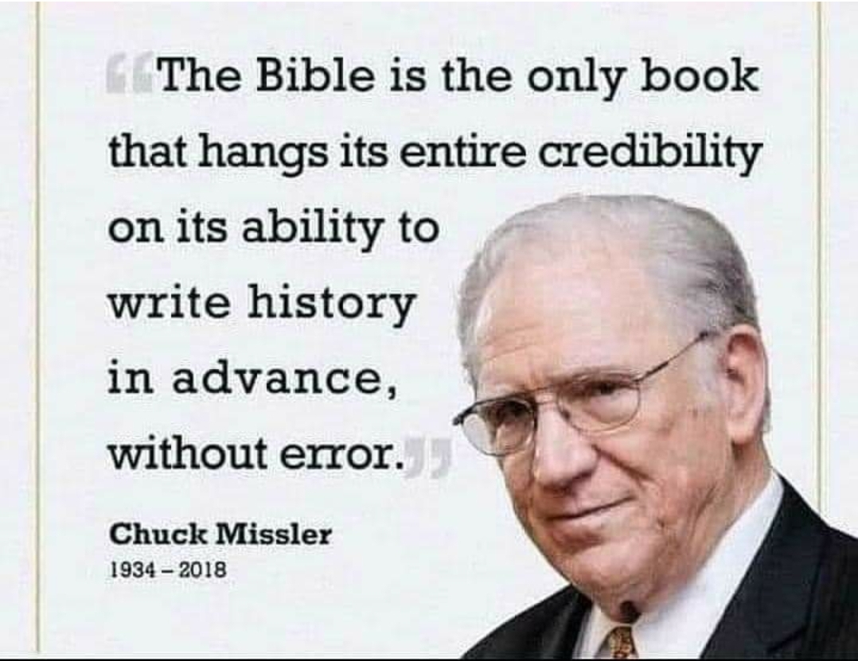

Slide 11
Ezekiel 37
Vision: Valley of the Dry Bones (1-14)
  Vision (1-10)
  Interpretation (11-14)
Sign: Two Sticks (15-28)
  Sign (15-17)
  Interpretation (18-28)

Slide 12
Ezekiel 37
Vision: Valley of the Dry Bones (1-14)
  Vision (1-10)
  Interpretation (11-14)
Sign: Two Sticks (15-28)
  Sign (15-17)
  Interpretation (18-28)

Slide 13
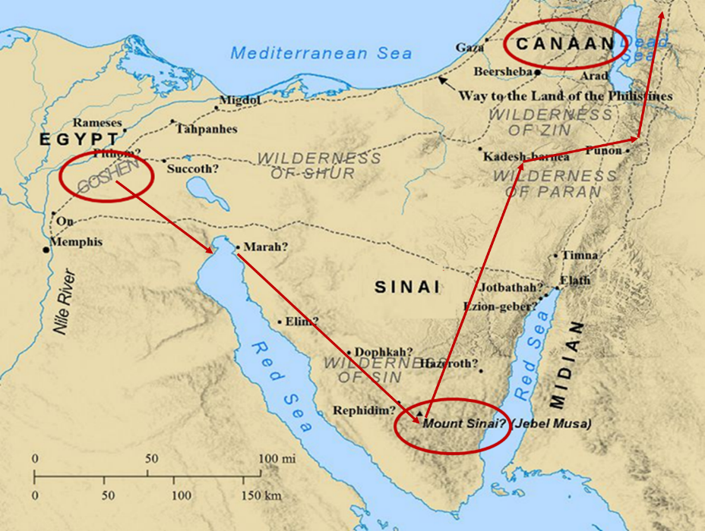

Slide 14
Six Parts of a Suzerain-Vassal Treaty in Deuteronomy
Preamble (1:1-5)
Prologue (1:6–4:40)
Covenant obligations (5–26)
Storage and reading instructions (27:2-3; 31:9, 24, 26)
Witnesses (32:1)
Blessings and curses (28)

Slide 15
Israel's Judgments
Division of the kingdom in 931 B.C. (1 Kgs. 12)
Assyrian judgment in 722 B.C. (2 Kgs. 17)
Babylonian captivity in 586 B.C. (2 Kgs. 25)
Rome Diaspora in A.D. 70 (Luke 19:41-44)

Slide 16
Israel's Judgments
Division of the kingdom in 931 B.C. (1 Kgs. 12)
Assyrian judgment in 722 B.C. (2 Kgs. 17)
Babylonian captivity in 586 B.C. (2 Kgs. 25)
Rome Diaspora in A.D. 70 (Luke 19:41-44)

Slide 17
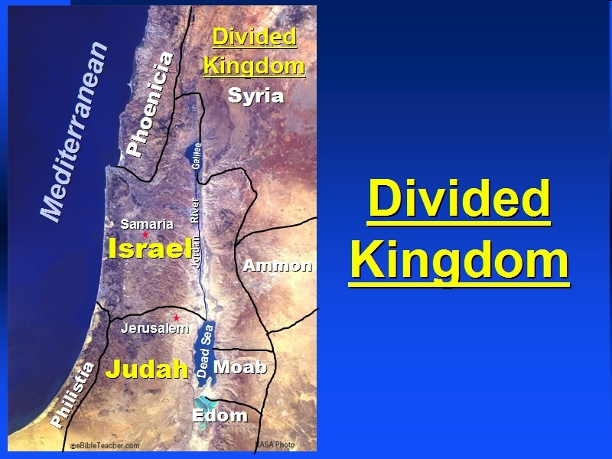

Slide 18

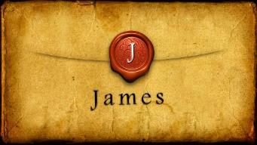
James 1:1
“James, a bond-servant of God and of the Lord Jesus Christ, To the twelve tribes who are dispersed abroad: Greetings.”

Slide 19
Distinctions Between 144,000 & Multitude
144,000 | MULTITUDE
Revelation 7:1-8 | Revelation 7:9-17
Numbered | Innumerable
Jews | All nations
Sealed | Slain
Sealed before the Tribulation | Converted out of the Tribulation
Hitchcock and Ice, The Truth Behind Left Behind, 77

Slide 20
Ezekiel 37
Vision: Valley of the Dry Bones (1-14)
  Vision (1-10)
  Interpretation (11-14)
Sign: Two Sticks (15-28)
  Sign (15-17)
  Interpretation (18-28)

Slide 21
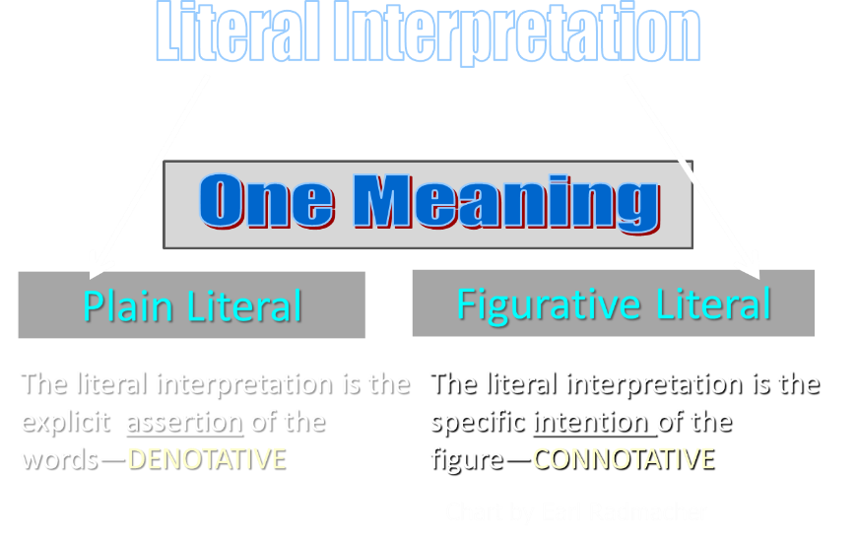

Slide 22
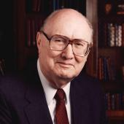
Two Rules of Interpretation
Search the immediate context
  Walvoord: 26X
Search the remote context
  Old Testament
  Thomas: 278 / 404 verses

Slide 23
Israel's Judgments
Division of the kingdom in 931 B.C. (1 Kgs. 12)
Assyrian judgment in 722 B.C. (2 Kgs. 17)
Babylonian captivity in 586 B.C. (2 Kgs. 25)
Rome Diaspora in A.D. 70 (Luke 19:41-44)

Slide 25
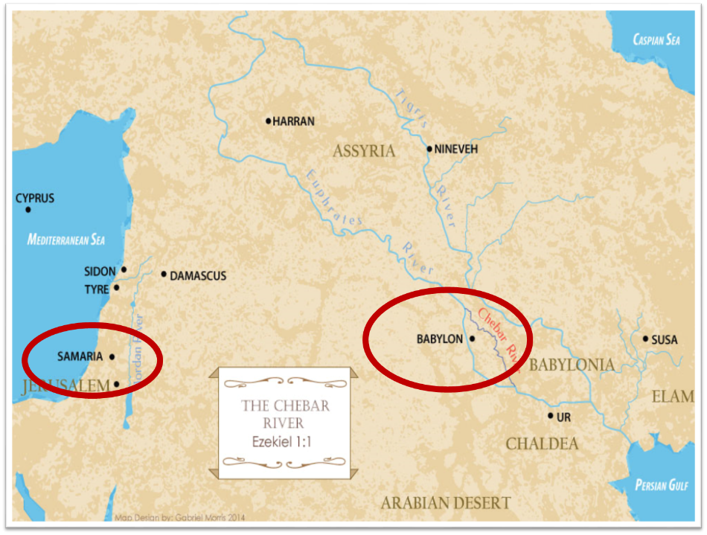

Slide 26

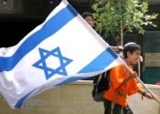
Charles L. Feinberg
The Prophecy of Ezekiel: The Glory of the Lord, Paperback ed. (Chicago: Moody, 1969; reprint, Chicago: Moody, 1984), 207.
“These prophecies, especially those in verses 12-15, could not have been fulfilled in the return from Babylon…Thus many take the primary reference to the return from Babylon. But the predictions will not be completely fulfilled until the future restoration, of which the return from Babylon was a foreshadowing.”

Slide 27
The Millennial David
Hosea 3:5; Jer. 30:9; Ezek. 34:23; 37:24
Root of Jesse
Branch of David
Son of David
Seed of David

Slide 29
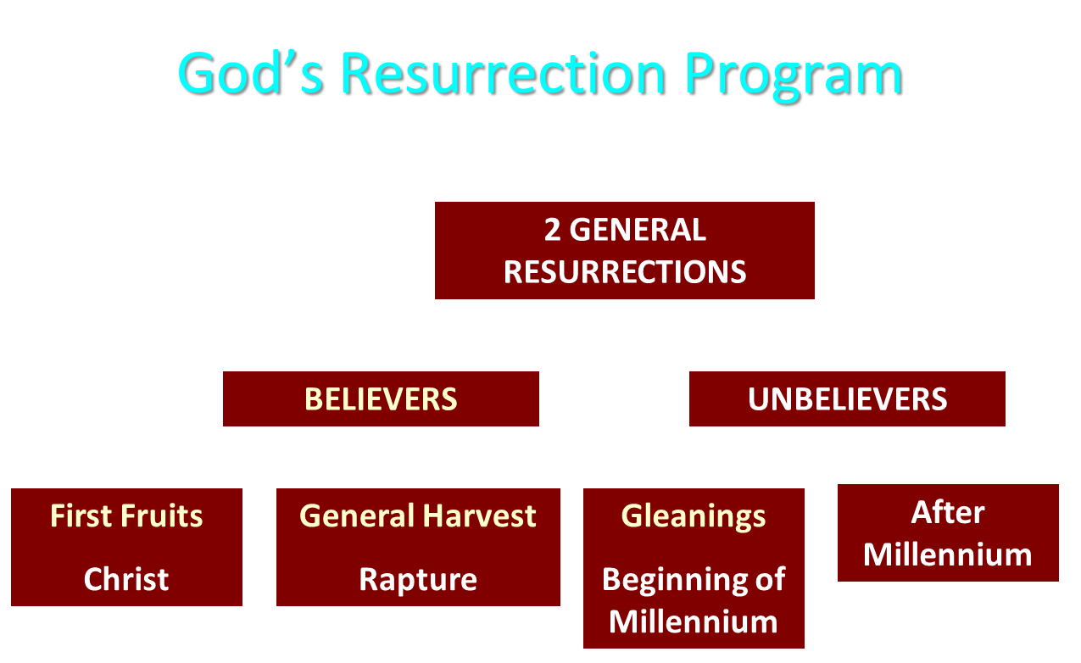

Slide 30
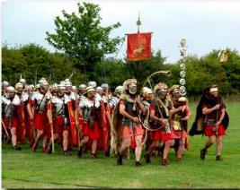
Order or Tagma (1 Cor. 15:23)
General: Christ’s resurrection (1 Cor 15:23)
Officer: Rapture (1 Thess 4:13-18)
Soldiers: OT saints & Tribulation martyrs (Rev 20:4)
Captives: Unsaved of all ages (Rev 20:5)

Slide 31
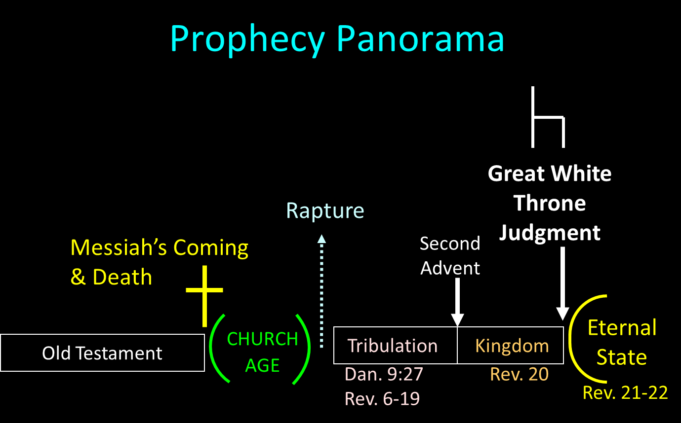

Slide 32
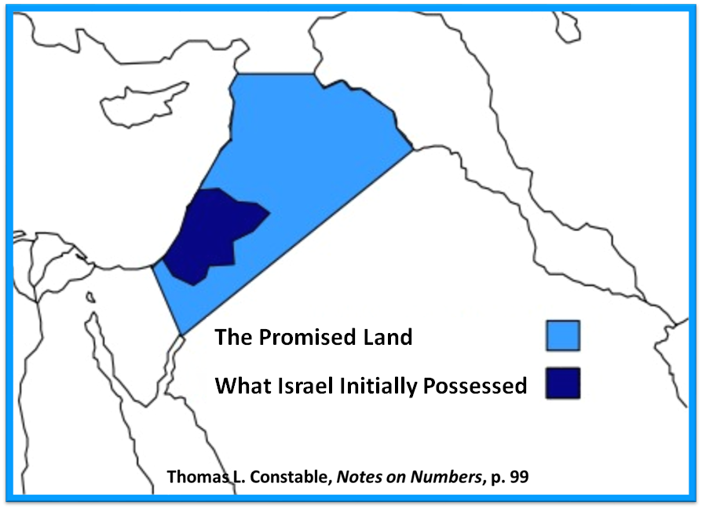

Slide 33
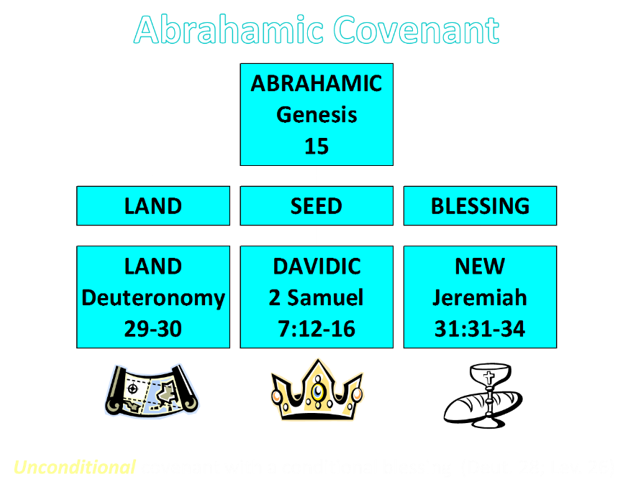

Slide 34
Charles L. Feinberg
The Prophecy of Ezekiel: The Glory of the Lord, Paperback ed. (Chicago: Moody, 1969; reprint, Chicago: Moody, 1984), 216.
“Many have denied that this refers to a physical building in sanctuary, but this seems pointless in view of the last nine chapters of the book, which are treated at length. Just as it pleases God to dwell in a tabernacle when Israel departed from Egypt, so He will tabernacle among them in their converted condition (cf. Exodus 25:8).”

Slide 35
ISRAEL’S FOUR TEMPLES
Solomon’s pre-exilic temple (Kings and Chronicles)
Zerubbabel’s post exilic temple (Ezra 1-6; John 2:20)
Antichrist's temple (Dan. 9:27; Matt. 24:15; 2 Thess. 2:4; Rev. 11:1-2)
Millennial temple (Ezek. 40-48)

Slide 36
ISRAEL’S FOUR TEMPLES
Solomon’s pre-exilic temple (Kings and Chronicles)
Zerubbabel’s post exilic temple (Ezra 1-6; John 2:20)
Antichrist's temple (Dan. 9:27; Matt. 24:15; 2 Thess. 2:4; Rev. 11:1-2)
Millennial temple (Ezek. 40-48)

Slide 37
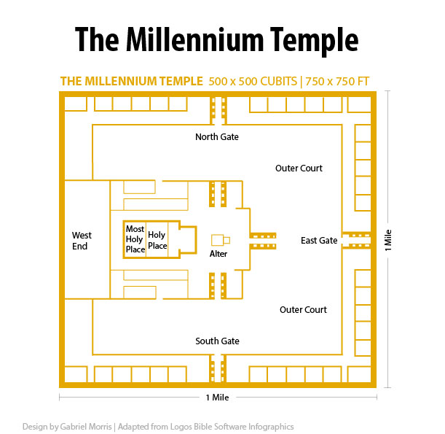

Slide 38
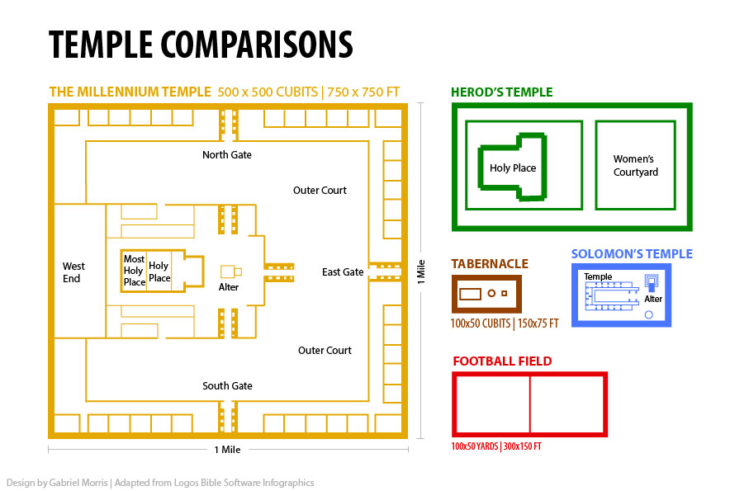

Slide 39
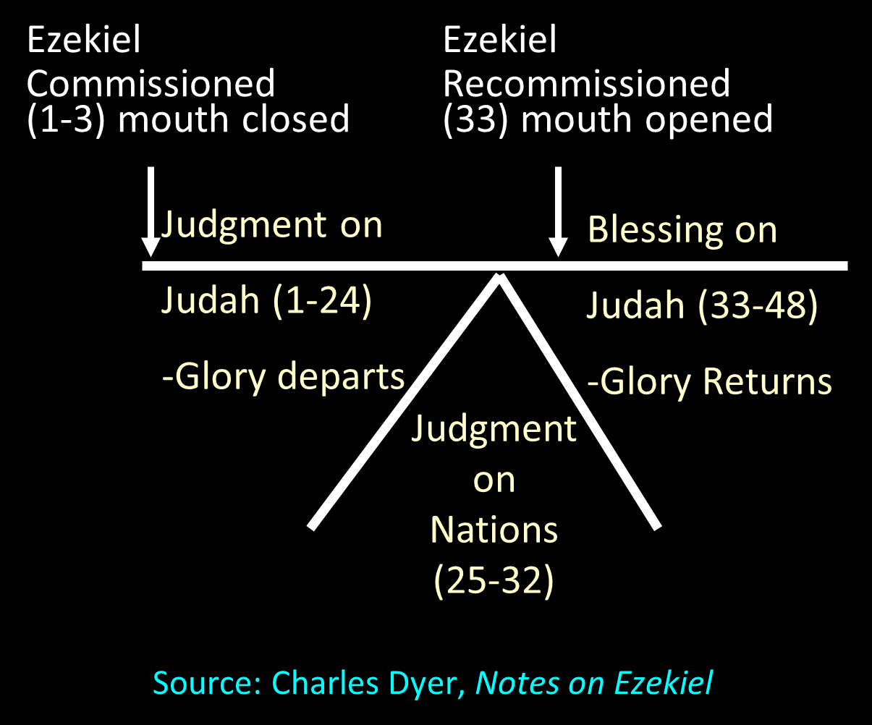

Slide 41
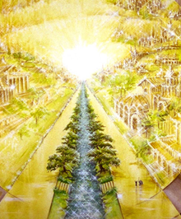
Eternal State is Future
No Satan (Rev 20:10)
No sea (Rev 21:1)
No death, crying, or pain (Rev 21:4)
No Sun (Rev 22:5)
No Moon (Rev 21:23)
No temple (Rev. 21:22)
No night (Rev 21:25)
No evil (Rev 21:27)
No curse (Rev 22:3)

Slide 42
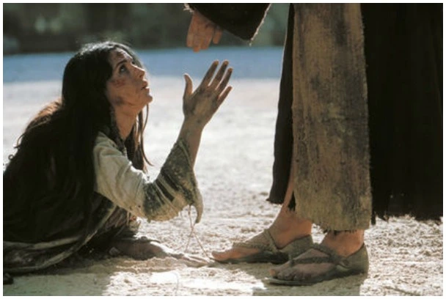
Revelation 21:4
“and He will wipe away every tear from their eyes; and there will no longer be any death; there will no longer be any mourning, or crying, or pain; the first things have passed away.”

Slide 43
CONCLUSION

Slide 44
Ezekiel 37
Vision: Valley of the Dry Bones (1-14)
  Vision (1-10)
  Interpretation (11-14)
Sign: Two Sticks (15-28)
  Sign (15-17)
  Interpretation (18-28)

