Slide 1


Zechariah
God Remembers!

Slide 2

Structure
Introductory call to repentance (1:1-6)
Eight-night visions (1:7–6:15)
Question and answers about fasting (7–8)
Two burdens (9–14)

Slide 3
ZECHARIAH’S EIGHT NIGHT VISIONS
Vision | Reference | Meaning
The Red-horse Rider among the Myrtles | 1:7-17 | God’s anger against the nations & blessing on restored Israel.
The Four Horns & the Four Craftsmen | 1:18-21 | God’s judgment on the nations that afflict Israel.
The Surveyor with a Measuring Line | Chapter 2 | God’s future blessing on restored Israel.
The Cleansing & Crowning of Joshua the Hight Priest. | Chapter 3 | Israel’s future cleansing from sin & reinstatement as a priestly nation.
The Golden Lampstand & the Two Olive Trees | Chapter 4 | Israel as the light to the nations under Messiah, the King-Priest.
The Flying Scroll | 5:1-4 | The severity & totality of divine judgment on individual Israelites.
The Woman in the Ephah | 5:5-11 | The removal of national Israel’s sin of rebellion against God.
The Four Chariots | 6:1-8 | Divine judgment on Gentile nations.

Slide 4
II. Eight Night Visions
(1:7‒6:15)
  Riders & horses among the myrtle trees (1:7-17)
  Four horns & four craftsmen (1:18-21)
  Man with the measuring line (2)
  Cleansing of the High Priest Joshua (3)
  Lampstand & olive tree (4)
  Flying scroll (5:1-4)
  Woman in the basket (5:5-11)
  Four chariots (6:1-8)
  Conclusion: crowning of Joshua (6:9-15)

Slide 5
Structure
Introductory call to repentance (1:1-6)
Eight-night visions (1:7–6:15)
Question and answers about fasting (7–8)
Two burdens (9–14)

Slide 6

III. Questions & Answers Concerning Fasting
(7‒8)
  Question (7:1-3)
  Four divine answers (7:4‒8:23)
    Condemnation of empty ritualism (7:4-7)
    Condemnation of past covenant failure (7:8-14)
    Prediction of Jerusalem’s restoration (8:1-17)
    Prediction of future blessing (8:18-23)

Slide 7
III. Questions & Answers Concerning Fasting
(7‒8)
  Question (7:1-3)
  Four divine answers (7:4‒8:23)
    Condemnation of empty ritualism (7:4-7)
    Condemnation of past covenant failure (7:8-14)
    Prediction of Jerusalem’s restoration (8:1-17)
    Prediction of future blessing (8:18-23)

Slide 8
Question
(7:1-3)
    Date (1)
    Questioner (2)
    Question (3)

Slide 9
III. Questions & Answers Concerning Fasting
(7‒8)
  Question (7:1-3)
  Four divine answers (7:4‒8:23)
    Condemnation of empty ritualism (7:4-7)
    Condemnation of past covenant failure (7:8-14)
    Prediction of Jerusalem’s restoration (8:1-17)
    Prediction of future blessing (8:18-23)

Slide 10
III. Questions & Answers Concerning Fasting
(7‒8)
  Question (7:1-3)
  Four divine answers (7:4‒8:23)
    Condemnation of empty ritualism (7:4-7)
    Condemnation of past covenant failure (7:8-14)
    Prediction of Jerusalem’s restoration (8:1-17)
    Prediction of future blessing (8:18-23)

Slide 11
Empty Ritualism
(7:4-7)
Israel’s insincerity (4-5)
Israel’s selfishness (6-7)

Slide 12
III. Questions & Answers Concerning Fasting
(7‒8)
  Question (7:1-3)
  Four divine answers (7:4‒8:23)
    Condemnation of empty ritualism (7:4-7)
    Condemnation of past covenant failure (7:8-14)
    Prediction of Jerusalem’s restoration (8:1-17)
    Prediction of future blessing (8:18-23)

Slide 13
Covenant Rebellion
(7:8-14)
Covenant requirements (8-10)
Covenant rebellion (11-12)
Covenant judgment (13-14)

Slide 14
III. Questions & Answers Concerning Fasting
(7‒8)
  Question (7:1-3)
  Four divine answers (7:4‒8:23)
    Condemnation of empty ritualism (7:4-7)
    Condemnation of past covenant failure (7:8-14)
    Prediction of Jerusalem’s restoration (8:1-17)
    Prediction of future blessing (8:18-23)

Slide 15
Prediction of Jerusalem's Restoration
(8:1-17)
Prediction (1-8)
Application (9-17)

Slide 16
Prediction of Jerusalem's Restoration
(8:1-17)
Prediction (1-8)
Application (9-17)

Slide 17
Application
(8:9-17)
Rebuild the Temple (9-13)
Trust in God’s promises (14-15)
Obey the covenant (16-17)

Slide 18



Slide 19
III. Questions & Answers Concerning Fasting
(7‒8)
  Question (7:1-3)
  Four divine answers (7:4‒8:23)
    Condemnation of empty ritualism (7:4-7)
    Condemnation of past covenant failure (7:8-14)
    Prediction of Jerusalem’s restoration (8:1-17)
    Prediction of future blessing (8:18-23)

Slide 20
4. Prediction of Jerusalem's Restoration
(8:18-23)
From fasting to feasting (18-19)
Jerusalem’s exaltation (20-23)

Slide 21
4. Prediction of Jerusalem's Restoration
(8:18-23)
From fasting to feasting (18-19)
Jerusalem’s exaltation (20-23)

Slide 22
From Fasting to Feasting
(8:18-19)
New oracle (18)
From fasting to feasting (19)

Slide 23
From Fasting to Feasting
(8:18-19)
New oracle (18)
From fasting to feasting (19)

Slide 24
From Fasting to Feasting
(8:18-19)
New oracle (18)
From fasting to feasting (19)

Slide 25


Slide 26
Question
(7:1-3)
    Date (1)
    Questioner (2)
    Question (3)

Slide 27


Slide 28
Six Parts of a Suzerain-Vassal Treaty in Deuteronomy
Preamble (1:1-5)
Prologue (1:6–4:40)
Covenant obligations (5–26)
Storage and reading instructions (27:2-3; 31:9, 24, 26)
Witnesses (32:1)
Blessings and curses (28)

Slide 29
4. Prediction of Jerusalem's Restoration
(8:18-23)
From fasting to feasting (18-19)
Jerusalem’s exaltation (20-23)

Slide 30
Jerusalem's Exaltation
(8:20-23)
The gathering (20)
The reason (21)
The location (22)
The preeminence (23)

Slide 31
Jerusalem's Exaltation
(8:20-23)
The gathering (20)
The reason (21)
The location (22)
The preeminence (23)

Slide 32
Jerusalem's Exaltation
(8:20-23)
The gathering (20)
The reason (21)
The location (22)
The preeminence (23)

Slide 33
Jerusalem's Exaltation
(8:20-23)
The gathering (20)
The reason (21)
The location (22)
The preeminence (23)

Slide 34

Isaiah 2:2-3
“Now it will come about that In the last days The mountain of the house of the Lord Will be established as the chief of the mountains, And will be raised above the hills; And all the nations will stream to it.³ And many peoples will come and say, ‘Come, let us go up to the mountain of the Lord, To the house of the God of Jacob; That He may teach us concerning His ways And that we may walk in His paths.’ For the law will go forth from Zion And the word of the Lord from Jerusalem.”

Slide 35

Zechariah 14:16-18
“Then it will come about that any who are left of all the nations that went against Jerusalem will go up from year to year to worship the King, the Lord of hosts, and to celebrate the Feast of Booths. ¹⁷ And it will be that whichever of the families of the earth does not go up to Jerusalem to worship the King, the Lord of hosts, there will be no rain on them. ¹⁸ If the family of Egypt does not go up or enter, then no rain will fall on them; it will be the plague with which the Lord smites the nations who do not go up to celebrate the Feast of Booths.”

Slide 36

Revelation 20:7-9
“⁷ When the thousand years are completed, Satan will be released from his prison, ⁸ and will come out to deceive the nations which are in the four corners of the earth, Gog and Magog, to gather them together for the war; the number of them is like the sand of the seashore. ⁹ And they came up on the broad plain of the earth and surrounded the camp of the saints and the beloved city, and fire came down from heaven and devoured them.”

Slide 37

Robert Thomas
Four Views on the Book of Revelation, page 207.
“At the end of the Millennium that city will be Satan’s prime objective with his rebel army, because Israel will be a leader among the nations.”

Slide 38
David J. Ellis
Ellis, David J. "Zechariah." In The New Layman's Bible Commentary, pp. 1025-50. Edited by G. C. D. Howley, et al. Grand Rapids: Zondervan Publishing House, 1979. p. 1039.
“Jerusalem is no longer viewed simply as the heart of Judaism but as the centre of God's dealings with all nations, and as a glorious realization of the ancient promise given to Abraham (cf. Gen. 12:3).”

Slide 39
Jerusalem's Exaltation
(8:20-23)
The gathering (20)
The reason (21)
The location (22)
The preeminence (23)

Slide 40

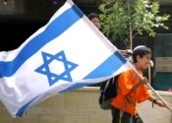
Zechariah 12:3
“It will come about in that day that I will make Jerusalem a heavy stone for all the peoples; all who lift it will be severely injured. And all the nations of the earth will be gathered against it.”

Slide 41
Zechariah 14:2-3
“² For I will gather all the nations against Jerusalem to battle, and the city will be captured, the houses plundered, the women ravished and half of the city exiled, but the rest of the people will not be cut off from the city. ³ Then the Lord will go forth and fight against those nations, as when He fights on a day of battle.”

Slide 42
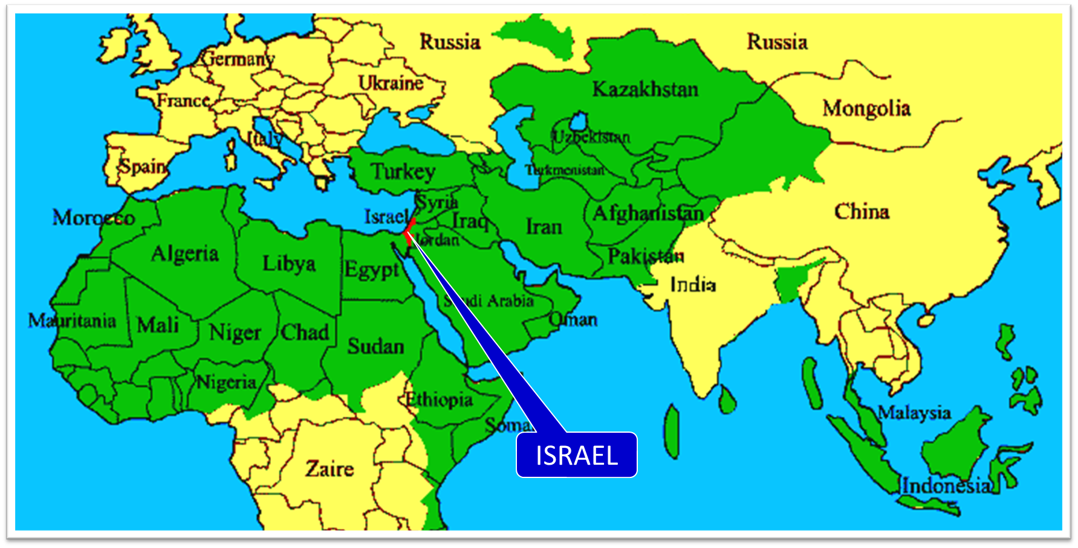

Slide 43
Revelation 20:7-9
“⁷ When the thousand years are completed, Satan will be released from his prison, ⁸ and will come out to deceive the nations which are in the four corners of the earth, Gog and Magog, to gather them together for the war; the number of them is like the sand of the seashore. ⁹ And they came up on the broad plain of the earth and surrounded the camp of the saints and the beloved city, and fire came down from heaven and devoured them.”

Slide 44
Robert Thomas
Four Views on the Book of Revelation, page 207.
“At the end of the Millennium that city will be Satan’s prime objective with his rebel army, because Israel will be a leader among the nations.”

Slide 45
Merrill F. Unger
Unger, Merrill F. Zechariah. Grand Rapids: Zondervan Publishing House, 1963. p. 148.
“With the Davidic kingdom established, Israel will be a medium of blessing to the entire globe.”

Slide 46
Isaiah 2:2-3
“Now it will come about that In the last days The mountain of the house of the Lord Will be established as the chief of the mountains, And will be raised above the hills; And all the nations will stream to it.³ And many peoples will come and say, ‘Come, let us go up to the mountain of the Lord, To the house of the God of Jacob; That He may teach us concerning His ways And that we may walk in His paths.’ For the law will go forth from Zion And the word of the Lord from Jerusalem.”

Slide 47
Zechariah 14:16-18
“Then it will come about that any who are left of all the nations that went against Jerusalem will go up from year to year to worship the King, the Lord of hosts, and to celebrate the Feast of Booths. ¹⁷ And it will be that whichever of the families of the earth does not go up to Jerusalem to worship the King, the Lord of hosts, there will be no rain on them. ¹⁸ If the family of Egypt does not go up or enter, then no rain will fall on them; it will be the plague with which the Lord smites the nations who do not go up to celebrate the Feast of Booths.”

Slide 48
Conclusion

Slide 49
III. Questions & Answers Concerning Fasting
(7‒8)
  Question (7:1-3)
  Four divine answers (7:4‒8:23)
    Condemnation of empty ritualism (7:4-7)
    Condemnation of past covenant failure (7:8-14)
    Prediction of Jerusalem’s restoration (8:1-17)
    Prediction of future blessing (8:18-23)

Slide 50
4. Prediction of Jerusalem's Restoration
(8:18-23)
From fasting to feasting (18-19)
Jerusalem’s exaltation (20-23)

Slide 51
Structure
Introductory call to repentance (1:1-6)
Eight-night visions (1:7–6:15)
Question and answers about fasting (7–8)
Two burdens (9–14)

