Slide 1
The Proper View of Scripture

Slide 2
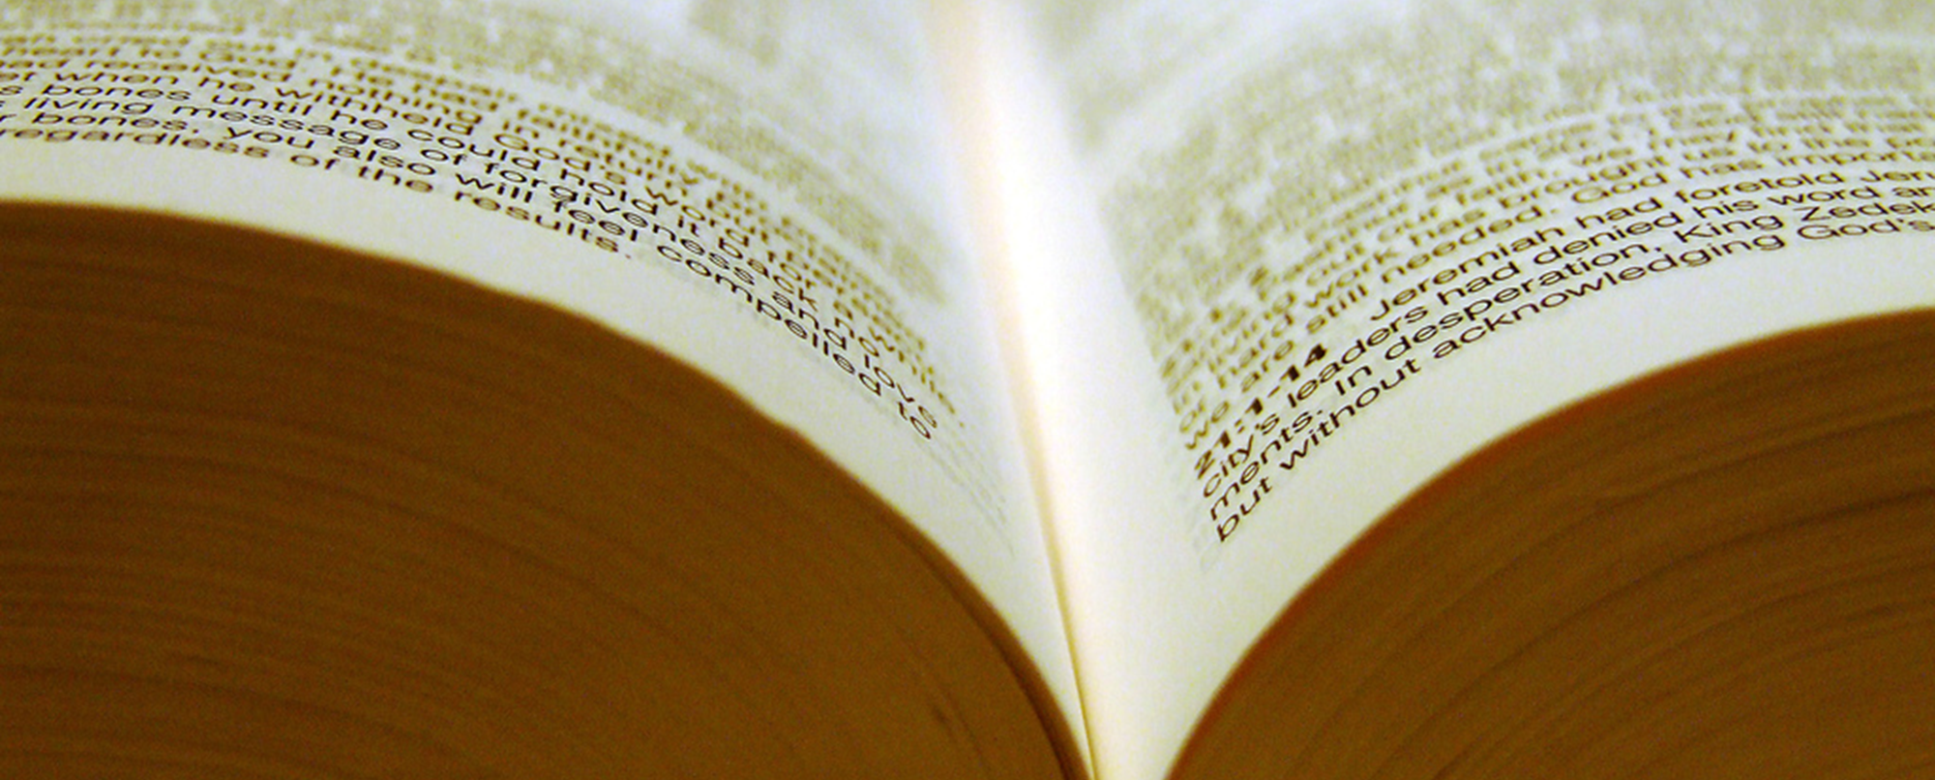
The Proper View of Scripture
Is to believe that…
All Scripture is God’s Word
Scripture was written by men yet inspired by God
Scripture is inerrant
Scripture is historically accurate
Scripture is the highest authority
Scripture points to Jesus
Scripture is enough
Scripture will endure forever
Scripture is your sustenance

Slide 3
On Creation and Origins…
“…Although I do not have hard and fast opinions in this area, my tentative inclination is to say that Genesis 1 is figurative language, that is not to be taken in a literal sense, and therefore it is quite compatible with any sort of theory of biological evolution that might be on offer. So that the question of the origin of life and biological complexities for me is not a Biblical question, it’s a scientific question. I think as a Christian, I am free to follow the evidence where it leads. As I look at the evidence…my understanding is that there is no adequate theory, not even a shadow of a theory, that would explain the origin of life.”
Dr. Willian Lane Craig
Source: https://www.youtube.com/watch?v=bqUaWiuR4TY, accessed 8/17/2109.

Slide 4
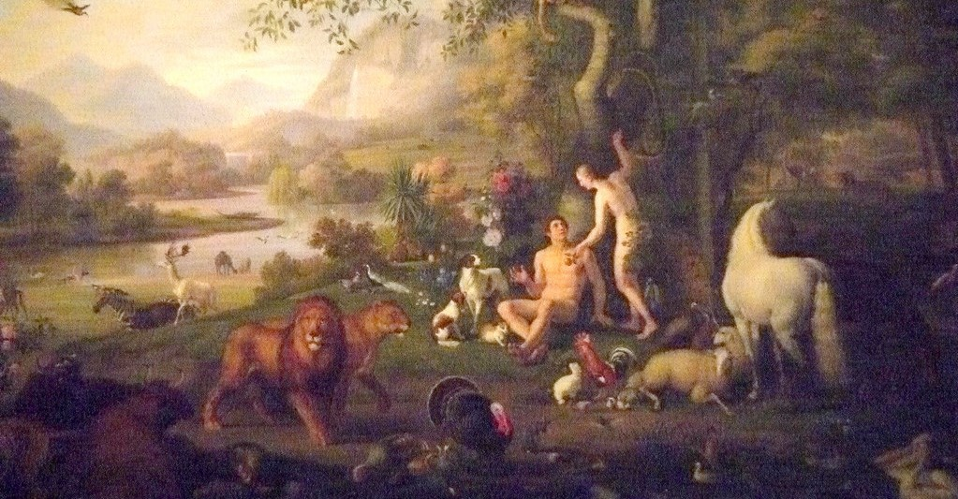
Mark 10:6
“But from the beginning of creation, God MADE THEM MALE AND FEMALE.”

Slide 5
The Proper View of Scripture
Is to believe that…
All Scripture is God’s Word
Scripture was written by men yet inspired by God
Scripture is inerrant
Scripture is historically accurate
Scripture is the highest authority
Scripture points to Jesus
Scripture is enough
Scripture will endure forever
Scripture is your sustenance

Slide 7
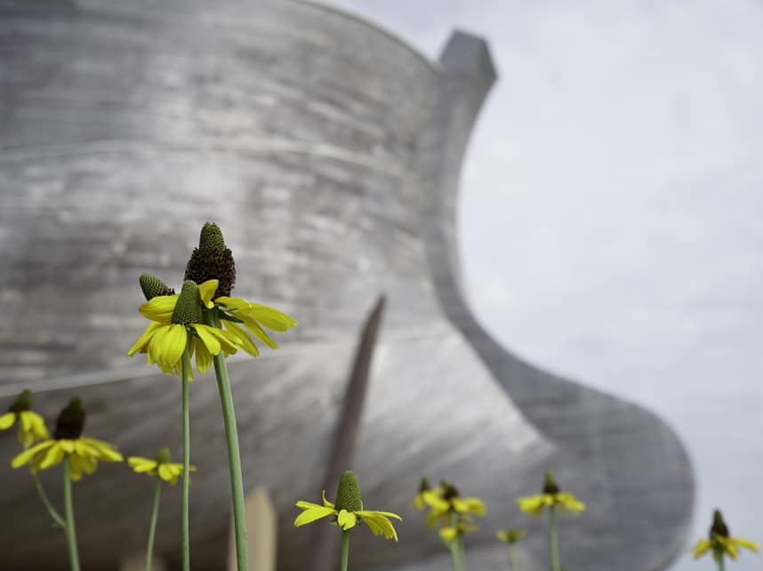

Slide 8
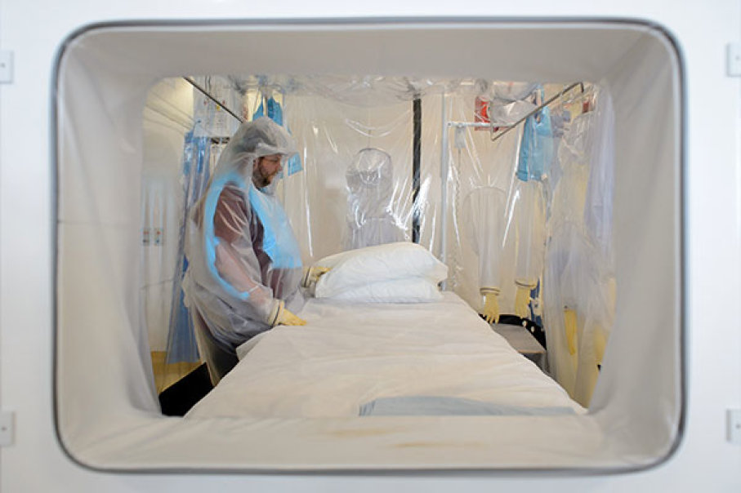

Slide 9
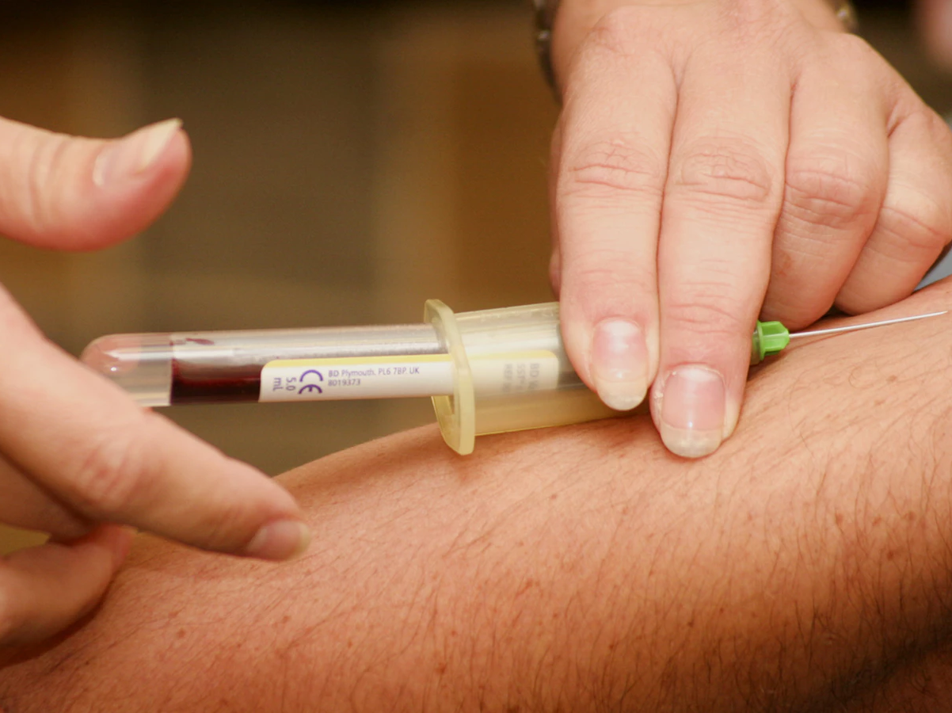
“..the life of the flesh is in the blood.” Leviticus 17:11

Slide 10
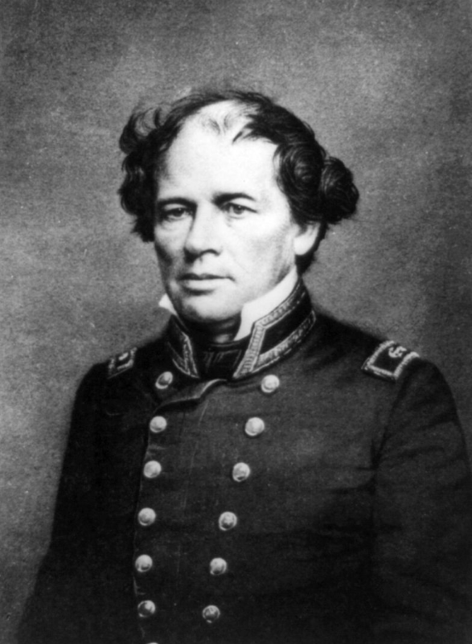
Matthew Fontaine Maury

Slide 11
Psalm 8:1-9
1 O Lord, our Lord, How majestic is Your name in all the earth, Who have displayed Your splendor above the heavens!
2 From the mouth of infants and nursing babes You have established strength Because of Your adversaries, To make the enemy and the revengeful cease.
3 When I consider Your heavens, the work of Your fingers, The moon and the stars, which You have ordained;
4 What is man that You take thought of him, And the son of man that You care for him?
5 Yet You have made him a little lower than God, And You crown him with glory and majesty!
6 You make him to rule over the works of Your hands; You have put all things under his feet,
7 All sheep and oxen, And also the beasts of the field,
8 The birds of the heavens and the fish of the sea, Whatever passes through the paths of the seas.
9 O Lord, our Lord, How majestic is Your name in all the earth!

Slide 12
Psalm 8:1-9
1 O Lord, our Lord, How majestic is Your name in all the earth, Who have displayed Your splendor above the heavens!
2 From the mouth of infants and nursing babes You have established strength Because of Your adversaries, To make the enemy and the revengeful cease.
3 When I consider Your heavens, the work of Your fingers, The moon and the stars, which You have ordained;
4 What is man that You take thought of him, And the son of man that You care for him?
5 Yet You have made him a little lower than God, And You crown him with glory and majesty!
6 You make him to rule over the works of Your hands; You have put all things under his feet,
7 All sheep and oxen, And also the beasts of the field,
8 The birds of the heavens and the fish of the sea, whatever passes through the paths of the seas.
9 O Lord, our Lord, How majestic is Your name in all the earth!

Slide 13
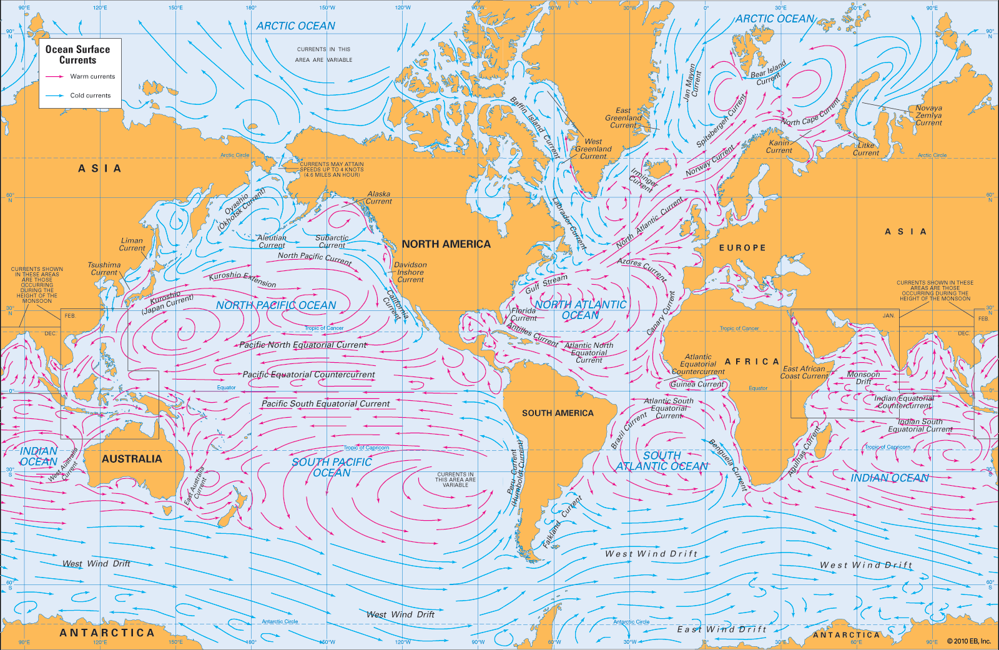

Slide 14
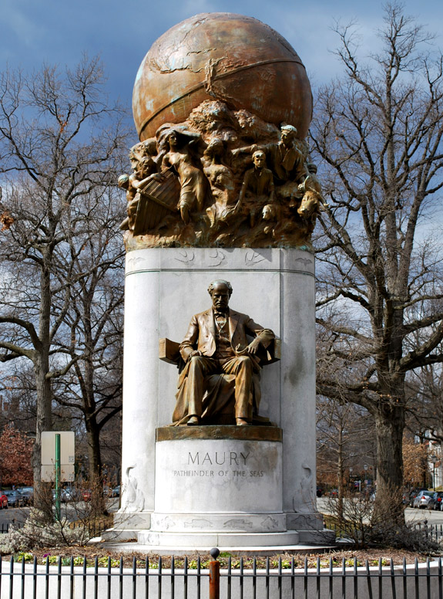
“Matthew Fontaine Maury, Pathfinder of the Seas, the genius who first snatched from the oceans and atmosphere the secret of their laws. His inspiration, Holy Writ, Psalm 8:8;
Ecclesiastes 1:6.’

Slide 15
The Proper View of Scripture
Is to believe that…
All Scripture is God’s Word
Scripture was written by men yet inspired by God
Scripture is inerrant
Scripture is historically accurate
Scripture is the highest authority
Scripture points to Jesus
Scripture is enough
Scripture will endure forever
Scripture is your sustenance

Slide 16
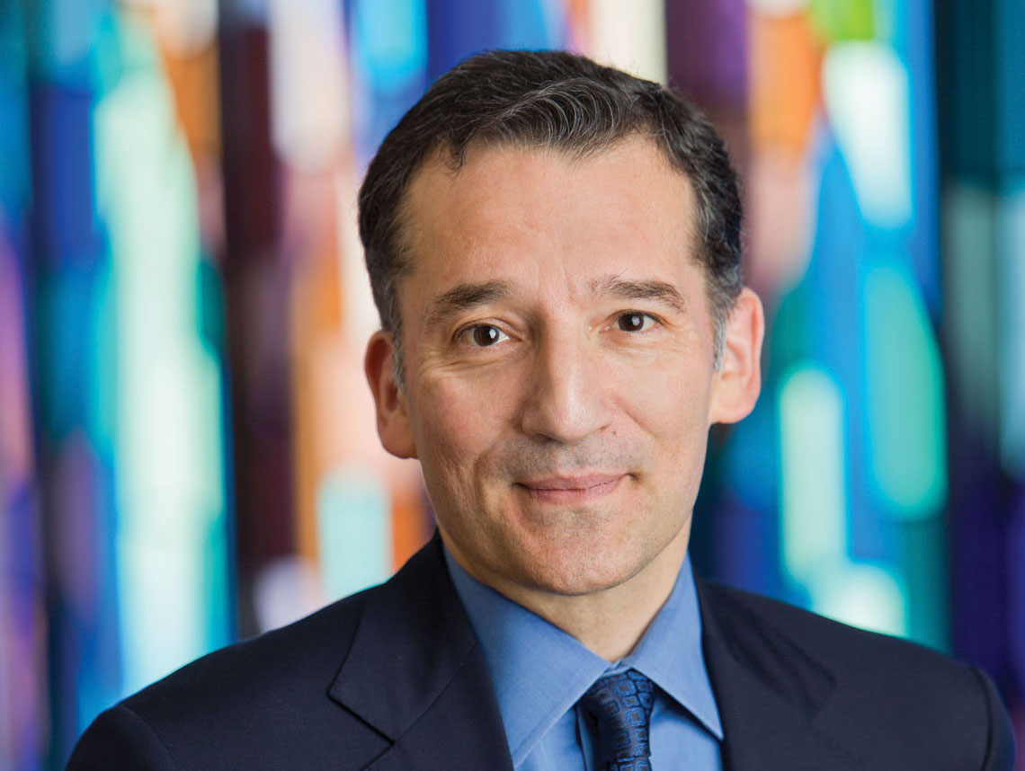
“…if you look at it scientifically, its virtually indefensible to make a biblical case…You also have to understand that your faith isn’t based on splitting seas or archeological digs, it’s based on something much deeper…”
Rabbi David Wolpe
Taken form the documentary by Timothy P. Mahoney, Patterns of Evidence: The Exodus, Virgil Films and Entertainment, 2015.

Slide 17
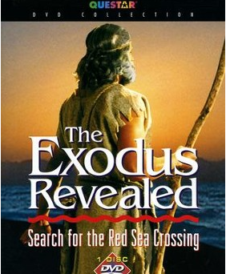
The Exodus Revealed
Directed by Lad Allen, 2006.

Slide 18
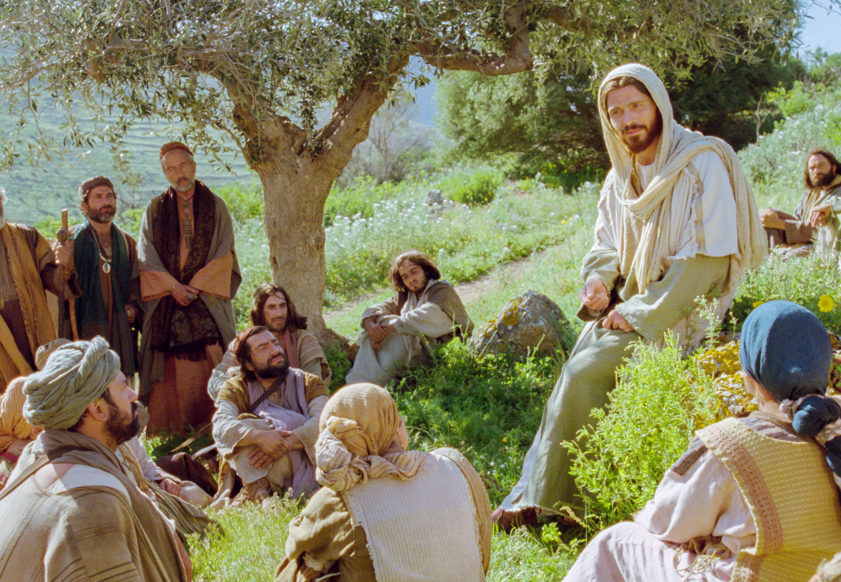

Slide 19
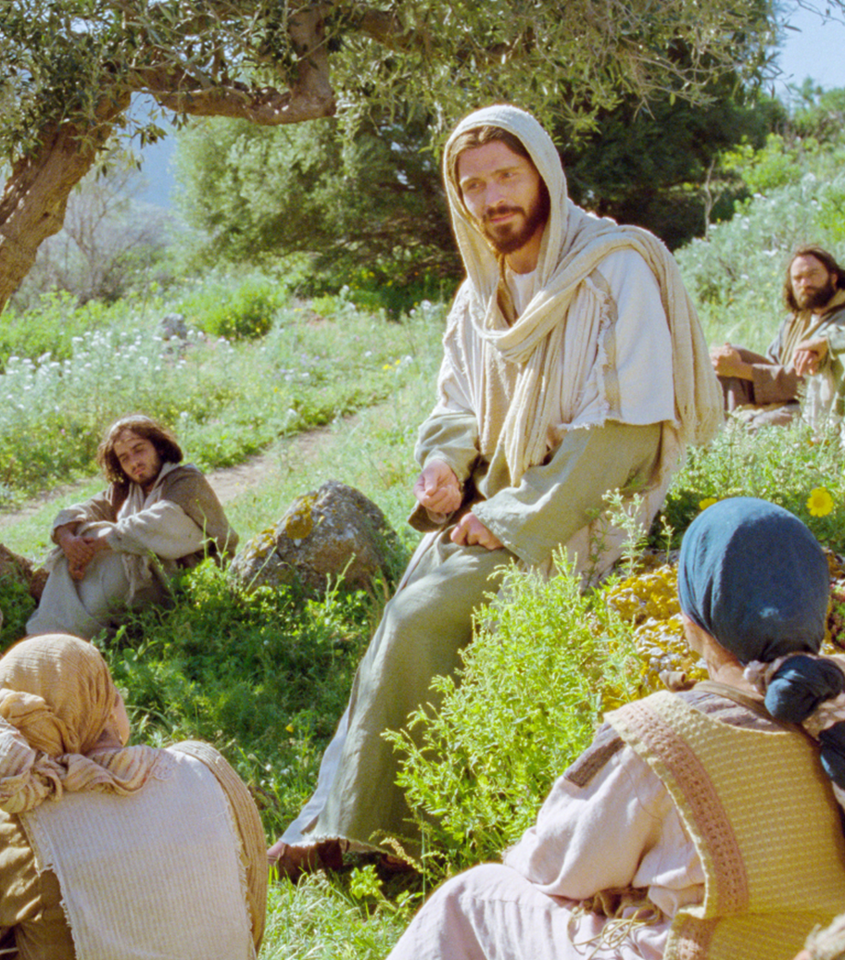
Matthew 19:3-6
“Is it lawful for a man to divorce his wife for any reason at all? Jesus answered and said, Have you not read that He who created them from the beginning made them male and female, and for this reason a man shall leave his father and mother and be joined to his wife, and the two shall become one flesh.”

Slide 20
Matthew 19:3-6
“Is it lawful for a man to divorce his wife for any reason at all? Jesus answered and said, Have you not read that He who created them from the beginning made them male and female, and for this reason a man shall leave his father and mother and be joined to his wife, and the two shall become one flesh.”

Slide 21
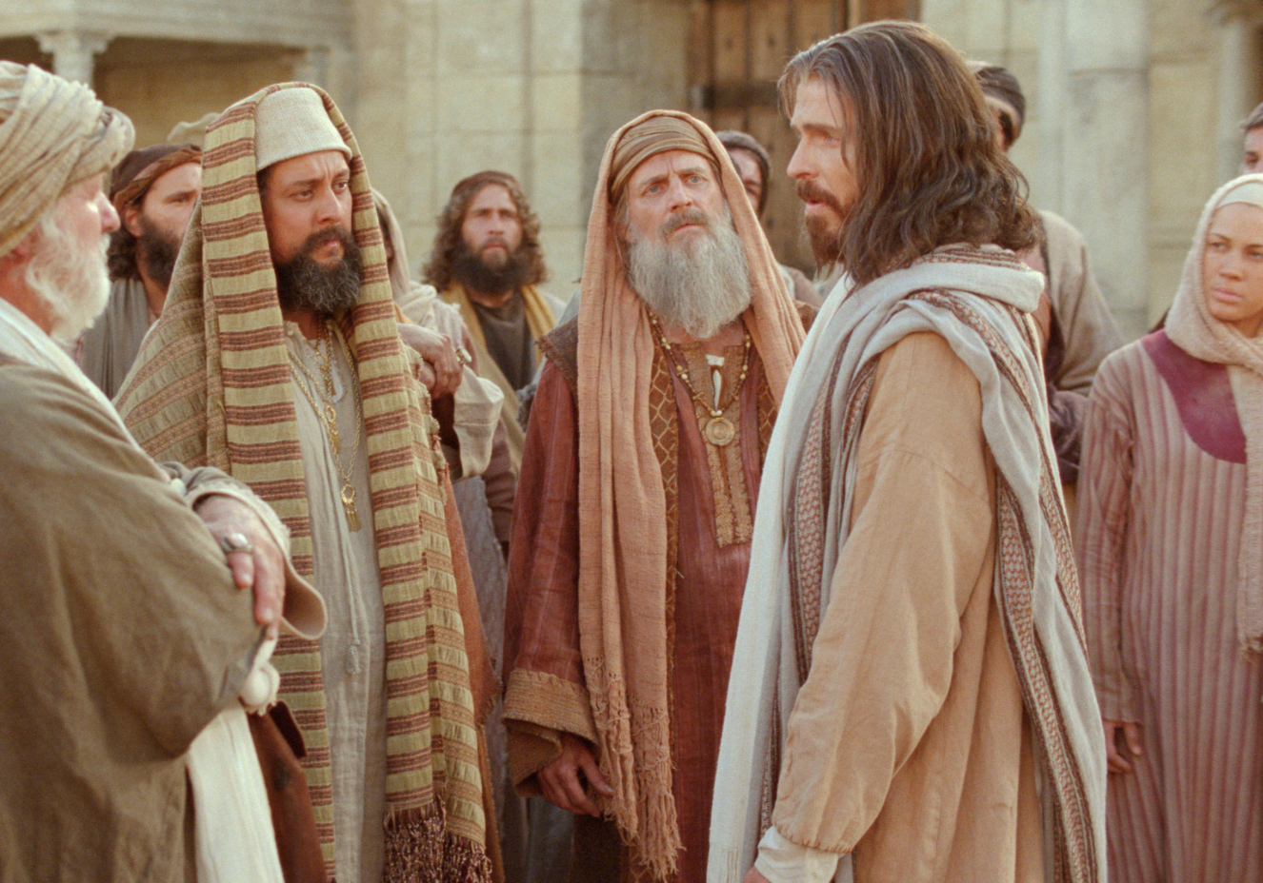
“…we want to see a sign from you…An evil and adulterous generation craves for a sign; and yet no sign will be given to it but the sign of Jonah the prophet; for just as Jonah was three days and three nights in the belly of the sea monster, so will the Son of Man be three days and three nights in the heart of the earth.” Matthew 12:38-40

Slide 22
“…we want to see a sign from you…An evil and adulterous generation craves for a sign; and yet no sign will be given to it but the sign of Jonah the prophet; for just as Jonah was three days and three nights in the belly of the sea monster, so will the Son of Man be three days and three nights in the heart of the earth.” Matthew 12:38-40

Slide 23
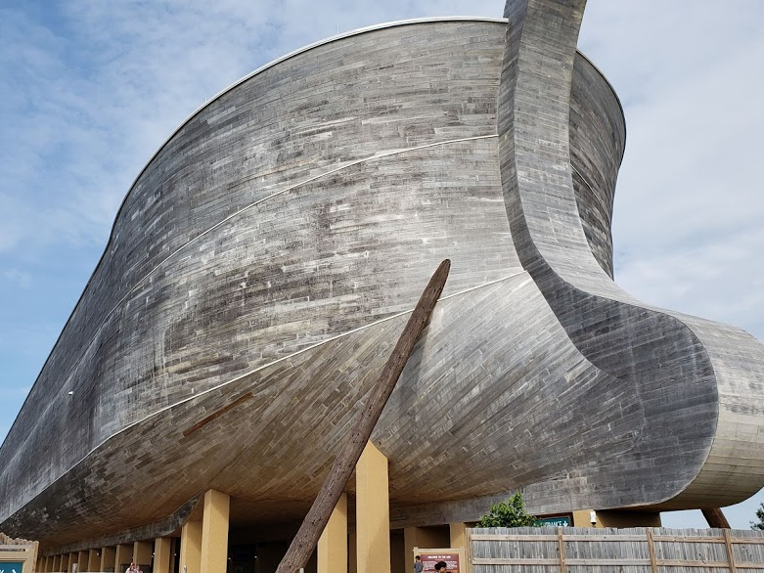
“And just as it happened in the days of Noah, so it will be also in the days of the Son of Man: they were eating, they were drinking, they were marrying, they were being given in marriage, until the day that Noah entered the ark, and the flood came and destroyed them all.” Luke 17:26-27

Slide 24
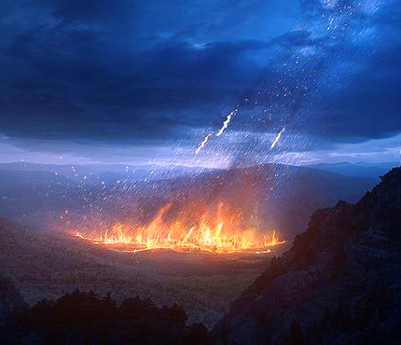
“It was the same as happened in the days of Lot: they were eating, they were drinking, they were buying, they were selling, they were planting, they were building; but on the day that Lot went out from Sodom it rained fire and brimstone from heaven and destroyed them all. It will be just the same on the day that the Son of Man is revealed. Luke 17:28-30

Slide 25
The Proper View of Scripture
Is to believe that…
All Scripture is God’s Word
Scripture was written by men yet inspired by God
Scripture is inerrant
Scripture is historically accurate
Scripture is the highest authority
Scripture points to Jesus
Scripture is enough
Scripture will endure forever
Scripture is your sustenance

Slide 26
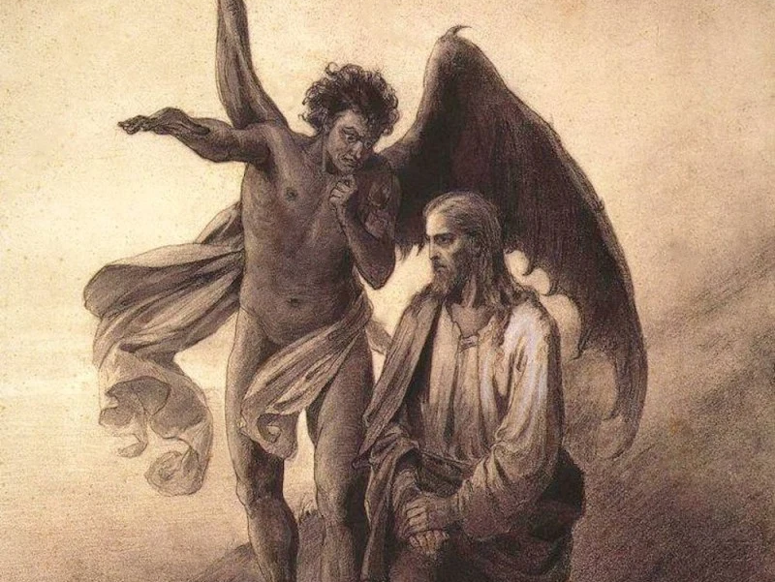

Slide 27
“And the tempter came and said to Him, ‘If You are the Son of God, command that these stones become bread.’” Matthew 4:3

Slide 28
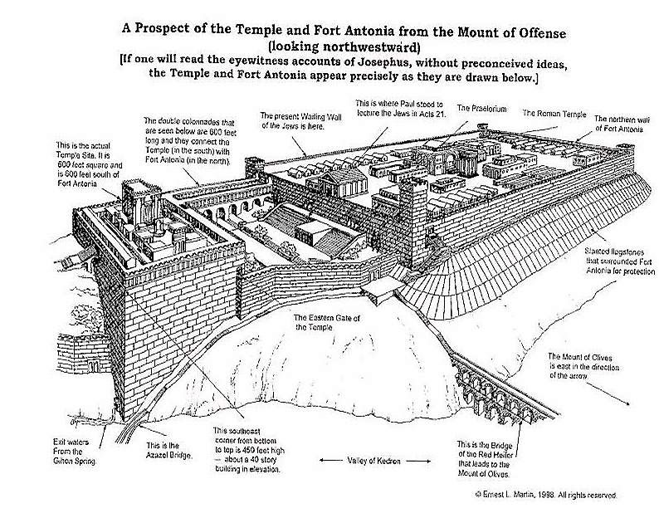

Slide 30
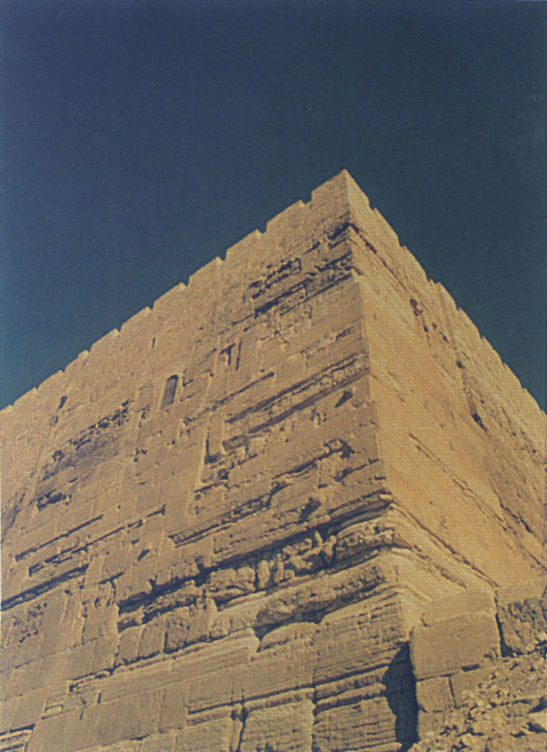

Slide 31
“If You are the Son of God, throw Yourself down; for it is written, ‘He will command His angels concerning You’; and ‘On their hands they will bear You up, so that You will not strike Your foot against a stone.’ ” Matthew 4:6.

Slide 32
“Jesus said to him, “On the other hand, it is written, ‘YOU SHALL NOT PUT THE LORD YOUR GOD TO THE TEST.’ ” Matthew 4:7
“Then Jesus said to him, “Go, Satan! For it is written, ‘YOU SHALL WORSHIP THE LORD YOUR GOD, AND SERVE HIM ONLY.’ Then the devil left Him…” Matthew 4:10

Slide 33
“For we do not have a high priest who cannot sympathize with our weaknesses, but One who has been tempted in all things as we are, yet without sin.” Hebrews 4:15

Slide 34
“He made Him who knew no sin to be sin on our behalf, so that we might become the righteousness of God in Him.”
2 Corinthians 5:21

Slide 35
The Proper View of Scripture
Is to believe that…
All Scripture is God’s Word
Scripture was written by men yet inspired by God
Scripture is inerrant
Scripture is historically accurate
Scripture is the highest authority
Scripture points to Jesus
Scripture is enough
Scripture will endure forever
Scripture is your sustenance

Slide 36
“You search the Scriptures because you think that in them you have eternal life; it is these that testify about Me; and you are unwilling to come to Me so that you may have life.”
John 5:39

Slide 37
“Then beginning with Moses and with all the prophets, He explained to them the things concerning Himself in all the Scripture.” Luke 24:27

Slide 38
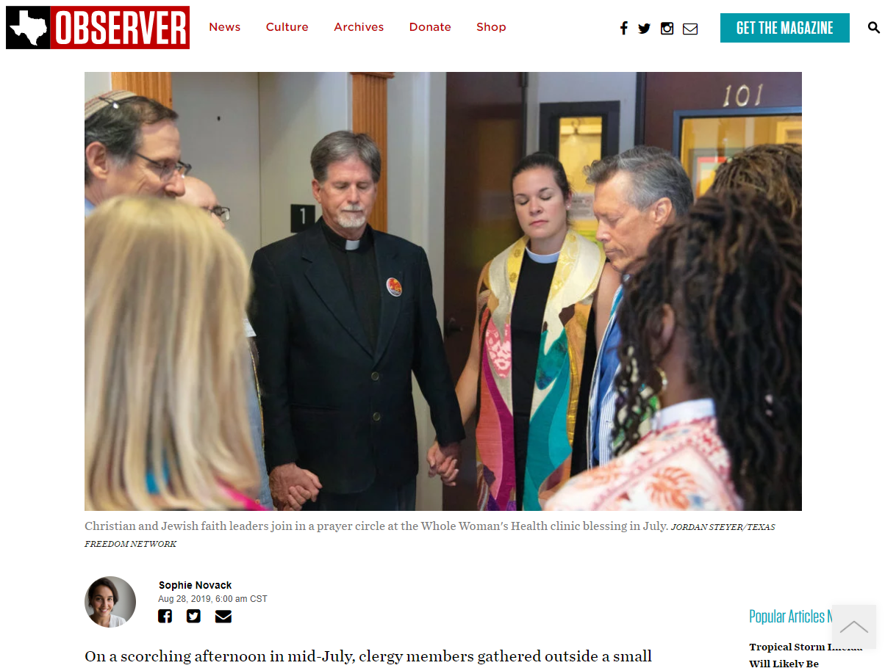
Sophie Novak, ‘My Congregation Trusts Women’: Progressive Faith Groups Counter Anti-Abortion Narratives, Texas Observer, August 28, 2019, https://www.texasobserver.org/my-congregation-trusts-women-progressive-faith-groups-counter-anti-abortion-narratives/, accessed Feb 12, 2022.

Slide 39
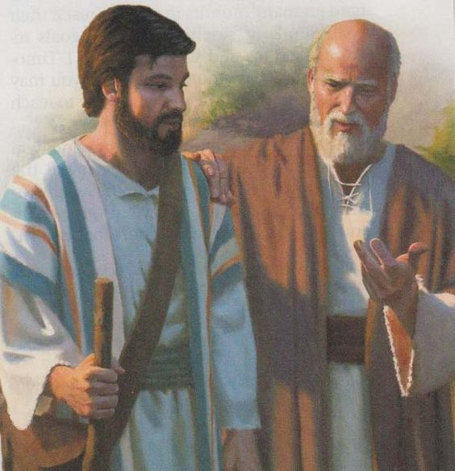
2 Timothy 3:14-15
“You, however, continue in the things you have learned and become convinced of, knowing from whom you have learned them, and that from childhood you have known the sacred writings which are able to give you the wisdom that leads to salvation through faith which is in Christ Jesus.”

Slide 40
The Proper View of Scripture
Is to believe that…
All Scripture is God’s Word
Scripture was written by men yet inspired by God
Scripture is inerrant
Scripture is historically accurate
Scripture is the highest authority
Scripture points to Jesus
Scripture is enough
Scripture will endure forever
Scripture is your sustenance

Slide 41
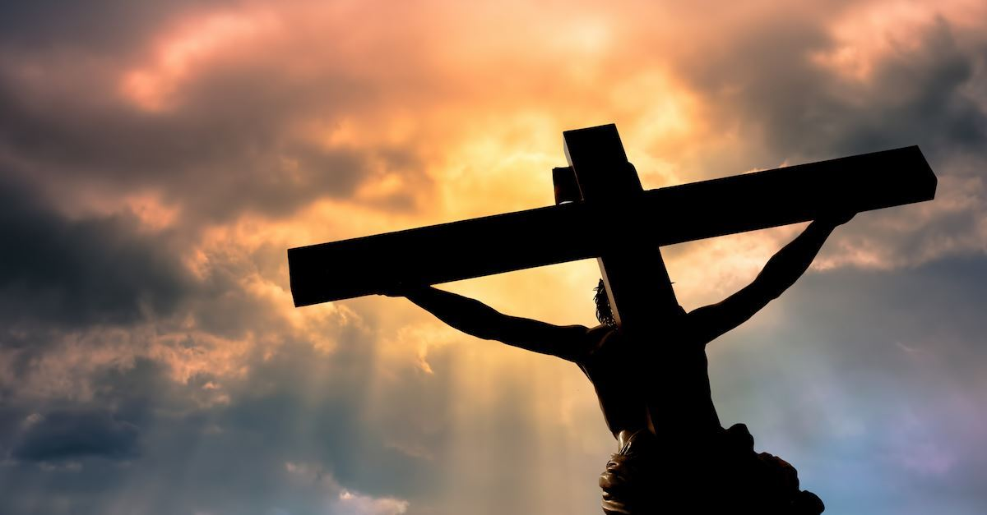

Slide 42
The Proper View of Scripture
Is to believe that…
All Scripture is God’s Word
Scripture was written by men yet inspired by God
Scripture is inerrant
Scripture is historically accurate
Scripture is the highest authority
Scripture points to Jesus
Scripture is enough
Scripture will endure forever
Scripture is your sustenance

Slide 43
“But it is easier for heaven and earth to pass away than for one stroke of a letter of the Law to fail.” Luke 16:17

Slide 44
“For truly I say to you, until heaven and earth pass away, not the smallest letter or stroke shall pass from the Law until all is accomplished.” Matthew 5:18

Slide 45
The Proper View of Scripture
Is to believe that…
All Scripture is God’s Word
Scripture was written by men yet inspired by God
Scripture is inerrant
Scripture is historically accurate
Scripture is the highest authority
Scripture points to Jesus
Scripture is enough
Scripture will endure forever
Scripture is your sustenance

Slide 46
Psalm 119:1, 9
1 “How blessed are those whose way is blameless, who walk in the law of the Lord.”
9 “How can a young man keep his way pure? By keeping it according to Your word.”
11 “Your word I have treasured in my heart, That I may not sin against You.”

Slide 48
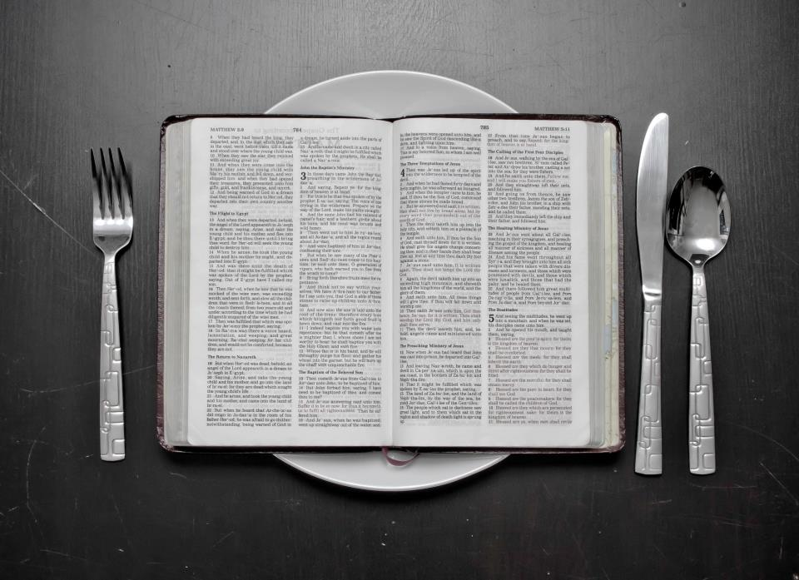
“Man shall not live on bread alone, but on every word that proceeds out of the mouth of God.” -Jesus (Matt 4:4)

Slide 49
The Proper View of Scripture
Is to believe that…
All Scripture is God’s Word
Scripture was written by men yet inspired by God
Scripture is inerrant
Scripture is historically accurate
Scripture is the highest authority
Scripture points to Jesus
Scripture is enough
Scripture will endure forever
Scripture is your sustenance

Slide 50
The Proper View of Scripture

