Slide 1

Ezekiel 36‒39
The Middle East Meltdown 2022
Dr. Andy Woods
Senior Pastor – Sugar Land Bible Church
President – Chafer Theological Seminary

Slide 2
Ezekiel 33‒48
Ezekiel recommissioned (33)
False shepherds removed (34)
Edom destroyed (35)
Israel’s restoration: physical & spiritual (36)
Israel’s restoration illustrated (37)
Means of restoration: Northern invasion (38)
Results of the Northern invasion: conversion (39)
Millennial Temple (40‒46)
Tribal land allotment (47‒48)

Slide 3
Ezekiel 36
Israel to prosper again (1-15)
Israel’s sins inhibiting prosperity (16-21)
Israel to be restored: physically & spiritually (22-38)

Slide 4
Ezekiel 33‒48
Ezekiel recommissioned (33)
False shepherds removed (34)
Edom destroyed (35)
Israel’s restoration: physical & spiritual (36)
Israel’s restoration illustrated (37)
Means of restoration: Northern invasion (38)
Results of the Northern invasion: conversion (39)
Millennial Temple (40‒46)
Tribal land allotment (47‒48)

Slide 5
Ezekiel 37
Vision: Valley of the Dry Bones (1-14)
  Vision (1-10)
  Interpretation (11-14)
Sign: Two Sticks (15-28)
  Sign (15-17)
  Interpretation (18-28)

Slide 6
Ezekiel 37
Vision: Valley of the Dry Bones (1-14)
  Vision (1-10)
  Interpretation (11-14)
Sign: Two Sticks (15-28)
  Sign (15-17)
  Interpretation (18-28)

Slide 7
Ezekiel 37
Vision: Valley of the Dry Bones (1-14)
  Vision (1-10)
  Interpretation (11-14)
Sign: Two Sticks (15-28)
  Sign (15-17)
  Interpretation (18-28)

Slide 8

Ezekiel 36:24-28
²⁴ “For I will take you from the nations, gather you from all the lands and bring you into your own land. ²⁵ Then I will sprinkle clean water on you, and you will be clean; I will cleanse you from all your filthiness and from all your idols. ²⁶ Moreover, I will give you a new heart and put a new spirit within you; and I will remove the heart of stone from your flesh and give you a heart of flesh. ²⁷ I will put My Spirit within you and cause you to walk in My statutes, and you will be careful to observe My ordinances. ²⁸ You will live in the land that I gave to your forefathers; so you will be My people, and I will be your God.”

Slide 9
ISRAEL’S TWO REGATHERINGS
THE PRESENT (FIRST) REGATHERING | THE PERMANENT (SECOND) REGATHERING
Return to part of the land | Return to all the land
Return in unbelief | Return in faith
Restored to the land only | Restored to the land and the Lord
Sets the stage for Tribulation (discipline) | Sets the stage for Millennium (blessing)
Adapted from: Price, Jerusalem In Prophecy, 219

Slide 10

Charles L. Feinberg
The Prophecy of Ezekiel: The Glory of the Lord, Paperback ed. (Chicago: Moody, 1969; reprint, Chicago: Moody, 1984), 213-14.
“Apparently the reference to the absence of breath in the bodies indicated that when Israel will be returned to the land in the latter days, they will be unconverted. Surely the general tenor of the prophetic Scriptures points in this direction (See Zech. 13:8-9). Otherwise, it is difficult to see how a covenant could be made nationally with such a godless one as the Roman prince of the end times (cf. Dan. 9:27).”

Slide 11

Daniel 9:27
And he will make a firm covenant with the many for one week, but in the middle of the week he will put a stop to sacrifice and grain offering; and on the wing of abominations will come one who makes desolate, even until a complete destruction, one that is decreed, is poured out on the one who makes desolate.

Slide 12


Slide 13

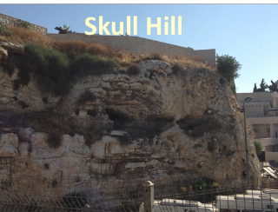
Revelation 11:8
“And their dead bodies will lie in the street of the great city which mystically is called Sodom and Egypt, where also their Lord was crucified.”

Slide 14
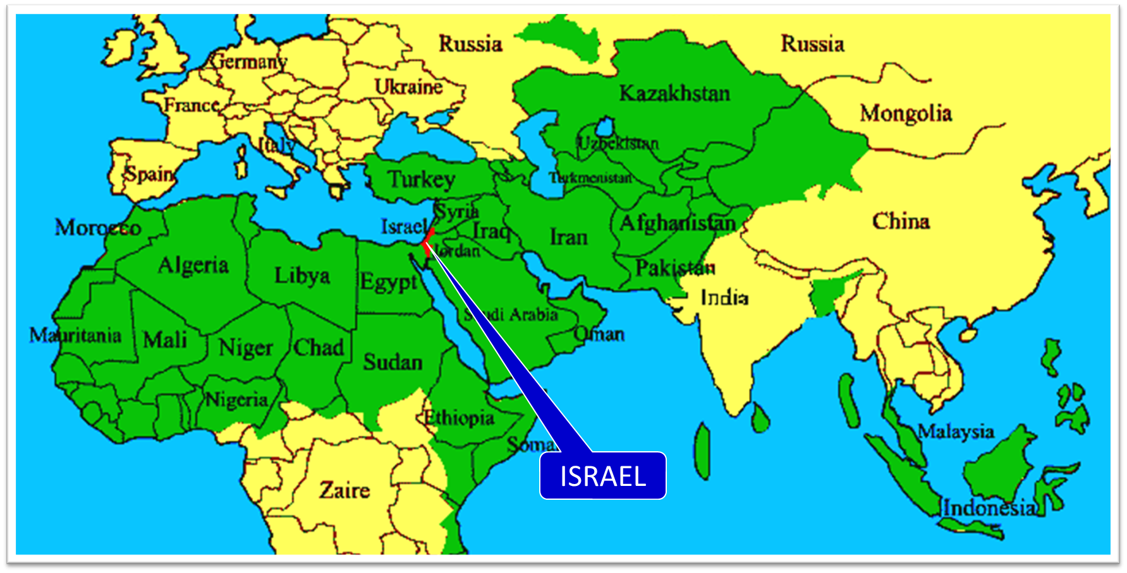

Slide 15
Ezekiel 37
Vision: Valley of the Dry Bones (1-14)
  Vision (1-10)
  Interpretation (11-14)
Sign: Two Sticks (15-28)
  Sign (15-17)
  Interpretation (18-28)

Slide 16
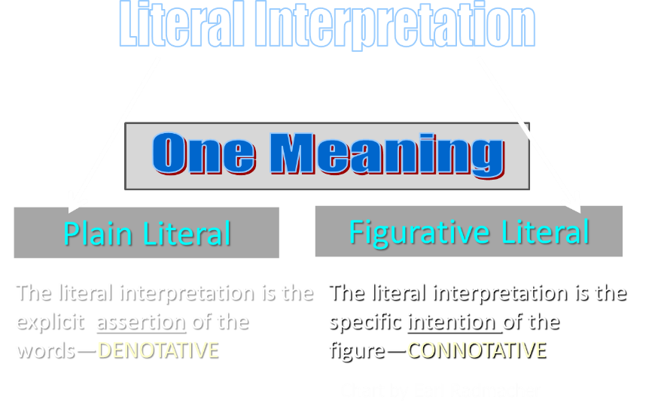

Slide 17
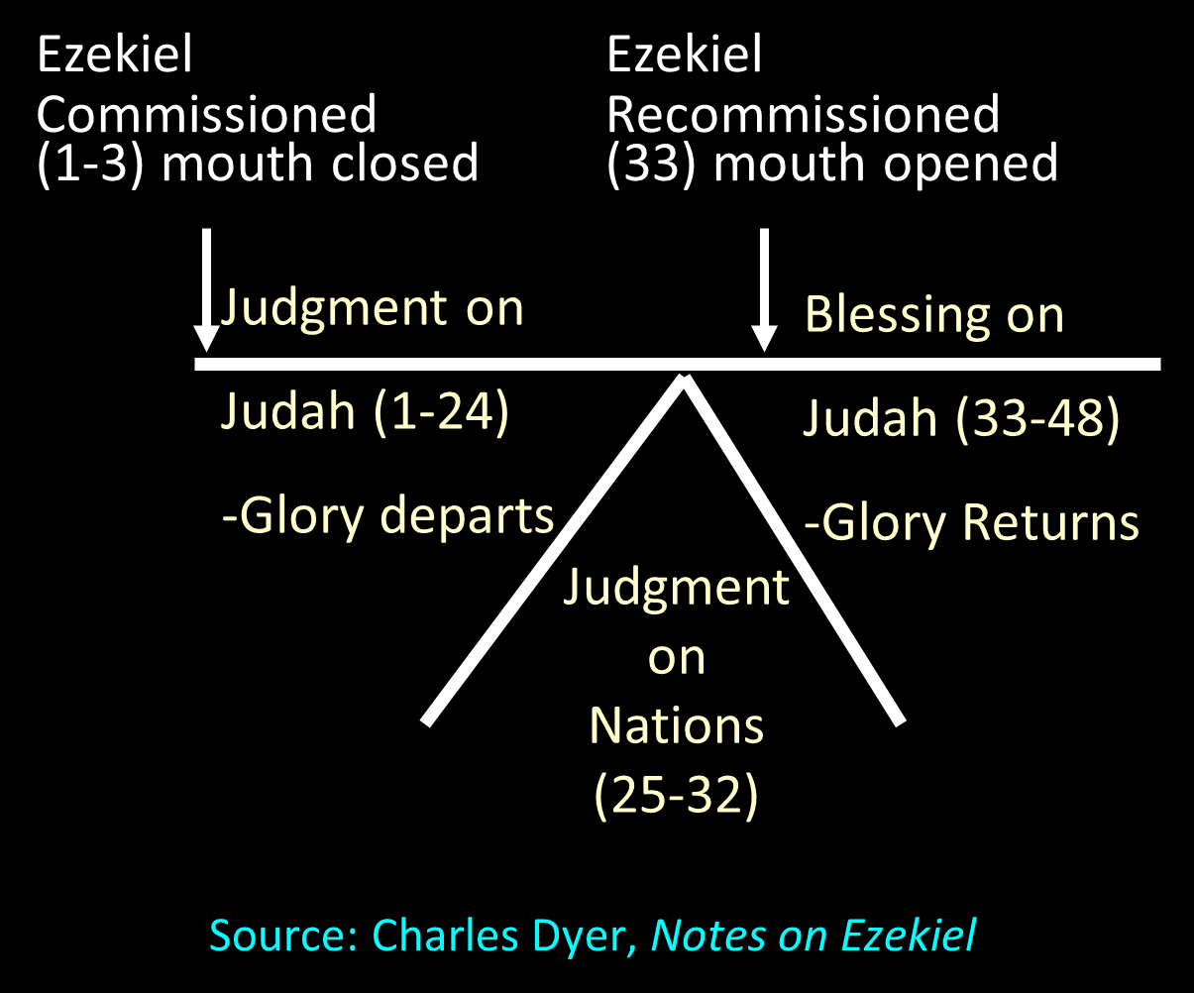

Slide 18
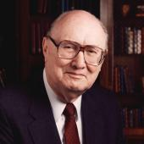
Two Rules of Interpretation
Search the immediate context
  Walvoord: 26X
Search the remote context
  Old Testament
  Thomas: 278 / 404 verses

Slide 19

Ezekiel 37:7-11
⁷ So I prophesied as I was commanded; and as I prophesied, there was a noise, and behold, a rattling; and the bones came together, bone to its bone. ⁸ And I looked, and behold, sinews were on them, and flesh grew and skin covered them; but there was no breath in them. ⁹ Then He said to me, “Prophesy to the breath, prophesy, son of man, and say to the breath, ‘Thus says the Lord God, “Come from the four winds, O breath, and breathe on these slain, that they come to life.”’” ¹⁰ So I prophesied as He . . .

Slide 20
Ezekiel 37:7-11
. . .commanded me, and the breath came into them, and they came to life and stood on their feet, an exceedingly great army. ¹¹ Then He said to me, “Son of man, these bones are the whole house of Israel; behold, they say, ‘Our bones are dried up and our hope has perished. We are completely cut off’.”

Slide 21


Matthew 16:18
I also say to you that you are Peter, and upon this rock I will build [oikodomeō] My church; and the gates of Hades will not overpower it.

Slide 22

Arnold Fruchtenbaum
Arnold G. Fruchtenbaum, “Israel and the Church,” in Issues in Dispensationalism, ed. Wesley R. Willis and John R. Master (Chicago: Moody, 1994), 118.
“In the book of Acts, both Israel and the church exist simultaneously. The term Israel is used twenty times and ekklēsia (church) nineteen times, yet the two groups are always kept distinct.”

Slide 23


Slide 24
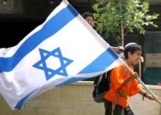
Charles L. Feinberg
The Prophecy of Ezekiel: The Glory of the Lord, Paperback ed. (Chicago: Moody, 1969; reprint, Chicago: Moody, 1984), 209.
“In addition to the gift of the responsive heart the Lord will grant the gift of his Holy Spirit to willing ones in Israel. This is the coming of the Holy Spirit upon Israel in the future, not that at Pentecost.”

Slide 25
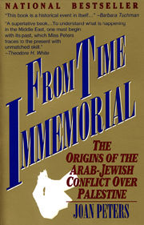
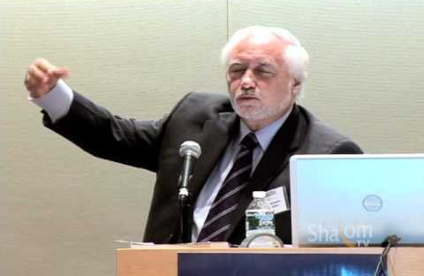

Slide 26

John 13:19; 14:29
“^{13:19} From now on I am telling you before it comes to pass, so that when it does occur, you may believe that I am He… ^{14:29} Now I have told you before it happens, so that when it happens, you may believe.”

Slide 27
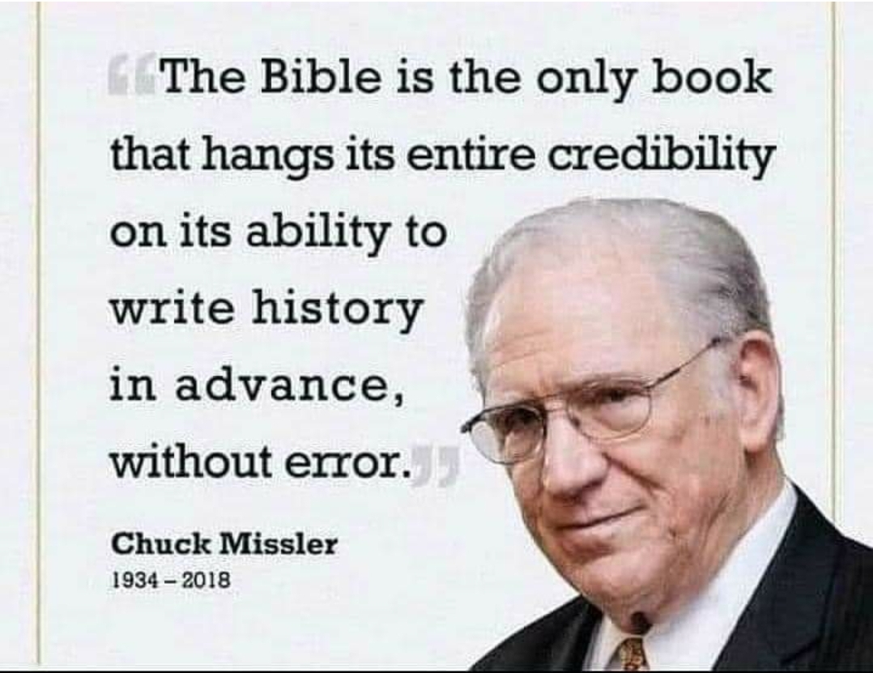

Slide 28
Ezekiel 37
Vision: Valley of the Dry Bones (1-14)
  Vision (1-10)
  Interpretation (11-14)
Sign: Two Sticks (15-28)
  Sign (15-17)
  Interpretation (18-28)

Slide 29
Ezekiel 37
Vision: Valley of the Dry Bones (1-14)
  Vision (1-10)
  Interpretation (11-14)
Sign: Two Sticks (15-28)
  Sign (15-17)
  Interpretation (18-28)

Slide 30
Six Parts of a Suzerain-Vassal Treaty in Deuteronomy
Preamble (1:1-5)
Prologue (1:6–4:40)
Covenant obligations (5–26)
Storage and reading instructions (27:2-3; 31:9, 24, 26)
Witnesses (32:1)
Blessings and curses (28)

Slide 31
Israel's Judgments
Division of the kingdom in 931 B.C. (1 Kgs. 12)
Assyrian judgment in 722 B.C. (2 Kgs. 17)
Babylonian captivity in 586 B.C. (2 Kgs. 25)
Rome Diaspora in A.D. 70 (Luke 19:41-44)

Slide 32
Israel's Judgments
Division of the kingdom in 931 B.C. (1 Kgs. 12)
Assyrian judgment in 722 B.C. (2 Kgs. 17)
Babylonian captivity in 586 B.C. (2 Kgs. 25)
Rome Diaspora in A.D. 70 (Luke 19:41-44)

Slide 33
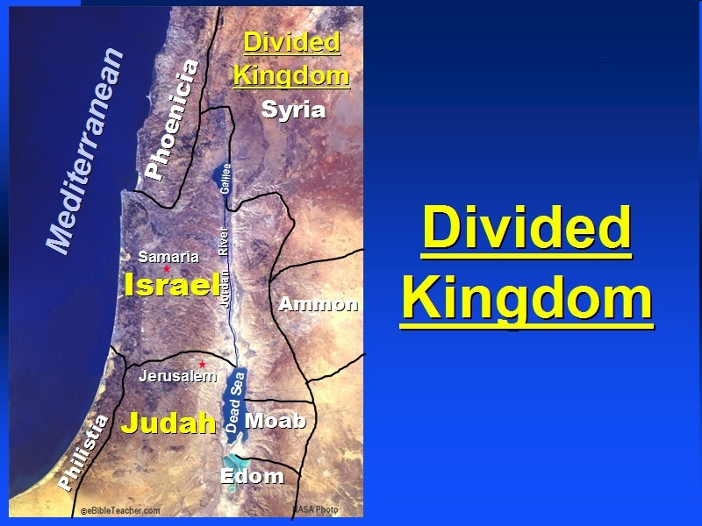

Slide 34

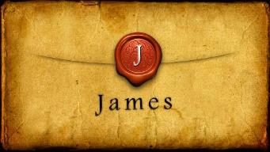
James 1:1
“James, a bond-servant of God and of the Lord Jesus Christ, To the twelve tribes who are dispersed abroad: Greetings.”

Slide 35
Distinctions Between 144,000 & Multitude
144,000 | MULTITUDE
Revelation 7:1-8 | Revelation 7:9-17
Numbered | Innumerable
Jews | All nations
Sealed | Slain
Sealed before the Tribulation | Converted out of the Tribulation
Hitchcock and Ice, The Truth Behind Left Behind, 77

Slide 36
Ezekiel 37
Vision: Valley of the Dry Bones (1-14)
  Vision (1-10)
  Interpretation (11-14)
Sign: Two Sticks (15-28)
  Sign (15-17)
  Interpretation (18-28)

Slide 38
Israel's Judgments
Division of the kingdom in 931 B.C. (1 Kgs. 12)
Assyrian judgment in 722 B.C. (2 Kgs. 17)
Babylonian captivity in 586 B.C. (2 Kgs. 25)
Rome Diaspora in A.D. 70 (Luke 19:41-44)

Slide 40
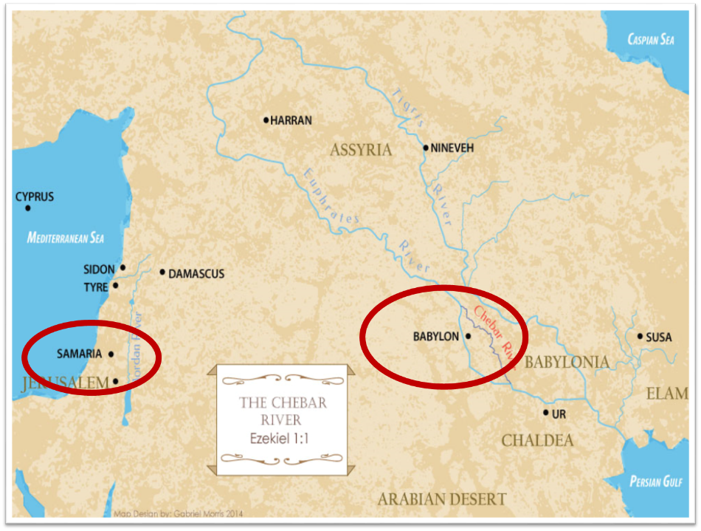

Slide 41
Charles L. Feinberg
The Prophecy of Ezekiel: The Glory of the Lord, Paperback ed. (Chicago: Moody, 1969; reprint, Chicago: Moody, 1984), 207.
“These prophecies, especially those in verses 12-15, could not have been fulfilled in the return from Babylon…Thus many take the primary reference to the return from Babylon. But the predictions will not be completely fulfilled until the future restoration, of which the return from Babylon was a foreshadowing.”

Slide 42
The Millennial David
Hosea 3:5; Jer. 30:9; Ezek. 34:23; 37:24
Root of Jesse
Branch of David
Son of David
Seed of David

Slide 44
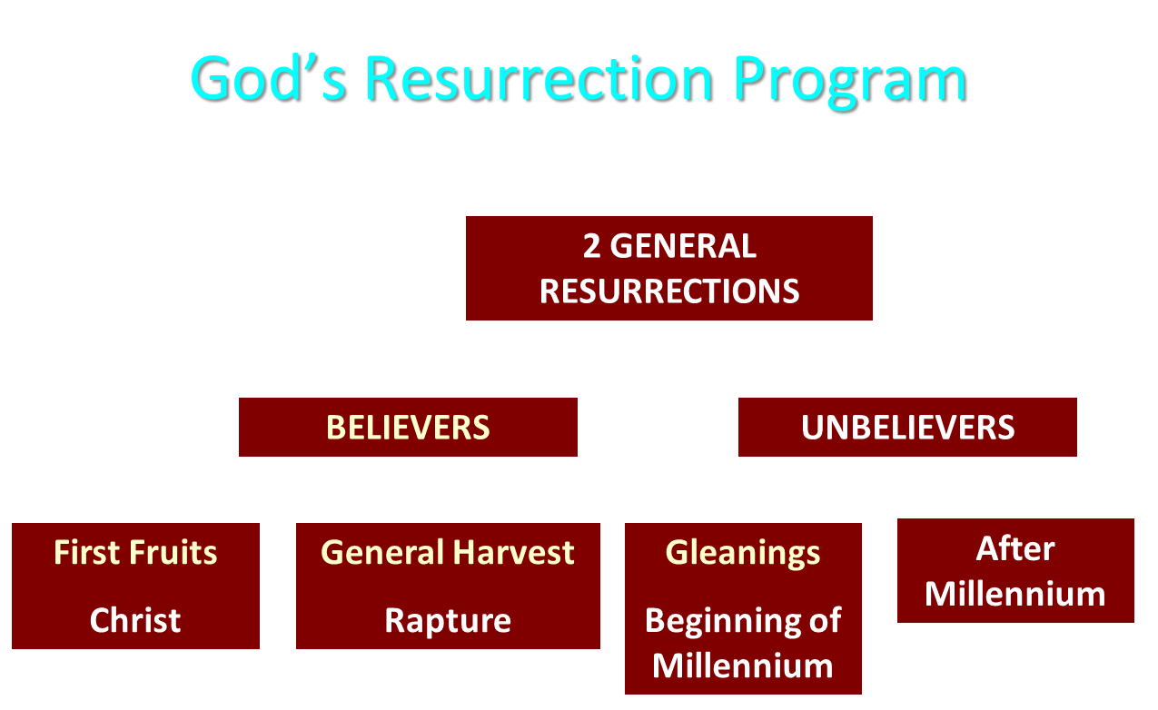

Slide 45
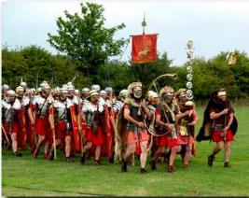
Order or Tagma (1 Cor. 15:23)
General: Christ’s resurrection (1 Cor 15:23)
Officer: Rapture (1 Thess 4:13-18)
Soldiers: OT saints & Tribulation martyrs (Rev 20:4)
Captives: Unsaved of all ages (Rev 20:5)

Slide 46


Slide 47


Slide 48


Slide 49
Charles L. Feinberg
The Prophecy of Ezekiel: The Glory of the Lord, Paperback ed. (Chicago: Moody, 1969; reprint, Chicago: Moody, 1984), 216.
“Many have denied that this refers to a physical building in sanctuary, but this seems pointless in view of the last nine chapters of the book, which are treated at length. Just as it pleases God to dwell in a tabernacle when Israel departed from Egypt, so He will tabernacle among them in their converted condition (cf. Exodus 25:8).”

Slide 50
ISRAEL’S FOUR TEMPLES
Solomon’s pre-exilic temple (Kings and Chronicles)
Zerubbabel’s post exilic temple (Ezra 1-6; John 2:20)
Antichrist's temple (Dan. 9:27; Matt. 24:15; 2 Thess. 2:4; Rev. 11:1-2)
Millennial temple (Ezek. 40-48)

Slide 51
ISRAEL’S FOUR TEMPLES
Solomon’s pre-exilic temple (Kings and Chronicles)
Zerubbabel’s post exilic temple (Ezra 1-6; John 2:20)
Antichrist's temple (Dan. 9:27; Matt. 24:15; 2 Thess. 2:4; Rev. 11:1-2)
Millennial temple (Ezek. 40-48)

Slide 52


Slide 53


Slide 56
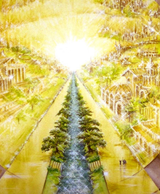
Eternal State is Future
No Satan (Rev 20:10)
No sea (Rev 21:1)
No death, crying, or pain (Rev 21:4)
No Sun (Rev 22:5)
No Moon (Rev 21:23)
No temple (Rev. 21:22)
No night (Rev 21:25)
No evil (Rev 21:27)
No curse (Rev 22:3)

Slide 57
Revelation 21:4 (NASB)
“and He will wipe away every tear from their eyes; and there will no longer be any death; there will no longer be any mourning, or crying, or pain; the first things have passed away.”

Slide 58
CONCLUSION

Slide 59
Ezekiel 37
Vision: Valley of the Dry Bones (1-14)
  Vision (1-10)
  Interpretation (11-14)
Sign: Two Sticks (15-28)
  Sign (15-17)
  Interpretation (18-28)

