Slide 1


Zechariah
God Remembers!

Slide 2

Structure
Introductory call to repentance (1:1-6)
Eight-night visions (1:7–6:15)
Question and answers about fasting (7–8)
Two burdens (9–14)

Slide 3
ZECHARIAH’S EIGHT NIGHT VISIONS
Vision | Reference | Meaning
The Red-horse Rider among the Myrtles | 1:7-17 | God’s anger against the nations & blessing on restored Israel.
The Four Horns & the Four Craftsmen | 1:18-21 | God’s judgment on the nations that afflict Israel.
The Surveyor with a Measuring Line | Chapter 2 | God’s future blessing on restored Israel.
The Cleansing & Crowning of Joshua the Hight Priest. | Chapter 3 | Israel’s future cleansing from sin & reinstatement as a priestly nation.
The Golden Lampstand & the Two Olive Trees | Chapter 4 | Israel as the light to the nations under Messiah, the King-Priest.
The Flying Scroll | 5:1-4 | The severity & totality of divine judgment on individual Israelites.
The Woman in the Ephah | 5:5-11 | The removal of national Israel’s sin of rebellion against God.
The Four Chariots | 6:1-8 | Divine judgment on Gentile nations.

Slide 4
II. Eight Night Visions
(1:7‒6:15)
  Riders & horses among the myrtle trees (1:7-17)
  Four horns & four craftsmen (1:18-21)
  Man with the measuring line (2)
  Cleansing of the High Priest Joshua (3)
  Lampstand & olive tree (4)
  Flying scroll (5:1-4)
  Woman in the basket (5:5-11)
  Four chariots (6:1-8)
  Conclusion: crowning of Joshua (6:9-15)

Slide 5
Structure
Introductory call to repentance (1:1-6)
Eight-night visions (1:7–6:15)
Question and answers about fasting (7–8)
Two burdens (9–14)

Slide 6

III. Questions & Answers Concerning Fasting
(7‒8)
  Question (7:1-3)
  Four divine answers (7:4‒8:23)
    Condemnation of empty ritualism (7:4-7)
    Condemnation of past covenant failure (7:8-14)
    Prediction of Jerusalem’s restoration (8:1-17)
    Prediction of future blessing (8:18-23)

Slide 7
III. Questions & Answers Concerning Fasting
(7‒8)
  Question (7:1-3)
  Four divine answers (7:4‒8:23)
    Condemnation of empty ritualism (7:4-7)
    Condemnation of past covenant failure (7:8-14)
    Prediction of Jerusalem’s restoration (8:1-17)
    Prediction of future blessing (8:18-23)

Slide 8
Question
(7:1-3)
    Date (1)
    Questioner (2)
    Question (3)

Slide 9
III. Questions & Answers Concerning Fasting
(7‒8)
  Question (7:1-3)
  Four divine answers (7:4‒8:23)
    Condemnation of empty ritualism (7:4-7)
    Condemnation of past covenant failure (7:8-14)
    Prediction of Jerusalem’s restoration (8:1-17)
    Prediction of future blessing (8:18-23)

Slide 10
III. Questions & Answers Concerning Fasting
(7‒8)
  Question (7:1-3)
  Four divine answers (7:4‒8:23)
    Condemnation of empty ritualism (7:4-7)
    Condemnation of past covenant failure (7:8-14)
    Prediction of Jerusalem’s restoration (8:1-17)
    Prediction of future blessing (8:18-23)

Slide 11
Empty Ritualism
(7:4-7)
Israel’s insincerity (4-5)
Israel’s selfishness (6-7)

Slide 12
III. Questions & Answers Concerning Fasting
(7‒8)
  Question (7:1-3)
  Four divine answers (7:4‒8:23)
    Condemnation of empty ritualism (7:4-7)
    Condemnation of past covenant failure (7:8-14)
    Prediction of Jerusalem’s restoration (8:1-17)
    Prediction of future blessing (8:18-23)

Slide 13
Covenant Rebellion
(7:8-14)
Covenant requirements (8-10)
Covenant rebellion (11-12)
Covenant judgment (13-14)

Slide 14
Covenant Rebellion
(7:8-14)
Covenant requirements (8-10)
Covenant rebellion (11-12)
Covenant judgment (13-14)

Slide 15


Slide 16
Covenant Rebellion
(7:8-14)
Covenant requirements (8-10)
Covenant rebellion (11-12)
Covenant judgment (13-14)

Slide 17
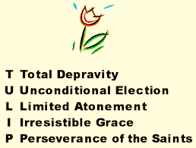
Running TULIP Through the Grid of Scripture
Total Depravity
Unconditional Election
Limited Atonement
Irresistible Grace
Perseverance of the Saints

Slide 18

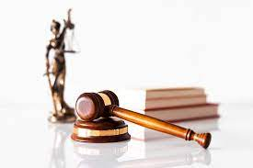
Hosea 4:1
“Listen to the word of the Lord, you sons of Israel, Because the Lord has a case against the inhabitants of the land, For there is no faithfulness, nor loyalty, Nor knowledge of God in the land.”

Slide 19
Micah 6:1-2
“¹ Hear now what the Lord is saying, “Arise, plead your case before the mountains, And let the hills hear your voice. ² Listen, you mountains, to the indictment by the Lord, And you enduring foundations of the earth, Because the Lord has a case against His people; And He will dispute with Israel.”

Slide 20
Joyce Baldwin
Baldwin, Joyce G. Haggai, Zechariah, Malachi: An Introduction and Commentary. Tyndale Old Testament Commentaries series. Leicester, Eng., and Downers Grove, Ill.: Inter-Varsity Press, 1972. p. 147.
“This remarkable doctrine of the Holy Spirit as mediator of God's word to the prophets, who were themselves its mediators, has no parallels in the prophetic books...Zechariah is the first to record this aspect of the doctrine of the Spirit.”

Slide 21
Six Parts of a Suzerain-Vassal Treaty in Deuteronomy
Preamble (1:1-5)
Prologue (1:6–4:40)
Covenant obligations (5–26)
Storage and reading instructions (27:2-3; 31:9, 24, 26)
Witnesses (32:1)
Blessings and curses (28)

Slide 22
Covenant Rebellion
(7:8-14)
Covenant requirements (8-10)
Covenant rebellion (11-12)
Covenant judgment (13-14)

Slide 23
Six Parts of a Suzerain-Vassal Treaty in Deuteronomy
Preamble (1:1-5)
Prologue (1:6–4:40)
Covenant obligations (5–26)
Storage and reading instructions (27:2-3; 31:9, 24, 26)
Witnesses (32:1)
Blessings and curses (28)

Slide 24
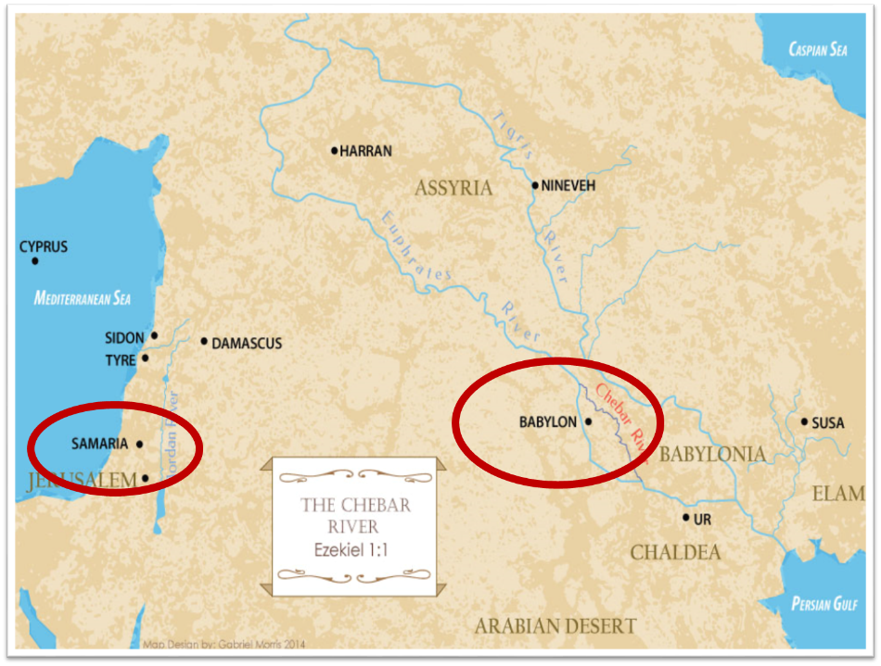

Slide 25

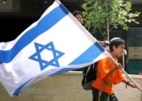
Charles L. Feinberg
The Prophecy of Ezekiel: The Glory of the Lord, Paperback ed. (Chicago: Moody, 1969; reprint, Chicago: Moody, 1984), 207.
“These prophecies, especially those in verses 12-15, could not have been fulfilled in the return from Babylon…Thus many take the primary reference to the return from Babylon. But the predictions will not be completely fulfilled until the future restoration, of which the return from Babylon was a foreshadowing.”

Slide 26
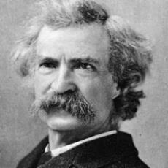
Mark Twain
The Innocents Abroad, Complete, 1st ed. (A Public Domain Book, 1869), 267, 285, 302. These quotes can be found in chapters 47, 49, 52.
“... A desolate country whose soil is rich enough, but is given over wholly to weeds… a silent mournful expanse…. a desolation is here that not even imagination can grace with the pomp of life and action…. we never saw a human being on the whole route…. there was hardly a tree or shrub anywhere. Even the olive tree and the cactus, those fast friends of a worthless soil, had almost deserted the country.” (cf. Zech. 7:14)

Slide 27
Conclusion

Slide 28
III. Questions & Answers Concerning Fasting
(7‒8)
  Question (7:1-3)
  Four divine answers (7:4‒8:23)
    Condemnation of empty ritualism (7:4-7)
    Condemnation of past covenant failure (7:8-14)
    Prediction of Jerusalem’s restoration (8:1-17)
    Prediction of future blessing (8:18-23)

Slide 29
Prediction of Jerusalem's Restoration
(8:1-17)
Prediction (1-8)
Application (9-17)

Slide 30
III. Questions & Answers Concerning Fasting
(7‒8)
  Question (7:1-3)
  Four divine answers (7:4‒8:23)
    Condemnation of empty ritualism (7:4-7)
    Condemnation of past covenant failure (7:8-14)
    Prediction of Jerusalem’s restoration (8:1-17)
    Prediction of future blessing (8:18-23)

