Slide 1

Ezekiel 36‒39
The Middle East Meltdown 2022
Dr. Andy Woods
Senior Pastor – Sugar Land Bible Church
President – Chafer Theological Seminary

Slide 2
Ezekiel 33‒48
Ezekiel recommissioned (33)
False shepherds removed (34)
Edom destroyed (35)
Israel’s restoration: physical & spiritual (36)
Israel’s restoration illustrated (37)
Means of restoration: Northern invasion (38)
Results of the Northern invasion: conversion (39)
Millennial Temple (40‒46)
Tribal land allotment (47‒48)

Slide 3
Ezekiel 36
Israel to prosper again (1-15)
Israel’s sins inhibiting prosperity (16-21)
Israel to be restored: physically & spiritually (22-38)

Slide 4
Ezekiel 36
Israel to prosper again (1-15)
Israel’s sins inhibiting prosperity (16-21)
Israel to be restored: physically & spiritually (22-38)

Slide 5
Ezekiel 36
Israel to prosper again (1-15)
Israel’s sins inhibiting prosperity (16-21)
Israel to be restored: physically & spiritually (22-38)

Slide 6
Ezekiel 36
Israel to prosper again (1-15)
Israel’s sins inhibiting prosperity (16-21)
Israel to be restored: physically & spiritually (22-38)

Slide 7
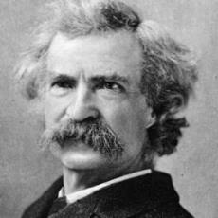
Mark Twain
The Innocents Abroad, Complete, 1st ed. (A Public Domain Book, 1869), 267, 285, 302. These quotes can be found in chapters 47, 49, 52.
“... A desolate country whose soil is rich enough, but is given over wholly to weeds… a silent mournful expanse…. a desolation is here that not even imagination can grace with the pomp of life and action…. we never saw a human being on the whole route…. there was hardly a tree or shrub anywhere. Even the olive tree and the cactus, those fast friends of a worthless soil, had almost deserted the country.”

Slide 8

Leviticus 26:43
“For the land will be abandoned by them, and will make up for its sabbaths while it is made desolate without them. They, meanwhile, will be making amends for their iniquity, because they rejected My ordinances and their soul abhorred My statutes.”

Slide 9
Ezekiel 38:8
“After many days you will be summoned; in the latter years you will come into the land that is restored from the sword, whose inhabitants have been gathered from many nations to the mountains of Israel which had been a continual waste; but its people were brought out from the nations, and they are living securely, all of them.”

Slide 10
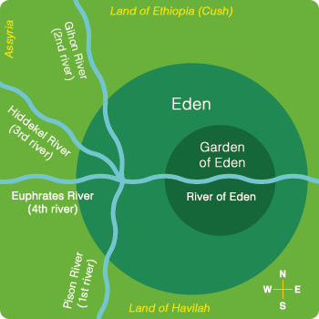

Slide 11

Divine Judgments
(3:14-19)
  Serpent (3:14-15)
  Woman (3:16)
  Man (3:17-19)

Slide 12
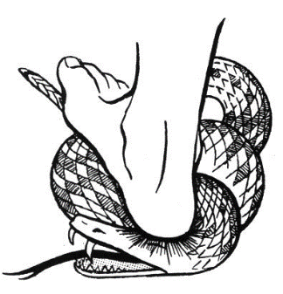
Serpent
(3:14-15)
  Serpent’s body (3:14)
  Protoevangelium (3:15)

Slide 13
Woman
(3:16)
  Painful child birth (3:16a)
  Relational conflict (3:16b)

Slide 14
Man
(3:17-19)
  Painful labor (3:17-19a)
  Death (3:19b)

Slide 15
Why?
COUNTRY | GROSS DOMESTIC PRODUCT
ISRAEL | $123 BILLION
Egypt | $81 billion
Syria | $26 billion
Lebanon | $21 billion
Jordan | $12 billion
Source: CIA World Fact Book, 2005

Slide 16


Slide 17
Levitical Feasts (23)
Feast | Season | Purpose | Type
Passover | Spring | Redemption | 1 Cor 5:7
Unleavened Bread | Spring | Separation | John 6:35
1st fruits | Spring | Praise | 1 Cor 15:20
Pentecost | Spring | Praise | Acts 2:1-4
Trumpets | Fall | New Year | Matt 24:31
Atonement | Fall | Lev 16 | Zech 12:10
Booths | Fall | Wilderness provision | Zech 14:16-18

Slide 18


Slide 19
Ezekiel 36
Israel to prosper again (1-15)
Israel’s sins inhibiting prosperity (16-21)
Israel to be restored: physically & spiritually (22-38)

Slide 20
Ezekiel 33‒48
Ezekiel recommissioned (33)
False shepherds removed (34)
Edom destroyed (35)
Israel’s restoration: physical & spiritual (36)
Israel’s restoration illustrated (37)
Means of restoration: Northern invasion (38)
Results of the Northern invasion: conversion (39)
Millennial Temple (40‒46)
Tribal land allotment (47‒48)

Slide 21
Ezekiel 37
Vision: Valley of the Dry Bones (1-14)
  Vision (1-10)
  Interpretation (11-14)
Sign: Two Sticks (15-28)
  Sign (15-17)
  Interpretation (18-28)

Slide 22
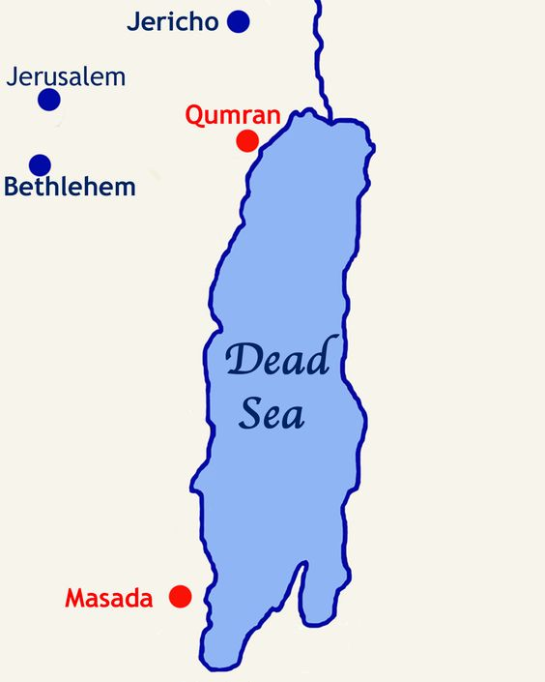

Slide 23
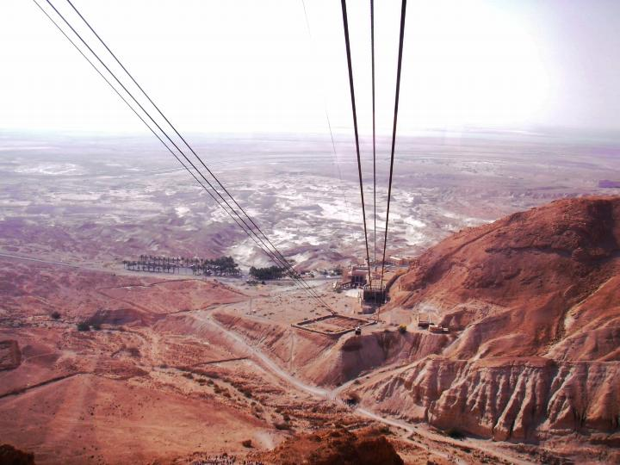

Slide 24
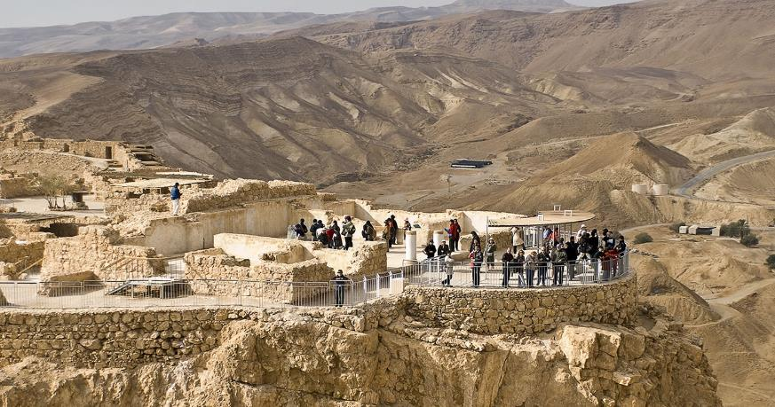
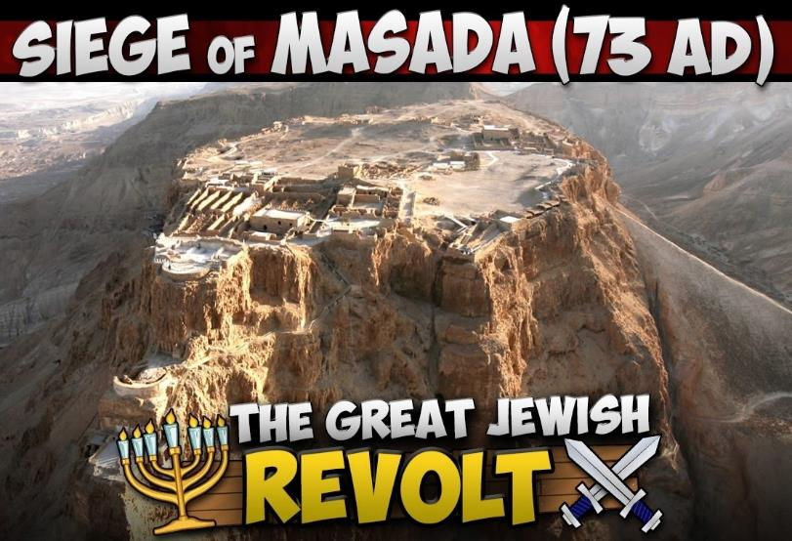
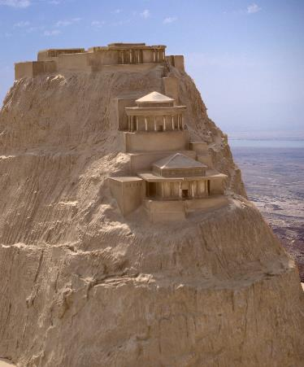
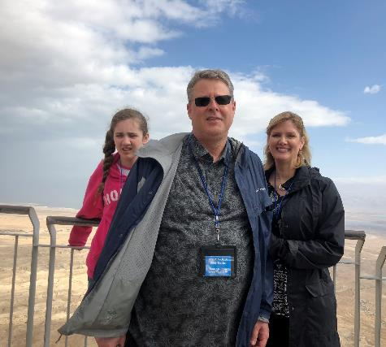

Slide 25
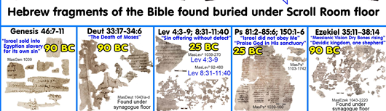
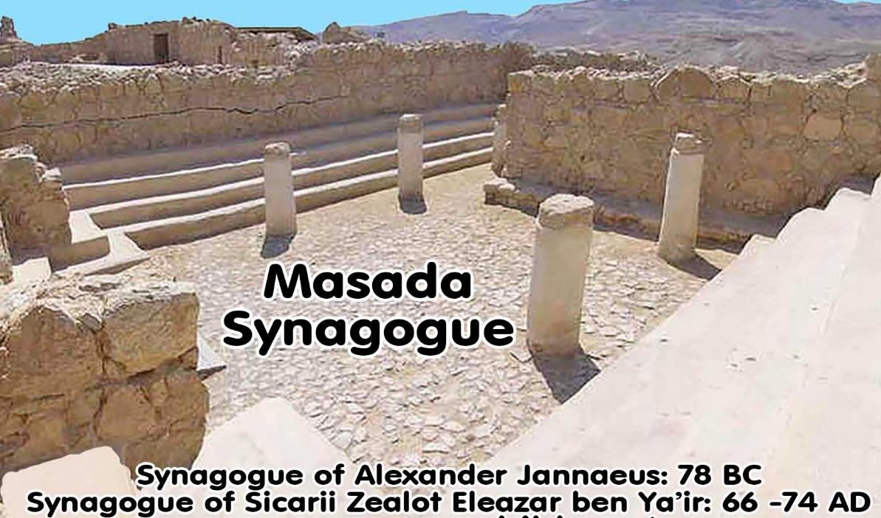

Slide 26
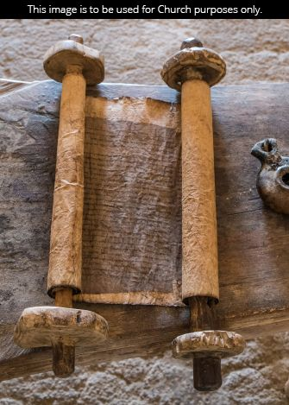
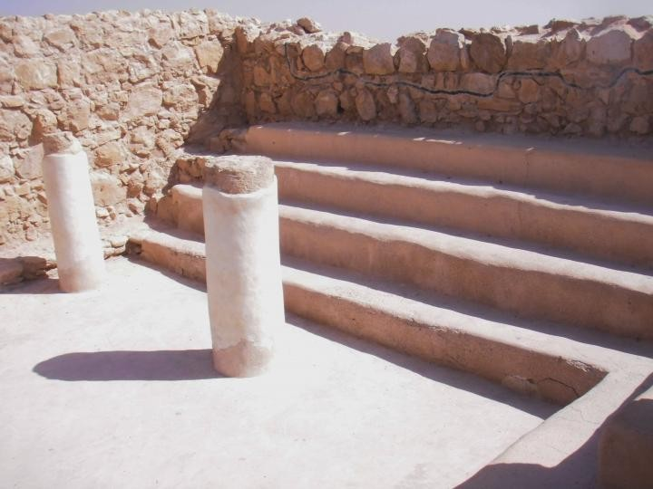
Masada

Slide 27
Ezekiel 37
Vision: Valley of the Dry Bones (1-14)
  Vision (1-10)
  Interpretation (11-14)
Sign: Two Sticks (15-28)
  Sign (15-17)
  Interpretation (18-28)

Slide 28
Ezekiel 37
Vision: Valley of the Dry Bones (1-14)
  Vision (1-10)
  Interpretation (11-14)
Sign: Two Sticks (15-28)
  Sign (15-17)
  Interpretation (18-28)

Slide 29

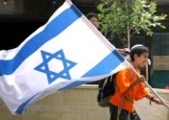
Charles L. Feinberg
The Prophecy of Ezekiel: The Glory of the Lord, Paperback ed. (Chicago: Moody, 1969; reprint, Chicago: Moody, 1984), 213.
“In order to emphasize the hopelessness of the situation from the human point of view, the Lord asked Ezekiel whether these bones could live. Ezekiel’s answer revealed that it would require a power beyond man’s to bring this about. It was an answer of reverence, not giving a positive or negative response.”

Slide 30

Revelation 7:13-14
¹³ . . .‘These who are clothed in the white robes, who are they, and where have they come from?’ ¹⁴ I said to him, ‘My lord, you know.’ And he said to me, ‘These are the ones who come out of the great tribulation [thlípsis], and they have washed their robes and made them white in the blood of the Lamb.’”

Slide 31


John 13:19; 14:29
“^{13:19} From now on I am telling you before it comes to pass, so that when it does occur, you may believe that I am He… ^{14:29} Now I have told you before it happens, so that when it happens, you may believe.”

Slide 32

Ezekiel 37:7-11
⁷ So I prophesied as I was commanded; and as I prophesied, there was a noise, and behold, a rattling; and the bones came together, bone to its bone. ⁸ And I looked, and behold, sinews were on them, and flesh grew and skin covered them; but there was no breath in them. ⁹ Then He said to me, “Prophesy to the breath, prophesy, son of man, and say to the breath, ‘Thus says the Lord God, “Come from the four winds, O breath, and breathe on these slain, that they come to life.”’” ¹⁰ So I prophesied as He . . .

Slide 33

Zechariah 12:3
“It will come about in that day that I will make Jerusalem a heavy stone for all the peoples; all who lift it will be severely injured. And all the nations of the earth will be gathered against it.”

Slide 34
Zechariah 14:2
“For I will gather all the nations against Jerusalem to battle, and the city will be captured, the houses plundered, the women ravished and half of the city exiled, but the rest of the people will not be cut off from the city.”

Slide 35
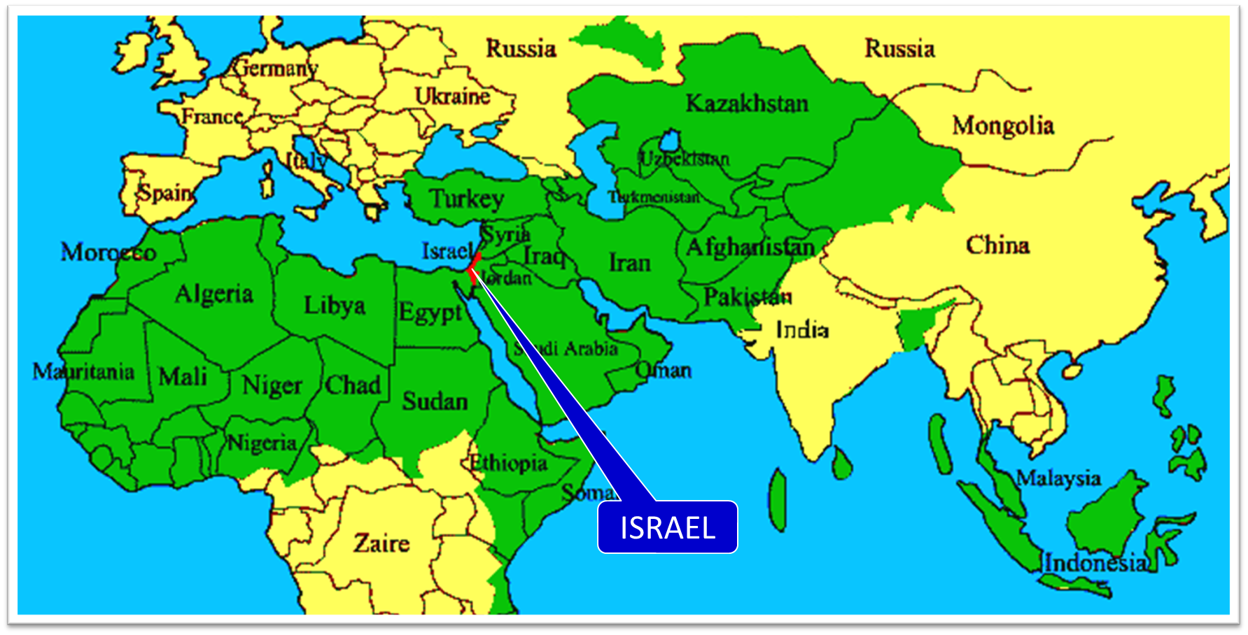

Slide 36

Ezekiel 36:24-28
²⁴ “For I will take you from the nations, gather you from all the lands and bring you into your own land. ²⁵ Then I will sprinkle clean water on you, and you will be clean; I will cleanse you from all your filthiness and from all your idols. ²⁶ Moreover, I will give you a new heart and put a new spirit within you; and I will remove the heart of stone from your flesh and give you a heart of flesh. ²⁷ I will put My Spirit within you and cause you to walk in My statutes, and you will be careful to observe My ordinances. ²⁸ You will live in the land that I gave to your forefathers; so you will be My people, and I will be your God.”

Slide 37
ISRAEL’S TWO REGATHERINGS
THE PRESENT (FIRST) REGATHERING | THE PERMANENT (SECOND) REGATHERING
Return to part of the land | Return to all the land
Return in unbelief | Return in faith
Restored to the land only | Restored to the land and the Lord
Sets the stage for Tribulation (discipline) | Sets the stage for Millennium (blessing)
Adapted from: Price, Jerusalem In Prophecy, 219

Slide 38
Charles L. Feinberg
The Prophecy of Ezekiel: The Glory of the Lord, Paperback ed. (Chicago: Moody, 1969; reprint, Chicago: Moody, 1984), 213-14.
“Apparently the reference to the absence of breath in the bodies indicated that when Israel will be returned to the land in the latter days, they will be unconverted. Surely the general tenor of the prophetic Scriptures points in this direction (See Zech. 13:8-9). Otherwise, it is difficult to see how a covenant could be made nationally with such a godless one as the Roman prince of the end times (cf. Dan. 9:27).”

Slide 39

Daniel 9:27
And he will make a firm covenant with the many for one week, but in the middle of the week he will put a stop to sacrifice and grain offering; and on the wing of abominations will come one who makes desolate, even until a complete destruction, one that is decreed, is poured out on the one who makes desolate.

Slide 40


Slide 41
Ezekiel 37
Vision: Valley of the Dry Bones (1-14)
  Vision (1-10)
  Interpretation (11-14)
Sign: Two Sticks (15-28)
  Sign (15-17)
  Interpretation (18-28)

Slide 42
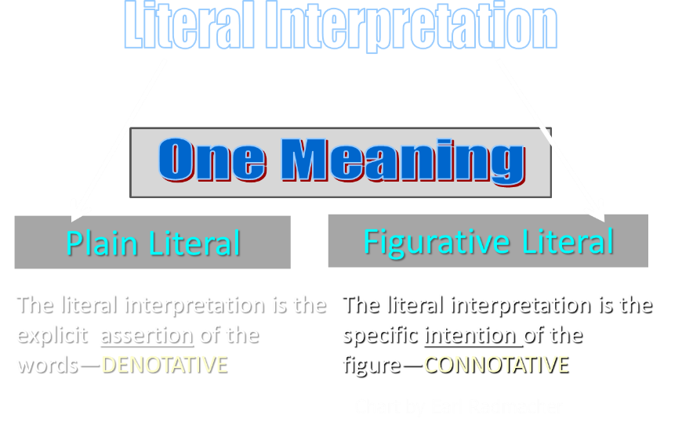

Slide 43
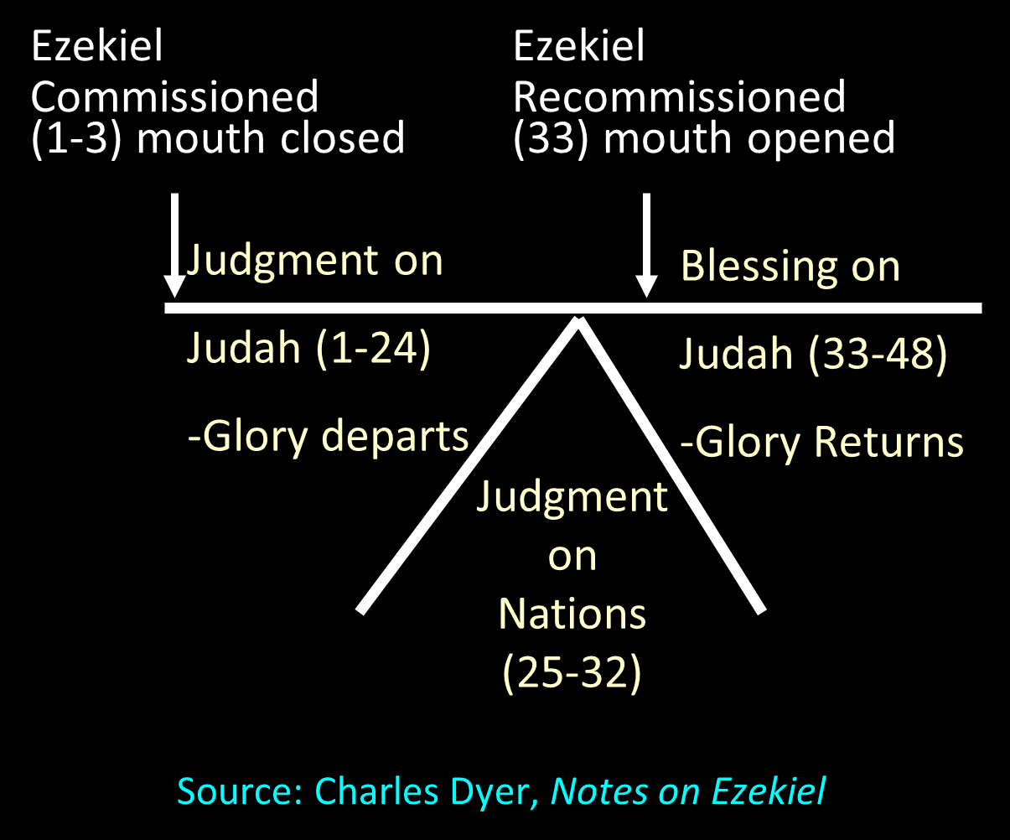

Slide 44
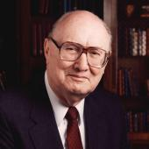
Two Rules of Interpretation
Search the immediate context
  Walvoord: 26X
Search the remote context
  Old Testament
  Thomas: 278 / 404 verses

Slide 45
Ezekiel 37:7-11
⁷ So I prophesied as I was commanded; and as I prophesied, there was a noise, and behold, a rattling; and the bones came together, bone to its bone. ⁸ And I looked, and behold, sinews were on them, and flesh grew and skin covered them; but there was no breath in them. ⁹ Then He said to me, “Prophesy to the breath, prophesy, son of man, and say to the breath, ‘Thus says the Lord God, “Come from the four winds, O breath, and breathe on these slain, that they come to life.”’” ¹⁰ So I prophesied as He . . .

Slide 46
Ezekiel 37:7-11
. . .commanded me, and the breath came into them, and they came to life and stood on their feet, an exceedingly great army. ¹¹ Then He said to me, “Son of man, these bones are the whole house of Israel; behold, they say, ‘Our bones are dried up and our hope has perished. We are completely cut off’.”

Slide 47

Arnold Fruchtenbaum
Arnold G. Fruchtenbaum, “Israel and the Church,” in Issues in Dispensationalism, ed. Wesley R. Willis and John R. Master (Chicago: Moody, 1994), 118.
“In the book of Acts, both Israel and the church exist simultaneously. The term Israel is used twenty times and ekklēsia (church) nineteen times, yet the two groups are always kept distinct.”

Slide 49
Charles L. Feinberg
The Prophecy of Ezekiel: The Glory of the Lord, Paperback ed. (Chicago: Moody, 1969; reprint, Chicago: Moody, 1984), 209.
“In addition to the gift of the responsive heart the Lord will grant the gift of his Holy Spirit to willing ones in Israel. This is the coming of the Holy Spirit upon Israel in the future, not that at Pentecost.”

Slide 50
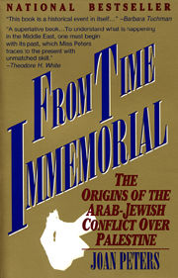
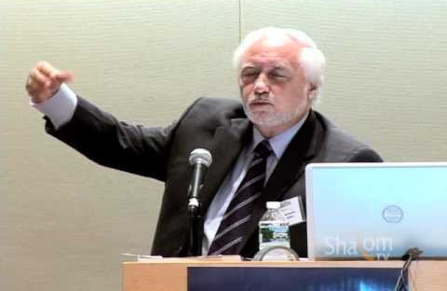

Slide 51
John 13:19; 14:29
“^{13:19} From now on I am telling you before it comes to pass, so that when it does occur, you may believe that I am He… ^{14:29} Now I have told you before it happens, so that when it happens, you may believe.”

Slide 52
CONCLUSION

Slide 53
Ezekiel 37
Vision: Valley of the Dry Bones (1-14)
  Vision (1-10)
  Interpretation (11-14)
Sign: Two Sticks (15-28)
  Sign (15-17)
  Interpretation (18-28)

