Slide 1


Genesis 12‒50
Israel’s Birth & Preservation

Slide 2


GENESIS STRUCTURE
  Beginning of the Human race (Gen. 1‒11)
  Beginning of the Hebrew race (Gen. 12‒50)

Slide 3

GENESIS STRUCTURE
  Genesis 1-11 (four events)
    Creation (1-2)
    Fall (3-5)
    Flood (6-9)
    National dispersion (10-11)

Slide 4


Genesis 3:15
“And I will put enmity Between you and the woman, And between your seed and her seed; He shall bruise you on the head, And you shall bruise him on the heel.”

Slide 5
GENESIS STRUCTURE
  Beginning of the Human race (Gen. 1‒11)
  Beginning of the Hebrew race (Gen. 12‒50)

Slide 6

GENESIS STRUCTURE
  Genesis 12-50 (four people)
    Abraham (12:1–25:11)
    Isaac (25:12–26:35)
    Jacob (27–36)
    Joseph (37–50)

Slide 7


Isaiah 43:1
“But now, thus says the Lord, your Creator, O Jacob, And He who formed you, O Israel, 'Do not fear, for I have redeemed you; I have called you by name; you are Mine!'”

Slide 8
GENESIS STRUCTURE
  Genesis 12-50 (four people)
    Abraham (12:1–25:11)
    Isaac (25:12–26:35)
    Jacob (27–36)
    Joseph (37–50)

Slide 9
Genesis 12‒16
Abram’s Early Journeys
  Unconditional promises (Gen. 12:1-3)
  From Haran to Canaan (Gen. 12:4-5)
  In Canaan (Gen. 12:6-9)
  In Egypt (Gen. 12:10-20)
  Abram and Lot Separate (Gen. 13:1-13)
  Reaffirmation of Abram’s promises (Gen. 13:14-18)
  Abram Rescues Lot (14:1-24)
  Abrahamic Covenant (15:1-21)
  Hagar & Ishmael (16:1-16)
  Circumcision (Gen. 17:1-27)

Slide 10
Genesis 16:1‒16
Sarai and Hagar
    Sarai & Hagar (16:1-6)
    Angel of the Lord & Hagar (16:7-14)
    Ishmael’s Birth (16:15-16)

Slide 11
Genesis 16:1‒16
Sarai and Hagar
    Sarai & Hagar (16:1-6)
    Angel of the Lord & Hagar (16:7-14)
    Ishmael’s Birth (16:15-16)

Slide 12
Sarah & Hagar
Genesis 16:1-6
Circumstances (1) Proposal (2a) Acceptance (2b) Consummation (3) Conception (4a) | Change of attitude (4b) Conflict & complaint (5) Response (6a) Harsh treatment (6b) Flight (6c)

Slide 13
Genesis 16:1‒16
Sarai and Hagar
    Sarai & Hagar (16:1-6)
    Angel of the Lord & Hagar (16:7-14)
    Ishmael’s Birth (16:15-16)

Slide 14
Angel of the Lord & Hagar
Genesis 16:7-14
Angel of the Lord (7a) Location (7b) Questions (8a) Answer (8b) | Command (9) Prophecies (10-12) Response (13) Location (14)

Slide 15
Genesis 16:1‒16
Sarai and Hagar
    Sarai & Hagar (16:1-6)
    Angel of the Lord & Hagar (16:7-14)
    Ishmael’s Birth (16:15-16)

Slide 16
Ishmael’s Birth
Genesis 16:15-16
    Birth of a son (15a)
    Name: Ishmael (15b)
    Abram’s age (16)

Slide 17
Ishmael’s Birth
Genesis 16:15-16
    Birth of a son (15a)
    Name: Ishmael (15b)
    Abram’s age (16)

Slide 18
Ishmael’s Birth
Genesis 16:15-16
    Birth of a son (15a)
    Name: Ishmael (15b)
    Abram’s age (16)

Slide 19
Ishmael’s Birth
Genesis 16:15-16
    Birth of a son (15a)
    Name: Ishmael (15b)
    Abram’s age (16)

Slide 20
Genesis 12‒16
Abram’s Early Journeys
  Unconditional promises (Gen. 12:1-3)
  From Haran to Canaan (Gen. 12:4-5)
  In Canaan (Gen. 12:6-9)
  In Egypt (Gen. 12:10-20)
  Abram and Lot Separate (Gen. 13:1-13)
  Reaffirmation of Abram’s promises (Gen. 13:14-18)
  Abram Rescues Lot (14:1-24)
  Abrahamic Covenant (15:1-21)
  Hagar & Ishmael (16:1-16)
  Circumcision (Gen. 17:1-27)

Slide 21
Genesis 17:1‒27
Sarai and Hagar
    Covenant Restated (17:1-8)
    Covenant Token (17:9-14)
    Sarah’s Role (17:15-21)
    Abraham’s Obedience (17:22-27)

Slide 22
Genesis 17:1‒27
Sarai and Hagar
    Covenant Restated (17:1-8)
    Covenant Token (17:9-14)
    Sarah’s Role (17:15-21)
    Abraham’s Obedience (17:22-27)

Slide 23
Covenant Restated
Genesis 17:1-8
    Timing (1a)
    Divine disclosure (1b-2)
    Abram’s response (3a)
    Amplification of promises (3b-8)

Slide 24
Covenant Restated
Genesis 17:1-8
    Timing (1a)
    Divine disclosure (1b-2)
    Abram’s response (3a)
    Amplification of promises (3b-8)

Slide 25
8 New Promises
Genesis 12:1-3
    Land (Gen. 12:1b)
    Great nation (Gen. 12:2a)
    Personal blessing (Gen. 12:2b)
    Great name (Gen. 12:2c)
    Blessing to others (Gen. 12:2d)
    Blessing to blessers (Gen. 12:3a)
    Cursing to cursers (Gen. 12:3b)
    Blessing to the world (Gen. 12:3c)

Slide 26
Covenant Restated
Genesis 17:1-8
    Timing (1a)
    Divine disclosure (1b-2)
    Abram’s response (3a)
    Amplification of promises (3b-8)

Slide 27
Divine Disclosure
Genesis 17:1b-2
    God’s appearance (1b)
    God’s commands (1c-d)
    God’s promises (2)

Slide 28
Divine Disclosure
Genesis 17:1b-2
    God’s appearance (1b)
    God’s commands (1c-d)
    God’s promises (2)

Slide 29


Dr. Arnold G. Fruchtenbaum
The Book of Genesis, 240
“This is the first of seven times that Abraham receives a direct revelation from God. In 12:1–3 is God’s initial call to Abram outside the Land of Canaan; in 12:7 is the first appearance to Abraham in the Land; in 13:14–17, Abraham encounters God after the separation of Lot; in 15:1–21, God signs and seals the Abrahamic Covenant; in 17:1–21, Abraham receives the token of the covenant; in 18:1–33, God speaks to him in conjunction with the destruction of Sodom; and in 22:1–2 and 22:11–18, God directs Abraham to offer Isaac.”

Slide 30
Divine Disclosure
Genesis 17:1b-2
    God’s appearance (1b)
    God’s commands (1c-d)
    God’s promises (2)

Slide 31
God’s Commands
Genesis 17:1c-d
    Walk before me (1c)
    Be perfect (1d)

Slide 32
God’s Commands
Genesis 17:1c-d
    Walk before me (1c)
    Be perfect (1d)

Slide 33

Evidence of Abrahamic Covenant’s Unconditional Nature
ANE covenant ratification ceremony (Gen 15)
Lack of stated conditions for Israel’s obedience (Gen 15)
Covenant's eternality (Gen 17:7, 13, 19; Ps. 90:2)
Covenant's immutability (Heb 6:13-18; Mal. 3:6)
Trans-generational reaffirmation despite perpetual national disobedience (Jer 31:35-37)
Walvoord, The Millennial Kingdom, 149-52

Slide 34
God’s Commands
Genesis 17:1c-d
    Walk before me (1c)
    Be perfect (1d)

Slide 35

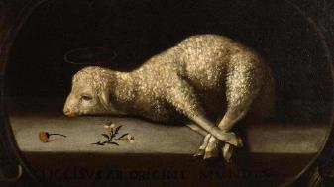
Exodus 12:5
“Your lamb shall be an unblemished male a year old; you may take it from the sheep or from the goats.”

Slide 36
Divine Disclosure
Genesis 17:1b-2
    God’s appearance (1b)
    God’s commands (1c-d)
    God’s promises (2)

Slide 37
God’s Promises
Genesis 17:2
    Covenant (2a)
    Multiplied seed (2b)

Slide 38
God’s Promises
Genesis 17:2
    Covenant (2a)
    Multiplied seed (2b)

Slide 39
Evidence of Abrahamic Covenant’s Unconditional Nature
ANE covenant ratification ceremony (Gen 15)
Lack of stated conditions for Israel’s obedience (Gen 15)
Covenant's eternality (Gen 17:7, 13, 19; Ps. 90:2)
Covenant's immutability (Heb 6:13-18; Mal. 3:6)
Trans-generational reaffirmation despite perpetual national disobedience (Jer 31:35-37)
Walvoord, The Millennial Kingdom, 149-52

Slide 40
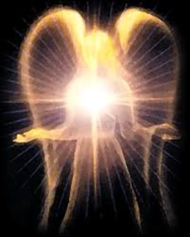
Satan’s Original State and First Sin
Isaiah 14:12-15
  5 “I will” statements
    Ascend to heaven (13)
    Raise my throne above the stars of God (13)
    Sit enthroned on the Mt. of the Assembly (13)
    Ascend above the tops of the clouds (14)
    Make myself like the Most High (14)

Slide 41
God’s Promises
Genesis 17:2
    Covenant (2a)
    Multiplied seed (2b)

Slide 42
Covenant Restated
Genesis 17:1-8
    Timing (1a)
    Divine disclosure (1b-2)
    Abram’s response (3a)
    Amplification of promises (3b-8)

Slide 43
Covenant Restated
Genesis 17:1-8
    Timing (1a)
    Divine disclosure (1b-2)
    Abram’s response (3a)
    Amplification of promises (3b-8)

Slide 44
Amplification of Promises
Genesis 17:3b-8
    God’s disclosure (3b)
    Covenant reaffirmed (4a)
    Seed promise (4b-7)
    Land promise (8)

Slide 45
Amplification of Promises
Genesis 17:3b-8
    God’s disclosure (3b)
    Covenant reaffirmed (4a)
    Seed promise (4b-7)
    Land promise (8)

Slide 46
Dr. Arnold G. Fruchtenbaum
The Book of Genesis, 240
“This is the first of seven times that Abraham receives a direct revelation from God. In 12:1–3 is God’s initial call to Abram outside the Land of Canaan; in 12:7 is the first appearance to Abraham in the Land; in 13:14–17, Abraham encounters God after the separation of Lot; in 15:1–21, God signs and seals the Abrahamic Covenant; in 17:1–21, Abraham receives the token of the covenant; in 18:1–33, God speaks to him in conjunction with the destruction of Sodom; and in 22:1–2 and 22:11–18, God directs Abraham to offer Isaac.”

Slide 47
Amplification of Promises
Genesis 17:3b-8
    God’s disclosure (3b)
    Covenant reaffirmed (4a)
    Seed promise (4b-7)
    Land promise (8)

Slide 48
Evidence of Abrahamic Covenant’s Unconditional Nature
ANE covenant ratification ceremony (Gen 15)
Lack of stated conditions for Israel’s obedience (Gen 15)
Covenant's eternality (Gen 17:7, 13, 19; Ps. 90:2)
Covenant's immutability (Heb 6:13-18; Mal. 3:6)
Trans-generational reaffirmation despite perpetual national disobedience (Jer 31:35-37)
Walvoord, The Millennial Kingdom, 149-52

Slide 49
Amplification of Promises
Genesis 17:3b-8
    God’s disclosure (3b)
    Covenant reaffirmed (4a)
    Seed promise (4b-7)
    Land promise (8)

Slide 50
Seed Promise
Genesis 17:4b-7
    Father of many nations (4b)
    Abram’s name changed (5)
    Father of kings (6)
    Eternal covenant with seed (7)

Slide 51
Seed Promise
Genesis 17:4b-7
    Father of many nations (4b)
    Abram’s name changed (5)
    Father of kings (6)
    Eternal covenant with seed (7)

Slide 52
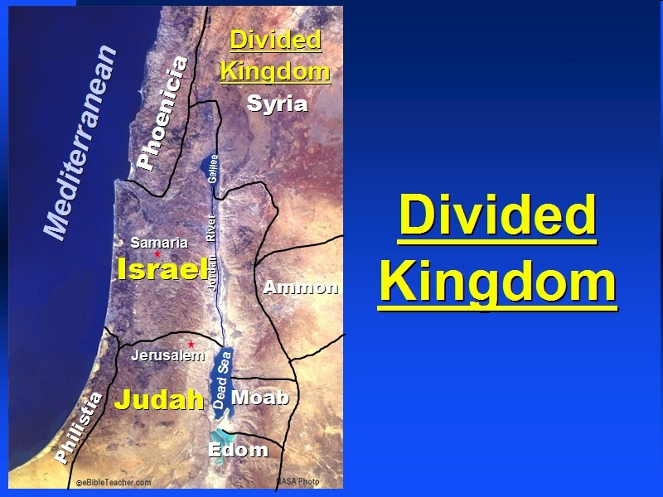

Slide 53
Seed Promise
Genesis 17:4b-7
    Father of many nations (4b)
    Abram’s name changed (5)
    Father of kings (6)
    Eternal covenant with seed (7)

Slide 54


Matthew 16:18
I also say to you that you are Peter, and upon this rock I will build [oikodomeō] My church; and the gates of Hades will not overpower it.

Slide 55
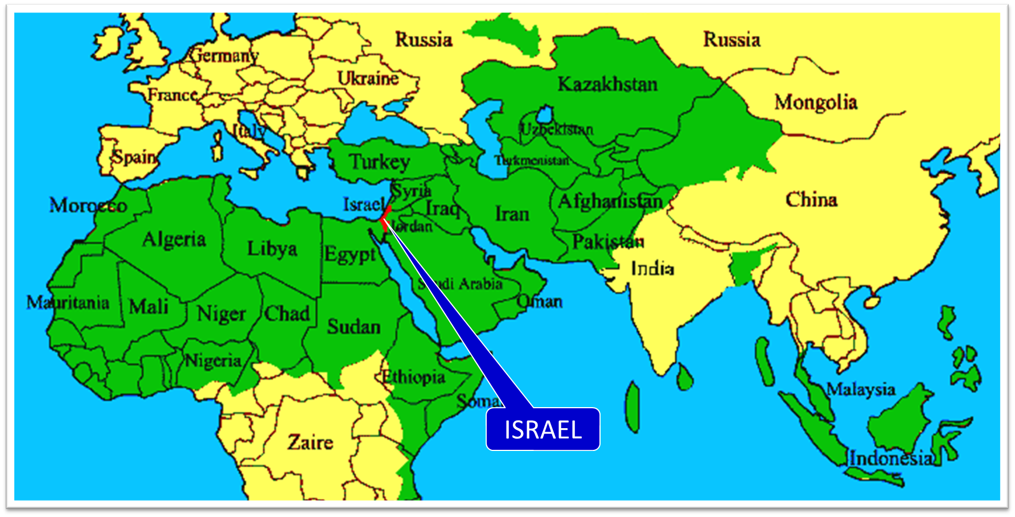

Slide 56
Seed Promise
Genesis 17:4b-7
    Father of many nations (4b)
    Abram’s name changed (5)
    Father of kings (6)
    Eternal covenant with seed (7)

Slide 59
Seed Promise
Genesis 17:4b-7
    Father of many nations (4b)
    Abram’s name changed (5)
    Father of kings (6)
    Eternal covenant with seed (7)

Slide 60
Evidence of Abrahamic Covenant’s Unconditional Nature
ANE covenant ratification ceremony (Gen 15)
Lack of stated conditions for Israel’s obedience (Gen 15)
Covenant's eternality (Gen 17:7, 13, 19; Ps. 90:2)
Covenant's immutability (Heb 6:13-18; Mal. 3:6)
Trans-generational reaffirmation despite perpetual national disobedience (Jer 31:35-37)
Walvoord, The Millennial Kingdom, 149-52

Slide 61
Amplification of Promises
Genesis 17:3b-8
    God’s disclosure (3b)
    Covenant reaffirmed (4a)
    Seed promise (4b-7)
    Land promise (8)

Slide 62


Slide 63


Slide 64
Dr. Arnold G. Fruchtenbaum
The Book of Genesis, 298
“…Abraham owned almost nothing of the Promised Land. While his seed has possessed much more of the Promised Land, they have not as yet in Jewish history possessed all the Promised Land. However, the promise here is clear: to have all the land of Canaan, all the Promised Land. This is yet future, to be fulfilled in the Messianic Kingdom.”

Slide 65
Israel's Judgments
Division of the kingdom in 931 B.C. (1 Kgs. 12)
Assyrian judgment in 722 B.C. (2 Kgs. 17)
Babylonian captivity in 586 B.C. (2 Kgs. 25)
Rome Diaspora in A.D. 70 (Luke 19:41-44)

Slide 67
Conclusion

Slide 68
Covenant Restated
Genesis 17:1-8
    Timing (1a)
    Divine disclosure (1b-2)
    Abram’s response (3a)
    Amplification of promises (3b-8)

Slide 69

“The Lord bless you and keep you; the Lord make his face shine on you and be gracious to you; the Lord turn his face toward you and give you peace.” (NIV)

