Slide 1


Zechariah
God Remembers!

Slide 2

Structure
Introductory call to repentance (1:1-6)
Eight-night visions (1:7–6:15)
Question and answers about fasting (7–8)
Two burdens (9–14)

Slide 3
ZECHARIAH’S EIGHT NIGHT VISIONS
Vision | Reference | Meaning
The Red-horse Rider among the Myrtles | 1:7-17 | God’s anger against the nations & blessing on restored Israel.
The Four Horns & the Four Craftsmen | 1:18-21 | God’s judgment on the nations that afflict Israel.
The Surveyor with a Measuring Line | Chapter 2 | God’s future blessing on restored Israel.
The Cleansing & Crowning of Joshua the Hight Priest. | Chapter 3 | Israel’s future cleansing from sin & reinstatement as a priestly nation.
The Golden Lampstand & the Two Olive Trees | Chapter 4 | Israel as the light to the nations under Messiah, the King-Priest.
The Flying Scroll | 5:1-4 | The severity & totality of divine judgment on individual Israelites.
The Woman in the Ephah | 5:5-11 | The removal of national Israel’s sin of rebellion against God.
The Four Chariots | 6:1-8 | Divine judgment on Gentile nations.

Slide 4
II. Eight Night Visions
(1:7‒6:15)
  Riders & horses among the myrtle trees (1:7-17)
  Four horns & four craftsmen (1:18-21)
  Man with the measuring line (2)
  Cleansing of the High Priest Joshua (3)
  Lampstand & olive tree (4)
  Flying scroll (5:1-4)
  Woman in the basket (5:5-11)
  Four chariots (6:1-8)
  Conclusion: crowning of Joshua (6:9-15)

Slide 5
Structure
Introductory call to repentance (1:1-6)
Eight-night visions (1:7–6:15)
Question and answers about fasting (7–8)
Two burdens (9–14)

Slide 6

III. Questions & Answers Concerning Fasting
(7‒8)
  Question (7:1-3)
  Four divine answers (7:4‒8:23)
    Condemnation of empty ritualism (7:4-7)
    Condemnation of past covenant failure (7:8-14)
    Prediction of Jerusalem’s restoration (8:1-17)
    Prediction of future blessing (8:18-23)

Slide 7
III. Questions & Answers Concerning Fasting
(7‒8)
  Question (7:1-3)
  Four divine answers (7:4‒8:23)
    Condemnation of empty ritualism (7:4-7)
    Condemnation of past covenant failure (7:8-14)
    Prediction of Jerusalem’s restoration (8:1-17)
    Prediction of future blessing (8:18-23)

Slide 8
Question
(7:1-3)
    Date (1)
    Questioner (2)
    Question (3)

Slide 9
Question
(7:1-3)
    Date (1)
    Questioner (2)
    Question (3)

Slide 10

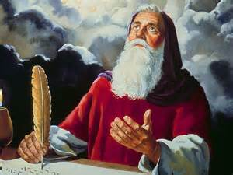
Zechariah 1:7
“On the twenty-fourth day of the eleventh month, which is the month Shebat, in the second year of Darius (519 b.c.*), the word of the Lord came to Zechariah the prophet, the son of Berechiah, the son of Iddo, as follows:”
*Babylon fell in 539 b.c!

Slide 11
Zechariah 7:1
“In the fourth year of King Darius, the word of the Lord came to Zechariah on the fourth day of the ninth month, which is Chislev.”

Slide 12


Slide 13
Question
(7:1-3)
    Date (1)
    Questioner (2)
    Question (3)

Slide 14
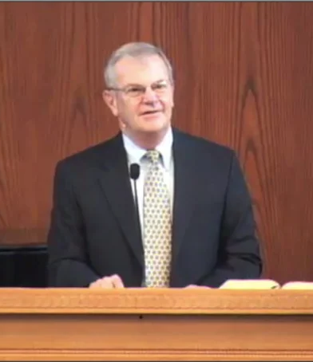
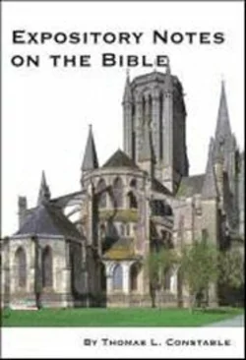
Thomas L. Constable
Constable’s online notes on Zechariah, p. 72.
“Israelites who lived in ‘Bethel,’ about 10 miles north of Jerusalem (cf. Ezra 2:28; Neh. 7:32; 11:31), sent two representatives to ask the priests and prophets in the capital about how they should worship the Lord (cf. Mal. 1:9).”

Slide 15
Question
(7:1-3)
    Date (1)
    Questioner (2)
    Question (3)

Slide 16
Thomas L. Constable
Constable’s online notes on Zechariah, p. 72-73.
“Whoever these men were, they wanted to know if they should continue to ‘weep’ and ‘abstain’ from food (i.e., to fast), which had become traditional but which the Mosaic Law did not require. The only fast that the Mosaic Law prescribed was on the Day of Atonement (Lev. 16:29; 23:27-32)...The question was a reasonable one.”

Slide 17
ISRAEL’S FOUR TEMPLES
Solomon’s pre-exilic temple (Kings and Chronicles)
Zerubbabel’s post exilic temple (Ezra 1-6; John 2:20)
Antichrist's temple (Dan. 9:27; Matt. 24:15; 2 Thess. 2:4; Rev. 11:1-2)
Millennial temple (Ezek. 40-48)

Slide 19
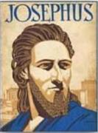
Josephus
Antiquities 6.4.5
“So Titus retired into the tower of Antonia, and resolved to storm the temple the next day, early in the morning, with his whole army, and to encamp round about the holy house; but, as for that house, God had for certain long ago doomed it to the fire; and now that fatal day was come, according to the revolution of ages; it was the tenth day of the month Lous [Ab], upon which it was formerly burnt by the king of Babylon; although these flames took their rise from the Jews themselves, and were occasioned by them…”

Slide 20
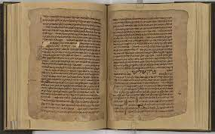
Mishnah
m. Taanit 4.6
“On the ninth of Ab (1) the decree was made against our forefathers that they should not enter the land, (2) the first Temple and (3) the second [Temple] were destroyed, (4) Betar was taken, and (5) the city was ploughed up [after the war of Hadrian].”

Slide 21
III. Questions & Answers Concerning Fasting
(7‒8)
  Question (7:1-3)
  Four divine answers (7:4‒8:23)
    Condemnation of empty ritualism (7:4-7)
    Condemnation of past covenant failure (7:8-14)
    Prediction of Jerusalem’s restoration (8:1-17)
    Prediction of future blessing (8:18-23)

Slide 22
III. Questions & Answers Concerning Fasting
(7‒8)
  Question (7:1-3)
  Four divine answers (7:4‒8:23)
    Condemnation of empty ritualism (7:4-7)
    Condemnation of past covenant failure (7:8-14)
    Prediction of Jerusalem’s restoration (8:1-17)
    Prediction of future blessing (8:18-23)

Slide 23
Empty Ritualism
(7:4-7)
Israel’s insincerity (4-5)
Israel’s selfishness (6-7)

Slide 24
Empty Ritualism
(7:4-7)
Israel’s insincerity (4-5)
Israel’s selfishness (6-7)

Slide 25
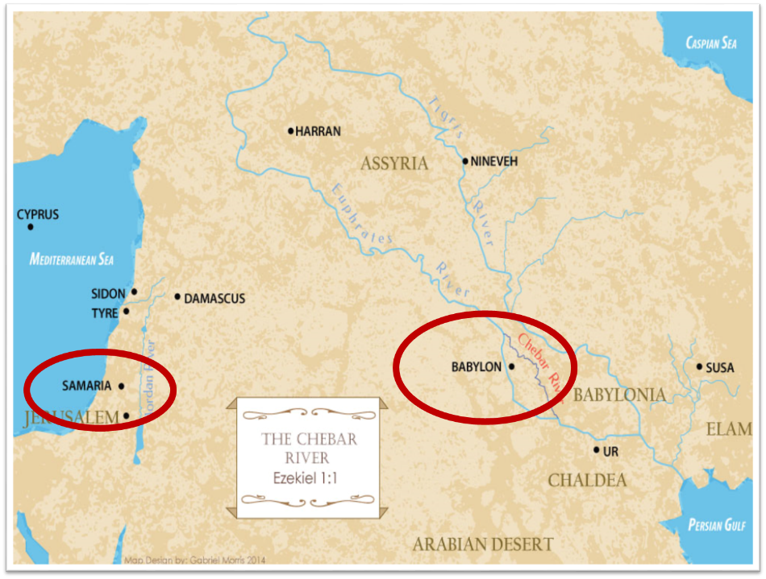

Slide 26
Empty Ritualism
(7:4-7)
Israel’s insincerity (4-5)
Israel’s selfishness (6-7)

Slide 27
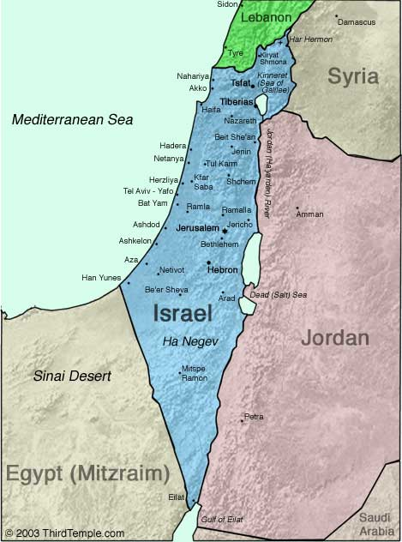
Negev

Slide 28
III. Questions & Answers Concerning Fasting
(7‒8)
  Question (7:1-3)
  Four divine answers (7:4‒8:23)
    Condemnation of empty ritualism (7:4-7)
    Condemnation of past covenant failure (7:8-14)
    Prediction of Jerusalem’s restoration (8:1-17)
    Prediction of future blessing (8:18-23)

Slide 29
Covenant Rebellion
(7:8-14)
Covenant requirements (8-10)
Covenant rebellion (11-12)
Covenant judgment (13-14)

Slide 30
Covenant Rebellion
(7:8-14)
Covenant requirements (8-10)
Covenant rebellion (11-12)
Covenant judgment (13-14)

Slide 31


Slide 32
Six Parts of a Suzerain-Vassal Treaty in Deuteronomy
Preamble (1:1-5)
Prologue (1:6–4:40)
Covenant obligations (5–26)
Storage and reading instructions (27:2-3; 31:9, 24, 26)
Witnesses (32:1)
Blessings and curses (28)

Slide 33
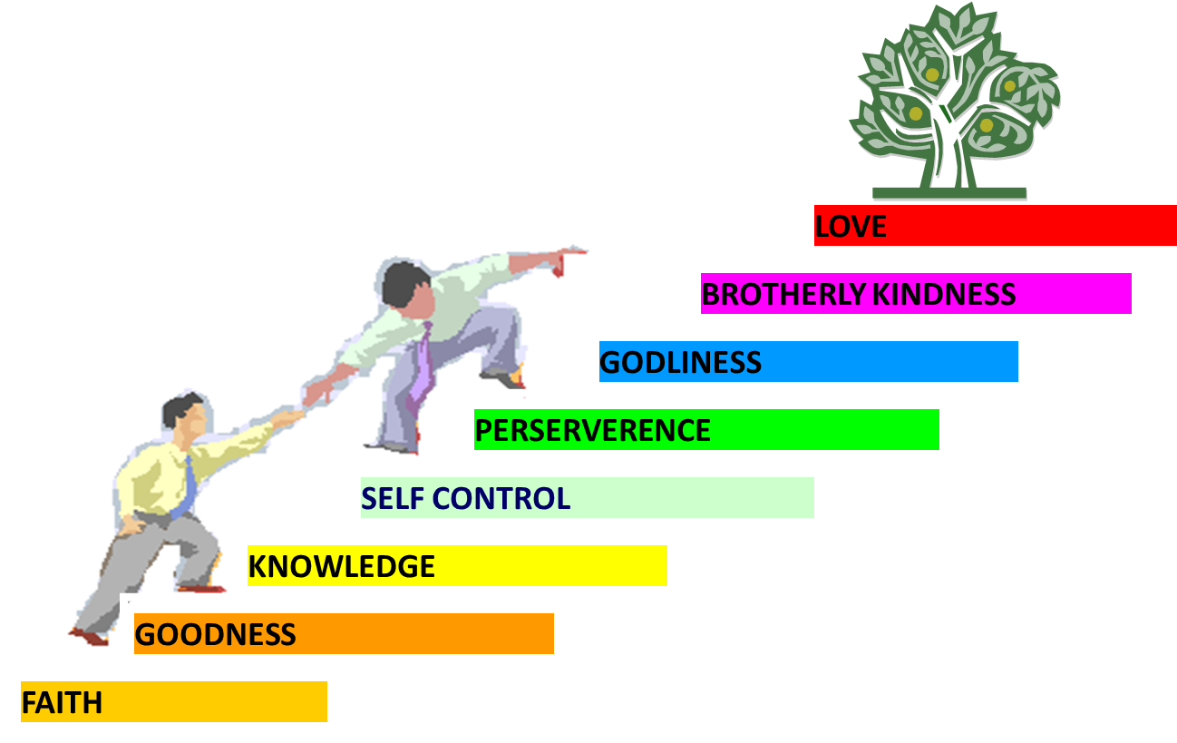
PORTRAIT OF GROWTH
1:5-7

Slide 34

2 Peter 1:5-7
⁵ Now for this very reason also, applying all diligence, in your faith supply moral excellence, and in your moral excellence, knowledge, ⁶ and in your knowledge, self-control, and in your self-control, perseverance, and in your perseverance, godliness, ⁷ and in your godliness, brotherly kindness, and in your brotherly kindness, love.

Slide 35
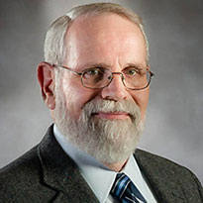
James Hoffmeier,
The Immigration Crisis, 52.
“In the Hebrew Bible the alien (Ger) was a person who entered Israel and followed legal procedures to obtain recognized standing as a resident alien. Hence I will use the term alien or ger throughout the book to refer to legal immigrants. Clearly there was a distinction between the alien (Ger) and a foreigner (nekhar or zar) in the Old Testament, and this difference will be clear in the narratives, stories, and laws that will be reviewed in the following sections.”

Slide 36
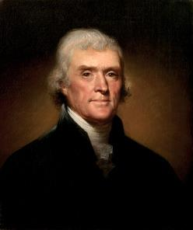
Thomas Jefferson
“His moral doctrines...were more pure and perfect than those of the most correct of the philosophers...gathering all into one family under the bonds of love, charity, peace, common wants and common aids. A development of this head will evince the peculiar superiority of the system of Jesus over all others. The precepts of philosophy, and of the Hebrew code, laid hold of actions only. He pushed his scrutinies into the heart of man; erected his tribunal in the region of his thoughts, and purified the waters at the fountain head.”
On April 21, 1803, Jefferson wrote to Dr. Benjamin Rush, also a signer of the Declaration

Slide 37
Covenant Rebellion
(7:8-14)
Covenant requirements (8-10)
Covenant rebellion (11-12)
Covenant judgment (13-14)

Slide 38
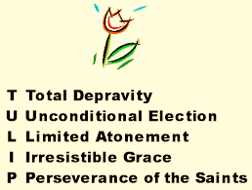
Running TULIP Through the Grid of Scripture
Total Depravity
Unconditional Election
Limited Atonement
Irresistible Grace
Perseverance of the Saints

Slide 39
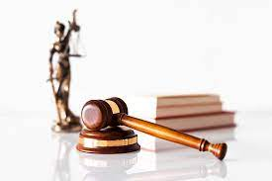
Hosea 4:1
“Listen to the word of the Lord, you sons of Israel, Because the Lord has a case against the inhabitants of the land, For there is no faithfulness, nor loyalty, Nor knowledge of God in the land.”

Slide 40
Micah 6:1-2
“¹ Hear now what the Lord is saying, “Arise, plead your case before the mountains, And let the hills hear your voice. ² Listen, you mountains, to the indictment by the Lord, And you enduring foundations of the earth, Because the Lord has a case against His people; And He will dispute with Israel.”

Slide 41
Joyce Baldwin
Baldwin, Joyce G. Haggai, Zechariah, Malachi: An Introduction and Commentary. Tyndale Old Testament Commentaries series. Leicester, Eng., and Downers Grove, Ill.: Inter-Varsity Press, 1972. p. 147.
“This remarkable doctrine of the Holy Spirit as mediator of God's word to the prophets, who were themselves its mediators, has no parallels in the prophetic books...Zechariah is the first to record this aspect of the doctrine of the Spirit.”

Slide 42
Six Parts of a Suzerain-Vassal Treaty in Deuteronomy
Preamble (1:1-5)
Prologue (1:6–4:40)
Covenant obligations (5–26)
Storage and reading instructions (27:2-3; 31:9, 24, 26)
Witnesses (32:1)
Blessings and curses (28)

Slide 43
Covenant Rebellion
(7:8-14)
Covenant requirements (8-10)
Covenant rebellion (11-12)
Covenant judgment (13-14)

Slide 44
Six Parts of a Suzerain-Vassal Treaty in Deuteronomy
Preamble (1:1-5)
Prologue (1:6–4:40)
Covenant obligations (5–26)
Storage and reading instructions (27:2-3; 31:9, 24, 26)
Witnesses (32:1)
Blessings and curses (28)

Slide 46

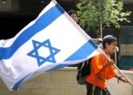
Charles L. Feinberg
The Prophecy of Ezekiel: The Glory of the Lord, Paperback ed. (Chicago: Moody, 1969; reprint, Chicago: Moody, 1984), 207.
“These prophecies, especially those in verses 12-15, could not have been fulfilled in the return from Babylon…Thus many take the primary reference to the return from Babylon. But the predictions will not be completely fulfilled until the future restoration, of which the return from Babylon was a foreshadowing.”

Slide 47
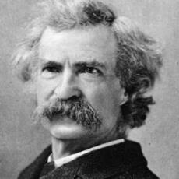
Mark Twain
The Innocents Abroad, Complete, 1st ed. (A Public Domain Book, 1869), 267, 285, 302. These quotes can be found in chapters 47, 49, 52.
“... A desolate country whose soil is rich enough, but is given over wholly to weeds… a silent mournful expanse…. a desolation is here that not even imagination can grace with the pomp of life and action…. we never saw a human being on the whole route…. there was hardly a tree or shrub anywhere. Even the olive tree and the cactus, those fast friends of a worthless soil, had almost deserted the country.”

Slide 48
Conclusion

Slide 49
III. Questions & Answers Concerning Fasting
(7‒8)
  Question (7:1-3)
  Four divine answers (7:4‒8:23)
    Condemnation of empty ritualism (7:4-7)
    Condemnation of past covenant failure (7:8-14)
    Prediction of Jerusalem’s restoration (8:1-17)
    Prediction of future blessing (8:18-23)

Slide 50
III. Questions & Answers Concerning Fasting
(7‒8)
  Question (7:1-3)
  Four divine answers (7:4‒8:23)
    Condemnation of empty ritualism (7:4-7)
    Condemnation of past covenant failure (7:8-14)
    Prediction of Jerusalem’s restoration (8:1-17)
    Prediction of future blessing (8:18-23)

