Slide 1

Ezekiel 36‒39
The Middle East Meltdown 2022
Dr. Andy Woods
Senior Pastor – Sugar Land Bible Church
President – Chafer Theological Seminary

Slide 2
Ezekiel 33‒48
Ezekiel recommissioned (33)
False shepherds removed (34)
Edom destroyed (35)
Israel’s restoration: physical & spiritual (36)
Israel’s restoration illustrated (37)
Means of restoration: Northern invasion (38)
Results of the Northern invasion: conversion (39)
Millennial Temple (40‒46)
Tribal land allotment (47‒48)

Slide 3
Ezekiel 36
Israel to prosper again (1-15)
Israel’s sins inhibiting prosperity (16-21)
Israel to be restored: physically & spiritually (22-38)

Slide 4
Ezekiel 36
Israel to prosper again (1-15)
Israel’s sins inhibiting prosperity (16-21)
Israel to be restored: physically & spiritually (22-38)

Slide 5
Ezekiel 36
Israel to prosper again (1-15)
Israel’s sins inhibiting prosperity (16-21)
Israel to be restored: physically & spiritually (22-38)

Slide 6
Ezekiel 36
Israel to prosper again (1-15)
Israel’s sins inhibiting prosperity (16-21)
Israel to be restored: physically & spiritually (22-38)

Slide 7

Ezekiel 36:22
“Therefore, say to the house of Israel, ‘This is what the Lord God says: “It is not for your sake, house of Israel, that I am about to act, but for My holy name, which you have profaned among the nations where you went.”

Slide 8
Ezekiel 36:22
“Therefore, say to the house of Israel, ‘This is what the Lord God says: “It is not for your sake, house of Israel, that I am about to act, but for My holy name, which you have profaned among the nations where you went.”

Slide 9


Slide 10
Exodus 2:24
“So God heard their groaning; and God remembered His covenant with Abraham, Isaac, and Jacob.”

Slide 11

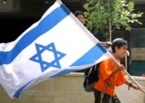
Charles L. Feinberg
The Prophecy of Ezekiel: The Glory of the Lord, Paperback ed. (Chicago: Moody, 1969; reprint, Chicago: Moody, 1984), 206.
“It is vital to remember that’s such action on God’s part does not reveal in any sense a partiality toward Israel. It is rather a vindication of God‘s glory and will, for He has condescended to link his purposes on earth with the people of Israel.”

Slide 12
Dispensational Theology is a System of Theology
Traditional-normative dispensational theology is a system that embodies three essential, fundamental concepts called the sine qua non (lit. “without which is not”):
The consistent use of a plain, normal, literal, grammatical-historical method of interpretation;
Which reveals that the Church is distinct from Israel;
God’s overall purpose is to bring glory to Himself (Eph. 1:6, 12, 14).
Dr. Charles Ryrie, Dispensationalism, pp. 38-41

Slide 13
Doxological Purpose
God’s ultimate purpose for the ages is to glorify Himself. Scripture is not human-centered, as though salvation were the principle point, but God-centered, because His glory is at the center.
The glory of God is the primary principle that unifies all dispensations, the program of salvation being just one of the means by which God glorifies Himself. Each successive revelation of God’s plan for the ages, as well as His dealing with the elect, non-elect, angels, and nations all manifest His glory.
Dictionary of Premillennial Theology, Charles Ryrie, p. 94

Slide 14
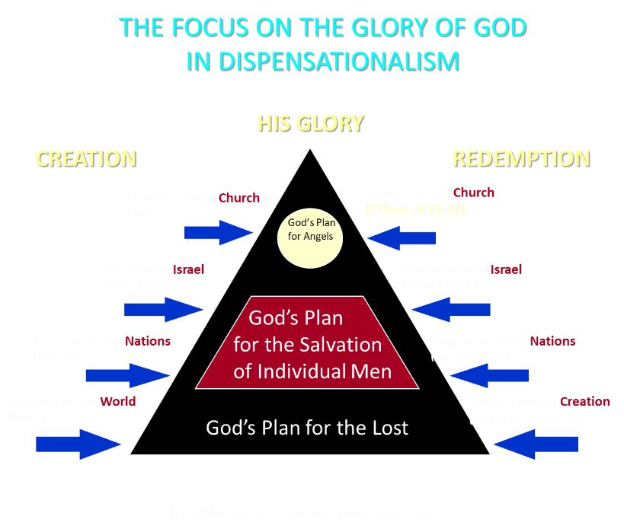

Slide 15

Ezekiel 36:24-28
²⁴ “For I will take you from the nations, gather you from all the lands and bring you into your own land. ²⁵ Then I will sprinkle clean water on you, and you will be clean; I will cleanse you from all your filthiness and from all your idols. ²⁶ Moreover, I will give you a new heart and put a new spirit within you; and I will remove the heart of stone from your flesh and give you a heart of flesh. ²⁷ I will put My Spirit within you and cause you to walk in My statutes, and you will be careful to observe My ordinances. ²⁸ You will live in the land that I gave to your forefathers; so you will be My people, and I will be your God.”

Slide 16
ISRAEL’S TWO REGATHERINGS
THE PRESENT (FIRST) REGATHERING | THE PERMANENT (SECOND) REGATHERING
Return to part of the land | Return to all the land
Return in unbelief | Return in faith
Restored to the land only | Restored to the land and the Lord
Sets the stage for Tribulation (discipline) | Sets the stage for Millennium (blessing)
Adapted from: Price, Jerusalem In Prophecy, 219

Slide 17
Ezekiel 36:24-28
²⁴ “For I will take you from the nations, gather you from all the lands and bring you into your own land. ²⁵ Then I will sprinkle clean water on you, and you will be clean; I will cleanse you from all your filthiness and from all your idols. ²⁶ Moreover, I will give you a new heart and put a new spirit within you; and I will remove the heart of stone from your flesh and give you a heart of flesh. ²⁷ I will put My Spirit within you and cause you to walk in My statutes, and you will be careful to observe My ordinances. ²⁸ You will live in the land that I gave to your forefathers; so you will be My people, and I will be your God.”

Slide 18


Slide 19

Jeremiah 31:31-34
“Behold, days are coming,” declares the Lord, “when I will make a new covenant with the house of Israel and with the house of Judah, ³² not like the covenant which I made with their fathers in the day I took them by the hand to bring them out of the land of Egypt, My covenant which they broke, although I was a husband to them,” declares the Lord. ³³ “But this is the covenant which I will make with the house of Israel after those days,” declares the Lord, . . .

Slide 20
Jeremiah 31:31-34
...“I will put My law within them and on their heart I will write it; and I will be their God, and they shall be My people. ³⁴ They will not teach again, each man his neighbor and each man his brother, saying, ‘Know the Lord,’ for they will all know Me, from the least of them to the greatest of them,” declares the Lord, “for I will forgive their iniquity, and their sin I will remember no more.”

Slide 21
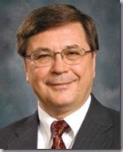
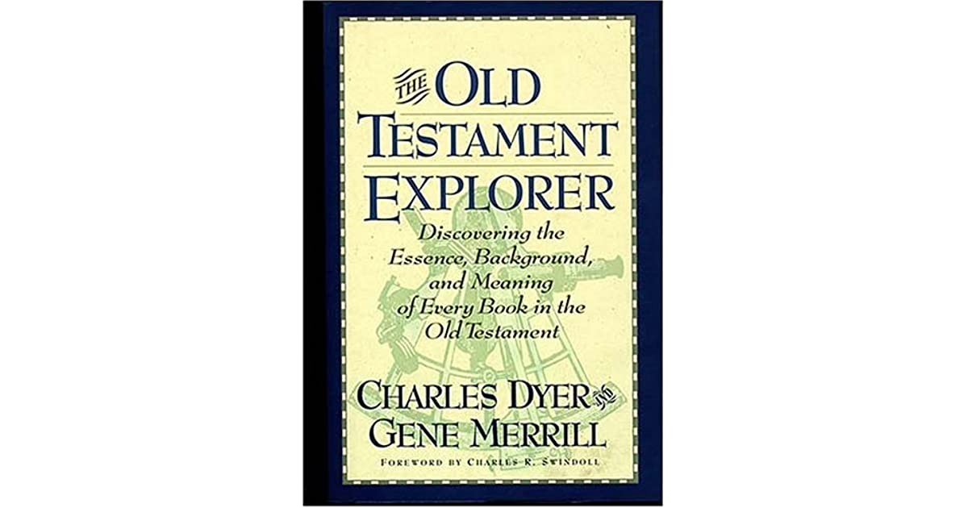
Charles H. Dyer
Old Testament Explorer, p. 690.
“Ezekiel 36 parallels the New Covenant God promised to Israel and Judah in Jeremiah 31. This covenant includes at least three specific elements: (a) restoration to the land (Ezek. 36:24; Jer. 31:27–29), (b) forgiveness of sin (Ezek. 36:25; Jer. 31:34), and (c) the indwelling presence of God’s Holy Spirit (Ezek. 36:26–27; Jer. 31:33).”

Slide 22
Six Parts of a Suzerain-Vassal Treaty in Deuteronomy
Preamble (1:1-5)
Prologue (1:6–4:40)
Covenant obligations (5–26)
Storage and reading instructions (27:2-3; 31:9, 24, 26)
Witnesses (32:1)
Blessings and curses (28)

Slide 23
Ezekiel 36:22
“Therefore, say to the house of Israel, ‘This is what the Lord God says: “It is not for your sake, house of Israel, that I am about to act, but for My holy name, which you have profaned among the nations where you went.”

Slide 24
Exodus 2:24
“So God heard their groaning; and God remembered His covenant with Abraham, Isaac, and Jacob.”

Slide 25
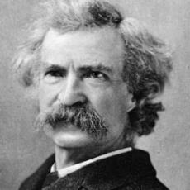
Mark Twain
The Innocents Abroad, Complete, 1st ed. (A Public Domain Book, 1869), 267, 285, 302. These quotes can be found in chapters 47, 49, 52.
“... A desolate country whose soil is rich enough, but is given over wholly to weeds… a silent mournful expanse…. a desolation is here that not even imagination can grace with the pomp of life and action…. we never saw a human being on the whole route…. there was hardly a tree or shrub anywhere. Even the olive tree and the cactus, those fast friends of a worthless soil, had almost deserted the country.”

Slide 26

Leviticus 26:43
“For the land will be abandoned by them, and will make up for its sabbaths while it is made desolate without them. They, meanwhile, will be making amends for their iniquity, because they rejected My ordinances and their soul abhorred My statutes.”

Slide 27
Ezekiel 38:8
“After many days you will be summoned; in the latter years you will come into the land that is restored from the sword, whose inhabitants have been gathered from many nations to the mountains of Israel which had been a continual waste; but its people were brought out from the nations, and they are living securely, all of them.”

Slide 28
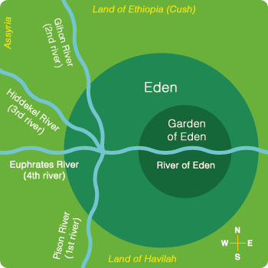

Slide 29

Divine Judgments
(3:14-19)
  Serpent (3:14-15)
  Woman (3:16)
  Man (3:17-19)

Slide 30
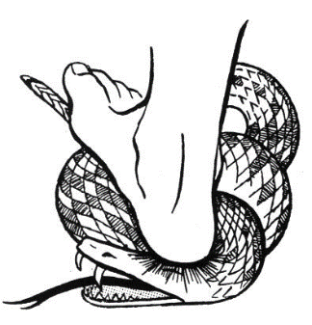
Serpent
(3:14-15)
  Serpent’s body (3:14)
  Protoevangelium (3:15)

Slide 31
Woman
(3:16)
  Painful child birth (3:16a)
  Relational conflict (3:16b)

Slide 32
Man
(3:17-19)
  Painful labor (3:17-19a)
  Death (3:19b)

Slide 33
Why?
COUNTRY | GROSS DOMESTIC PRODUCT
ISRAEL | $123 BILLION
Egypt | $81 billion
Syria | $26 billion
Lebanon | $21 billion
Jordan | $12 billion
Source: CIA World Fact Book, 2005

Slide 34


Slide 35
Levitical Feasts (23)
Feast | Season | Purpose | Type
Passover | Spring | Redemption | 1 Cor 5:7
Unleavened Bread | Spring | Separation | John 6:35
1st fruits | Spring | Praise | 1 Cor 15:20
Pentecost | Spring | Praise | Acts 2:1-4
Trumpets | Fall | New Year | Matt 24:31
Atonement | Fall | Lev 16 | Zech 12:10
Booths | Fall | Wilderness provision | Zech 14:16-18

Slide 36


Slide 37
CONCLUSION

Slide 38
Ezekiel 36
Israel to prosper again (1-15)
Israel’s sins inhibiting prosperity (16-21)
Israel to be restored: physically & spiritually (22-38)

Slide 39
Ezekiel 33‒48
Ezekiel recommissioned (33)
False shepherds removed (34)
Edom destroyed (35)
Israel’s restoration: physical & spiritual (36)
Israel’s restoration illustrated (37)
Means of restoration: Northern invasion (38)
Results of the Northern invasion: conversion (39)
Millennial Temple (40‒46)
Tribal land allotment (47‒48)

