Slide 1


Zechariah
God Remembers!

Slide 2

Structure
Introductory call to repentance (1:1-6)
Eight-night visions (1:7–6:15)
Question and answers about fasting (7–8)
Two burdens (9–14)

Slide 3
ZECHARIAH’S EIGHT NIGHT VISIONS
Vision | Reference | Meaning
The Red-horse Rider among the Myrtles | 1:7-17 | God’s anger against the nations & blessing on restored Israel.
The Four Horns & the Four Craftsmen | 1:18-21 | God’s judgment on the nations that afflict Israel.
The Surveyor with a Measuring Line | Chapter 2 | God’s future blessing on restored Israel.
The Cleansing & Crowning of Joshua the Hight Priest. | Chapter 3 | Israel’s future cleansing from sin & reinstatement as a priestly nation.
The Golden Lampstand & the Two Olive Trees | Chapter 4 | Israel as the light to the nations under Messiah, the King-Priest.
The Flying Scroll | 5:1-4 | The severity & totality of divine judgment on individual Israelites.
The Woman in the Ephah | 5:5-11 | The removal of national Israel’s sin of rebellion against God.
The Four Chariots | 6:1-8 | Divine judgment on Gentile nations.

Slide 4
II. Eight Night Visions
(1:7‒6:15)
  Riders & horses among the myrtle trees (1:7-17)
  Four horns & four craftsmen (1:18-21)
  Man with the measuring line (2)
  Cleansing of the High Priest Joshua (3)
  Lampstand & olive tree (4)
  Flying scroll (5:1-4)
  Woman in the basket (5:5-11)
  Four chariots (6:1-8)
  Conclusion: crowning of Joshua (6:9-15)

Slide 5

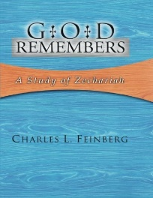
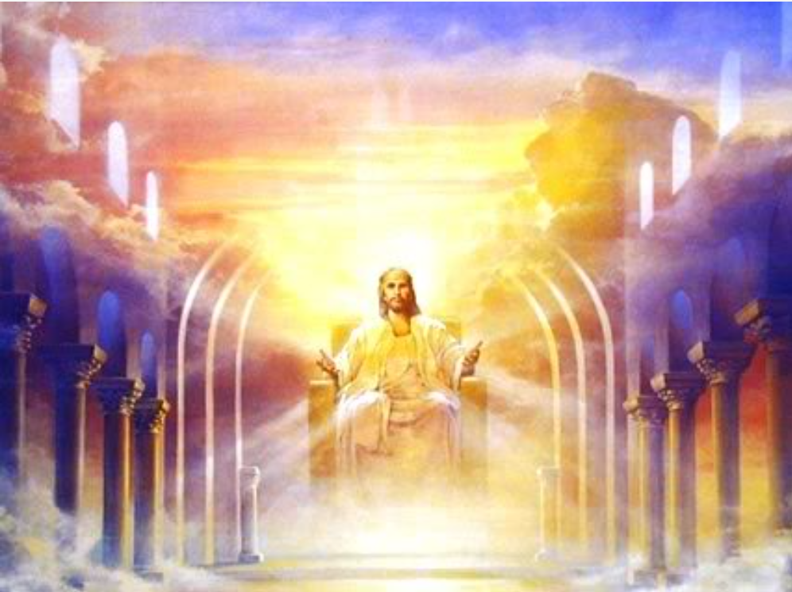
Charles L. Feinberg
God Remembers: A Study of Zechariah (Wheaton: Van Kampen, 1950, p. 100.
“Here we have the end and consummation of all the prophetic Scriptures: the crowning of the Lord Jesus Christ. It is only after the dark night of world judgment and punishment is passed, that the glorious light of Christ's coronation day will follow. This is one of the sublimest passages in the Scriptures on the Person and work of the Messiah.”

Slide 6
The Crowning of Joshua
(6:9-15)
The Offering (6:9-10)
The Coronation (6:11)
The Branch (6:12)
The King‒Priest (6:13)
The Reminder (6:14)
The Testimony (6:15)

Slide 7
The Crowning of Joshua
(6:9-15)
The Offering (6:9-10)
The Coronation (6:11)
The Branch (6:12)
The King‒Priest (6:13)
The Reminder (6:14)
The Testimony (6:15)

Slide 8
ISRAEL’S FOUR TEMPLES
Solomon’s pre-exilic temple (Kings and Chronicles)
Zerubbabel’s post exilic temple (Ezra 1-6; John 2:20)
Antichrist's temple (Dan. 9:27; Matt. 24:15; 2 Thess. 2:4; Rev. 11:1-2)
Millennial temple (Ezek. 40-48)

Slide 9
The Crowning of Joshua
(6:9-15)
The Offering (6:9-10)
The Coronation (6:11)
The Branch (6:12)
The King‒Priest (6:13)
The Reminder (6:14)
The Testimony (6:15)

Slide 10
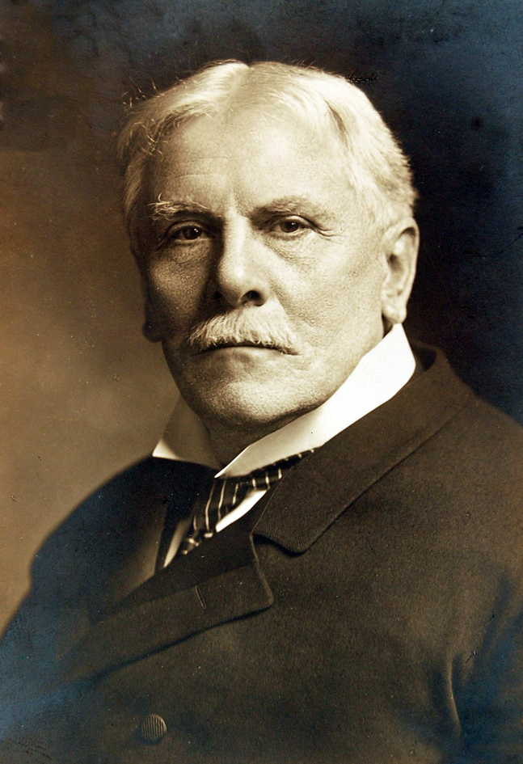
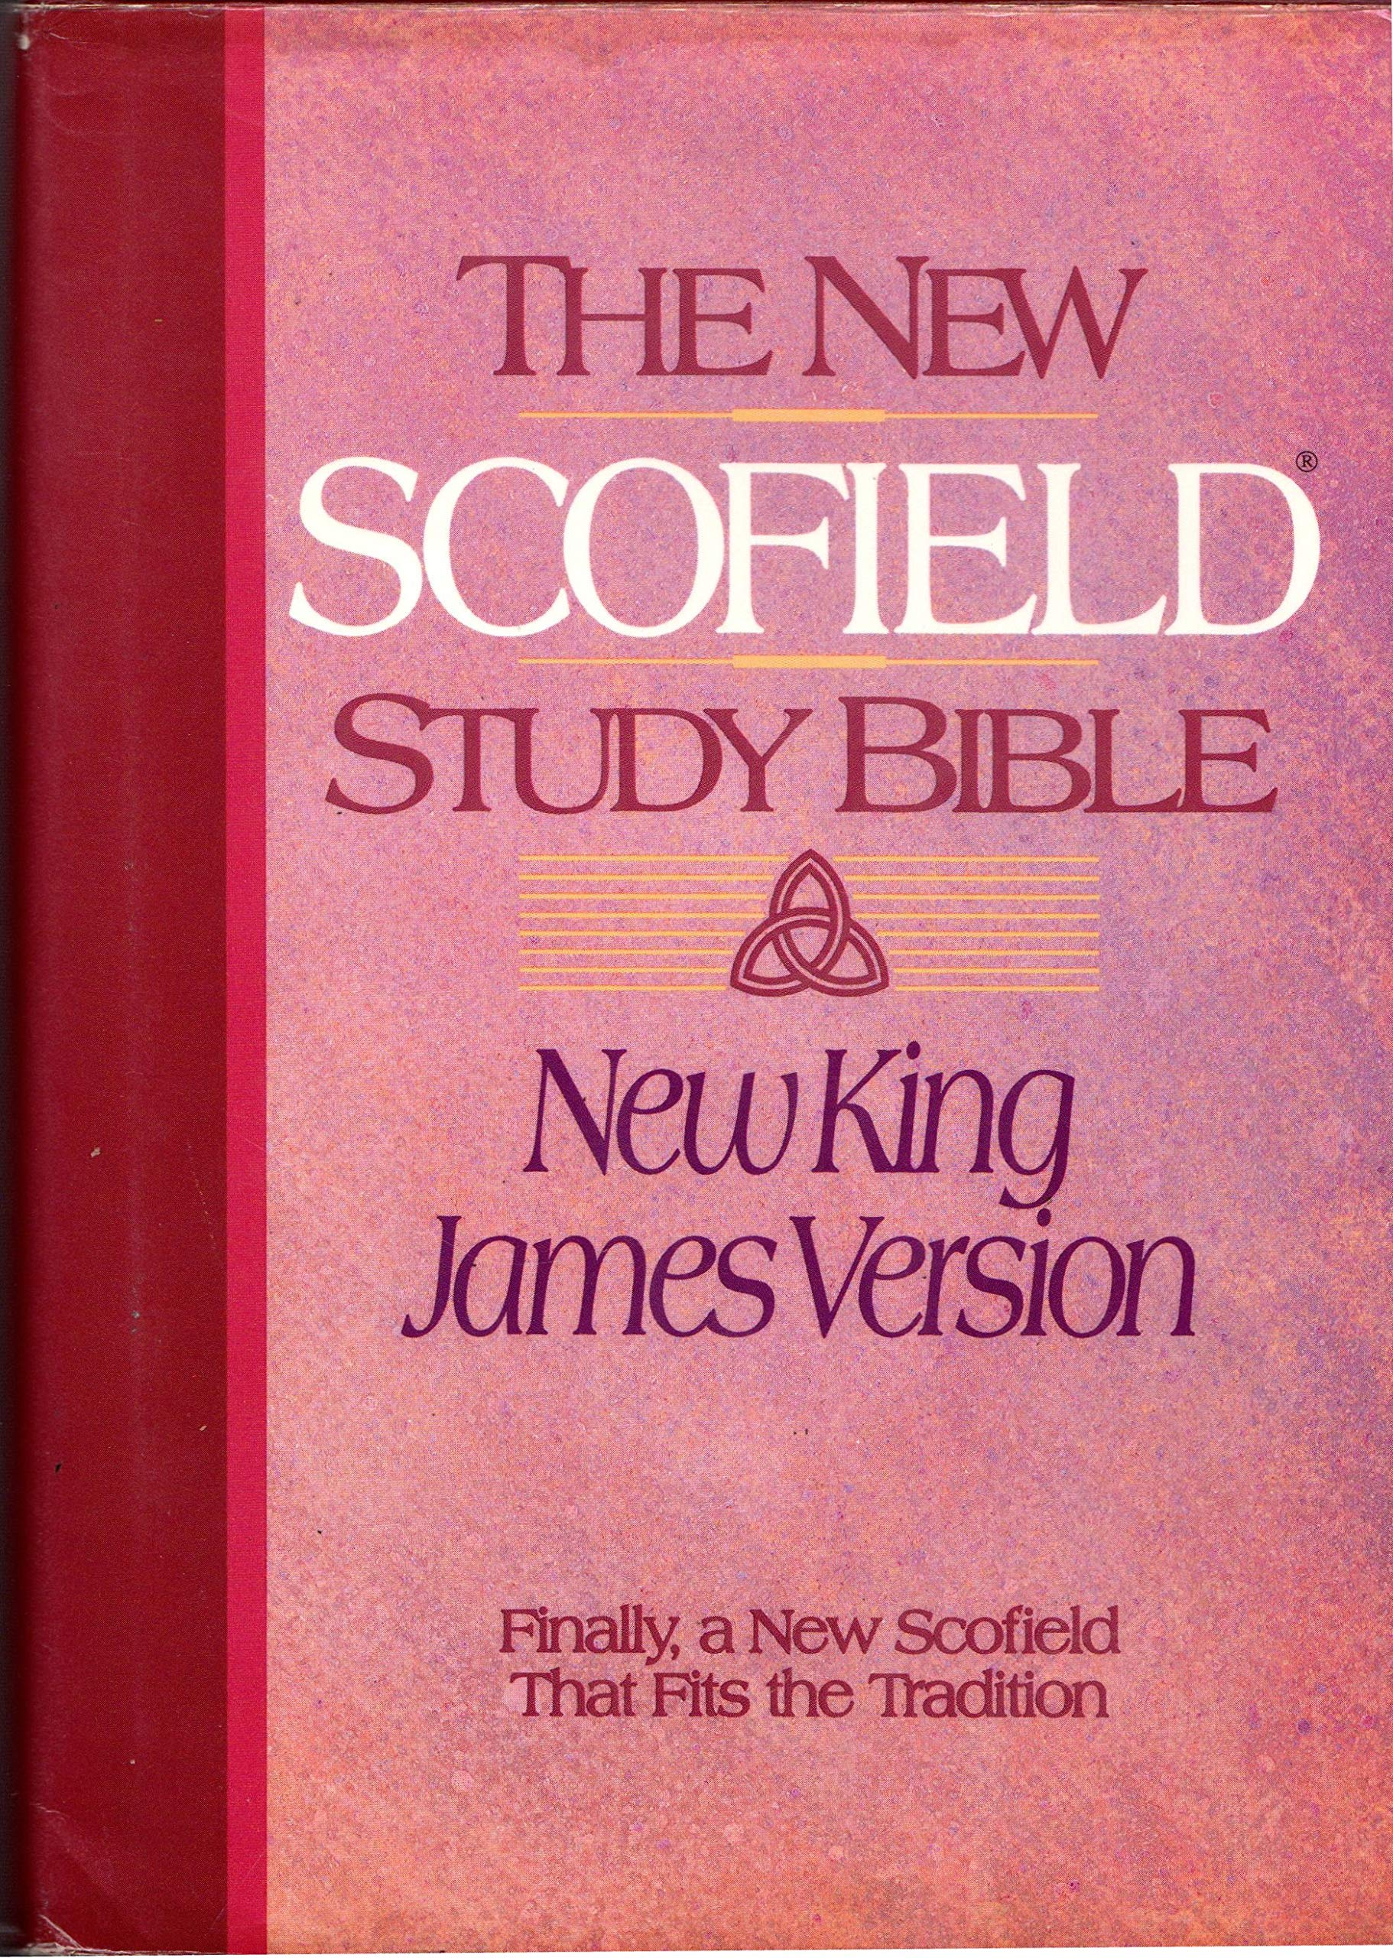
Scofield Bible
The New Scofield Bible. p. 968
“Christ is now a Priest but is still in the holiest within the veil (Heb. 9:11-14, 24; cp. Lev. 16:15) and seated on the Father's throne (Rev. 3:21). He has not yet come out to take His own throne (Heb. 9:28).”

Slide 11
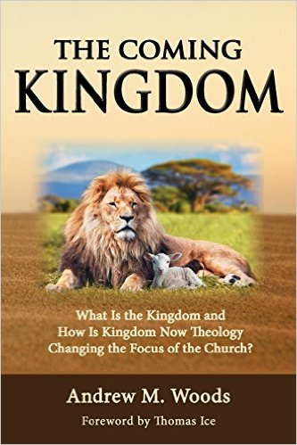

Slide 12
The Crowning of Joshua
(6:9-15)
The Offering (6:9-10)
The Coronation (6:11)
The Branch (6:12)
The King‒Priest (6:13)
The Reminder (6:14)
The Testimony (6:15)

Slide 13
Kenneth L. Barker
Kenneth L. Barker "Zechariah." In Daniel-Minor Prophets. Vol. 7 of The Expositor's Bible Commentary. 12 vols. Edited by Frank E. Gaebelein and Richard P. Polcyn. Grand Rapids: Zondervan Publishing House, 1985. Page 639
“How appropriate therefore that both the type (Joshua) and the antitype (Jesus) have a name meaning 'the Lord saves' (cf. NIV mg. at Matt 1:21).”

Slide 14
ISRAEL’S FOUR TEMPLES
Solomon’s pre-exilic temple (Kings and Chronicles)
Zerubbabel’s post exilic temple (Ezra 1-6; John 2:20)
Antichrist's temple (Dan. 9:27; Matt. 24:15; 2 Thess. 2:4; Rev. 11:1-2)
Millennial temple (Ezek. 40-48)

Slide 15
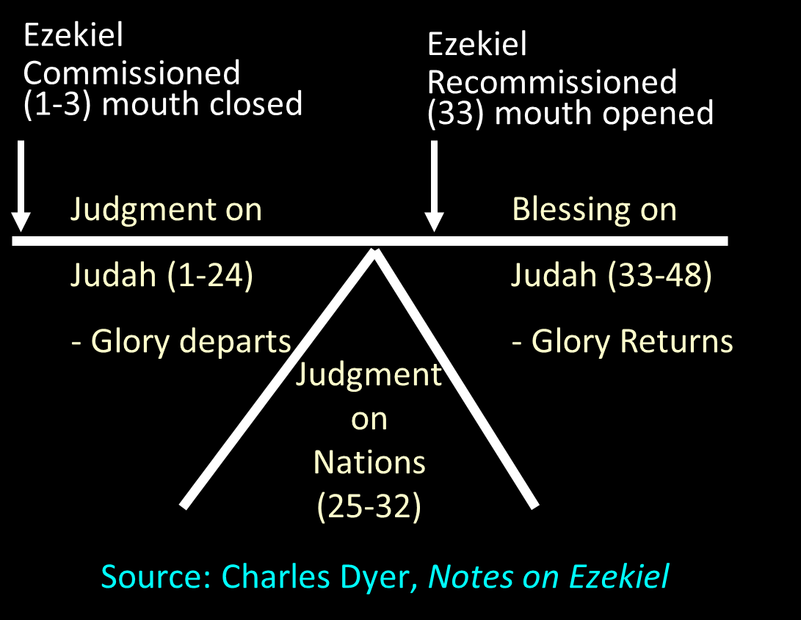

Slide 16


Slide 17


Slide 18

Isaiah 2:2-3
“Now it will come about that In the last days The mountain of the house of the Lord Will be established as the chief of the mountains, And will be raised above the hills; And all the nations will stream to it.³ And many peoples will come and say, ‘Come, let us go up to the mountain of the Lord, To the house of the God of Jacob; That He may teach us concerning His ways And that we may walk in His paths.’ For the law will go forth from Zion And the word of the Lord from Jerusalem.”

Slide 19


Slide 20
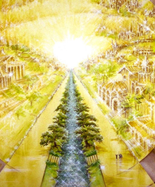
Eternal State is Future
No Satan (Rev 20:10)
No sea (Rev 21:1)
No death, crying, or pain (Rev 21:4)
No Sun (Rev 22:5)
No Moon (Rev 21:23)
No temple (Rev. 21:22)
No night (Rev 21:25)
No evil (Rev 21:27)
No curse (Rev 22:3)

Slide 21
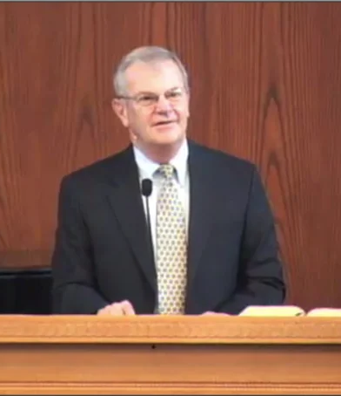
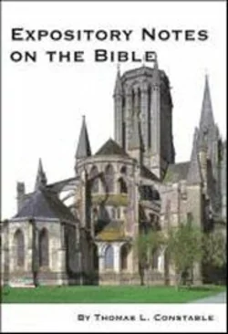
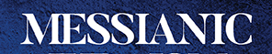
Thomas L. Constable
Constable’s online notes on Zechariah, p. 69.
“The Aramaic Targum, the Jerusalem Talmud, and a Midrash all regarded verse 12 as messianic.”

Slide 22
The Crowning of Joshua
(6:9-15)
The Offering (6:9-10)
The Coronation (6:11)
The Branch (6:12)
The King‒Priest (6:13)
The Reminder (6:14)
The Testimony (6:15)

Slide 23

Zechariah 14:16-18
“Then it will come about that any who are left of all the nations that went against Jerusalem will go up from year to year to worship the King, the Lord of hosts, and to celebrate the Feast of Booths. ¹⁷ And it will be that whichever of the families of the earth does not go up to Jerusalem to worship the King, the Lord of hosts, there will be no rain on them. ¹⁸ If the family of Egypt does not go up or enter, then no rain will fall on them; it will be the plague with which the Lord smites the nations who do not go up to celebrate the Feast of Booths.”

Slide 24


Slide 25
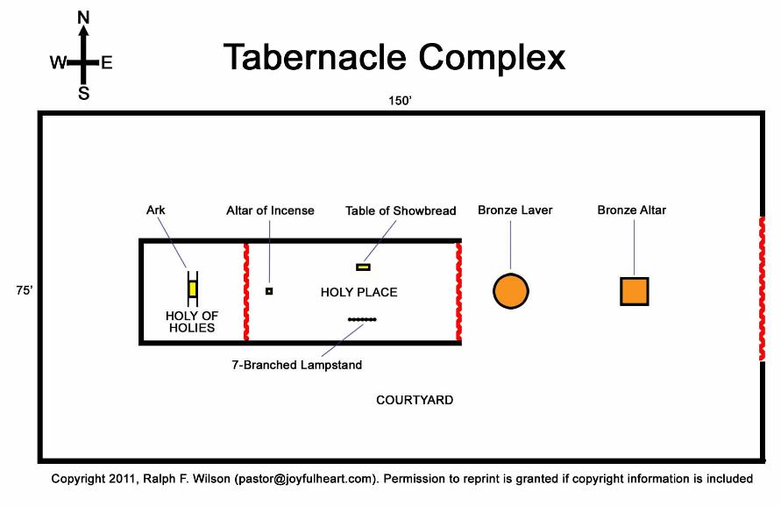

Slide 26

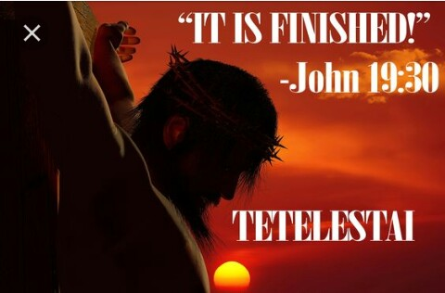
John 19:30
“Therefore when Jesus had received the sour wine, He said, ‘It is finished!’ And He bowed His head and gave up His spirit.”

Slide 27


Slide 28

2 Samuel 7:12-16
“¹² When your days are complete and you lie down with your fathers, I will raise up your descendant after you, who will come forth from you, and I will establish his kingdom. ¹³ He shall build a house for My name, and I will establish the throne of his kingdom forever. ¹⁴ I will be a father to him and he will be a son to Me; when he commits iniquity, I will correct him with the rod of men and the strokes of the . . .

Slide 29
2 Samuel 7:12-16
. . . sons of men, ¹⁵ but My lovingkindness shall not depart from him, as I took it away from Saul, whom I removed from before you. ¹⁶ Your house and your kingdom shall endure before Me forever; your throne shall be established forever.” ¹⁷ In accordance with all these words and all this vision, so Nathan spoke to David.”

Slide 30

Isaiah 9:6-7
^{6 “}For a child will be born to us, a son will be given to us; And the government will rest on His shoulders; And His name will be called Wonderful Counselor, Mighty God, Eternal Father, Prince of Peace.⁷ There will be no end to the increase of His government or of peace, The zeal of the Lord of hosts will accomplish this. On the throne of David and over his kingdom, To establish it and to uphold it with justice and righteousness From then on and forevermore.”

Slide 31
The Crowning of Joshua
(6:9-15)
The Offering (6:9-10)
The Coronation (6:11)
The Branch (6:12)
The King‒Priest (6:13)
The Reminder (6:14)
The Testimony (6:15)

Slide 35
The Crowning of Joshua
(6:9-15)
The Offering (6:9-10)
The Coronation (6:11)
The Branch (6:12)
The King‒Priest (6:13)
The Reminder (6:14)
The Testimony (6:15)

Slide 36
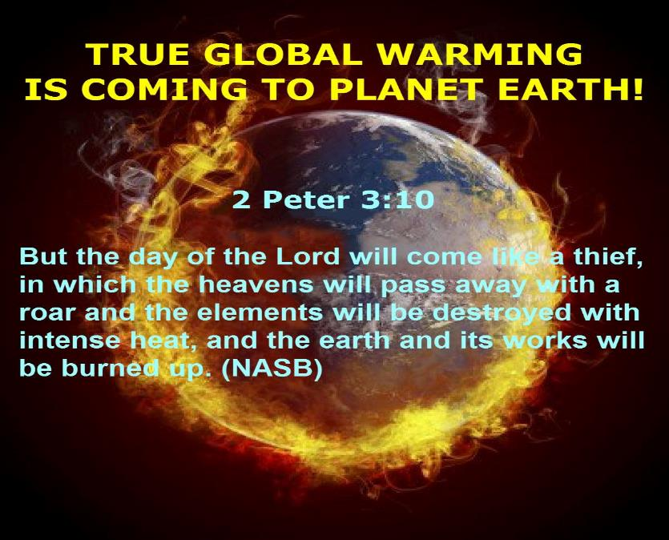

Slide 37


John 13:19; 14:29
“^{13:19} From now on I am telling you before it comes to pass, so that when it does occur, you may believe that I am He… ^{14:29} Now I have told you before it happens, so that when it happens, you may believe.”

Slide 39
Six Parts of a Suzerain-Vassal Treaty in Deuteronomy
Preamble (1:1-5)
Prologue (1:6–4:40)
Covenant obligations (5–26)
Storage and reading instructions (27:2-3; 31:9, 24, 26)
Witnesses (32:1)
Blessings and curses (28)

Slide 40
Jeremiah 31:31-34
“Behold, days are coming,” declares the Lord, “when I will make a new covenant with the house of Israel and with the house of Judah, ³² not like the covenant which I made with their fathers in the day I took them by the hand to bring them out of the land of Egypt, My covenant which they broke, although I was a husband to them,” declares the Lord. ³³ “But this is the covenant which I will make with the house of Israel after those days,” declares the Lord, . . .

Slide 41
Jeremiah 31:31-34
...“I will put My law within them and on their heart I will write it; and I will be their God, and they shall be My people. ³⁴ They will not teach again, each man his neighbor and each man his brother, saying, ‘Know the Lord,’ for they will all know Me, from the least of them to the greatest of them,” declares the Lord, “for I will forgive their iniquity, and their sin I will remember no more.”

Slide 42
Charles L. Feinberg
God Remembers: A Study of Zechariah (Wheaton: Van Kampen, 1950, p. 100.
“The fulness [sic] of this Messianic prophecy can better be seen if we but marshal the distinctive features in order: 1. The humanity of the Branch. 2. The place of His birth. 3. The building of the millennial temple by Him. 4. His fitness to bear the glory of God. 5. His reign on the throne of David. 6. His priestly ministry. 7. The issue of His blessed ministry—peace.”

Slide 43
Conclusion

Slide 44
The Crowning of Joshua
(6:9-15)
The Offering (6:9-10)
The Coronation (6:11)
The Branch (6:12)
The King‒Priest (6:13)
The Reminder (6:14)
The Testimony (6:15)

Slide 45
Structure
Introductory call to repentance (1:1-6)
Eight-night visions (1:7–6:15)
Question and answers about fasting (7–8)
Two burdens (9–14)

