Slide 1
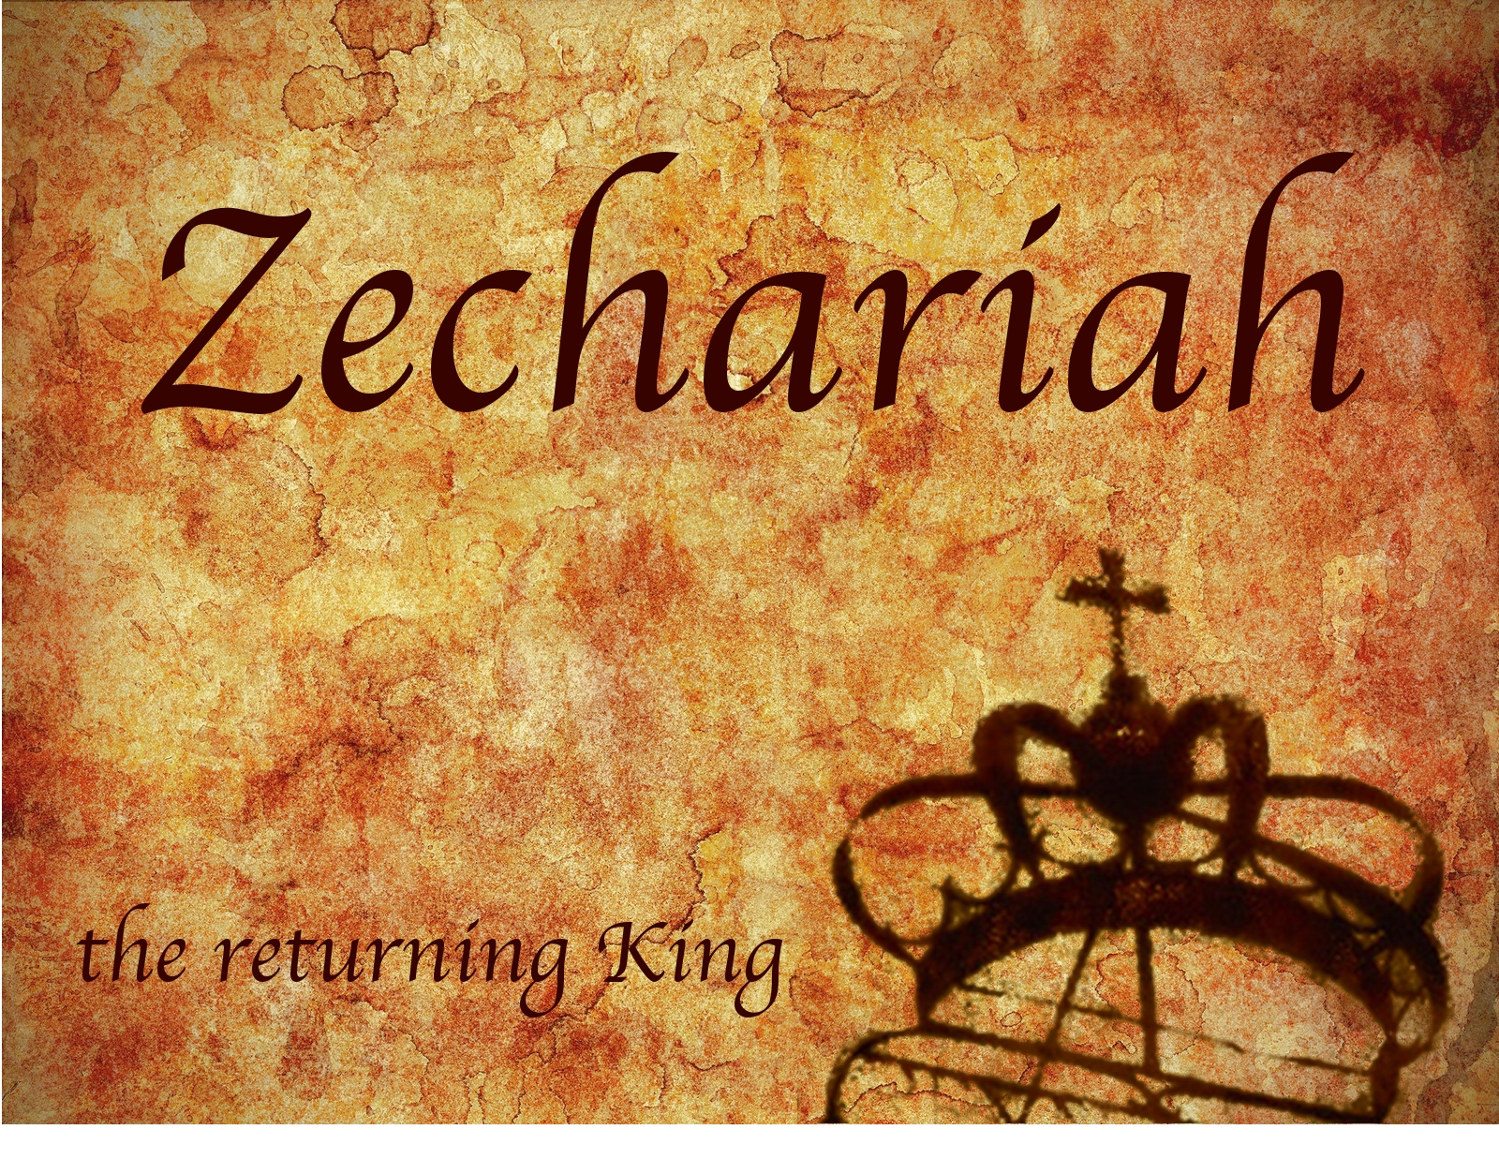
Zechariah
God Remembers!

Slide 2
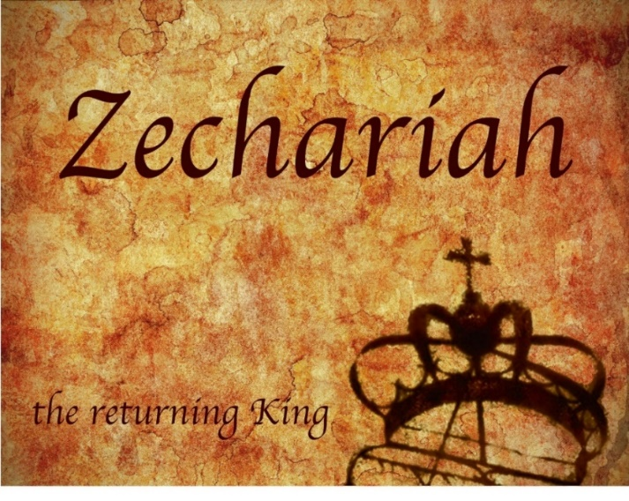
Structure
Introductory call to repentance (1:1-6)
Eight-night visions (1:7–6:15)
Question and answers about fasting (7–8)
Two burdens (9–14)

Slide 3
II. Eight Night Visions (1:7‒6:15)
Riders & horses among the myrtle trees (1:7-17)
Four horns & four craftsmen (1:18-21)
Man with the measuring line (2)
Cleansing of the High Priest Joshua (3)
Lampstand & olive tree (4)
Flying scroll (5:1-4)
Woman in the basket (5:5-11)
Four chariots (6:1-8)
Conclusion: crowning of Joshua (6:9-15)

Slide 4
ZECHARIAH’S EIGHT NIGHT VISIONS
Vision | Reference | Meaning
The Red-horse Rider among the Myrtles | 1:7-17 | God’s anger against the nations & blessing on restored Israel.
The Four Horns & the Four Craftsmen | 1:18-21 | God’s judgement on the nations that afflict Israel.
The Surveyor with a Measuring Line | Chapter 2 | God’s future blessing on restored Israel.
The Cleansing & Crowning of Joshua the Hight Priest. | Chapter 3 | Israel’s future cleansing from sin & reinstatement as a priestly nation.
The Golden Lampstand & the Two Olive Trees | Chapter 4 | Israel as the light to the nations under Messiah, the King-Priest.
The Flying Scroll | 5:1-4 | The severity & totality of divine judgment on individual Israelites.
The Woman in the Ephah | 5:5-11 | The removal of national Israel’s sin of rebellion against God.
The Four Chariots | 6:1-8 | Divine judgment on Gentile nations.

Slide 5
7. The Woman in the Ephah (5:5-11)
The Woman’s Identity (5:5-8)
The Woman’s Destination (5:9-11)

Slide 6
7. The Woman in the Ephah (5:5-11)
The Woman’s Identity (5:5-8)
The Woman’s Destination (5:9-11)

Slide 7
Zechariah 5:5-11
⁵ Then the angel who was speaking with me went out and said to me, “Lift up now your eyes and see what this is going forth.” ⁶ I said, “What is it?” And he said, “This is the ephah going forth.” Again he said, “This is their appearance in all the land ⁷ (and behold, a lead cover was lifted up); and this is a woman sitting inside the ephah.” ⁸ Then he said, “This is Wickedness!” And he threw her down into the middle of the ephah and cast the lead weight on its opening.

Slide 8
7. The Woman in the Ephah (5:5-11)
The Woman’s Identity (5:5-8)
The Woman’s Destination (5:9-11)

Slide 9
Zechariah 5:5-11
⁹ Then I lifted up my eyes and looked, and there two women were coming out with the wind in their wings; and they had wings like the wings of a stork, and they lifted up the ephah between the earth and the heavens. ¹⁰ I said to the angel who was speaking with me, “Where are they taking the ephah?” ¹¹ Then he said to me, “To build a temple for her in the land of Shinar; and when it is prepared, she will be set there on her own pedestal.”

Slide 10
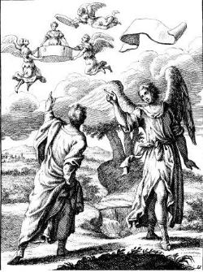
Zechariah 5:5-11
Woman (wickedness)
Ephah (commerce)
House (Temple – 2 Sam 7; religion)
Shinar (Gen 10:10; 11:2; Dan 1:2)

Slide 11
Charles L. Feinberg
God Remembers: A Study of Zechariah (Wheaton: Van Kampen, 1950, p. 91.
“The first mention of Shinar in the Bible is in Genesis 10:10. (It is found in all, six other times: Gen. 11:2; 14:1, 9; Isa. 11:11; Dan. 1:2; and here). In all instances where it occurs it is used as a definite geographical designation. Strictly speaking it covers more than Babylon but is it is employed to denote this land.”

Slide 12
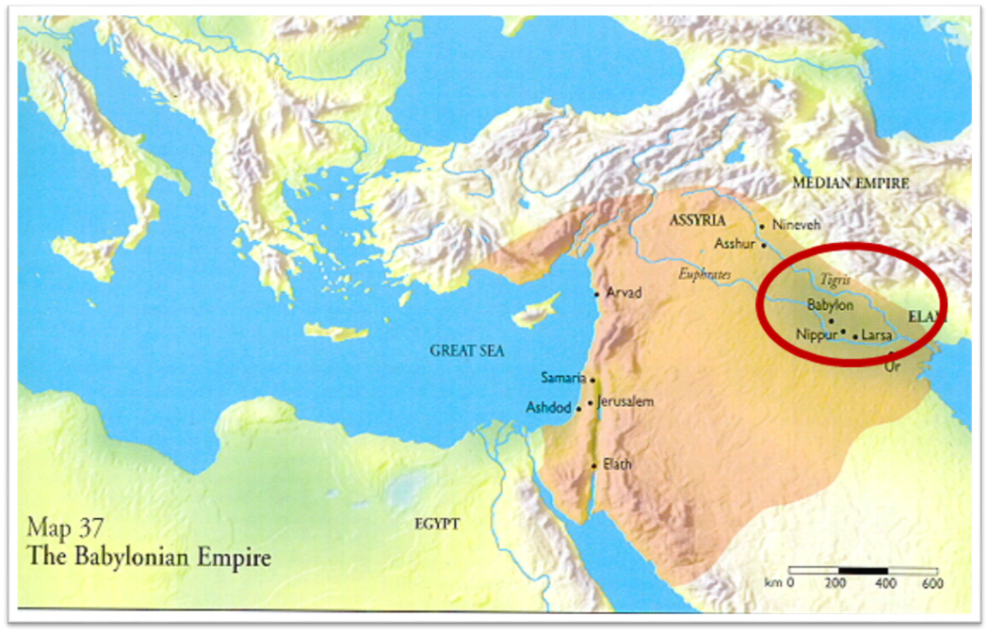

Slide 13
Genesis 11:1-4
¹ Now the whole earth used the same language and the same words. ² It came about as they journeyed east, that they found a plain in the land of Shinar and settled there. ³ They said to one another, “Come, let us make bricks and burn them thoroughly.” And they used brick for stone, and they used tar for mortar. ⁴ They said, “Come, let us build for ourselves a city, and a tower whose top will reach into heaven, and let us make for ourselves a name, otherwise we will be scattered abroad over the face of the whole earth.”

Slide 14
Daniel 1:1-2
“¹ In the third year of the reign of Jehoiakim king of Judah, Nebuchadnezzar king of Babylon came to Jerusalem and besieged it.² The Lord gave Jehoiakim king of Judah into his hand, along with some of the vessels of the house of God; and he brought them to the land of Shinar, to the house of his god, and he brought the vessels into the treasury of his god.”

Slide 15
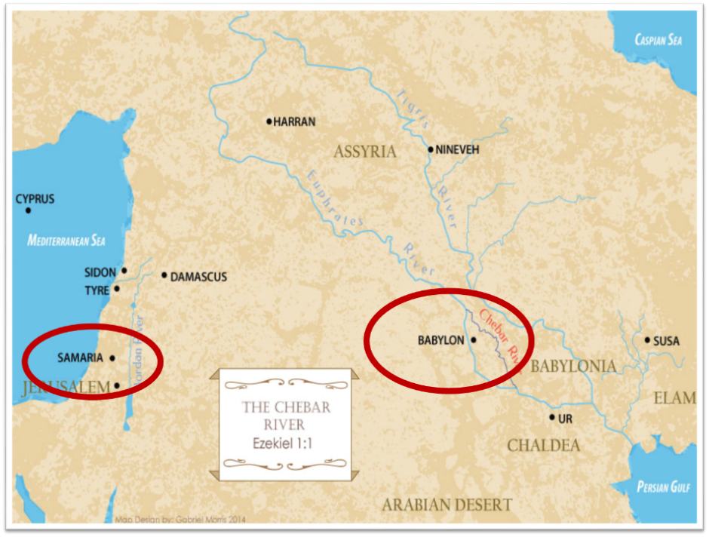

Slide 16
Charles L. Feinberg
God Remembers: A Study of Zechariah (Wheaton: Van Kampen, 1950, p. 93.
“Now, the prophet Zechariah foretells that in the last days all wickedness, with idolatry particularly in mind (see Matt. 12:43–45), that will be existent in Israel at that time will go back forcibly to the place of its origin, Babylon, the great apostate religious system. Such is the meaning of being settled on her own base. When we come to the book of Revelation all of this is clearly set forth in chapter 17 and 18. Not only the evil in Judaism, but that in Christendom as well, will wind up and culminate in that abominable system called mystical or mystery Babylon. The greatest sin in Israel, even wickedness itself, was idolatry. It will come to it’s settled abode at the very place of its inception (Rev. 18:24).”

Slide 17
Spread of the Mother-Child Cult
 | Mother | Child
Assyria | Ishtar | Tammuz
Phoenicia | Astarte | Baal
Egypt | Isis | Osirus/Horus
Greece | Aphrodite | Eros
Rome | Venus | Cupid
Asia | Cybele | Desius
India | Isi | Aswara
Roman Catholicism | Mary | Jesus
Israel | Queen of Heaven (Jer. 7:18; 44:17) | Tammuz (Ezek. 8:14-15)
Alexander Hislop, Two Babylons

Slide 18
Larkin, The Book of Revelation, 151.
“The river Euphrates, on which the city of Babylon was built, was one of the four branches into which the river that flowed through the Garden of Eden was divided, and Satan doubtless chose the site of Babylon as his headquarters from which to sally forth to tempt Adam and Eve. It was doubtless here that the Antediluvian apostasy had its source that ended in the flood. To this centre the ‘forces of Evil’ gravitated after the Flood, and ‘Babel’ was the result. This was the origin of the nations, but the nations were not scattered abroad over the earth until Satan had implanted in them the ‘Virus’ of a doctrine that has been the source of every false religion the world has ever known.”

Slide 19
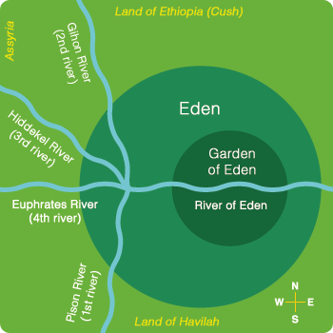

Slide 21
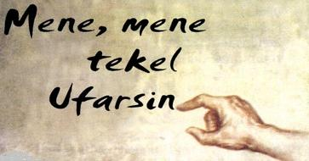
Daniel Interprets the Writing (5:24-28)

Slide 22
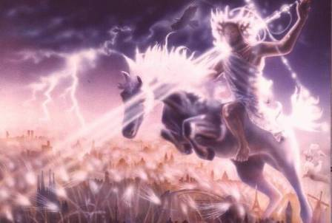
Isaiah 13-14
Day of the Lord (13:6-9)
Cosmic disturbances (13:10-13)
Global judgment (13:11-12)
Sodom and Gomorrah (13:19)
Complete and final desolation (13:20-22)
Universal peace and rest (14:5-8)
Israel’s regeneration (14:1-4)
Henry Morris, Revelation Record, 348.

Slide 23
Isaiah 13:12
“I will make mortal man scarcer than pure gold and mankind than the gold of Ophir.”

Slide 24
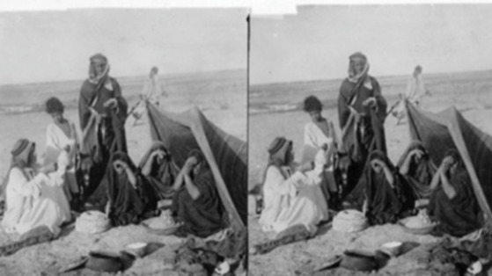
ARAB TENT HOME at Babylon 1899-1908 “It will never be inhabited or lived in from generation to generation; Nor will the Arab pitch his tent there” (Isaiah 13:20)
https://www.bibleprophecyaswritten.com/2-arabs/

Slide 25
Isaiah’s Oracles Against the Nations (Isa 13–23)
Babylon (13:1-14:23) Assyria (14:24-27) Philistia (14:28-32) Moab (15-16) Damascus and Samaria (17) Ethiopia (18) | Egypt (19-20) Babylon (21:1-10) Edom (21:11-12) Arabia (21:13-17) Jerusalem (22) Tyre (23)

Slide 26
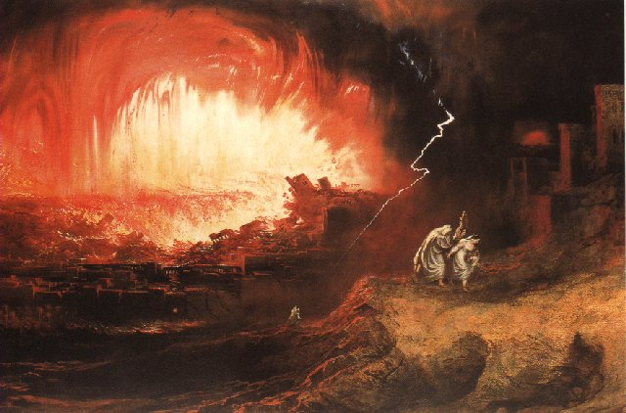
Jeremiah 50-51
Sudden destruction (51:8)
Complete destruction (50:3, 13, 26, 39-40; 51:29, 43, 62)
No reuse of building materials (51:26)
Believers flee (50:8; 51:6, 45)
Israel’s regeneration (50:2, 4-5, 20; 51:50)
Dyer, "The Identity of Babylon in Revelation 17–18 (Part 2)," 443-49.

Slide 27
Herodotus, Histories, 1:191 (450 B.C.)
“…he (Cyrus) conducted the river by a channel into the lake…and so he made the former course of the river passable by the sinking of the stream. When this had been done, the Persians who had been posted for this very purpose entered by the bed of the river Euphrates into Babylon, the stream having sunk so far that it reached about to the middle of a man’s thigh…those Babylonians who dwelt in the middle did not know that they had been captured…”

Slide 29
James Pritchard
The Ancient Near East Texts Relating to the Old Testament, 315-16.
Without any battle... sparing Babylon... any calamity....I am Cyrus...king of Babylon....When I entered Babylon...under jubilation and rejoicing...troops walked around Babylon...in peace, I did not allow anybody to terrorize (any place) of the [country of Sumer] and Akkad. I strove for peace in Babylon...and in all his (other) sacred cities....I returned to (these) sacred cities on the other side of the Tigris, the sanctuaries of which have been in ruins for a long time, the images which (used) to live therein and established for them permanent sanctuaries.

Slide 30
James Pritchard
The Ancient Near East Texts Relating to the Old Testament, 315-16.
I (also) gathered all their (former) inhabitants and returned (to them) their habitations. Furthermore, I resettled... unharmed, in their (former) chapels, the places which make them happy. May all the gods whom I have resettled in their sacred cities ask daily Bel and Nebo for a long life for me...all of them I resettled in a peaceful place... ducks and doves,...I endeavoured to fortify/repair their dwelling places . . .

Slide 31
Babylon’s History After 539 B.C.
Herodotus gives Babylon’s measurements (450 B.C.)
Alexander the Great visits and dies in Babylon (323 B.C.)
Seleucus seizes Babylon (312 B.C.)
Strabo pronounces Babylon’s hanging gardens as one of “seven wonders of the world” (25 B.C)
Babylonians present on Pentecost (Acts 2:9)
Talmud promulgated from Babylon (A.D. 500)
Haukal mentions Babylonian village (A.D. 917)
Babylon known as “Two Mosques” and “Hilah” (A.D. 1100)
Hitchcock and Ice, The Truth Behind Left Behind, 109

Slide 32
Dr. John Walvoord
The Nations in Prophecy, 63-64
“As far as the historic fulfillment is concerned, it is obvious from both Scripture and history that these verses have not been literally fulfilled. The city of Babylon continued to flourish after the Medes conquered it, and though its glory dwindled, especially after the control of the Medes and the Persians ended in 323 B.C., the city continued in some form or substance until A.D. 1000 and did not experience a sudden termination such as anticipated in this prophecy.”

Slide 33
Parallels Between Jeremiah 50-51 & Revelation 17-18
 | Jeremiah | Revelation
Associated with a Golden cup | 51:7a | 17:3-4; 18:6
Dwelling on many waters | 51:13 | 17:1
Intoxicating the nations | 51:7b | 17:2
Same name | 50:1 | 17:5
Persecuting the saints | 51:48 | 17:6; 18:24
Stone sinking into Euphrates | 51:63-64 | 18:21
Sudden destruction | 51:8 | 18:8
Destroyed by fire | 51:30 | 17:16
Final, uninhabitable | 50:39 | 18:21
Deserved | 50:29 | 18:6
God’s people flee | 51:6, 45 | 18:4
Heaven rejoices | 51:48 | 18:20
Dyer, "The Identity of Babylon in Revelation 17–18 (Part 2)," 441-43.

Slide 34
Larkin, The Book of Revelation, 158.
“…and this is in exact harmony with the words of Isa. 13:19. ‘And Babylon, the glory of kingdoms, the beauty of the Chaldees’ excellency, shall be as when God overthrew Sodom and Gomorrah;’ and the Prophet Jeremiah makes the same statement. Jer. 50:40. The destruction of Sodom and Gomorrah was not protracted through many centuries, their glory disappeared in a few hours (Gen. 19:24–28), and as ancient Babylon was not thus destroyed, the prophecies of Isaiah and Jeremiah cannot be fulfilled unless there is to be a future Babylon that shall be thus destroyed. In Rev. 16:17–19, we are told that Babylon shall be destroyed by an Earthquake, attended with most vivid and incessant lightning and awful thunder.”

Slide 35
Zechariah 1:7
On the twenty-fourth day of the eleventh month, which is the month Shebat, in the second year of Darius (519 b.c.*), the word of the Lord came to Zechariah the prophet, the son of Berechiah, the son of Iddo, as follows:
*Babylon fell in 539 b.c!

Slide 36
Newton Babylon: Its Future, History, and Doom, 1890, p. 64.
“That this event predicted in this remarkable passage remains still unaccomplished, is sufficiently evident from the fact of Zechariah’s having prophesied after Babylon had received that blow under which it has gradually waned. Zechariah lived after Babylon had passed into the hands of the Persians . . .”

Slide 37
Morris
The Revelation Record, 349
“Computer studies of the Institute for Creation Research have shown, for example, that Babylon is very near the geographical center of all the earth’s land masses. It is within navigable distances of the Persian Gulf and is at the crossroads of the three great continents of Europe, Asia and Africa. Thus there is no more ideal location anywhere for a world trade center, a world communication center, a world banking center, a world educational center, or especially, a world capital! The greatest historian of modern times, Arnold Toynbee, used to stress to all his readers and hearers that Babylon would be the best place in the world to build a future world cultural metropolis.”

Slide 38
June 2007 Conventional Oil Reserves
Rank | Country | Percentage of oil reserves
1 | Saudia Arabia | 21.9 %
2 | Iran | 11.4 %
3 | Iraq | 9.5 %
4 | Kuwait | 8.4 %
5 | United Arab Emirates | 8.1 %
6 | Venezuela | 6.6 %
7 | Russia | 6.6 %
8 | Libya | 3.4 %
David Jeremiah, What in the World is Going On, 207

Slide 39
Iraq Celebrates Naming Babylon a UNESCO World Heritage Site
QASSIM ABDUL-ZAHRA of Times of Israel - July 6, 2019
“BAGHDAD (AP) — Iraq on Friday celebrated the UNESCO World Heritage Committee’s decision to name the historic city of Babylon a World Heritage Site in a vote held in Azerbaijan’s capital, years after Baghdad began campaigning for the site to be added to the list…The 4,300-year-old Babylon — now mainly an archaeological ruin and two important museums — is where dynasties have risen and fallen since the earliest days of settled human civilization. King Hammurabi wrote his famous code of laws in Babylon, while Nebuchadnezzar sent his vast army from the city to Jerusalem to put down an uprising and bring the Jews back as slaves.”

Slide 40
“Want Middle East Stability? Move UN to Iraq”
“The idea of moving U.N. headquarters seems to resonate with many....Where should it go? Try Iraq…In order to maintain its fledgling democracy, Iraq needs international commitment, an inducement to stop factional violence, and a stable form of income not subject to the terrorists’ reprisals…New York is an expensive city, and representation at the U.N. is currently a costly endeavor…The remaining big spenders should have a positive effect on the Iraqi job market and improve the overall economy of the entire region, which might in turn reduce the tendency …”
Cynthia E. Ayers and David W. Cammons, “Want Middle East Stability? Move UN to Iraq,” Newsweek, April 9, 2007, posted at: Http://newsweek.washingtonpost.com/postglobal/needtoknow/2007/04/want_middle_east_stability_mov.html

Slide 41
A Prince’s $500 Billion Desert Dream: Flying Cars, Robot Dinosaurs and a Giant Artificial Moon
“Saudi Arabia’s crown prince turned to U.S. consultants for help imagining a massive new city-state in a barren section of his kingdom. What emerged was a Jetsons-style world of automation. SHARMA, Saudi Arabia—This seaside corner of northwest Saudi Arabia is so barren that the only abundant resources a group of consultants could identify were sunlight and ‘unlimited access to salt water.’ But Saudi crown prince Mohammed bin Salman didn’t see a wasteland when he landed in his helicopter here a few years ago. He saw the future — and hatched a plan for a $500 billion city-state to cover 10,000 square miles of rocky desert and empty coastline to attract the ‘world’s greatest minds and best talents’ to the world’s best paying jobs in the world’s most livable city.”
Justin Scheck, Rory Jones, and Summer Sawww.wsj.comid, “A Prince’s $500 Billion Dollar Desert Dream,” online:, 25 July 2019.

Slide 42
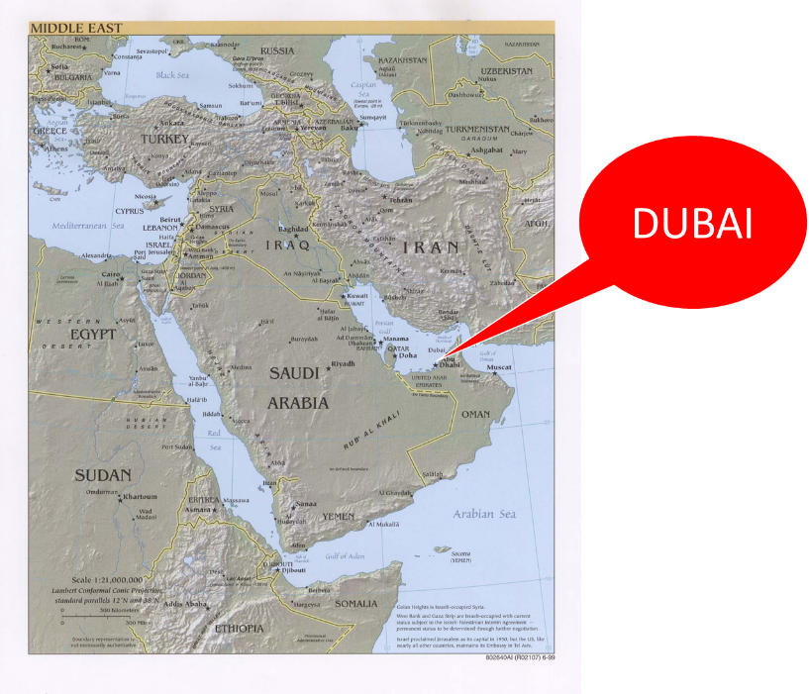

Slide 43
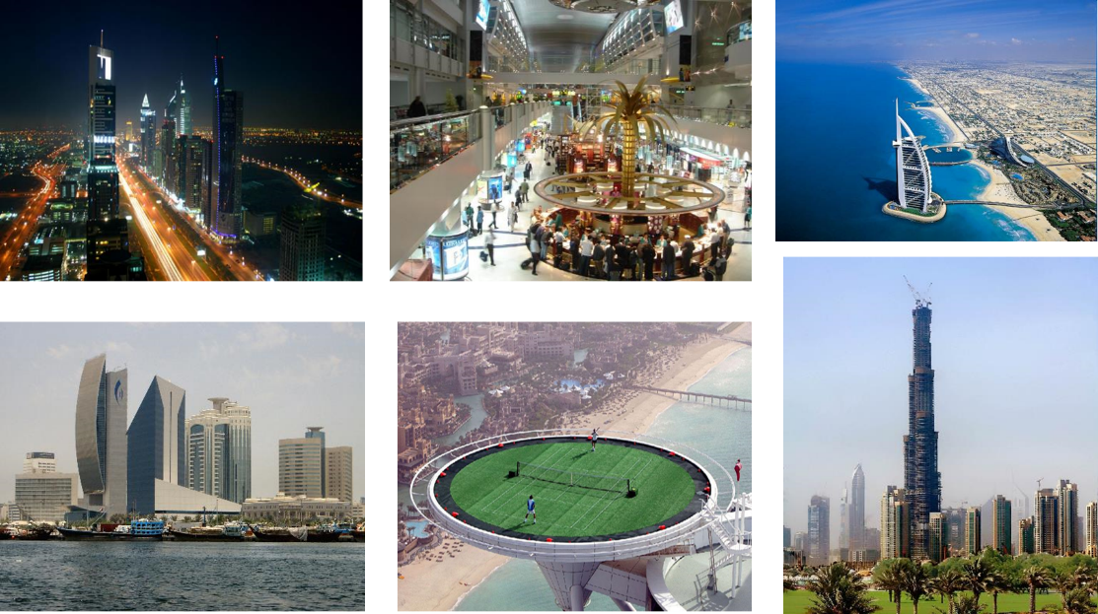

Slide 44
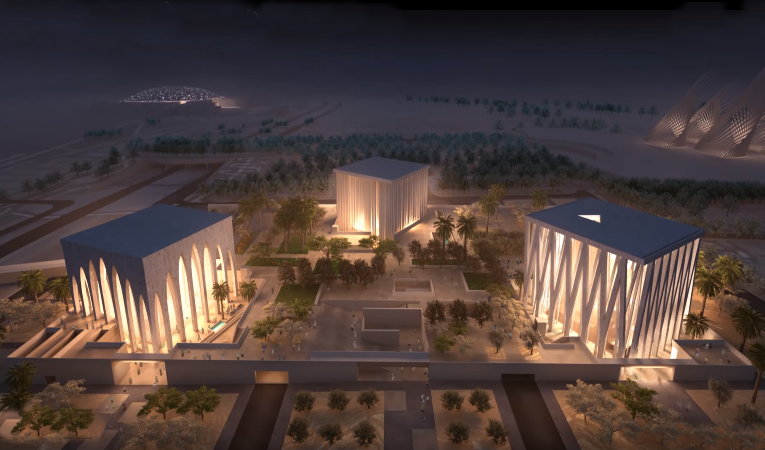

Slide 45
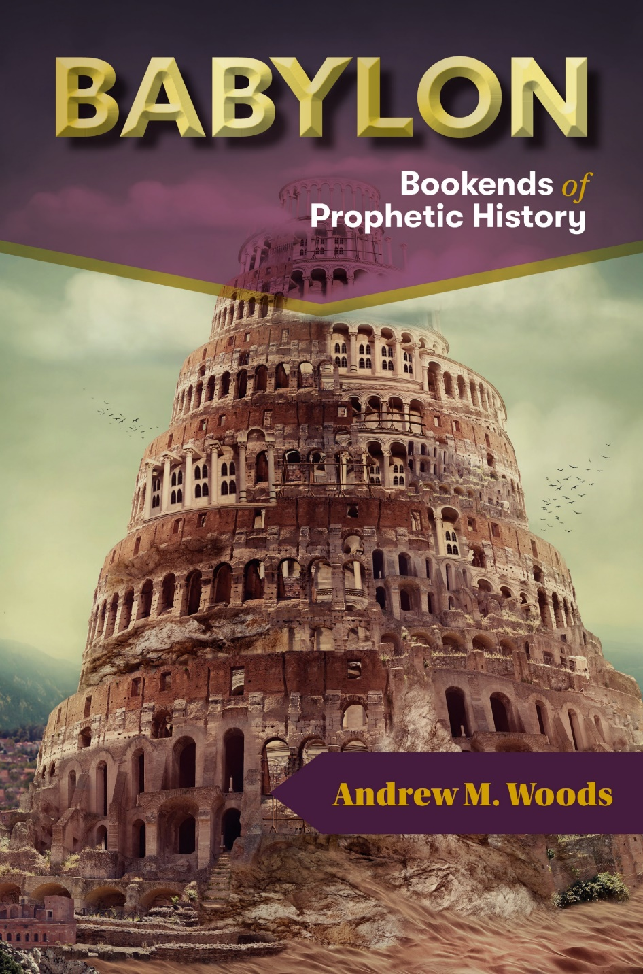
https://dispensationalpublishing.com/product/babylon-the-bookends-of-prophetic-history/

Slide 46
II. Eight Night Visions (1:7‒6:15)
Riders & horses among the myrtle trees (1:7-17)
Four horns & four craftsmen (1:18-21)
Man with the measuring line (2)
Cleansing of the High Priest Joshua (3)
Lampstand & olive tree (4)
Flying scroll (5:1-4)
Woman in the basket (5:5-11)
Four chariots (6:1-8)
Conclusion: crowning of Joshua (6:9-15)

Slide 47
ZECHARIAH’S EIGHT NIGHT VISIONS
Vision | Reference | Meaning
The Red-horse Rider among the Myrtles | 1:7-17 | God’s anger against the nations & blessing on restored Israel.
The Four Horns & the Four Craftsmen | 1:18-21 | God’s judgement on the nations that afflict Israel.
The Surveyor with a Measuring Line | Chapter 2 | God’s future blessing on restored Israel.
The Cleansing & Crowning of Joshua the Hight Priest. | Chapter 3 | Israel’s future cleansing from sin & reinstatement as a priestly nation.
The Golden Lampstand & the Two Olive Trees | Chapter 4 | Israel as the light to the nations under Messiah, the King-Priest.
The Flying Scroll | 5:1-4 | The severity & totality of divine judgment on individual Israelites.
The Woman in the Ephah | 5:5-11 | The removal of national Israel’s sin of rebellion against God.
The Four Chariots | 6:1-8 | Divine judgment on Gentile nations.

Slide 48
8. The Four Chariots (6:1-8)
The Vision (6:1-3)
The Interpretation (6:4-8)

Slide 49
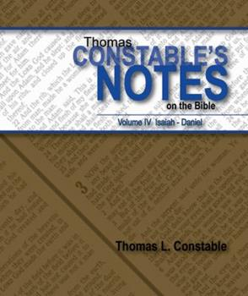
Thomas L. Constable
Constable’s online notes on Zechariah, p. 62.
“There is a similar emphasis on the fact that Yahweh controls history and subdues the nations that oppress Israel.”

Slide 50
8. The Four Chariots (6:1-8)
The Vision (6:1-3)
The Interpretation (6:4-8)

Slide 51
I. The Vision (6:1-3)
Four Chariots (1)
Four Horses (2-3)

Slide 52
I. The Vision (6:1-3)
Four Chariots (1)
Four Horses (2-3)

Slide 53
Charles L. Feinberg
God Remembers: A Study of Zechariah (Wheaton: Van Kampen, 1950, p. 76.
“Since the chariots go forth to actual geographical designations, as we shall see later, just so the mountains from whence they proceed are to be taken as representing a specific geographical locality. The mountains, in all probability, are Mount Zion and the Mount of Olives…Between these two mountains in Palestine [Israel] lies the Valley of Jehoshaphat, which is related in Scripture to the judgment of the nations.”

Slide 54
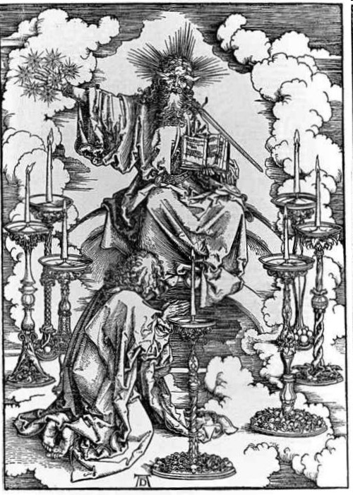
His Body (Rev. 1:14-16)
His hair (14a)
His eyes (14b)
His feet (15a)
His voice (15b)
His right hand (16a)
His mouth (16b)
His face (16c)

Slide 55
I. The Vision (6:1-3)
Four Chariots (1)
Four Horses (2-3)

Slide 56
8. The Four Chariots (6:1-8)
The Vision (6:1-3)
The Interpretation (6:4-8)

Slide 57
II. The Interpretation (6:4-8)
Zechariah’s Question (4)
Four Spirits Patrolling the Earth (5-7)
Destruction of the Land of the North (8)

Slide 58
II. The Interpretation (6:4-8)
Zechariah’s Question (4)
Four Spirits Patrolling the Earth (5-7)
Destruction of the Land of the North (8)

Slide 59
II. The Interpretation (6:4-8)
Zechariah’s Question (4)
Four Spirits Patrolling the Earth (5-7)
Destruction of the Land of the North (8)

Slide 60
Charles L. Feinberg
God Remembers: A Study of Zechariah (Wheaton: Van Kampen, 1950, p. 78.
“The four winds speak of divine judicial power exerted in judgment, carrying out the purposes of God. CF. Psalm 148:8; Jeremiah 49:36; Daniel 7:2; Revelation 7:1.”

Slide 61
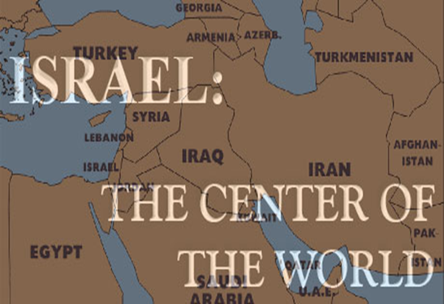
Ezekiel 38:12
“to capture spoil and to seize plunder, to turn your hand against the waste places which are now inhabited, and against the people who are gathered from the nations, who have acquired cattle and goods, who live at the center of the world.”

Slide 62
Ezekiel 5:5
“Thus says the Lord God, ‘This is Jerusalem; I have set her at the center of the nations, with lands around her.'”

Slide 63
Charles L. Feinberg
The Prophecy of Ezekiel: The Glory of the Lord, Paperback ed. (Chicago: Moody, 1969; reprint, Chicago: Moody, 1984), 223.
“An interesting phrase is employed to define the place where God’s people will be dwelling. It is called the middle (literally, the navel) of the earth as explained in 5:5. The land of Israel is in the center of the earth as far as God’s purposes for the world are concerned (cf. Deut. 32:8). Rabbinic literature states: ‘As the navel is set in the center of the human body, so the land of Israel is the navel of the world…Situated in the center of the world, in Jerusalem in the center of the land of Israel, and the sanctuary in the center of Jerusalem, and the holy place in the center of the sanctuary, and the ark in the center of the holy place, and the foundation stone before the holy place, because from it the world was founded.’ Midrash, Tanachma, Qedoshim.”

Slide 64
Ezekiel 39:2, 4
“² and I will turn you around, drive you on, take you up from the remotest parts of the north and bring you against the mountains of Israel…⁴You will fall on the mountains of Israel, you and all your troops and the peoples who are with you; I will give you as food to every kind of predatory bird and beast of the field.”

Slide 66
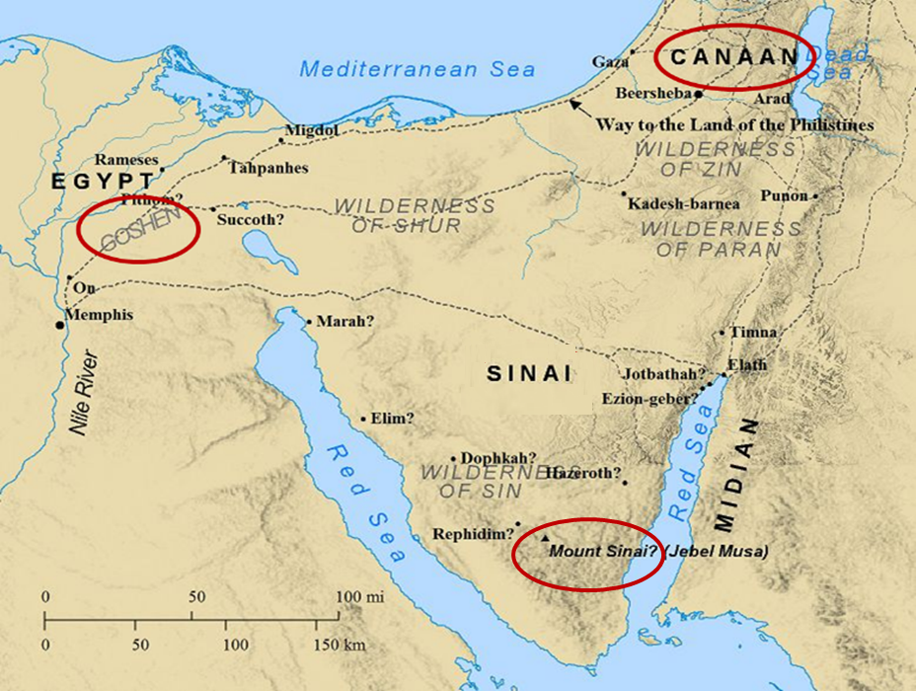

Slide 67
Harry Ironside
God Remembers: A Study of Zechariah (Wheaton: Van Kampen, 1950, p. 79.
“The special prophetic application of what Zechariah had beheld was at that moment connected with the king of Babylon on the north [Jer. 1:14, 15; 25:9] and Egypt on the south. Between these two powers God would sustain His feeble flock, checkmating every effort to destroy them till Messiah should Himself appear.”

Slide 68
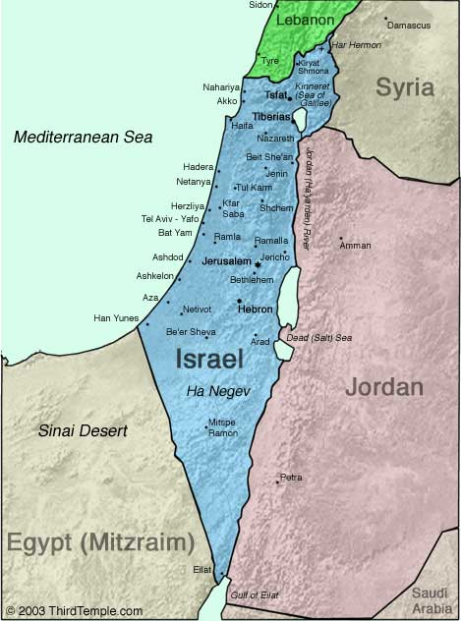

Slide 69
Thomas L. Constable
Constable’s online notes on Zechariah, p. 64-65.
“Because of the geography of Palestine [Israel], all of Israel's enemies came against her from the north or from the south; the Mediterranean Sea on the west, and the Arabian Desert on the east, prohibited major foreign invasions from those directions.”

Slide 70
Thomas L. Constable
Constable’s online notes on Zechariah, p. 65.
“Since the chariots went in compass directions, we should probably understand their judgment to be universal (cf. 2:6; Jer. 49:36; Ezek. 37:9; Rev. 7:1). They went north and south out of Palestine [Israel], but they executed judgment in every direction. The total picture is of God executing His judgments against all nations that oppose Israel.”

Slide 71
II. The Interpretation (6:4-8)
Zechariah’s Question (4)
Four Spirits Patrolling the Earth (5-7)
Destruction of the Land of the North (8)

Slide 73
Isaiah’s Oracles Against the Nations (Isa 13–23)
Babylon (13:1-14:23) Assyria (14:24-27) Philistia (14:28-32) Moab (15-16) Damascus and Samaria (17) Ethiopia (18) | Egypt (19-20) Babylon (21:1-10) Edom (21:11-12) Arabia (21:13-17) Jerusalem (22) Tyre (23)

Slide 74
Charles L. Feinberg
God Remembers: A Study of Zechariah (Wheaton: Van Kampen, 1950, p. 79.
“Why, then, is Babylon again before us in verse 8? First, it would serve to comfort and encourage the returned remnant of Israel that had come from Babylon. Second, the Babylonian world-empire, as a matter of history, had already experienced the judgment of God in her overthrow and downfall. Third, it is where that wickedness will again be established and finally extirpated. Cf. 5:11. In the end time, the coming of Christ again in the establishment of His kingdom in righteousness will be preceded by final judgment on wicked Babylon.”

Slide 75
Zechariah 5:5-11
⁹ Then I lifted up my eyes and looked, and there two women were coming out with the wind in their wings; and they had wings like the wings of a stork, and they lifted up the ephah between the earth and the heavens. ¹⁰ I said to the angel who was speaking with me, “Where are they taking the ephah?” ¹¹ Then he said to me, “To build a temple for her in the land of Shinar; and when it is prepared, she will be set there on her own pedestal.”

Slide 76
Charles L. Feinberg
God Remembers: A Study of Zechariah (Wheaton: Van Kampen, 1950, p. 91.
“The first mention of Shinar in the Bible is in Genesis 10:10. (It is found in all, six other times: Gen. 11:2; 14:1, 9; Isa. 11:11; Dan. 1:2; and here). In all instances where it occurs it is used as a definite geographical designation. Strictly speaking it covers more than Babylon but is it is employed to denote this land.”

Slide 77
Daniel Interprets the Writing (5:24-28)

Slide 78
Herodotus, Histories, 1:191 (450 B.C.)
“…he (Cyrus) conducted the river by a channel into the lake…and so he made the former course of the river passable by the sinking of the stream. When this had been done, the Persians who had been posted for this very purpose entered by the bed of the river Euphrates into Babylon, the stream having sunk so far that it reached about to the middle of a man’s thigh…those Babylonians who dwelt in the middle did not know that they had been captured…”

Slide 79
James Pritchard
The Ancient Near East Texts Relating to the Old Testament, 315-16.
Without any battle... sparing Babylon... any calamity....I am Cyrus...king of Babylon....When I entered Babylon...under jubilation and rejoicing...troops walked around Babylon...in peace, I did not allow anybody to terrorize (any place) of the [country of Sumer] and Akkad. I strove for peace in Babylon...and in all his (other) sacred cities....I returned to (these) sacred cities on the other side of the Tigris, the sanctuaries of which have been in ruins for a long time, the images which (used) to live therein and established for them permanent sanctuaries.

Slide 80
James Pritchard
The Ancient Near East Texts Relating to the Old Testament, 315-16.
I (also) gathered all their (former) inhabitants and returned (to them) their habitations. Furthermore, I resettled... unharmed, in their (former) chapels, the places which make them happy. May all the gods whom I have resettled in their sacred cities ask daily Bel and Nebo for a long life for me...all of them I resettled in a peaceful place... ducks and doves,...I endeavoured to fortify/repair their dwelling places . . .

Slide 81
VI. 8 New Promises Genesis 12:1-3
Land (Gen. 12:1b)
Great nation (Gen. 12:2a)
Personal blessing (Gen. 12:2b)
Great name (Gen. 12:2c)
Blessing to others (Gen. 12:2d)
Blessing to blessers (Gen. 12:3a)
Cursing to cursers (Gen. 12:3b)
Blessing to the world (Gen. 12:3c)

Slide 82
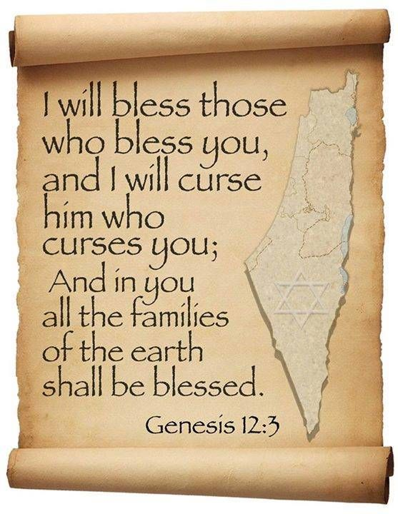
Genesis 12:3
“And I will bless those who bless you, And the one who curses you I will curse. And in you all the families of the earth will be blessed.”

Slide 83
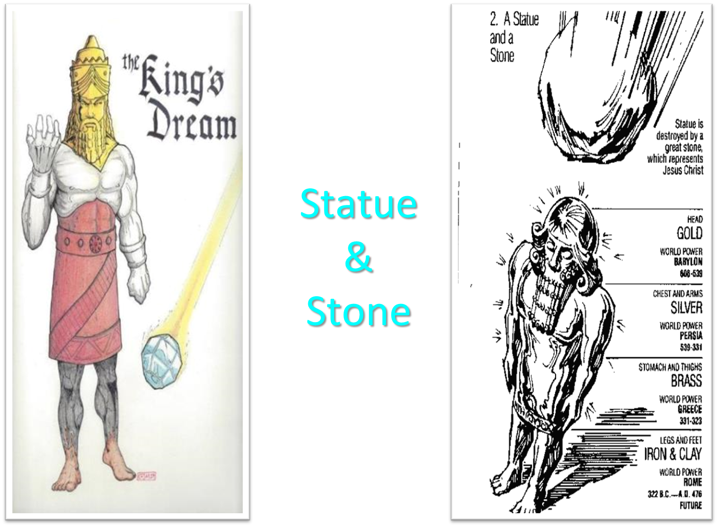

Slide 84
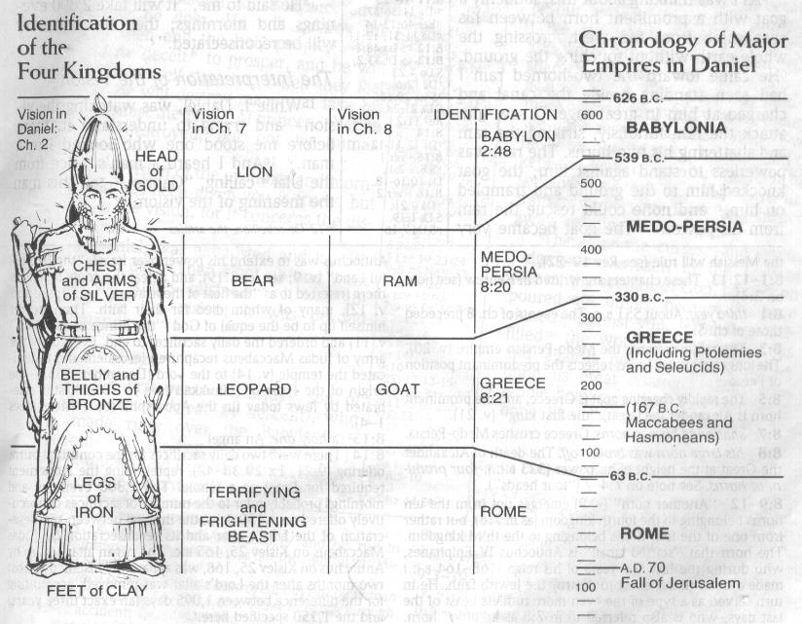

Slide 85
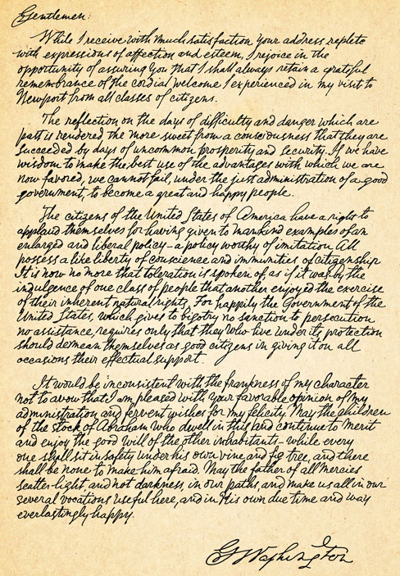
George Washington’s Letter to the Hebrew Congregation of Newport, Rhode Island, August 18, 1790
"I rejoice in the opportunity of assuring you, that I shall always retain a grateful remembrance of the cordial welcome I experienced in my visit to Newport... the Government of the United States, which gives to bigotry no sanction, to persecution no assistance... May the Children of the Stock of Abraham, who dwell in this land, continue to merit and enjoy the good will of the other Inhabitants; while every one shall sit in safety under his own vine and fig tree, and there shall be none to make him afraid."

Slide 86
Conclusion

Slide 87
8. The Four Chariots (6:1-8)
The Vision (6:1-3)
The Interpretation (6:4-8)

Slide 88
II. Eight Night Visions (1:7‒6:15)
Riders & horses among the myrtle trees (1:7-17)
Four horns & four craftsmen (1:18-21)
Man with the measuring line (2)
Cleansing of the High Priest Joshua (3)
Lampstand & olive tree (4)
Flying scroll (5:1-4)
Woman in the basket (5:5-11)
Four chariots (6:1-8)
Conclusion: crowning of Joshua (6:9-15)

