Slide 1
THE RAPTURE
Question and Answer – Part 12
Andrew Marshall Woods, Th.M., JD., PhD.
Sr. Pastor, Sugar Land Bible Church

Slide 2
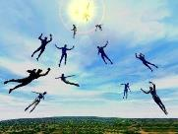
The Rapture Course Overview
What is the Rapture?
When is the Rapture?
Strengthening the Pre-Tribulational case
The opposing views
One second after the Rapture
Questions & Answers

Slide 3
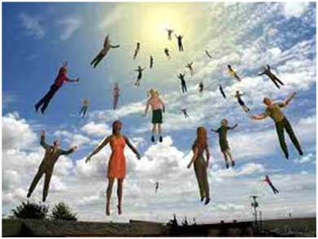
MAIL BAG
Church in Rev. 11:3-13?
Referring to the Tribulation?

Slide 4
MAIL BAG
Church in Rev. 11:3-13?
Referring to the Tribulation?

Slide 5
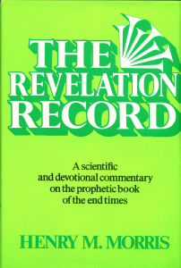
Morris
The Revelation Record, 323
“At the very least, it would be confusing to John’s first century readers, as well as to later generations, for him to write so much about Babylon when he really meant Rome (Paul was not afraid to speak directly against Rome in his writings, so why should John be?) or ‘the false church’ (all the apostles , including John, wrote plainly and scathingly about false teachers and false doctrines in the church and would not hide their teachings by symbols). It must be stressed that Revelation means ‘unveiling,’ not ‘veiling.’ In the absence of any statement in the text to the contrary, therefore, we must assume that the term Babylon applies to the real city of Babylon…”

Slide 6
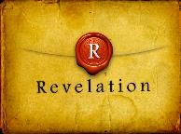
Revelation 1:1
“The Revelation [apokalypsis] of Jesus Christ, which God gave Him to show to His bond-servants, the things which must soon take place; and He sent and communicated it by His angel to His bond-servant John.”

Slide 8
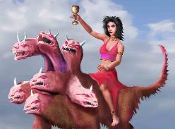
Revelation's Symbols and Figures of Speech
“Spiritually” (11:8)
“Sign” (12:1)
“Like” or “as” (8:8)
OT correspondence (Rev 13:2; Dan 7)
Contextual interpretations (17:18)
Absurdity (12:1)

Slide 9
Revelation's Symbols and Figures of Speech
“Spiritually” (11:8)
“Sign” (12:1)
“Like” or “as” (8:8)
OT correspondence (Rev 13:2; Dan 7)
Contextual interpretations (17:18)
Absurdity (12:1)

Slide 10
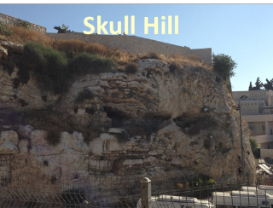
Revelation 11:8
“And their dead bodies will lie in the street of the great city which mystically is called Sodom and Egypt, where also their Lord was crucified.”

Slide 11
Revelation's Symbols and Figures of Speech
“Spiritually” (11:8)
“Sign” (12:1)
“Like” or “as” (8:8)
OT correspondence (Rev 13:2; Dan 7)
Contextual interpretations (17:18)
Absurdity (12:1)

Slide 12
Revelation 12:1-5
And a great sign (sēmeion) appeared in heaven: a woman clothed in the sun, and the moon under her feet, and upon her head a crown of twelve stars; ²and she was with child; and she cried out, being in labor pain to give birth. ³And another sign (sēmeion) was seen in heaven: and behold, a great red dragon, having seven heads and ten horns, and upon his heads seven diadems…

Slide 13
Revelation's Symbols and Figures of Speech
“Spiritually” (11:8)
“Sign” (12:1)
“Like” or “as” (8:8)
OT correspondence (Rev 13:2; Dan 7)
Contextual interpretations (17:18)
Absurdity (12:1)

Slide 14
Revelation's Symbols and Figures of Speech
“Spiritually” (11:8)
“Sign” (12:1)
“Like” or “as” (8:8)
OT correspondence (Rev 13:2; Dan 7)
Contextual interpretations (17:18)
Absurdity (12:1)

Slide 15
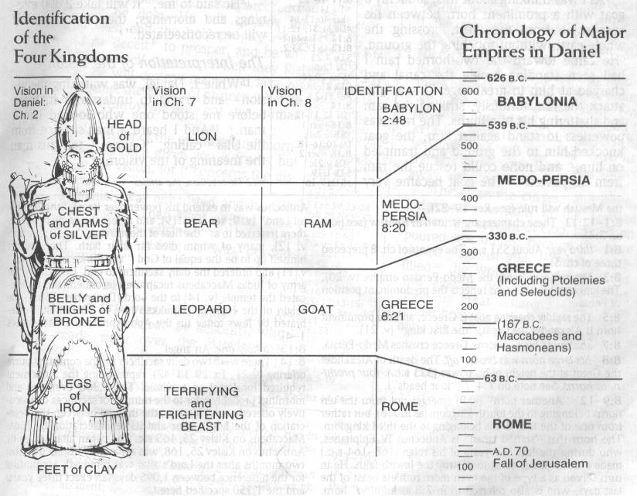

Slide 16
Revelation's Symbols and Figures of Speech
“Spiritually” (11:8)
“Sign” (12:1)
“Like” or “as” (8:8)
OT correspondence (Rev 13:2; Dan 7)
Contextual interpretations (17:18)
Absurdity (12:1)

Slide 17
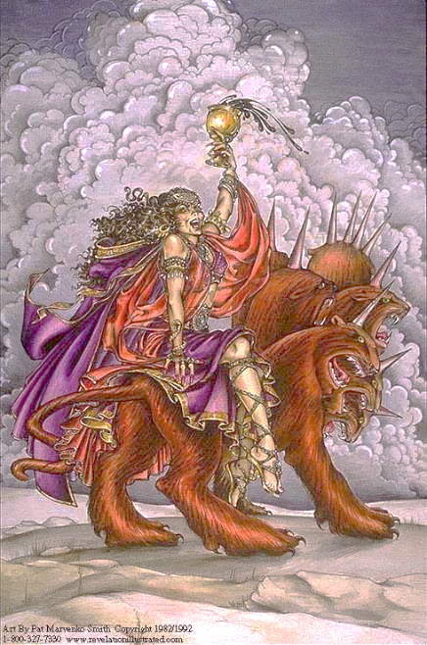

Slide 18
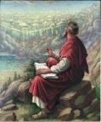
Revelation 17:18
“The woman whom you saw is the great city, which reigns over the kings of the earth.

Slide 19
Revelation's Symbols and Figures of Speech
“Spiritually” (11:8)
“Sign” (12:1)
“Like” or “as” (8:8)
OT correspondence (Rev 13:2; Dan 7)
Contextual interpretations (17:18)
Absurdity (12:1)

Slide 20
Revelation 12:1-5
¹And a great sign (sēmeion) appeared in heaven: a woman clothed in the sun, and the moon under her feet, and upon her head a crown of twelve stars; ²and she was with child; and she cried out, being in labor pain to give birth. ³And another sign (sēmeion) was seen in heaven: and behold, a great red dragon, having seven heads and ten horns, and upon his heads seven diadems. . . .

Slide 21
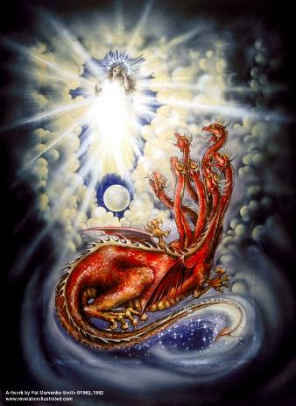
Assigning Meaning to Revelation’s Symbols and Figures of Speech
Comparison (Rev 8:8)
Context (Rev 12:3, 9)
Old Testament (Rev 12:1; Gen 37:9-10)

Slide 22
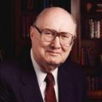
Two Rules of Interpretation
Search the immediate context
Walvoord: 26X
Search the remote context
Old Testament
Thomas: 278 / 404 verses

Slide 23
Revelation 12:1-5
¹And a great sign appeared in heaven: a woman clothed in the sun, and the moon under her feet, and upon her head a crown of twelve stars; ²and she was with child; and she cried out, being in labor pain to give birth. ³And another sign was seen in heaven: and behold, a great red dragon, having seven heads and ten horns, and upon his heads seven diadems ⁴And his tail swept a third part . . .

Slide 24
Revelation 12:1-5 (cont’d)
. . . of the stars of heaven, and did cast them to the earth: and the dragon stood before the woman that is about to give birth, so that when she gave birth he may devour her child. ⁵And she gave birth to a son, a man child, who is to rule all the nations with a rod of iron: and her child was caught up unto God, and to his throne.

Slide 25
CAST OF 3 CHARACTERS Revelation 12:1-5
SON (v.5)
DRAGON (v. 3)
WOMAN (v.1)

Slide 26
CAST OF 3 CHARACTERS Revelation 12:1-5
SON = MESSIAH
Ps. 2:9; Acts 1:9
DRAGON = SATAN
Rev. 12:9; 20:2
WOMAN = ISRAEL
Gen. 37:9-10

Slide 27
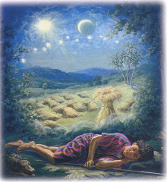
Genesis 37:9
Now he had still another dream, and related it to his brothers, and said, “Lo, I have had still another dream; and behold, the sun and the moon and eleven stars were bowing down to me.

Slide 28
Genesis 37:10
He related it to his father and to his brothers; and his father rebuked him and said to him, “What is this dream that you have had? Shall I and your mother and your brothers actually come to bow ourselves down before you to the ground?”

Slide 29
Sun = Jacob
Moon = Leah
11 Stars = Joseph’s brothers
12th Star = Joseph
12 Stars = Israel’s twelve tribes

Slide 30
MAIL BAG
Church in Rev. 11:3-13?
Referring to the Tribulation?

Slide 31
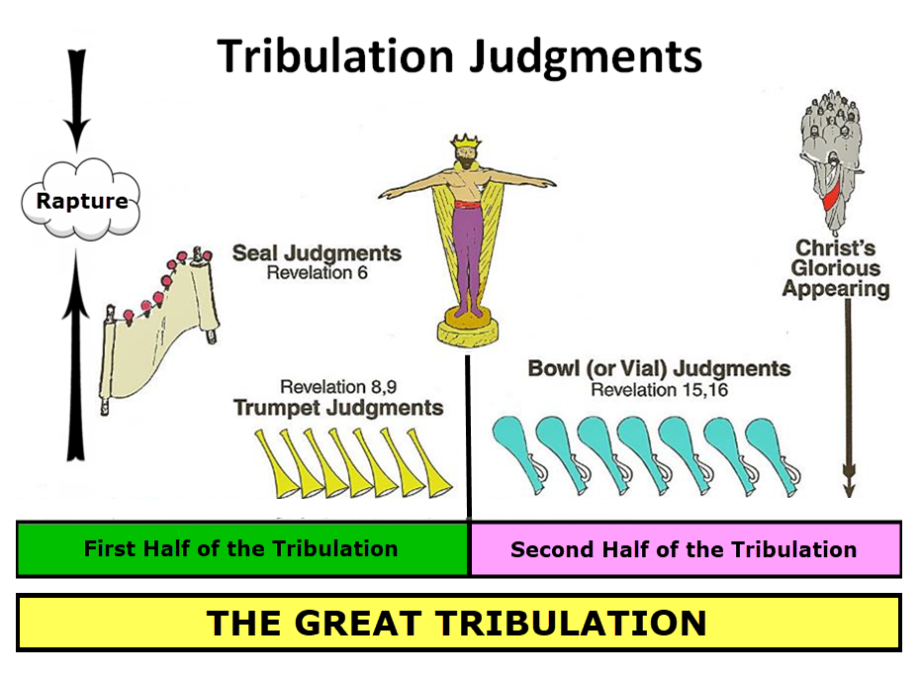

Slide 32
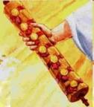
1st Six Seals (Revelation 6)
SEAL 1 – 6:1-2 – Advent of antichrist
SEAL 2 – 6:3-4 – War
SEAL 3 – 6:5-6 – Famine
SEAL 4 – 6:7-8 – Death
SEAL 5 – 6:9-11 – Martyrdoms
SEAL 6 – 6:12-17 – Cosmic disturbances

Slide 33
Revelation 7:14
“I said to him, “My lord, you know.” And he said to me, “These are the ones who come out of the great tribulation [thlípsis], and they have washed their robes and made them white in the blood of the Lamb.”

Slide 34
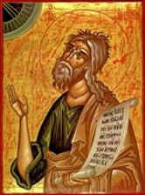
Jeremiah 30:7
“Alas! for that day is great, There is none like it; And it is the time of Jacob’s distress (Gen. 32:8; 35:10), But he will be saved from it.”

Slide 35
Isaiah 28:15
Because you have said, “We have made a covenant with death, And with Sheol we have made a pact. The gushing flood will not reach us when it passes by, Because we have made falsehood our refuge and we have concealed ourselves with deception.”

Slide 36
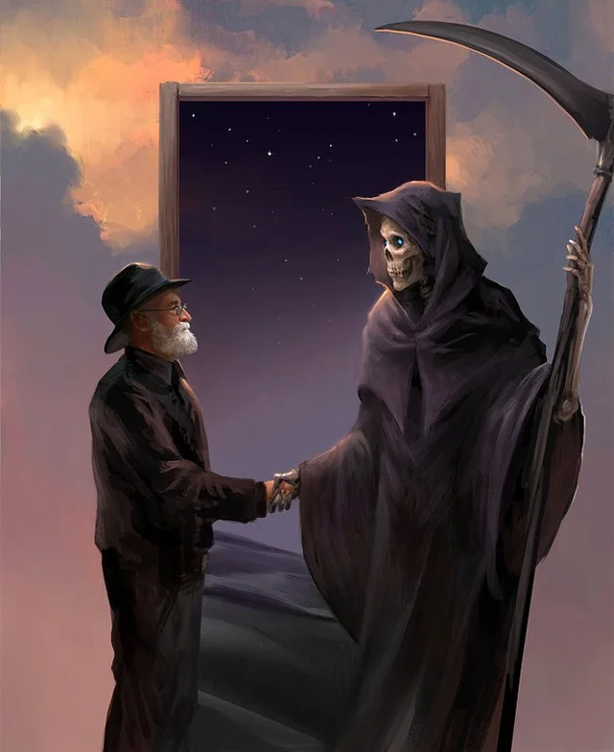
Isaiah 28:18
“Your covenant with death will be canceled, And your pact with Sheol will not stand; When the gushing flood passes through, Then you will become its trampling ground.

Slide 37
Daniel 9:27
And he will make a firm covenant with the many for one week, but in the middle of the week he will put a stop to sacrifice and grain offering; and on the wing of abominations will come one who makes desolate, even until a complete destruction, one that is decreed, is poured out on the one who makes desolate.

Slide 39
Matthew 24:15-16
“¹⁵ Therefore when you see the abomination of desolation which was spoken of through Daniel the prophet, standing in the holy place (let the reader understand) ¹⁶ then those who are in Judea must flee to the mountains.”

Slide 40
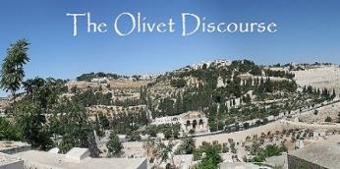
Matthew 24:21-22
“²¹ For then there will be a great tribulation, such as has not occurred since the beginning of the world until now, nor ever will. ²² Unless those days had been cut short, no life would have been saved; but for the sake of the elect those days will be cut short.”

Slide 41
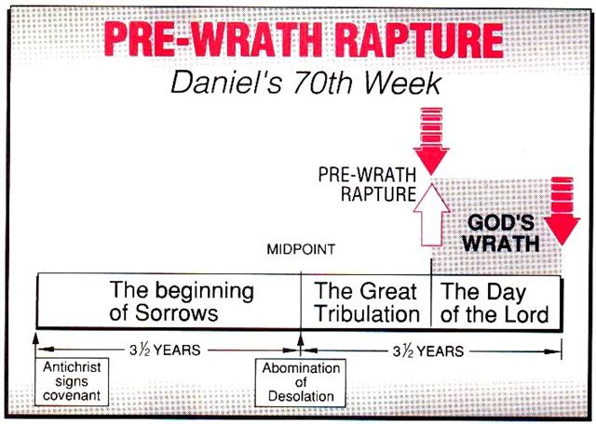
Marvin J. Rosenthal, The Pre-Wrath Rapture of the Church: A New Understanding of the Tribulation, and the Second Coming (Nashville, TN: Thomas Nelson, 1990), 112.

Slide 42
Zephaniah 1:14-15
¹⁴ The great day of the Lord is near, Near and coming very quickly; Listen, the day of the Lord! In it the warrior cries out bitterly. ¹⁵ That day is a day of anger, A day of trouble (LXX: thlipis) and distress, A day of destruction and desolation, A day of darkness and gloom, A day of clouds and thick darkness.

Slide 43
CONCLUSION

Slide 44
MAIL BAG
Church in Rev. 11:3-13?
Referring to the Tribulation?

