Slide 1
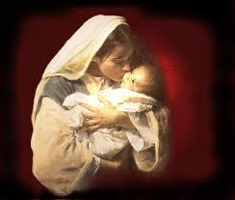

The Christmas That ‘Almost’
Did Not Happen
Andrew Marshall Woods, Th.M., JD., PhD.
Sr. Pastor, Sugar Land Bible Church

Slide 2

Revelation 12:1-5
¹And a great sign appeared in heaven: a woman clothed in the sun, and the moon under her feet, and upon her head a crown of twelve stars; ²and she was with child; and she cried out, being in labor pain to give birth. ³And another sign was seen in heaven: and behold, a great red dragon, having seven heads and ten horns, and upon his heads seven diadems ⁴And his tail swept a third part of . . .

Slide 3
Revelation 12:1-5 (cont’d)
. . . the stars of heaven, and did cast them to the earth: and the dragon stood before the woman that is about to give birth, so that when she gave birth he may devour her child. ⁵And she gave birth to a son, a man child, who is to rule all the nations with a rod of iron: and her child was caught up unto God, and to his throne.

Slide 4
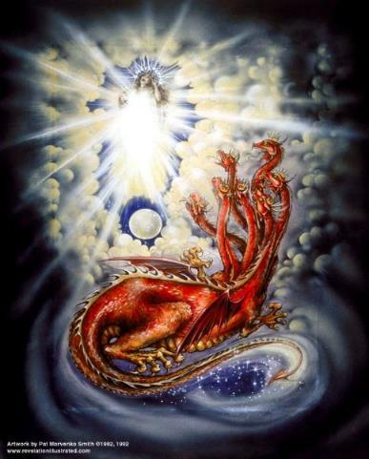
CAST OF 3 CHARACTERS
Revelation 12:1-5
SON (v.5)
DRAGON (v. 3)
WOMAN (v.1)

Slide 5
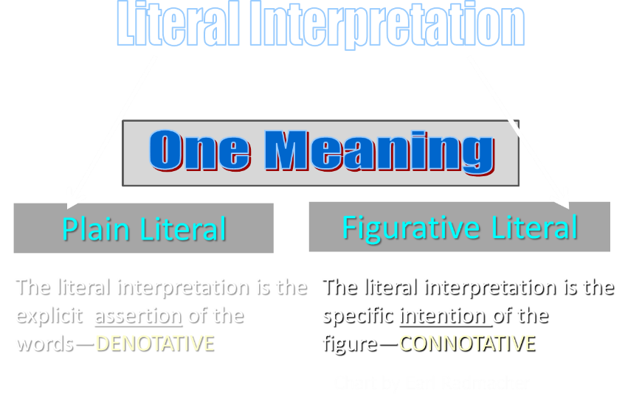

Slide 6
Revelation 12:1-5
¹And a great sign (sēmeion) appeared in heaven: a woman clothed in the sun, and the moon under her feet, and upon her head a crown of twelve stars; ²and she was with child; and she cried out, being in labor pain to give birth. ³And another sign (sēmeion) was seen in heaven: and behold, a great red dragon, having seven heads and ten horns, and upon his heads seven diadems…

Slide 7
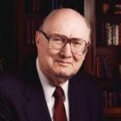
Two Rules of Interpretation
Search the immediate context
  Walvoord: 26X
Search the remote context
  Old Testament
  Thomas: 278 / 404 verses

Slide 8
CAST OF 3 CHARACTERS
Revelation 12:1-5
SON = MESSIAH
  Ps. 2:9; Acts 1:9
DRAGON = SATAN
  Rev. 12:9; 20:2
WOMAN = ISRAEL
  Gen. 37:9-10

Slide 9

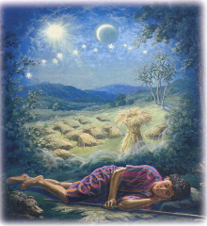
Genesis 37:9
Now he had still another dream, and related it to his brothers, and said, “Lo, I have had still another dream; and behold, the sun and the moon and eleven stars were bowing down to me.

Slide 10

Genesis 37:10
He related it to his father and to his brothers; and his father rebuked him and said to him, “What is this dream that you have had? Shall I and your mother and your brothers actually come to bow ourselves down before you to the ground?”

Slide 11

Sun = Jacob
Moon = Leah
11 Stars = Joseph’s brothers
12th Star = Joseph
12 Stars = Israel’s twelve tribes

Slide 12
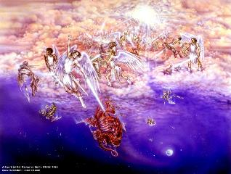
Biblical Reality of the Angelic World
Job 1:12
2 Kings 6:15-17
1 Chron. 21:1
Dan. 10:12-13, 20
Matt. 16:21-23
Luke. 22:31-32
Eph. 6:12

Slide 13
Satan as Ruler of this World
Job 1:7; 2:2
Luke 4:5-7
John 12:31; 14:30; 16:11
2 Corinthians 4:4
Ephesians 2:2
1 John 4:4; 5:19

Slide 14

Names & Titles Demonstrating Satan’s Post-Fall, Earthly Authority
(Job 1:7; 2:2; Luke 4:5-8; Rom. 8:19-22)
Prince of this world (John 12:31; 14:30; 16:11)
God of this age (2 Cor. 4:4)
Prince and power of the air (Eph. 2:2)
Who the believer wrestles with (Eph. 6:12)
Roaring lion (1 Pet. 5:8)
Whole world lies in his power (1 John 5:19)

Slide 15


2 Corinthians 2:11
“so that no advantage would be taken of us by Satan, for we are not ignorant of his schemes.”

Slide 16
Ezekiel 28:17
“Your heart was lifted up because of your beauty; You corrupted your wisdom by reason of your splendor.”

Slide 17
Revelation 12:1-5 (cont’d)
. . . the stars of heaven, and did cast them to the earth: and the dragon stood before the woman that is about to give birth, so that when she gave birth he may devour her child. ⁵And she gave birth to a son, a man child, who is to rule all the nations with a rod of iron: and her child was caught up unto God, and to his throne.

Slide 18
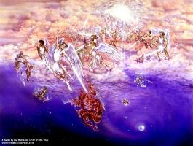
Different Perspectives – Same Event
Matt. 2 – Physical World
Rev. 12:1-5 – Spiritual World

Slide 19


Genesis 3:15
“And I will put enmity Between you and the woman, And between your seed and her seed; He shall bruise you on the head, And you shall bruise him on the heel.”

Slide 20

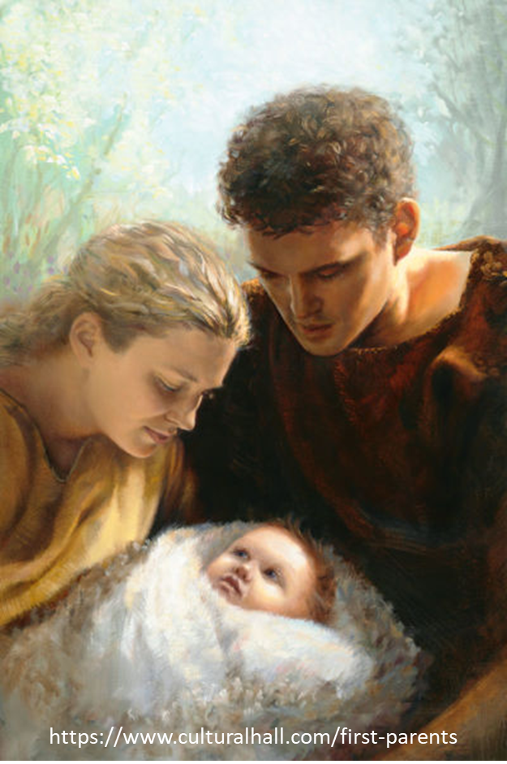
Genesis 4:1
“Now the man had relations with his wife Eve, and she conceived and gave birth to Cain, and she said, ‘I have gotten a manchild with the help of the Lord.’”

Slide 21
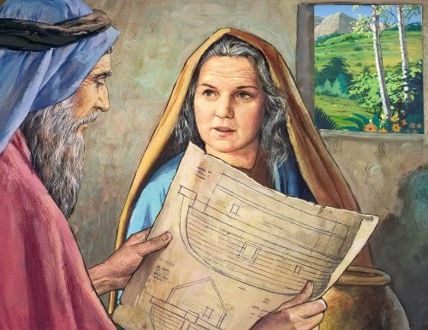
Genesis 5:29
“Now he called his name Noah, saying, ‘This one will give us rest from our work and from the toil of our hands arising from the ground which the Lord has cursed.’”

Slide 22
Genesis 3:15
“And I will put enmity Between you and the woman, And between your seed and her seed; He shall bruise you on the head, And you shall bruise him on the heel.”

Slide 23
Two-Fold Pattern
Satanic attack
God’s miraculous protection

Slide 24
Satanic Attempts to Stop Messiah’s Birth
Cain & Abel (Gen. 4)
Sons of God (Gen. 6)
Pharaoh persecutes Israel (Exod. 1)
Joash protected from Athaliah (2 Chron. 22‒23)
Haman persecutes Israel (Esther)
Antiochus Epiphanes (Dan. 11:31)
Herod persecutes Christ (Matt 2; Rev 12:4)

Slide 25
Satanic Attempts to Stop Messiah’s Birth
Cain & Abel (Gen. 4)
Sons of God (Gen. 6)
Pharaoh persecutes Israel (Exod. 1)
Joash protected from Athaliah (2 Chron. 22‒23)
Haman persecutes Israel (Esther)
Antiochus Epiphanes (Dan. 11:31)
Herod persecutes Christ (Matt 2; Rev 12:4)

Slide 26
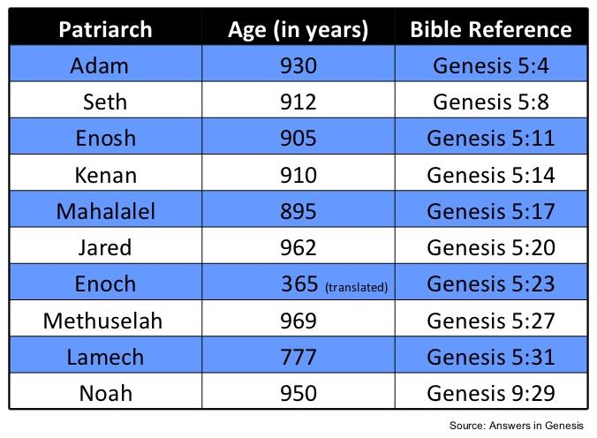

Slide 27
Satanic Attempts to Stop Messiah’s Birth
Cain & Abel (Gen. 4)
Sons of God (Gen. 6)
Pharaoh persecutes Israel (Exod. 1)
Joash protected from Athaliah (2 Chron. 22‒23)
Haman persecutes Israel (Esther)
Antiochus Epiphanes (Dan. 11:31)
Herod persecutes Christ (Matt 2; Rev 12:4)

Slide 28
Genesis 3:15
“And I will put enmity Between you and the woman, And between your seed and her seed; He shall bruise you on the head, And you shall bruise him on the heel.”

Slide 29

Genesis 6:1-4
“¹ Now it came about, when men began to multiply on the face of the land, and daughters were born to them, ² that the sons of God saw that the daughters of men were beautiful; and they took wives for themselves, whomever they chose. ³ Then the Lord said, ‘My Spirit shall not strive with man forever, because he also is flesh; nevertheless his days shall be one hundred and. . .

Slide 30
Genesis 6:1-4
. . . twenty years.’ ⁴ The Nephilim were on the earth in those days, and also afterward, when the sons of God came in to the daughters of men, and they bore children to them. Those were the mighty men who were of old, men of renown.”

Slide 31

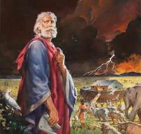
Genesis 6:8-9
“ ⁸ But Noah found favor in the eyes of the Lord. ⁹ These are the records of the generations of Noah. Noah was a righteous man, blameless in his time; Noah walked with God.”

Slide 32
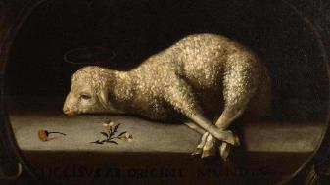
Exodus 12:5
“Your lamb shall be an unblemished male a year old; you may take it from the sheep or from the goats.”

Slide 33
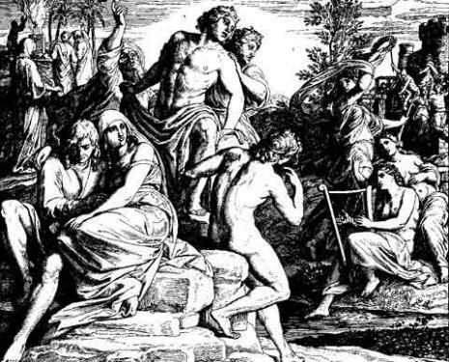
3 Major Alternative Views
Intermarriage between the Godly line of Seth and the ungodly lines of Cain.
Polygamous Cainite despots.
Fallen angels procreating with human women.

Slide 34
DOES NOT REFER TO ANGELS | DOES REFER TO ANGELS
Millard Erickson | John MacArthur
J. Sidlow Baxter | Henry Morris
Warren Wiersbe | Arnold Fruchtenbaum
Paul Enns | Robert Lightner
Gleason Archer | D. Edmond Hiebert
John Sailhammer | James Boice
Wayne Grudem | Robert Morey
Meredith Kline | M. R. DeHann
Leupold | Charles Ryrie
Williamson, unpublished paper, DTS

Slide 35
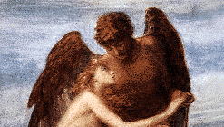
3 Reasons Supporting Sons of God
Men (6:1) versus the sons of God (6:2)
Old Testament uses (Gen 6:2, 4; Job 1:6; 2:1; 38:7)
Septuagint (LXX)

Slide 36
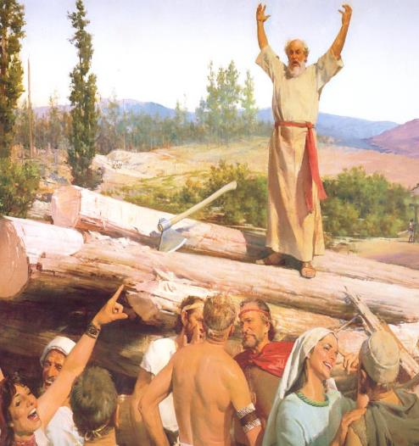
4 Additional Arguments From Genesis 6
Nephilim (Gen 6:4)
Noah’s perfection (6:9)
Evil of pre-flood humanity (Gen 6:3, 5-7, 11-13)
Necessity of the flood

Slide 37
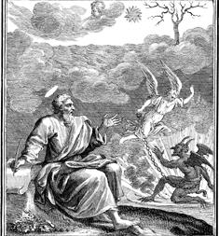
Relevant New Testament Passages
1 Peter 3:19-20
2 Peter 2:4-5
Jude 6-7

Slide 38
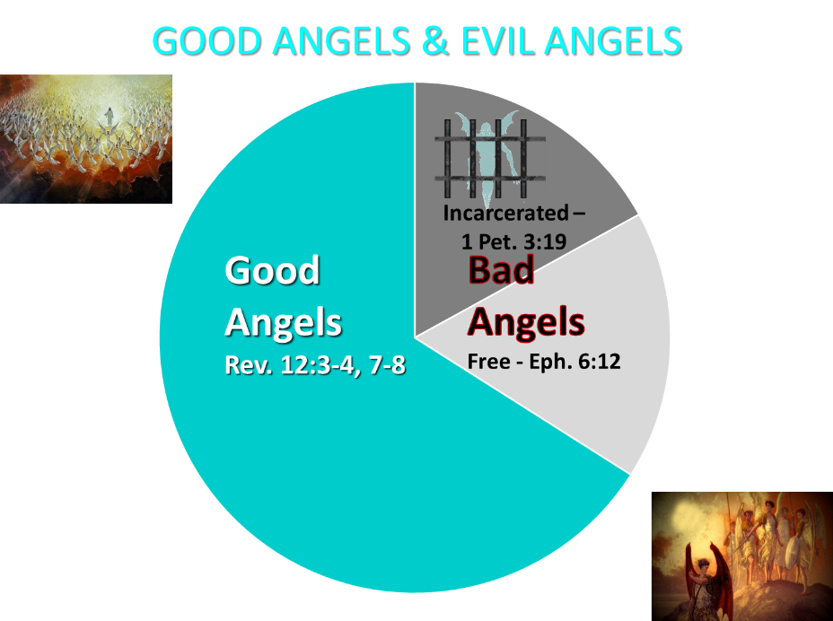

Slide 39

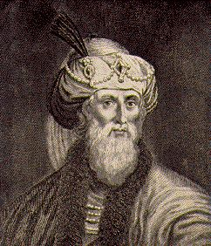
Jewish Tradition
Philo
Josephus
Most Rabbinical Writers
Apocrypha
Pseudepigrapha
Renald Showers, Those Invisible Spirits Called Angels, 93-109

Slide 40
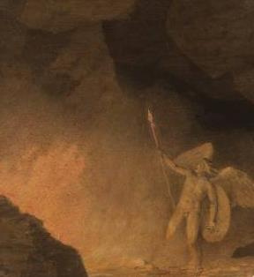
Christian Tradition
Justin
Clement
Tertullian
Cyprian
Ambrose
Lactantius
Renald Showers, Those Invisible Spirits Called Angels, 93-109

Slide 41
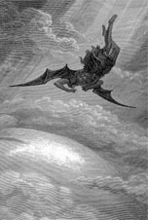
Objections
Angels do not marry? (Matt. 22:30)
Angels are spirits (Heb. 1:14)

Slide 42
Satanic Attempts to Stop Messiah’s Birth
Cain & Abel (Gen. 4)
Sons of God (Gen. 6)
Pharaoh persecutes Israel (Exod. 1)
Joash protected from Athaliah (2 Chron. 22‒23)
Haman persecutes Israel (Esther)
Antiochus Epiphanes (Dan. 11:31)
Herod persecutes Christ (Matt 2; Rev 12:4)

Slide 43
Messiah Must Be:
  A man (Gen 3:15)
  Semitic (Gen 9:26)
  From Abraham’s line (Gen 12:3)
  From Isaac’s line (Gen 17:18-19)
  From Jacob’s line (Num 24:17)

Slide 44


Slide 45
Satanic Attempts to Stop Messiah’s Birth
Cain & Abel (Gen. 4)
Sons of God (Gen. 6)
Pharaoh persecutes Israel (Exod. 1)
Joash protected from Athaliah (2 Chron. 22‒23)
Haman persecutes Israel (Esther)
Antiochus Epiphanes (Dan. 11:31)
Herod persecutes Christ (Matt 2; Rev 12:4)

Slide 46
Messiah Must Be:
  A man (Gen 3:15)
  Semitic (Gen 9:26)
  From Abraham’s line (Gen 12:3)
  From Isaac’s line (Gen 17:18-19)
  From Jacob’s line (Num 24:17)
  From the Tribe of Judah (Gen. 49:10)

Slide 47
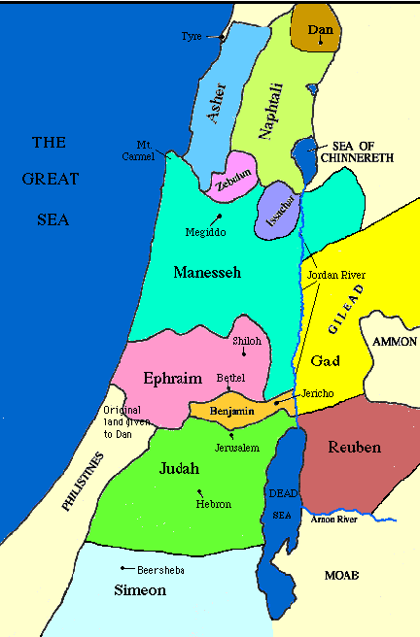

Slide 49
Satanic Attempts to Stop Messiah’s Birth
Cain & Abel (Gen. 4)
Sons of God (Gen. 6)
Pharaoh persecutes Israel (Exod. 1)
Joash protected from Athaliah (2 Chron. 22‒23)
Haman persecutes Israel (Esther)
Antiochus Epiphanes (Dan. 11:31)
Herod persecutes Christ (Matt 2; Rev 12:4)

Slide 50


Slide 51


Slide 52
Levitical Feasts (Leviticus 23)
Feast | Season | Purpose | Type
Passover | Spring | Redemption | 1 Cor 5:7
Unleavened Bread | Spring | Separation | John 6:35
1st fruits | Spring | Praise | 1 Cor 15:20
Pentecost | Spring | Praise | Acts 2:1-4
Trumpets | Fall | New Year | Matt 24:31
Atonement | Fall | Lev 16 | Zech 12:10
Booths | Fall | Wilderness provision | Zech 14:16-18

Slide 53


Slide 54
Satanic Attempts to Stop Messiah’s Birth
Cain & Abel (Gen. 4)
Sons of God (Gen. 6)
Pharaoh persecutes Israel (Exod. 1)
Joash protected from Athaliah (2 Chron. 22‒23)
Haman persecutes Israel (Esther)
Antiochus Epiphanes (Dan. 11:31)
Herod persecutes Christ (Matt 2; Rev 12:4)

Slide 55

HANUKKAH
The Maccabean revolt
December 25th 164 BC : the temple is liberated and rededicated
1 & 2 Maccabees
The miracle of the lamp oil
Hanukkah “Feast of Dedication” (festival of lights).
Christmas / Jewish Holiday
John 10:22-24

Slide 57
Satanic Attempts to Stop Messiah’s Birth
Cain & Abel (Gen. 4)
Sons of God (Gen. 6)
Pharaoh persecutes Israel (Exod. 1)
Joash protected from Athaliah (2 Chron. 22‒23)
Haman persecutes Israel (Esther)
Antiochus Epiphanes (Dan. 11:31)
Herod persecutes Christ (Matt 2; Rev 12:4)

Slide 58
Different Perspectives – Same Event
Matt. 2 – Physical World
Rev. 12:1-5 – Spiritual World

Slide 59
Revelation 12:1-5 (cont’d)
. . . the stars of heaven, and did cast them to the earth: and the dragon stood before the woman that is about to give birth, so that when she gave birth he may devour her child. ⁵And she gave birth to a son, a man child, who is to rule all the nations with a rod of iron: and her child was caught up unto God, and to his throne.

Slide 60
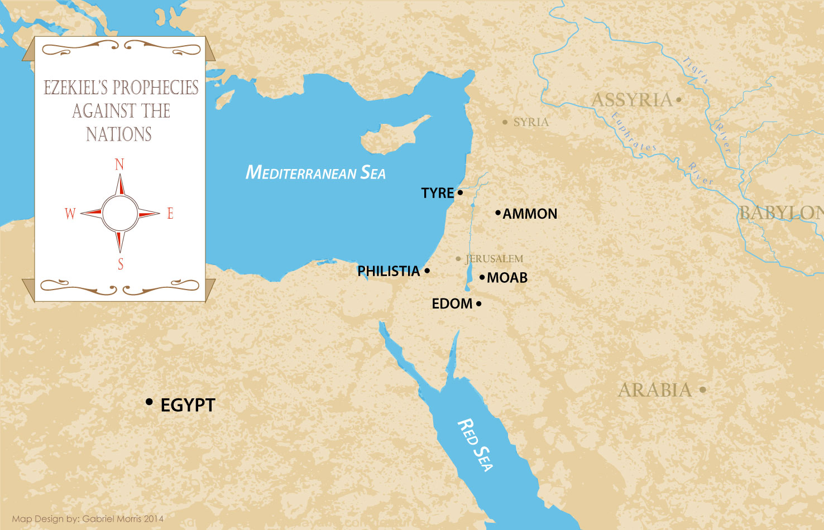

Slide 61
Conclusion

Slide 62
Satanic Attempts to Stop Messiah’s Birth
Cain & Abel (Gen. 4)
Sons of God (Gen. 6)
Pharaoh persecutes Israel (Exod. 1)
Joash protected from Athaliah (2 Chron. 22‒23)
Haman persecutes Israel (Esther)
Antiochus Epiphanes (Dan. 11:31)
Herod persecutes Christ (Matt 2; Rev 12:4)

Slide 63

“The Lord bless you and keep you; the Lord make his face shine on you and be gracious to you; the Lord turn his face toward you and give you peace.” (NIV)

