Slide 1
THE RAPTURE
Question and Answer – Part 10
Andrew Marshall Woods, Th.M., JD., PhD.
Sr. Pastor, Sugar Land Bible Church

Slide 2
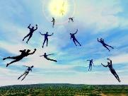
The Rapture Course Overview
What is the Rapture?
When is the Rapture?
Strengthening the Pre-Tribulational case
The opposing views
One second after the Rapture
Questions & Answers

Slide 3
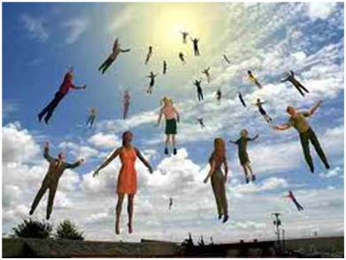
MAIL BAG
Infants & the Rapture?
Church in Rev. 7:9?
Church in Rev. 11:3-13?

Slide 4
MAIL BAG
Infants & the Rapture?
Church in Rev. 7:9?
Church in Rev. 11:3-13?

Slide 5
2 Samuel 12:22-24
²² “While the child was still alive, I fasted and wept; for I said, ‘Who knows, the Lord may be gracious to me, that the child may live.’ ²³ But now he has died; why should I fast? Can I bring him back again? I will go to him, but he will not return to me. ²⁴ Then David comforted his wife Bathsheba, and went into her and slept with her; and she gave birth to a son, and he named him Solomon. Now the Lord loved him.”

Slide 6
1 Corinthians 7:14
“For the unbelieving husband is sanctified through his wife, and the unbelieving wife is sanctified through her believing husband; for otherwise your children are unclean, but now they are holy.”

Slide 8
Dr. Robert Lightner
Safe in the Arms of Jesus, p. 3
“The pregnant women who are saved will be caught up (raptured) when Jesus comes for His own. It is reasonable to believe that their unborn children will share in the physical transformation that takes place at the Lord's coming.”

Slide 9
Dr. Robert Lightner
Safe in the Arms of Jesus, p. 73
“What about those who cannot believe, who are living when the Lord returns, and who have saved parents? Will the parents be taken to be with the Lord and the children left on earth? I think not! Because those who are living at the Lord's return…who are incapable of believing…will be caught up to be with the Lord in just the same way as all of those who have trusted Jesus Christ as their personal Savior. I do not believe God will divide families by taking the parents to be with Him and leaving their children who cannot believe to endure His wrath in the Tribulation. To be sure, there will be separations when the Lord returns, but they will be between those who have trusted Christ and those who have not trusted Him. It is unlikely that the separation will be between saved parents and their children who are unable to believe.”

Slide 10
Dr. Robert Lightner
Safe in the Arms of Jesus, p. 72
“What of pregnant women who are not saved? They will not be changed but will remain on the earth to endure the time of the Great Tribulation (Rev. 6-19). And what about their unborn infants? We know that there will be great suffering on the earth as it experiences a time of unparalleled tribulation. Jesus specifically mentioned expectant mothers when he spoke of it (Matt. 24:19). Regardless of their mothers' choices not to accept Christ, all children born during the tribulation period are protected by grace. They are no different than other children who are not able to believe.”

Slide 11
2 Peter 3:9
“The Lord is not slow about His promise, as some count slowness, but is patient toward you, not wishing for any to perish but for all to come to repentance.”

Slide 12
MAIL BAG
Infants & the Rapture?
Church in Rev. 7:9?
Church in Rev. 11:3-13?

Slide 13
Distinctions Between 144,000 & Multitude
144,000 | MULTITUDE
Revelation 7:1-8 | Revelation 7:9-17
Numbered | Innumerable
Jews | All nations
Sealed | Slain
Sealed before the Tribulation | Converted out of the Tribulation
Hitchcock and Ice, The Truth Behind Left Behind, 77

Slide 14
Revelation 1:19
“Therefore write the things which you have seen, and the things which are, and the things which will take place after these things [meta tauta].”

Slide 15
Revelation 1:19
Seen (1)
Are (2–3)
After these things (4–22)

Slide 16
God’s Work Through Israel
Revelation 7 – 144,000 Jews
Revelation 11 – Two Jewish witnesses
Revelation 12 – Israel flees

Slide 17
Distinctions Between 144,000 & Multitude
144,000 | MULTITUDE
Revelation 7:1-8 | Revelation 7:9-17
Numbered | Innumerable
Jews | All nations
Sealed | Slain
Sealed before the Tribulation | Converted out of the Tribulation
Hitchcock and Ice, The Truth Behind Left Behind, 77

Slide 18
Galatians 3:28
There is neither Jew nor Greek, there is neither slave nor free man, there is neither male nor female; for you are all one in Christ Jesus.

Slide 19
Ephesians 2:14
For He Himself is our peace, who made both groups into one and broke down the barrier of the dividing wall.

Slide 20
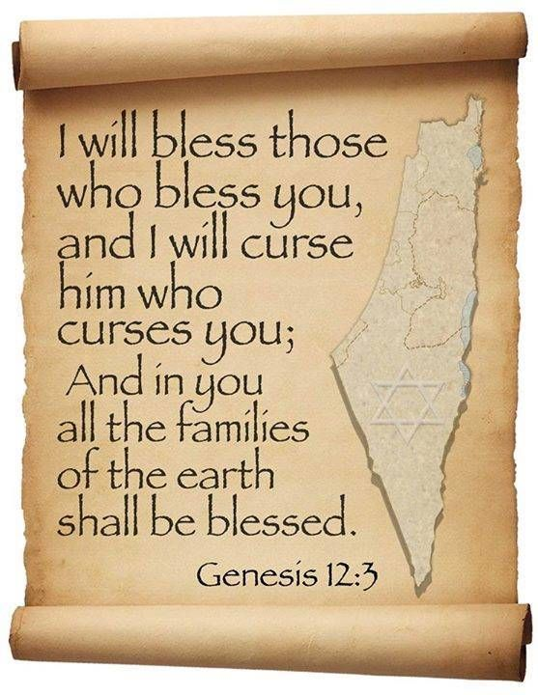
Genesis 12:3
“And I will bless those who bless you, And the one who curses you I will curse. And in you all the families of the earth will be blessed.”

Slide 21
MAIL BAG
Infants & the Rapture?
Church in Rev. 7:9?
Church in Rev. 11:3-13?

Slide 22
Revelation 1:19
“Therefore write the things which you have seen, and the things which are, and the things which will take place after these things [meta tauta].”

Slide 23
Revelation 1:19
Seen (1)
Are (2–3)
After these things (4–22)

Slide 24
God’s Work Through Israel
Revelation 7 – 144,000 Jews
Revelation 11 – Two Jewish witnesses
Revelation 12 – Israel flees

Slide 25
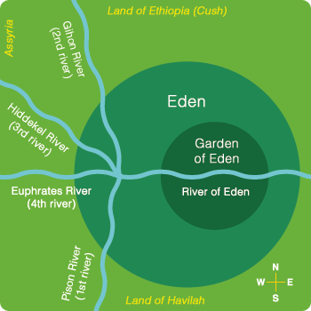

Slide 26
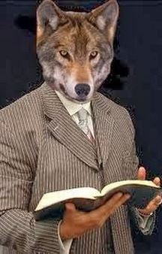
“He (or she) who spiritualizes tells spiritual lies.”

Slide 27
ISRAEL’S FOUR TEMPLES
Solomon’s pre-exilic temple (Kings and Chronicles)
Zerubbabel’s post exilic temple (Ezra 1-6; John 2:20)
Antichrist's temple (Dan. 9:27; Matt. 24:15; 2 Thess. 2:4; Rev. 11:1-2)
Millennial temple (Ezek. 40-48)

Slide 29
Daniel 9:27
And he will make a firm covenant with the many for one week, but in the middle of the week he will put a stop to sacrifice and grain offering; and on the wing of abominations will come one who makes desolate, even until a complete destruction, one that is decreed, is poured out on the one who makes desolate.

Slide 32
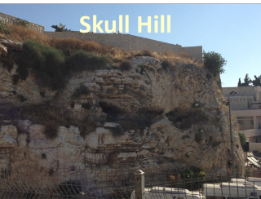
Revelation 11:8
“And their dead bodies will lie in the street of the great city which mystically is called Sodom and Egypt, where also their Lord was crucified.”

Slide 33
Robert Thomas
Revelation 8 to 22: An Exegetical Commentary (Chicago: Moody Press, 1992), 408.
Robert Thomas observes that, "no number in Revelation is verifiably a symbolic number.”

Slide 35
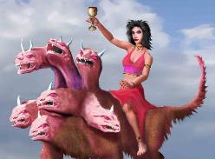
Revelation's Symbols and Figures of Speech
“Spiritually” (11:8)
“Sign” (12:1)
“Like” or “as” (8:8)
OT correspondence (Rev 13:2; Dan 7)
Contextual interpretations (17:18)
Absurdity (12:1)

Slide 36
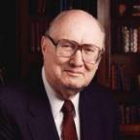
Two Rules of Interpretation
Search the immediate context
Walvoord: 26X
Search the remote context
Old Testament
Thomas: 278 / 404 verses

Slide 37
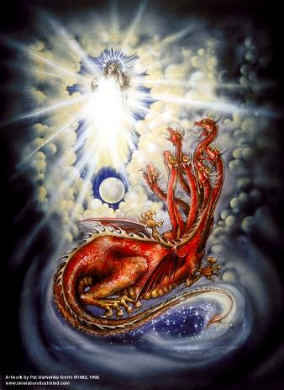
Assigning Meaning to Revelation’s Symbols and Figures of Speech
Context (Rev 12:3, 9)
Old Testament (Rev 12:1; Gen 37:9-10)
Comparison (Rev 8:8)

Slide 38
CONCLUSION

Slide 39
MAIL BAG
Infants & the Rapture?
Church in Rev. 7:9?
Church in Rev. 11:3-13?

