Slide 1
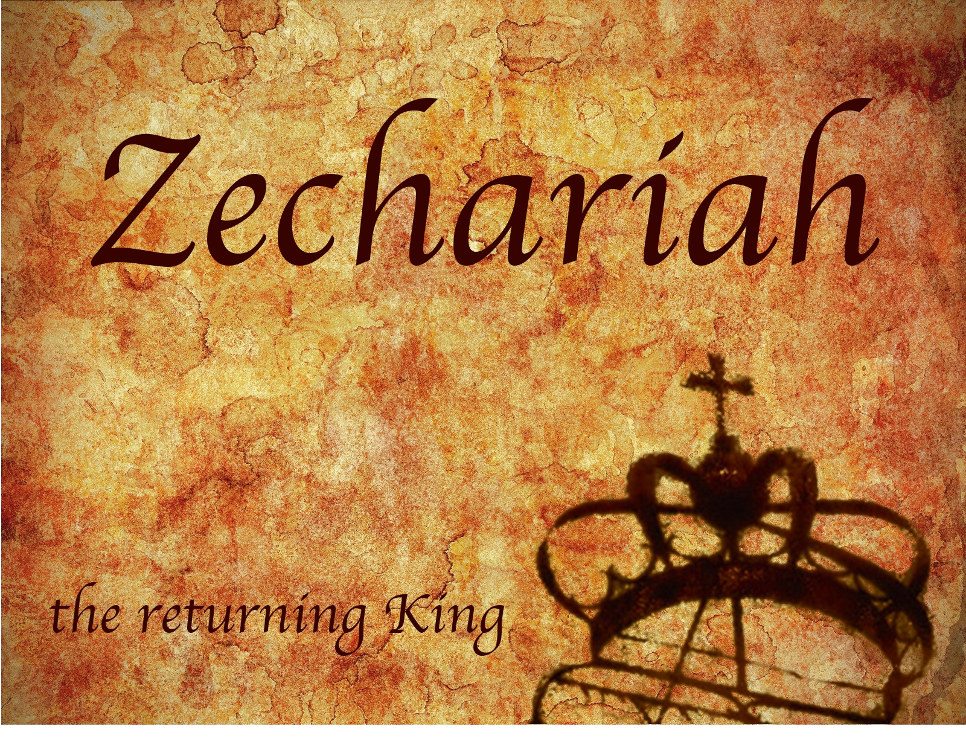
Zechariah
God Remembers!

Slide 2
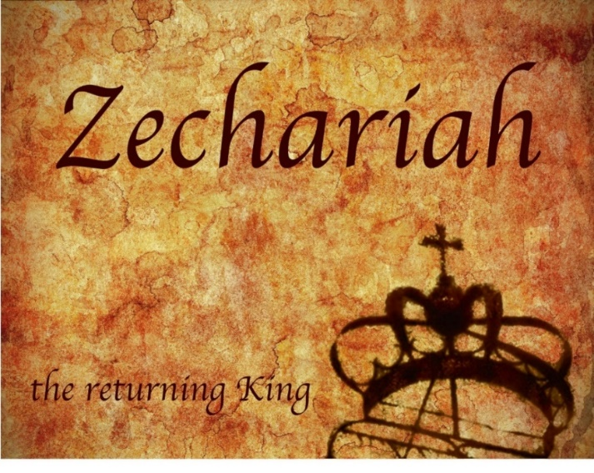
Structure
Introductory call to repentance (1:1-6)
Eight-night visions (1:7–6:15)
Question and answers about fasting (7–8)
Two burdens (9–14)

Slide 3
II. Eight Night Visions (1:7‒6:15)
Riders & horses among the myrtle trees (1:7-17)
Four horns & four craftsmen (1:18-21)
Man with the measuring line (2)
Cleansing of the High Priest Joshua (3)
Lampstand & olive tree (4)
Flying scroll (5:1-4)
Woman in the basket (5:5-11)
Four chariots (6:1-8)
Conclusion: crowning of Joshua (6:9-15)

Slide 4
ZECHARIAH’S EIGHT NIGHT VISIONS
Vision | Reference | Meaning
The Red-horse Rider among the Myrtles | 1:7-17 | God’s anger against the nations & blessing on restored Israel.
The Four Horns & the Four Craftsmen | 1:18-21 | God’s judgement on the nations that afflict Israel.
The Surveyor with a Measuring Line | Chapter 2 | God’s future blessing on restored Israel.
The Cleansing & Crowning of Joshua the Hight Priest. | Chapter 3 | Israel’s future cleansing from sin & reinstatement as a priestly nation.
The Golden Lampstand & the Two Olive Trees | Chapter 4 | Israel as the light to the nations under Messiah, the King-Priest.
The Flying Scroll | 5:1-4 | The severity & totality of divine judgment on individual Israelites.
The Woman in the Ephah | 5:5-11 | The removal of national Israel’s sin of rebellion against God.
The Four Chariots | 6:1-8 | Divine judgment on Gentile nations.

Slide 5
7. The Woman in the Ephah (5:5-11)
The Woman’s Identity (5:5-8)
The Woman’s Destination (5:9-11)

Slide 6
7. The Woman in the Ephah (5:5-11)
The Woman’s Identity (5:5-8)
The Woman’s Destination (5:9-11)

Slide 7
Zechariah 5:5-11
⁵ Then the angel who was speaking with me went out and said to me, “Lift up now your eyes and see what this is going forth.” ⁶ I said, “What is it?” And he said, “This is the ephah going forth.” Again he said, “This is their appearance in all the land ⁷ (and behold, a lead cover was lifted up); and this is a woman sitting inside the ephah.” ⁸ Then he said, “This is Wickedness!” And he threw her down into the middle of the ephah and cast the lead weight on its opening.

Slide 8
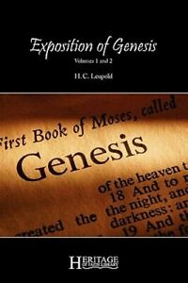
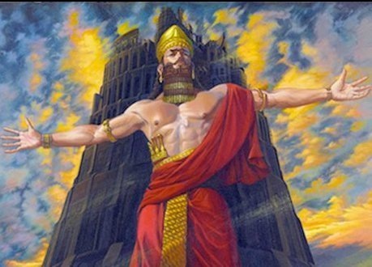
H. C. Leupold
H.C. Leupold, Exposition of Zechariah, 103.
“So little is human nature capable of readily appropriating divine revelation that it is not only necessary for God to let the necessary visions appear but also to stimulate the recipient's attention step by step lest, overcome by the power of the heavenly, he fail to appropriate all that God desires to offer.”

Slide 9
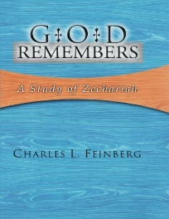
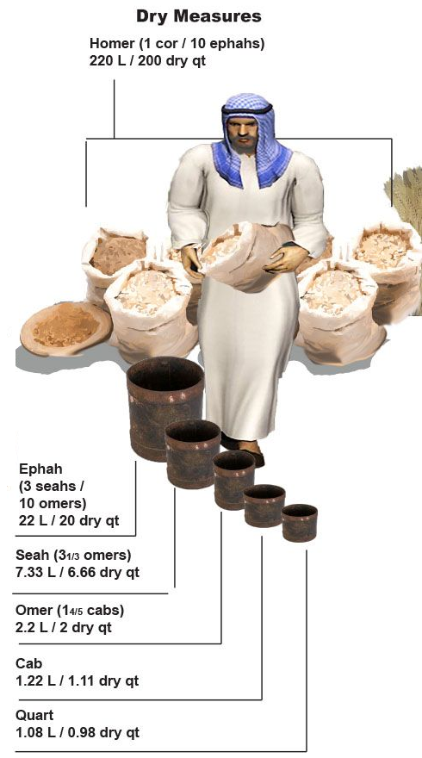
Charles L. Feinberg
God Remembers: A Study of Zechariah (Wheaton: Van Kampen, 1950, p. 88.
“The ephah was the greatest dry measure in use among the Hebrew people.”

Slide 10
Genesis 1:1–3
¹ In the beginning God created the heavens and the earth. ² The earth was formless and void, and darkness was over the surface of the deep, and the Spirit of God was moving over the surface of the waters. ³ Then God said, “Let there be light”; and there was light.

Slide 11
Hitchcock The Second Coming of Babylon, 109.
ZECHARIAH 5:5-11 | REVELATION 17–18
Woman sitting in a basket | Woman sitting on beast, seven mountains, many waters (17: 3, 9, 15)
Emphasis on commerce (basket for measuring grain) | Emphasis on commerce (merchant of grain, 18:13)
Woman’s name is wickedness | Woman’s name is Babylon the Great, Mother of Harlots and Abominations of the Earth
Focus on False worship (temple is built for the woman) | Focus on False worship (17:5)
Woman taken to Babylon | Woman called Babylon

Slide 12
“The vision or prophecy (Zec. 5) contains the germ which is afterward expanded and developed in such detail in Rev. 17 and 18.” Pink, The Antichrist, 281.

Slide 13
2 Thessalonians 2:6-7
⁶And you know what restrains [katechon; neuter] him now, so that in his time he will be revealed. ⁷For the mystery of lawlessness is already at work; only he who now restrains [katechōn; masculine] will do so until he is taken out of the way.

Slide 14
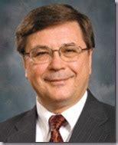
Charles H. Dyer
Old Testament Explorer, p. 825.
“The woman in Zechariah’s vision represented ‘iniquity’ and ‘wickedness.’ The cover holding the woman captive pictured God’s restraint of evil. As bad as things were in Zechariah’s day, things could have been worse if God had not been restraining evil (see also 2 Thess. 2:7).”

Slide 15
Charles L. Feinberg
God Remembers: A Study of Zechariah (Wheaton: Van Kampen, 1950, p. 90-91.
“The woman of the vision under consideration represents wickedness, as the interpreting angel specifically states, as it will be culminated in the last days. It will be organized both among Israel and the nations of the earth into a colossal confederacy, holding sway religiously over the earth. Nor is this wickedness dormant, for the great laden weight must be cast upon the mouth of the ephah to keep it bound there (II Thess. 2:6–8).”

Slide 16
7. The Woman in the Ephah (5:5-11)
The Woman’s Identity (5:5-8)
The Woman’s Destination (5:9-11)

Slide 17
Zechariah 5:5-11
⁹ Then I lifted up my eyes and looked, and there two women were coming out with the wind in their wings; and they had wings like the wings of a stork, and they lifted up the ephah between the earth and the heavens. ¹⁰ I said to the angel who was speaking with me, “Where are they taking the ephah?” ¹¹ Then he said to me, “To build a temple for her in the land of Shinar; and when it is prepared, she will be set there on her own pedestal.”

Slide 18
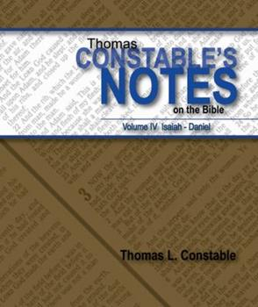
Thomas L. Constable
Constable’s online notes on Zechariah, p. 60-61.
“The prophet next saw ‘two’ other ‘women’ flying through the air with ‘stork ... wings.’ Perhaps they were women, and not men, because of the motherly attention they brought to their task. Storks are strong, motherly birds that are capable of carrying loads a long distance in flight. They are also reliable and careful creatures. They were commonly seen in Palestine [Israel] in the spring months, while they were migrating to Europe (Jer. 8:7).”

Slide 19
Thomas L. Constable
Constable’s online notes on Zechariah, p. 60-61.
“The word ‘stork’ (Heb. sida) means ‘faithful one.’ These women would faithfully carry the ephah and its contents to God's appointed destination. Some believe the ‘two women’ represent agents of evil, perhaps demonic forces. If they were that, however, would they not try to help Wickedness escape? Storks were unclean birds for the Israelites (Lev. 11:19; Deut. 14:18), so these stork-like women were appropriate carriers of the contaminated basket. ‘They lifted up the ephah’ into the air, flying off from earth to heaven with the divine assistance of ‘the wind’ (Spirit, Heb. ruah).”

Slide 20
Charles L. Feinberg
God Remembers: A Study of Zechariah (Wheaton: Van Kampen, 1950, p. 91.
“That these women are representative of God’s agents for His purpose is clear from the fact that they have wings. They are like the storks for he has broad pinions and in his annual migration covers great distances.”

Slide 21
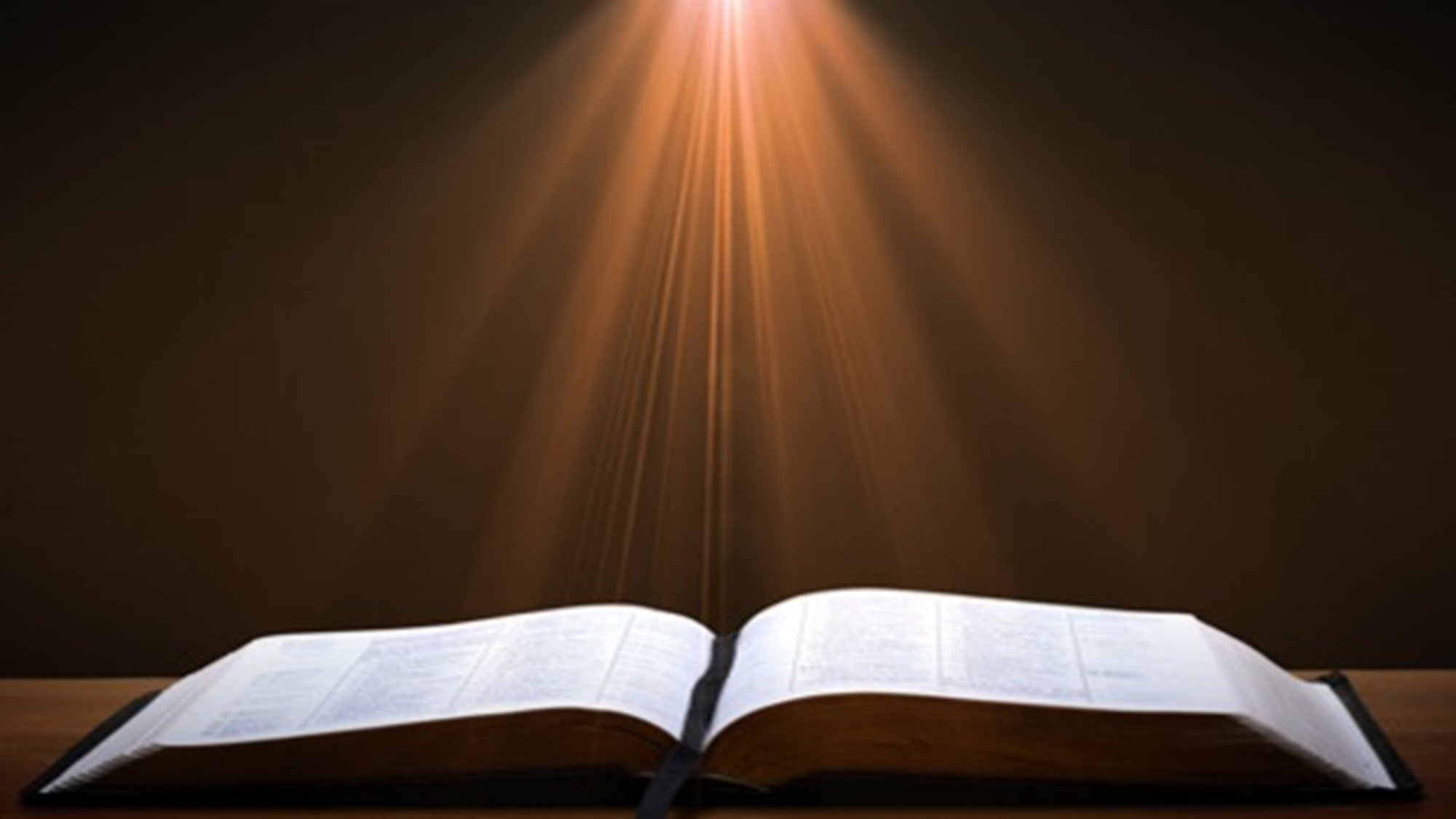
2 Samuel 7:12-16
“When your days are complete and you lie down with your fathers, I will raise up your descendant after you, who will come forth from you, and I will establish his kingdom. ¹³ He shall build a house for My name, and I will establish the throne of his kingdom forever. ¹⁴ I will be a father to him and he will be a son to Me; when he commits iniquity, I will correct him with the rod of men and the strokes of the sons of men, ¹⁵ but My lovingkindness shall not depart from . . .

Slide 22
2 Samuel 7:12-16
. . .him, as I took it away from Saul, whom I removed from before you. ¹⁶ Your house and your kingdom shall endure before Me forever; your throne shall be established forever.” ¹⁷ In accordance with all these words and all this vision, so Nathan spoke to David.”

Slide 23
ISRAEL’S FOUR TEMPLES
Solomon’s pre-exilic temple (Kings and Chronicles)
Zerubbabel’s post exilic temple (Ezra 1-6; John 2:20)
Antichrist's temple (Dan. 9:27; Matt. 24:15; 2 Thess. 2:4; Rev. 11:1-2)
Millennial temple (Ezek. 40-48)

Slide 24
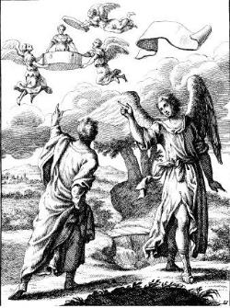
Zechariah 5:5-11
Woman (wickedness)
Ephah (commerce)
House (Temple-2 Sam 7; religion)
Shinar (Gen 10:10; 11:2; Dan 1:2)

Slide 25
Zechariah 5:5-11
Woman (wickedness)
Ephah (commerce)
House (Temple-2 Sam 7; religion)
Shinar (Gen 10:10; 11:2; Dan 1:2)

Slide 26
Charles L. Feinberg
God Remembers: A Study of Zechariah (Wheaton: Van Kampen, 1950, p. 91.
“The first mention of Shinar in the Bible is in Genesis 10:10. (It is found in all six other times: Gen. 11:2; 14:1, 9; Isa. 11:11; Dan. 1:2; and here). In all instances where it occurs it is used as a definite geographical designation. Strictly speaking it covers more than Babylon but is it is employed to denote this land.”

Slide 27
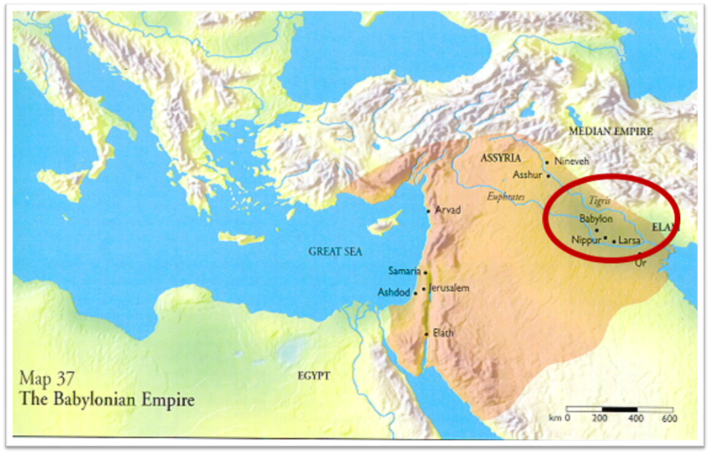

Slide 28
Genesis 11:1-4
¹ Now the whole earth used the same language and the same words. ² It came about as they journeyed east, that they found a plain in the land of Shinar and settled there. ³ They said to one another, “Come, let us make bricks and burn them thoroughly.” And they used brick for stone, and they used tar for mortar. ⁴ They said, “Come, let us build for ourselves a city, and a tower whose top will reach into heaven, and let us make for ourselves a name, otherwise we will be scattered abroad over the face of the whole earth.”

Slide 29
Daniel 1:1-2
“¹ In the third year of the reign of Jehoiakim king of Judah, Nebuchadnezzar king of Babylon came to Jerusalem and besieged it.² The Lord gave Jehoiakim king of Judah into his hand, along with some of the vessels of the house of God; and he brought them to the land of Shinar, to the house of his god, and he brought the vessels into the treasury of his god.”

Slide 30
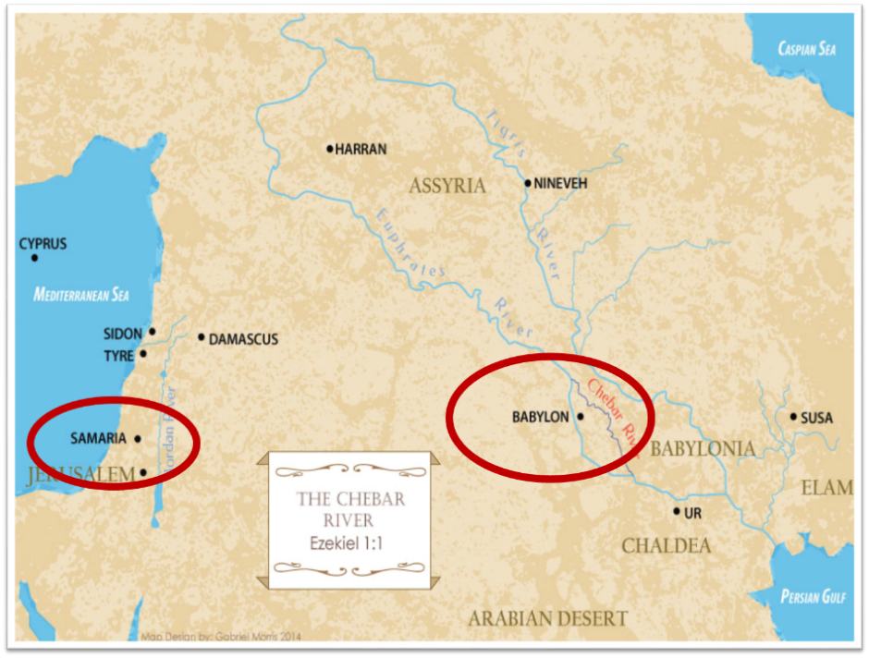

Slide 31
Charles L. Feinberg
God Remembers: A Study of Zechariah (Wheaton: Van Kampen, 1950, p. 93.
“Now, the prophet Zechariah foretells that in the last days all wickedness, with idolatry particularly in mind (see Matt. 12:43–45), that will be existent in Israel at that time will go back forcibly to the place of its origin, Babylon, the great apostate religious system. Such is the meaning of being settled on her own base. When we come to the book of Revelation all of this is clearly set forth in chapter 17 and 18. Not only the evil in Judaism, but that in Christendom as well, will wind up and culminate in that abominable system called mystical or mystery Babylon. The greatest sin in Israel, even wickedness itself, was idolatry. It will come to it’s settled abode at the very place of its inception (Rev. 18:24).”

Slide 32
Spread of the Mother-Child Cult
 | Mother | Child
Assyria | Ishtar | Tammuz
Phoenicia | Astarte | Baal
Egypt | Isis | Osirus/Horus
Greece | Aphrodite | Eros
Rome | Venus | Cupid
Asia | Cybele | Desius
India | Isi | Aswara
Roman Catholicism | Mary | Jesus
Israel | Queen of Heaven (Jer. 7:18; 44:17) | Tammuz (Ezek. 8:14-15)
Alexander Hislop, Two Babylons

Slide 33
Larkin, The Book of Revelation, 151.
“The river Euphrates, on which the city of Babylon was built, was one of the four branches into which the river that flowed through the Garden of Eden was divided, and Satan doubtless chose the site of Babylon as his headquarters from which to sally forth to tempt Adam and Eve. It was doubtless here that the Antediluvian apostasy had its source that ended in the flood. To this centre the ‘forces of Evil’ gravitated after the Flood, and ‘Babel’ was the result. This was the origin of the nations, but the nations were not scattered abroad over the earth until Satan had implanted in them the ‘Virus’ of a doctrine that has been the source of every false religion the world has ever known.”

Slide 34
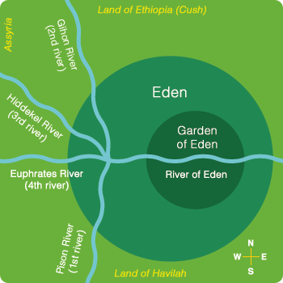

Slide 36
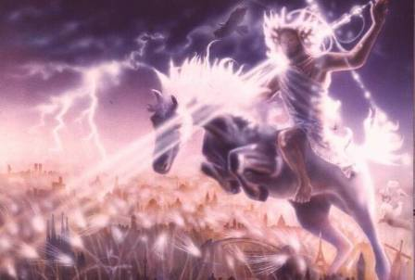
Isaiah 13-14
Day of the Lord (13:6-9)
Cosmic disturbances (13:10-13)
Global judgment (13:11-12)
Sodom and Gomorrah (13:19)
Complete and final desolation (13:20-22)
Universal peace and rest (14:5-8)
Israel’s regeneration (14:1-4)
Henry Morris, Revelation Record, 348.

Slide 37
Isaiah 13:12
“I will make mortal man scarcer than pure gold and mankind than the gold of Ophir.”

Slide 38
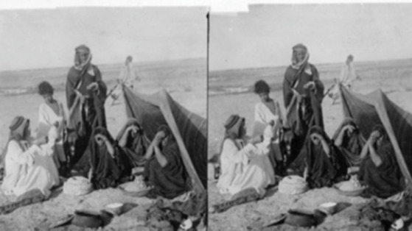
ARAB TENT HOME at Babylon 1899-1908 “It will never be inhabited or lived in from generation to generation; Nor will the Arab pitch his tent there” (Isaiah 13:20)
https://www.bibleprophecyaswritten.com/2-arabs/

Slide 39
Isaiah’s Oracles Against the Nations (Isa 13–23)
Babylon (13:1-14:23) Assyria (14:24-27) Philistia (14:28-32) Moab (15-16) Damascus and Samaria (17) Ethiopia (18) | Egypt (19-20) Babylon (21:1-10) Edom (21:11-12) Arabia (21:13-17) Jerusalem (22) Tyre (23)

Slide 40
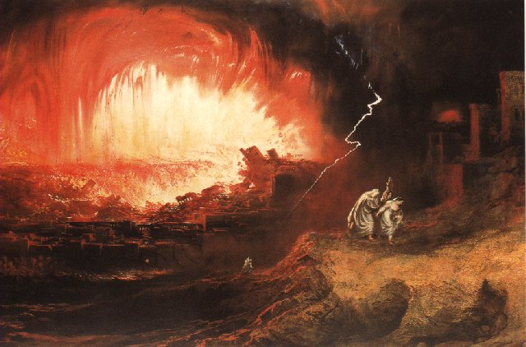
Jeremiah 50-51
Sudden destruction (51:8)
Complete destruction (50:3, 13, 26, 39-40; 51:29, 43, 62)
No reuse of building materials (51:26)
Believers flee (50:8; 51:6, 45)
Israel’s regeneration (50:2, 4-5, 20; 51:50)
Dyer, "The Identity of Babylon in Revelation 17–18 (Part 2)," 443-49.

Slide 41
Herodotus, Histories, 1:191 (450 B.C.)
“…he (Cyrus) conducted the river by a channel into the lake…and so he made the former course of the river passable by the sinking of the stream. When this had been done, the Persians who had been posted for this very purpose entered by the bed of the river Euphrates into Babylon, the stream having sunk so far that it reached about to the middle of a man’s thigh…those Babylonians who dwelt in the middle did not know that they had been captured…”

Slide 43
James Pritchard
The Ancient Near East Texts Relating to the Old Testament, 315-16.
Without any battle... sparing Babylon... any calamity....I am Cyrus...king of Babylon....When I entered Babylon...under jubilation and rejoicing...troops walked around Babylon...in peace, I did not allow anybody to terrorize (any place) of the [country of Sumer] and Akkad. I strove for peace in Babylon...and in all his (other) sacred cities....I returned to (these) sacred cities on the other side of the Tigris, the sanctuaries of which have been in ruins for a long time, the images which (used) to live therein and established for them permanent sanctuaries.

Slide 44
James Pritchard
The Ancient Near East Texts Relating to the Old Testament, 315-16.
I (also) gathered all their (former) inhabitants and returned (to them) their habitations. Furthermore, I resettled... unharmed, in their (former) chapels, the places which make them happy. May all the gods whom I have resettled in their sacred cities ask daily Bel and Nebo for a long life for me...all of them I resettled in a peaceful place... ducks and doves,...I endeavoured to fortify/repair their dwelling places . . .

Slide 45
Babylon’s History After 539 B.C.
Herodotus gives Babylon’s measurements (450 B.C.)
Alexander the Great visits and dies in Babylon (323 B.C.)
Seleucus seizes Babylon (312 B.C.)
Strabo pronounces Babylon’s hanging gardens as one of “seven wonders of the world” (25 B.C)
Babylonians present on Pentecost (Acts 2:9)
Talmud promulgated from Babylon (A.D. 500)
Haukal mentions Babylonian village (A.D. 917)
Babylon known as “Two Mosques” and “Hilah” (A.D. 1100)
Hitchcock and Ice, The Truth Behind Left Behind, 109

Slide 46
Dr. John Walvoord
The Nations in Prophecy, 63-64
“As far as the historic fulfillment is concerned, it is obvious from both Scripture and history that these verses have not been literally fulfilled. The city of Babylon continued to flourish after the Medes conquered it, and though its glory dwindled, especially after the control of the Medes and the Persians ended in 323 B.C., the city continued in some form or substance until A.D. 1000 and did not experience a sudden termination such as anticipated in this prophecy.”

Slide 47
Parallels Between Jeremiah 50-51 & Revelation 17-18
 | Jeremiah | Revelation
Associated with a Golden cup | 51:7a | 17:3-4; 18:6
Dwelling on many waters | 51:13 | 17:1
Intoxicating the nations | 51:7b | 17:2
Same name | 50:1 | 17:5
Persecuting the saints | 51:48 | 17:6; 18:24
Stone sinking into Euphrates | 51:63-64 | 18:21
Sudden destruction | 51:8 | 18:8
Destroyed by fire | 51:30 | 17:16
Final, uninhabitable | 50:39 | 18:21
Deserved | 50:29 | 18:6
God’s people flee | 51:6, 45 | 18:4
Heaven rejoices | 51:48 | 18:20
Dyer, "The Identity of Babylon in Revelation 17–18 (Part 2)," 441-43.

Slide 48
Larkin, The Book of Revelation, 158.
“…and this is in exact harmony with the words of Isa. 13:19. ‘And Babylon, the glory of kingdoms, the beauty of the Chaldees’ excellency, shall be as when God overthrew Sodom and Gomorrah;’ and the Prophet Jeremiah makes the same statement. Jer. 50:40. The destruction of Sodom and Gomorrah was not protracted through many centuries, their glory disappeared in a few hours (Gen. 19:24–28), and as ancient Babylon was not thus destroyed, the prophecies of Isaiah and Jeremiah cannot be fulfilled unless there is to be a future Babylon that shall be thus destroyed. In Rev. 16:17–19, we are told that Babylon shall be destroyed by an Earthquake, attended with most vivid and incessant lightning and awful thunder.”

Slide 49
Zechariah 1:7
On the twenty-fourth day of the eleventh month, which is the month Shebat, in the second year of Darius (519 b.c.*), the word of the Lord came to Zechariah the prophet, the son of Berechiah, the son of Iddo, as follows:
*Babylon fell in 539 b.c!

Slide 50
Newton Babylon: Its Future, History, and Doom, 1890, p. 64.
“That this event predicted in this remarkable passage remains still unaccomplished, is sufficiently evident from the fact of Zechariah’s having prophesied after Babylon had received that blow under which it has gradually waned. Zechariah lived after Babylon had passed into the hands of the Persians . . .”

Slide 51
Morris
The Revelation Record, 349
“Computer studies of the Institute for Creation Research have shown, for example, that Babylon is very near the geographical center of all the earth’s land masses. It is within navigable distances of the Persian Gulf and is at the crossroads of the three great continents of Europe, Asia and Africa. Thus there is no more ideal location anywhere for a world trade center, a world communication center, a world banking center, a world educational center, or especially, a world capital! The greatest historian of modern times, Arnold Toynbee, used to stress to all his readers and hearers that Babylon would be the best place in the world to build a future world cultural metropolis.”

Slide 52
June 2007 Conventional Oil Reserves
Rank | Country | Percentage of oil reserves
1 | Saudia Arabia | 21.9 %
2 | Iran | 11.4 %
3 | Iraq | 9.5 %
4 | Kuwait | 8.4 %
5 | United Arab Emirates | 8.1 %
6 | Venezuela | 6.6 %
7 | Russia | 6.6 %
8 | Libya | 3.4 %
David Jeremiah, What in the World is Going On, 207

Slide 53
Iraq Celebrates Naming Babylon a UNESCO World Heritage Site
QASSIM ABDUL-ZAHRA of Times of Israel - July 6, 2019
“BAGHDAD (AP) — Iraq on Friday celebrated the UNESCO World Heritage Committee’s decision to name the historic city of Babylon a World Heritage Site in a vote held in Azerbaijan’s capital, years after Baghdad began campaigning for the site to be added to the list…The 4,300-year-old Babylon — now mainly an archaeological ruin and two important museums — is where dynasties have risen and fallen since the earliest days of settled human civilization. King Hammurabi wrote his famous code of laws in Babylon, while Nebuchadnezzar sent his vast army from the city to Jerusalem to put down an uprising and bring the Jews back as slaves.”

Slide 54
“Want Middle East Stability? Move UN to Iraq”
“The idea of moving U.N. headquarters seems to resonate with many....Where should it go? Try Iraq…In order to maintain its fledgling democracy, Iraq needs international commitment, an inducement to stop factional violence, and a stable form of income not subject to the terrorists’ reprisals…New York is an expensive city, and representation at the U.N. is currently a costly endeavor…The remaining big spenders should have a positive effect on the Iraqi job market and improve the overall economy of the entire region, which might in turn reduce the tendency …”
Cynthia E. Ayers and David W. Cammons, “Want Middle East Stability? Move UN to Iraq,” Newsweek, April 9, 2007, posted at: Http://newsweek.washingtonpost.com/postglobal/needtoknow/2007/04/want_middle_east_stability_mov.html

Slide 55
A Prince’s $500 Billion Desert Dream: Flying Cars, Robot Dinosaurs and a Giant Artificial Moon
“Saudi Arabia’s crown prince turned to U.S. consultants for help imagining a massive new city-state in a barren section of his kingdom. What emerged was a Jetsons-style world of automation. SHARMA, Saudi Arabia—This seaside corner of northwest Saudi Arabia is so barren that the only abundant resources a group of consultants could identify were sunlight and ‘unlimited access to salt water.’ But Saudi crown prince Mohammed bin Salman didn’t see a wasteland when he landed in his helicopter here a few years ago. He saw the future — and hatched a plan for a $500 billion city-state to cover 10,000 square miles of rocky desert and empty coastline to attract the ‘world’s greatest minds and best talents’ to the world’s best paying jobs in the world’s most livable city.”
Justin Scheck, Rory Jones, and Summer Sawww.wsj.comid, “A Prince’s $500 Billion Dollar Desert Dream,” online:, 25 July 2019.

Slide 56
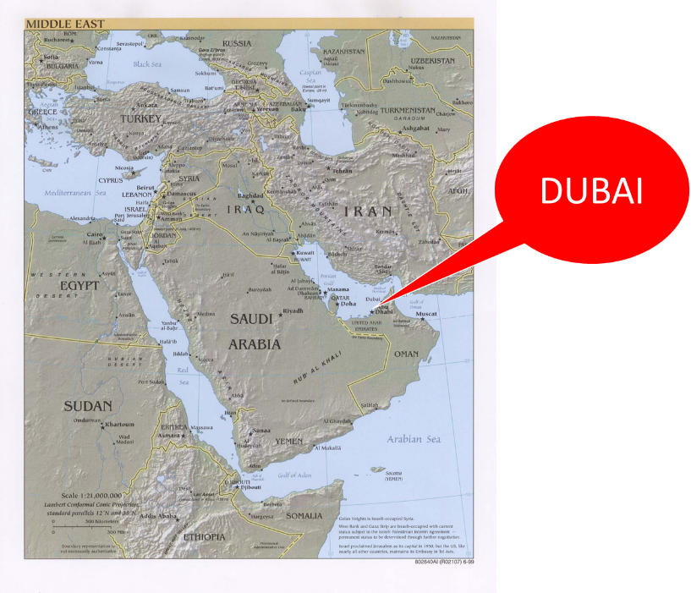

Slide 57
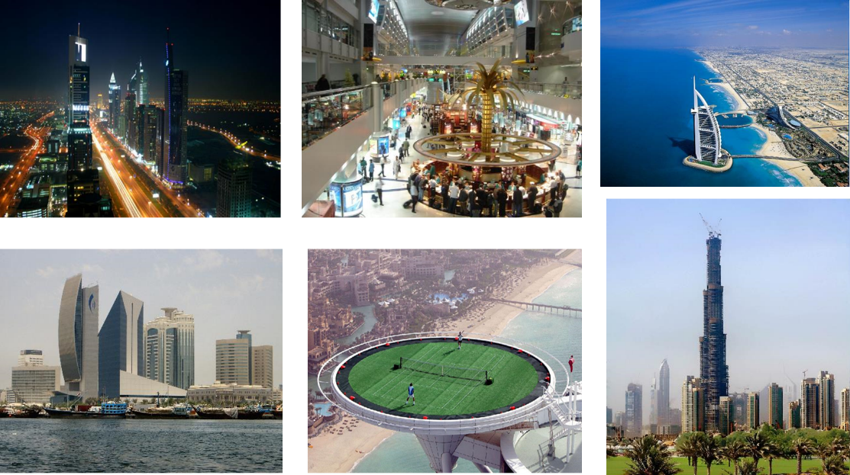

Slide 58
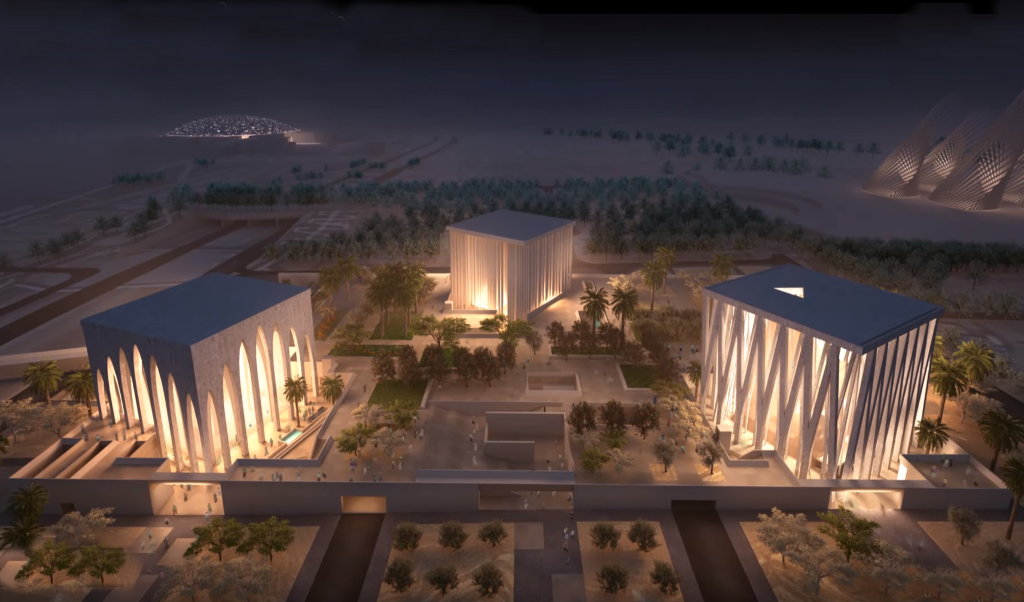

Slide 59
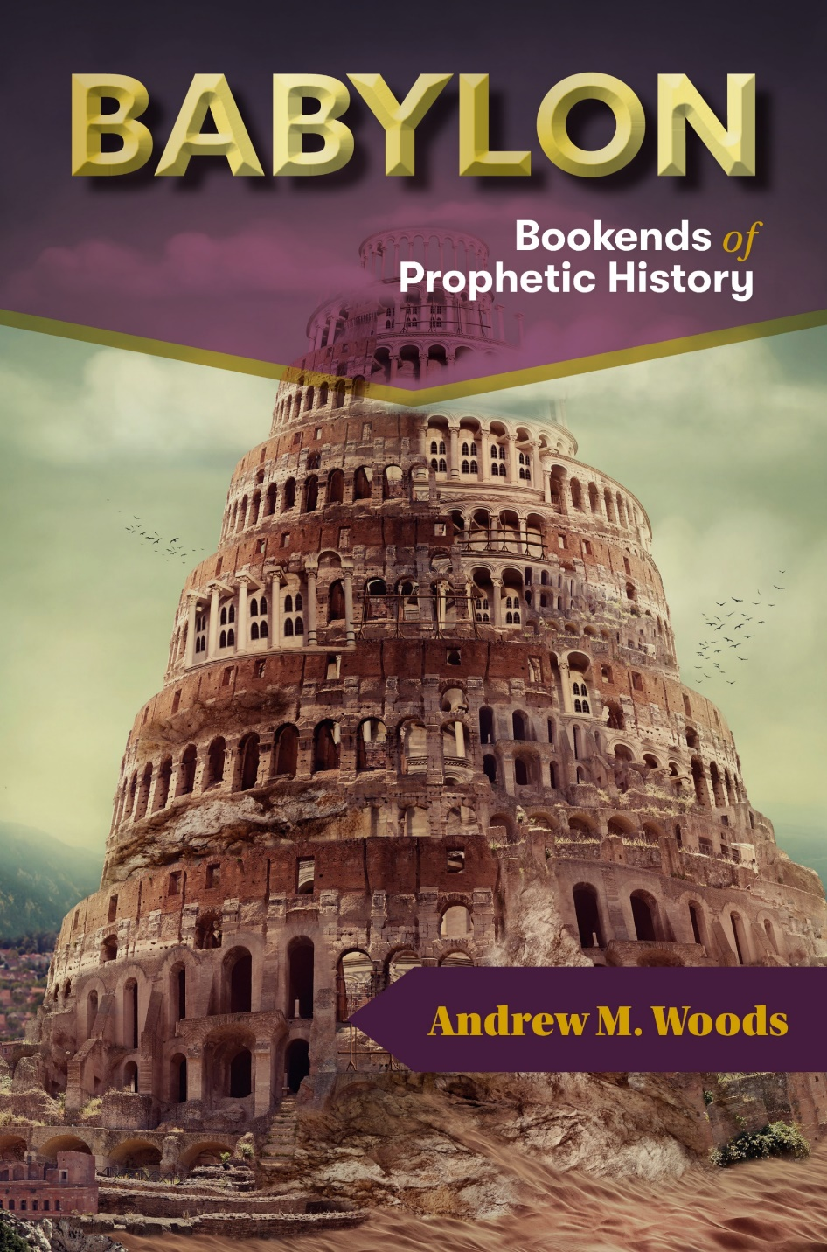
https://dispensationalpublishing.com/product/babylon-the-bookends-of-prophetic-history/

Slide 60
Conclusion

Slide 61
7. The Woman in the Ephah (5:5-11)
The Woman’s Identity (5:5-8)
The Woman’s Destination (5:9-11)

Slide 62
II. Eight Night Visions (1:7‒6:15)
Riders & horses among the myrtle trees (1:7-17)
Four horns & four craftsmen (1:18-21)
Man with the measuring line (2)
Cleansing of the High Priest Joshua (3)
Lampstand & olive tree (4)
Flying scroll (5:1-4)
Woman in the basket (5:5-11)
Four chariots (6:1-8)
Conclusion: crowning of Joshua (6:9-15)

