Slide 1


Genesis 12‒50
Israel’s Birth & Preservation

Slide 2


GENESIS STRUCTURE
  Beginning of the Human race (Gen. 1‒11)
  Beginning of the Hebrew race (Gen. 12‒50)

Slide 3

GENESIS STRUCTURE
  Genesis 1-11 (four events)
    Creation (1-2)
    Fall (3-5)
    Flood (6-9)
    National dispersion (10-11)

Slide 4


Genesis 3:15
“And I will put enmity Between you and the woman, And between your seed and her seed; He shall bruise you on the head, And you shall bruise him on the heel.”

Slide 5
GENESIS STRUCTURE
  Beginning of the Human race (Gen. 1‒11)
  Beginning of the Hebrew race (Gen. 12‒50)

Slide 6

GENESIS STRUCTURE
  Genesis 12-50 (four people)
    Abraham (12:1–25:11)
    Isaac (25:12–26:35)
    Jacob (27–36)
    Joseph (37–50)

Slide 7


Isaiah 43:1
“But now, thus says the Lord, your Creator, O Jacob, And He who formed you, O Israel, 'Do not fear, for I have redeemed you; I have called you by name; you are Mine!'”

Slide 8
GENESIS STRUCTURE
  Genesis 12-50 (four people)
    Abraham (12:1–25:11)
    Isaac (25:12–26:35)
    Jacob (27–36)
    Joseph (37–50)

Slide 9
Genesis 12‒14
Abram’s Early Journeys
  Unconditional promises (Gen. 12:1-3)
  From Haran to Canaan (Gen. 12:4-5)
  In Canaan (Gen. 12:6-9)
  In Egypt (Gen. 12:10-20)
  Abram and Lot Separate (Gen. 13:1-13)
  Reaffirmation of Abram’s promises (Gen. 13:14-18)
  Abram Rescues Lot (14:1-24)
  Abrahamic Covenant (15:1-21)

Slide 10
Genesis 15:1‒21
Abrahamic Covenant
    Seed Promise Clarified (15:1-6)
    Land Promise Ratified (15:7-21)

Slide 11
Genesis 15:1‒21
Abrahamic Covenant
    Seed Promise Clarified (15:1-6)
    Land Promise Ratified (15:7-21)

Slide 12
Seed Promise Clarified
Genesis 15:1-6
    God’s Promise (1)
    Abram’s misunderstanding (2-3)
    God’s clarification (4-5)
    Abram’s response (6)

Slide 13
Seed Promise Clarified
Genesis 15:1-6
    God’s Promise (1)
    Abram’s misunderstanding (2-3)
    God’s clarification (4-5)
    Abram’s response (6)

Slide 14

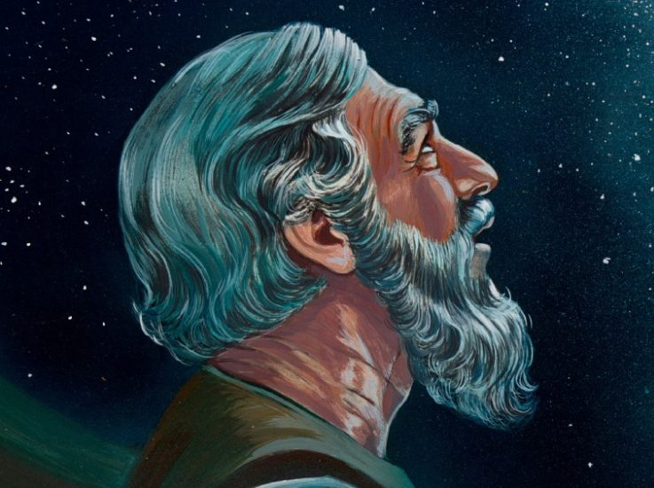
Genesis 15:1
After these things the word of the Lord came to Abram in a vision, saying, “Do not fear, Abram, I am a shield to you; Your reward shall be very great.”

Slide 15


Dr. Arnold G. Fruchtenbaum
The Book of Genesis, 240
“This is the first of seven times that Abraham receives a direct revelation from God. In 12:1–3 is God’s initial call to Abram outside the Land of Canaan; in 12:7 is the first appearance to Abraham in the Land; in 13:14–17, Abraham encounters God after the separation of Lot; in 15:1–21, God signs and seals the Abrahamic Covenant; in 17:1–21, Abraham receives the token of the covenant; in 18:1–33, God speaks to him in conjunction with the destruction of Sodom; and in 22:1–2 and 22:11–18, God directs Abraham to offer Isaac.”

Slide 16
VI. 8 New Promises
Genesis 12:1-3
    Land (Gen. 12:1b)
    Great nation (Gen. 12:2a)
    Personal blessing (Gen. 12:2b)
    Great name (Gen. 12:2c)
    Blessing to others (Gen. 12:2d)
    Blessing to blessers (Gen. 12:3a)
    Cursing to cursers (Gen. 12:3b)
    Blessing to the world (Gen. 12:3c)

Slide 17
Seed Promise Clarified
Genesis 15:1-6
    God’s Promise (1)
    Abram’s misunderstanding (2-3)
    God’s clarification (4-5)
    Abram’s response (6)

Slide 18


Slide 19
Dr. Arnold G. Fruchtenbaum
The Book of Genesis, 273
“The inheritor Abram had was one of his servants: He that shall be possessor of my house is Eliezer of Damascus, who was his chief servant. This statement is in accordance with the Code of Hammurabi and the Nuzi Tablets: A childless husband and wife were free to adopt their slave in order to have an heir to inherit their possessions.”

Slide 20

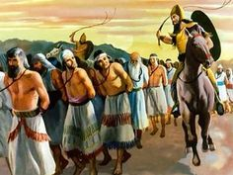
Colossians 2:8
“See to it that no one takes you captive through philosophy and empty deception, according to the tradition of men, according to the elementary principles of the world, rather than according to Christ.”

Slide 21
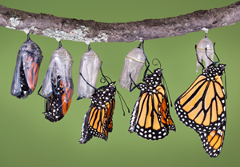
Romans 12:2
“And do not be conformed to this world, but be transformed by the renewing of your mind, so that you may prove what the will of God is, that which is good and acceptable and perfect.”

Slide 22
Seed Promise Clarified
Genesis 15:1-6
    God’s Promise (1)
    Abram’s misunderstanding (2-3)
    God’s clarification (4-5)
    Abram’s response (6)

Slide 23
Dr. Arnold G. Fruchtenbaum
The Book of Genesis, 240
“This is the first of seven times that Abraham receives a direct revelation from God. In 12:1–3 is God’s initial call to Abram outside the Land of Canaan; in 12:7 is the first appearance to Abraham in the Land; in 13:14–17, Abraham encounters God after the separation of Lot; in 15:1–21, God signs and seals the Abrahamic Covenant; in 17:1–21, Abraham receives the token of the covenant; in 18:1–33, God speaks to him in conjunction with the destruction of Sodom; and in 22:1–2 and 22:11–18, God directs Abraham to offer Isaac.”

Slide 24

Genesis 15:4-5
Then behold, the word of the Lord came to him, saying, “This man will not be your heir; but one who will come forth from your own body, he shall be your heir.” ⁵ And He took him outside and said, “Now look toward the heavens, and count the stars, if you are able to count them.” And He said to him, “So shall your descendants be.”

Slide 25
Seed Promise Clarified
Genesis 15:1-6
    God’s Promise (1)
    Abram’s misunderstanding (2-3)
    God’s clarification (4-5)
    Abram’s response (6)

Slide 26

Galatians 3:16
“Now the promises were spoken to Abraham and to his seed. He does not say, “And to seeds,” as referring to many, but rather to one, “And to your seed,” that is, Christ.”

Slide 27
Genesis 3:15
“And I will put enmity Between you and the woman, And between your seed and her seed; He shall bruise you on the head, And you shall bruise him on the heel.”

Slide 28

Genesis 4:1
“Now the man had relations with his wife Eve, and she conceived and gave birth to Cain, and she said, ‘I have gotten a manchild with the help of the Lord.’”

Slide 29
Genesis 5:29
“Now he called his name Noah, saying, ‘This one will give us rest from our work and from the toil of our hands arising from the ground which the Lord has cursed.’”

Slide 30

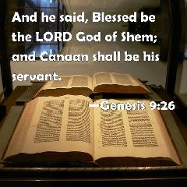
Genesis 9:26
“He also said, “Blessed be the Lord, The God of Shem; And let Canaan be his servant.”

Slide 31
VI. 8 New Promises
Genesis 12:1-3
    Land (Gen. 12:1b)
    Great nation (Gen. 12:2a)
    Personal blessing (Gen. 12:2b)
    Great name (Gen. 12:2c)
    Blessing to others (Gen. 12:2d)
    Blessing to blessers (Gen. 12:3a)
    Cursing to cursers (Gen. 12:3b)
    Blessing to the world (Gen. 12:3c)

Slide 32


Genesis 12:3
“And I will bless those who bless you, And the one who curses you I will curse. And in you all the families of the earth will be blessed.”

Slide 33

God’s Messianic Purposes Beginning in Genesis
Proto-evangelium from Adam & Eve (3:15)
Seth (4:25)
Noah (Gen 5:29)
Shem (9:26)
Abraham (12:3)
Isaac (21:12)
Jacob (25:23)
Judah (49:10)

Slide 34


Slide 35

Lewis Sperry Chafer, vol. 7, Systematic Theology
(Grand Rapids, MI: Kregel Publications, 1993), 265-66.
Belief-God’s One Condition for Justification
“…because upwards of 150 passages of Scripture condition salvation upon believing only (cf. John 3:16; Acts 16:31).”

Slide 36
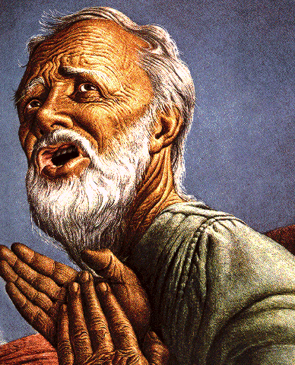
Belief – God’s One Condition for Justification
Gen 15:6
Then he believed in the LORD; and He reckoned it to him as righteousness.
John 3:16
For God so loved the world, that He gave His only begotten Son, that whoever believes in Him shall not perish, but have eternal life.
Acts 16:30-31
"Sirs, what must I do to be saved?" They said, "Believe in the Lord Jesus, and you will be saved..."

Slide 37
Genesis 15:1‒21
Abrahamic Covenant
    Seed Promise Clarified (15:1-6)
    Land Promise Ratified (15:7-21)

Slide 38
Land Promise Ratified
Genesis 15:7-21
    God’s Promise (7)
    Abram’s Question (8)
    Preparation of the Animal pieces (9-11)
    Prophecy of redemption from Egyptian bondage (12-16)
    Covenant ratification ritual (17-21)

Slide 39
Land Promise Ratified
Genesis 15:7-21
    God’s Promise (7)
    Abram’s Question (8)
    Preparation of the Animal pieces (9-11)
    Prophecy of redemption from Egyptian bondage (12-16)
    Covenant ratification ritual (17-21)

Slide 42


Slide 43
Land Promise Ratified
Genesis 15:7-21
    God’s Promise (7)
    Abram’s Question (8)
    Preparation of the Animal pieces (9-11)
    Prophecy of redemption from Egyptian bondage (12-16)
    Covenant ratification ritual (17-21)

Slide 44
VI. 8 New Promises
Genesis 12:1-3
    Land (Gen. 12:1b)
    Great nation (Gen. 12:2a)
    Personal blessing (Gen. 12:2b)
    Great name (Gen. 12:2c)
    Blessing to others (Gen. 12:2d)
    Blessing to blessers (Gen. 12:3a)
    Cursing to cursers (Gen. 12:3b)
    Blessing to the world (Gen. 12:3c)

Slide 45
Land Promise Ratified
Genesis 15:7-21
    God’s Promise (7)
    Abram’s Question (8)
    Preparation of the Animal pieces (9-11)
    Prophecy of redemption from Egyptian bondage (12-16)
    Covenant ratification ritual (17-21)

Slide 46
Dr. Arnold G. Fruchtenbaum
The Book of Genesis, 279-80
“The nature of a blood covenant is spelled out in Jeremiah 34:8–11 and 17–20. A blood covenant pledged the lives of the ones making the covenant to the covenant: If one failed, his blood was to be poured out just as the blood of the animal had been poured out. In other words, he would invoke upon himself the death penalty. The animal sacrificed was the substitute in death for the two making the covenant. Once the covenant was made and once both parties walked between the pieces of the animal, the terms of the covenant could not be changed.”

Slide 47
Dr. Arnold G. Fruchtenbaum
The Book of Genesis, 279
“The exception is that while he divided the three animals, he did not divide the birds. This was all in keeping with the ancient methods of making a blood covenant. For example, in the Mari Tablets, to make a covenant was ‘to slay an animal.’ Normally, when two men made a blood covenant, only one animal was used.”

Slide 48
Land Promise Ratified
Genesis 15:7-21
    God’s Promise (7)
    Abram’s Question (8)
    Preparation of the Animal pieces (9-11)
    Prophecy of redemption from Egyptian bondage (12-16)
    Covenant ratification ritual (17-21)

Slide 49
Dr. Arnold G. Fruchtenbaum
The Book of Genesis, 280
“The Hebrew word for deep sleep is tardeimah; it was a supernatural deep sleep that fell upon Abram. It was the same deep sleep that fell upon Adam (Gen. 2:21) in preparation for the creation of Eve. It also fell upon Saul (I Sam. 26:12 and Dan. 8:18; 10:9). It is also mentioned in Job 4:13 and 33:15.”

Slide 50

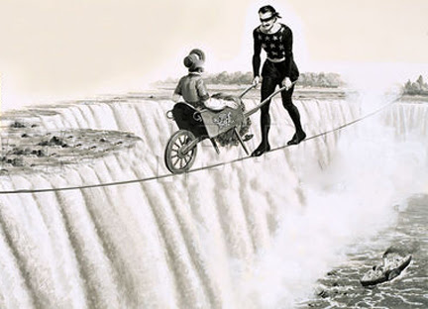
Proverbs 3:5-6
“Trust in the Lord with all your heart And do not lean on your own understanding. In all your ways acknowledge Him, And He will make your paths straight.”

Slide 51

Evidence of Abrahamic Covenant’s Unconditional Nature
ANE covenant ratification ceremony (Gen 15)
Lack of stated conditions for Israel’s obedience (Gen 15)
Covenant's eternality (Gen 17:7, 13, 19; Ps. 90:2)
Covenant's immutability (Heb 6:13-18; Mal. 3:6)
Trans-generational reaffirmation despite perpetual national disobedience (Jer 31:35-37)
Walvoord, The Millennial Kingdom, 149-52

Slide 52
ANE covenant ratification ceremony (Genesis 15)
ANE covenant ratification ceremony (Jer. 34:8-10, 18-19)
Abram never passed through the animal pieces
  Asleep (Gen. 15:12)
  Tardeimah (Gen. 2:21)
God alone passed through the animal pieces (Gen. 15:17; Exod. 13:21)
Oven and torch do not represent God and man
Walvoord, The Millennial Kingdom, 149-52

Slide 53
Trans-generational reaffirmation despite perpetual national disobedience
Covenant continuously reaffirmed to Abraham (Gen. 13:14-17; Rev. 22:17-18) despite his perpetual disobedience (Gen. 12:10-20; 20; 12:1, 4-5, 10; Acts 7:3-4)
Covenant continuously reaffirmed to Jacob (Gen. 28:14-15) despite his perpetual disobedience (Gen. 27; meaning of “Jacob”)
Covenant continuously reaffirmed to the nation of Israel (Jer. 31:35-37) despite her perpetual disobedience (Jer. 7:18; 44:17-18)
Walvoord, The Millennial Kingdom, 149-52

Slide 55
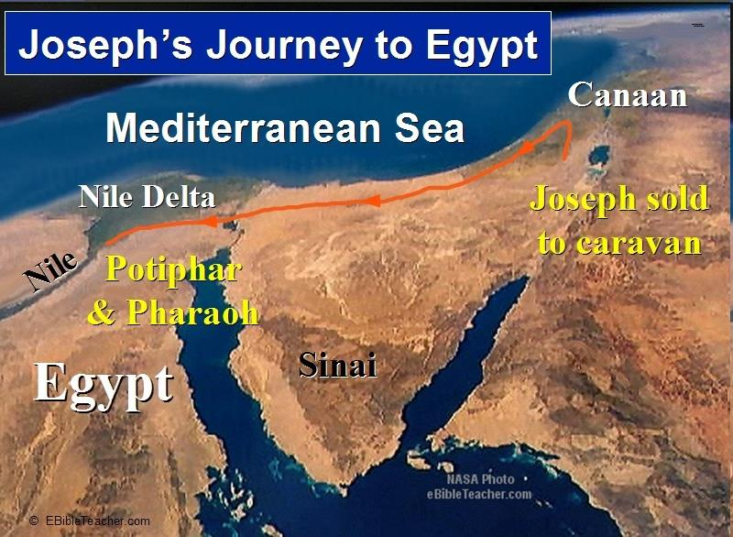

Slide 56


John 13:19; 14:29
“^{13:19} From now on I am telling you before it comes to pass, so that when it does occur, you may believe that I am He… ^{14:29} Now I have told you before it happens, so that when it happens, you may believe.”

Slide 57
What Happened to Christ’s Disciples?
Disciple | Place | Martyrdom
James the Son of Alpheus | Jerusalem | Clubbed to death
Simon the Zealot | Jerusalem | Martyred
James the Son of Zebedee | Judea (Acts 12:2) | Executed
Thaddeus | Mesopotamia | Beaten to death
Peter | Babylon, Rome | Crucified upside down
Matthew | Parthia (Tehran) | Beheaded
Notes:
109 prophecies…
Peter Stoner – SCIENCE SPEAKS, An Evaluation of Certain Christian Evidences
To fulfill just 8 prophecies =1 X 10 to the twenty-eighth power!
Can we visualize this with an illustration? Suppose we took an atheistic professor, blindfolded him and covered the state of Texas two feet deep with silver dollars. Then we put a check on one of those silver dollars and mixed them up. The odds of one person fulfilling just these eight prophecies would be the same as this atheistic professor selecting the silver dollar upon which we have placed a check, in his first try.
https://www.bereanpublishers.com/the-odds-of-eight-messianic-prophecies-coming-true/

Slide 58
What Happened to Christ’s Disciples?
Disciple | Place | Martyrdom
John | Asia Minor, Patmos, Ephesus | Fried in boiling oil
Philip | E. Turkey | Tortured & crucified
Thomas | India | Speared
Bartholomew | India | Flayed & crucified
Andrew | Ukraine, Russia, Greece | Hanged
Notes:
109 prophecies…
Peter Stoner – SCIENCE SPEAKS, An Evaluation of Certain Christian Evidences
To fulfill just 8 prophecies =1 X 10 to the twenty-eighth power!
Can we visualize this with an illustration? Suppose we took an atheistic professor, blindfolded him and covered the state of Texas two feet deep with silver dollars. Then we put a check on one of those silver dollars and mixed them up. The odds of one person fulfilling just these eight prophecies would be the same as this atheistic professor selecting the silver dollar upon which we have placed a check, in his first try.
https://www.bereanpublishers.com/the-odds-of-eight-messianic-prophecies-coming-true/

Slide 59


Slide 60
VI. 8 New Promises
Genesis 12:1-3
    Land (Gen. 12:1b)
    Great nation (Gen. 12:2a)
    Personal blessing (Gen. 12:2b)
    Great name (Gen. 12:2c)
    Blessing to others (Gen. 12:2d)
    Blessing to blessers (Gen. 12:3a)
    Cursing to cursers (Gen. 12:3b)
    Blessing to the world (Gen. 12:3c)

Slide 61
Genesis 12:3
“And I will bless those who bless you, And the one who curses you I will curse. And in you all the families of the earth will be blessed.”

Slide 62

Chafer Theological Seminary Distinctives
sufficiency of the scriptures
"We believe in the complete adequacy of Scripture, for in it God has given us all things that pertain to life and godliness. We hold, therefore, that the Word of God by itself is sufficient to prepare a person for a lifetime of effective ministry.”
https://www.chafer.edu/distinctives

Slide 63


Slide 64
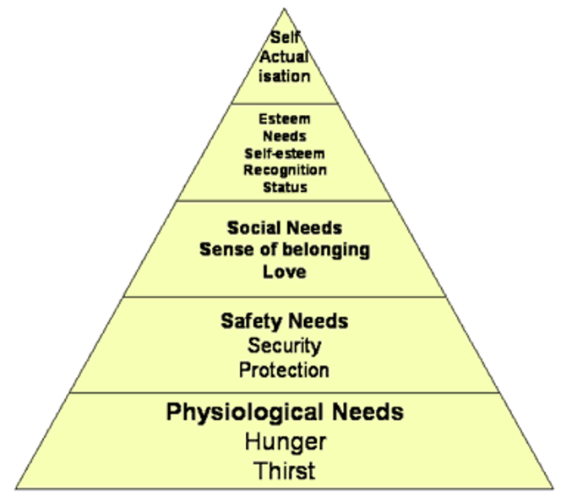
Maslow’s Hierarchy of Needs

Slide 65
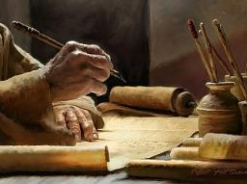
1 Peter 2:2
“like newborn babies, long for the pure [adolos] milk of the word, so that by it you may grow in respect to salvation, ³ if you have tasted the kindness of the Lord.”

Slide 66
2 Timothy 3:16-17
“All Scripture is inspired by God [theopneustos] and profitable for teaching, for reproof, for correction, for training in righteousness; so that the man of God may be adequate, equipped for every good work.”

Slide 67

2 Peter 1:3-4
“³ Seeing that His divine power has granted to us everything pertaining to life and godliness, through the true knowledge of Him who called us by His own glory and excellence. ⁴For by these He has granted to us His precious and magnificent promises, so that by them you may become partakers of the divine nature, having escaped the corruption that is in the world by lust.”

Slide 68

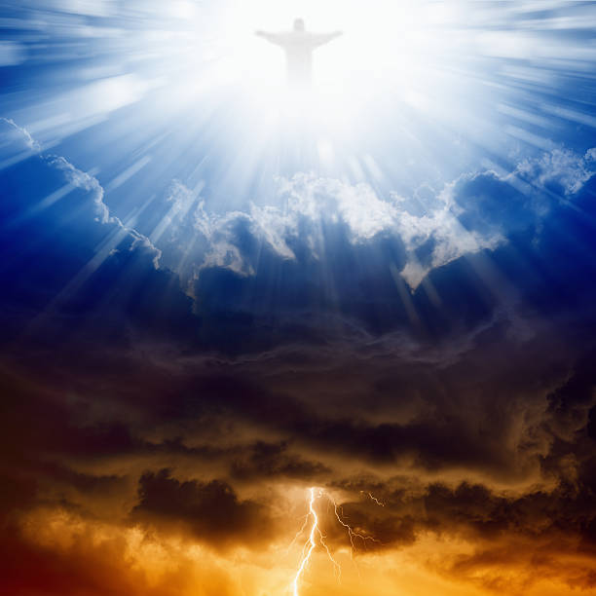
Daniel 12:2
“Many of those who sleep in the dust of the ground will awake, these to everlasting (olam) life, but the others to disgrace and everlasting (olam) contempt.”

Slide 69
Dr. Arnold G. Fruchtenbaum
The Book of Genesis, 283
“By stating: You shall go to your fathers, God is saying that the ancestors of Abram are viewed as being in a definite place to which Abram will go. That definite place is Sheol in the center of the earth. This kind of phraseology always emphasizes the afterlife and reflects faith in the afterlife. Furthermore, this has to be a reference to the soul of Abram and not to the interment of his body because the fathers of Abram were in Haran and in Ur, but they were not here in the Land where Abram’s physical remains would be buried.”

Slide 70

Luke 16:24-26
“²⁴ And he cried out and said, ‘Father Abraham, have mercy on me, and send Lazarus so that he may dip the tip of his finger in water and cool off my tongue, for I am in agony in this flame.’ ²⁵ But Abraham said, ‘Child, remember that during your life you received your good things, and likewise Lazarus bad things; but now he is being comforted here, and you are in agony. ²⁶ And besides all this, between us and you there is a great chasm fixed, so that those who wish to come over from here to you will not be able, and that none may cross over from there to us.’”

Slide 71
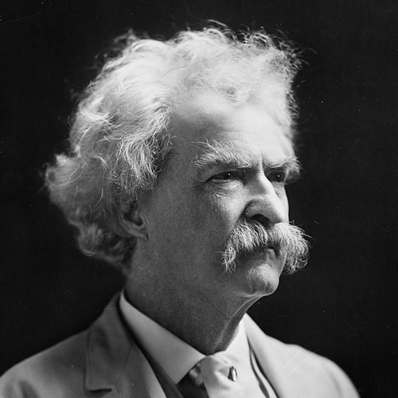
Mark Twain
Autobiography, 2:37
“A myriad of men are born; they labor and sweat and struggle for bread; they squabble and scold and fight; they scramble for little mean advantages over each other. Age creeps upon them and infirmities follow; shames and humiliations bring down their prides and their vanities. Those they love are taken from them, and the joy of life is turned to aching grief. The burden of pain, care, and misery grows heavier year by year. At length ambition is dead, pride is dead, vanity is dead; longing for release is in their place. It comes at last-the only un-poisoned gift earth ever had for them-and they vanish from a world where they were of no consequence; where they achieved nothing, where they were a mistake and a failure and a foolishness; where they left no sign that they have existed-a world that will lament them a day and forget them forever.”

Slide 72
2 Timothy 4:7-8
“⁷ I have fought the good fight, I have finished the course, I have kept the faith; ⁸ in the future there is reserved for me the crown of righteousness, which the Lord, the righteous Judge, will award to me on that day; and not only to me, but also to all who have loved His appearing.”

Slide 73
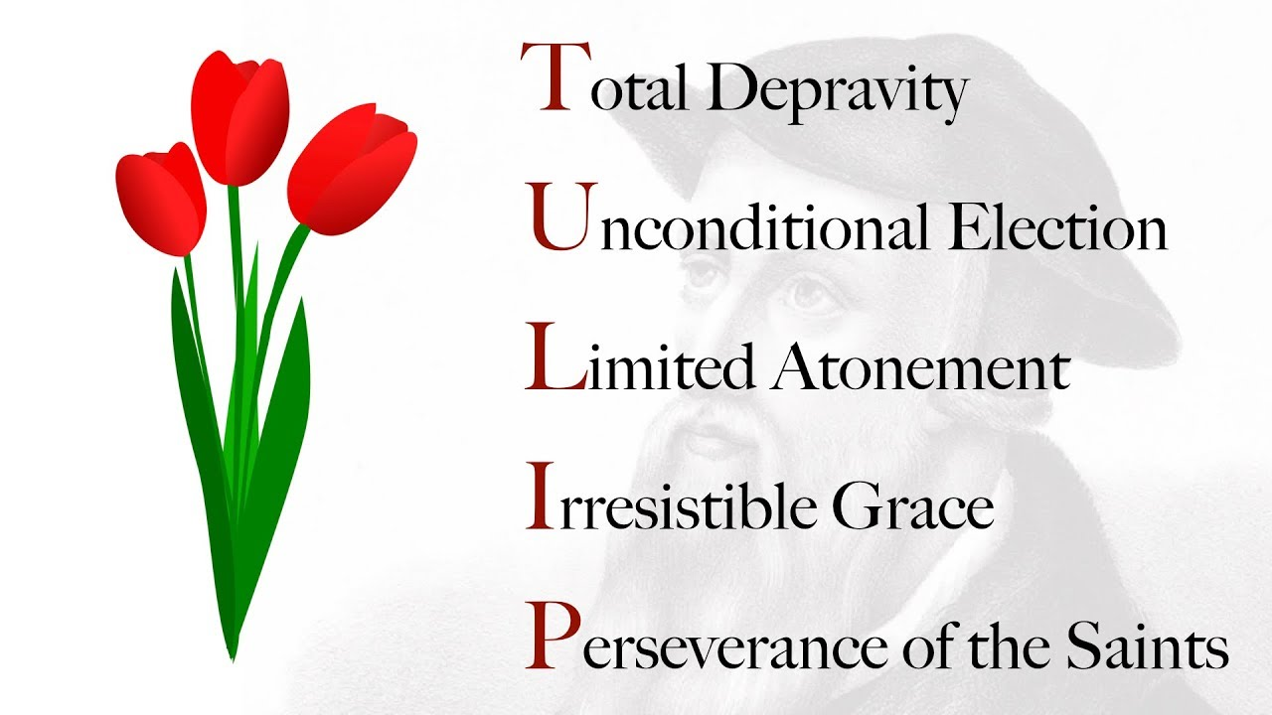
Ephesians 2:10
“For we are His workmanship, created in Christ Jesus for good works, which God prepared beforehand so that we would walk (peripateō) in them.”

Slide 74


Genesis 15:16
“Then in the fourth generation they will return here, for the wrongdoing of the Amorite is not yet complete.”

Slide 75
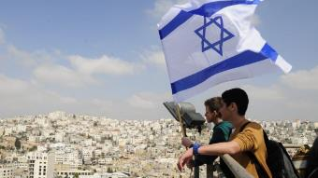
Reliability of the “Divine Regathering” Predictions
 | RETURN | PREDICTED | FULFILLED
1st | From Egypt to Canaan | Gen. 15:13-14 | Joshua 1‒12
2nd | From Babylon to Israel | Jer. 25:11; 29:10 | Ezra & Nehemiah
3rd | From the Diaspora to Israel’s restoration | Ezekiel 36:24-28 | Millennial Kingdom

Slide 76

Ham’s Sons (vs. 6)
  Cush
  Mizraim
  Put
  Canaan

Slide 77
4. Canaan’s Sons (vs. 15-18)
    Sidon
    Heth
    Jebusite
    Amorite
    Girgashite
    Hivite
    Arkite
    Sinite
    Arvadite
    Zemarite
    Hamathite
    Perrizite

Slide 78
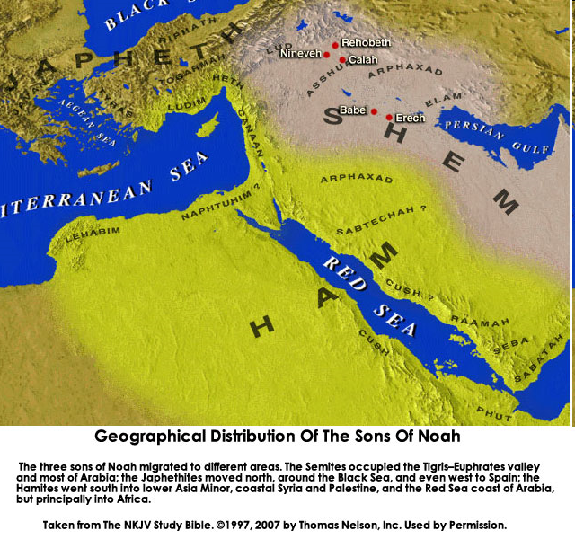
CANNAN

Slide 80
Genesis 6:1-4
“¹ Now it came about, when men began to multiply on the face of the land, and daughters were born to them, ² that the sons of God saw that the daughters of men were beautiful; and they took wives for themselves, whomever they chose. ³ Then the Lord said, ‘My Spirit shall not strive with man forever, because he also is flesh; nevertheless his days shall be one hundred and. . .

Slide 81
Genesis 6:1-4
. . . twenty years.’ ⁴ The Nephilim were on the earth in those days, and also afterward, when the sons of God came in to the daughters of men, and they bore children to them. Those were the mighty men who were of old, men of renown.”

Slide 82

2 Peter 3:9
“The Lord is not slow about His promise, as some count slowness, but is patient toward you, not wishing for any to perish but for all to come to repentance.”

Slide 83
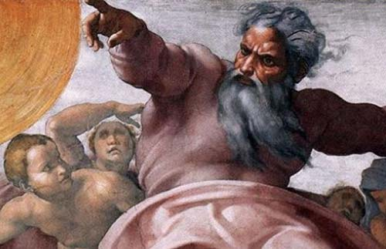
Romans 2:5
“But because of your stubbornness and unrepentant heart you are storing up wrath for yourself in the day of wrath and revelation of the righteous judgment of God.”

Slide 84
Genesis 6:1-4
“¹ Now it came about, when men began to multiply on the face of the land, and daughters were born to them, ² that the sons of God saw that the daughters of men were beautiful; and they took wives for themselves, whomever they chose. ³ Then the Lord said, ‘My Spirit shall not strive with man forever, because he also is flesh; nevertheless his days shall be one hundred and. . .

Slide 85
Genesis 6:1-4
. . . twenty years.’ ⁴ The Nephilim were on the earth in those days, and also afterward, when the sons of God came in to the daughters of men, and they bore children to them. Those were the mighty men who were of old, men of renown.”

Slide 86
Land Promise Ratified
Genesis 15:7-21
    God’s Promise (7)
    Abram’s Question (8)
    Preparation of the Animal pieces (9-11)
    Prophecy of redemption from Egyptian bondage (12-16)
    Covenant ratification ritual (17-21)

Slide 87
Covenant Ratification Ritual
Genesis 15:17-21
  The ceremony (17)
  The covenant (18a)
  The land (18b-21)

Slide 88
Covenant Ratification Ritual
Genesis 15:17-21
  The ceremony (17)
  The covenant (18a)
  The land (18b-21)

Slide 89
Dr. Arnold G. Fruchtenbaum
The Book of Genesis, 280
“The Hebrew word for deep sleep is tardeimah; it was a supernatural deep sleep that fell upon Abram. It was the same deep sleep that fell upon Adam (Gen. 2:21) in preparation for the creation of Eve. It also fell upon Saul (I Sam. 26:12 and Dan. 8:18; 10:9). It is also mentioned in Job 4:13 and 33:15.”

Slide 90
Evidence of Abrahamic Covenant’s Unconditional Nature
ANE covenant ratification ceremony (Gen 15)
Lack of stated conditions for Israel’s obedience (Gen 15)
Covenant's eternality (Gen 17:7, 13, 19; Ps. 90:2)
Covenant's immutability (Heb 6:13-18; Mal. 3:6)
Trans-generational reaffirmation despite perpetual national disobedience (Jer 31:35-37)
Walvoord, The Millennial Kingdom, 149-52

Slide 91
Dr. Arnold G. Fruchtenbaum
The Book of Genesis, 283-84
“The normal procedure was for both persons making the covenant to walk between the pieces of the animal, rendering the terms of the covenant obligatory to both parties. This procedure also rendered the covenant conditional: If one party broke the terms and forfeited his life, it would exempt the other party from keeping his part of the covenant. Since the covenant was between God and Abram, it was normal here that God passed between these pieces. The previous abnormality was the fact that in place of one animal, there were five. Now there was a second differentiation.”

Slide 92
Dr. Arnold G. Fruchtenbaum
The Book of Genesis, 283-84
“It was not God and Abram that walked between these pieces of the animals, but it was God alone Who passed between the pieces of the animals, which rendered the covenant unconditional. Abram’s lack of participation emphasizes the unconditionality of this particular covenant. So Abram did not become an active participant in the signing and sealing of the covenant as such; he was only the recipient of the covenant and the covenantal promises. It meant that no matter how often Abram failed (and he will fail in the next chapter), and no matter how often his seed, the Jewish people fail, the Abrahamic Covenant cannot be rendered null and void.”

Slide 93
Covenant Ratification Ritual
Genesis 15:17-21
  The ceremony (17)
  The covenant (18a)
  The land (18b-21)

Slide 94
Genesis 15:18-21
¹⁸ On that day the Lord made a covenant with Abram, saying, “To your descendants I have given this land, From the river of Egypt as far as the great river, the river Euphrates: ¹⁹ the Kenite and the Kenizzite and the Kadmonite ²⁰ and the Hittite and the Perizzite and the Rephaim ²¹ and the Amorite and the Canaanite and the Girgashite and the Jebusite.”

Slide 95
Genesis 15:18-21
¹⁸ On that day the Lord made a covenant with Abram, saying, “To your descendants I have given this land, From the river of Egypt as far as the great river, the river Euphrates: ¹⁹ the Kenite and the Kenizzite and the Kadmonite ²⁰ and the Hittite and the Perizzite and the Rephaim ²¹ and the Amorite and the Canaanite and the Girgashite and the Jebusite.”

Slide 96
Noahic vs. Abrahamic & Mosaic Covenants
Name | NOAHIC | ABRAHAMIC | MOSAIC
Human agent | Noah | Abraham | Moses
Scripture | Gen. 8‒9 | Gen. 12‒17 | Exod. 19‒40
Covenant (Berit) | Gen. 9:9 | Gen. 15:18 | Exod. 19:5
Party | World, humanity | Israel, Hebrews | Israel, Hebrews
Israel | Pre-Israel | Post-Israel | Post-Israel

Slide 97
Noahic vs. Abrahamic & Mosaic Covenants
Covenant | NOAHIC | ABRAHAMIC | MOSAIC
Conditional or unconditional | Unconditional | Unconditional | Conditional
Promises | No more flood judgment, enduring earth, capital punishment | Ownership of land, seed, and blessing | Enjoyment or possession of land, seed, and blessing
Sign | Rainbow | Circumcision | Sabbath
Purpose | Restrain & preserve | Redemptive | Redemptive
Directly binding today? | Yes | No | No

Slide 98
Dr. William F. Albright
W. F. Albright, Yahweh and the Gods of Canaan: A Historical Analysis of Two Contrasting Faiths (Garden City, NY: Doubleday, 1968), 106-08.
“‘Contracts and treaties were common everywhere, but only the Hebrews, so far as we know, made covenants with their gods or God. Being prevailing caravaneers and so ethno-political intruders in the West, the early Hebrews were in constant need of contractual and treaty protection.’ Of course, we biblicists would insist that it was God that made the contracts with men, not the other way around.”
Charles C. Clough, "Social-Political Implications of the New Covenant," in An Introduction to the New Covenant, ed. Christopher Cone(Hurst, TX: Tyndale Seminary Press, 2013), 277, fn. 13.

Slide 99
Genesis 15:18-21
¹⁸ On that day the Lord made a covenant with Abram, saying, “To your descendants I have given this land, From the river of Egypt as far as the great river, the river Euphrates: ¹⁹ the Kenite and the Kenizzite and the Kadmonite ²⁰ and the Hittite and the Perizzite and the Rephaim ²¹ and the Amorite and the Canaanite and the Girgashite and the Jebusite.”

Slide 100
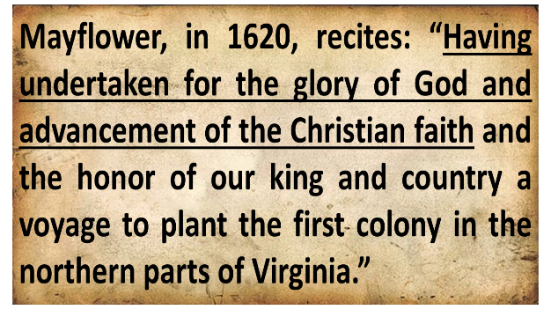
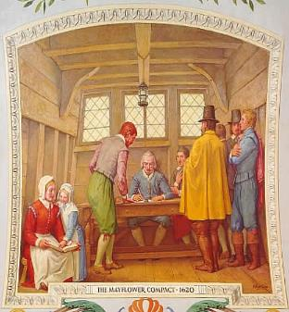
Mayflower Compact (1620)
David Brewer, United States A Christian Nation, 14

Slide 102

Exodus 2:24
“So God heard their groaning; and God remembered His covenant with Abraham, Isaac, and Jacob.”

Slide 103
Ezekiel 36:22
“Therefore, say to the house of Israel, ‘This is what the Lord God says: “It is not for your sake, house of Israel, that I am about to act, but for My holy name, which you have profaned among the nations where you went.”

Slide 104

Jeremiah 31:35-37
Thus says the Lord, Who gives the sun for light by day And the fixed order of the moon and the stars for light by night, Who stirs up the sea so that its waves roar; The Lord of hosts is His name:³⁶ “If this fixed order departs From before Me,” declares the Lord, “Then the offspring of Israel also will cease From being a nation before Me forever.”³⁷ Thus says the Lord, “If the heavens above can be measured And the foundations of the earth searched out below, Then I will also cast off all the offspring of Israel For all that they have done,” declares the Lord.

Slide 105
John 10:27-29
“My sheep hear My voice, and I know them, and they follow Me; ²⁸ and I give eternal life to them, and they will never perish [ou mē; aiōnia]; and no one will snatch them out of My hand. ²⁹ My Father, who has given them to Me, is greater than all; and no one is able to snatch them out of the Father’s hand.”

Slide 106
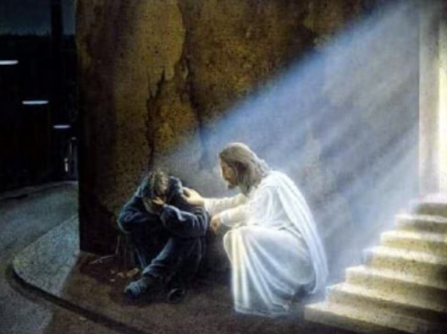
2 Timothy 2:11, 13
“The statement is trustworthy:…If we are faithless, He remains faithful, for He cannot deny Himself.”

Slide 107

John MacArthur
John MacArthur, The Gospel According to Jesus, p. 140
"Eternal life is indeed a free gift (Rom. 6:23). Salvation cannot be earned with good deeds or purchased with money. It has already been bought by Christ, who paid the ransom with His blood. But that does not mean there is no cost in terms of salvation's impact on the sinner's life. This paradox may be difficult but it is nevertheless true: salvation is both free and costly. Eternal life brings immediate death to self. 'Knowing this, that our old self was crucified with Him, that our body of sin might be done away with, that we should no longer be slaves to sin' (Rom 6:6). Thus in a sense we pay the ultimate price for salvation when our sinful self is nailed to a cross. It is a total abandonment of self-will, like the grain of wheat that falls to the ground and dies so that it can bear much fruit (cf. John 12:24). It is an exchange of all that we are for all that Christ is. And it denotes implicit obedience, full surrender to the lordship of Christ. Nothing less can qualify as saving faith.”

Slide 108
John MacArthur
John MacArthur, Faith Works, p. 25
“Jesus is Lord of all, and the faith He demands involves unconditional surrender…He does not bestow eternal life on those whose hearts remain set against Him.”

Slide 109
John MacArthur
John MacArthur, Transcription of The Art of Self-Discipline, part 2, www.gty.org.
“Self discipline comes when you look back to the covenant of your salvation…that is to say when you remember that at the point of your salvation you made a promise to submit to the Lord. You made a pledge at that time to be obedient to Christ. You confessed Him as Lord…And Lord means that He is above all. It’s essential then as believers to remember that we made a covenant of obedience when we confessed Jesus as Lord. We were saved unto obedience which God had before ordained that we should walk…and obedience characterized by good works…and obedience to God's Word. That pledge was inherent in salvation. God at the time you came to Him for salvation promised you forgiveness and eternal life and all the grace necessary to fulfill His will, and the Holy Spirit, and you pledged obedience. And you need to go back and remember that and have the integrity to be faithful to your original promise…”

Slide 110
Covenant Ratification Ritual
Genesis 15:17-21
  The ceremony (17)
  The covenant (18a)
  The land (18b-21)

Slide 111
Genesis 15:18-21
¹⁸ On that day the Lord made a covenant with Abram, saying, “To your descendants I have given this land, From the river of Egypt as far as the great river, the river Euphrates: ¹⁹ the Kenite and the Kenizzite and the Kadmonite ²⁰ and the Hittite and the Perizzite and the Rephaim ²¹ and the Amorite and the Canaanite and the Girgashite and the Jebusite.”

Slide 112


Slide 113
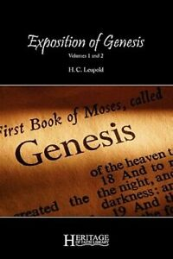
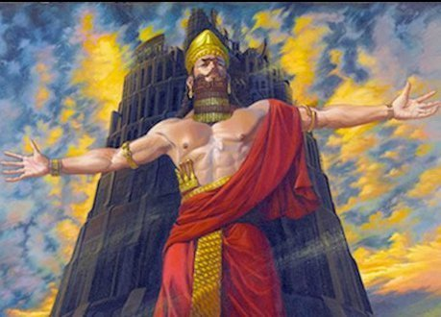
H. C. Leupold
H.C. Leupold, Exposition of Genesis, 490.
“‘The River of Egypt’ could hardly be the Wady el ‘Arish (Rhinocolura), for that insignificant winter torrent could hardly be set in contrast to the ‘Great River, the River Euphrates.’ Consequently, ‘the River of Egypt’ is the Nile.”

Slide 116
Dr. Arnold G. Fruchtenbaum
The Book of Genesis, 284
“The southern border of the Land is from the river of Egypt. The river of Egypt is not the Nile, as has often been misinterpreted; for if it was the Nile, the Jews were already in the Promised Land before they ever left Egypt. Nor is the River of Egypt the Wadi el-Arish, the wadi that runs through the center of the Sinai Peninsula, because that was referred to in the Bible as the Brook (nachal) of Egypt, not the River (nahar) of Egypt. The river of Egypt refers to the most eastern branch of the Nile Delta. As the Nile River flows from south to north before emptying into the Mediterranean Sea, it breaks up into various branches flowing through the Nile Delta, and the most eastern branch was known as the River of Egypt. This is known today as the Pelogiac branch of the Nile Delta, which flows into Lake Sironbis. It is also known as the River Shihor, the fourteenth nome of Egypt.”

Slide 117
Evidence of Abrahamic Covenant’s Unconditional Nature
ANE covenant ratification ceremony (Gen 15)
Lack of stated conditions for Israel’s obedience (Gen 15)
Covenant's eternality (Gen 17:7, 13, 19; Ps. 90:2)
Covenant's immutability (Heb 6:13-18; Mal. 3:6)
Trans-generational reaffirmation despite perpetual national disobedience (Jer 31:35-37)
Walvoord, The Millennial Kingdom, 149-52

Slide 118
Land Promises Fulfilled in the Time of Joshua (Josh. 11:23; 21:43-45) or Solomon (1 Kgs. 4:21)?
Extended context (Josh 13:1-7; Judges 1:19, 21, 27, 29, 30-36)
Land gained in conquest was only a fraction of what was promised (1 Kgs. 4:25)
Jerusalem not conquered in Joshua’s day (Josh 15:63; 2 Sam 5)
Solomon’s reign extended to the border of Egypt (1 Kgs. 4:21) and not the River of Egypt (Gen. 15:18)
Solomon’s reign was tributary only (1 Kgs. 4:21)
Forever? (Gen 17:7-8, 13, 19)
Reaffirmation of land promises long after Joshua and Solomon’s time (Amos 9:11-15)
Fruchtenbaum, Israelology, 521-22, 631-32

Slide 119
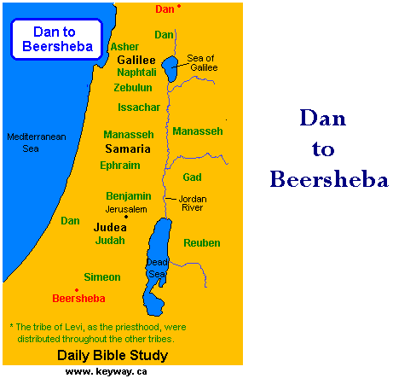

Slide 120
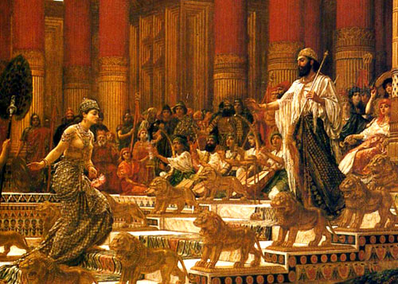
1 Kings 4:21
“Now Solomon ruled over all the kingdoms from the River to the land of the Philistines and to the border of Egypt; they brought tribute and served Solomon all the days of his life.”

Slide 121
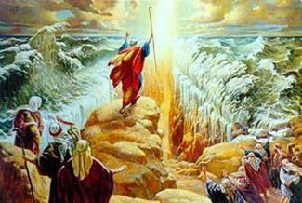
IMPORTANCE
God’s promises and covenant to Israel remain literal, reliable, unconditional, and unfulfilled (Gen. 23)
Basis of God’s intervention in history (Gen. 15:14-16; Exod. 2:24)
God must once again move His hand in history to fulfill His Word (Ezek. 36:22)
Forms the expectation of a future earthly kingdom

Slide 122


Slide 124
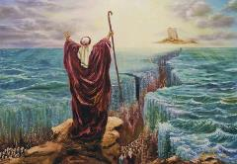
Deuteronomy 29:1
“These are the words of the covenant which the Lord commanded Moses to make with the sons of Israel in the land of Moab, besides the covenant which He had made with them at Horeb.”

Slide 125
Deuteronomy 30:3
“ Then the Lord your God will restore you from captivity, and have compassion on you, and will gather you again from all the peoples where the Lord your God has scattered you.”

Slide 126

2 Samuel 7:12-16
“When your days are complete and you lie down with your fathers, I will raise up your descendant after you, who will come forth from you, and I will establish his kingdom. ¹³ He shall build a house for My name, and I will establish the throne of his kingdom forever. ¹⁴ I will be a father to him and he will be a son to Me; when he commits iniquity, I will correct him with the rod of men and the strokes of the sons of men, ¹⁵ but My lovingkindness shall not depart from him, as I took it away. . .

Slide 127
2 Samuel 7:12-16
. . .from Saul, whom I removed from before you. ¹⁶ Your house and your kingdom shall endure before Me forever; your throne shall be established forever.” ¹⁷ In accordance with all these words and all this vision, so Nathan spoke to David.”

Slide 128
Jeremiah 31:31-34
“Behold, days are coming,” declares the Lord, “when I will make a new covenant with the house of Israel and with the house of Judah, ³² not like the covenant which I made with their fathers in the day I took them by the hand to bring them out of the land of Egypt, My covenant which they broke, although I was a husband to them,” declares the Lord. ³³ “But this is the covenant which I will make with the house of Israel after those days,” declares the Lord, “I will put My law within them and on their heart I will. . .

Slide 129
Jeremiah 31:31-34
. . .write it; and I will be their God, and they shall be My people. ³⁴ They will not teach again, each man his neighbor and each man his brother, saying, ‘Know the Lord,’ for they will all know Me, from the least of them to the greatest of them,” declares the Lord, “for I will forgive their iniquity, and their sin I will remember no more.”

Slide 130
Genesis 15:18-21
¹⁸ On that day the Lord made a covenant with Abram, saying, “To your descendants I have given this land, From the river of Egypt as far as the great river, the river Euphrates: ¹⁹ the Kenite and the Kenizzite and the Kadmonite ²⁰ and the Hittite and the Perizzite and the Rephaim ²¹ and the Amorite and the Canaanite and the Girgashite and the Jebusite.”

Slide 131
Ham’s Sons (vs. 6)
  Cush
  Mizraim
  Put
  Canaan

Slide 132
4. Canaan’s Sons (vs. 15-18)
    Sidon
    Heth
    Jebusite
    Amorite
    Girgashite
    Hivite
    Arkite
    Sinite
    Arvadite
    Zemarite
    Hamathite
    Perrizite

Slide 133
CANNAN

Slide 134
Genesis 15:16
“Then in the fourth generation they will return here, for the wrongdoing of the Amorite is not yet complete.”

Slide 136
Conclusion

Slide 137
Genesis 15:1‒21
Abrahamic Covenant
    Seed Promise Clarified (15:1-6)
    Land Promise Ratified (15:7-21)

Slide 138

“The Lord bless you and keep you; the Lord make his face shine on you and be gracious to you; the Lord turn his face toward you and give you peace.” (NIV)

