Slide 1
THE RAPTURE
Question and Answer – Part 9
Andrew Marshall Woods, Th.M., JD., PhD.
Sr. Pastor, Sugar Land Bible Church

Slide 2
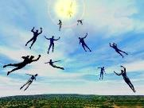
The Rapture Course Overview
What is the Rapture?
When is the Rapture?
Strengthening the Pre-Tribulational case
The opposing views
One second after the Rapture
Questions & Answers

Slide 3
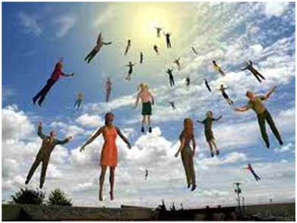
MAIL BAG
Overview of end time events?
Intermediate state?
Infants & the Rapture?
Church in Rev. 7:9?
Church in Rev. 11:3-13?

Slide 4
MAIL BAG
Overview of end time events?
Intermediate state?
Infants & the Rapture?
Church in Rev. 7:9?
Church in Rev. 11:3-13?

Slide 7
Messiah must present Himself to Israel on March 30, A.D. 33 (Daniel 9:25)

Slide 8
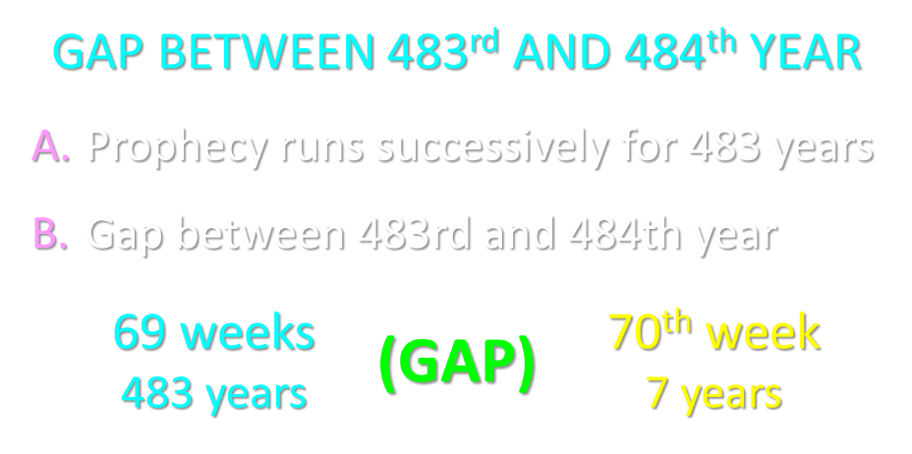

Slide 9
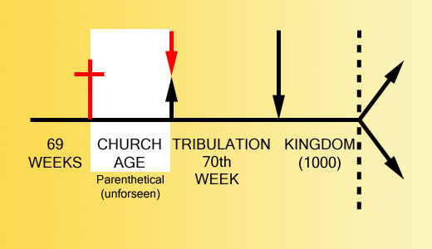

Slide 11
Daniel 9:27
And he will make a firm covenant with the many for one week, but in the middle of the week he will put a stop to sacrifice and grain offering; and on the wing of abominations will come one who makes desolate, even until a complete destruction, one that is decreed, is poured out on the one who makes desolate.

Slide 13
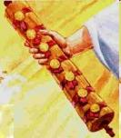
1st Six Seals (Revelation 6)
6:1-2 – Advent of antichrist
6:3-4 – War
6:5-6 – Famine
6:7-8 – Death
6:9-11 – Martyrdoms
6:12-17 – Cosmic disturbances

Slide 14
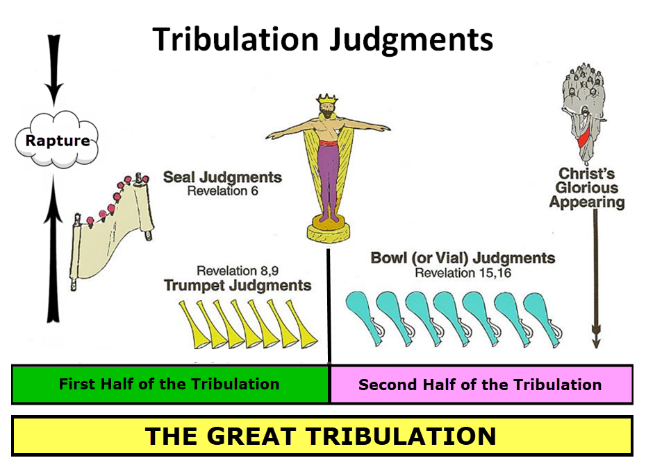

Slide 15
5 Non-Chronological Parenthetical Insertions
Rev 7 – 144,000 Jews
Rev 10:1-11:13 – Announcement of no more delay and the two witnesses
Rev 12-14 – Israel’s flight, two beasts, six scenes of hope
Rev 16:13-16 – Gathering of the nations to Armageddon
Rev 17:1-19:6 – Babylon’s fall

Slide 17
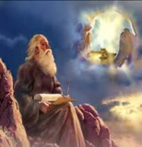
“After These Things” (Rev. 4‒22)
Before the Tribulation (4‒5)
During the Tribulation (6‒19)
After the Tribulation (20‒22)
Kingdom (20:1-10)
Great White Throne Judgment (20:11-15)
Destruction of the Earth (21:1)
New Heaven and New Earth (21‒22)

Slide 19
MAIL BAG
Overview of end time events?
Intermediate state?
Infants & the Rapture?
Church in Rev. 7:9?
Church in Rev. 11:3-13?

Slide 20
Luke 16:24-26
“²⁴ And he cried out and said, ‘Father Abraham, have mercy on me, and send Lazarus so that he may dip the tip of his finger in water and cool off my tongue, for I am in agony in this flame.’ ²⁵ But Abraham said, ‘Child, remember that during your life you received your good things, and likewise Lazarus bad things; but now he is being comforted here, and you are in agony. ²⁶ And besides all this, between us and you there is a great chasm fixed, so that those who wish to come over from here to you will not be able, and that none may cross over from there to us.’”

Slide 22
MAIL BAG
Overview of end time events?
Intermediate state?
Infants & the Rapture?
Church in Rev. 7:9?
Church in Rev. 11:3-13?

Slide 23
2 Peter 3:9
“The Lord is not slow about His promise, as some count slowness, but is patient toward you, not wishing for any to perish but for all to come to repentance.”

Slide 25
MAIL BAG
Overview of end time events?
Intermediate state?
Infants & the Rapture?
Church in Rev. 7:9?
Church in Rev. 11:3-13?

Slide 26
Distinctions Between 144,000 & Multitude
144,000 | MULTITUDE
Revelation 7:1-8 | Revelation 7:9-17
Numbered | Innumerable
Jews | All nations
Sealed | Slain
Sealed before the Tribulation | Converted out of the Tribulation
Hitchcock and Ice, The Truth Behind Left Behind, 77

Slide 27
Revelation 1:19
“Therefore write the things which you have seen, and the things which are, and the things which will take place after these things [meta tauta].”

Slide 28
Revelation 1:19
Seen (1)
Are (2–3)
After these things (4–22)

Slide 29
God’s Work Through Israel
Revelation 7 – 144,000 Jews
Revelation 11 – Two Jewish witnesses
Revelation 12 – Israel flees

Slide 30
Galatians 3:28
There is neither Jew nor Greek, there is neither slave nor free man, there is neither male nor female; for you are all one in Christ Jesus.

Slide 31
Ephesians 2:14
For He Himself is our peace, who made both groups into one and broke down the barrier of the dividing wall.

Slide 32
MAIL BAG
Overview of end time events?
Intermediate state?
Infants & the Rapture?
Church in Rev. 7:9?
Church in Rev. 11:3-13?

Slide 33
Revelation 1:19
“Therefore write the things which you have seen, and the things which are, and the things which will take place after these things [meta tauta].”

Slide 34
Revelation 1:19
Seen (1)
Are (2–3)
After these things (4–22)

Slide 35
God’s Work Through Israel
Revelation 7 – 144,000 Jews
Revelation 11 – Two Jewish witnesses
Revelation 12 – Israel flees

Slide 36
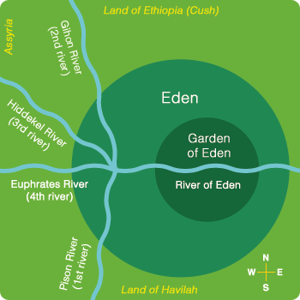

Slide 37
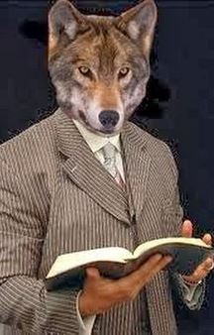
“He (or she) who spiritualizes tells spiritual lies.”

Slide 38
ISRAEL’S FOUR TEMPLES
Solomon’s pre-exilic temple (Kings and Chronicles)
Zerubbabel’s post exilic temple (Ezra 1-6; John 2:20)
Antichrist's temple (Dan. 9:27; Matt. 24:15; 2 Thess. 2:4; Rev. 11:1-2)
Millennial temple (Ezek. 40-48)

Slide 40
Daniel 9:27
And he will make a firm covenant with the many for one week, but in the middle of the week he will put a stop to sacrifice and grain offering; and on the wing of abominations will come one who makes desolate, even until a complete destruction, one that is decreed, is poured out on the one who makes desolate.

Slide 42
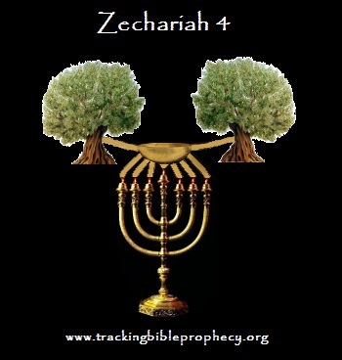

Slide 43
CONCLUSION

Slide 44
MAIL BAG
Overview of end time events?
Intermediate state?
Infants & the Rapture?
Church in Rev. 7:9?
Church in Rev. 11:3-13?

