Slide 1


Zechariah
God Remembers!

Slide 2

Structure
Introductory call to repentance (1:1-6)
Eight-night visions (1:7–6:15)
Question and answers about fasting (7–8)
Two burdens (9–14)

Slide 3

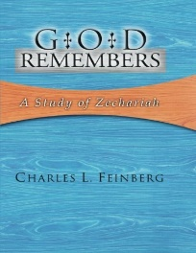
Charles L. Feinberg
God Remembers: A Study of Zechariah (Wheaton: Van Kampen, 1950, p. 82-83.
“Zechariah knows nothing (nor does any other writer of the Scriptures) of the mawkish theology which is so much in vogue in our day that considers God as the God of love, overlooking every failure, shortcoming, and defection in man. True, twice over John the Apostle in his First Epistle designates God as. the God of love, but he sounds forth the warning of impending judgment on all ungodliness in all the writings that the Spirit of God directed him to pen. If God can overlook sin lightly because of His love, then what need is there for Isaiah to a state of him that He is ‘the high and lofty One that inhabiteth eternity, whose name is Holy’ (Isa. 57:15)? What object is accomplished in Habakkuk’s great declaration: ‘Thou that art of . . .

Slide 4
Charles L. Feinberg
God Remembers: A Study of Zechariah (Wheaton: Van Kampen, 1950, p. 82-83.
. . . eyes than to behold evil, and that canst not look on perverseness’ (Hab. 1:13)? Why should the majestic Epistle to the Hebrews inject such notes as these ‘it is a fearful thing to fall into the hands of the living God’ or ‘our God is a consuming fire’ (Hebrews 10:31; 12:29)? Away with half-baked theology! Let us magnify the love of God and at the same time maintain His irreproachable holiness.”

Slide 5
II. Eight Night Visions
(1:7‒6:15)
  Riders & horses among the myrtle trees (1:7-17)
  Four horns & four craftsmen (1:18-21)
  Man with the measuring line (2)
  Cleansing of the High Priest Joshua (3)
  Lampstand & olive tree (4)
  Flying scroll (5:1-4)
  Woman in the basket (5:5-11)
  Four chariots (6:1-8)
  Conclusion: crowning of Joshua (6:9-15)

Slide 6
ZECHARIAH’S EIGHT NIGHT VISIONS
Vision | Reference | Meaning
The Red-horse Rider among the Myrtles | 1:7-17 | God’s anger against the nations & blessing on restored Israel.
The Four Horns & the Four Craftsmen | 1:18-21 | God’s judgement on the nations that afflict Israel.
The Surveyor with a Measuring Line | Chapter 2 | God’s future blessing on restored Israel.
The Cleansing & Crowning of Joshua the Hight Priest. | Chapter 3 | Israel’s future cleansing from sin & reinstatement as a priestly nation.
The Golden Lampstand & the Two Olive Trees | Chapter 4 | Israel as the light to the nations under Messiah, the King-Priest.
The Flying Scroll | 5:1-4 | The severity & totality of divine judgment on individual Israelites.
The Woman in the Ephah | 5:5-11 | The removal of national Israel’s sin of rebellion against God.
The Four Chariots | 6:1-8 | Divine judgment on Gentile nations.

Slide 7
6. The Flying Scroll
(5:1-4)
Vision Described (1-2)
Vision Interpreted (3-4)
  Covenant judgment coming (3a)
  Sins to be judged (3b-4)
    Stealing (3b)
    Swearing falsely (3c-4)

Slide 8
6. The Flying Scroll
(5:1-4)
Vision Described (1-2)
Vision Interpreted (3-4)
  Covenant judgment coming (3a)
  Sins to be judged (3b-4)
    Stealing (3b)
    Swearing falsely (3c-4)

Slide 9

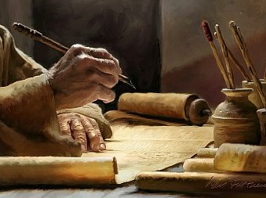
2 Timothy 3:16-17
“All Scripture is inspired by God [theopneustos] and profitable for teaching, for reproof, for correction, for training in righteousness; so that the man of God may be adequate, equipped for every good work.”

Slide 10
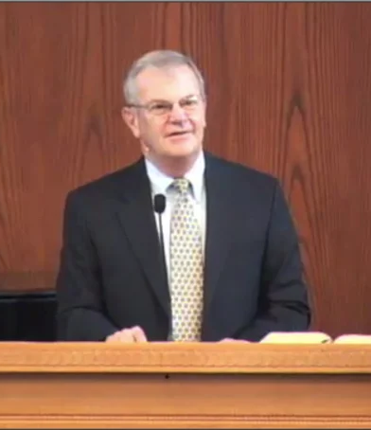
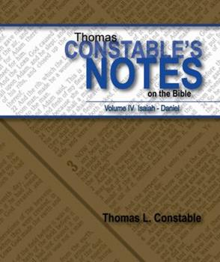
Thomas L. Constable
Constable’s online notes on Zechariah, p. 56.
“The scroll that Zechariah saw was open—and large—so that people could read it easily. During the restoration period, the returnees demonstrated an increased interest in the Mosaic Law, which was written on scrolls (cf. Neh. 8). No one could plead ignorance, because the scroll in Zechariah's vision was large enough for all to see and read.”

Slide 11
6. The Flying Scroll
(5:1-4)
Vision Described (1-2)
Vision Interpreted (3-4)
  Covenant judgment coming (3a)
  Sins to be judged (3b-4)
    Stealing (3b)
    Swearing falsely (3c-4)

Slide 12
6. The Flying Scroll
(5:1-4)
Vision Described (1-2)
Vision Interpreted (3-4)
  Covenant judgment coming (3a)
  Sins to be judged (3b-4)
    Stealing (3b)
    Swearing falsely (3c-4)

Slide 13


Slide 14
Six Parts of a Suzerain-Vassal Treaty in Deuteronomy
Preamble (1:1-5)
Prologue (1:6–4:40)
Covenant obligations (5–26)
Storage and reading instructions (27:2-3; 31:9, 24, 26)
Witnesses (32:1)
Blessings and curses (28)

Slide 15

Genesis 1:1–3
¹ In the beginning God created the heavens and the earth. ² The earth was formless and void, and darkness was over the surface of the deep, and the Spirit of God was moving over the surface of the waters. ³ Then God said, “Let there be light”; and there was light.

Slide 16
Charles L. Feinberg
God Remembers: A Study of Zechariah (Wheaton: Van Kampen, 1950, p. 85.
“In this case ha’arets can only refer to the land of Israel, the whole of it. The reasons are to be found in the context: (1) because of the land of Judah only could it be affirmed that they swore in the name of Jehovah (vs. 4); (2) because in verse 11 the land is distinctly contrasted with the land of Shinar; and (3) because the reference to the two tables of the law restricts the curse primarily to those under the law. In view of these facts it is difficult to see how the whole earth could be referred to here.”

Slide 17
6. The Flying Scroll
(5:1-4)
Vision Described (1-2)
Vision Interpreted (3-4)
  Covenant judgment coming (3a)
  Sins to be judged (3b-4)
    Stealing (3b)
    Swearing falsely (3c-4)

Slide 18
6. The Flying Scroll
(5:1-4)
Vision Described (1-2)
Vision Interpreted (3-4)
  Covenant judgment coming (3a)
  Sins to be judged (3b-4)
    Stealing (3b)
    Swearing falsely (3c-4)

Slide 19

Zechariah 13:8-9
⁸“It will come about in all the land,” Declares the Lord, “That two parts in it will be cut off and perish; But the third will be left in it. ⁹“And I will bring the third part through the fire, Refine them as silver is refined, And test them as gold is tested. They will call on My name, And I will answer them; I will say, ‘They are My people,’ And they will say, ‘The Lord is my God.’ ”

Slide 20

Ezekiel 20:33-38
³³ “As I live,” declares the Lord God, “surely with a mighty hand and with an outstretched arm and with wrath poured out, I shall be king over you. ³⁴ I will bring you out from the peoples and gather you from the lands where you are scattered, with a mighty hand and with an outstretched arm and with wrath poured out; ³⁵ and I will bring you into the wilderness of the peoples, and there I will enter into judgment with you face to face. ³⁶ As I entered into . . .

Slide 21
Ezekiel 20:33-38
. . . judgment with your fathers in the wilderness of the land of Egypt, so I will enter into judgment with you,” declares the Lord God. ³⁷ “I will make you pass under the rod, and I will bring you into the bond of the covenant; ³⁸ and I will purge from you the rebels and those who transgress against Me; I will bring them out of the land where they sojourn, but they will not enter the land of Israel. Thus you will know that I am the Lord.

Slide 22
Charles L. Feinberg
God Remembers: A Study of Zechariah (Wheaton: Van Kampen, 1950, p. 86-87.
“To what period of Israel’s history should this version be referred?… We take the position that the immediate reference of the prophecy is to the time of the prophet without any need to specify that the sins were committed either with regard to the rebuilding of the temple or the offerings and tithes of the Lord. Surely these infractions were committed many times over by the contemporaries of the prophet and in many phases of their life. But, judging from the weight of the context, the fuller realization of the prophecy is in that time before the purging of the land from all sin and sinners, the period immediately preceding the setting up of the kingdom of the Son of David…According to the character of the former visions the prophet proceeds from the immediate present to the remote future.”

Slide 23
Charles L. Feinberg
God Remembers: A Study of Zechariah (Wheaton: Van Kampen, 1950, p. 86-87.
“…And so here. It is sufficient to say, in refuting the contention…granted that this passage does not speak of a cleansing preparatory to the kingdom of the Messiah, surely other passages teach it. First of all, we take the full force of the passage, but we must go on from this to compare Scripture with Scripture. There is a partial aspect to all prophecy which leads us not to expect all of any given truth in one prophetic revelation or passage. If it is sad to contemplate that such sins were actually present in Israel after the chastening of the Babylonian captivity, it is all the more so to understand from the Word of God that such will be the condition after a world-wide exile and dispersion during this age of grace.”

Slide 24
6. The Flying Scroll
(5:1-4)
Vision Described (1-2)
Vision Interpreted (3-4)
  Covenant judgment coming (3a)
  Sins to be judged (3b-4)
    Stealing (3b)
    Swearing falsely (3c-4)

Slide 25
Thomas L. Constable
Constable’s online notes on Zechariah, p. 56-57.
“Writing was on both sides of the scroll, as it had been on the stone tables that contained the Ten Commandments (Exod. 32:15). On one side there was a curse against Israelites who broke the eighth commandment (Exod. 20:15), and on the other side was a curse for breaking the third commandment (Exod. 20:7). These two commandments, from the first part of the Decalogue and the second part, which Zechariah's contemporaries were apparently breaking frequently, probably represent by synecdoche the whole Law (cf. James 2:10). ‘Synecdoche’ is a figure of speech in which the writer uses a part, or parts, to represent the whole, or the whole to represent a part.”

Slide 26
Thomas L. Constable
Constable’s online notes on Zechariah, p. 57.
“Yahweh then promised to cause His curse to seek out the guilty and to bring judgment on them. He personified the curse and pictured it going throughout the land, even into homes, to seek out law-breakers. God's Word still had its ancient power even in post-exilic Judaism. Even the privacy of their homes would not afford protection from the judgment that the Lord would send on those of His people who broke His law.”

Slide 27
II. Eight Night Visions
(1:7‒6:15)
  Riders & horses among the myrtle trees (1:7-17)
  Four horns & four craftsmen (1:18-21)
  Man with the measuring line (2)
  Cleansing of the High Priest Joshua (3)
  Lampstand & olive tree (4)
  Flying scroll (5:1-4)
  Woman in the basket (5:5-11)
  Four chariots (6:1-8)
  Conclusion: crowning of Joshua (6:9-15)

Slide 28
ZECHARIAH’S EIGHT NIGHT VISIONS
Vision | Reference | Meaning
The Red-horse Rider among the Myrtles | 1:7-17 | God’s anger against the nations & blessing on restored Israel.
The Four Horns & the Four Craftsmen | 1:18-21 | God’s judgement on the nations that afflict Israel.
The Surveyor with a Measuring Line | Chapter 2 | God’s future blessing on restored Israel.
The Cleansing & Crowning of Joshua the Hight Priest. | Chapter 3 | Israel’s future cleansing from sin & reinstatement as a priestly nation.
The Golden Lampstand & the Two Olive Trees | Chapter 4 | Israel as the light to the nations under Messiah, the King-Priest.
The Flying Scroll | 5:1-4 | The severity & totality of divine judgment on individual Israelites.
The Woman in the Ephah | 5:5-11 | The removal of national Israel’s sin of rebellion against God.
The Four Chariots | 6:1-8 | Divine judgment on Gentile nations.

Slide 29
7. The Woman in the Ephah
(5:5-11)
The Woman’s Identity (5:5-8)
The Woman’s Destination (5:9-11)

Slide 30
7. The Woman in the Ephah
(5:5-11)
The Woman’s Identity (5:5-8)
The Woman’s Destination (5:9-11)

Slide 31

Zechariah 5:5-11
⁵ Then the angel who was speaking with me went out and said to me, “Lift up now your eyes and see what this is going forth.” ⁶ I said, “What is it?” And he said, “This is the ephah going forth.” Again he said, “This is their appearance in all the land ⁷ (and behold, a lead cover was lifted up); and this is a woman sitting inside the ephah.” ⁸ Then he said, “This is Wickedness!” And he threw her down into the middle of the ephah and cast the lead weight on its opening.

Slide 32
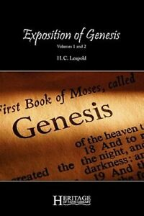
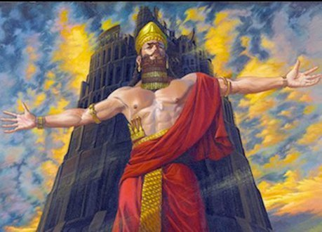
H. C. Leupold
H.C. Leupold, Exposition of Zechariah, 103.
“So little is human nature capable of readily appropriating divine revelation that it is not only necessary for God to let the necessary visions appear but also to stimulate the recipient's attention step by step lest, overcome by the power of the heavenly, he fail to appropriate all that God desires to offer.”

Slide 33
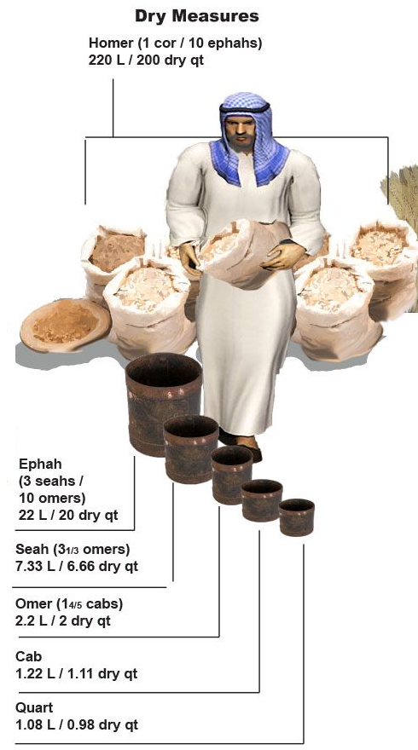
Charles L. Feinberg
God Remembers: A Study of Zechariah (Wheaton: Van Kampen, 1950, p. 88.
“The ephah was the greatest dry measure in use among the Hebrew people.”

Slide 34
Hitchcock The Second Coming of Babylon, 109.
ZECHARIAH 5:5-11 | REVELATION 17–18
Woman sitting in a basket | Woman sitting on beast, seven mountains, many waters (17: 3, 9, 15)
Emphasis on commerce (basket for measuring grain) | Emphasis on commerce (merchant of grain, 18:13)
Woman’s name is wickedness | Woman’s name is Babylon the Great, Mother of Harlots and Abominations of the Earth
Focus on False worship (temple is built for the woman) | Focus on False worship (17:5)
Woman taken to Babylon | Woman called Babylon

Slide 35
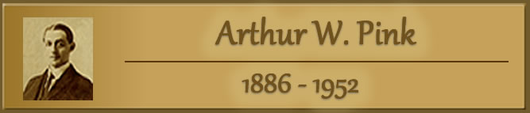
“The vision or prophecy (Zec. 5) contains the germ which is afterward expanded and developed in such detail in Rev. 17 and 18.” Pink, The Antichrist, 281.

Slide 36


2 Thessalonians 2:6-7
⁶And you know what restrains [katechon; neuter] him now, so that in his time he will be revealed. ⁷For the mystery of lawlessness is already at work; only he who now restrains [katechōn; masculine] will do so until he is taken out of the way.

Slide 37
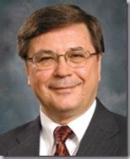
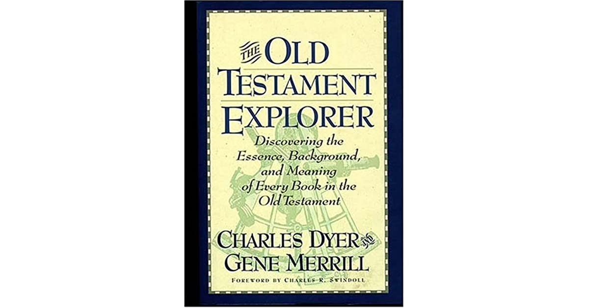
Charles H. Dyer
Old Testament Explorer, p. 825.
“The woman in Zechariah’s vision represented ‘iniquity’ and ‘wickedness.’ The cover holding the woman captive pictured God’s restraint of evil. As bad as things were in Zechariah’s day, things could have been worse if God had not been restraining evil (see also 2 Thess. 2:7).”

Slide 38
Charles L. Feinberg
God Remembers: A Study of Zechariah (Wheaton: Van Kampen, 1950, p. 90-91.
“The woman of the vision under consideration represents wickedness, as the interpreting angel specifically states, as it will be culminated in the last days. It will be organized both among Israel and the nations of the earth into a colossal confederacy, holding sway religiously over the earth. Nor is this wickedness dormant, for the great laden weight must be cast upon the mouth of the ephah to keep it bound there (II Thess. 2:6–8).”

Slide 39
7. The Woman in the Ephah
(5:5-11)
The Woman’s Identity (5:5-8)
The Woman’s Destination (5:9-11)

Slide 40
Zechariah 5:5-11
⁹ Then I lifted up my eyes and looked, and there two women were coming out with the wind in their wings; and they had wings like the wings of a stork, and they lifted up the ephah between the earth and the heavens. ¹⁰ I said to the angel who was speaking with me, “Where are they taking the ephah?” ¹¹ Then he said to me, “To build a temple for her in the land of Shinar; and when it is prepared, she will be set there on her own pedestal.”

Slide 41
Thomas L. Constable
Constable’s online notes on Zechariah, p. 60-61.
“The prophet next saw ‘two’ other ‘women’ flying through the air with ‘stork ... wings.’ Perhaps they were women, and not men, because of the motherly attention they brought to their task. Storks are strong, motherly birds that are capable of carrying loads a long distance in flight. They are also reliable and careful creatures. They were commonly seen in Palestine [Israel] in the spring months, while they were migrating to Europe (Jer. 8:7).”

Slide 42
Thomas L. Constable
Constable’s online notes on Zechariah, p. 60-61.
“The word ‘stork’ (Heb. sida) means ‘faithful one.’ These women would faithfully carry the ephah and its contents to God's appointed destination. Some believe the ‘two women’ represent agents of evil, perhaps demonic forces. If they were that, however, would they not try to help Wickedness escape? Storks were unclean birds for the Israelites (Lev. 11:19; Deut. 14:18), so these stork-like women were appropriate carriers of the contaminated basket. ‘They lifted up the ephah’ into the air, flying off from earth to heaven with the divine assistance of ‘the wind’ (Spirit, Heb. ruah).”

Slide 43
Charles L. Feinberg
God Remembers: A Study of Zechariah (Wheaton: Van Kampen, 1950, p. 91.
“That these women are representative of God’s agents for His purpose is clear from the fact that they have wings. They are like the storks for he has broad pinions and in his annual migration covers great distances.”

Slide 44
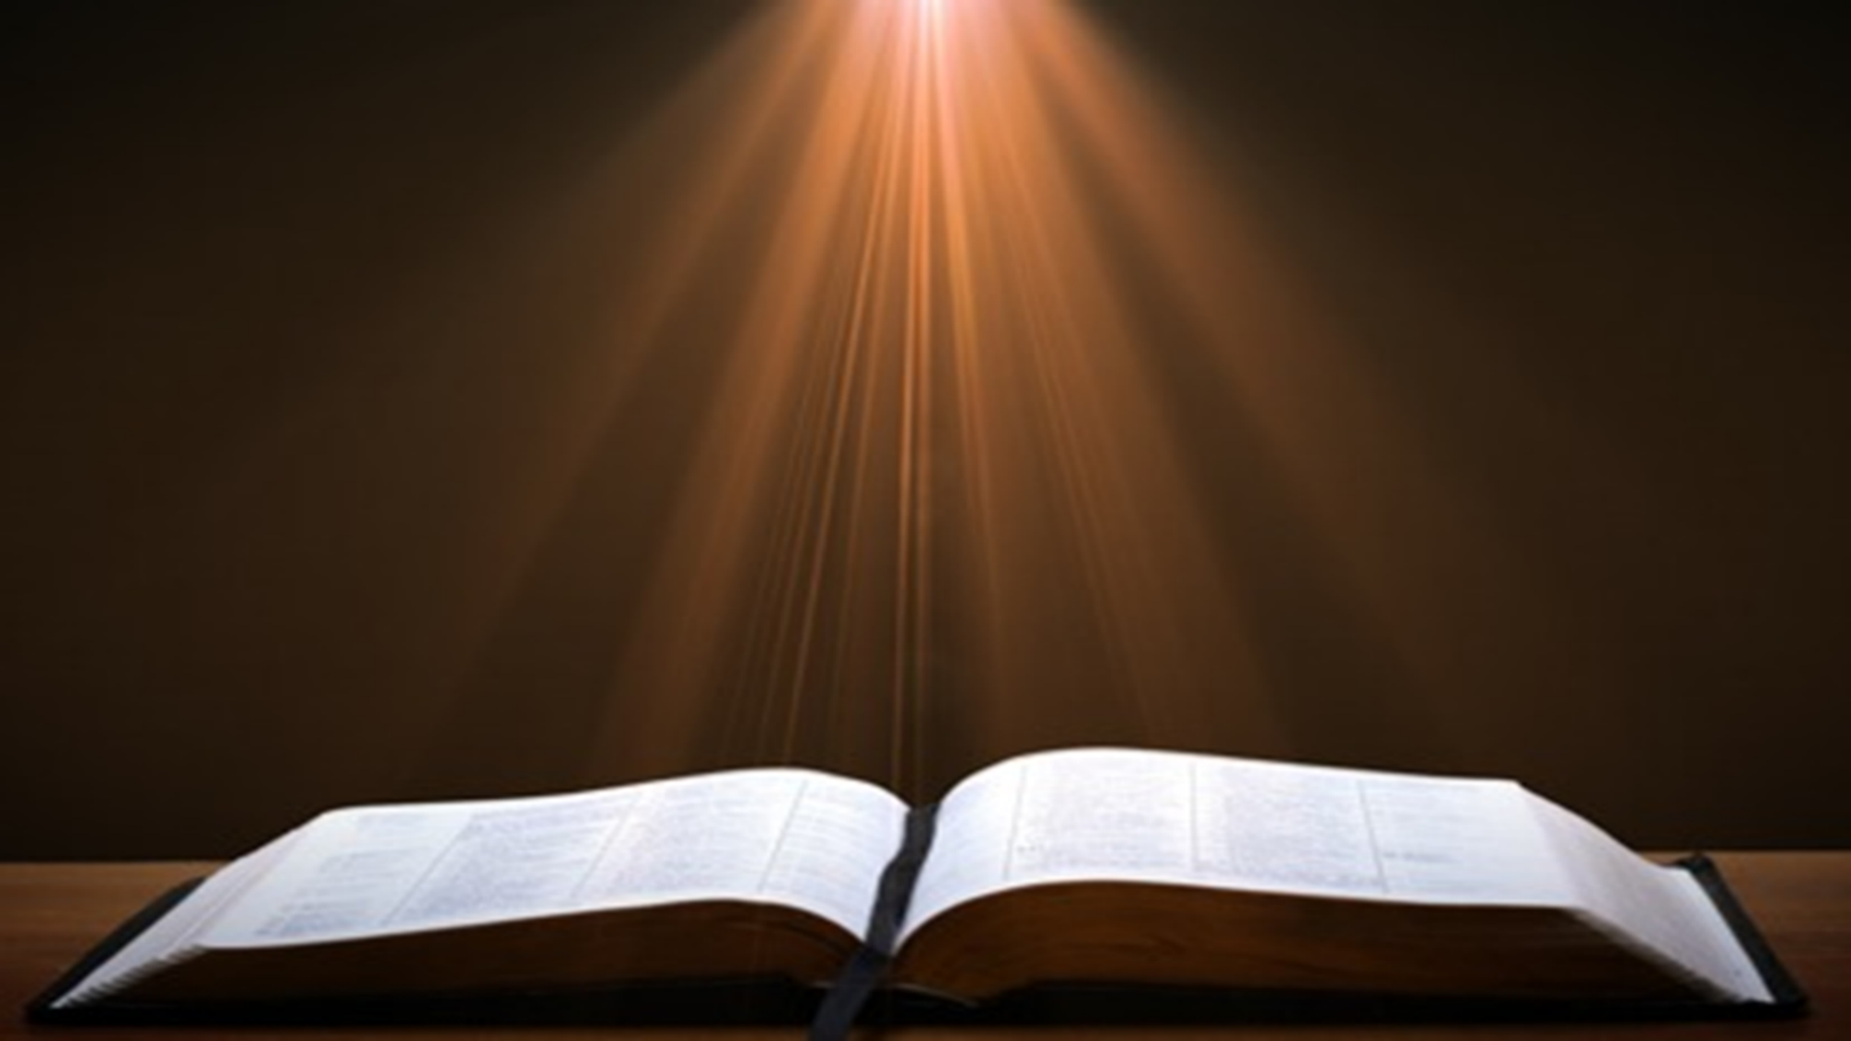
2 Samuel 7:12-16
“When your days are complete and you lie down with your fathers, I will raise up your descendant after you, who will come forth from you, and I will establish his kingdom. ¹³ He shall build a house for My name, and I will establish the throne of his kingdom forever. ¹⁴ I will be a father to him and he will be a son to Me; when he commits iniquity, I will correct him with the rod of men and the strokes of the sons of men, ¹⁵ but My lovingkindness shall not depart from . . .

Slide 45
2 Samuel 7:12-16
. . .him, as I took it away from Saul, whom I removed from before you. ¹⁶ Your house and your kingdom shall endure before Me forever; your throne shall be established forever.” ¹⁷ In accordance with all these words and all this vision, so Nathan spoke to David.”

Slide 46
ISRAEL’S FOUR TEMPLES
Solomon’s pre-exilic temple (Kings and Chronicles)
Zerubbabel’s post exilic temple (Ezra 1-6; John 2:20)
Antichrist's temple (Dan. 9:27; Matt. 24:15; 2 Thess. 2:4; Rev. 11:1-2)
Millennial temple (Ezek. 40-48)

Slide 47
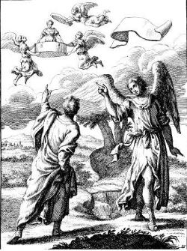
Zechariah 5:5-11
Woman (wickedness)
Ephah (commerce)
House (Temple-2 Sam 7; religion)
Shinar (Gen 10:10; 11:2; Dan 1:2)

Slide 48
Zechariah 5:5-11
Woman (wickedness)
Ephah (commerce)
House (Temple-2 Sam 7; religion)
Shinar (Gen 10:10; 11:2; Dan 1:2)

Slide 49
Charles L. Feinberg
God Remembers: A Study of Zechariah (Wheaton: Van Kampen, 1950, p. 91.
“The first mention of Shinar in the Bible is in Genesis 10:10. (It is found in all six other times: Gen. 11:2; 14:1, 9; Isa. 11:11; Dan. 1:2; and here). In all instances where it occurs it is used as a definite geographical designation. Strictly speaking it covers more than Babylon but is it is employed to denote this land.”

Slide 50


Slide 51
Genesis 11:1-4
¹ Now the whole earth used the same language and the same words. ² It came about as they journeyed east, that they found a plain in the land of Shinar and settled there. ³ They said to one another, “Come, let us make bricks and burn them thoroughly.” And they used brick for stone, and they used tar for mortar. ⁴ They said, “Come, let us build for ourselves a city, and a tower whose top will reach into heaven, and let us make for ourselves a name, otherwise we will be scattered abroad over the face of the whole earth.”

Slide 52
Daniel 1:1-2
“¹ In the third year of the reign of Jehoiakim king of Judah, Nebuchadnezzar king of Babylon came to Jerusalem and besieged it.² The Lord gave Jehoiakim king of Judah into his hand, along with some of the vessels of the house of God; and he brought them to the land of Shinar, to the house of his god, and he brought the vessels into the treasury of his god.”

Slide 53


Slide 54
Charles L. Feinberg
God Remembers: A Study of Zechariah (Wheaton: Van Kampen, 1950, p. 93.
“Now, the prophet Zechariah foretells that in the last days all wickedness, with idolatry particularly in mind (see Matt. 12:43–45), that will be existent in Israel at that time will go back forcibly to the place of its origin, Babylon, the great apostate religious system. Such is the meaning of being settled on her own base. When we come to the book of Revelation all of this is clearly set forth in chapter 17 and 18. Not only the evil in Judaism, but that in Christendom as well, will wind up and culminate in that abominable system called mystical or mystery Babylon. The greatest sin in Israel, even wickedness itself, was idolatry. It will come to it’s settled abode at the very place of its inception (Rev. 18:24).”

Slide 55
Spread of the Mother-Child Cult
 | Mother | Child
Assyria | Ishtar | Tammuz
Phoenicia | Astarte | Baal
Egypt | Isis | Osirus/Horus
Greece | Aphrodite | Eros
Rome | Venus | Cupid
Asia | Cybele | Desius
India | Isi | Aswara
Roman Catholicism | Mary | Jesus
Israel | Queen of Heaven (Jer. 7:18; 44:17) | Tammuz (Ezek. 8:14-15)
Alexander Hislop, Two Babylons

Slide 56
Larkin, The Book of Revelation, 151.
“The river Euphrates, on which the city of Babylon was built, was one of the four branches into which the river that flowed through the Garden of Eden was divided, and Satan doubtless chose the site of Babylon as his headquarters from which to sally forth to tempt Adam and Eve. It was doubtless here that the Antediluvian apostasy had its source that ended in the flood. To this centre the ‘forces of Evil’ gravitated after the Flood, and ‘Babel’ was the result. This was the origin of the nations, but the nations were not scattered abroad over the earth until Satan had implanted in them the ‘Virus’ of a doctrine that has been the source of every false religion the world has ever known.”

Slide 57
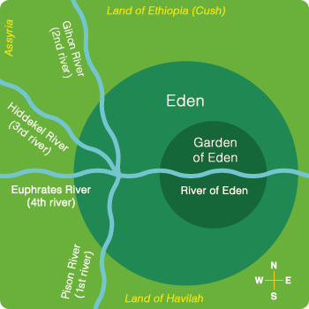

Slide 58


Slide 59
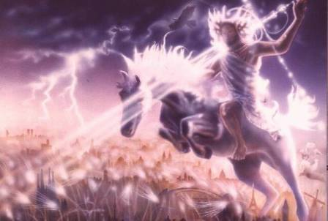
Isaiah 13-14
Day of the Lord (13:6-9)
Cosmic disturbances (13:10-13)
Global judgment (13:11-12)
Sodom and Gomorrah (13:19)
Complete and final desolation (13:20-22)
Universal peace and rest (14:5-8)
Israel’s regeneration (14:1-4)
Henry Morris, Revelation Record, 348.

Slide 60

Isaiah 13:12
“I will make mortal man scarcer than pure gold and mankind than the gold of Ophir.”

Slide 61
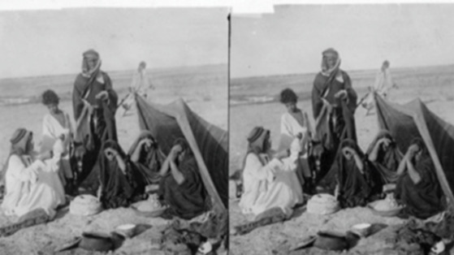
ARAB TENT HOME at Babylon 1899-1908
“It will never be inhabited or lived in from generation to generation; Nor will the Arab pitch his tent there” (Isaiah 13:20)
https://www.bibleprophecyaswritten.com/2-arabs/

Slide 62
Isaiah’s Oracles Against the Nations (Isa 13–23)
Babylon (13:1-14:23) Assyria (14:24-27) Philistia (14:28-32) Moab (15-16) Damascus and Samaria (17) Ethiopia (18) | Egypt (19-20) Babylon (21:1-10) Edom (21:11-12) Arabia (21:13-17) Jerusalem (22) Tyre (23)

Slide 63
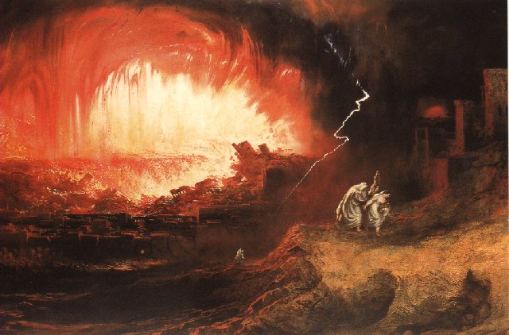
Jeremiah 50-51
Sudden destruction (51:8)
Complete destruction (50:3, 13, 26, 39-40; 51:29, 43, 62)
No reuse of building materials (51:26)
Believers flee (50:8; 51:6, 45)
Israel’s regeneration (50:2, 4-5, 20; 51:50)
Dyer, "The Identity of Babylon in Revelation 17–18 (Part 2)," 443-49.

Slide 64

Herodotus, Histories, 1:191 (450 B.C.)
“…he (Cyrus) conducted the river by a channel into the lake…and so he made the former course of the river passable by the sinking of the stream. When this had been done, the Persians who had been posted for this very purpose entered by the bed of the river Euphrates into Babylon, the stream having sunk so far that it reached about to the middle of a man’s thigh…those Babylonians who dwelt in the middle did not know that they had been captured…”

Slide 65
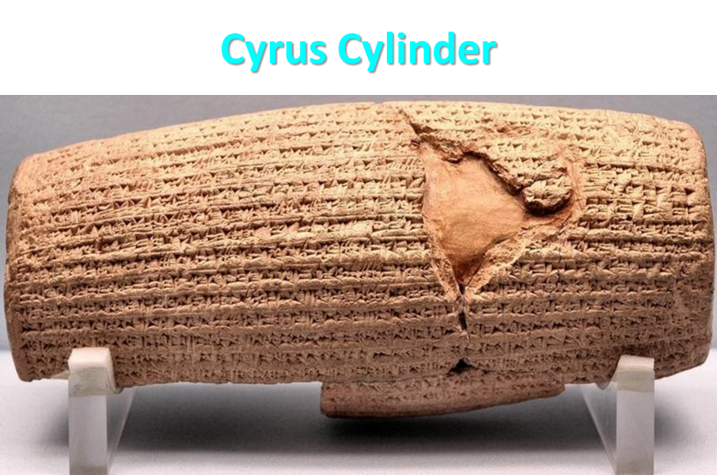

Slide 66

James Pritchard
The Ancient Near East Texts Relating to the Old Testament, 315-16.
Without any battle... sparing Babylon... any calamity....I am Cyrus...king of Babylon....When I entered Babylon...under jubilation and rejoicing...troops walked around Babylon...in peace, I did not allow anybody to terrorize (any place) of the [country of Sumer] and Akkad. I strove for peace in Babylon...and in all his (other) sacred cities....I returned to (these) sacred cities on the other side of the Tigris, the sanctuaries of which have been in ruins for a long time, the images which (used) to live therein and established for them permanent sanctuaries.

Slide 67
James Pritchard
The Ancient Near East Texts Relating to the Old Testament, 315-16.
I (also) gathered all their (former) inhabitants and returned (to them) their habitations. Furthermore, I resettled... unharmed, in their (former) chapels, the places which make them happy. May all the gods whom I have resettled in their sacred cities ask daily Bel and Nebo for a long life for me...all of them I resettled in a peaceful place... ducks and doves,...I endeavoured to fortify/repair their dwelling places . . .

Slide 68
Babylon’s History After 539 B.C.
Herodotus gives Babylon’s measurements (450 B.C.)
Alexander the Great visits and dies in Babylon (323 B.C.)
Seleucus seizes Babylon (312 B.C.)
Strabo pronounces Babylon’s hanging gardens as one of “seven wonders of the world” (25 B.C)
Babylonians present on Pentecost (Acts 2:9)
Talmud promulgated from Babylon (A.D. 500)
Haukal mentions Babylonian village (A.D. 917)
Babylon known as “Two Mosques” and “Hilah” (A.D. 1100)
Hitchcock and Ice, The Truth Behind Left Behind, 109

Slide 69

Dr. John Walvoord
The Nations in Prophecy, 63-64
“As far as the historic fulfillment is concerned, it is obvious from both Scripture and history that these verses have not been literally fulfilled. The city of Babylon continued to flourish after the Medes conquered it, and though its glory dwindled, especially after the control of the Medes and the Persians ended in 323 B.C., the city continued in some form or substance until A.D. 1000 and did not experience a sudden termination such as anticipated in this prophecy.”

Slide 70
Parallels Between Jeremiah 50-51 & Revelation 17-18
 | Jeremiah | Revelation
Associated with a Golden cup | 51:7a | 17:3-4; 18:6
Dwelling on many waters | 51:13 | 17:1
Intoxicating the nations | 51:7b | 17:2
Same name | 50:1 | 17:5
Persecuting the saints | 51:48 | 17:6; 18:24
Stone sinking into Euphrates | 51:63-64 | 18:21
Sudden destruction | 51:8 | 18:8
Destroyed by fire | 51:30 | 17:16
Final, uninhabitable | 50:39 | 18:21
Deserved | 50:29 | 18:6
God’s people flee | 51:6, 45 | 18:4
Heaven rejoices | 51:48 | 18:20
Dyer, "The Identity of Babylon in Revelation 17–18 (Part 2)," 441-43.

Slide 71
Larkin, The Book of Revelation, 158.
“…and this is in exact harmony with the words of Isa. 13:19. ‘And Babylon, the glory of kingdoms, the beauty of the Chaldees’ excellency, shall be as when God overthrew Sodom and Gomorrah;’ and the Prophet Jeremiah makes the same statement. Jer. 50:40. The destruction of Sodom and Gomorrah was not protracted through many centuries, their glory disappeared in a few hours (Gen. 19:24–28), and as ancient Babylon was not thus destroyed, the prophecies of Isaiah and Jeremiah cannot be fulfilled unless there is to be a future Babylon that shall be thus destroyed. In Rev. 16:17–19, we are told that Babylon shall be destroyed by an Earthquake, attended with most vivid and incessant lightning and awful thunder.”

Slide 72
Zechariah 1:7
On the twenty-fourth day of the eleventh month, which is the month Shebat, in the second year of Darius (519 b.c.*), the word of the Lord came to Zechariah the prophet, the son of Berechiah, the son of Iddo, as follows:
*Babylon fell in 539 b.c!

Slide 73
Newton
Babylon: Its Future, History, and Doom, 1890, p. 64.
“That this event predicted in this remarkable passage remains still unaccomplished, is sufficiently evident from the fact of Zechariah’s having prophesied after Babylon had received that blow under which it has gradually waned. Zechariah lived after Babylon had passed into the hands of the Persians . . .”

Slide 74

Morris
The Revelation Record, 349
“Computer studies of the Institute for Creation Research have shown, for example, that Babylon is very near the geographical center of all the earth’s land masses. It is within navigable distances of the Persian Gulf and is at the crossroads of the three great continents of Europe, Asia and Africa. Thus there is no more ideal location anywhere for a world trade center, a world communication center, a world banking center, a world educational center, or especially, a world capital! The greatest historian of modern times, Arnold Toynbee, used to stress to all his readers and hearers that Babylon would be the best place in the world to build a future world cultural metropolis.”

Slide 75
June 2007 Conventional Oil Reserves
Rank | Country | Percentage of oil reserves
1 | Saudia Arabia | 21.9 %
2 | Iran | 11.4 %
3 | Iraq | 9.5 %
4 | Kuwait | 8.4 %
5 | United Arab Emirates | 8.1 %
6 | Venezuela | 6.6 %
7 | Russia | 6.6 %
8 | Libya | 3.4 %
David Jeremiah, What in the World is Going On, 207

Slide 76

Iraq Celebrates Naming Babylon a UNESCO World Heritage Site
QASSIM ABDUL-ZAHRA of Times of Israel - July 6, 2019
“BAGHDAD (AP) — Iraq on Friday celebrated the UNESCO World Heritage Committee’s decision to name the historic city of Babylon a World Heritage Site in a vote held in Azerbaijan’s capital, years after Baghdad began campaigning for the site to be added to the list…The 4,300-year-old Babylon — now mainly an archaeological ruin and two important museums — is where dynasties have risen and fallen since the earliest days of settled human civilization. King Hammurabi wrote his famous code of laws in Babylon, while Nebuchadnezzar sent his vast army from the city to Jerusalem to put down an uprising and bring the Jews back as slaves.”

Slide 77
“Want Middle East Stability? Move UN to Iraq”
“The idea of moving U.N. headquarters seems to resonate with many....Where should it go? Try Iraq…In order to maintain its fledgling democracy, Iraq needs international commitment, an inducement to stop factional violence, and a stable form of income not subject to the terrorists’ reprisals…New York is an expensive city, and representation at the U.N. is currently a costly endeavor…The remaining big spenders should have a positive effect on the Iraqi job market and improve the overall economy of the entire region, which might in turn reduce the tendency …”
Cynthia E. Ayers and David W. Cammons, “Want Middle East Stability? Move UN to Iraq,” Newsweek, April 9, 2007, posted at: Http://newsweek.washingtonpost.com/postglobal/needtoknow/2007/04/want_middle_east_stability_mov.html

Slide 78
A Prince’s $500 Billion Desert Dream: Flying Cars, Robot Dinosaurs and a Giant Artificial Moon
“Saudi Arabia’s crown prince turned to U.S. consultants for help imagining a massive new city-state in a barren section of his kingdom. What emerged was a Jetsons-style world of automation. SHARMA, Saudi Arabia—This seaside corner of northwest Saudi Arabia is so barren that the only abundant resources a group of consultants could identify were sunlight and ‘unlimited access to salt water.’ But Saudi crown prince Mohammed bin Salman didn’t see a wasteland when he landed in his helicopter here a few years ago. He saw the future — and hatched a plan for a $500 billion city-state to cover 10,000 square miles of rocky desert and empty coastline to attract the ‘world’s greatest minds and best talents’ to the world’s best paying jobs in the world’s most livable city.”
Justin Scheck, Rory Jones, and Summer Sawww.wsj.comid, “A Prince’s $500 Billion Dollar Desert Dream,” online:, 25 July 2019.

Slide 79
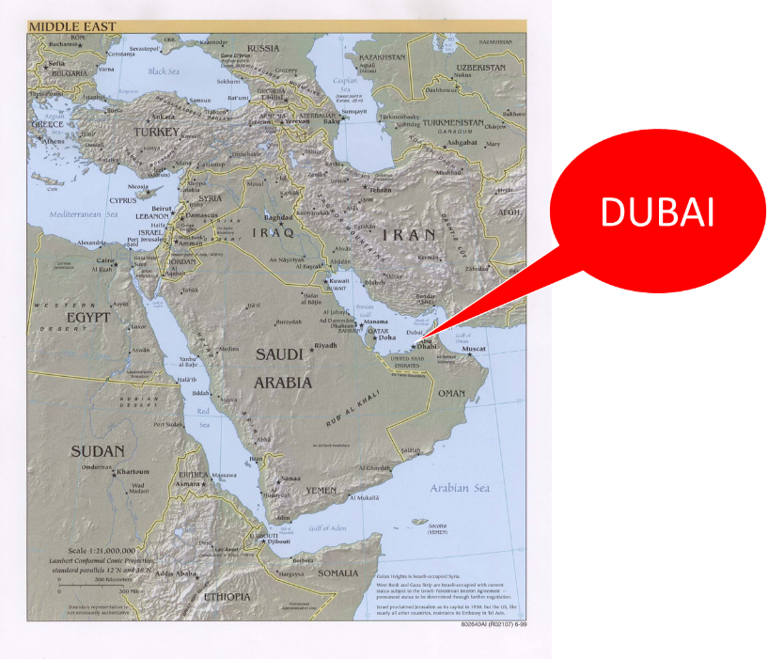

Slide 80
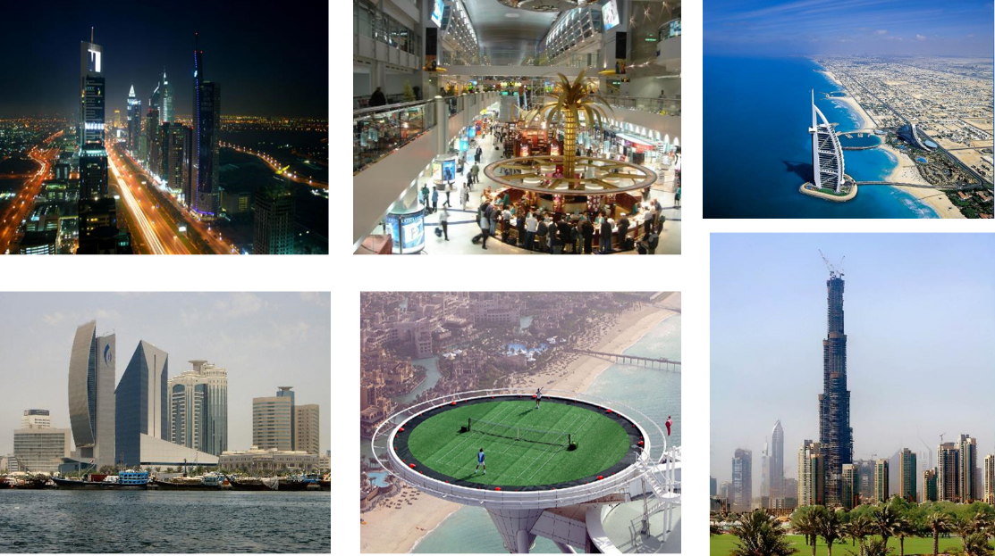

Slide 81
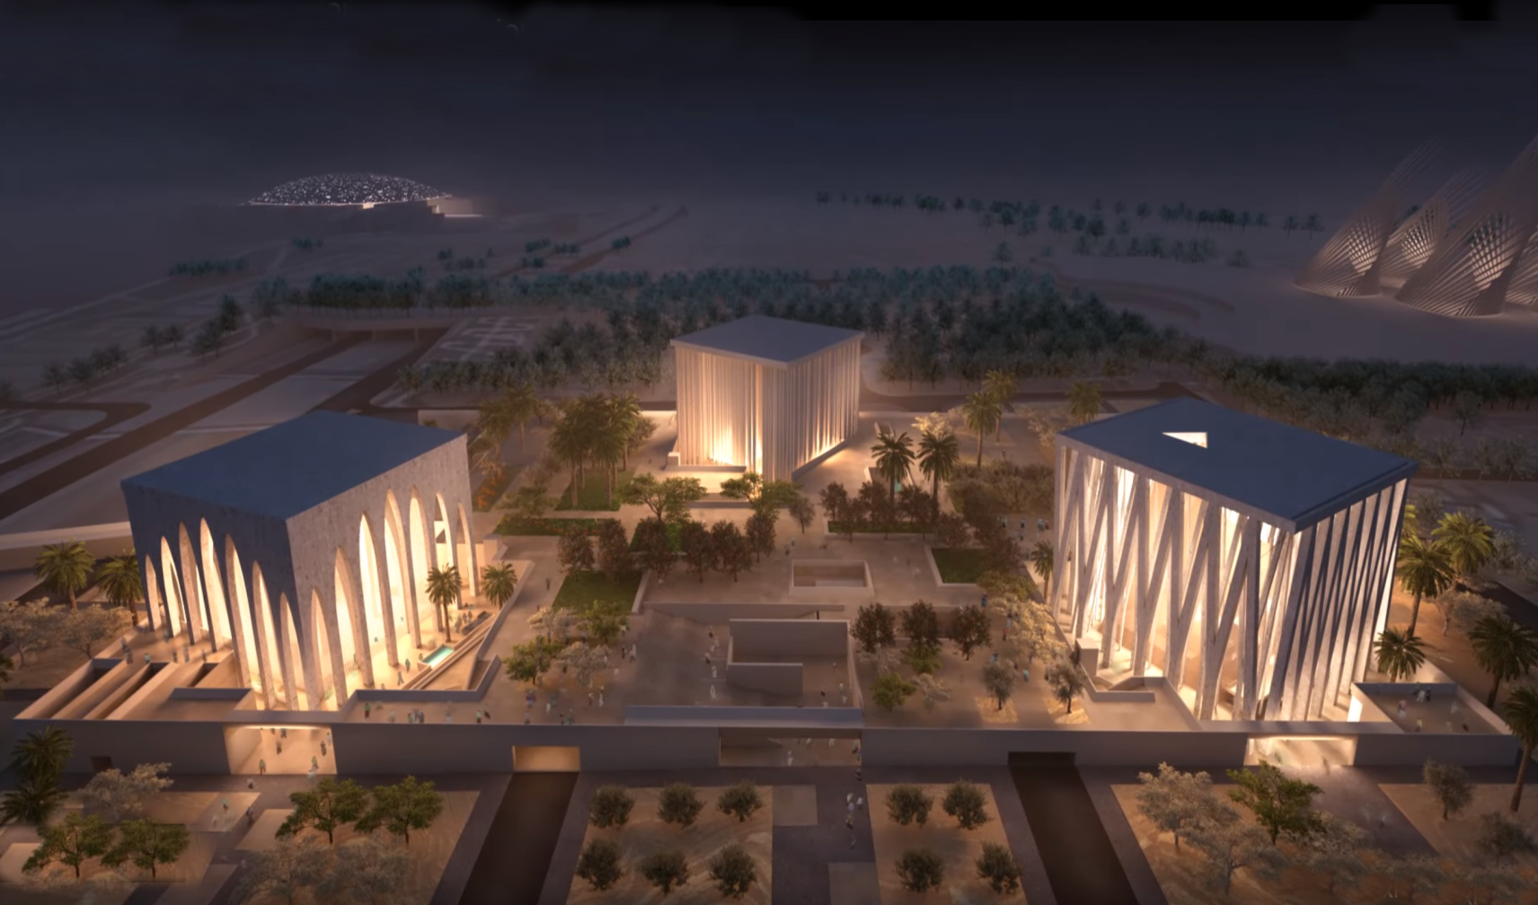
81

Slide 82
Conclusion

Slide 83
6. The Flying Scroll
(5:1-4)
Vision Described (1-2)
Vision Interpreted (3-4)
  Covenant judgment coming (3a)
  Sins to be judged (3b-4)
    Stealing (3b)
    Swearing falsely (3c-4)

Slide 84
7. The Woman in the Ephah
(5:5-11)
The Woman’s Identity (5:5-8)
The Woman’s Destination (5:9-11)

Slide 85
II. Eight Night Visions
(1:7‒6:15)
  Riders & horses among the myrtle trees (1:7-17)
  Four horns & four craftsmen (1:18-21)
  Man with the measuring line (2)
  Cleansing of the High Priest Joshua (3)
  Lampstand & olive tree (4)
  Flying scroll (5:1-4)
  Woman in the basket (5:5-11)
  Four chariots (6:1-8)
  Conclusion: crowning of Joshua (6:9-15)

