Slide 1


Genesis 12‒50
Israel’s Birth & Preservation

Slide 2


GENESIS STRUCTURE
  Beginning of the Human race (Gen. 1‒11)
  Beginning of the Hebrew race (Gen. 12‒50)

Slide 3

GENESIS STRUCTURE
  Genesis 1-11 (four events)
    Creation (1-2)
    Fall (3-5)
    Flood (6-9)
    National dispersion (10-11)

Slide 4


Genesis 3:15
“And I will put enmity Between you and the woman, And between your seed and her seed; He shall bruise you on the head, And you shall bruise him on the heel.”

Slide 5
GENESIS STRUCTURE
  Beginning of the Human race (Gen. 1‒11)
  Beginning of the Hebrew race (Gen. 12‒50)

Slide 6

GENESIS STRUCTURE
  Genesis 12-50 (four people)
    Abraham (12:1–25:11)
    Isaac (25:12–26:35)
    Jacob (27–36)
    Joseph (37–50)

Slide 7


Isaiah 43:1
“But now, thus says the Lord, your Creator, O Jacob, And He who formed you, O Israel, 'Do not fear, for I have redeemed you; I have called you by name; you are Mine!'”

Slide 8
GENESIS STRUCTURE
  Genesis 12-50 (four people)
    Abraham (12:1–25:11)
    Isaac (25:12–26:35)
    Jacob (27–36)
    Joseph (37–50)

Slide 9
Genesis 12‒14
Abram’s Early Journeys
  Unconditional promises (Gen. 12:1-3)
  From Haran to Canaan (Gen. 12:4-5)
  In Canaan (Gen. 12:6-9)
  In Egypt (Gen. 12:10-20)
  Abram and Lot Separate (Gen. 13:1-13)
  Reaffirmation of Abram’s promises (Gen. 13:14-18)
  Abram Rescues Lot (14:1-24)

Slide 10
Genesis 14:1‒24
Abram Rescues Lot
    War (14:1-12)
    Rescue (14:13-16)
    Interaction with two kings (14:17-24)

Slide 11
DOCUMENTARY HYPOTHESIS
J – Yahwist (850 B.C.)
E – Elohist (750 B.C.)
D – Deuteronomist (621 B.C.)
P – Priestly code (525 B.C.)

Slide 12

Charles Ryrie
The Ryrie Study Bible
“Genesis 14:1 (RSBEE:NASB1995U): Though some have dismissed this chapter as being an historical impossibility, archaeological discoveries have demonstrated the existence of a flourishing civilization in Palestine [Israel] between the twenty-first and nineteenth centuries b.c. and of the savage destruction of the cities at the end of that period.”

Slide 13
Genesis 14:1‒24
Abram Rescues Lot
    War (14:1-12)
    Rescue (14:13-16)
    Interaction with two kings (14:17-24)

Slide 14
Interaction with Two Kings
Genesis 14:17-24
    Abram & the King of Sodom (Gen. 14:17)
    Abram & the King of Salem (Gen. 14:18-20)
    Abram & the King of Sodom (Gen. 14:21-24)

Slide 15
Interaction with Two Kings
Genesis 14:17-24
    Abram & the King of Sodom (Gen. 14:17)
    Abram & the King of Salem (Gen. 14:18-20)
    Abram & the King of Sodom (Gen. 14:21-24)

Slide 16
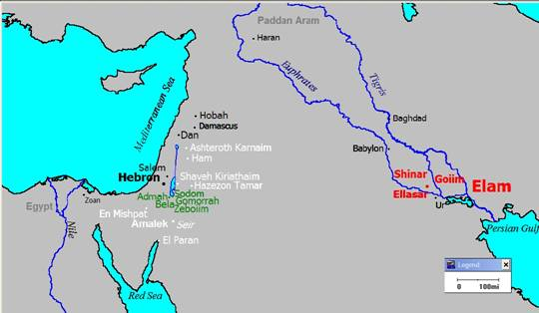

Slide 18
Interaction with Two Kings
Genesis 14:17-24
    Abram & the King of Sodom (Gen. 14:17)
    Abram & the King of Salem (Gen. 14:18-20)
    Abram & the King of Sodom (Gen. 14:21-24)

Slide 19
Abram & The King of Salem
Genesis 14:18-20
  Name (18a)
  King (18b)
  Priest (18c)
  Blessing to Abram (19)
  Blessing to God (20a)
  Reception of tithes (20b)

Slide 20
Abram & The King of Salem
Genesis 14:18-20
  Name (18a)
  King (18b)
  Priest (18c)
  Blessing to Abram (19)
  Blessing to God (20a)
  Reception of tithes (20b)

Slide 21
Abram & The King of Salem
Genesis 14:18-20
  Name (18a)
  King (18b)
  Priest (18c)
  Blessing to Abram (19)
  Blessing to God (20a)
  Reception of tithes (20b)

Slide 22
Abram & The King of Salem
Genesis 14:18-20
  Name (18a)
  King (18b)
  Priest (18c)
  Blessing to Abram (19)
  Blessing to God (20a)
  Reception of tithes (20b)

Slide 23
Genesis 3:15
“And I will put enmity Between you and the woman, And between your seed and her seed; He shall bruise you on the head, And you shall bruise him on the heel.”

Slide 24

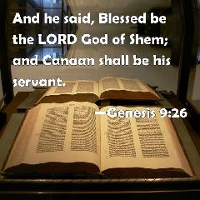
Genesis 9:26
“He also said, “Blessed be the Lord, The God of Shem; And let Canaan be his servant.”

Slide 25

God’s Messianic Purposes Beginning in Genesis
Proto-evangelium from Adam & Eve (3:15)
Seth (4:25)
Noah (Gen 5:29)
Shem (9:26)
Abraham (12:3)
Isaac (21:12)
Jacob (25:23)
Judah (49:10)

Slide 26

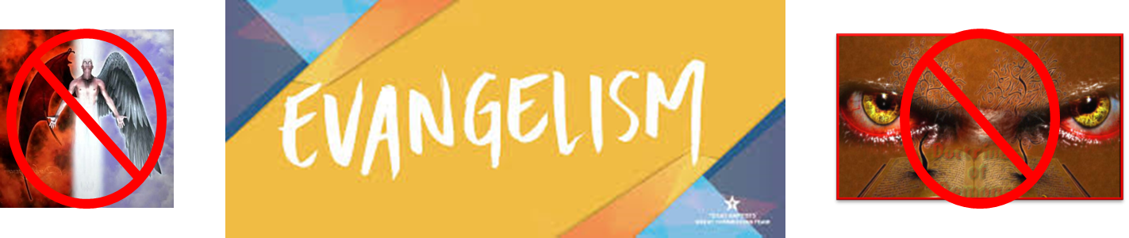
Matthew 16:18
“I also say to you that you are Peter, and upon this rock I will build [oikodomeō] My church; and the gates of Hades WILL NOT overpower it.”

Slide 27
6 Reasons Why Melchizedek is a Type of Christ (Heb. 7:1-3)
Jerusalem
Peace and Righteousness
King and Priest
No beginning and ending
Bread and wine
Priest of the Most High

Slide 28
Melchizedek is Not a Theophany
No known genealogy
“Like” the Son of God
No message from God to man
Ruler over a geo-political place

Slide 29


Dr. Arnold G. Fruchtenbaum
The Book of Genesis, 268, 270-71
“While many have taught that Melchizedek was a preincarnate Christ, this simply cannot be. This was not a theophany, because theophanies came and went; they appeared, gave their proclamation, message, or commandment and then disappeared. Theophanies never held an office here on earth. Here, Melchizedek holds two offices: that of king and that of priest...Again, he was not a theophany (or he was only a type), for several reasons. First, theophanies merely appeared and disappeared, not holding an earthly office like king or priest. Second, Hebrews 5:1, which begins listing several prerequisites for priesthood, makes the point that a priest had to be human.”

Slide 30
Dr. Arnold G. Fruchtenbaum
The Book of Genesis, 268, 270-71
“The Messiah did not become human until the Incarnation. So for Melchizedek to first be a priest, he first had to be human. Third, Hebrews states that he was like the Son of God, not that he was the Son of God: He was made like unto the Son of God. Therefore, there is no biblical basis for making Melchizedek a theophany or the preincarnate Christ. Melchizedek was a human being who was said to be a type of the Messiah in that he was both king and priest. When the Book of Hebrews mentions that he had no genealogy—no father, no mother—the main point of the author of Hebrews is that there is no record of a genealogy for Melchizedek, no mention of a father or a mother.”

Slide 31
Dr. Arnold G. Fruchtenbaum
The Book of Genesis, 268, 270-71
“It does not say that he did not have one, only that there is no record of it. The point Hebrews is making is that the correct genealogy was vital for the Levitical Priesthood. Unless one could prove that he was a descendant of Aaron, he could not serve as a priest under the Levitical Law. However, the Melchizedekian Priesthood was not based upon descent, but it was based strictly on divine appointment. When Hebrews states: neither beginning nor end, it does not say he did not have one; it just means that there is no beginning or end of his priesthood in the biblical record. The typology being drawn is that of a continuous priesthood, as is the case with Jesus.”

Slide 32
Dr. Arnold G. Fruchtenbaum
The Book of Genesis, 268, 270-71
“Others try to defend the theophany view by pointing out that the name Melchizedek means ‘king of righteousness’; and, therefore, he had to be a preincarnate Christ. However, the last part of the name, zedek, was a Jebusite dynastic name for the kings of Jerusalem. This is seen in Joshua 10:1, where the king of Jerusalem then was named Adonizedek, which means the ‘lord of righteousness’, yet this was a wicked, idol-worshipping, Canaanite, Jebusite king. So using the meaning of the name to prove a theophany does not work here, since zedek was merely a dynastic title of Jebusite kings of Jerusalem, as in the case of Melchizedek and Adonizedek.”

Slide 33
Abram & The King of Salem
Genesis 14:18-20
  Name (18a)
  King (18b)
  Priest (18c)
  Blessing to Abram (19)
  Blessing to God (20a)
  Reception of tithes (20b)

Slide 34

Genesis 1:1–3
“¹ In the beginning God created the heavens and the earth. ² The earth was formless and void, and darkness was over the surface of the deep, and the Spirit of God was moving over the surface of the waters. ³ Then God said, “Let there be light”; and there was light.”

Slide 35
Abram & The King of Salem
Genesis 14:18-20
  Name (18a)
  King (18b)
  Priest (18c)
  Blessing to Abram (19)
  Blessing to God (20a)
  Reception of tithes (20b)

Slide 36
Abram & The King of Salem
Genesis 14:18-20
  Name (18a)
  King (18b)
  Priest (18c)
  Blessing to Abram (19)
  Blessing to God (20a)
  Reception of tithes (20b)

Slide 37


Slide 38


Psalm 147:19-20
“He declares His words to Jacob, His statutes and His ordinances to Israel. He has not dealt thus with any nation; And as for His ordinances, they have not known them. Praise the Lord!”

Slide 39
Dr. Arnold G. Fruchtenbaum
The Book of Genesis, 268
“In verse 20b is Abram’s response to Melchizedek: And he gave him a tenth of all. Abram is again proving to be a blessing to others. What should be noted, however, is that Abram is giving a tenth of the spoils of war, not his income. Many have used this passage to try to claim that tithing was an Old Testament law even before the Mosaic Law, and they do this because they recognize that the Mosaic Law is no longer in effect. If, therefore, they want to teach tithing, they have to use a different basis for tithing; and so they often refer to this event. However, one should note the following points. First, there was…

Slide 40
Dr. Arnold G. Fruchtenbaum
The Book of Genesis, 268
…no commandment to do so; Abram did it voluntarily. Second, this was a one-time event; there is no record of him doing it repeatedly. Third, this was not a tithe from his income; there is no record of Abram giving a tenth of the income he received from all the wealth gifted to him by Pharaoh, etc. This is one-tenth from the spoils of war, and the spoils originally belonged to others.”

Slide 41
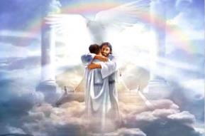
Ephesians 1:3
“Blessed be the God and Father of our Lord Jesus Christ, who has blessed us with every spiritual blessing in the heavenly places in Christ.”

Slide 42
Interaction with Two Kings
Genesis 14:17-24
    Abram & the King of Sodom (Gen. 14:17)
    Abram & the King of Salem (Gen. 14:18-20)
    Abram & the King of Sodom (Gen. 14:21-24)

Slide 43
Abram & The King of Sodom
Genesis 14:21-24
  Kings' offer (21)
  Abram’s response (22-24)
    Oath (22)
    Content (23)
    Exceptions (24)

Slide 44
Abram & The King of Sodom
Genesis 14:21-24
  Kings' offer (21)
  Abram’s response (22-24)
    Oath (22)
    Content (23)
    Exceptions (24)

Slide 45
Abram & The King of Sodom
Genesis 14:21-24
  Kings' offer (21)
  Abram’s response (22-24)
    Oath (22)
    Content (23)
    Exceptions (24)

Slide 46
Abram & The King of Sodom
Genesis 14:21-24
  Kings' offer (21)
  Abram’s response (22-24)
    Oath (22)
    Content (23)
    Exceptions (24)

Slide 47
Abram & The King of Sodom
Genesis 14:21-24
  Kings' offer (21)
  Abram’s response (22-24)
    Oath (22)
    Content (23)
    Exceptions (24)

Slide 48

Biblical Basis for Separation?
2 Thess. 3:6, 14
1 Cor. 5:11
2 Cor. 6:14-18
Rom. 16:17
Eph. 5:11
Titus 3:9-11
2 John 9-11

Slide 49

2 John 7-11
“⁷ For many deceivers have gone out into the world, those who do not acknowledge Jesus Christ as coming in the flesh. This is the deceiver and the antichrist. ⁸ Watch yourselves, that you do not lose what we have accomplished, but that you may receive a full reward. ⁹ Anyone who goes too far and does not abide in the teaching of Christ, does not have God; the one who . . .

Slide 50
2 John 7-11
…teaching of Christ, does not have God; the one who abides in the teaching, he has both the Father and the Son. ¹⁰ If anyone comes to you and does not bring this teaching, do not receive him into your house, and do not give him a greeting; ¹¹ for the one who gives him a greeting participates in his evil deeds.”

Slide 51
VI. 8 New Promises
Genesis 12:1-3
    Land (Gen. 12:1b)
    Great nation (Gen. 12:2a)
    Personal blessing (Gen. 12:2b)
    Great name (Gen. 12:2c)
    Blessing to others (Gen. 12:2d)
    Blessing to blessers (Gen. 12:3a)
    Cursing to cursers (Gen. 12:3b)
    Blessing to the world (Gen. 12:3c)

Slide 52
Abram & The King of Sodom
Genesis 14:21-24
  Kings' offer (21)
  Abram’s response (22-24)
    Oath (22)
    Content (23)
    Exceptions (24)

Slide 53
VI. 8 New Promises
Genesis 12:1-3
    Land (Gen. 12:1b)
    Great nation (Gen. 12:2a)
    Personal blessing (Gen. 12:2b)
    Great name (Gen. 12:2c)
    Blessing to others (Gen. 12:2d)
    Blessing to blessers (Gen. 12:3a)
    Cursing to cursers (Gen. 12:3b)
    Blessing to the world (Gen. 12:3c)

Slide 54


Genesis 12:3
“And I will bless those who bless you, And the one who curses you I will curse. And in you all the families of the earth will be blessed.”

Slide 55
VI. 8 New Promises
Genesis 12:1-3
    Land (Gen. 12:1b)
    Great nation (Gen. 12:2a)
    Personal blessing (Gen. 12:2b)
    Great name (Gen. 12:2c)
    Blessing to others (Gen. 12:2d)
    Blessing to blessers (Gen. 12:3a)
    Cursing to cursers (Gen. 12:3b)
    Blessing to the world (Gen. 12:3c)

Slide 56
Genesis 12:3
“And I will bless those who bless you, And the one who curses you I will curse. And in you all the families of the earth will be blessed.”

Slide 57
Conclusion

Slide 58
Genesis 14:1‒24
Abram Rescues Lot
    War (14:1-12)
    Rescue (14:13-16)
    Interaction with two kings (14:17-24)

Slide 59

“The Lord bless you and keep you; the Lord make his face shine on you and be gracious to you; the Lord turn his face toward you and give you peace.” (NIV)

