Slide 1
THE RAPTURE
What and When? – Part 8
Andrew Marshall Woods, Th.M., JD., PhD.
Sr. Pastor, Sugar Land Bible Church

Slide 2
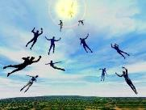
The Rapture Course Overview
What is the Rapture?
When is the Rapture?
Strengthening the Pre-Tribulational case
The opposing views
One second after the Rapture
Questions & Answers

Slide 3
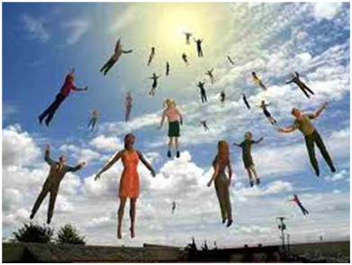
MAIL BAG
Gap between rapture and Tribulation?
Restrainer = Michael the archangel?
Overview of end time events?

Slide 4
MAIL BAG
Gap between rapture and Tribulation?
Restrainer = Michael the archangel?
Overview of end time events?

Slide 6
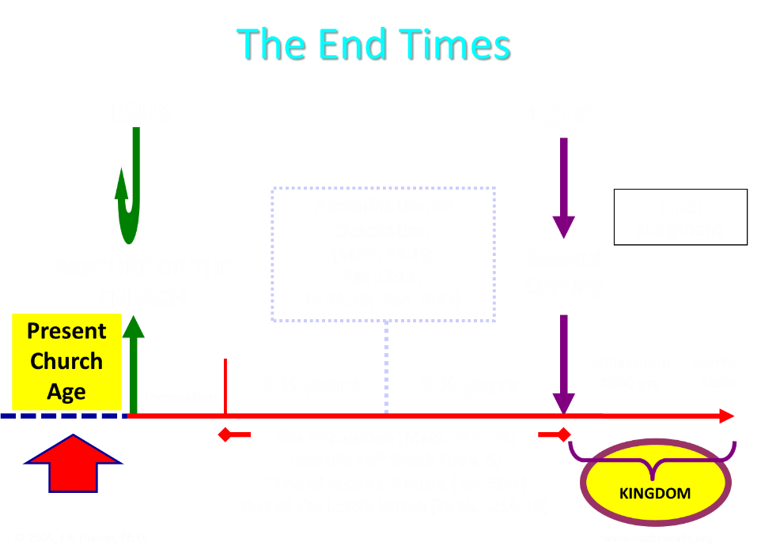

Slide 7
Bullinger (1909)
Commentary on Revelation, 577
“And Babylon, though fallen gradually, and very low, has never suffered such a destruction. There is only one conclusion, that in the interval of, say some 30 or more years between the removal of the church and the last "week "of Daniel's prophecy, it will be revived and exceed all its former magnificence.”

Slide 8
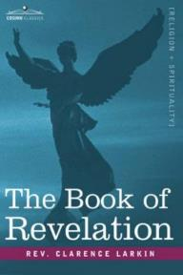
Larkin (1919)
The Book of Revelation, 162
“But I hear the protest, how can you say we be expecting Jesus to come at "any moment," if the city of Babylon must be rebuilt before He can come? There is not a word in Scripture that says that Jesus cannot come and take away His Church until Babylon is rebuilt. The Church may be taken out of the world 25 or even 50 years before that.”

Slide 9
9
https://dispensationalpublishing.com/product/babylon-the-bookends-of-prophetic-history/

Slide 10
MAIL BAG
Gap between rapture and Tribulation?
Restrainer = Michael the archangel?
Overview of end time events?

Slide 11
2 Thessalonians 2:6-7
⁶And you know what restrains [katechon; neuter] him now, so that in his time he will be revealed. ⁷For the mystery of lawlessness is already at work; only he who now restrains [katechōn; masculine] will do so until he is taken out of the way.

Slide 12
Marvin Rosenthal
“…of paramount importance is the identification of the one who restraints or hinders the Antichrist until ‘he [the restrainer] be taken out of the way.’ The restrainer is neither the Holy Spirit nor human government. Evidence is strained to support either of those contentions. There is, however, substantial evidence to identify the restrainer. He who restraints until ‘he be taken out of the way’ is the Archangel Michael.”
Marvin J. Rosenthal, The Pre-Wrath Rapture of the Church: A New Understanding of the Tribulation, and the Second Coming (Nashville, TN: Thomas Nelson, 1990), 112.

Slide 13
2 Thessalonians 2:6-7
⁶And you know what restrains [katechon; neuter] him now, so that in his time he will be revealed. ⁷For the mystery of lawlessness is already at work; only he who now restrains [katechōn; masculine] will do so until he is taken out of the way.

Slide 14
John 14:16-17
¹⁶ I will ask the Father, and He will give you another Helper, that He may be with you forever; ¹⁷ that is the Spirit of truth, whom the world cannot receive, because it does not see Him or know Him, but you know Him because He abides with you and will be in you.

Slide 15
John 16:7-11
⁷ “But I tell you the truth, it is to your advantage that I go away; for if I do not go away, the Helper will not come to you; but if I go, I will send Him to you. ⁸ “And He, when He comes, will convict the world concerning sin and righteousness and judgment; ⁹ concerning sin, because they do not believe in Me; ¹⁰ and concerning righteousness, because I go to the Father and you no longer see Me; ¹¹ and concerning judgment, because the ruler of this world has been judged.

Slide 16
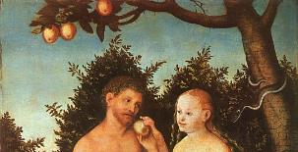
2 Thessalonians 2:9
“that is, the one whose coming is in accord with the activity of Satan, with all power and signs and false wonders.”

Slide 17
Antichrist’s Satanic Miracles (2 Thessalonians 2:9)
MIRACLE | GREEK | CHRIST’S MINISTRY
Powers | Dynamis | Matt. 11:20
Signs | Semēion | John 20:30
Wonders | Teras | Acts 2:22

Slide 18
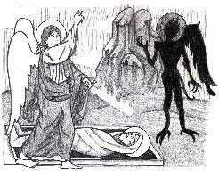
Jude 9
“But Michael the archangel, when he disputed with the devil and argued about the body of Moses, did not dare pronounce against him a railing judgment, but said, ‘The Lord rebuke you!’”

Slide 19
Daniel 12:1
“Now at that time Michael, the great prince who stands guard over the sons of your people [Israel], will arise. And there will be a time of distress such as never occurred since there was a nation until that time; and at that time your people, everyone who is found written in the book, will be rescued.”

Slide 20
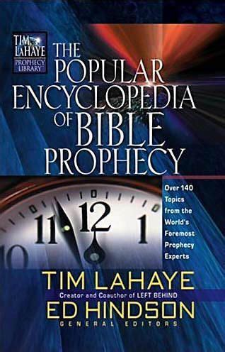
Tony Kessinger
“The pre-wrath view holds to the rather inventive idea that Michael the archangel is the restrainer. This concept fails to take into consideration Michael's special protective ministry toward Israel.”
Tony Kessinger, "Pre-Wrath Rapture," in The Popular Encyclopedia of Bible Prophecy: Over 140 Topics from the World's Foremost Prophecy Experts, ed. Tim LaHaye and Ed Hindson (Eugene, OR: Harvest, 2004), 294.

Slide 21
2 Thessalonians 2:6-7
⁶And you know what restrains [katechon; neuter] him now, so that in his time he will be revealed. ⁷For the mystery of lawlessness is already at work; only he who now restrains [katechōn; masculine] will do so until he is taken out of the way.

Slide 22
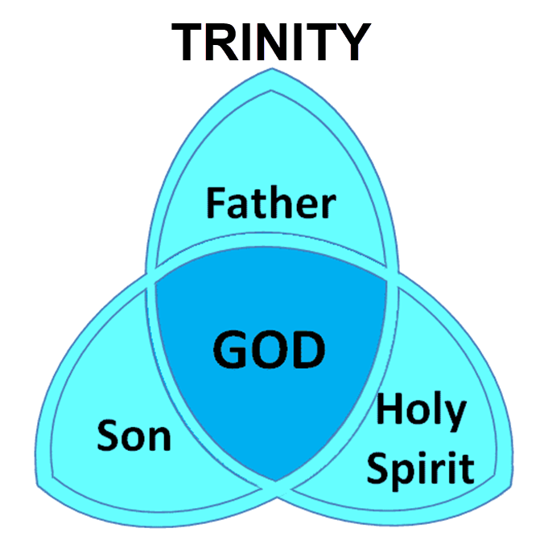

Slide 23
3 Reasons Why the Restrainer is the Holy Spirit (2 Thessalonians 2:6-7)
The Holy Spirit is omnipotent
The Holy Spirit view handles well the switch in gender from the neuter (vs. 6) to the masculine (vs. 7)
The Holy Spirit is active in the world (Gen. 6:3; John 16:7-11)

Slide 24
John 16:7-11
⁷ “But I tell you the truth, it is to your advantage that I go away; for if I do not go away, the Helper will not come to you; but if I go, I will send Him to you. ⁸ “And He, when He comes, will convict the world concerning sin and righteousness and judgment; ⁹ concerning sin, because they do not believe in Me; ¹⁰ and concerning righteousness, because I go to the Father and you no longer see Me; ¹¹ and concerning judgment, because the ruler of this world has been judged.

Slide 25
Genesis 6:1-3
“¹ Now it came about, when men began to multiply on the face of the land, and daughters were born to them, ² that the sons of God saw that the daughters of men were beautiful; and they took wives for themselves, whomever they chose. ³ Then the Lord said, ‘My Spirit shall not strive with man forever, because he also is flesh; nevertheless his days shall be one hundred and twenty years.’ . . .”

Slide 26
2 Thessalonians 2:5
“Do you not remember that while I was still with you, I was telling you these things?”

Slide 27
John 14:16-17
¹⁶ I will ask the Father, and He will give you another Helper, that He may be with you forever; ¹⁷ that is the Spirit of truth, whom the world cannot receive, because it does not see Him or know Him, but you know Him because He abides with you and will be in you.

Slide 28
John 16:7-11
“⁷ But I tell you the truth, it is to your advantage that I go away; for if I do not go away, the Helper will not come to you; but if I go, I will send Him to you. ⁸ And He, when He comes, will convict the world concerning sin and righteousness and judgment; ⁹ concerning sin, because they do not believe in Me; ¹⁰ and concerning righteousness, because I go to the Father and you no longer see Me; ¹¹ and concerning judgment, because the ruler of this world has been judged.”

Slide 29
Romans 8:5-6
^{5 “}For those who are according to the flesh set their minds on the things of the flesh, but those who are according to the Spirit, the things of the Spirit. ⁶ For the mind set on the flesh is death, but the mind set on the Spirit is life and peace.”

Slide 31
Restrainer Must First be Removed
Restrainer holds back the Antichrist (2 Thess 2:6-7)
Restrainer = the omnipotent Holy Spirit (2 Thess 2:9)
Holy Spirit permanently indwells all Christians (John 14:16; Rom 8:9)
Spirit indwelt Christians must first be removed prior to the Antichrist's advent

Slide 32
John 14:16-17
¹⁶ I will ask the Father, and He will give you another Helper, that He may be with you forever; ¹⁷ that is the Spirit of truth, whom the world cannot receive, because it does not see Him or know Him, but you know Him because He abides with you and will be in you.

Slide 33
MAIL BAG
Gap between rapture and Tribulation?
Restrainer = Michael the archangel?
Overview of end time events?

Slide 34
Daniel 9:27
And he will make a firm covenant with the many for one week, but in the middle of the week he will put a stop to sacrifice and grain offering; and on the wing of abominations will come one who makes desolate, even until a complete destruction, one that is decreed, is poured out on the one who makes desolate.

Slide 36
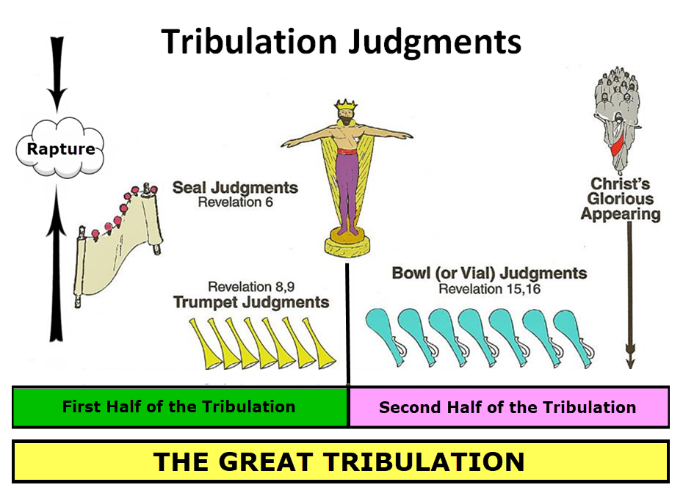

Slide 37
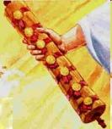
1st Six Seals (Revelation 6)
6:1-2 – Advent of antichrist
6:3-4 – War
6:5-6 – Famine
6:7-8 – Death
6:9-11 – Martyrdoms
6:12-17 – Cosmic disturbances

Slide 39
5 Non-Chronological Parenthetical Insertions
Rev 7 – 144,000 Jews
Rev 10:1-11:13 – Announcement of no more delay and the two witnesses
Rev 12-14 – Israel’s flight, two beasts, six scenes of hope
Rev 16:13-16 – Gathering of the nations to Armageddon
Rev 17:1-19:6 – Babylon’s fall

Slide 40
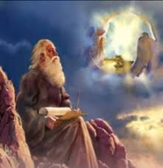
“After These Things” (Rev. 4‒22)
Before the Tribulation (4‒5)
During the Tribulation (6‒19)
After the Tribulation (20‒22)
Kingdom (20:1-10)
Great White Throne Judgment (20:11-15)
Destruction of the Earth (21:1)
New Heaven and New Earth (21‒22)

Slide 42
CONCLUSION

Slide 43
MAIL BAG
Gap between rapture and Tribulation?
Restrainer = Michael the archangel?
Overview of end time events?

