Slide 1
THE RAPTURE
What and When? – Part 8
Andrew Marshall Woods, Th.M., JD., PhD.
Sr. Pastor, Sugar Land Bible Church

Slide 2
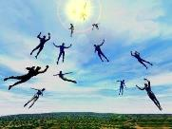
The Rapture Course Overview
What is the Rapture?
When is the Rapture?
Strengthening the Pre-Tribulational case
The opposing views
One second after the Rapture
Questions & Answers

Slide 3
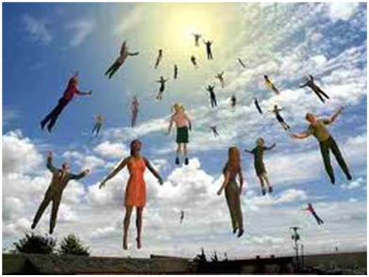
MAIL BAG
Is Isaiah 26:19-20 speaking of the Rapture?
Gap between rapture and Tribulation?
Restrainer = Michael the archangel?
Overview of end time events?

Slide 4
MAIL BAG
Is Isaiah 26:19-20 speaking of the Rapture?
Gap between rapture and Tribulation?
Restrainer = Michael the archangel?
Overview of end time events?

Slide 5
Isaiah 26:19-20
“¹⁹ Your dead will live; Their corpses will rise. You who lie in the dust, awake and shout for joy, For your dew is as the dew of the dawn, And the earth will give birth to the departed spirits. ²⁰ Come, my people, enter into your rooms And close your doors behind you; Hide for a little while.”

Slide 7
1 Corinthians 15:51
“Behold, I tell you a mystery [mystērion]; we will not all sleep, but we will all be changed.”

Slide 8
Colossians 1:26
“that is, the mystery which has been hidden from the past ages and generations, but has now been manifested to His saints.”

Slide 9
“Mystery” Defined
“In the N.T, it [mystērion] denotes, not the mysterious (as with the Eng. word), but that which, being outside the range of unassisted natural apprehension, can be made known only by Divine revelation, and is made known in a manner and at a time appointed by God, and to those who are illumined by His Spirit.”
W. E. Vine, Merrill F. Unger, and William White, Vine's Complete Expository Dictionary of the Old and New Testament Words (Nashville: Nelson, 1996), 424.

Slide 10
Daniel 2:5-6, 9
“⁵ The king replied to the Chaldeans, ‘The command from me is firm: if you do not make known to me the dream and its interpretation, you will be torn limb from limb and your houses will be made a rubbish heap. ⁶ But if you declare the dream and its interpretation, you will receive from me gifts and a reward and great honor; therefore declare to me the dream and its interpretation.’… ⁹ ‘that …

Slide 11
Daniel 2:5-6, 9
. . . if you do not make the dream known to me, there is only one decree for you. For you have agreed together to speak lying and corrupt words before me until the situation is changed; therefore tell me the dream, that I may know that you can declare to me its interpretation.’”

Slide 12
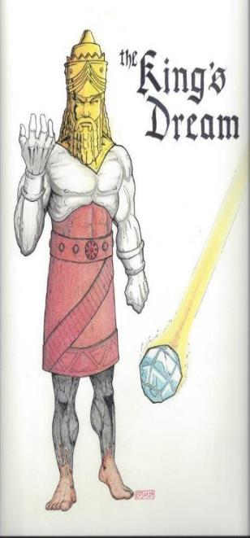
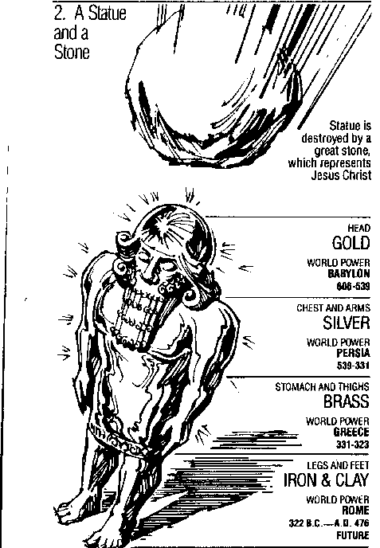
Statue
&
Stone

Slide 13
Daniel 2:18-19, 27-30
“¹⁸ so that they might request compassion from the God of heaven concerning this mystery, so that Daniel and his friends would not be destroyed with the rest of the wise men of Babylon. ¹⁹ Then the mystery was revealed to Daniel in a night vision. Then Daniel blessed the God of heaven;…²⁷ Daniel answered before the king and said, “As for the mystery about which the king has inquired, neither wise men, conjurers, magicians nor diviners are able to . . .

Slide 14
Daniel 2:18-19, 27-30
…declare it to the king. ²⁸ However, there is a God in heaven who mysteries, and He has made known to King Nebuchadnezzar what will take place in the“¹⁸ so that they might request compassion from the God of heaven concerning this mystery, so that Daniel and his friends would not be destroyed with the rest of the wise men of Babylon. ¹⁹ Then the mystery was revealed to Daniel in a night vision. Then Daniel blessed the God of heaven; . . .

Slide 15
Daniel 2:18-19, 27-30
…²⁷ Daniel answered before the king and said, “As for the mystery about which the king has inquired, neither wise men, conjurers, magicians nor diviners are able to declare it to the king. ²⁸ However, there is a God in heaven who mysteries, and He has made known to King Nebuchadnezzar what will take place in the latter days. This was your dream and the visions in your mind while on your bed. ²⁹ As for you, O king, while on your bed your . . .

Slide 16
Daniel 2:18-19, 27-30
. . . thoughts turned to what would take place in the future; and He who reveals mysteries has made known to you what will take place. ³⁰ But as for me, this mystery has not been revealed to me for any wisdom residing in me more than in any other living man, but for the purpose of making the interpretation known to the king, and that you may understand the thoughts of your mind.”

Slide 17
John 14:1–4
¹ “Do not let your heart be troubled; believe in God, believe also in Me. ² “In My Father’s house are many dwelling places; if it were not so, I would have told you; for I go to prepare a place for you. ³ “If I go and prepare a place for you, I will come again and receive you to Myself, that where I am, there you may be also. ⁴ “And you know the way where I am going.”

Slide 18
NEW MYSTERY TRUTH
“But here in John 14 the Lord gives a new and unique revelation; He speaks of something which no prophet had promised, or even could promise. Where is it written that this Messiah would come and instead of gathering His saints into an earthly Jerusalem, would take them to the Father's house, to the very place where He is? It is something new.”
Arno C. Gaebelein, The Gospel of John, 268.

Slide 19
Ephesians 3:3-6
“³ that by revelation there was made known to me the mystery, as I wrote before in brief. ⁴ By referring to this, when you read you can understand my insight into the mystery of Christ, ⁵ which in other generations was not made known to the sons of men, as it has now been revealed to His holy apostles and prophets in the Spirit; ⁶ to be specific, that the Gentiles are fellow heirs and fellow members of the body, and fellow partakers of the promise in Christ Jesus through the gospel”.

Slide 20
Ephesians 3:9
“and to bring to light what is the administration of the mystery which for ages has been hidden in God who created all things.”

Slide 21
Matthew 16:18
“I also say to you that you are Peter, and upon this rock I will build [oikodomeō] My church; and the gates of Hades WILL NOT overpower it.”
21

Slide 23
Isaiah 9:6-7
⁶ For a child will be born to us, a son will be given to us; And the government will rest on His shoulders; And His name will be called Wonderful Counselor, Mighty God, Eternal Father, Prince of Peace.⁷ There will be no end to the increase of His government or of peace, On the throne of David and over his kingdom, To establish it and to uphold it with justice and righteousness From then on and forevermore. The zeal of the Lord of hosts will accomplish this.

Slide 24
Zechariah 9:9-10
⁹ Rejoice greatly, O daughter of Zion! Shout in triumph, O daughter of Jerusalem! Behold, your king is coming to you; He is just and endowed with salvation, Humble, and mounted on a donkey, Even on a colt, the foal of a donkey.¹⁰ I will cut off the chariot from Ephraim And the horse from Jerusalem; And the bow of war will be cut off. And He will speak peace to the nations; And His dominion will be from sea to sea, And from the River to the ends of the earth.

Slide 25
Statue
&
Stone

Slide 26
Isaiah 26:19-20
“¹⁹ Your dead will live; Their corpses will rise. You who lie in the dust, awake and shout for joy, For your dew is as the dew of the dawn, And the earth will give birth to the departed spirits. ²⁰ Come, my people, enter into your rooms And close your doors behind you; Hide for a little while.”

Slide 29
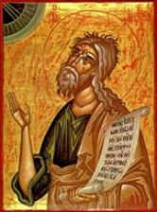
Joel 2:2
“A day of darkness and gloom, A day of clouds and thick darkness. As the dawn is spread over the mountains, So there is a great and mighty people; There has never been anything like it, Nor will there be again after it To the years of many generations.”

Slide 30
Jeremiah 30:7
“Alas! for that day is great, There is none like it; And it is the time of Jacob’s distress (Gen. 32:8; 35:10), But he will be saved from it.”

Slide 31
Daniel 12:1
“Now at that time Michael, the great prince who stands guard over the sons of your people, will arise. And there will be a time of distress such as never occurred since there was a nation until that time; and at that time your people, everyone who is found written in the book, will be rescued.”

Slide 32
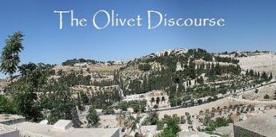
Matthew 24:21-22
“²¹ For then there will be a great tribulation, such as has not occurred since the beginning of the world until now, nor ever will. ²² Unless those days had been cut short, no life would have been saved; but for the sake of the elect those days will be cut short.”

Slide 33
Isaiah 26:19-20
“¹⁹ Your dead will live; Their corpses will rise. You who lie in the dust, awake and shout for joy, For your dew is as the dew of the dawn, And the earth will give birth to the departed spirits. ²⁰ Come, my people, enter into your rooms And close your doors behind you; Hide for a little while. ²¹ For behold, the Lord is about to come out from His place To punish the inhabitants of the earth for their iniquity; And the earth will reveal her bloodshed And will no longer cover her slain.”

Slide 34
Zechariah 13:8-9
⁸“It will come about in all the land,” Declares the Lord, “That two parts in it will be cut off and perish; But the third will be left in it. ⁹“And I will bring the third part through the fire, Refine them as silver is refined, And test them as gold is tested. They will call on My name, And I will answer them; I will say, ‘They are My people,’ And they will say, ‘The Lord is my God.’ ”

Slide 35
Daniel 12:1-2
“¹ Now at that time Michael, the great prince who stands guard over the sons of your people, will arise. And there will be a time of distress such as never occurred since there was a nation until that time; and at that time your people, everyone who is found written in the book, will be rescued. ² Many of those who sleep in the dust of the ground will awake, these to everlasting (olam) life, but the others to disgrace and everlasting (olam) contempt.”

Slide 36
Revelation 20:4-6
“⁴ Then I saw thrones, and they sat on them, and judgment was given to them. And I saw the souls of those who had been beheaded because of their testimony of Jesus and because of the word of God, and those who had not worshiped the beast or his image, and had not received the mark on their forehead and on their hand; and they came to life [zaō] and reigned with Christ for a thousand years. ⁵ The rest of the dead did not come to life [zaō] until the. . .

Slide 37
Revelation 20:4-6
…thousand years were completed. This is the first resurrection [anastasis and not palingenesia]. ⁶ Blessed and holy is the one who has a part in the first resurrection [anastasis and not palingenesia]; over these the second death has no power, but they will be priests of God and of Christ and will reign with Him for a thousand years.”

Slide 39
Isaiah 26:19-20
“¹⁹ Your dead will live; Their corpses will rise. You who lie in the dust, awake and shout for joy, For your dew is as the dew of the dawn, And the earth will give birth to the departed spirits. ²⁰ Come, my people, enter into your rooms And close your doors behind you; Hide for a little while.”

Slide 40
MAIL BAG
Is Isaiah 26:19-20 speaking of the Rapture?
Gap between rapture and Tribulation?
Restrainer = Michael the archangel?
Overview of end time events?

Slide 42
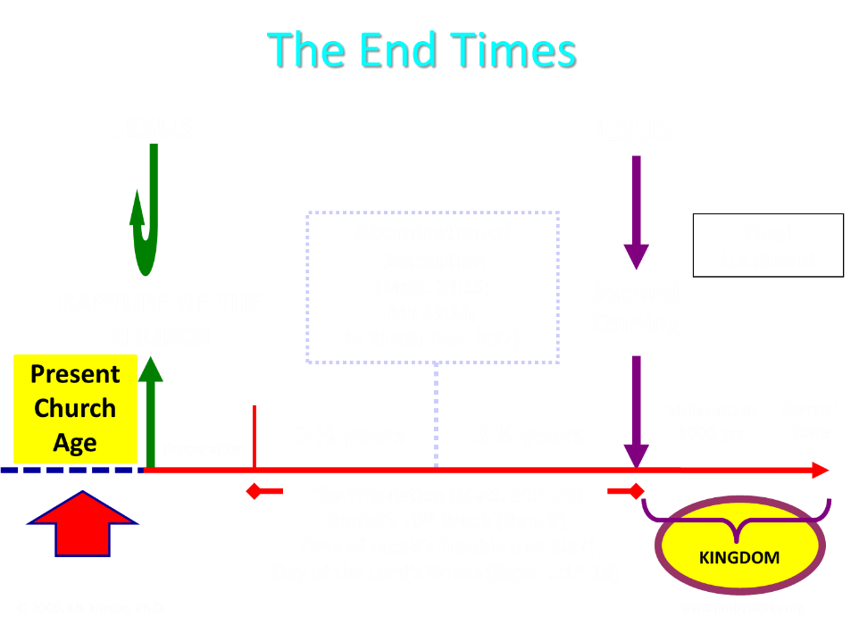

Slide 43
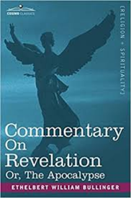
Bullinger (1909)
Commentary on Revelation, 577
“And Babylon, though fallen gradually, and very low, has never suffered such a destruction. There is only one conclusion, that in the interval of, say some 30 or more years between the removal of the church and the last "week "of Daniel's prophecy, it will be revived and exceed all its former magnificence.”

Slide 44
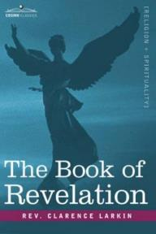
Larkin (1919)
The Book of Revelation, 162
“But I hear the protest, how can you say we be expecting Jesus to come at "any moment," if the city of Babylon must be rebuilt before He can come? There is not a word in Scripture that says that Jesus cannot come and take away His Church until Babylon is rebuilt. The Church may be taken out of the world 25 or even 50 years before that.”

Slide 45
MAIL BAG
Is Isaiah 26:19-20 speaking of the Rapture?
Gap between rapture and Tribulation?
Restrainer = Michael the archangel?
Overview of end time events?

Slide 46
2 Thessalonians 2:6-7
⁶And you know what restrains [katechon; neuter] him now, so that in his time he will be revealed. ⁷For the mystery of lawlessness is already at work; only he who now restrains [katechōn; masculine] will do so until he is taken out of the way.

Slide 47
Marvin Rosenthal
“…of paramount importance is the identification of the one who restraints or hinders the Antichrist until ‘he [the restrainer] be taken out of the way.’ The restrainer is neither the Holy Spirit nor human government. Evidence is strained to support either of those contentions. There is, however, substantial evidence to identify the restrainer. He who restraints until ‘he be taken out of the way’ is the Archangel Michael.”
Marvin J. Rosenthal, The Pre-Wrath Rapture of the Church: A New Understanding of the Tribulation, and the Second Coming (Nashville, TN: Thomas Nelson, 1990), 112.

Slide 48
2 Thessalonians 2:6-7
⁶And you know what restrains [katechon; neuter] him now, so that in his time he will be revealed. ⁷For the mystery of lawlessness is already at work; only he who now restrains [katechōn; masculine] will do so until he is taken out of the way.

Slide 49
John 14:16-17
¹⁶ I will ask the Father, and He will give you another Helper, that He may be with you forever; ¹⁷ that is the Spirit of truth, whom the world cannot receive, because it does not see Him or know Him, but you know Him because He abides with you and will be in you.

Slide 50
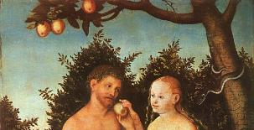
2 Thessalonians 2:9
“that is, the one whose coming is in accord with the activity of Satan, with all power and signs and false wonders.”

Slide 51
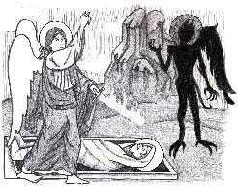
Jude 9
“But Michael the archangel, when he disputed with the devil and argued about the body of Moses, did not dare pronounce against him a railing judgment, but said, ‘The Lord rebuke you!’”

Slide 52
Daniel 12:1
“Now at that time Michael, the great prince who stands guard over the sons of your people [Israel], will arise. And there will be a time of distress such as never occurred since there was a nation until that time; and at that time your people, everyone who is found written in the book, will be rescued.”

Slide 53
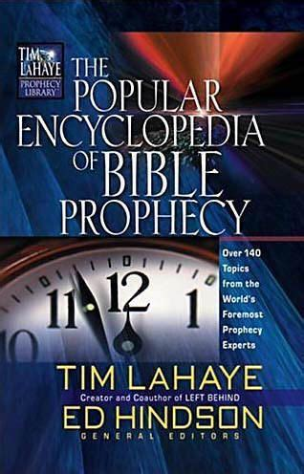
Tony Kessinger
“The pre-wrath view holds to the rather inventive idea that Michael the archangel is the restrainer. This concept fails to take into consideration Michael's special protective ministry toward Israel.”
Tony Kessinger, "Pre-Wrath Rapture," in The Popular Encyclopedia of Bible Prophecy: Over 140 Topics from the World's Foremost Prophecy Experts, ed. Tim LaHaye and Ed Hindson (Eugene, OR: Harvest, 2004), 294.

Slide 54
2 Thessalonians 2:6-7
⁶And you know what restrains [katechon; neuter] him now, so that in his time he will be revealed. ⁷For the mystery of lawlessness is already at work; only he who now restrains [katechōn; masculine] will do so until he is taken out of the way.

Slide 55
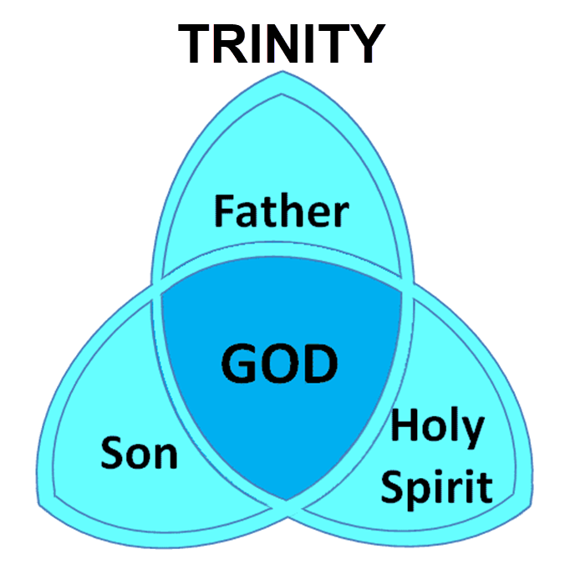

Slide 56
3 Reasons Why the Restrainer is the Holy Spirit (2 Thessalonians 2:6-7)
The Holy Spirit is omnipotent
The Holy Spirit view handles well the switch in gender from the neuter (vs. 6) to the masculine (vs. 7)
The Holy Spirit is active in the world (Gen. 6:3; John 16:7-11)

Slide 57
John 16:7-11
⁷ “But I tell you the truth, it is to your advantage that I go away; for if I do not go away, the Helper will not come to you; but if I go, I will send Him to you. ⁸ “And He, when He comes, will convict the world concerning sin and righteousness and judgment; ⁹ concerning sin, because they do not believe in Me; ¹⁰ and concerning righteousness, because I go to the Father and you no longer see Me; ¹¹ and concerning judgment, because the ruler of this world has been judged.

Slide 58
Genesis 6:1-4
“¹ Now it came about, when men began to multiply on the face of the land, and daughters were born to them, ² that the sons of God saw that the daughters of men were beautiful; and they took wives for themselves, whomever they chose. ³ Then the Lord said, ‘My Spirit shall not strive with man forever, because he also is flesh; nevertheless his days shall be one hundred and twenty years.’ . . .

Slide 59
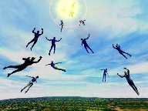
Restrainer Must First be Removed
Restrainer holds back the Antichrist (2 Thess 2:6-7)
Restrainer = the omnipotent Holy Spirit (2 Thess 2:9)
Holy Spirit permanently indwells all Christians (John 14:16; Rom 8:9)
Spirit indwelt Christians must first be removed prior to the Antichrist's advent

Slide 60
John 14:16-17
¹⁶ I will ask the Father, and He will give you another Helper, that He may be with you forever; ¹⁷ that is the Spirit of truth, whom the world cannot receive, because it does not see Him or know Him, but you know Him because He abides with you and will be in you.

Slide 61
MAIL BAG
Is Isaiah 26:19-20 speaking of the Rapture?
Gap between rapture and Tribulation?
Restrainer = Michael the archangel?
Overview of end time events?

Slide 62
Daniel 9:27
And he will make a firm covenant with the many for one week, but in the middle of the week he will put a stop to sacrifice and grain offering; and on the wing of abominations will come one who makes desolate, even until a complete destruction, one that is decreed, is poured out on the one who makes desolate.

Slide 64
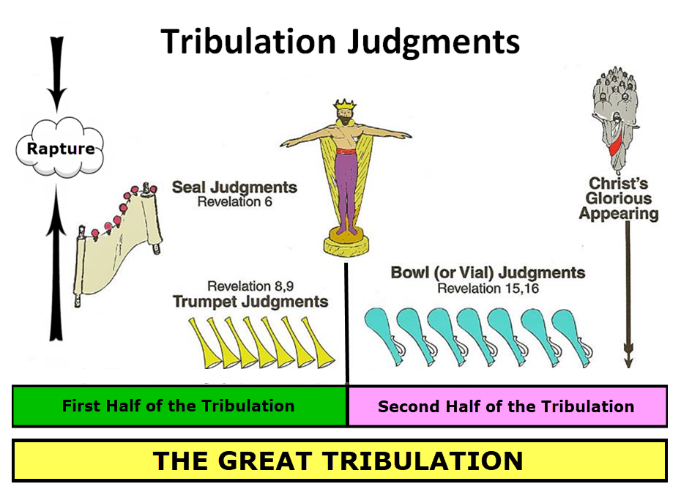

Slide 65
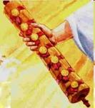
1st Six Seals (Revelation 6)
6:1-2 – Advent of antichrist
6:3-4 – War
6:5-6 – Famine
6:7-8 – Death
6:9-11 – Martyrdoms
6:12-17 – Cosmic disturbances

Slide 67
5 Non-Chronological Parenthetical Insertions
Rev 7 – 144,000 Jews
Rev 10:1-11:13 – Announcement of no more delay and the two witnesses
Rev 12-14 – Israel’s flight, two beasts, six scenes of hope
Rev 16:13-16 – Gathering of the nations to Armageddon
Rev 17:1-19:6 – Babylon’s fall

Slide 69
CONCLUSION

Slide 70
MAIL BAG
Is Isaiah 26:19-20 speaking of the Rapture?
Gap between rapture and Tribulation?
Restrainer = Michael the archangel?
Overview of end time events?

