Slide 1
THE RAPTURE
What and When? – Part 7
Andrew Marshall Woods, Th.M., JD., PhD.
Sr. Pastor, Sugar Land Bible Church

Slide 2
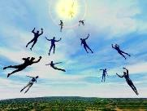
The Rapture Course Overview
What is the Rapture?
When is the Rapture?
Strengthening the Pre-Tribulational case
The opposing views
One second after the Rapture
Questions & Answers

Slide 3
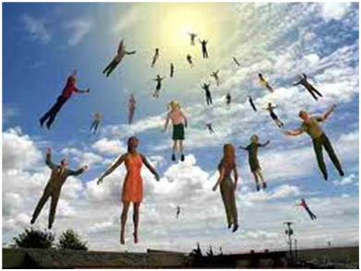
MAIL BAG
Will the Rapture occur on a Hebrew feast day?
Is Isaiah 26:19-20 speaking of the Rapture?

Slide 4
MAIL BAG
Will the Rapture occur on a Hebrew feast day?
Is Isaiah 26:19-20 speaking of the Rapture?

Slide 5
Levitical Feasts (Leviticus 23)
Feast | Season | Purpose | Type
Passover | Spring | Redemption | 1 Cor 5:7
Unleavened Bread | Spring | Separation | John 6:35
1st fruits | Spring | Praise for initial crop | 1 Cor. 15:20
Pentecost | Spring | Praise for full crop | Acts 2:1-4
Trumpets | Fall | New Year | Matt. 24:31
Atonement | Fall | Lev. 16 | Zech. 12:10
Booths | Fall | Wilderness provision | Zech. 14:16-18

Slide 6
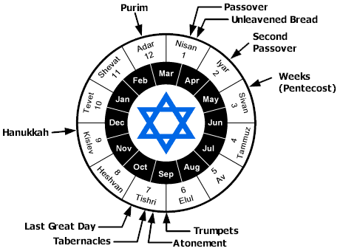

Slide 7
Levitical Feasts (Leviticus 23)
Feast | Season | Purpose | Type
Passover | Spring | Redemption | 1 Cor 5:7
Unleavened Bread | Spring | Separation | John 6:35
1st fruits | Spring | Praise | 1 Cor 15:20
Pentecost | Spring | Praise | Acts 2:1-4
Trumpets | Fall | New Year | Matt 24:31
Atonement | Fall | Lev 16 | Zech 12:10
Booths | Fall | Wilderness provision | Zech 14:16-18

Slide 8
1 Thessalonians 4:13-18
. . . have fallen asleep. ¹⁶ For the Lord Himself will descend from heaven with a shout, with the voice of the archangel and with the trumpet of God, and the dead in Christ will rise first. ¹⁷ Then we who are alive and remain will be caught up together with them in the clouds to meet the Lord in the air, and so we shall always be with the Lord. ¹⁸ Therefore comfort one another with these words."

Slide 9
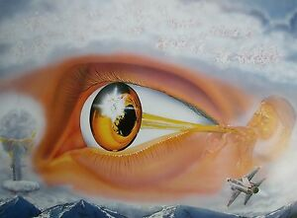
1 Corinthians 15:52
“in a moment, in the twinkling of an eye, at the last trumpet; for the trumpet will sound, and the dead will be raised imperishable, and we will be changed.”

Slide 10
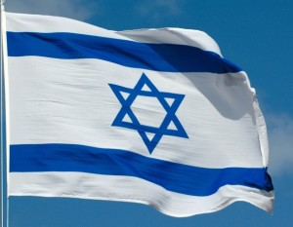
Matthew 24:31
³¹ “And He will send His angels with a great sound of a trumpet, and they will gather together His elect from the four winds, from one end of heaven to the other.”

Slide 11
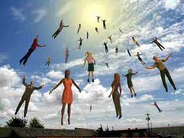
1. Rapture on a Feast Day?
Denies imminency
Places Church under the Mosaic Law
Misunderstands the nature of the Church
Why did the Church begin on Pentecost?

Slide 12
1. Rapture on a Feast Day?
Denies imminency
Places Church under the Mosaic Law
Misunderstands the nature of the Church
Why did the Church begin on Pentecost?

Slide 13
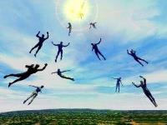
Imminent (1 Cor 15:51; 1 Thess 4:15)
Imminency definition
James 5:8; 1 Thess 1:10; 1 Cor 1:7; Philip 3:20
We are to be looking for Jesus Christ and not the Antichrist!
Motivator (Holiness, Evangelism)
Feast of Trumpets?

Slide 15
1. Rapture on a Feast Day?
Denies imminency
Places Church under the Mosaic Law
Misunderstands the nature of the Church
Why did the Church begin on Pentecost?

Slide 16
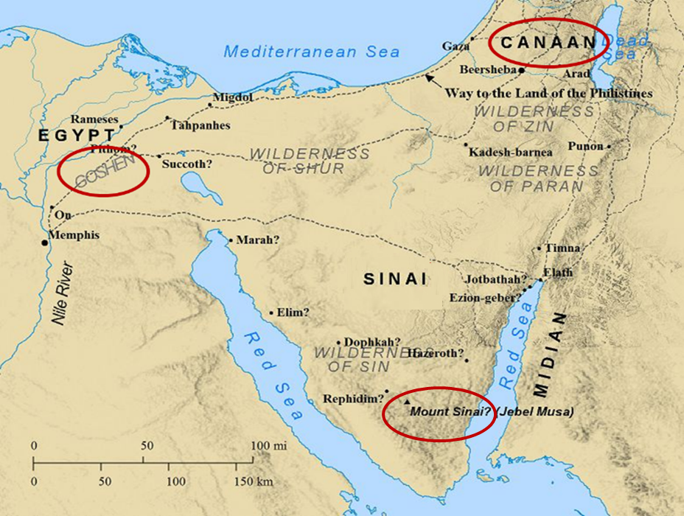

Slide 17
Levitical Feasts (Leviticus 23)
Feast | Season | Purpose | Type
Passover | Spring | Redemption | 1 Cor 5:7
Unleavened Bread | Spring | Separation | John 6:35
1st fruits | Spring | Praise | 1 Cor 15:20
Pentecost | Spring | Praise | Acts 2:1-4
Trumpets | Fall | New Year | Matt 24:31
Atonement | Fall | Lev 16 | Zech 12:10
Booths | Fall | Wilderness provision | Zech 14:16-18

Slide 18
Psalm 147:19-20
“He declares His words to Jacob, His statutes and His ordinances to Israel. He has not dealt thus with any nation; And as for His ordinances, they have not known them. Praise the Lord!”

Slide 19
Romans 6:14; 8:2;
“For sin shall not be master over you, for you are not under law but under grace…For the law of the Spirit of life in Christ Jesus has set you free from the law of sin and of death…
Galatians 6:2
Bear one another’s burdens, and thereby fulfill the law of Christ.”

Slide 20
1. Rapture on a Feast Day?
Denies imminency
Places Church under the Mosaic Law
Misunderstands the nature of the Church
Why did the Church begin on Pentecost?

Slide 21
5. Discontinuity Between Israel & the Church
 | ISRAEL | CHURCH
Marriage | Wife | Bride
Christ | Birthed Christ | Birthed by Christ
Return | 2nd advent | Rapture
Leader | King | Head, Groom
Beginning | Gen 12 | Acts 2
Scripture | 4/5 | 1/5
Covenants | Parties | Beneficiaries
Nation | Political | Spiritual

Slide 22
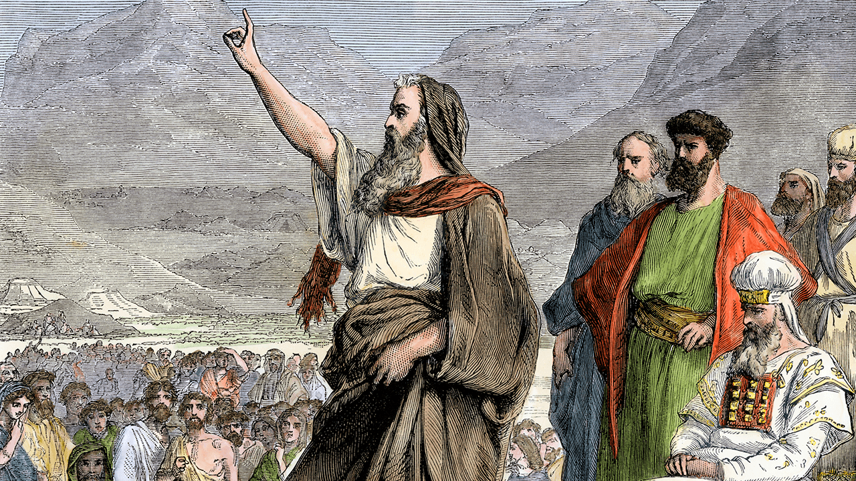
Romans 10:19
But I say, surely Israel did not know, did they? First Moses says, “I will make you jealous by that which is not a nation, By a nation without understanding will I anger you.”

Slide 23
Levitical Feasts (Leviticus 23)
Feast | Season | Purpose | Type
Passover | Spring | Redemption | 1 Cor 5:7
Unleavened Bread | Spring | Separation | John 6:35
1st fruits | Spring | Praise | 1 Cor 15:20
Pentecost | Spring | Praise | Acts 2:1-4
Trumpets | Fall | New Year | Matt 24:31
Atonement | Fall | Lev 16 | Zech 12:10
Booths | Fall | Wilderness provision | Zech 14:16-18

Slide 25
Colossians 2:16-17
^{“16} Therefore no one is to act as your judge in regard to food or drink or in respect to a festival or a new moon or a Sabbath day— ¹⁷ things which are a mere shadow of what is to come; but the substance belongs to Christ.”

Slide 26
1. Rapture on a Feast Day?
Denies imminency
Places Church under the Mosaic Law
Misunderstands the nature of the Church
Why did the Church begin on Pentecost?

Slide 28
When Did the Church Begin?
Christ referred to the Church in the future tense (Matt. 16:18)
Paul referred to the Church as a “mystery” (Eph. 3:4-5, 9)
The Church did not exist prior to Acts 1 since Christ became the head of the Church (Eph. 5:23) after His Ascension (Eph. 1:20-22)
The Church did not exist prior to Acts 1 since spiritual gifts (1 Cor. 12:7; 14:26) only came into existence after His Ascension (Eph. 4:7-11)

Slide 29
When Did the Church Begin?
The Church existed before Paul’s conversion in Acts 9 (Acts 5:11; 8:1,3; Rom. 16:7)
The Baptizing (joining, uniting, identifying) ministry of the Holy Spirit began in Acts 2
1 Cor. 12:13
Acts 1:5
Acts 11:15-16
Acts 2:1-4, 37-41

Slide 30
Levitical Feasts (Leviticus 23)
Feast | Season | Fulfillment | Rejected
Passover | Spring | John 1:29 | John 1:11
Unleavened Bread | Spring | John 6:35 | John 6:41
1st fruits | Spring | 1 Cor. 15:20 | Matt. 28:11-15
Pentecost | Spring | Joel 2:28-32 | Acts 2:13; 1 Cor. 14:22
Trumpets | Fall | New Year | Matt 24:31
Atonement | Fall | Lev 16 | Zech. 12:10
Booths | Fall | Wilderness provision | Zech. 14:16-18

Slide 31
Levitical Feasts (Leviticus 23)
Feast | Season | Fulfillment | Rejected
Passover | Spring | John 1:29 | John 1:11
Unleavened Bread | Spring | John 6:35 | John 6:41
1st fruits | Spring | 1 Cor. 15:20 | Matt. 28:11-15
Pentecost | Spring | Joel 2:28-32 | Acts 2:13; 1 Cor. 14:22
Trumpets | Fall | New Year | Matt 24:31
Atonement | Fall | Lev 16 | Zech. 12:10
Booths | Fall | Wilderness provision | Zech. 14:16-18

Slide 33
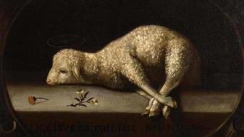
Exodus 12:5
“Your lamb shall be an unblemished male a year old; you may take it from the sheep or from the goats.”

Slide 34
John 1:29
^{“29} The next day he saw Jesus coming to him and said, “‘Behold, the Lamb of God who takes away the sin of the world!’”

Slide 35
Levitical Feasts (Leviticus 23)
Feast | Season | Fulfillment | Rejected
Passover | Spring | John 1:29 | John 1:11
Unleavened Bread | Spring | John 6:35 | John 6:41
1st fruits | Spring | 1 Cor. 15:20 | Matt. 28:11-15
Pentecost | Spring | Joel 2:28-32 | Acts 2:13; 1 Cor. 14:22
Trumpets | Fall | New Year | Matt 24:31
Atonement | Fall | Lev 16 | Zech. 12:10
Booths | Fall | Wilderness provision | Zech. 14:16-18

Slide 36
7 “I AM” statements in John
I am the Bread of Life | 6:35
I am the Light of the world | 8:12
I am the Gate for the sheep | 10:7; cf. v.9
I am the Good Shepherd | 10:11,14
I am the Resurrection and the Life | 11:25
I am the Way and the Truth and the Life | 14:6
I am the true Vine | 15:1; cf. v.5

Slide 37
Levitical Feasts (Leviticus 23)
Feast | Season | Fulfillment | Rejected
Passover | Spring | John 1:29 | John 1:11
Unleavened Bread | Spring | John 6:35 | John 6:41
1st fruits | Spring | 1 Cor. 15:20 | Matt. 28:11-15
Pentecost | Spring | Joel 2:28-32 | Acts 2:13; 1 Cor. 14:22
Trumpets | Fall | New Year | Matt 24:31
Atonement | Fall | Lev 16 | Zech. 12:10
Booths | Fall | Wilderness provision | Zech. 14:16-18

Slide 38
1 Corinthians 15:20-23
“²⁰ But now Christ has been raised from the dead, the first fruits of those who are asleep. ²¹-For since by a man came death, by a man also came the resurrection of the dead. ²² For as in Adam all die, so also in Christ all will be made alive. ²³ But each in his own order (tagma): Christ the first fruits, after that those who are Christ’s at His coming.”

Slide 39
Levitical Feasts (Leviticus 23)
Feast | Season | Fulfillment | Rejected
Passover | Spring | John 1:29 | John 1:11
Unleavened Bread | Spring | John 6:35 | John 6:41
1st fruits | Spring | 1 Cor. 15:20 | Matt. 28:11-15
Pentecost | Spring | Joel 2:28-32 | Acts 2:13; 1 Cor. 14:22
Trumpets | Fall | New Year | Matt 24:31
Atonement | Fall | Lev 16 | Zech. 12:10
Booths | Fall | Wilderness provision | Zech. 14:16-18

Slide 41
Act 3:19-21
“¹⁹ Therefore repent and return, so that your sins may be wiped away, in order that times of refreshing may come from the presence of the Lord; ²⁰ and that He may send Jesus, the Christ appointed for you, ²¹ whom heaven must receive until the period of restoration of all things about which God spoke by the mouth of His holy prophets from ancient time.”

Slide 42
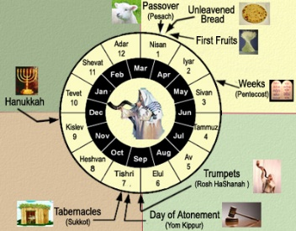
Terry Hulbert Terry C. Hulbert, The Eschatological Significance of Israel's Annual Feasts. Doctoral Dissertation. Dallas Theological Seminary. 1965. Pages 2, 115-116.
“When God fulfilled the first four feasts, He had provided everything necessary for Israel to enter into literal kingdom blessing‒redemption, separation, resurrection, and the presence of the Holy Spirit. Israel’s rejection of these, however, made a necessary national change of heart before the kingdom could be established…The paschal lamb of God pointed out by John the Baptist was rejected as an imposter. The resurrection of Christ, as it answered to the Feast of First Fruits, was suppressed in it’s proclamation by the bribe money paid to the sentries…Finally, the coming of the Spirit was rejected at Pentecost as the Jews…

Slide 43
Terry Hulbert Terry C. Hulbert, The Eschatological Significance of Israel's Annual Feasts. Doctoral Dissertation. Dallas Theological Seminary. 1965. Pages 2, 115-116.
…taunted the apostles with charges of drunkenness. By the time of the close of Acts chapter 2, God had done all He could do for Israel until they repented as a nation. Thus, the significance of Peter’s second sermon in Acts 3 was that it re-emphasized the condition of millennial blessing already laid down in the Old Testament, but as yet unfulfilled...Of the upmost importance here is the fact that the shedding of the blood of Christ to take away sin, and with the coming of the Spirit to empower the life of the redeemed, all of the spiritual requirements for the millennial kingdom had been met as far as God was concerned….

Slide 44
Terry Hulbert Terry C. Hulbert, The Eschatological Significance of Israel's Annual Feasts. Doctoral Dissertation. Dallas Theological Seminary. 1965. Pages 2, 115-116.
…But, God‘s provision could not be operative until man appropriated it. This point cannot be over emphasized, for it is not only the reason for the delay in the fulfillment of the final three feasts, it is the basis for understanding the relationship of the church to the feasts.”

Slide 45
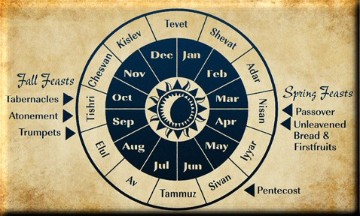

Slide 46
Levitical Feasts (Leviticus 23)
Feast | Season | Fulfillment | Rejected
Passover | Spring | John 1:29 | John 1:11
Unleavened Bread | Spring | John 6:35 | John 6:41
1st fruits | Spring | 1 Cor. 15:20 | Matt. 28:11-15
Pentecost | Spring | Joel 2:28-32 | Acts 2:13; 1 Cor. 14:22
Church Age
Trumpets | Fall | New Year | Matt 24:31
Atonement | Fall | Lev 16 | Zech. 12:10
Booths | Fall | Wilderness provision | Zech. 14:16-18

Slide 47
Levitical Feasts (Leviticus 23)
Feast | Season | Fulfillment | Rejected
Passover | Spring | John 1:29 | John 1:11
Unleavened Bread | Spring | John 6:35 | John 6:41
1st fruits | Spring | 1 Cor. 15:20 | Matt. 28:11-15
Pentecost | Spring | Joel 2:28-32 | Acts 2:13; 1 Cor. 14:22
Church Age
Trumpets | Fall | New Year | Matt 24:31
Atonement | Fall | Lev 16 | Zech. 12:10
Booths | Fall | Wilderness provision | Zech. 14:16-18

Slide 48
Matthew 24:31
³¹ “And He will send His angels with a great sound of a trumpet, and they will gather together His elect from the four winds, from one end of heaven to the other.”

Slide 49
Isaiah 27:13
“It will come about also in that day that a great trumpet will be blown, and those who were perishing in the land of Assyria and who were scattered in the land of Egypt will come and worship the Lord in the holy mountain at Jerusalem.”

Slide 50
Levitical Feasts (Leviticus 23)
Feast | Season | Fulfillment | Rejected
Passover | Spring | John 1:29 | John 1:11
Unleavened Bread | Spring | John 6:35 | John 6:41
1st fruits | Spring | 1 Cor. 15:20 | Matt. 28:11-15
Pentecost | Spring | Joel 2:28-32 | Acts 2:13; 1 Cor. 14:22
Church Age
Trumpets | Fall | New Year | Matt 24:31
Atonement | Fall | Lev 16 | Zech. 12:10
Booths | Fall | Wilderness provision | Zech. 14:16-18

Slide 51
Zechariah 12:10
“I will pour out on the house of David and on the inhabitants of Jerusalem, the Spirit of grace and of supplication, so that they will look on Me whom they have pierced; and they will mourn for Him, as one mourns for an only son, and they will weep bitterly over Him like the bitter weeping over a firstborn.”

Slide 52
Romans 11:25-26
“²⁵ For I do not want you, brethren, to be uninformed of this mystery—so that you will not be wise in your own estimation—that a partial hardening has happened to Israel until the fullness of the Gentiles has come in; ²⁶ and so all Israel will be saved; just as it is written, ‘The Deliverer will come from Zion, He will remove ungodliness from Jacob.’”

Slide 53
Levitical Feasts (Leviticus 23)
Feast | Season | Fulfillment | Rejected
Passover | Spring | John 1:29 | John 1:11
Unleavened Bread | Spring | John 6:35 | John 6:41
1st fruits | Spring | 1 Cor. 15:20 | Matt. 28:11-15
Pentecost | Spring | Joel 2:28-32 | Acts 2:13; 1 Cor. 14:22
Church Age
Trumpets | Fall | New Year | Matt 24:31
Atonement | Fall | Lev 16 | Zech. 12:10
Booths | Fall | Wilderness provision | Zech. 14:16-18

Slide 55
Zechariah 14:16-18
“Then it will come about that any who are left of all the nations that went against Jerusalem will go up from year to year to worship the King, the Lord of hosts, and to celebrate the Feast of Booths. ¹⁷ And it will be that whichever of the families of the earth does not go up to Jerusalem to worship the King, the Lord of hosts, there will be no rain on them. ¹⁸ If the family of Egypt does not go up or enter, then no rain will fall on them; it will be the plague with which the Lord smites the nations who do not go up to celebrate the Feast of Booths.”

Slide 56
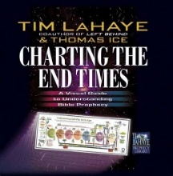
Thomas D. Ice Thomas D. Ice, "The Feasts of Israel in Prophecy," in Charting the End Times: A Visual Guide to Understanding Bible Prophecy, ed. Time LaHaye and Thomas Ice (Eugene, OR: Harvest House, 2001), 103-104.
“The three fall feasts await fulfillment in the events that will take place at the Second Coming of Christ and in the Millennium. The Feast of Trumpets will take place at the Second Coming, as Matthew 24:31 indicates: ‘He will send forth his angels with a great trumpet and they will gather together His elect from the four winds, from one end of the sky to the other.’ The Day of Atonement will be applied to the nation of Israel when the people realize that Jesus was their long-awaited Messiah all along (Zechariah 12:10; Romans 11:25–27). And the Feast of Tabernacle’s will be fulfilled by the Millennial kingdom when the Jewish nation will dwell with their God in the land of Israel for 1000 years.”

Slide 57
1. Rapture on a Feast Day?
Denies imminency
Places Church under the Mosaic Law
Misunderstands the nature of the Church
Why did the Church begin on Pentecost?

Slide 58
MAIL BAG
Will the Rapture occur on a Hebrew feast day?
Is Isaiah 26:19-20 speaking of the Rapture?

Slide 59
Isaiah 26:19-20
“¹⁹ Your dead will live; Their corpses will rise. You who lie in the dust, awake and shout for joy, For your dew is as the dew of the dawn, And the earth will give birth to the departed spirits. ²⁰ Come, my people, enter into your rooms And close your doors behind you; Hide for a little while.”

Slide 61
1 Corinthians 15:51
“Behold, I tell you a mystery [mystērion]; we will not all sleep, but we will all be changed.”

Slide 62
Colossians 1:26
“that is, the mystery which has been hidden from the past ages and generations, but has now been manifested to His saints.”

Slide 63
“Mystery” Defined
“In the N.T, it [mystērion] denotes, not the mysterious (as with the Eng. word), but that which, being outside the range of unassisted natural apprehension, can be made known only by Divine revelation, and is made known in a manner and at a time appointed by God, and to those who are illumined by His Spirit.”
W. E. Vine, Merrill F. Unger, and William White, Vine's Complete Expository Dictionary of the Old and New Testament Words (Nashville: Nelson, 1996), 424.

Slide 64
Daniel 2:5-6, 9
“⁵ The king replied to the Chaldeans, ‘The command from me is firm: if you do not make known to me the dream and its interpretation, you will be torn limb from limb and your houses will be made a rubbish heap. ⁶ But if you declare the dream and its interpretation, you will receive from me gifts and a reward and great honor; therefore declare to me the dream and its interpretation.’… ⁹ ‘that …

Slide 65
Daniel 2:5-6, 9
. . . if you do not make the dream known to me, there is only one decree for you. For you have agreed together to speak lying and corrupt words before me until the situation is changed; therefore tell me the dream, that I may know that you can declare to me its interpretation.’”

Slide 66
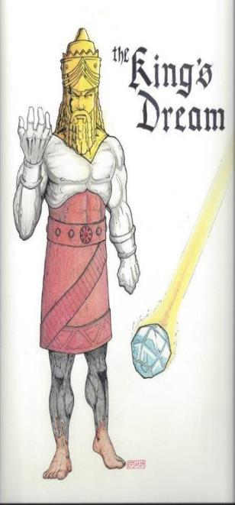
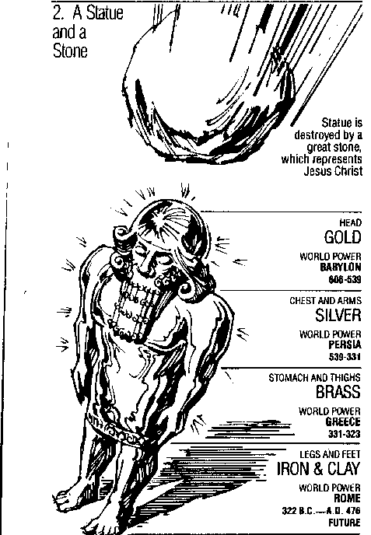
Statue
&
Stone

Slide 67
Daniel 2:18-19, 27-30
“¹⁸ so that they might request compassion from the God of heaven concerning this mystery, so that Daniel and his friends would not be destroyed with the rest of the wise men of Babylon. ¹⁹ Then the mystery was revealed to Daniel in a night vision. Then Daniel blessed the God of heaven;…²⁷ Daniel answered before the king and said, “As for the mystery about which the king has inquired, neither wise men, conjurers, magicians nor diviners are able to . . .

Slide 68
Daniel 2:18-19, 27-30
…declare it to the king. ²⁸ However, there is a God in heaven who mysteries, and He has made known to King Nebuchadnezzar what will take place in the“¹⁸ so that they might request compassion from the God of heaven concerning this mystery, so that Daniel and his friends would not be destroyed with the rest of the wise men of Babylon. ¹⁹ Then the mystery was revealed to Daniel in a night vision. Then Daniel blessed the God of heaven; . . .

Slide 69
Daniel 2:18-19, 27-30
…²⁷ Daniel answered before the king and said, “As for the mystery about which the king has inquired, neither wise men, conjurers, magicians nor diviners are able to declare it to the king. ²⁸ However, there is a God in heaven who mysteries, and He has made known to King Nebuchadnezzar what will take place in the latter days. This was your dream and the visions in your mind while on your bed. ²⁹ As for you, O king, while on your bed your . . .

Slide 70
Daniel 2:18-19, 27-30
. . . thoughts turned to what would take place in the future; and He who reveals mysteries has made known to you what will take place. ³⁰ But as for me, this mystery has not been revealed to me for any wisdom residing in me more than in any other living man, but for the purpose of making the interpretation known to the king, and that you may understand the thoughts of your mind.”

Slide 71
John 14:1–4
¹ “Do not let your heart be troubled; believe in God, believe also in Me. ² “In My Father’s house are many dwelling places; if it were not so, I would have told you; for I go to prepare a place for you. ³ “If I go and prepare a place for you, I will come again and receive you to Myself, that where I am, there you may be also. ⁴ “And you know the way where I am going.”

Slide 72
NEW MYSTERY TRUTH
“But here in John 14 the Lord gives a new and unique revelation; He speaks of something which no prophet had promised, or even could promise. Where is it written that this Messiah would come and instead of gathering His saints into an earthly Jerusalem, would take them to the Father's house, to the very place where He is? It is something new.”
Arno C. Gaebelein, The Gospel of John, 268.

Slide 73
Ephesians 3:3-6
“³ that by revelation there was made known to me the mystery, as I wrote before in brief. ⁴ By referring to this, when you read you can understand my insight into the mystery of Christ, ⁵ which in other generations was not made known to the sons of men, as it has now been revealed to His holy apostles and prophets in the Spirit; ⁶ to be specific, that the Gentiles are fellow heirs and fellow members of the body, and fellow partakers of the promise in Christ Jesus through the gospel”.

Slide 74
Ephesians 3:9
“and to bring to light what is the administration of the mystery which for ages has been hidden in God who created all things.”

Slide 75
Matthew 16:18
“I also say to you that you are Peter, and upon this rock I will build [oikodomeō] My church; and the gates of Hades WILL NOT overpower it.”
75

Slide 77
Isaiah 9:6-7
⁶ For a child will be born to us, a son will be given to us; And the government will rest on His shoulders; And His name will be called Wonderful Counselor, Mighty God, Eternal Father, Prince of Peace.⁷ There will be no end to the increase of His government or of peace, On the throne of David and over his kingdom, To establish it and to uphold it with justice and righteousness From then on and forevermore. The zeal of the Lord of hosts will accomplish this.

Slide 78
Zechariah 9:9-10
⁹ Rejoice greatly, O daughter of Zion! Shout in triumph, O daughter of Jerusalem! Behold, your king is coming to you; He is just and endowed with salvation, Humble, and mounted on a donkey, Even on a colt, the foal of a donkey.¹⁰ I will cut off the chariot from Ephraim And the horse from Jerusalem; And the bow of war will be cut off. And He will speak peace to the nations; And His dominion will be from sea to sea, And from the River to the ends of the earth.

Slide 79
Statue
&
Stone

Slide 80
Isaiah 26:19-20
“¹⁹ Your dead will live; Their corpses will rise. You who lie in the dust, awake and shout for joy, For your dew is as the dew of the dawn, And the earth will give birth to the departed spirits. ²⁰ Come, my people, enter into your rooms And close your doors behind you; Hide for a little while.”

Slide 83
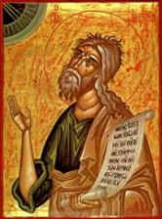
Joel 2:2
“A day of darkness and gloom, A day of clouds and thick darkness. As the dawn is spread over the mountains, So there is a great and mighty people; There has never been anything like it, Nor will there be again after it To the years of many generations.”

Slide 84
Jeremiah 30:7
“Alas! for that day is great, There is none like it; And it is the time of Jacob’s distress (Gen. 32:8; 35:10), But he will be saved from it.”

Slide 85
Daniel 12:1
“Now at that time Michael, the great prince who stands guard over the sons of your people, will arise. And there will be a time of distress such as never occurred since there was a nation until that time; and at that time your people, everyone who is found written in the book, will be rescued.”

Slide 86
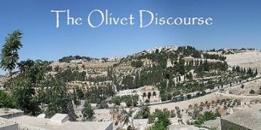
Matthew 24:21-22
“²¹ For then there will be a great tribulation, such as has not occurred since the beginning of the world until now, nor ever will. ²² Unless those days had been cut short, no life would have been saved; but for the sake of the elect those days will be cut short.”

Slide 87
Isaiah 26:19-20
“¹⁹ Your dead will live; Their corpses will rise. You who lie in the dust, awake and shout for joy, For your dew is as the dew of the dawn, And the earth will give birth to the departed spirits. ²⁰ Come, my people, enter into your rooms And close your doors behind you; Hide for a little while. ²¹ For behold, the Lord is about to come out from His place To punish the inhabitants of the earth for their iniquity; And the earth will reveal her bloodshed And will no longer cover her slain.”

Slide 88
Zechariah 13:8-9
⁸“It will come about in all the land,” Declares the Lord, “That two parts in it will be cut off and perish; But the third will be left in it. ⁹“And I will bring the third part through the fire, Refine them as silver is refined, And test them as gold is tested. They will call on My name, And I will answer them; I will say, ‘They are My people,’ And they will say, ‘The Lord is my God.’ ”

Slide 89
Daniel 12:1-2
“¹ Now at that time Michael, the great prince who stands guard over the sons of your people, will arise. And there will be a time of distress such as never occurred since there was a nation until that time; and at that time your people, everyone who is found written in the book, will be rescued. ² Many of those who sleep in the dust of the ground will awake, these to everlasting (olam) life, but the others to disgrace and everlasting (olam) contempt.”

Slide 90
Revelation 20:4-6
“⁴ Then I saw thrones, and they sat on them, and judgment was given to them. And I saw the souls of those who had been beheaded because of their testimony of Jesus and because of the word of God, and those who had not worshiped the beast or his image, and had not received the mark on their forehead and on their hand; and they came to life [zaō] and reigned with Christ for a thousand years. ⁵ The rest of the dead did not come to life [zaō] until the. . .

Slide 91
Revelation 20:4-6
…thousand years were completed. This is the first resurrection [anastasis and not palingenesia]. ⁶ Blessed and holy is the one who has a part in the first resurrection [anastasis and not palingenesia]; over these the second death has no power, but they will be priests of God and of Christ and will reign with Him for a thousand years.”

Slide 93
Isaiah 26:19-20
“¹⁹ Your dead will live; Their corpses will rise. You who lie in the dust, awake and shout for joy, For your dew is as the dew of the dawn, And the earth will give birth to the departed spirits. ²⁰ Come, my people, enter into your rooms And close your doors behind you; Hide for a little while.”

Slide 94
CONCLUSION

Slide 95
MAIL BAG
Will the Rapture occur on a Hebrew feast day?
Is Isaiah 26:19-20 speaking of the Rapture?

