Slide 1
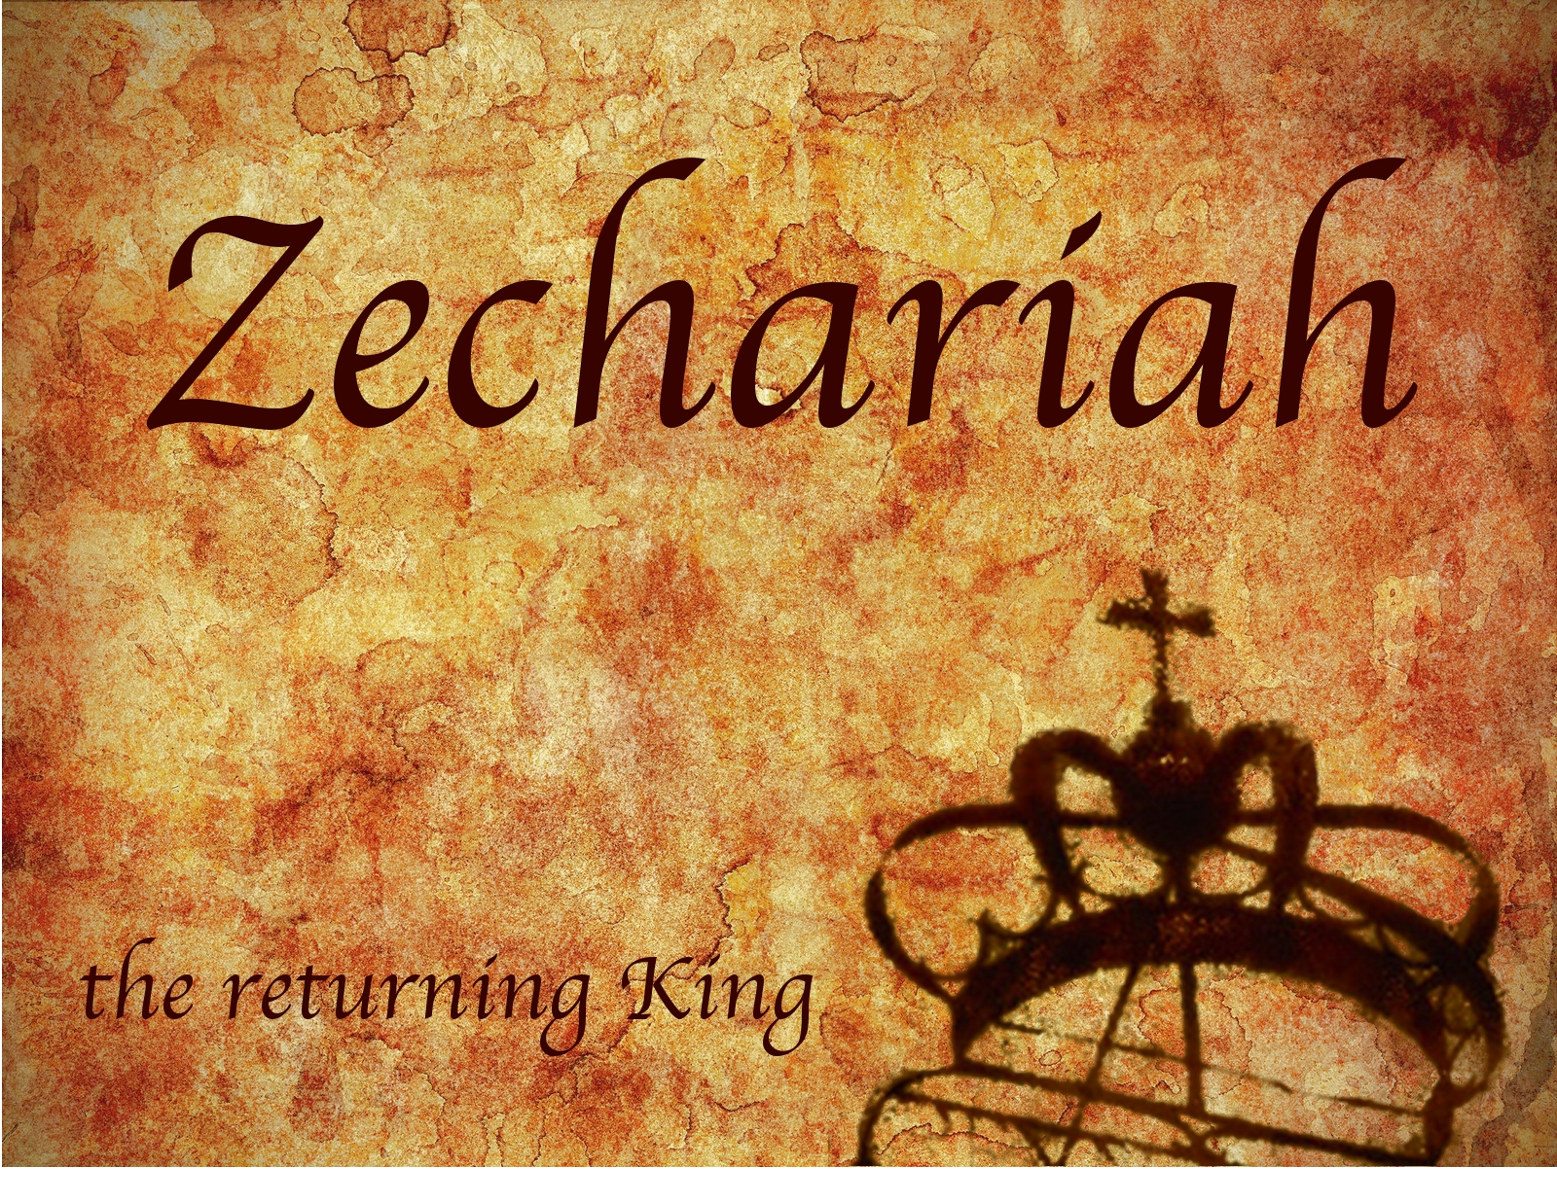
Zechariah
God Remembers!

Slide 2
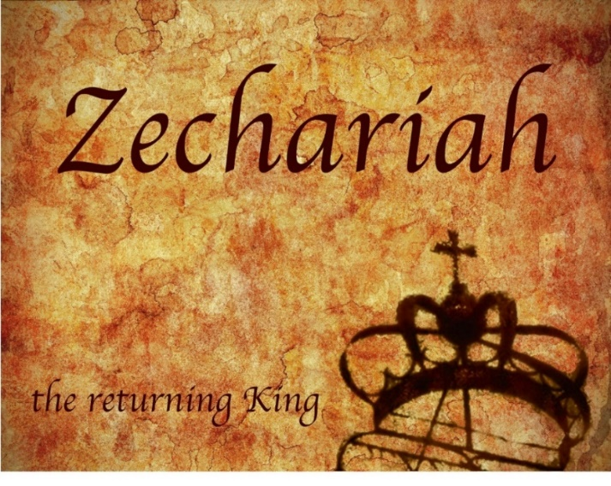
Structure
Introductory call to repentance (1:1-6)
Eight-night visions (1:7–6:15)
Question and answers about fasting (7–8)
Two burdens (9–14)

Slide 3
II. Eight Night Visions (1:7‒6:15)
Riders & horses among the myrtle trees (1:7-17)
Four horns & four craftsmen (1:18-21)
Man with the measuring line (2)
Cleansing of the High Priest Joshua (3)
Lampstand & olive tree (4)
Flying scroll (5:1-4)
Woman in the basket (5:5-11)
Four chariots (6:1-8)
Conclusion: crowning of Joshua (6:9-15)

Slide 4
ZECHARIAH’S EIGHT NIGHT VISIONS
Vision | Reference | Meaning
The Red-horse Rider among the Myrtles | 1:7-17 | God’s anger against the nations & blessing on restored Israel.
The Four Horns & the Four Craftsmen | 1:18-21 | God’s judgement on the nations that afflict Israel.
The Surveyor with a Measuring Line | Chapter 2 | God’s future blessing on restored Israel.
The Cleansing & Crowning of Joshua the Hight Priest. | Chapter 3 | Israel’s future cleansing from sin & reinstatement as a priestly nation.
The Golden Lampstand & the Two Olive Trees | Chapter 4 | Israel as the light to the nations under Messiah, the King-Priest.
The Flying Scroll | 5:1-4 | The severity & totality of divine judgment on individual Israelites.
The Woman in the Ephah | 5:5-11 | The removal of national Israel’s sin of rebellion against God.
The Four Chariots | 6:1-8 | Divine judgment on Gentile nations.

Slide 5
4. The Cleansing & Coronation of Joshua the High Priest (3:1-10)
Stages of Joshua’s Cleansing (1-5)
Satan’s condemnation (1)
God’s rebuke (2)
Joshua’s cleansing (3-5)
Jerusalem’s Future Cleansing (6-10)
King-Priest (6-7)
Future Branch (8)
Cleansing (9)
Peace (10)

Slide 6
4. The Cleansing & Coronation of Joshua the High Priest (3:1-10)
Stages of Joshua’s Cleansing (1-5)
Satan’s condemnation (1)
God’s rebuke (2)
Joshua’s cleansing (3-5)
Jerusalem’s Future Cleansing (6-10)
King-Priest (6-7)
Future Branch (8)
Cleansing (9)
Peace (10)

Slide 7
4. The Cleansing & Coronation of Joshua the High Priest (3:1-10)
Stages of Joshua’s Cleansing (1-5)
Satan’s condemnation (1)
God’s rebuke (2)
Joshua’s cleansing (3-5)
Jerusalem’s Future Cleansing (6-10)
King-Priest (6-7)
Future Branch (8)
Cleansing (9)
Peace (10)

Slide 8
4. The Cleansing & Coronation of Joshua the High Priest (3:1-10)
Stages of Joshua’s Cleansing (1-5)
Satan’s condemnation (1)
God’s rebuke (2)
Joshua’s cleansing (3-5)
Jerusalem’s Future Cleansing (6-10)
King-Priest (6-7)
Future Branch (8)
Cleansing (9)
Peace (10)

Slide 9
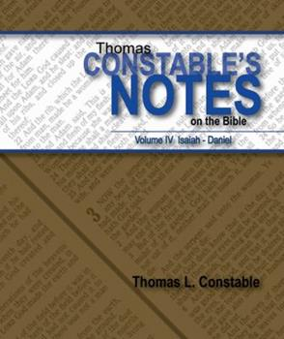
Thomas L. Constable
Constable’s online notes on Zechariah, p. 40.
“The Lord then referred to Joshua as a burning stick ‘plucked from the fire,’ evidently for His future use (cf. Amos 4:11). If Joshua represents Israel, then the fire must refer to the Babylonian Captivity from which Israel had emerged almost destroyed, and the stick refers to the surviving remnant. Israel had experienced another brush with extinction at the Exodus (Deut. 4:20; 7:7-8; Jer. 11:4), and she will do so again in the Tribulation (13:8-9; Jer. 30:7; Rev. 12:13-17).”

Slide 10
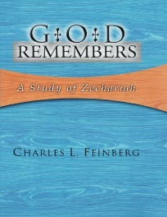
Charles L. Feinberg
God Remembers: A Study of Zechariah (Wheaton: Van Kampen, 1950, p. 57.
“For the figure of the brand plucked from the fire we can be referred to Amos 4:11. It is most meaningful here. It speaks of Israel snatched from the Babylonian Captivity, for the wrath and fire of God have not been permitted to do their complete work of destruction.…Would Jehovah have delivered Israel from Babylon, if his ultimate purpose was to destroy her?”

Slide 11
Charles L. Feinberg
God Remembers: A Study of Zechariah (Wheaton: Van Kampen, 1950, p. 57.
“Since God has done so much, not only is His love proved, but the continuance of it is assured and guaranteed. A piece of timber is rescued from fire only when it’s possessor sees further purposes in it. Similarly, God’s plan for Israel did not close with the captivity of the southern kingdom and the deportation to Babylon. His love sought her out yet once more.”

Slide 12
4. The Cleansing & Coronation of Joshua the High Priest (3:1-10)
Stages of Joshua’s Cleansing (1-5)
Satan’s condemnation (1)
God’s rebuke (2)
Joshua’s cleansing (3-5)
Jerusalem’s Future Cleansing (6-10)
King-Priest (6-7)
Future Branch (8)
Cleansing (9)
Peace (10)

Slide 13
1 Corinthians 15:21-22
“²¹ For since by a man came death, by a man also came the resurrection of the dead. ²² For as in Adam all die, so also in Christ all will be made alive.”

Slide 14
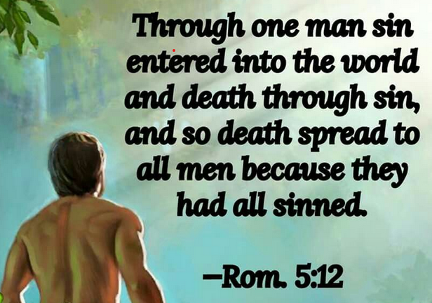
Romans 5:12
“Therefore, just as through one man sin entered into the world, and death through sin, and so death spread to all men, because all sinned—.”

Slide 15
Kenneth L. Barker
Kenneth L. Barker "Zechariah." In Daniel-Minor Prophets. Vol. 7 of The Expositor's Bible Commentary. 12 vols. Edited by Frank E. Gaebelein and Richard P. Polcyn. Grand Rapids: Zondervan Publishing House, 1985. Page 624
“Theologically, however, there also seems to be a picture here of the negative aspect of what God does when he saves a person. Negatively, he takes away sin. Positively, he adds or imputes to the sinner saved by grace his own divine righteousness (cf. v. 5).”

Slide 16
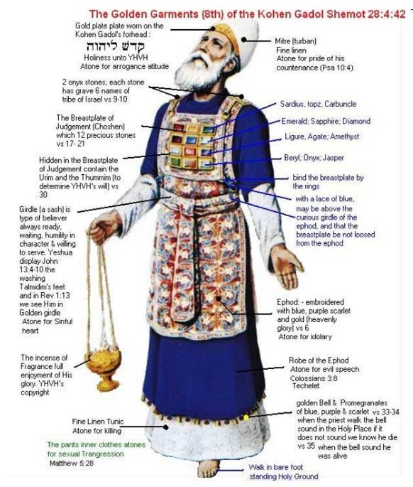

Slide 17
4. The Cleansing & Coronation of Joshua the High Priest (3:1-10)
Stages of Joshua’s Cleansing (1-5)
Satan’s condemnation (1)
God’s rebuke (2)
Joshua’s cleansing (3-5)
Jerusalem’s Future Cleansing (6-10)
King-Priest (6-7)
Future Branch (8)
Cleansing (9)
Peace (10)

Slide 18
4. The Cleansing & Coronation of Joshua the High Priest (3:1-10)
Stages of Joshua’s Cleansing (1-5)
Satan’s condemnation (1)
God’s rebuke (2)
Joshua’s cleansing (3-5)
Jerusalem’s Future Cleansing (6-10)
King-Priest (6-7)
Future Branch (8)
Cleansing (9)
Peace (10)

Slide 19
Isaiah 9:6-7
^{6 “}For a child will be born to us, a son will be given to us; And the government will rest on His shoulders; And His name will be called Wonderful Counselor, Mighty God, Eternal Father, Prince of Peace.⁷ There will be no end to the increase of His government or of peace, The zeal of the Lord of hosts will accomplish this. On the throne of David and over his kingdom, To establish it and to uphold it with justice and righteousness From then on and forevermore.”

Slide 20
4. The Cleansing & Coronation of Joshua the High Priest (3:1-10)
Stages of Joshua’s Cleansing (1-5)
Satan’s condemnation (1)
God’s rebuke (2)
Joshua’s cleansing (3-5)
Jerusalem’s Future Cleansing (6-10)
King-Priest (6-7)
Future Branch (8)
Cleansing (9)
Peace (10)

Slide 21
4. The Cleansing & Coronation of Joshua the High Priest (3:1-10)
Stages of Joshua’s Cleansing (1-5)
Satan’s condemnation (1)
God’s rebuke (2)
Joshua’s cleansing (3-5)
Jerusalem’s Future Cleansing (6-10)
King-Priest (6-7)
Future Branch (8)
Cleansing (9)
Peace (10)

Slide 22
Thomas L. Constable
Constable’s online notes on Zechariah, p. 43-44.
“Zechariah also saw in the vision a ‘stone … set’ in front of Joshua. The stone, too, is a common figure of God and Messiah in the Bible (10:4; Exod. 17:6; Num. 20:7-11; Ps. 118:22; et al.). In the past, God had promised that ‘the Stone’ would be a secure, never-failing refuge for His people (Isa. 28:16; 1 Pet. 2:6). When Messiah appeared, however, He proved to be a ‘stone’ over which the Jews ‘stumbled,’ and an offensive ‘rock’ to them that they ‘rejected’ (Ps. 118:22-23; Isa. 8:13- 15; Matt. 21:42; 1 Pet. 2:7-8).”

Slide 23
Thomas L. Constable
Constable’s online notes on Zechariah, p. 43-44.
“Presently He is the ‘foundation stone,’ the ‘chief cornerstone’ of the church (Eph. 2:19-22). And in the future, He will be the ‘great stone’ that ‘smites the nations’ (Dan. 2:35, 45)…The stone that Zechariah saw had ‘seven eyes’ (Heb. 'ayin), probably symbolizing its complete, divine intelligence (omniscience; cf. 1:10; 4:10; 2 Chron. 16:9; Isa. 11:2; Ezek. 1:18; 10:12; Col. 2:3, 9; Rev. 5:6).”

Slide 24
Charles L. Feinberg
God Remembers: A Study of Zechariah (Wheaton: Van Kampen, 1950, p. 65-66.
“Why is the Messiah called the Stone? It relates Him to Israel. To them He was the stumbling stone and rock of offense (Isa. 8:14). But to those in Israel who trusted Him, He was a never failing refuge (Isa. 28:16). The Stone relates Christ to the nations. He will be the destroyer of the godless world-monarchies (Dan. 2:35). The Stone connects Christ with the Church. He is her foundation and top-stone (Psa. 118:22; Eph. 2:20–22).”

Slide 25
Charles L. Feinberg
God Remembers: A Study of Zechariah (Wheaton: Van Kampen, 1950, p. 65-66.
“The designation relates the Messiah to God. He is the Stone made without hands, the one who is called the Tabernacle which God pitched, not man (Dan. 2:34). The Stone speaks of the beauty of the Son of God (Zech. 3:9)…The Stone reveals Him to be the dependable rock, fortress, high tower of the trusting soul…The stone relates Him to the Spirit of God, for the seven eyes are symbolic of manifold intelligence and omniscience (Isa. 11:2; Rev. 5:6).”

Slide 26
Ezekiel 36:24-28
²⁴ “For I will take you from the nations, gather you from all the lands and bring you into your own land. ²⁵ Then I will sprinkle clean water on you, and you will be clean; I will cleanse you from all your filthiness and from all your idols. ²⁶ Moreover, I will give you a new heart and put a new spirit within you; and I will remove the heart of stone from your flesh and give you a heart of flesh. ²⁷ I will put My Spirit within you and cause you to walk in My statutes, and you will be careful to observe My ordinances. ²⁸ You will live in the land that I gave to your forefathers; so you will be My people, and I will be your God.”

Slide 27
Ezekiel 37:7-11
⁷ So I prophesied as I was commanded; and as I prophesied, there was a noise, and behold, a rattling; and the bones came together, bone to its bone. ⁸ And I looked, and behold, sinews were on them, and flesh grew and skin covered them; but there was no breath in them. ⁹ Then He said to me, “Prophesy to the breath, prophesy, son of man, and say to the breath, ‘Thus says the Lord God, “Come from the four winds, O breath, and breathe on these slain, that they . . .

Slide 28
Ezekiel 37:7-11
... come to life.”’” ¹⁰ So I prophesied as He commanded me, and the breath came into them, and they came to life and stood on their feet, an exceedingly great army. ¹¹ Then He said to me, “Son of man, these bones are the whole house of Israel; behold, they say, ‘Our bones are dried up and our hope has perished. We are completely cut off’.”

Slide 29
ISRAEL’S TWO REGATHERINGS
THE PRESENT (FIRST) REGATHERING | THE PERMANENT (SECOND) REGATHERING
Return to part of the land | Return to all the land
Return in unbelief | Return in faith
Restored to the land only | Restored to the land and the Lord
Sets the stage for Tribulation (discipline) | Sets the stage for Millennium (blessing)
Adapted from: Price, Jerusalem In Prophecy, 219

Slide 30
Levitical Feasts (Leviticus 23)
Feast | Season | Purpose | Type
Passover | Spring | Redemption | 1 Cor 5:7
Unleavened Bread | Spring | Separation | John 6:35
1st fruits | Spring | Praise | 1 Cor 15:20
Pentecost | Spring | Praise | Acts 2:1-4
Trumpets | Fall | New Year | Matt 24:31
Atonement | Fall | Lev 16 | Zech 12:10
Booths | Fall | Wilderness provision | Zech 14:16-18

Slide 31
Zechariah 12:10
“I will pour out on the house of David and on the inhabitants of Jerusalem, the Spirit of grace and of supplication, so that they will look on Me whom they have pierced; and they will mourn for Him, as one mourns for an only son, and they will weep bitterly over Him like the bitter weeping over a firstborn.”

Slide 32
Charles L. Feinberg
God Remembers: A Study of Zechariah (Wheaton: Van Kampen, 1950, p. 66.
“Most Christian expositors claim it is the day of Calvary, but it must look beyond that to a day when Israel in a time of national atonement and repentance will have ratified for her in her national life actually, that which was rotted out potentially and provisionally at Calvary.”

Slide 33
4. The Cleansing & Coronation of Joshua the High Priest (3:1-10)
Stages of Joshua’s Cleansing (1-5)
Satan’s condemnation (1)
God’s rebuke (2)
Joshua’s cleansing (3-5)
Jerusalem’s Future Cleansing (6-10)
King-Priest (6-7)
Future Branch (8)
Cleansing (9)
Peace (10)

Slide 34
Isaiah 65:21–22
²¹ “They will build houses and inhabit them; They will also plant vineyards and eat their fruit. ²² “They will not build and another inhabit, They will not plant and another eat; For as the lifetime of a tree, so will be the days of My people, And My chosen ones will wear out the work of their hands.

Slide 35
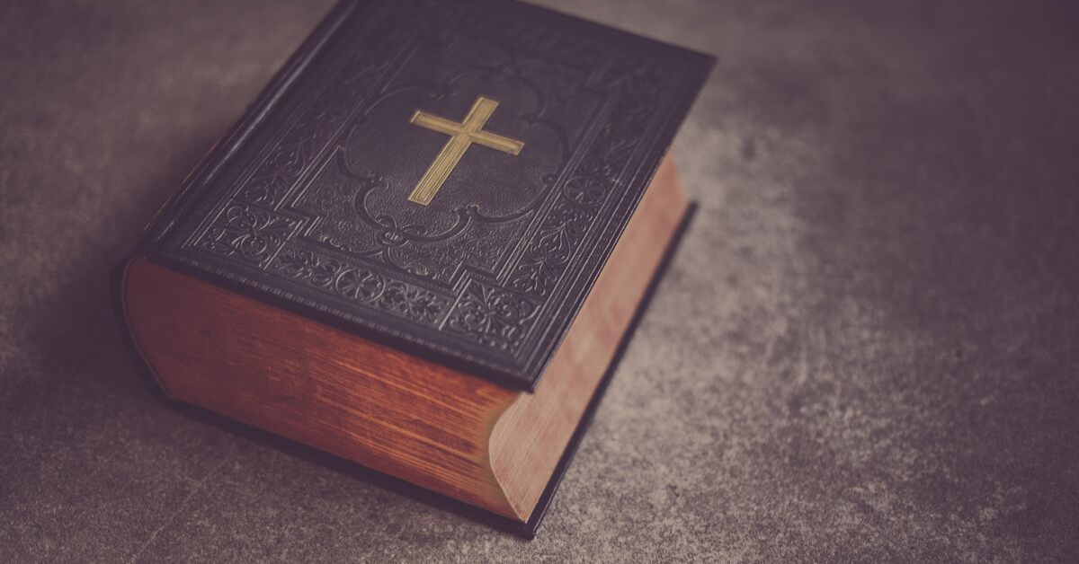
George Washington’s Favorite Verse Peter A. Lillback and Jerry Newcombe, George Washington's Sacred Fire (Bryn Mawr, PA: Providence Forum, 2006), 316-17.
“Probably, George's Washington's favorite biblical allusion referred to each sitting under his own vine and fig tree. Washington used this phrase more than forty times in his writings. It comes from Micah chapter 4, verse 4: ‘But they shall sit every man under his vine and under his fig tree; and none shall make them afraid: for the mouth of the Lord of hosts hath spoken it.’ He saw the new nation and especially his own Mount Vernon as places where each citizen, including himself, could enjoy the fruit of his own labor without fear of government intrusion.”

Slide 36
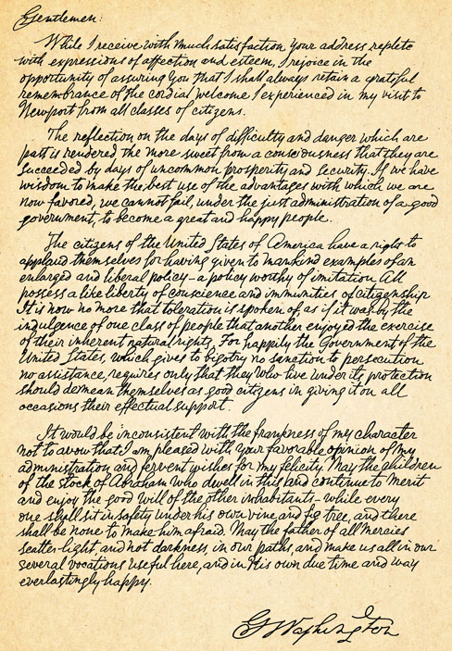
George Washington’s Letter to the Hebrew Congregation of Newport, Rhode Island, August 18, 1790
"I rejoice in the opportunity of assuring you, that I shall always retain a grateful remembrance of the cordial welcome I experienced in my visit to Newport... the Government of the United States, which gives to bigotry no sanction, to persecution no assistance...May the Children of the Stock of Abraham, who dwell in this land, continue to merit and enjoy the good will of the other Inhabitants; while every one shall sit in safety under his own vine and fig tree, and there shall be none to make him afraid."

Slide 37
Conclusion

Slide 38
4. The Cleansing & Coronation of Joshua the High Priest (3:1-10)
Stages of Joshua’s Cleansing (1-5)
Satan’s condemnation (1)
God’s rebuke (2)
Joshua’s cleansing (3-5)
Jerusalem’s Future Cleansing (6-10)
King-Priest (6-7)
Future Branch (8)
Cleansing (9)
Peace (10)

Slide 39
II. Eight Night Visions (1:7‒6:15)
Riders & horses among the myrtle trees (1:7-17)
Four horns & four craftsmen (1:18-21)
Man with the measuring line (2)
Cleansing of the High Priest Joshua (3)
Lampstand & olive tree (4)
Flying scroll (5:1-4)
Woman in the basket (5:5-11)
Four chariots (6:1-8)
Conclusion: crowning of Joshua (6:9-15)

