Slide 1
THE RAPTURE
What and When? – Part 67
Andrew Marshall Woods, Th.M., JD., PhD.
Sr. Pastor, Sugar Land Bible Church

Slide 2
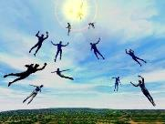
The Rapture Course Overview
What is the Rapture?
When is the Rapture?
Strengthening the Pre-Tribulational case
The opposing views
One second after the Rapture
Questions & Answers

Slide 3
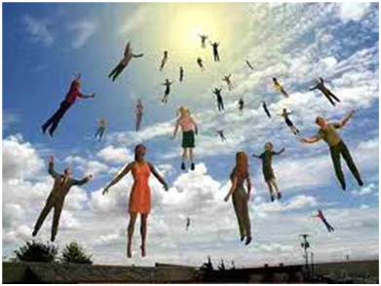
MAIL BAG
Will the Rapture occur on a Hebrew feast day?
Is Isaiah 26:19-20 speaking of the Rapture?

Slide 4
MAIL BAG
Will the Rapture occur on a Hebrew feast day?
Is Isaiah 26:19-20 speaking of the Rapture?

Slide 5
Levitical Feasts (Leviticus 23)
Feast | Season | Purpose | Type
Passover | Spring | Redemption | 1 Cor 5:7
Unleavened Bread | Spring | Separation | John 6:35
1st fruits | Spring | Praise | 1 Cor 15:20
Pentecost | Spring | Praise | Acts 2:1-4
Trumpets | Fall | New Year | Matt 24:31
Atonement | Fall | Lev 16 | Zech 12:10
Booths | Fall | Wilderness provision | Zech 14:16-18

Slide 6
Levitical Feasts (Leviticus 23)
Feast | Season | Purpose | Type
Passover | Spring | Redemption | 1 Cor 5:7
Unleavened Bread | Spring | Separation | John 6:35
1st fruits | Spring | Praise | 1 Cor 15:20
Pentecost | Spring | Praise | Acts 2:1-4
Trumpets | Fall | New Year | Matt 24:31
Atonement | Fall | Lev 16 | Zech 12:10
Booths | Fall | Wilderness provision | Zech 14:16-18

Slide 7
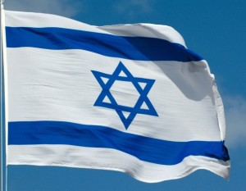
Matthew 24:31
³¹ “And He will send His angels with a great sound of a trumpet, and they will gather together His elect from the four winds, from one end of heaven to the other.”

Slide 8
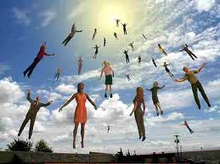
6. Rapture on a Feast Day?
Denies imminency
Places Church under the Mosaic Law
Misunderstands the nature of the Church
Why did the Church begin on Pentecost?

Slide 9
6. Rapture on a Feast Day?
Denies imminency
Places Church under the Mosaic Law
Misunderstands the nature of the Church
Why did the Church begin on Pentecost?

Slide 10
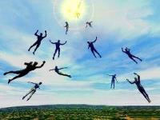
Imminent (1 Cor 15:51; 1 Thess 4:15)
Imminency definition
James 5:8; 1 Thess 1:10; 1 Cor 1:7; Philip 3:20
We are to be looking for Jesus Christ and not the Antichrist!
Motivator (Holiness, Evangelism)
Feast of Trumpets?

Slide 11
John 14:1–4
¹ “Do not let your heart be troubled; believe in God, believe also in Me. ² “In My Father’s house are many dwelling places; if it were not so, I would have told you; for I go to prepare a place for you. ³ “If I go and prepare a place for you, I will come again and receive you to Myself, that where I am, there you may be also. ⁴ “And you know the way where I am going.”

Slide 12
1 Corinthians 15:51
“Behold, I tell you a mystery; we will not all sleep, but we will all be changed.”

Slide 13
Imminent (1 Cor 15:51; 1 Thess 4:15)
Imminency definition
James 5:8; 1 Thess 1:10; 1 Cor 1:7; Philip 3:20
We are to be looking for Jesus Christ and not the Antichrist!
Motivator (Holiness, Evangelism)
Feast of Trumpets?

Slide 14
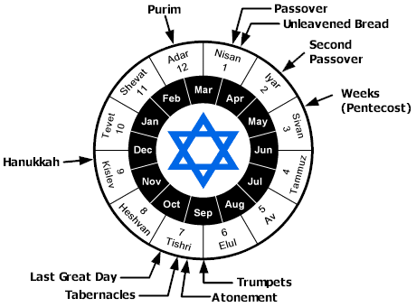

Slide 15
6. Rapture on a Feast Day?
Denies imminency
Places Church under the Mosaic Law
Misunderstands the nature of the Church
Why did the Church begin on Pentecost?

Slide 16
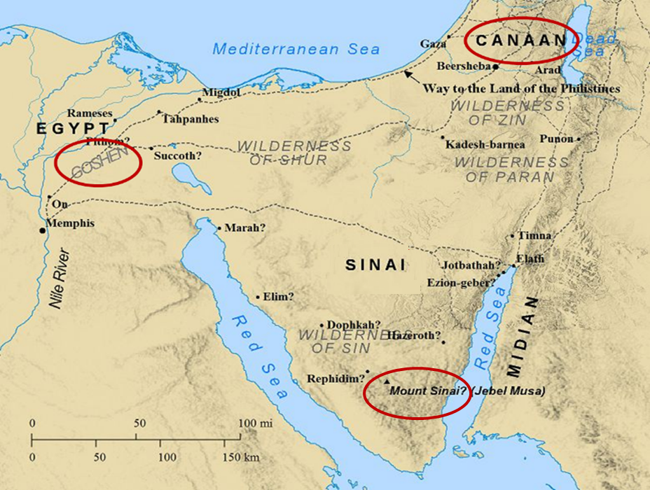

Slide 17
Levitical Feasts (Leviticus 23)
Feast | Season | Purpose | Type
Passover | Spring | Redemption | 1 Cor 5:7
Unleavened Bread | Spring | Separation | John 6:35
1st fruits | Spring | Praise | 1 Cor 15:20
Pentecost | Spring | Praise | Acts 2:1-4
Trumpets | Fall | New Year | Matt 24:31
Atonement | Fall | Lev 16 | Zech 12:10
Booths | Fall | Wilderness provision | Zech 14:16-18

Slide 18
Psalm 147:19-20
“He declares His words to Jacob, His statutes and His ordinances to Israel. He has not dealt thus with any nation; And as for His ordinances, they have not known them. Praise the Lord!”

Slide 19
Ephesians 2:14-16
¹⁴ “For He Himself is our peace, who made both groups into one and broke down the barrier of the dividing wall, ¹⁵ by abolishing in His flesh the enmity, which is the Law of commandments contained in ordinances, so that in Himself He might make the two into one new man, thus establishing peace, ¹⁶ and might reconcile them both in one body to God through the cross, by it having put to death the enmity.”

Slide 20
1 Corinthians 10:32
“Give no offense, either to the Jews or to the Greeks or to the church of God.”

Slide 21
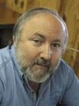
Arnold G. Fruchtenbaum “Israel and the Church,” in Issues in Dispensationalism, ed. Wesley R. Willis and John R. Master (Chicago: Moody, 1994), 118.
“In the book of Acts, both Israel and the church exist simultaneously. The term Israel is used twenty times and ekklēsia (church) nineteen times, yet the two groups are always kept distinct.”

Slide 22
6. Rapture on a Feast Day?
Denies imminency
Places Church under the Mosaic Law
Misunderstands the nature of the Church
Why did the Church begin on Pentecost?

Slide 23
5. Discontinuity Between Israel & the Church
 | ISRAEL | CHURCH
Marriage | Wife | Bride
Christ | Birthed Christ | Birthed by Christ
Return | 2nd advent | Rapture
Leader | King | Head, Groom
Beginning | Gen 12 | Acts 2
Scripture | 4/5 | 1/5
Covenants | Parties | Beneficiaries
Nation | Political | Spiritual

Slide 24
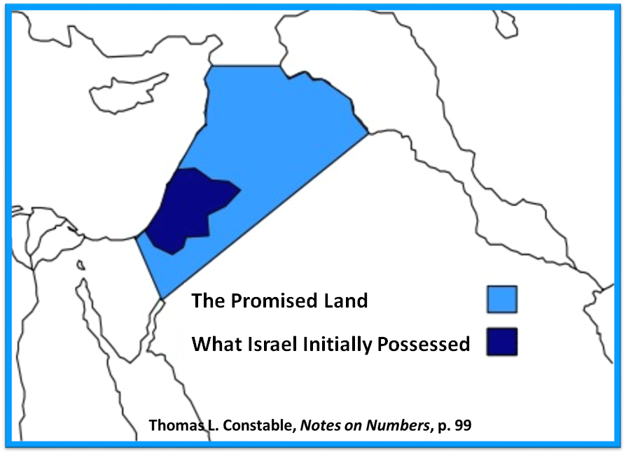

Slide 26
Romans 10:19
But I say, surely Israel did not know, did they? First Moses says, “I will make you jealous by that which is not a nation, By a nation without understanding will I anger you.”

Slide 27
Galatians 3:28
There is neither Jew nor Greek, there is neither slave nor free man, there is neither male nor female; for you are all one in Christ Jesus.

Slide 28
5. Discontinuity Between Israel & the Church
 | ISRAEL | CHURCH
Wars | Political | Spiritual
Timing | A quo / ad quem | No time indicators
Priesthood | Have a priesthood | Are a priesthood
Temple | Physical | Body
Resurrection | 1st resurrection | Rapture
Judgment | Earthly (Ezek. 20:33-44) | Heavenly (Bema)
New Jerusalem | Gates | Foundations
Entrance | Physical birth | Spiritual birth

Slide 32
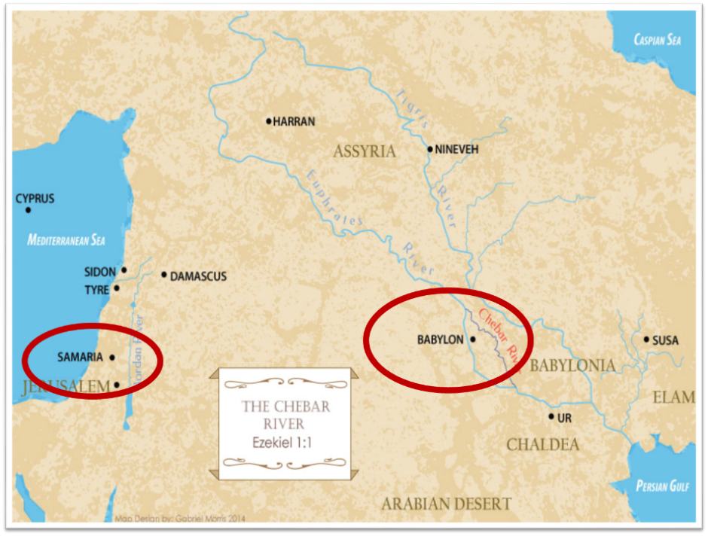

Slide 34
Levitical Feasts (Leviticus 23)
Feast | Season | Purpose | Type
Passover | Spring | Redemption | 1 Cor 5:7
Unleavened Bread | Spring | Separation | John 6:35
1st fruits | Spring | Praise | 1 Cor 15:20
Pentecost | Spring | Praise | Acts 2:1-4
Trumpets | Fall | New Year | Matt 24:31
Atonement | Fall | Lev 16 | Zech 12:10
Booths | Fall | Wilderness provision | Zech 14:16-18

Slide 36
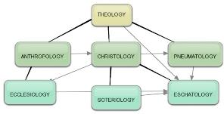
Areas of Systematic Theology
Prolegomena – Introduction
Theology – Study of God
Christology – Study of Christ
Pneumatology – Study of the Holy Spirit
Anthropology – Study of Man
Hamartiology – Study of sin
Soteriology – Study of salvation
Angelology – Study of angels
Ecclesiology – Study of the Church
Eschatology – Study of the end

Slide 37
6. Rapture on a Feast Day?
Denies imminency
Places Church under the Mosaic Law
Misunderstands the nature of the Church
Why did the Church begin on Pentecost?

Slide 38
When Did the Church Begin?
Christ referred to the Church in the future tense (Matt. 16:18)
Paul referred to the Church as a “mystery” (Eph. 3:4-5, 9)
The Church did not exist prior to Acts 1 since Christ became the head of the Church (Eph. 5:23) after His Ascension (Eph. 1:20-22)
The Church did not exist prior to Acts 1 since spiritual gifts (1 Cor. 12:7; 14:26) only came into existence after His Ascension (Eph. 4:7-11)

Slide 39
When Did the Church Begin?
The Church existed before Paul’s conversion in Acts 9 (Acts 5:11; 8:1,3; Rom. 16:7)
The Baptizing (joining, uniting, identifying) ministry of the Holy Spirit began in Acts 2
1 Cor. 12:13
Acts 1:5
Acts 11:15-16
Acts 2:1-4, 37-41

Slide 41
Levitical Feasts (Leviticus 23)
Feast | Season | Fulfillment | Rejected
Passover | Spring | John 1:29 | John 1:11
Unleavened Bread | Spring | John 6:35 | John 6:41
1st fruits | Spring | 1 Cor. 15:20 | Matt. 28:11-15
Pentecost | Spring | Joel 2:28-32 | Acts 2:13; 1 Cor. 14:22
Trumpets | Fall | New Year | Matt 24:31
Atonement | Fall | Lev 16 | Zech. 12:10
Booths | Fall | Wilderness provision | Zech. 14:16-18

Slide 42
Act 3:19-21
“¹⁹ Therefore repent and return, so that your sins may be wiped away, in order that times of refreshing may come from the presence of the Lord; ²⁰ and that He may send Jesus, the Christ appointed for you, ²¹ whom heaven must receive until the period of restoration of all things about which God spoke by the mouth of His holy prophets from ancient time.”

Slide 43
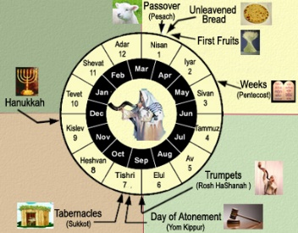
Terry Hulbert Terry C. Hulbert, The Eschatological Significance of Israel's Annual Feasts. Doctoral Dissertation. Dallas Theological Seminary. 1965. Pages 2, 115-116.
“When God fulfilled the first four feasts, He had provided everything necessary for Israel to enter into literal kingdom blessing‒redemption, separation, resurrection, and the presence of the Holy Spirit. Israel’s rejection of these, however, made a necessary national change of heart before the kingdom could be established…The paschal lamb of God pointed out by John the Baptist was rejected as an imposter. The resurrection of Christ, as it answered to the Feast of First Fruits, was suppressed in it’s proclamation by the bribe money paid to the sentries…Finally, the coming of the Spirit was rejected at Pentecost as the Jews…

Slide 44
Terry Hulbert Terry C. Hulbert, The Eschatological Significance of Israel's Annual Feasts. Doctoral Dissertation. Dallas Theological Seminary. 1965. Pages 2, 115-116.
…taunted the apostles with charges of drunkenness. By the time of the close of Acts chapter 2, God had done all He could do for Israel until they repented as a nation. Thus, the significance of Peter’s second sermon in Acts 3 was that it re-emphasized the condition of millennial blessing already laid down in the Old Testament, but as yet unfulfilled...Of the upmost importance here is the fact that the shedding of the blood of Christ to take away sin, and with the coming of the Spirit to empower the life of the redeemed, all of the spiritual requirements for the millennial kingdom had been met as far as God was concerned….

Slide 45
Terry Hulbert Terry C. Hulbert, The Eschatological Significance of Israel's Annual Feasts. Doctoral Dissertation. Dallas Theological Seminary. 1965. Pages 2, 115-116.
…But, God‘s provision could not be operative until man appropriated it. This point cannot be over emphasized, for it is not only the reason for the delay in the fulfillment of the final three feasts, it is the basis for understanding the relationship of the church to the feasts.”

Slide 46
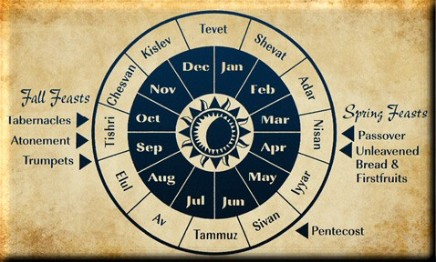

Slide 47
Levitical Feasts (Leviticus 23)
Feast | Season | Purpose | Type
Passover | Spring | Redemption | 1 Cor 5:7
Unleavened Bread | Spring | Separation | John 6:35
1st fruits | Spring | Praise | 1 Cor 15:20
Pentecost | Spring | Praise | Acts 2:1-4
Trumpets | Fall | New Year | Matt 24:31
Atonement | Fall | Lev 16 | Zech 12:10
Booths | Fall | Wilderness provision | Zech 14:16-18

Slide 48
Matthew 24:31
³¹ “And He will send His angels with a great sound of a trumpet, and they will gather together His elect from the four winds, from one end of heaven to the other.”

Slide 49
Zechariah 12:10
“I will pour out on the house of David and on the inhabitants of Jerusalem, the Spirit of grace and of supplication, so that they will look on Me whom they have pierced; and they will mourn for Him, as one mourns for an only son, and they will weep bitterly over Him like the bitter weeping over a firstborn.”

Slide 50
Zechariah 14:16-18
“Then it will come about that any who are left of all the nations that went against Jerusalem will go up from year to year to worship the King, the Lord of hosts, and to celebrate the Feast of Booths. ¹⁷ And it will be that whichever of the families of the earth does not go up to Jerusalem to worship the King, the Lord of hosts, there will be no rain on them. ¹⁸ If the family of Egypt does not go up or enter, then no rain will fall on them; it will be the plague with which the Lord smites the nations who do not go up to celebrate the Feast of Booths.”

Slide 51
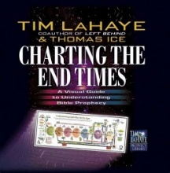
Thomas D. Ice Thomas D. Ice, "The Feasts of Israel in Prophecy," in Charting the End Times: A Visual Guide to Understanding Bible Prophecy, ed. Time LaHaye and Thomas Ice (Eugene, OR: Harvest House, 2001), 103-104.
“The three fall feasts await fulfillment in the events that will take place at the Second Coming of Christ and in the Millennium. The Feast of Trumpets will take place at the Second Coming, as Matthew 24:31 indicates: ‘He will send forth his angels with a great trumpet and they will gather together His elect from the four winds, from one end of the sky to the other.’ The Day of Atonement will be applied to the nation of Israel when the people realize that Jesus was their long-awaited Messiah all along (Zechariah 12:10; Romans 11:25–27). And the Feast of Tabernacle’s will be fulfilled by the Millennial kingdom when the Jewish nation will dwell with their God in the land of Israel for 1000 years.”

Slide 52
MAIL BAG
Will the Rapture occur on a Hebrew feast day?
Is Isaiah 26:19-20 speaking of the Rapture?

Slide 53
Isaiah 26:19-20
“¹⁹ Your dead will live; Their corpses will rise. You who lie in the dust, awake and shout for joy, For your dew is as the dew of the dawn, And the earth will give birth to the departed spirits. ²⁰ Come, my people, enter into your rooms And close your doors behind you; Hide for a little while.”

Slide 54
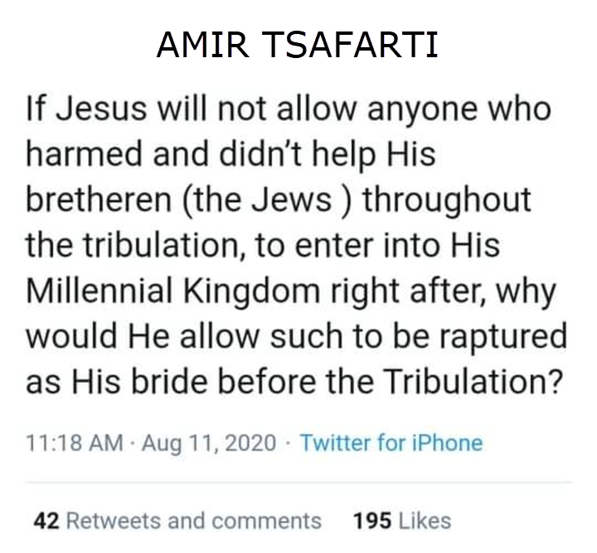

Slide 59
1 Corinthians 15:51
“Behold, I tell you a mystery [mystērion]; we will not all sleep, but we will all be changed.”

Slide 60
John 14:1–4
¹ “Do not let your heart be troubled; believe in God, believe also in Me. ² “In My Father’s house are many dwelling places; if it were not so, I would have told you; for I go to prepare a place for you. ³ “If I go and prepare a place for you, I will come again and receive you to Myself, that where I am, there you may be also. ⁴ “And you know the way where I am going.”

Slide 61
NEW MYSTERY TRUTH
“But here in John 14 the Lord gives a new and unique revelation; He speaks of something which no prophet had promised, or even could promise. Where is it written that this Messiah would come and instead of gathering His saints into an earthly Jerusalem, would take them to the Father's house, to the very place where He is? It is something new.”
Arno C. Gaebelein, The Gospel of John, 268.

Slide 62
Colossians 1:26
“that is, the mystery which has been hidden from the past ages and generations, but has now been manifested to His saints.”

Slide 63
“Mystery” Defined
“In the N.T, it [mystērion] denotes, not the mysterious (as with the Eng. word), but that which, being outside the range of unassisted natural apprehension, can be made known only by Divine revelation, and is made known in a manner and at a time appointed by God, and to those who are illumined by His Spirit.”
W. E. Vine, Merrill F. Unger, and William White, Vine's Complete Expository Dictionary of the Old and New Testament Words (Nashville: Nelson, 1996), 424.

Slide 64
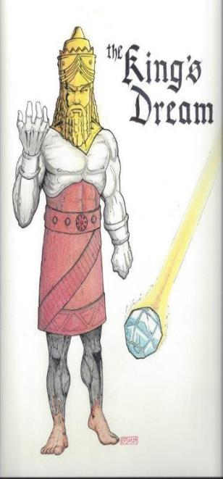
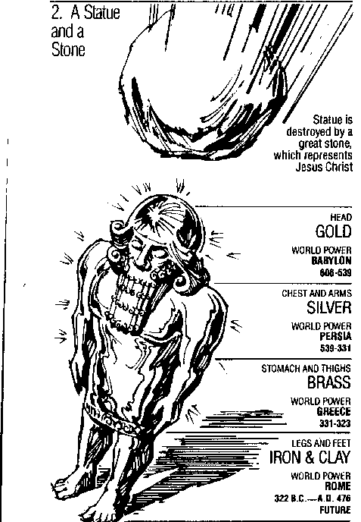
Statue
&
Stone

Slide 65
Daniel 2:18-19, 27-30
“¹⁸ so that they might request compassion from the God of heaven concerning this mystery, so that Daniel and his friends would not be destroyed with the rest of the wise men of Babylon. ¹⁹ Then the mystery was revealed to Daniel in a night vision. Then Daniel blessed the God of heaven;…²⁷ Daniel answered before the king and said, “As for the mystery about which the king has inquired, neither wise men, conjurers, magicians nor diviners are able to declare it to the king. ²⁸ However, there is a God in heaven who mysteries, and He has made known to King Nebuchadnezzar what will take place in the . . .

Slide 66
Daniel 2:18-19, 27-30
. . . latter days. This was your dream and the visions in your mind while on your bed. ²⁹ As for you, O king, while on your bed your thoughts turned to what would take place in the future; and He who reveals mysteries has made known to you what will take place. ³⁰ But as for me, this mystery has not been revealed to me for any wisdom residing in me more than in any other living man, but for the purpose of making the interpretation known to the king, and that you may understand the thoughts of your mind.”

Slide 67
Ephesians 3:3-6
“³ that by revelation there was made known to me the mystery, as I wrote before in brief. ⁴ By referring to this, when you read you can understand my insight into the mystery of Christ, ⁵ which in other generations was not made known to the sons of men, as it has now been revealed to His holy apostles and prophets in the Spirit; ⁶ to be specific, that the Gentiles are fellow heirs and fellow members of the body, and fellow partakers of the promise in Christ Jesus through the gospel”.

Slide 68
Ephesians 3:9
“and to bring to light what is the administration of the mystery which for ages has been hidden in God who created all things.”

Slide 69
Matthew 16:18
“I also say to you that you are Peter, and upon this rock I will build [oikodomeō] My church; and the gates of Hades WILL NOT overpower it.”
69

Slide 71
Isaiah 9:6-7
⁶ For a child will be born to us, a son will be given to us; And the government will rest on His shoulders; And His name will be called Wonderful Counselor, Mighty God, Eternal Father, Prince of Peace.⁷ There will be no end to the increase of His government or of peace, On the throne of David and over his kingdom, To establish it and to uphold it with justice and righteousness From then on and forevermore. The zeal of the Lord of hosts will accomplish this.

Slide 72
Zechariah 9:9-10
⁹ Rejoice greatly, O daughter of Zion! Shout in triumph, O daughter of Jerusalem! Behold, your king is coming to you; He is just and endowed with salvation, Humble, and mounted on a donkey, Even on a colt, the foal of a donkey.¹⁰ I will cut off the chariot from Ephraim And the horse from Jerusalem; And the bow of war will be cut off. And He will speak peace to the nations; And His dominion will be from sea to sea, And from the River to the ends of the earth.

Slide 75
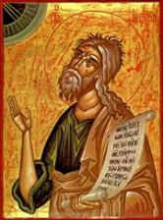
Joel 2:2
“A day of darkness and gloom, A day of clouds and thick darkness. As the dawn is spread over the mountains, So there is a great and mighty people; There has never been anything like it, Nor will there be again after it To the years of many generations.”

Slide 76
Jeremiah 30:7
“Alas! for that day is great, There is none like it; And it is the time of Jacob’s distress (Gen. 32:8; 35:10), But he will be saved from it.”

Slide 77
Daniel 12:1
“Now at that time Michael, the great prince who stands guard over the sons of your people, will arise. And there will be a time of distress such as never occurred since there was a nation until that time; and at that time your people, everyone who is found written in the book, will be rescued.”

Slide 78
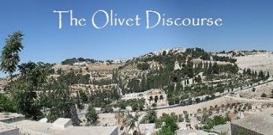
Matthew 24:21-22
“²¹ For then there will be a great tribulation, such as has not occurred since the beginning of the world until now, nor ever will. ²² Unless those days had been cut short, no life would have been saved; but for the sake of the elect those days will be cut short.”

Slide 79
Zechariah 13:8-9
⁸“It will come about in all the land,” Declares the Lord, “That two parts in it will be cut off and perish; But the third will be left in it. ⁹“And I will bring the third part through the fire, Refine them as silver is refined, And test them as gold is tested. They will call on My name, And I will answer them; I will say, ‘They are My people,’ And they will say, ‘The Lord is my God.’ ”

Slide 80
Daniel 12:1-2
“¹ Now at that time Michael, the great prince who stands guard over the sons of your people, will arise. And there will be a time of distress such as never occurred since there was a nation until that time; and at that time your people, everyone who is found written in the book, will be rescued. ² Many of those who sleep in the dust of the ground will awake, these to everlasting (olam) life, but the others to disgrace and everlasting (olam) contempt.”

Slide 81
Revelation 20:4-6
“⁴ Then I saw thrones, and they sat on them, and judgment was given to them. And I saw the souls of those who had been beheaded because of their testimony of Jesus and because of the word of God, and those who had not worshiped the beast or his image, and had not received the mark on their forehead and on their hand; and they came to life [zaō] and reigned with Christ for a thousand years. ⁵ The rest of the dead did not come to life [zaō] until the. . .

Slide 82
Revelation 20:4-6
…thousand years were completed. This is the first resurrection [anastasis and not palingenesia]. ⁶ Blessed and holy is the one who has a part in the first resurrection [anastasis and not palingenesia]; over these the second death has no power, but they will be priests of God and of Christ and will reign with Him for a thousand years.”

Slide 84
CONCLUSION

Slide 85
MAIL BAG
Will the Rapture occur on a Hebrew feast day?
Is Isaiah 26:19-20 speaking of the Rapture?

