Slide 1


Zechariah
God Remembers!

Slide 2

Structure
Introductory call to repentance (1:1-6)
Eight-night visions (1:7–6:15)
Question and answers about fasting (7–8)
Two burdens (9–14)

Slide 3
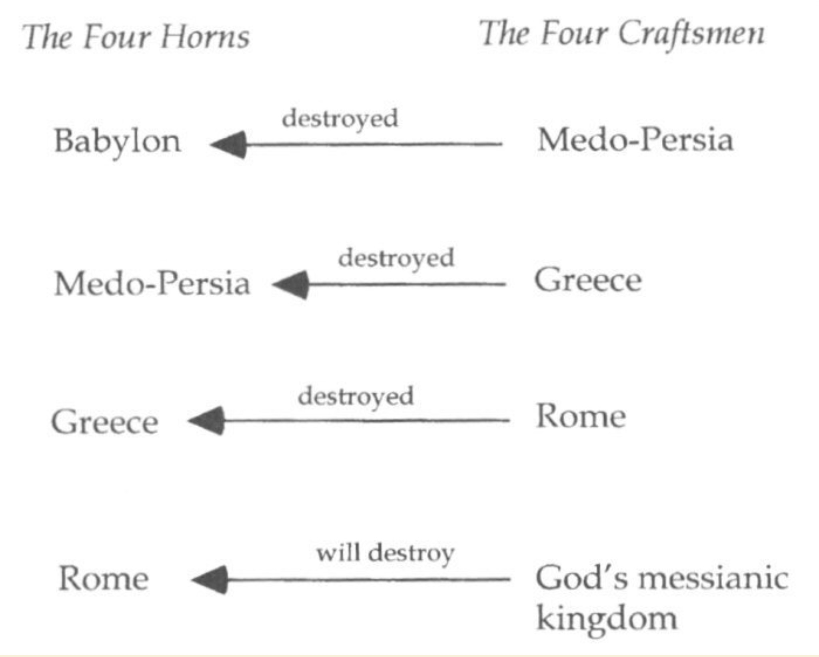

Slide 4

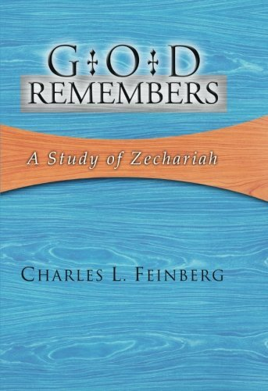
Charles L. Feinberg
God Remembers: A Study of Zechariah (Wheaton: Van Kampen, 1950, p. 42-43.
“Several features are noteworthy in this vision: (1) God takes account of everyone that lifts his hand against Israel; (2) He has complete knowledge of the dejected condition of His people and the extent of their injury; and (3) He has already provided the punishment for every foe of His chosen ones. As a definite matter of history three of the empires or kingdoms symbolized by the horns already know of the visitation of God upon them.”

Slide 5
II. Eight Night Visions
(1:7‒6:15)
  Riders & horses among the myrtle trees (1:7-17)
  Four horns & four craftsmen (1:18-21)
  Man with the measuring line (2)
  Cleansing of the High Priest Joshua (3)
  Lampstand & olive tree (4)
  Flying scroll (5:1-4)
  Woman in the basket (5:5-11)
  Four chariots (6:1-8)
  Conclusion: crowning of Joshua (6:9-15)

Slide 6
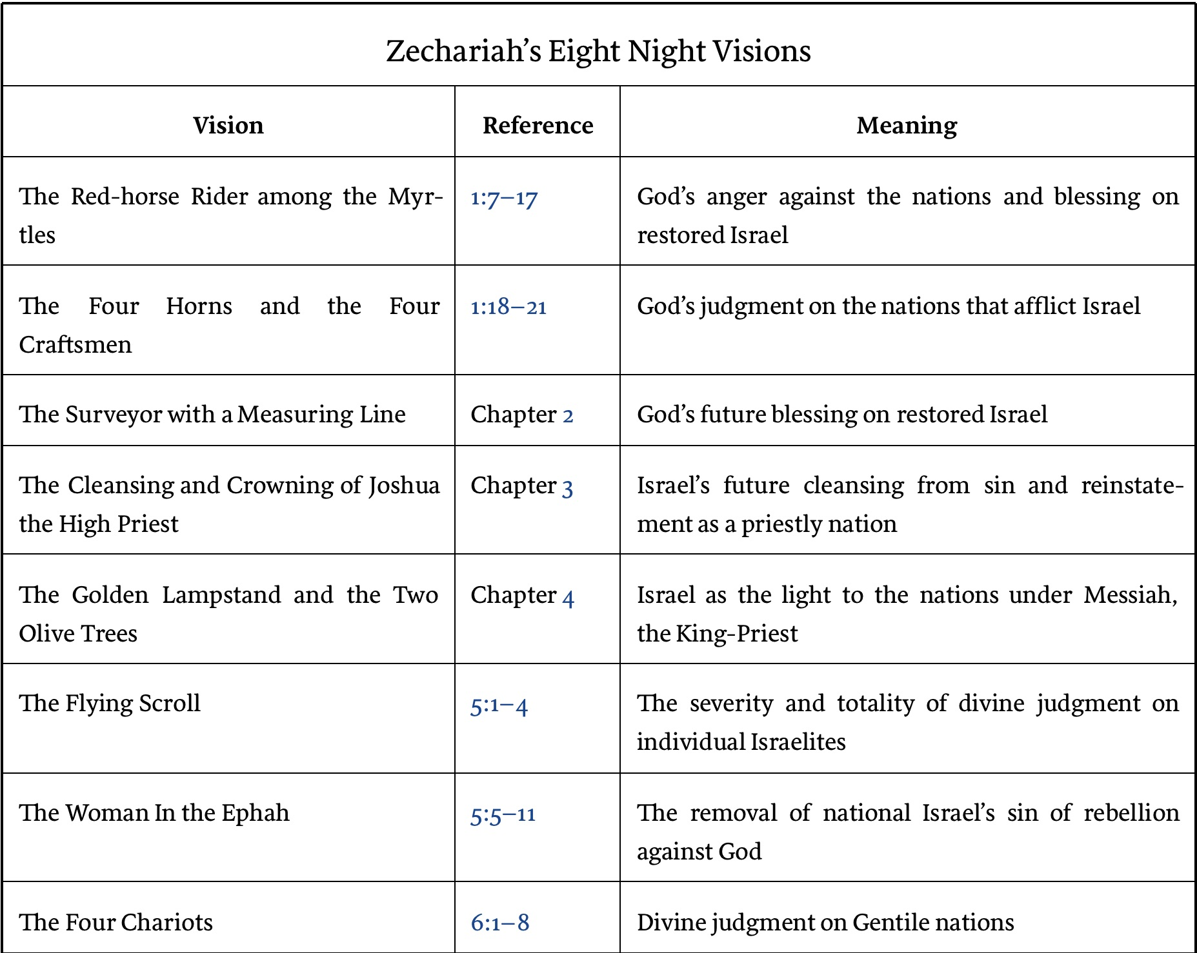

Slide 7

3. The Man with the Measuring Line
(2:1-13)
Vision (2:1-2)
Jerusalem’s restoration (2:3-5)
Exiles to return (2:6-7)
God and the nations (2:8-9)
God to inhabit Jerusalem (2:10-12)
Concluding exhortation (2:13)

Slide 8
3. The Man with the Measuring Line
(2:1-13)
Vision (2:1-2)
Jerusalem’s restoration (2:3-5)
Exiles to return (2:6-7)
God and the nations (2:8-9)
God to inhabit Jerusalem (2:10-12)
Concluding exhortation (2:13)

Slide 9
I. Vision
(2:1-2)
Vision (1)
Question (2a)
Answer (2b)

Slide 10
3. The Man with the Measuring Line
(2:1-13)
Vision (2:1-2)
Jerusalem’s restoration (2:3-5)
Exiles to return (2:6-7)
God and the nations (2:8-9)
God to inhabit Jerusalem (2:10-12)
Concluding exhortation (2:13)

Slide 11
II. Jerusalem’s
(2:3-5)
Angelic conversation (3)
Jerusalem's repopulation (4)
Jerusalem’s protection (5)

Slide 12
3. The Man with the Measuring Line
(2:1-13)
Vision (2:1-2)
Jerusalem’s restoration (2:3-5)
Exiles to return (2:6-7)
God and the nations (2:8-9)
God to inhabit Jerusalem (2:10-12)
Concluding exhortation (2:13)

Slide 13
III. Jerusalem’s
(2:6-7)
Future worldwide return (6)
Historic local return (7)

Slide 14
III. Jerusalem’s
(2:6-7)
Future worldwide return (6)
Historic local return (7)

Slide 15


Slide 16

Isaiah 11:11-12
Then it will happen on that day that the Lord Will again recover the second time with His hand The remnant of His people, who will remain, From Assyria, Egypt, Pathros, Cush, Elam, Shinar, Hamath, And from the islands of the sea.¹² And He will lift up a standard for the nations And assemble the banished ones of Israel, And will gather the dispersed of Judah From the four corners of the earth.

Slide 17

Isaiah 27:13
“It will come about also in that day that a great trumpet will be blown, and those who were perishing in the land of Assyria and who were scattered in the land of Egypt will come and worship the Lord in the holy mountain at Jerusalem.”

Slide 18
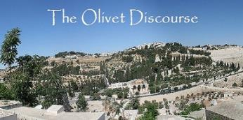
Matthew 24:31
“And He will send forth His angels with a great trumpet and they will gather together [episynagō] His elect from the four winds, from one end of the sky to the other.”

Slide 19
III. Jerusalem’s
(2:6-7)
Future worldwide return (6)
Historic local return (7)

Slide 20
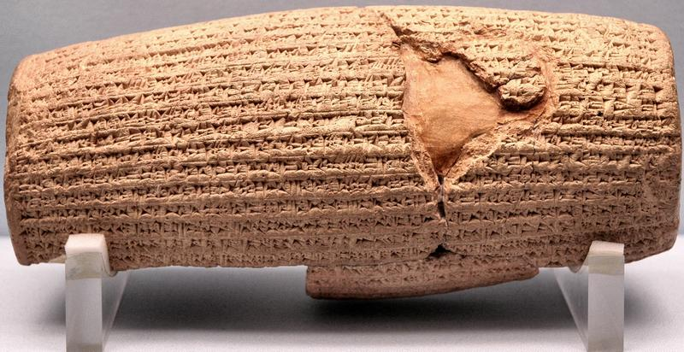
Cyrus Cylinder

Slide 21
Three Returns
 | DATE | DURATION | PERSIAN KING | JEWISH LEADER | SCRIPTURE | PURPOSE | NUMBER OF RETURNEES
1st return | 538–515 B.C. | 23 years | Cyrus (Isa 44:28‒45:1) | Zerubbabel | Ezra 1–6; Isaiah 44:28 | Rebuilding the temple | 50,000
2nd return | 458–457 B.C. | 2 years | Artaxerxes | Ezra | Ezra 7–10 | Adorning of the temple and reforming the people | 2,000
3rd return | 444–432 B.C. | 8 years | Artaxerxes | Nehemiah | Nehemiah | Rebuilding the wall

Slide 22

Genesis 11:1-4
¹ Now the whole earth used the same language and the same words. ² It came about as they journeyed east, that they found a plain in the land of Shinar and settled there. ³ They said to one another, “Come, let us make bricks and burn them thoroughly.” And they used brick for stone, and they used tar for mortar. ⁴ They said, “Come, let us build for ourselves a city, and a tower whose top will reach into heaven, and let us make for ourselves a name, otherwise we will be scattered abroad over the face of the whole earth.”

Slide 23
Spread of the Mother-Child Cult
 | MOTHER | CHILD
Assyria | Ishtar | Tammuz
Phoenicia | Astarte | Baal
Egypt | Isis | Osirus/Horus
Greece | Aphrodite | Eros
Rome | Venus | Cupid
Asia | Cybele | Desius
India | Isi | Aswara
Roman Catholicism | Mary | Jesus
Israel | Queen of Heaven (Jer. 7:18; 44:17) | Tammuz (Ezek. 8:14-15)
Alexander Hislop, Two Babylons

Slide 24
3. The Man with the Measuring Line
(2:1-13)
Vision (2:1-2)
Jerusalem’s restoration (2:3-5)
Exiles to return (2:6-7)
God and the nations (2:8-9)
God to inhabit Jerusalem (2:10-12)
Concluding exhortation (2:13)

Slide 25
IV. God and the Nations
(2:8-9)
God’s punishment of the nations (8)
Israel’s elevation (9)

Slide 26
IV. God and the Nations
(2:8-9)
God’s punishment of the nations (8)
Israel’s elevation (9)

Slide 27


Genesis 12:3
“And I will bless those who bless you, And the one who curses you I will curse. And in you all the families of the earth will be blessed.”

Slide 28
Genesis 12:3
“And I will bless those who bless you, And the one who curses you I will curse. And in you all the families of the earth will be blessed.”

Slide 29


Zechariah 2:8
“For thus says the Lord of hosts, “After glory He has sent me against the nations which plunder you, for he who touches you, touches the apple of His eye.”

Slide 30
Charles L. Feinberg
God Remembers: A Study of Zechariah (Wheaton: Van Kampen, 1950, p. 49-50.
“Though several MSS. have this reading, the better supported reading is ‘eno. Those who contend for the first, claim that the alteration was made that the text might be referred to the apple of a man’s eye; that is, whoever touches Israel, touches the apple of his own eye, doing himself irreparable damage.”

Slide 31
Charles L. Feinberg
God Remembers: A Study of Zechariah (Wheaton: Van Kampen, 1950, p. 49-50.
“In our opinion Deuteronomy 32:10 will allow no such interpretation, nor is it the most forceful here. True, that a man’s touching of the pupil of his own eye will bring him injury in a most sensitive part, how much more is this true if he touch the apple of God’s eye?”

Slide 32
IV. God and the Nations
(2:8-9)
God’s punishment of the nations (8)
Israel’s elevation (9)

Slide 33
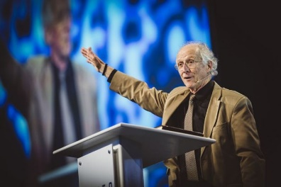
John Piper
John Piper, cited in Paul R. Wilkinson, Israel Betrayed: Volume 2: The Rise of Christian Palestinianism (San Antonio, TX: Ariel, 2018), 331-32.
“[God] has a saving purpose for Israel. All Israel will someday turn to the Lord Christ as a group. This is my deep understanding in belief of Romans 11. The broken off branches will be grafted in one day to the people of God, the bride of Christ, His church.”

Slide 34
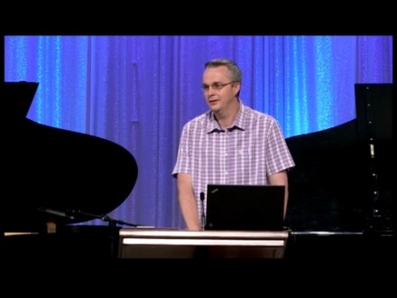
Paul Wilkinson
John Piper, cited in Paul R. Wilkinson, Israel Betrayed: Volume 2: The Rise of Christian Palestinianism (San Antonio, TX: Ariel, 2018), 332.
“On the basis of this kind of statement, many in the church are being misled into believing that Piper stands with Israel, but he does not. What Piper said is not what Paul taught. Israel’s destiny as a nation is not one of spiritual incorporation into the church, which is the classic Reformed, Calvinistic teaching. The church comprises individual Jews and Gentiles, not ‘Israel,’ which is a distinct national entity. The appointed destiny for Israel is for her to remain a nation in the sight of God and in the midst of all the nations, for as long as God’s ‘fixed order’ of creation endures (Jer. 31:36).”

Slide 35

Zechariah 14:16-18
“Then it will come about that any who are left of all the nations that went against Jerusalem will go up from year to year to worship the King, the Lord of hosts, and to celebrate the Feast of Booths. ¹⁷ And it will be that whichever of the families of the earth does not go up to Jerusalem to worship the King, the Lord of hosts, there will be no rain on them. ¹⁸ If the family of Egypt does not go up or enter, then no rain will fall on them; it will be the plague with which the Lord smites the nations who do not go up to celebrate the Feast of Booths.”

Slide 36

Isaiah 2:2-3
“Now it will come about that In the last days The mountain of the house of the Lord Will be established as the chief of the mountains, And will be raised above the hills; And all the nations will stream to it.³ And many peoples will come and say, ‘Come, let us go up to the mountain of the Lord, To the house of the God of Jacob; That He may teach us concerning His ways And that we may walk in His paths.’ For the law will go forth from Zion And the word of the Lord from Jerusalem.”

Slide 37

Revelation 20:7-9
“⁷ When the thousand years are completed, Satan will be released from his prison, ⁸ and will come out to deceive the nations which are in the four corners of the earth, Gog and Magog, to gather them together for the war; the number of them is like the sand of the seashore. ⁹ And they came up on the broad plain of the earth and surrounded the camp of the saints and the beloved city, and fire came down from heaven and devoured them.

Slide 38

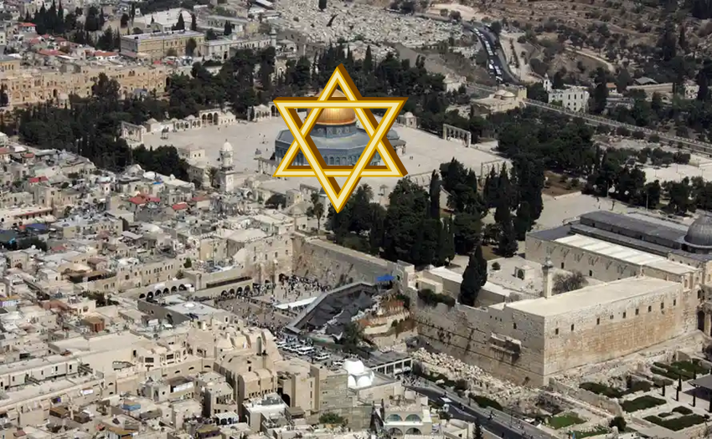
Robert Thomas
Four Views on the Book of Revelation, page 207.
“At the end of the Millennium that city will be Satan’s prime objective with his rebel army, because Israel will be a leader among the nations.”

Slide 39
3. The Man with the Measuring Line
(2:1-13)
Vision (2:1-2)
Jerusalem’s restoration (2:3-5)
Exiles to return (2:6-7)
God and the nations (2:8-9)
God to inhabit Jerusalem (2:10-12)
Concluding exhortation (2:13)

Slide 40
V. God to Inhabit Jerusalem
(2:10-12)
God to inhabit Jerusalem (10)
Nations to be blessed (11)
God to choose Jerusalem (12)

Slide 41
V. God to Inhabit Jerusalem
(2:10-12)
God to inhabit Jerusalem (10)
Nations to be blessed (11)
God to choose Jerusalem (12)

Slide 42
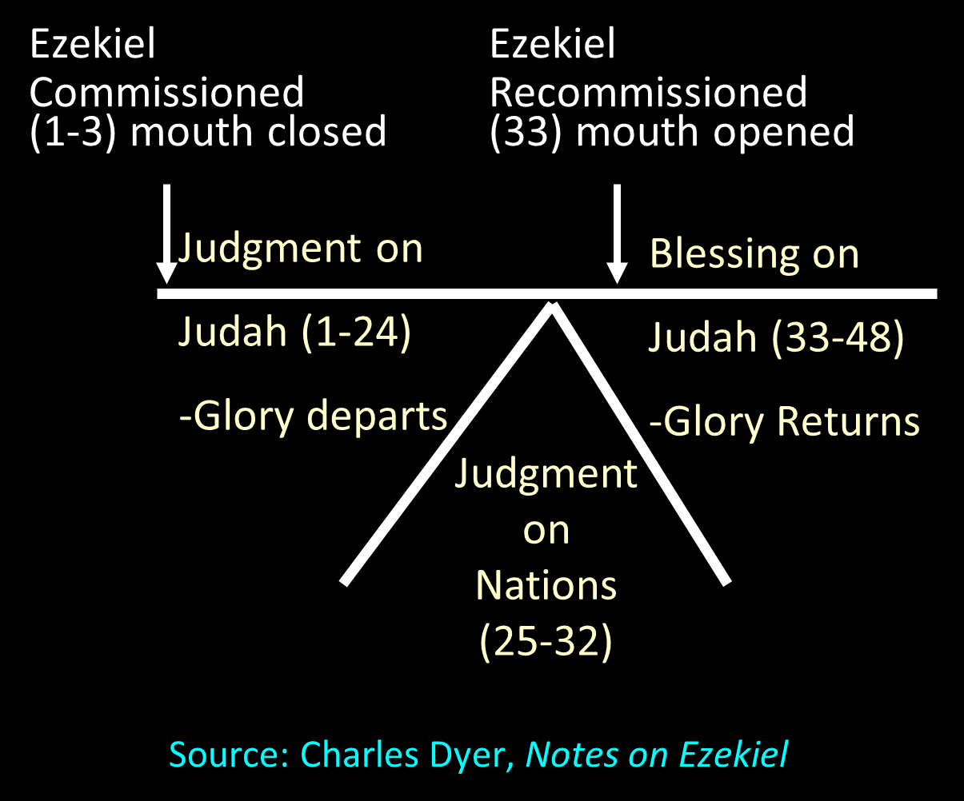

Slide 43
V. God to Inhabit Jerusalem
(2:10-12)
God to inhabit Jerusalem (10)
Nations to be blessed (11)
God to choose Jerusalem (12)

Slide 44
Charles L. Feinberg
God Remembers: A Study of Zechariah (Wheaton: Van Kampen, 1950, p. 52.
“The chapter reveals so vividly how little the nations of the earth realize how much their blessing depends upon Israel. They do well to take heed lest they fall into the hands of the living God, which is a fearful thing.”

Slide 45
V. God to Inhabit Jerusalem
(2:10-12)
God to inhabit Jerusalem (10)
Nations to be blessed (11)
God to choose Jerusalem (12)

Slide 46


Slide 47
3. The Man with the Measuring Line
(2:1-13)
Vision (2:1-2)
Jerusalem’s restoration (2:3-5)
Exiles to return (2:6-7)
God and the nations (2:8-9)
God to inhabit Jerusalem (2:10-12)
Concluding exhortation (2:13)

Slide 48
VI. Concluding Exhortation
(2:13)
The need for silence (13a)
Divine emotions (13b)
Heavenly action forthcoming (13c)

Slide 49
VI. Concluding Exhortation
(2:13)
The need for silence (13a)
Divine emotions (13b)
Heavenly action forthcoming (13c)

Slide 50
VI. Concluding Exhortation
(2:13)
The need for silence (13a)
Divine emotions (13b)
Heavenly action forthcoming (13c)

Slide 51
VI. Concluding Exhortation
(2:13)
The need for silence (13a)
Divine emotions (13b)
Heavenly action forthcoming (13c)

Slide 52
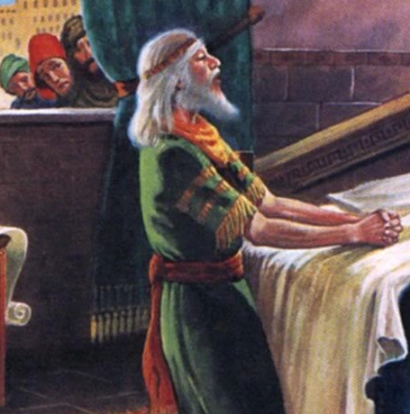
Daniel 2:44
“In the days of those kings the God of heaven will set up a kingdom which will never be destroyed, and that kingdom will not be left for another people; it will crush and put an end to all these kingdoms, but it will itself endure forever.”

Slide 53

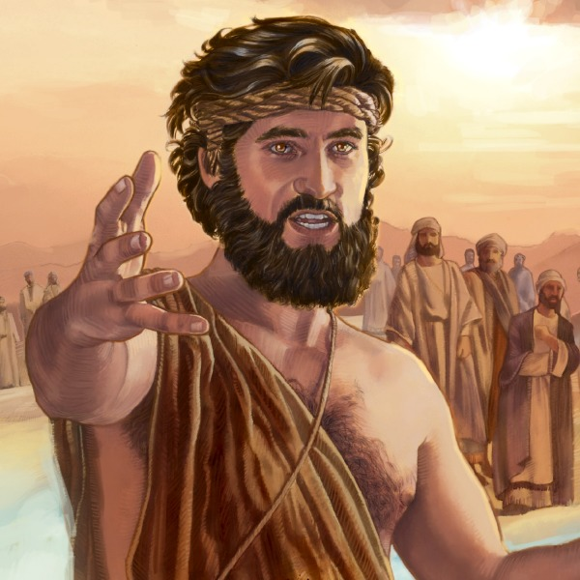
Matthew 3:1-2
“Now in those days John the Baptist came, preaching in the wilderness of Judea, saying, ‘Repent, for the kingdom of heaven is at hand.”

Slide 54
Messengers of the Kingdom In Matthew
John the Baptist – 3:2
Jesus Christ – 4:17
12 Apostles – 10:5-7
Seventy – Luke 10:1, 9
Toussaint, Behold the King, 18-20

Slide 55
Conclusion

Slide 56
3. The Man with the Measuring Line
(2:1-13)
Vision (2:1-2)
Jerusalem’s restoration (2:3-5)
Exiles to return (2:6-7)
God and the nations (2:8-9)
God to inhabit Jerusalem (2:10-12)
Concluding exhortation (2:13)

Slide 57
II. Eight Night Visions
(1:7‒6:15)
  Riders & horses among the myrtle trees (1:7-17)
  Four horns & four craftsmen (1:18-21)
  Man with the measuring line (2)
  Cleansing of the High Priest Joshua (3)
  Lampstand & olive tree (4)
  Flying scroll (5:1-4)
  Woman in the basket (5:5-11)
  Four chariots (6:1-8)
  Conclusion: crowning of Joshua (6:9-15)

