Slide 1
Genesis 12‒50
Israel’s Birth & Preservation

Slide 2
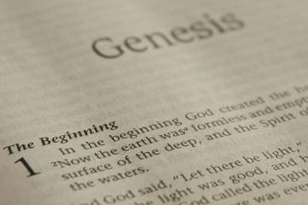
GENESIS STRUCTURE
Beginning of the Human race (Gen. 1‒11)
Beginning of the Hebrew race (Gen. 12‒50)

Slide 3
GENESIS STRUCTURE
Genesis 1-11 (four events)
Creation (1-2)
Fall (3-5)
Flood (6-9)
National dispersion (10-11)

Slide 4
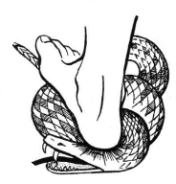
Genesis 3:15
“And I will put enmity Between you and the woman, And between your seed and her seed; He shall bruise you on the head, And you shall bruise him on the heel.”

Slide 5
GENESIS STRUCTURE
Beginning of the Human race (Gen. 1‒11)
Beginning of the Hebrew race (Gen. 12‒50)

Slide 6
GENESIS STRUCTURE
Genesis 12-50 (four people)
Abraham (12:1–25:11)
Isaac (25:12–26:35)
Jacob (27–36)
Joseph (37–50)

Slide 7
Isaiah 43:1
“But now, thus says the Lord, your Creator, O Jacob, And He who formed you, O Israel, 'Do not fear, for I have redeemed you; I have called you by name; you are Mine!'”

Slide 8
GENESIS STRUCTURE
Genesis 12-50 (four people)
Abraham (12:1–25:11)
Isaac (25:12–26:35)
Jacob (27–36)
Joseph (37–50)

Slide 9
VI. 8 New Promises Genesis 12:1-3
Land (Gen. 12:1b)
Great nation (Gen. 12:2a)
Personal blessing (Gen. 12:2b)
Great name (Gen. 12:2c)
Blessing to others (Gen. 12:2d)
Blessing to blessers (Gen. 12:3a)
Cursing to cursers (Gen. 12:3b)
Blessing to the world (Gen. 12:3c)

Slide 10
VI. 8 New Promises Genesis 12:1-3
Land (Gen. 12:1b)
Great nation (Gen. 12:2a)
Personal blessing (Gen. 12:2b)
Great name (Gen. 12:2c)
Blessing to others (Gen. 12:2d)
Blessing to blessers (Gen. 12:3a)
Cursing to cursers (Gen. 12:3b)
Blessing to the world (Gen. 12:3c)

Slide 11
Genesis 12:4‒20 Abraham’s Early Journeys
From Haran to Canaan (Gen. 12:4-5)
In Canaan (Gen. 12:6-9)
In Egypt (Gen. 12:10-20)

Slide 12
III. In Egypt Genesis 12:10-20
Famine (Gen. 12:10)
Fabrication (Gen. 12:11-13)
Fulfilled prediction (Gen. 12:14-16)
Fury of God (Gen. 12:17)
Fury of Pharoah (Gen. 12:18-20)

Slide 13
III. In Egypt Genesis 12:10-20
Famine (Gen. 12:10)
Fabrication (Gen. 12:11-13)
Fulfilled prediction (Gen. 12:14-16)
Fury of God (Gen. 12:17)
Fury of Pharoah (Gen. 12:18-20)

Slide 16
Dr. Arnold G. Fruchtenbaum
The Book of Genesis, 248
“Archeology has verified what is described in this verse, because paintings in the Tomb of Khnun-hotep III in Beni Hagan, which dates back to the time of Sesostris II (1897–1878 b.c.), show the arrival of thirty-seven Asiatic men, women, and children in the same time period of Abram. Thus, Egypt regularly experienced migrations of Asiatics into Egypt, especially in times of famine.”

Slide 17
Colossians 2:8
“See to it that no one takes you captive through philosophy and empty deception, according to the tradition of men, according to the elementary principles of the world, rather than according to Christ.”

Slide 18
III. In Egypt Genesis 12:10-20
Famine (Gen. 12:10)
Fabrication (Gen. 12:11-13)
Fulfilled prediction (Gen. 12:14-16)
Fury of God (Gen. 12:17)
Fury of Pharoah (Gen. 12:18-20)

Slide 19
Dr. Arnold G. Fruchtenbaum
The Book of Genesis, 248
“Verse 11b focuses on Sarai’s beauty: that he said unto Sarai his wife, Behold now, I know that you are a fair woman to look upon. The Hebrew literally reads ‘of beautiful appearance.’ This is phenomenal in light of the fact that she was 65 years old at this time. Nevertheless, in light of her longevity, she obviously aged at a slower pace than people do now.”

Slide 20
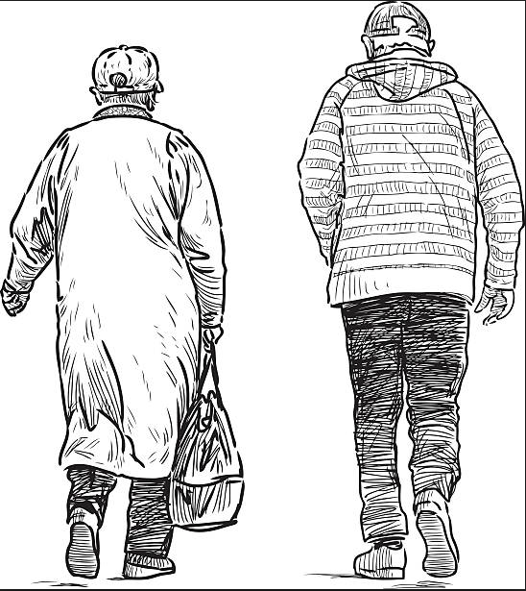
2 Cor. 4:16
Therefore we do not lose heart, but though our outer man is decaying, yet our inner man is being renewed day by day.

Slide 21
2 Cor. 4:17
For momentary, light affliction is producing for us an eternal weight of glory far beyond all comparison

Slide 22
2 Cor. 4:18
while we look not at the things which are seen, but at the things which are not seen; for the things which are seen are temporal, but the things which are not seen are eternal.

Slide 23
III. In Egypt Genesis 12:10-20
Famine (Gen. 12:10)
Fabrication (Gen. 12:11-13)
Fulfilled prediction (Gen. 12:14-16)
Fury of God (Gen. 12:17)
Fury of Pharoah (Gen. 12:18-20)

Slide 24
VI. 8 New Promises Genesis 12:1-3
Land (Gen. 12:1b)
Great nation (Gen. 12:2a)
Personal blessing (Gen. 12:2b)
Great name (Gen. 12:2c)
Blessing to others (Gen. 12:2d)
Blessing to blessers (Gen. 12:3a)
Cursing to cursers (Gen. 12:3b)
Blessing to the world (Gen. 12:3c)

Slide 25
III. In Egypt Genesis 12:10-20
Famine (Gen. 12:10)
Fabrication (Gen. 12:11-13)
Fulfilled prediction (Gen. 12:14-16)
Fury of God (Gen. 12:17)
Fury of Pharoah (Gen. 12:18-20)

Slide 26
VI. 8 New Promises Genesis 12:1-3
Land (Gen. 12:1b)
Great nation (Gen. 12:2a)
Personal blessing (Gen. 12:2b)
Great name (Gen. 12:2c)
Blessing to others (Gen. 12:2d)
Blessing to blessers (Gen. 12:3a)
Cursing to cursers (Gen. 12:3b)
Blessing to the world (Gen. 12:3c)

Slide 27
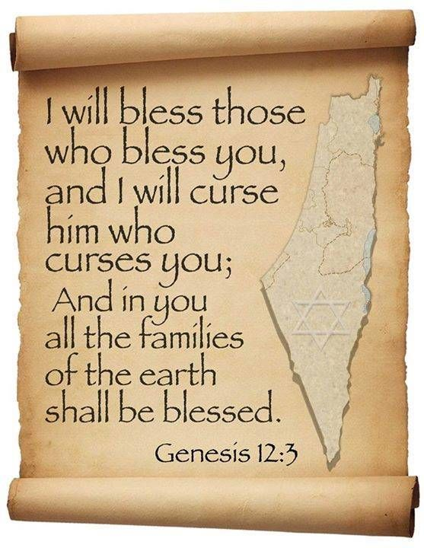
Genesis 12:3
“And I will bless those who bless you, And the one who curses you I will curse. And in you all the families of the earth will be blessed.”

Slide 28
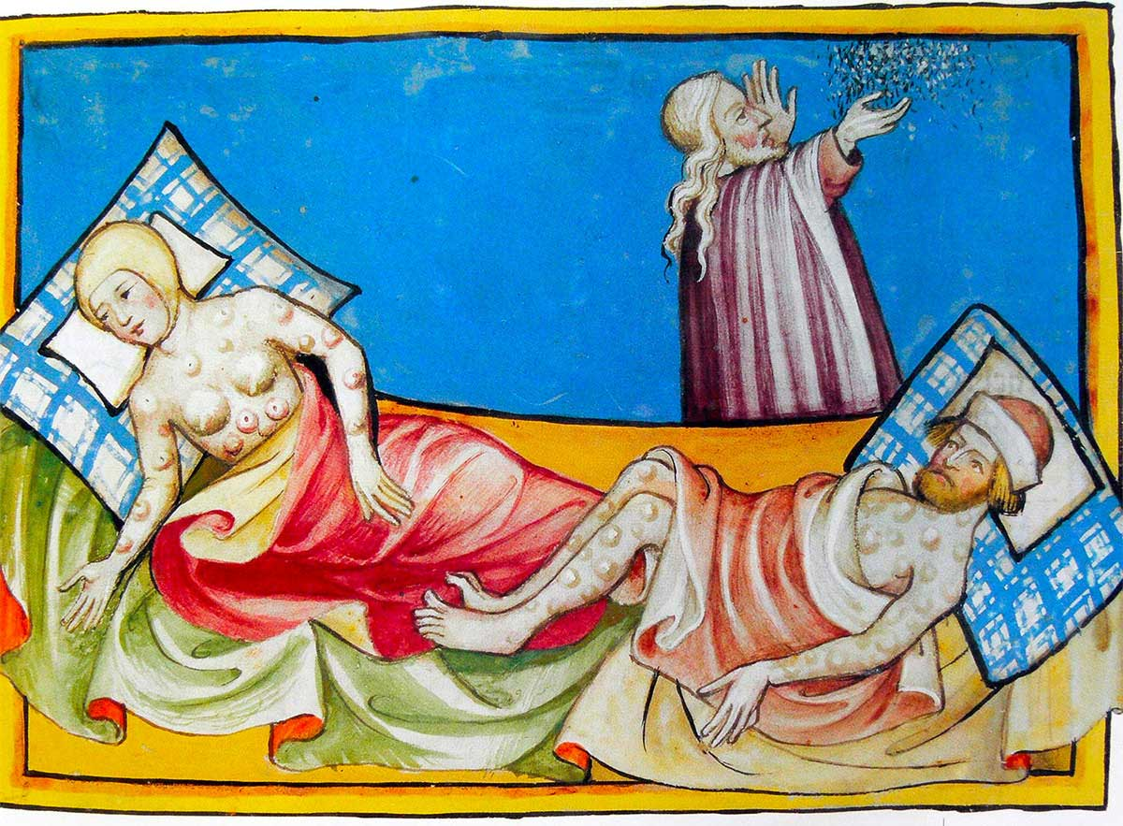
Dr. Arnold G. Fruchtenbaum
The Book of Genesis, 250
“The text does not state exactly what these plagues were, but according to rabbinic tradition, they were leprosy. According to Rashi, the plagues were a debilitating skin disease that made sexual intercourse impossible.”

Slide 29
Dr. Arnold G. Fruchtenbaum
The Book of Genesis, 250-51
“Although it was Abram who sinned, God still intervenes because the Abrahamic Covenant is indeed unconditional…The key observation here is that indeed the Abrahamic Covenant has now begun to work in earnest: Pharaoh was cursed for cursing Abram, and Abram was blessed in spite of his wrong actions. This all shows evidence that the covenant was unconditional.”

Slide 30
Jeremiah 31:35-37
Thus says the Lord, Who gives the sun for light by day And the fixed order of the moon and the stars for light by night, Who stirs up the sea so that its waves roar; The Lord of hosts is His name:³⁶ “If this fixed order departs From before Me,” declares the Lord, “Then the offspring of Israel also will cease From being a nation before Me forever.”³⁷ Thus says the Lord, “If the heavens above can be measured And the foundations of the earth searched out below, Then I will also cast off all the offspring of Israel For all that they have done,” declares the Lord.

Slide 31
III. In Egypt Genesis 12:10-20
Famine (Gen. 12:10)
Fabrication (Gen. 12:11-13)
Fulfilled prediction (Gen. 12:14-16)
Fury of God (Gen. 12:17)
Fury of Pharoah (Gen. 12:18-20)

Slide 32
Genesis 3:15
“And I will put enmity Between you and the woman, And between your seed and her seed; He shall bruise you on the head, And you shall bruise him on the heel.”

Slide 33
Dr. Arnold G. Fruchtenbaum
The Book of Genesis, 250
“Abram must learn that he survives not by human strategy, as he thought, but by divine covenantal protection.”

Slide 34
John 10:27-29
“My sheep hear My voice, and I know them, and they follow Me; ²⁸ and I give eternal life to them, and they will never perish [ou mē; aiōnia]; and no one will snatch them out of My hand. ²⁹ My Father, who has given them to Me, is greater than all; and no one is able to snatch them out of the Father’s hand.”

Slide 35
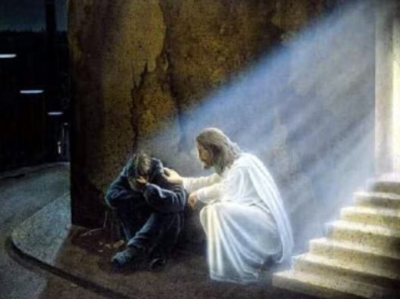
2 Timothy 2:11, 13
“The statement is trustworthy:…If we are faithless, He remains faithful, for He cannot deny Himself.”

Slide 36
Galatians 3:3
“Are you so foolish? Having begun by the Spirit, are you now being perfected by the flesh?”

Slide 37
Conclusion

Slide 38
Genesis 12:4‒20 Abraham’s Early Journeys
From Haran to Canaan (Gen. 12:4-5)
In Canaan (Gen. 12:6-9)
In Egypt (Gen. 12:10-20)

Slide 39
III. In Egypt Genesis 12:10-20
Famine (Gen. 12:10)
Fabrication (Gen. 12:11-13)
Fulfilled prediction (Gen. 12:14-16)
Fury of God (Gen. 12:17)
Fury of Pharoah (Gen. 12:18-20)

Slide 40
“The Lord bless you and keep you; the Lord make his face shine on you and be gracious to you; the Lord turn his face toward you and give you peace.” (NIV)

