Slide 1
THE RAPTURE
What and When? – Part 66
Andrew Marshall Woods, Th.M., JD., PhD.
Sr. Pastor, Sugar Land Bible Church

Slide 2
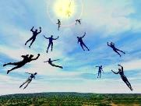
The Rapture Course Overview
What is the Rapture?
When is the Rapture?
Strengthening the Pre-Tribulational case
The opposing views
One second after the Rapture
Questions & Answers

Slide 3
MAIL BAG
First seal already opened?
Salvation in the Tribulation?
Global reset & Revelation 13?
Rapture in Revelation 1:7?
Rapture in Revelation 12:5?
Will the Rapture occur on a Hebrew feast day?

Slide 4
MAIL BAG
First seal already opened?
Salvation in the Tribulation?
Global reset & Revelation 13?
Rapture in Revelation 1:7?
Rapture in Revelation 12:5?
Will the Rapture occur on a Hebrew feast day?

Slide 6
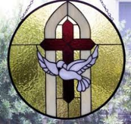
2 Thessalonians 2:6-7
⁶And you know what restrains [katechon; neuter] him now, so that in his time he will be revealed. ⁷For the mystery of lawlessness is already at work; only he who now restrains [katechōn; masculine] will do so until he is taken out of the way.

Slide 7
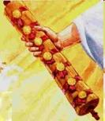
1st Six Seals (Revelation 6)
6:1-2 – Advent of antichrist
6:3-4 – War
6:5-6 – Famine
6:7-8 – Death
6:9-11 – Martyrdoms
6:12-17 – Cosmic disturbances

Slide 9
DESCRIPTION OF THE SEVEN CHURCHES REVELATION 2‒3
CHURCH | SCRIPTURE | DESCRIPTION
Ephesus | 2:1-7 | Loveless
Smyrna | 2:8-11 | Persecuted
Pergamum | 2:12-17 | Compromised
Thyatira | 2:18-29 | Corrupt
Sardis | 3:1-6 | Dead
Philadelphia | 3:7-13 | Missionary
Laodicea | 3:14-22 | Man-centered

Slide 10
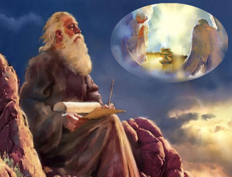
Twenty-Four Elders (Rev. 4:4; 5:8-10)
CHURCH
Crowned (Rev. 2:10; 3:11)
Resurrected (Rev. 4:4)
Clothed in White (Rev. 3:5)
Redeemed (Rev. 5:8-10)
Global (Rev. 5:9; Matt. 28:19)
Enthroned (Rev. 3:21)
Elders (Rev. 1 Tim. 3:1-7)
Kingdom of Priests (Rev. 1:6)
Twenty-four (Rev. 1:6)

Slide 11
MAIL BAG
First seal already opened?
Salvation in the Tribulation?
Global reset & Revelation 13?
Rapture in Revelation 1:7?
Rapture in Revelation 12:5?
Will the Rapture occur on a Hebrew feast day?

Slide 12
Distinctions Between 144,000 & Multitude
144,000 | MULTITUDE
Revelation 7:1-8 | Revelation 7:9-17
Numbered | Innumerable
Jews | All nations
Sealed (First Fruits) | Slain (Martyrs)
Sealed before the Tribulation | Converted out of the Tribulation
Hitchcock and Ice, The Truth Behind Left Behind, 77

Slide 13
MAIL BAG
First seal already opened?
Salvation in the Tribulation?
Global reset & Revelation 13?
Rapture in Revelation 1:7?
Rapture in Revelation 12:5?
Will the Rapture occur on a Hebrew feast day?

Slide 14
Revelation 13:16-18
¹⁶ And he causes all, the small and the great, and the rich and the poor, and the free men and the slaves, to be given a mark on their right hand or on their forehead, ¹⁷ and he provides that no one will be able to buy or to sell, except the one who has the mark, either the name of the beast or the number of his name. ¹⁸ Here is wisdom. Let him who has understanding calculate the number of the beast, for the number is that of a man; and his number is six hundred and sixty-six.
14

Slide 15
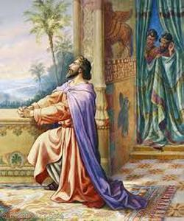
Daniel 7:23
“The fourth beast will be a fourth kingdom on the earth, which will be different from all the other kingdoms and will devour the whole earth and tread it down and crush it.”
15

Slide 16
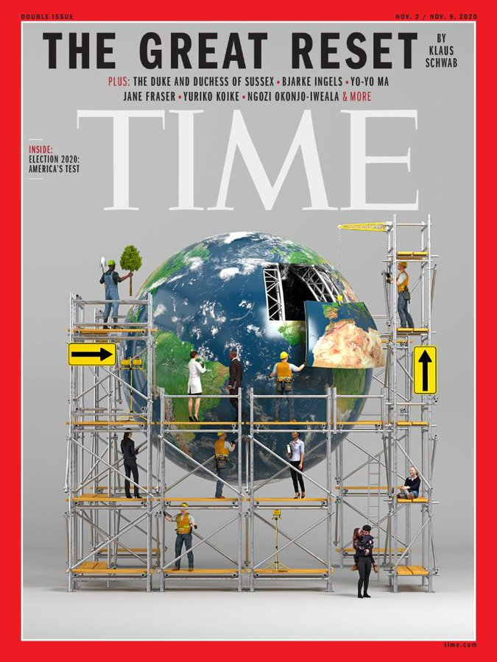

Slide 18
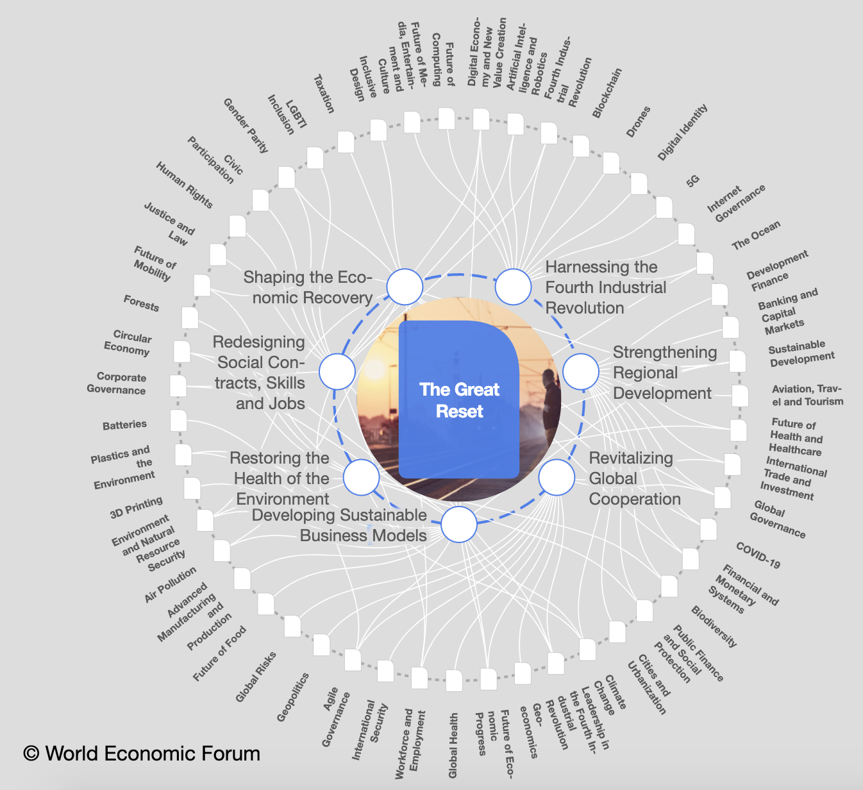

Slide 19
Scenario Narratives
“During the pandemic, national leaders around the world flexed their authority and imposed airtight rules and restrictions, from the mandatory wearing of face masks to body-temperature checks at the entries to communal spaces like train stations and supermarkets. Even after the pandemic faded, this more authoritarian control and oversight of citizens and their activities stuck and even intensified.”

Slide 23
Canadian Prime Minister: Justin Trudeau
“This pandemic has provided an opportunity for a reset. This is our chance to accelerate our pre-pandemic efforts to reimagine economic systems that actually address global challenges like extreme poverty, inequality and climate change.”
https://thenewamerican.com/canadas-justin-trudeau-ties-covid-19-recovery-to-reset-and-un-agenda-2030/
Notes:
Pretext for more power
Increasing social controls
In keeping with the movement toward global govt., more govt. power, etc.

Slide 25
MAIL BAG
First seal already opened?
Salvation in the Tribulation?
Global reset & Revelation 13?
Rapture in Revelation 1:7?
Rapture in Revelation 12:5?
Will the Rapture occur on a Hebrew feast day?

Slide 26
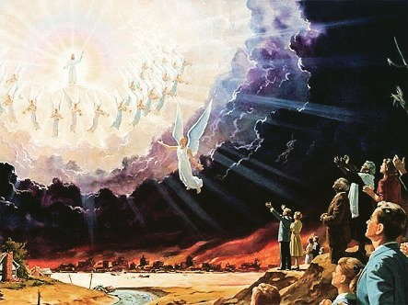
Revelation 1:7
“Behold, He is coming with the clouds, and every eye will see Him, even those who pierced Him; and all the tribes of the earth will mourn over Him.”
26

Slide 27
Rapture Distinct from Second Advent
RAPTURE (1 Thess 4:13-18; 1 Cor 15:51-58) | SECOND COMING (Rev 19:11-16)
Christ comes in the air (1 Thess 4:16-17) | Christ comes to the earth (Zech 14:4)
For His saints (1 Thess 4:15-17) | With His saints (Rev 19:14)
Blessing (1 Thess 4:18) | Judgment (Rev 19:15)
Effects only believers (1 Thess 4:16) | Effects both believers & unbelievers (Rev 19:15)

Slide 28
Rapture Distinct from Second Advent
RAPTURE (1 Thess 4:13-18; 1 Cor 15:51-58) | SECOND COMING (Rev 19:11-16)
Invisible (1 Thess 4:16) | Visible to all (Rev 1:7)
Announced only by an archangel (1 Thess 4:16) | Involves myriads of angels (Jude 14)
Resurrection (1 Cor 15: 51) | No resurrection
Rescue of the Church (1 Thess 1:10) | Rescue of Israel (Matt 23:37-39)

Slide 29
John 14:1–4
¹ “Do not let your heart be troubled; believe in God, believe also in Me. ² “In My Father’s house are many dwelling places; if it were not so, I would have told you; for I go to prepare a place for you. ³ “If I go and prepare a place for you, I will come again and receive you to Myself, that where I am, there you may be also. ⁴ “And you know the way where I am going.”

Slide 30
Revelation 1:7
“Behold, He is coming with the clouds, and every eye will see Him, even those who pierced Him; and all the tribes of the earth will mourn over Him.”
30

Slide 31
Revelation 1:7
“Behold, He is coming with the clouds, and every eye will see Him, even those who pierced Him; and all the tribes of the earth will mourn over Him.”
31

Slide 32
Zechariah 12:10
“I will pour out on the house of David and on the inhabitants of Jerusalem, the Spirit of grace and of supplication, so that they will look on Me whom they have pierced; and they will mourn for Him, as one mourns for an only son, and they will weep bitterly over Him like the bitter weeping over a firstborn.”

Slide 33
Revelation 1:7
“Behold, He is coming with the clouds, and every eye will see Him, even those who pierced Him; and all the tribes of the earth will mourn over Him.”
33

Slide 34
Matthew 23:37-39
³⁷ “Jerusalem, Jerusalem, who kills the prophets and stones those who are sent to her! How often I wanted to gather [episynagō] your children together, the way a hen gathers [episynagō] her chicks under her wings, and you were unwilling. ³⁸ Behold, your house is being left to you desolate! ³⁹ For I say to you, from now on you will not see Me until you say, ‘Blessed is He who comes in the name of the Lord!’”

Slide 36
MAIL BAG
First seal already opened?
Salvation in the Tribulation?
Global reset & Revelation 13?
Rapture in Revelation 1:7?
Rapture in Revelation 12:5?
Will the Rapture occur on a Hebrew feast day?

Slide 37
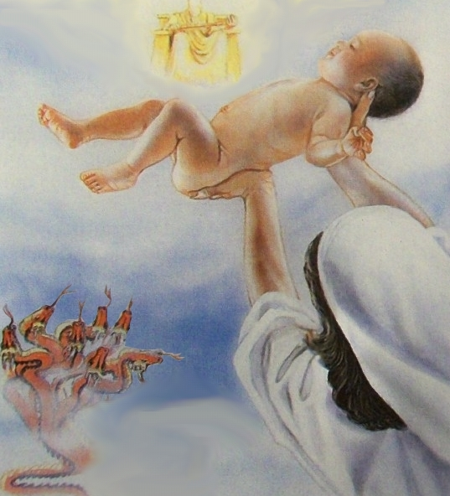
Revelation 12:5
“And she gave birth to a son, a male child, who is to rule all the nations with a rod of iron; and her child was caught up [harpazō] to God and to His throne.”

Slide 38
1 Thessalonians 4:13-18
. . . have fallen asleep. ¹⁶ For the Lord Himself will descend from heaven with a shout, with the voice of the archangel and with the trumpet of God, and the dead in Christ will rise first. ¹⁷ Then we who are alive and remain will be caught up [harpazō] together with them in the clouds to meet the Lord in the air, and so we shall always be with the Lord. ¹⁸ Therefore comfort one another with these words."

Slide 39
Revelation 12:1-5
¹And a great sign appeared in heaven: a woman clothed in the sun, and the moon under her feet, and upon her head a crown of twelve stars; ²and she was with child; and she cried out, being in labor pain to give birth. ³And another sign was seen in heaven: and behold, a great red dragon, having seven heads and ten horns, and upon his heads seven diadems ⁴And his tail swept a third part…

Slide 40
Revelation 12:1-5 (cont’d)
…of the stars of heaven, and did cast them to the earth: and the dragon stood before the woman that is about to give birth, so that when she gave birth he may devour her child. ⁵And she gave birth to a son, a man child, who is to rule all the nations with a rod of iron: and her child was caught up unto God, and to his throne.

Slide 41
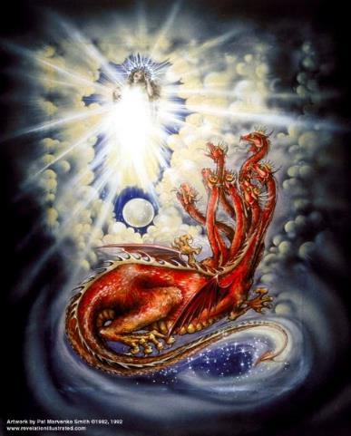
CAST OF 3 CHARACTERS Revelation 12:1-5
SON (v.5)
DRAGON (v. 3)
WOMAN (v.1)

Slide 42
CAST OF 3 CHARACTERS Revelation 12:1-5
SON = MESSIAH
Ps. 2:9; Acts 1:9
DRAGON = SATAN
Rev. 12:9; 20:2
WOMAN = ISRAEL
Gen. 37:9-10

Slide 43
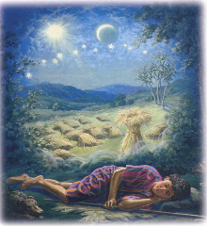
Genesis 37:9
Now he had still another dream, and related it to his brothers, and said, “Lo, I have had still another dream; and behold, the sun and the moon and eleven stars were bowing down to me.

Slide 44
Genesis 37:10
He related it to his father and to his brothers; and his father rebuked him and said to him, “What is this dream that you have had? Shall I and your mother and your brothers actually come to bow ourselves down before you to the ground?”

Slide 45
Sun = Jacob
Moon = Leah
11 Stars = Joseph’s brothers
12th Star = Joseph
12 Stars = Israel’s twelve tribes

Slide 46
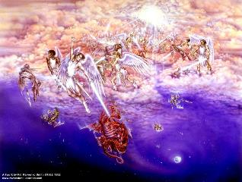
Satan’s Two Strategies
Rev 12:1-5 – Past failed strategy
Rev 12:6-17 – Present & future strategy

Slide 47
MAIL BAG
First seal already opened?
Salvation in the Tribulation?
Global reset & Revelation 13?
Rapture in Revelation 1:7?
Rapture in Revelation 12:5?
Will the Rapture occur on a Hebrew feast day?

Slide 48
Levitical Feasts (Leviticus 23)
Feast | Season | Purpose | Type
Passover | Spring | Redemption | 1 Cor 5:7
Unleavened Bread | Spring | Separation | John 6:35
1st fruits | Spring | Praise | 1 Cor 15:20
Pentecost | Spring | Praise | Acts 2:1-4
Trumpets | Fall | New Year | Matt 24:31
Atonement | Fall | Lev 16 | Zech 12:10
Booths | Fall | Wilderness provision | Zech 14:16-18

Slide 49
Levitical Feasts (Leviticus 23)
Feast | Season | Purpose | Type
Passover | Spring | Redemption | 1 Cor 5:7
Unleavened Bread | Spring | Separation | John 6:35
1st fruits | Spring | Praise | 1 Cor 15:20
Pentecost | Spring | Praise | Acts 2:1-4
Trumpets | Fall | New Year | Matt 24:31
Atonement | Fall | Lev 16 | Zech 12:10
Booths | Fall | Wilderness provision | Zech 14:16-18

Slide 50
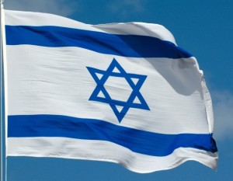
Matthew 24:31
³¹ “And He will send His angels with a great sound of a trumpet, and they will gather together His elect from the four winds, from one end of heaven to the other.”

Slide 51
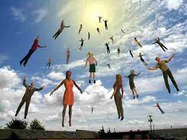
6. Rapture on a Feast Day?
Denies imminency
Places Church under the Mosaic Law
Why did the Church begin on Pentecost?

Slide 52
6. Rapture on a Feast Day?
Denies imminency
Places Church under the Mosaic Law
Why did the Church begin on Pentecost?

Slide 53
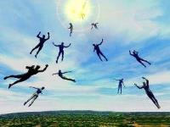
Imminent (1 Cor 15:51; 1 Thess 4:15)
Imminency definition
James 5:8; 1 Thess 1:10; 1 Cor 1:7; Philip 3:20
We are to be looking for Jesus Christ and not the Antichrist!
Motivator (Holiness, Evangelism)
Feast of Trumpets?

Slide 54
John 14:1–4
¹ “Do not let your heart be troubled; believe in God, believe also in Me. ² “In My Father’s house are many dwelling places; if it were not so, I would have told you; for I go to prepare a place for you. ³ “If I go and prepare a place for you, I will come again and receive you to Myself, that where I am, there you may be also. ⁴ “And you know the way where I am going.”

Slide 55
1 Corinthians 15:51
“Behold, I tell you a mystery; we will not all sleep, but we will all be changed.”

Slide 56
Imminent (1 Cor 15:51; 1 Thess 4:15)
Imminency definition
James 5:8; 1 Thess 1:10; 1 Cor 1:7; Philip 3:20
We are to be looking for Jesus Christ and not the Antichrist!
Motivator (Holiness, Evangelism)
Feast of Trumpets?

Slide 57
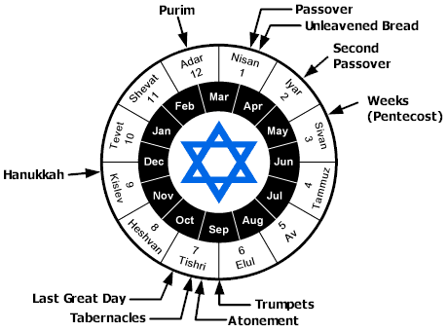

Slide 58
6. Rapture on a Feast Day?
Denies imminency
Places Church under the Mosaic Law
Why did the Church begin on Pentecost?

Slide 59
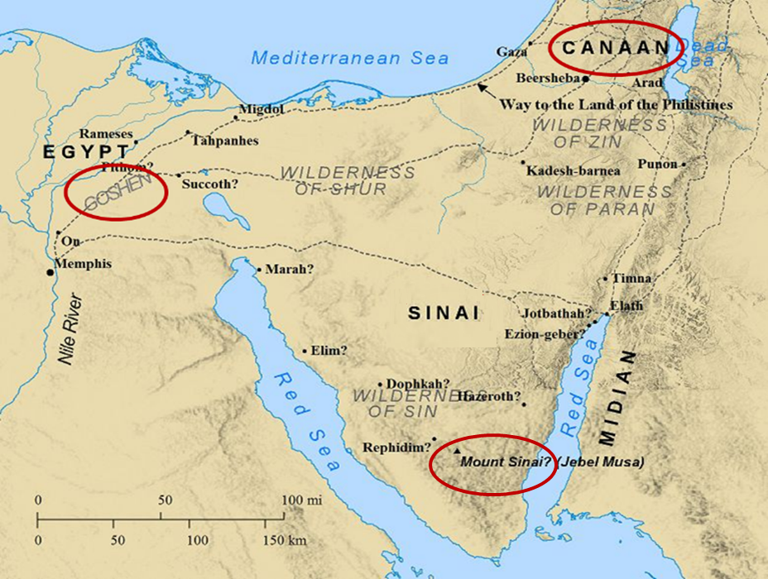

Slide 60
Levitical Feasts (Leviticus 23)
Feast | Season | Purpose | Type
Passover | Spring | Redemption | 1 Cor 5:7
Unleavened Bread | Spring | Separation | John 6:35
1st fruits | Spring | Praise | 1 Cor 15:20
Pentecost | Spring | Praise | Acts 2:1-4
Trumpets | Fall | New Year | Matt 24:31
Atonement | Fall | Lev 16 | Zech 12:10
Booths | Fall | Wilderness provision | Zech 14:16-18

Slide 61
Psalm 147:19-20
“He declares His words to Jacob, His statutes and His ordinances to Israel. He has not dealt thus with any nation; And as for His ordinances, they have not known them. Praise the Lord!”

Slide 62
Ephesians 2:14-16
¹⁴ “For He Himself is our peace, who made both groups into one and broke down the barrier of the dividing wall, ¹⁵ by abolishing in His flesh the enmity, which is the Law of commandments contained in ordinances, so that in Himself He might make the two into one new man, thus establishing peace, ¹⁶ and might reconcile them both in one body to God through the cross, by it having put to death the enmity.”

Slide 63
1 Corinthians 10:32
“Give no offense, either to the Jews or to the Greeks or to the church of God.”

Slide 64
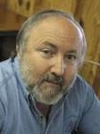
Arnold G. Fruchtenbaum “Israel and the Church,” in Issues in Dispensationalism, ed. Wesley R. Willis and John R. Master (Chicago: Moody, 1994), 118.
“In the book of Acts, both Israel and the church exist simultaneously. The term Israel is used twenty times and ekklēsia (church) nineteen times, yet the two groups are always kept distinct.”

Slide 65
6. Rapture on a Feast Day?
Denies imminency
Places Church under the Mosaic Law
Why did the Church begin on Pentecost?

Slide 66
When Did the Church Begin?
Christ referred to the Church in the future tense (Matt. 16:18)
Paul referred to the Church as a “mystery” (Eph. 3:4-5, 9)
The Church did not exist prior to Acts 1 since Christ became the head of the Church (Eph. 5:23) after His Ascension (Eph. 1:20-22)
The Church did not exist prior to Acts 1 since spiritual gifts (1 Cor. 12:7; 14:26) only came into existence after His Ascension (Eph. 4:7-11)

Slide 67
When Did the Church Begin?
The Church existed before Paul’s conversion in Acts 9 (Acts 5:11; 8:1,3; Rom. 16:7)
The Baptizing (joining, uniting, identifying) ministry of the Holy Spirit began in Acts 2
1 Cor. 12:13
Acts 1:5
Acts 11:15-16
Acts 2:1-4, 37-41

Slide 69
Levitical Feasts (Leviticus 23)
Feast | Season | Fulfillment | Rejected
Passover | Spring | John 1:29 | John 1:11
Unleavened Bread | Spring | John 6:35 | John 6:41
1st fruits | Spring | 1 Cor. 15:20 | Matt. 28:11-15
Pentecost | Spring | Joel 2:28-32 | Acts 2:13; 1 Cor. 14:22
Trumpets | Fall | New Year | Matt 24:31
Atonement | Fall | Lev 16 | Zech. 12:10
Booths | Fall | Wilderness provision | Zech. 14:16-18

Slide 70
Act 3:19-21
“¹⁹ Therefore repent and return, so that your sins may be wiped away, in order that times of refreshing may come from the presence of the Lord; ²⁰ and that He may send Jesus, the Christ appointed for you, ²¹ whom heaven must receive until the period of restoration of all things about which God spoke by the mouth of His holy prophets from ancient time.”

Slide 71
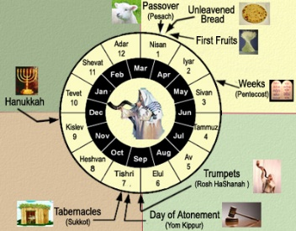
Terry Hulbert Terry C. Hulbert, The Eschatological Significance of Israel's Annual Feasts. Doctoral Dissertation. Dallas Theological Seminary. 1965. Pages 2, 115-116.
“When God fulfilled the first four feasts, He had provided everything necessary for Israel to enter into literal kingdom blessing‒redemption, separation, resurrection, and the presence of the Holy Spirit. Israel’s rejection of these, however, made a necessary national change of heart before the kingdom could be established…The paschal lamb of God pointed out by John the Baptist was rejected as an imposter. The resurrection of Christ, as it answered to the Feast of First Fruits, was suppressed in it’s proclamation by the bribe money paid to the sentries…Finally, the coming of the Spirit was rejected at Pentecost as the Jews…

Slide 72
Terry Hulbert Terry C. Hulbert, The Eschatological Significance of Israel's Annual Feasts. Doctoral Dissertation. Dallas Theological Seminary. 1965. Pages 2, 115-116.
…taunted the apostles with charges of drunkenness. By the time of the close of Acts chapter 2, God had done all He could do for Israel until they repented as a nation. Thus, the significance of Peter’s second sermon in Acts 3 was that it re-emphasized the condition of millennial blessing already laid down in the Old Testament, but as yet unfulfilled...Of the upmost importance here is the fact that the shedding of the blood of Christ to take away sin, and with the coming of the Spirit to empower the life of the redeemed, all of the spiritual requirements for the millennial kingdom had been met as far as God was concerned….

Slide 73
Terry Hulbert Terry C. Hulbert, The Eschatological Significance of Israel's Annual Feasts. Doctoral Dissertation. Dallas Theological Seminary. 1965. Pages 2, 115-116.
…But, God‘s provision could not be operative until man appropriated it. This point cannot be over emphasized, for it is not only the reason for the delay in the fulfillment of the final three feasts, it is the basis for understanding the relationship of the church to the feasts.”

Slide 74
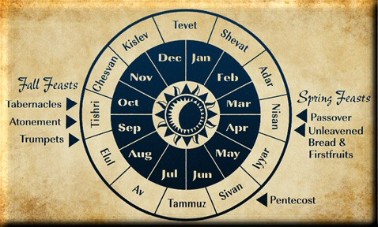

Slide 75
Levitical Feasts (Leviticus 23)
Feast | Season | Purpose | Type
Passover | Spring | Redemption | 1 Cor 5:7
Unleavened Bread | Spring | Separation | John 6:35
1st fruits | Spring | Praise | 1 Cor 15:20
Pentecost | Spring | Praise | Acts 2:1-4
Trumpets | Fall | New Year | Matt 24:31
Atonement | Fall | Lev 16 | Zech 12:10
Booths | Fall | Wilderness provision | Zech 14:16-18

Slide 76
Matthew 24:31
³¹ “And He will send His angels with a great sound of a trumpet, and they will gather together His elect from the four winds, from one end of heaven to the other.”

Slide 77
Zechariah 12:10
“I will pour out on the house of David and on the inhabitants of Jerusalem, the Spirit of grace and of supplication, so that they will look on Me whom they have pierced; and they will mourn for Him, as one mourns for an only son, and they will weep bitterly over Him like the bitter weeping over a firstborn.”

Slide 78
Zechariah 14:16-18
“Then it will come about that any who are left of all the nations that went against Jerusalem will go up from year to year to worship the King, the Lord of hosts, and to celebrate the Feast of Booths. ¹⁷ And it will be that whichever of the families of the earth does not go up to Jerusalem to worship the King, the Lord of hosts, there will be no rain on them. ¹⁸ If the family of Egypt does not go up or enter, then no rain will fall on them; it will be the plague with which the Lord smites the nations who do not go up to celebrate the Feast of Booths.”

Slide 79
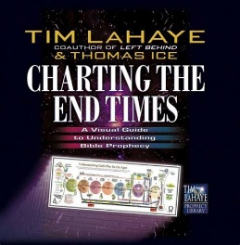
Thomas D. Ice Thomas D. Ice, "The Feasts of Israel in Prophecy," in Charting the End Times: A Visual Guide to Understanding Bible Prophecy, ed. Time LaHaye and Thomas Ice (Eugene, OR: Harvest House, 2001), 103-104.
“The three fall feasts await fulfillment in the events that will take place at the Second Coming of Christ and in the Millennium. The Feast of Trumpets will take place at the Second Coming, as Matthew 24:31 indicates: ‘He will send forth his angels with a great trumpet and they will gather together His elect from the four winds, from one end of the sky to the other.’ The Day of Atonement will be applied to the nation of Israel when the people realize that Jesus was their long-awaited Messiah all along (Zechariah 12:10; Romans 11:25–27). And the Feast of Tabernacle’s will be fulfilled by the Millennial kingdom when the Jewish nation will dwell with their God in the land of Israel for 1000 years.”

Slide 80
CONCLUSION

Slide 81
MAIL BAG
First seal already opened?
Salvation in the Tribulation?
Global reset & Revelation 13?
Rapture in Revelation 1:7?
Rapture in Revelation 12:5?
Will the Rapture occur on a Hebrew feast day?

