Slide 1
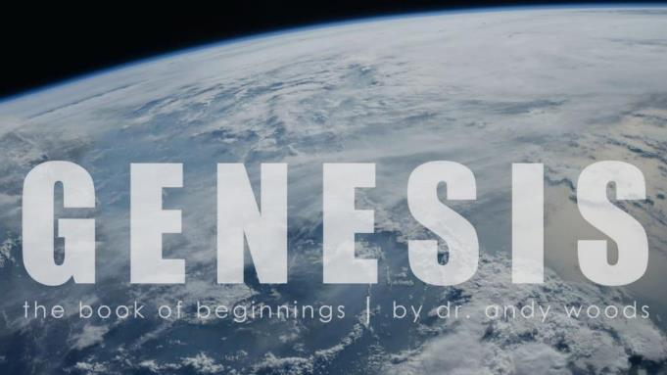
Genesis 12‒50
Israel’s Birth & Preservation

Slide 2
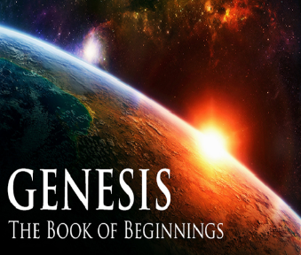
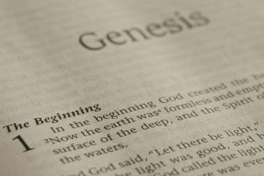
GENESIS STRUCTURE
Beginning of the Human race (Gen. 1‒11)
Beginning of the Hebrew race (Gen. 12‒50)

Slide 3
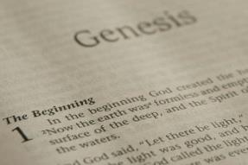
GENESIS STRUCTURE
Genesis 1-11 (four events)
Creation (1-2)
Fall (3-5)
Flood (6-9)
National dispersion (10-11)

Slide 4
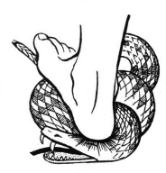
Genesis 3:15
“And I will put enmity Between you and the woman, And between your seed and her seed; He shall bruise you on the head, And you shall bruise him on the heel.”

Slide 5
GENESIS STRUCTURE
Beginning of the Human race (Gen. 1‒11)
Beginning of the Hebrew race (Gen. 12‒50)

Slide 6
GENESIS STRUCTURE
Genesis 12-50 (four people)
Abraham (12:1–25:11)
Isaac (25:12–26:35)
Jacob (27–36)
Joseph (37–50)

Slide 7
Isaiah 43:1
“But now, thus says the Lord, your Creator, O Jacob, And He who formed you, O Israel, 'Do not fear, for I have redeemed you; I have called you by name; you are Mine!'”

Slide 8
GENESIS STRUCTURE
Genesis 12-50 (four people)
Abraham (12:1–25:11)
Isaac (25:12–26:35)
Jacob (27–36)
Joseph (37–50)

Slide 9
Genesis 11:27‒12:3 A New Nation
A new record (Gen. 11:27a)
A new family (Gen. 11:27b-29)
A new crisis (Gen. 11:30)
A new journey (Gen. 11:31)
A death (Gen. 11:32)
New promises (Gen. 12:1-3)

Slide 10
VI. 8 New Promises Genesis 12:1-3
Land (Gen. 12:1b)
Great nation (Gen. 12:2a)
Personal blessing (Gen. 12:2b)
Great name (Gen. 12:2c)
Blessing to others (Gen. 12:2d)
Blessing to blessers (Gen. 12:3a)
Cursing to cursers (Gen. 12:3b)
Blessing to the world (Gen. 12:3c)

Slide 11
VI. 8 New Promises Genesis 12:1-3
Land (Gen. 12:1b)
Great nation (Gen. 12:2a)
Personal blessing (Gen. 12:2b)
Great name (Gen. 12:2c)
Blessing to others (Gen. 12:2d)
Blessing to blessers (Gen. 12:3a)
Cursing to cursers (Gen. 12:3b)
Blessing to the world (Gen. 12:3c)

Slide 12
Genesis 12:4‒20 Abraham’s Early Journeys
From Haran to Canaan (Gen. 12:4-5)
In Canaan (Gen. 12:6-9)
In Egypt (Gen. 12:10-20)

Slide 13
Genesis 12:4‒20 Abraham’s Early Journeys
From Haran to Canaan (Gen. 12:4-5)
In Canaan (Gen. 12:6-9)
In Egypt (Gen. 12:10-20)

Slide 14
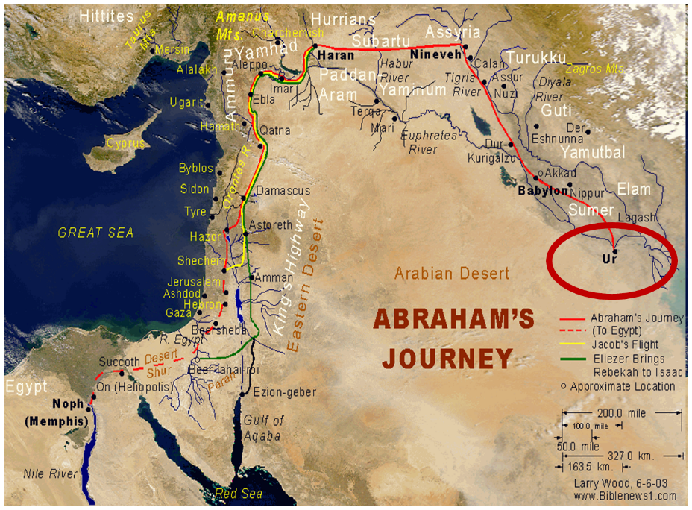

Slide 15
VI. 8 New Promises Genesis 12:1-3
Land (Gen. 12:1b)
Great nation (Gen. 12:2a)
Personal blessing (Gen. 12:2b)
Great name (Gen. 12:2c)
Blessing to others (Gen. 12:2d)
Blessing to blessers (Gen. 12:3a)
Cursing to cursers (Gen. 12:3b)
Blessing to the world (Gen. 12:3c)

Slide 17
Genesis 12:4‒20 Abraham’s Early Journeys
From Haran to Canaan (Gen. 12:4-5)
In Canaan (Gen. 12:6-9)
In Egypt (Gen. 12:10-20)

Slide 18
II. In Canaan Genesis 12:6-9
At Shechem (Gen. 12:6-7)
Between Bethel and Ai (Gen. 12:8)
Toward the Negev (Gen. 12:9)

Slide 19
II. In Canaan Genesis 12:6-9
At Shechem (Gen. 12:6-7)
Between Bethel and Ai (Gen. 12:8)
Toward the Negev (Gen. 12:9)

Slide 20
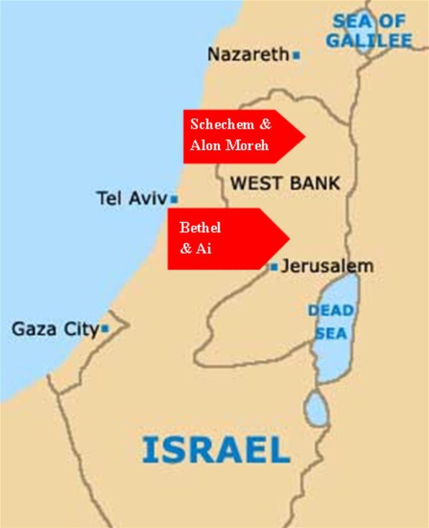

Slide 21
GENESIS 10 Outline
Introduction (1)
Japheth's line (2-5)
Ham’s Line (6-20)
Shem’s line (21-31)
Conclusion (32)

Slide 22
Ham’s Sons (vs. 6)
Cush
Mizraim
Put
Canaan

Slide 23
4. Canaan’s Sons (vs. 15-18)
Sidon
Heth
Jebusite
Amorite
Girgashite
Hivite
Arkite
Sinite
Arvadite
Zemarite
Hamathite

Slide 24
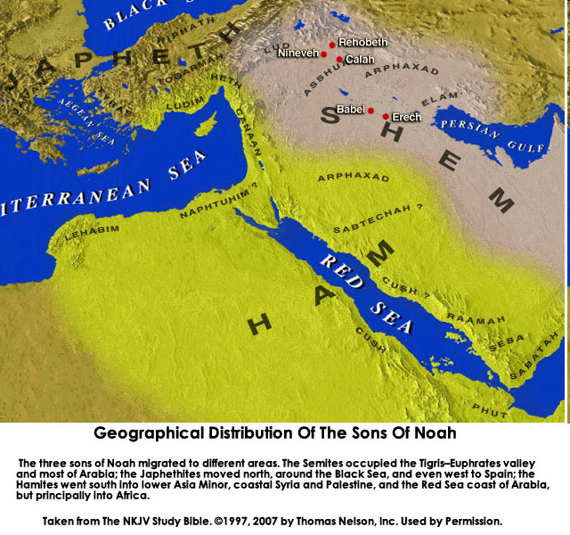

Slide 25
VI. 8 New Promises Genesis 12:1-3
Land (Gen. 12:1b)
Great nation (Gen. 12:2a)
Personal blessing (Gen. 12:2b)
Great name (Gen. 12:2c)
Blessing to others (Gen. 12:2d)
Blessing to blessers (Gen. 12:3a)
Cursing to cursers (Gen. 12:3b)
Blessing to the world (Gen. 12:3c)

Slide 27
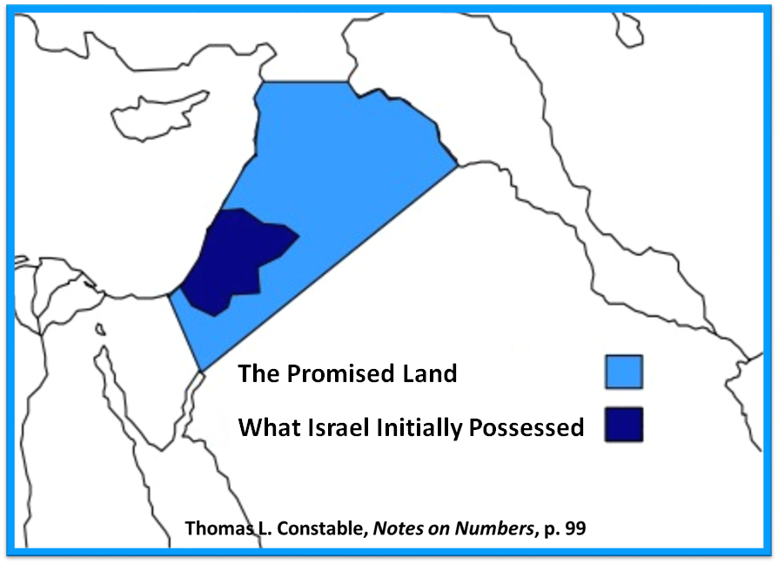

Slide 28
II. In Canaan Genesis 12:6-9
At Shechem (Gen. 12:6-7)
Between Bethel and Ai (Gen. 12:8)
Toward the Negev (Gen. 12:9)

Slide 30
II. In Canaan Genesis 12:6-9
At Shechem (Gen. 12:6-7)
Between Bethel and Ai (Gen. 12:8)
Toward the Negev (Gen. 12:9)

Slide 31
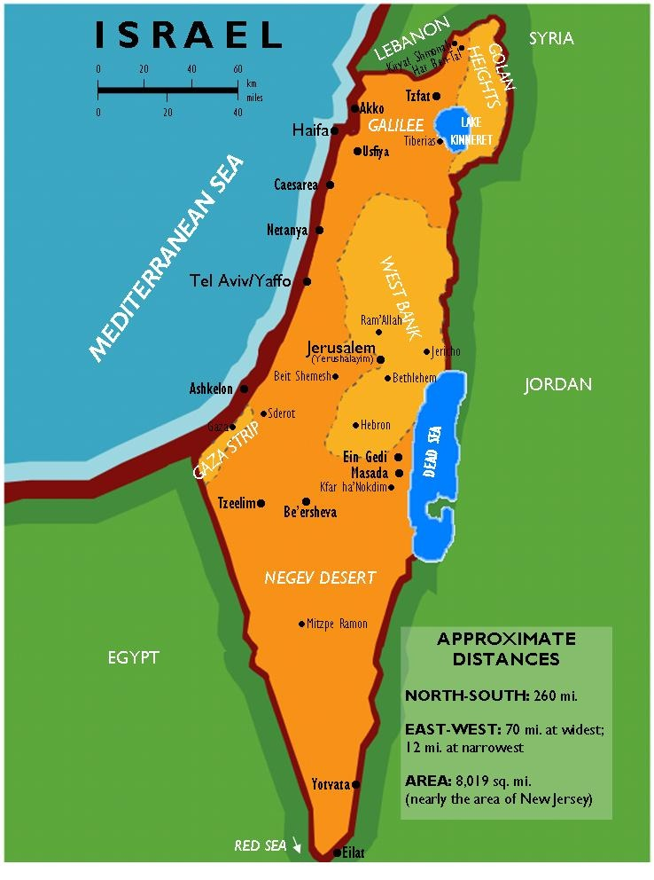
Negev

Slide 32
Genesis 12:4‒20 Abraham’s Early Journeys
From Haran to Canaan (Gen. 12:4-5)
In Canaan (Gen. 12:6-9)
In Egypt (Gen. 12:10-20)

Slide 33
III. In Egypt Genesis 12:10-20
Famine (Gen. 12:10)
Fabrication (Gen. 12:11-13)
Fulfilled prediction (Gen. 12:14-16)
Fury of God (Gen. 12:17)
Fury of Pharoah (Gen. 12:18-20)

Slide 34
III. In Egypt Genesis 12:10-20
Famine (Gen. 12:10)
Fabrication (Gen. 12:11-13)
Fulfilled prediction (Gen. 12:14-16)
Fury of God (Gen. 12:17)
Fury of Pharoah (Gen. 12:18-20)

Slide 35
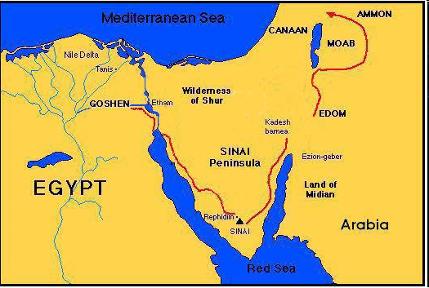

Slide 37
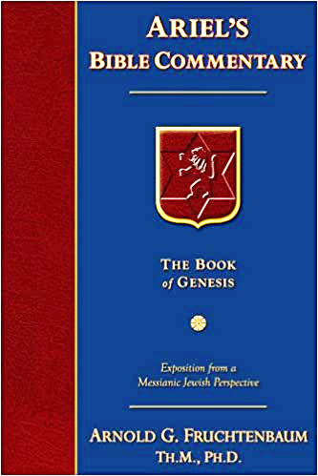
Dr. Arnold G. Fruchtenbaum
The Book of Genesis, 248
“Archeology has verified what is described in this verse, because paintings in the Tomb of Khnun-hotep III in Beni Hagan, which dates back to the time of Sesostris II (1897–1878 b.c.), show the arrival of thirty-seven Asiatic men, women, and children in the same time period of Abram. Thus, Egypt regularly experienced migrations of Asiatics into Egypt, especially in times of famine.”

Slide 38
III. In Egypt Genesis 12:10-20
Famine (Gen. 12:10)
Fabrication (Gen. 12:11-13)
Fulfilled prediction (Gen. 12:14-16)
Fury of God (Gen. 12:17)
Fury of Pharoah (Gen. 12:18-20)

Slide 39
Dr. Arnold G. Fruchtenbaum
The Book of Genesis, 248
“Verse 11b focuses on Sarai’s beauty: that he said unto Sarai his wife, Behold now, I know that you are a fair woman to look upon. The Hebrew literally reads “of beautiful appearance.” This is phenomenal in light of the fact that she was 65 years old at this time. Nevertheless, in light of her longevity, she obviously aged at a slower pace than people do now.”

Slide 40
III. In Egypt Genesis 12:10-20
Famine (Gen. 12:10)
Fabrication (Gen. 12:11-13)
Fulfilled prediction (Gen. 12:14-16)
Fury of God (Gen. 12:17)
Fury of Pharoah (Gen. 12:18-20)

Slide 41
VI. 8 New Promises Genesis 12:1-3
Land (Gen. 12:1b)
Great nation (Gen. 12:2a)
Personal blessing (Gen. 12:2b)
Great name (Gen. 12:2c)
Blessing to others (Gen. 12:2d)
Blessing to blessers (Gen. 12:3a)
Cursing to cursers (Gen. 12:3b)
Blessing to the world (Gen. 12:3c)

Slide 42
III. In Egypt Genesis 12:10-20
Famine (Gen. 12:10)
Fabrication (Gen. 12:11-13)
Fulfilled prediction (Gen. 12:14-16)
Fury of God (Gen. 12:17)
Fury of Pharoah (Gen. 12:18-20)

Slide 43
VI. 8 New Promises Genesis 12:1-3
Land (Gen. 12:1b)
Great nation (Gen. 12:2a)
Personal blessing (Gen. 12:2b)
Great name (Gen. 12:2c)
Blessing to others (Gen. 12:2d)
Blessing to blessers (Gen. 12:3a)
Cursing to cursers (Gen. 12:3b)
Blessing to the world (Gen. 12:3c)

Slide 44
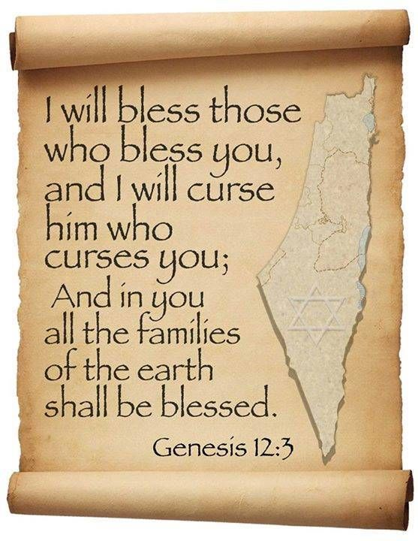
Genesis 12:3
“And I will bless those who bless you, And the one who curses you I will curse. And in you all the families of the earth will be blessed.”

Slide 45
Dr. Arnold G. Fruchtenbaum
The Book of Genesis, 250
“The text does not state exactly what these plagues were, but according to rabbinic tradition, they were leprosy. According to Rashi, the plagues were a debilitating skin disease that made sexual intercourse impossible.”

Slide 46
Dr. Arnold G. Fruchtenbaum
The Book of Genesis, 250-51
“Although it was Abram who sinned, God still intervenes because the Abrahamic Covenant is indeed unconditional…The key observation here is that indeed the Abrahamic Covenant has now begun to work in earnest: Pharaoh was cursed for cursing Abram, and Abram was blessed in spite of his wrong actions. This all shows evidence that the covenant was unconditional.”

Slide 47
III. In Egypt Genesis 12:10-20
Famine (Gen. 12:10)
Fabrication (Gen. 12:11-13)
Fulfilled prediction (Gen. 12:14-16)
Fury of God (Gen. 12:17)
Fury of Pharoah (Gen. 12:18-20)

Slide 48
Genesis 3:15
“And I will put enmity Between you and the woman, And between your seed and her seed; He shall bruise you on the head, And you shall bruise him on the heel.”

Slide 49
Dr. Arnold G. Fruchtenbaum
The Book of Genesis, 250
“Abram must learn that he survives not by human strategy, as he thought, but by divine covenantal protection.”

Slide 50
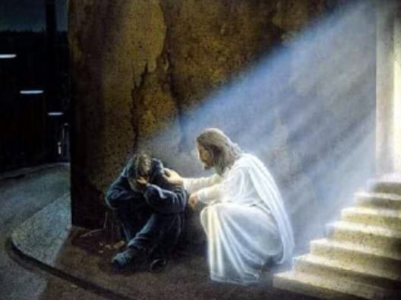
2 Timothy 2:11, 13
“The statement is trustworthy:…If we are faithless, He remains faithful, for He cannot deny Himself.”

Slide 51
Conclusion

Slide 52
Genesis 12:4‒20 Abraham’s Early Journeys
From Haran to Canaan (Gen. 12:4-5)
In Canaan (Gen. 12:6-9)
In Egypt (Gen. 12:10-20)

Slide 53
“The Lord bless you and keep you; the Lord make his face shine on you and be gracious to you; the Lord turn his face toward you and give you peace.” (NIV)

