Slide 1
ZIONISM
OLIVIER MELNICK
CHOSEN PEOPLE MINISTRIES
WHAT
IT IS
AND
WHAT
IT IS
NOT!
ZIONISM

Slide 2
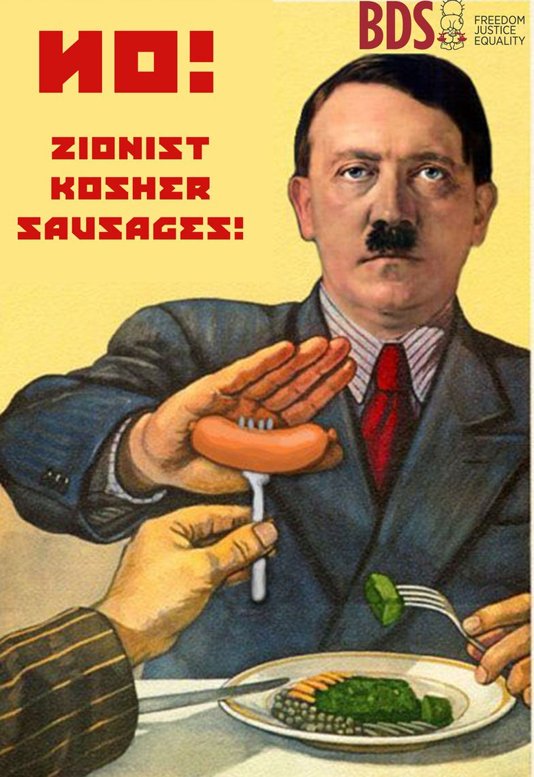
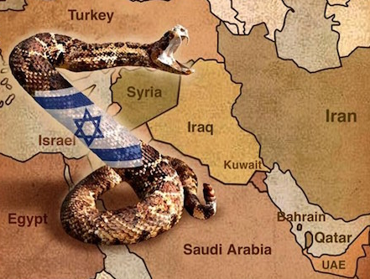
WHAT PEOPLE ARE SAYING ON ONE SIDE:
UN General Assembly Resolution 3379, adopted in November 1975 by a vote of 72 to 35
UN General Assembly Resolution 46/86, adopted in December 1991, revoked the determination in Resolution 3379, which had called Zionism a form of racism.

Slide 3
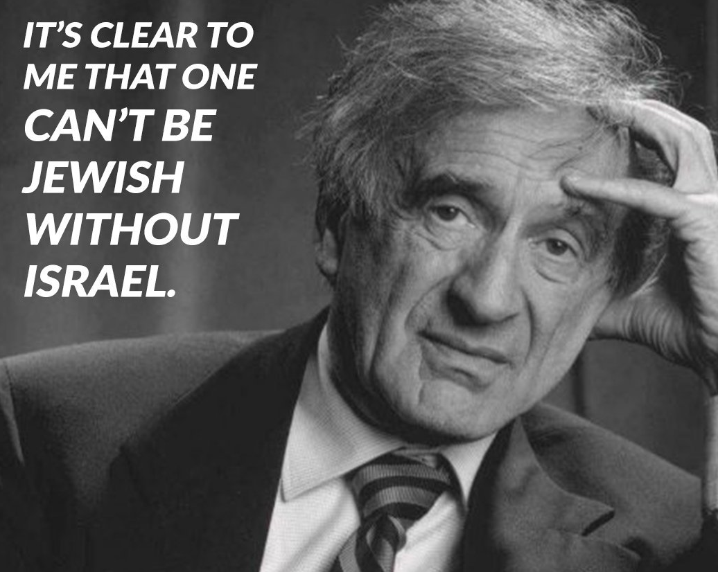
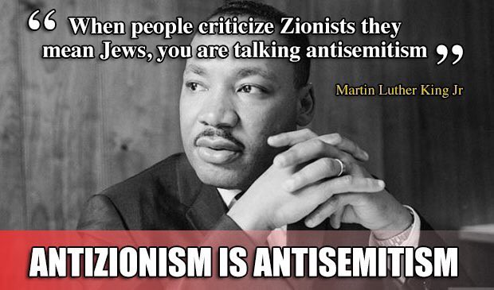
WHAT PEOPLE ARE SAYING ON THE OTHER SIDE:

Slide 4
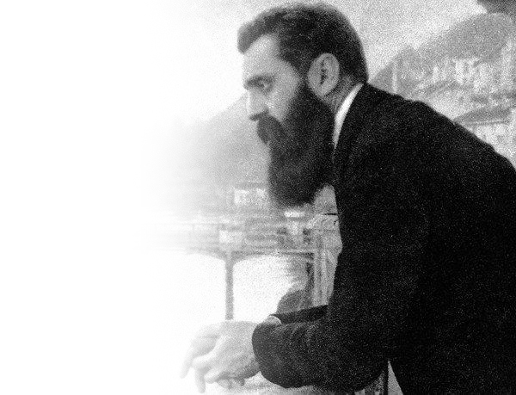
• COLONIZATION • APARTHEID • ETHNIC CLEANSING • RACISM • IMPERIALISM • HUMAN RIGHTS VIOLATIONS • OCCUPATION
ANTI-ZIONIST ACCUSATION

Slide 5
MYTH #1: ISRAEL IS GUILTY OF ETHNIC CLEANSING
FACT! Ethnic cleansing or genocide is intentional organized mass murder to eradicate a people group. The Armenian Genocide and the Holocaust qualify as ethnic cleansings.
• In 1947 there were about 1.2 MM Arabs in British Mandate Palestine. Today, there are about 6 MM Arabs in the whole land, including 1.8 MM in Israel alone. There are more Arabs in Israel today than before 1947. This is the opposite of ethnic cleansing. •On the other hand, there are still less Jewish people in 2019 than there were prior to the Holocaust.

Slide 6
MYTH #2: ISRAEL IS AN APARTHEID STATE
FACT! Apartheid was South Africa’s way of keeping blacks and whites separated, and as such, it forbade blacks to eat in white restaurants or cafes, attend white schools or universities, be treated in white hospitals, live in white neighborhoods and serve in the white government. • Israeli Arabs are full citizens who do not experience any of the restrictions that were known to South Africa.
•The only difference is with citizens of Gaza and the West Bank, but THEY do not want to be Israeli citizens.

Slide 7
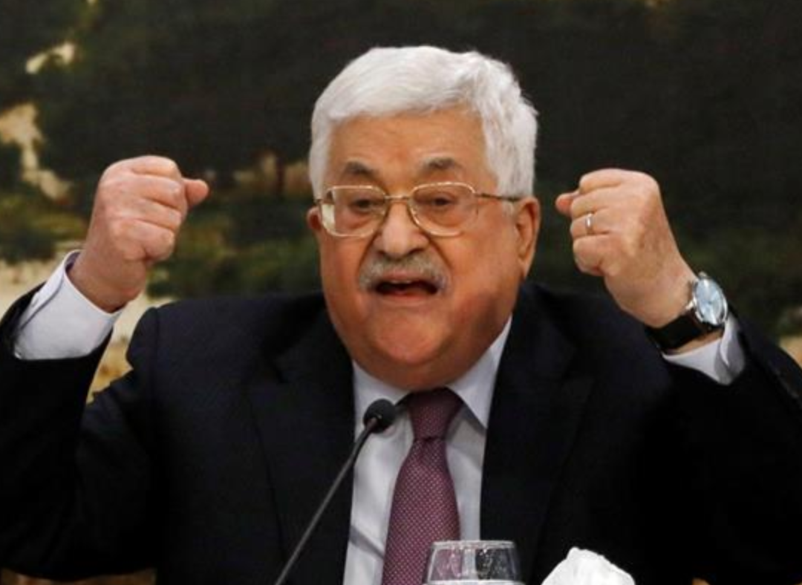
IN REALITY APARTHEID AND ETHNIC CLEANSING EXIST HERE:
“In a final resolution, we would not see the presence of a single Israeli – civilian or soldier- on our lands”
Mahmoud Abbas to an Egyptian journalist, 2013

Slide 8
SOME DEFINITIONS FOR ZIONISM
• Jewish nationalist movement that has had as its goal the creation and support of a Jewish national state in Palestine, the ancient homeland of the Jews. Encyclopædia Britannica • An international movement originally for the establishment of a Jewish national or religious community in Palestine and later for the support of modern Israel. Merriam-Webster Dictionary • The national movement for the return of the Jewish people to their homeland and the resumption of Jewish sovereignty in the Land of Israel. Jewish Virtual Library

Slide 9
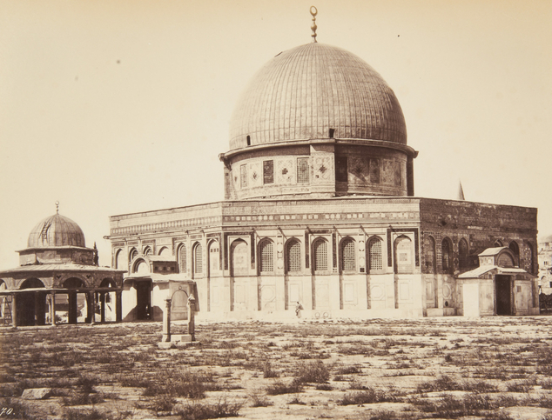
THE HOLY LAND BEFORE ZIONISM
The Dome of the Rock (c. 1870)
• Notice the overgrown grass patches indicating very little traffic or use of the area.

Slide 10
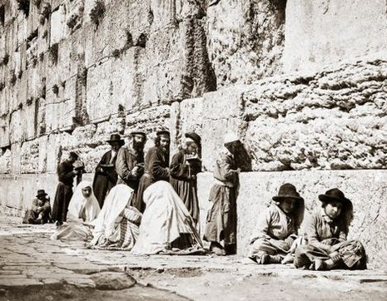
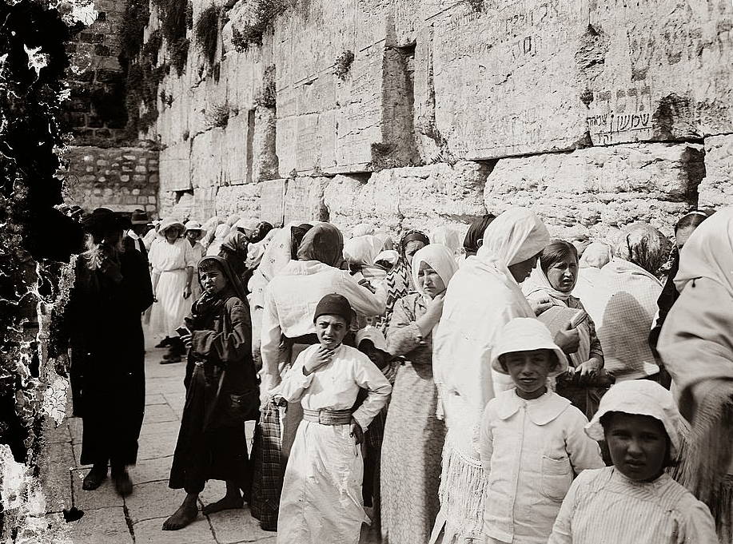
The Kotel (Wailing Wall, c. 1800)
• A time when both Jewish men and women prayed together.
THE HOLY LAND BEFORE ZIONISM

Slide 11
JEWISH LIFE IN THE DIASPORA BEFORE ZIONISM:
LEO PINSKER (1821-1891)
• Haskalah (Jewish enlightenment): Started in 1770s ended in 1880s. The Maskilim “Enlightened Ones” led an intellectual movement promoting liberalism and freedom of thought. The hope was the emancipation of European Jews and equality in the various countries where they lived. It failed!
• 1880s: Russian Pogroms
• 1882: Leo Pinsker, a physician who believed that Jews could attain equal rights, got discouraged and wrote “Auto-Emancipation”.

Slide 12
JEWISH LIFE IN THE DIASPORA BEFORE ZIONISM: LEO PINSKER
“Indeed, what a pitiful figure we cut! We are not counted among the nations, neither have we a voice in their councils, even when the affairs concern us. Our fatherland–the other man's country; our unity-dispersion; our solidarity - the battle against us; our weapon - humility; our defense - flight; our individuality - adaptability ; our future - the next day. What a miserable role for a nation which descends from the Maccabees!

Slide 13
… Happily, matters stand somewhat differently now. The events of the last few years in enlightened Germany, in Romania, in Hungary, and especially in Russia, have effected what the far bloodiest persecutions of the Middle Ages could not. The national consciousness which until then had lain dormant in sterile martyrdom awoke the masses of the Russian and Romanian Jews and took form in an irresistible movement toward Palestine.”
Leo Pinsker (Auto-Emancipation, 1882)

Slide 14
JEWISH LIFE IN THE DIASPORA AROUND THE START OF ZIONISM:
• The Dreyfus Affair: in 1894, French Captain Alfred Dreyfus is falsely accused of treason, stripped of his rank, sent to imprisonment on Devil’s Island, but eventually vindicated.
• The Austrian journalist, Theodor Herzl covered the trial in Paris, and became rapidly convinced that Dreyfus had been framed and that Jews had no future in Europe. Two years later he published “Der Judenstaadt.”

Slide 15
THE BIRTH OF ZIONISM: DER JUDENSTAAT
The idea I have developed in this pamphlet is an ancient one: It is the restoration of the Jewish State. . . The decisive factor is our propelling force. And what is that force? The plight of the Jews. . . I am profoundly convinced that I am right, though I doubt whether I shall live to see myself proved so. Those who today inaugurate this movement are unlikely to live to see its glorious culmination. But the very inauguration is enough to inspire in them a high pride and the joy of an inner liberation of their existence. . .

Slide 16
THE BIRTH OF ZIONISM:
1897: The 1st Zionist Congress Basel, Switzerland.
•“At Basel, I founded the Jewish State. If I said this out loud today, I would be answered by universal laughter. Perhaps in five years, certainly in fifty, everyone will know it.” • 1897 + 50 =1947
• November 29, 1947, the UN General Assembly voted in favor of partitioning Palestine, putting in motion the re-birth of the modern state of Israel that took place on May 14, 1948.

Slide 17
JEWISH LIFE IN THE DIASPORA BEFORE ZIONISM:
• The Protocols of the Elders of Zion: • A hoax first published by Russian Sergei Nilus in 1905.
• Possibly the most anti-Semitic pamphlet ever written in modern history.
• Used and re-used by many including Hitler, Henri Ford and many in the Middle East to this day.

Slide 18
THE BIRTH OF ZIONISM:
The Aliyot: Successive waves of Jewish Immigration to “Palestine”
• First Aliyah (1882-1903) – 25,000 Jews already live in the land. 25,000 more arrive from Eastern Europe.
• Second Aliyah (1904-1914) – Encouraged by Herzl and forced by increased pogroms and antisemitism, 40,000 more Jews arrive in Palestine by 1914.
• By 1914, there were almost 100,000 Jews in the land. Zionism was developing as they were purchasing land and settling down.

Slide 19
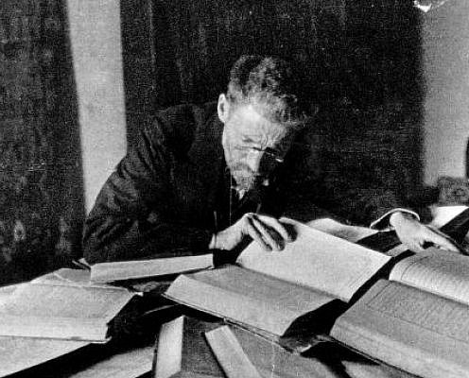
OTHER PILLARS OF ZIONISM:
Eliezer Ben Yehuda revives the Hebrew language and modernizes it.
•Ben Yehuda was a Russian
lexicographer who moved to
Israel in 1881 with his family. He spent the rest of his life
developing modern Hebrew to
replace Yiddish as the spoken
language of Israel.
• His son Ben Zion Ben Yehuda
was the first modern Hebrew
speaking person in 2,000 years.

Slide 20
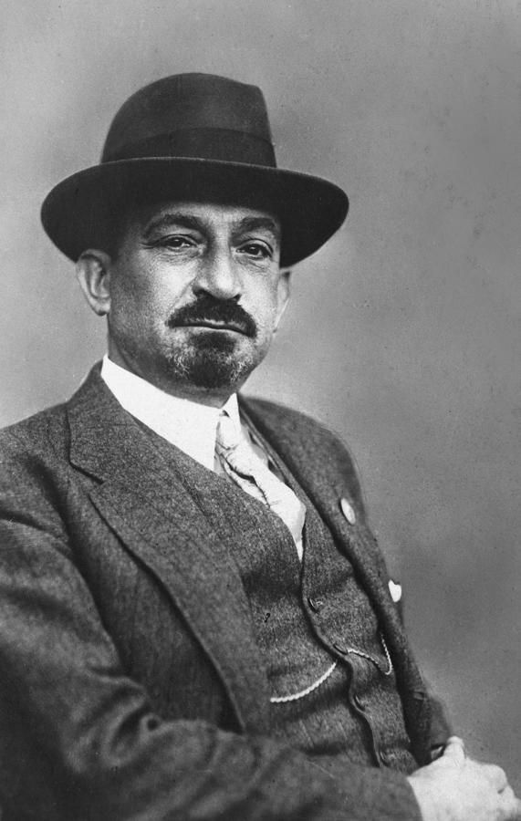
OTHER PILLARS OF ZIONISM:
Chaim Weizmann and Acetone •Chaim Weizmann was a chemist born in Russia in 1874.
• He was bolder than Herzl in his approach to Zionism.
• While in England, in 1916 he developed a way to make acetone (key component in the manufacturing of ammunitions.) His close ties with British politicians and his invention led to a critical moment in Israel’s history: The Balfour Declaration.

Slide 21
MILESTONES IN ZIONISM: THE BALFOUR DECLARATION
• “His Majesty's Government views with favour the establishment in Palestine of a national home for the Jewish people, and will use their best endeavours to facilitate the achievement of this object, it being clearly understood that nothing shall be done which may prejudice the civil and religious rights of existing non-Jewish communities in Palestine”

Slide 22
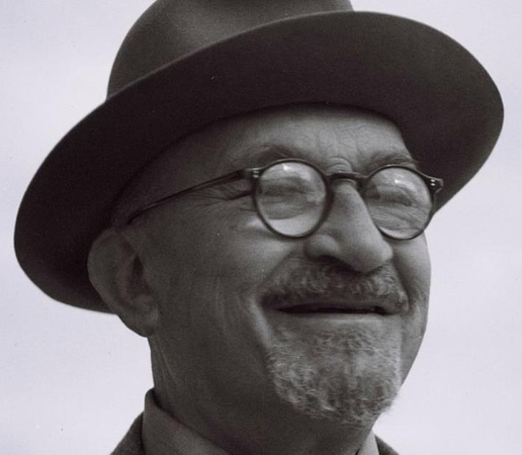
MILESTONES IN ZIONISM:
THE SAN REMO CONFERENCE
• A post-WW1 international conference (Great Britain, France, Italy, Japan and the United States)
• A continuation of the Balfour Declaration.
• Chaim Weizmann, present at the conference said “You can say that the State of Israel was born the 25th of April 1920 in San Remo”

Slide 23
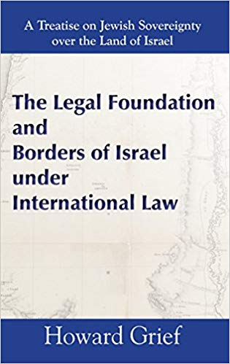
MILESTONES IN ZIONISM:
THE SAN REMO CONFERENCE
• Adopted by the League of Nations.
• 51/63 countries signed it.
• Gave the rights to Palestine to the Jews.
• Gave the rights to rest of Middle East to Arabs.
• Established an international legal precedent that superseded any later declaration, even from the UN
didn’t have the right to change in 1947.

Slide 24
MOVING FORWARD WITH ZIONISM:
THE 1930s: Aliyot, Germany and the Partitioning of Palestine
• Fifth Aliyah 1933-39: 225,000 mostly German Jews as a result of Hitler’s coming to power and the anti-Jewish laws.
• Boycott of Jerusalem by Muslims (1936-1939): The Grand Mufti of Jerusalem launches a bloody boycott (Jews and Arabs killed in the process.)
• 1939 British White Paper negates the Balfour Declaration and limits legal Jewish immigration to 75,000 for the next 5 years.
• In 1940: 470,000 Jews live in Palestine as the Nazi Holocaust starts to happen. 6,000.000 Jews will perish.

Slide 25
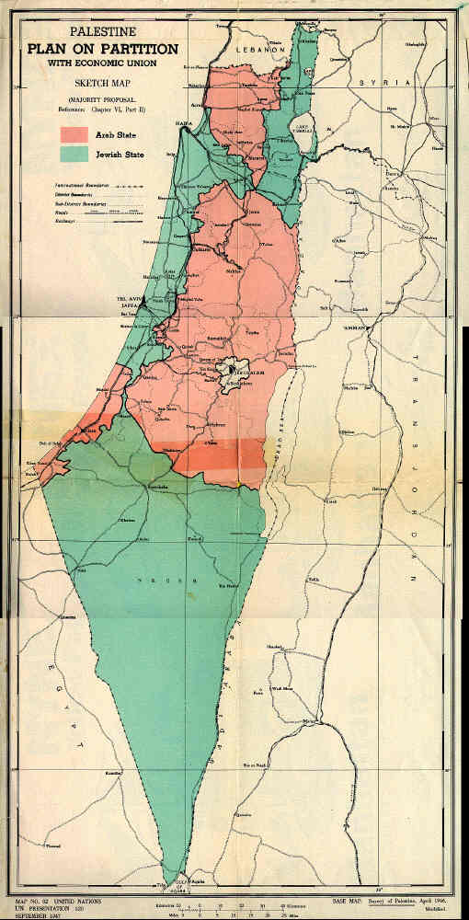
MOVING FORWARD WITH ZIONISM:
1947: UN Partition, Arab Rejection
• UN Resolution 181: Calls for the partitioning of a Jewish state and an Arab state with Jerusalem under UN control.
• UN General Assembly votes in favor
• Britain accepts the plan.
• The Jewish Agency accepts the plan.
• The Arab League rejects the plan.
• Riots start between Jews and Arabs.
• Multiple Arab terrorist attacks.

Slide 26
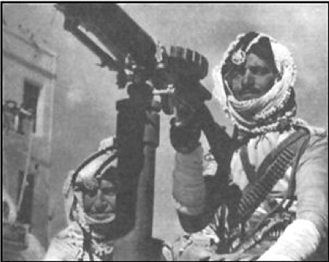
• Ben Gurion: “By virtue of our natural and historic right and the strength of the United Nations Resolution, we hereby declare the establishment of a Jewish state in Eretz-Israel, to be known as The State of Israel.” Full rights and peaceful residence were offered to Arabs.
• Within an hour, the United Sates and Soviet Union recognized Israel
THE BIRTH OF ERETZ YISRAEL:
1948: Declaration of Independence
AND Egypt, Syria, Jordan, Lebanon, Iraq and Saudi Arabia seek to annihilate Israel.
• Azzam Pasha, Leader of the Arab league: “This will be a war of extermination and a massacre which will be spoken of like the Mongolian massacres and the Crusades.”

Slide 27
THE SURVIVAL OF ERETZ YISRAEL:
From 1948 to Today:
1947-49: War of Independence 1956: Sinai War 1967: Six-Day War 1967-70: War of Attrition 1973: Yom Kippur War 1982-85: First Lebanon War 1987-93: First Intifada 2000-05: Second Intifada 2006: Second Lebanon War 2008-09: Operation Cast Lead 2012: Operation Pillar of Defense 2014: Gaza War 2016-19: Gaza Terror Tunnels

Slide 28
IS ZIONISM BIBLICAL?

Slide 29
THE LAND BELONGS TO GOD
LEVITICUS 25:23
The land, moreover, shall not be sold permanently, for the land is Mine; for you are but aliens and sojourners with Me. GOD HAS GRANTED THE JEWISH PEOPLE WITH THE DEED OF A PIECE OF LAND THAT IS HIS TO START WITH.

Slide 30
GOD’s COVENANT WITH ABRAHAM
Genesis 12:1-13 1 Now the Lord said to Abram,“ Go forth from your country, And from your relatives And from your father’s house, To the land which I will show you; 2 And I will make you a great nation, And I will bless you, And make your name great; And so you shall be a blessing; 3 And I will bless those who bless you, And the one who curses you I will curse. And in you all the families of the earth will be blessed.”
GOD’S PROMISE: A LAND, A SEED AND A BLESSING
UNCONDITIONAL AND ETERNAL

Slide 31
GOD’S COVENANT WITH ABRAHAM
Genesis 15:18-21 On that day the Lord made a covenant with Abram, saying,
“To your descendants I have given this land, From the river of Egypt as far as the great river, the river Euphrates: the Kenite and the Kenizzite and the Kadmonite and the Hittite and the Perizzite and the Rephaim and the Amorite and the Canaanite and the Girgashite and the Jebusite.”
GOD’S LAND: TO ABRAHAM’S DESCENDANTS (SEED)
UNCONDITIONAL AND ETERNAL

Slide 32
GOD’S COVENANT WITH ABRAHAM THROUGH ISAAC
Genesis 26:2-4 The Lord appeared to him and said, “Do not go down to Egypt; stay in the land of which I shall tell you. Sojourn in this land and I will be with you and bless you, for to you and to your descendants I will give all these lands, and I will establish the oath which I swore to your father Abraham. I will multiply your descendants as the stars of heaven, and will give your descendants all these lands; and by your descendants all the nations of the earth shall be blessed.
GOD’S LAND: TO ISAAC AND HIS DESCENDANTS (SEED)
UNCONDITIONAL AND ETERNAL

Slide 33
GOD’S COVENANT WITH ABRAHAM THROUGH ISAAC AND JACOB
Genesis 28:13 And behold, the Lord stood above it and said, “I am the Lord, the God of your father Abraham and the God of Isaac; the land on which you lie, I will give it to you and to your descendants.
GOD’S LAND: TO JACOB AND HIS DESCENDANTS (SEED)
UNCONDITIONAL AND ETERNAL

Slide 34
GOD’S COVENANT WITH ABRAHAM THROUGH ISAAC, JACOB AND HIS SONS
Genesis 50:24 Joseph said to his brothers, “I am about to die, but God will surely take care of you and bring you up from this land to the land which He promised on oath to Abraham, to Isaac and to Jacob.”
GOD’S LAND: TO GIVEN AND DIVIDED BETWEEN THE SONS(12 TRIBES) OF ISRAEL(JACOB)

Slide 35
GOD CARES ABOUT THE LAND AND WILL BLESS ISRAEL FOR OBEDIENCE:
Deuteronomy 11:8-17 “You shall therefore keep every commandment which I am commanding you today, so that you may be strong and go in and possess the land into which you are about to cross to possess it; so that you may prolong your days on the land which the Lord swore to your fathers to give to them and to their descendants, a land flowing with milk and honey. For the land, into which you are entering to possess it, is not like the land of Egypt from which you came, where you used to sow your seed and water it with your foot like a vegetable garden.

Slide 36
GOD CARES ABOUT THE LAND AND WILL BLESS ISRAEL FOR OBEDIENCE:
Deuteronomy 11:8-17 But the land into which you are about to cross to possess it, a land of hills and valleys, drinks water from the rain of heaven, a land for which the Lord your God cares; the eyes of the Lord your God are always on it, from the beginning even to the end of the year. “It shall come about, if you listen obediently to my commandments which I am commanding you today, to love the Lord your God and to serve Him with all your heart and all your soul, that He will give the rain for your land in its season, the early and late rain, that you may gather in your grain and your new wine and your oil.

Slide 37
GOD CARES ABOUT THE LAND AND WILL BLESS ISRAEL FOR OBEDIENCE:
Deuteronomy 11:8-17 He will give grass in your fields for your cattle, and you will eat and be satisfied. Beware that your hearts are not deceived, and that you do not turn away and serve other gods and worship them. Or the anger of the Lord will be kindled against you, and He will shut up the heavens so that there will be no rain and the ground will not yield its fruit; and you will perish quickly from the good land which the Lord is giving you.

Slide 38
THE LAND IS PROMISED BASED ON GOD’S CHARACTER NOT ISRAEL PERFORMANCE:
Deuteronomy 7:7-9
“The Lord did not set His love on you nor choose you because you were more in number than any of the peoples, for you were the fewest of all peoples, but because the Lord loved you and kept the oath which He swore to your forefathers, the Lord brought you out by a mighty hand and redeemed you from the house of slavery, from the hand of Pharaoh king of Egypt. Know therefore that the Lord your God, He is God, the faithful God, who keeps His covenant and His lovingkindness to a thousandth generation with those who love Him and keep His commandments;

Slide 39
GOD TOLD ISRAEL TO CONQUER THE LAND
Deuteronomy 9:3-5 Know therefore today that it is the Lord your God who is crossing over before you as a consuming fire. He will destroy them and He will subdue them before you, so that you may drive them out and destroy them quickly, just as the Lord has spoken to you. “Do not say in your heart when the Lord your God has driven them out before you, ‘Because of my righteousness the Lord has brought me in to possess this land,’ but it is because of the wickedness of these nations that the Lord is dispossessing them before you. It is not for your righteousness or for the uprightness of your heart that you are going to possess their land, but it is because of the wickedness of these nations that the Lord your God is driving them out before you, in order to confirm the oath which the Lord swore to your fathers, to Abraham, Isaac and Jacob.

Slide 40
GOD TOLD ISRAEL TO CONQUER THE LAND
Deuteronomy 9:3-5 • God goes before Israel to conquer the land.
• It is NOT because of Israel’s righteousness that the land is won.
• It is because of the Canaanites’ wickedness
• It is because of God’s oath to the forefathers
• Israel’s conquest was historical NOT normative
(Deuteronomy 2:3-5, 16-19)

Slide 41
THE BABYLONIAN CAPTIVITY DIDN’T
ANNUL THE OATH MADE BY GOD
Leviticus 26:41-45 I also was acting with hostility against them, to bring them into the land of their enemies—or if their uncircumcised heart becomes humbled so that they then make amends for their iniquity, then I will remember My covenant with Jacob, and I will remember also My covenant with Isaac, and My covenant with Abraham as well, and I will remember the land. For the land will be abandoned by them, and will make up for its sabbaths while it is made desolate without them.

Slide 42
THE BABYLONIAN CAPTIVITY DIDN’T
ANNUL THE OATH MADE BY GOD
Leviticus 26:41-45 They, meanwhile, will be making amends for their iniquity, because they rejected My ordinances and their soul abhorred My statutes. Yet in spite of this, when they are in the land of their enemies, I will not reject them, nor will I so abhor them as to destroy them, breaking My covenant with them; for I am the Lord their God. But I will remember for them the covenant with their ancestors, whom I brought out of the land of Egypt in the sight of the nations, that I might be their God. I am the Lord.’”

Slide 43
GOD PROMISES A GLORIOUS FUTURE FOR ISRAEL
Jeremiah 31:31-34
“Behold, days are coming,” declares the Lord, “when I will make a new covenant with the house of Israel and with the house of Judah, not like the covenant which I made with their fathers in the day I took them by the hand to bring them out of the land of Egypt, My covenant which they broke, although I was a husband to them,” declares the Lord. “But this is the covenant which I will make with the house of Israel after those days,” declares the Lord, “I will put My law within them and on their heart I will write it; and I will be their God, and they shall be My people. They will not teach again, each man his neighbor and each man his brother, saying, ‘Know the Lord,’ for they will all know Me, from the least of them to the greatest of them,” declares the Lord, “for I will forgive their iniquity, and their sin I will remember no more.”

Slide 44
ISRAEL’S GLORIOUS FUTURE INCLUDES A
FINAL PHYSICAL RESTORATION TO THE LAND
Ezekiel 39:25-29
Therefore thus says the Lord God, “Now I will restore the fortunes of Jacob and have mercy on the whole house of Israel; and I will be jealous for My holy name. They will forget their disgrace and all their treachery which they perpetrated against Me, when they live securely on their own land with no one to make them afraid. When I bring them back from the peoples and gather them from the lands of their enemies, then I shall be sanctified through them in the sight of the many nations. Then they will know that I am the Lord their God because I made them go into exile among the nations, and then gathered them again to their own land; and I will leave none of them there any longer. I will not hide My face from them any longer, for I will have poured out My Spirit on the house of Israel,” declares the Lord God.

Slide 45
ISRAEL’S GLORIOUS FUTURE IS SECURE BECAUSE OF GOD’S CHARACTER
Ezekiel 36:22-28
“Therefore say to the house of Israel, ‘Thus says the Lord God, “It is not for your sake, O house of Israel, that I am about to act, but for My holy name, which you have profaned among the nations where you went. I will vindicate the holiness of My great name which has been profaned among the nations, which you have profaned in their midst. Then the nations will know that I am the Lord,” declares the Lord God, “when I prove Myself holy among you in their sight.

Slide 46
ISRAEL’S GLORIOUS FUTURE IS SECURE BECAUSEOF GOD’S CHARACTER
Ezekiel 36:22-28
For I will take you from the nations, gather you from all the lands and bring you into your own land. Then I will sprinkle clean water on you, and you will be clean; I will cleanse you from all your filthiness and from all your idols. Moreover, I will give you a new heart and put a new spirit within you; and I will remove the heart of stone from your flesh and give you a heart of flesh. I will put My Spirit within you and cause you to walk in My statutes, and you will be careful to observe My ordinances. You will live in the land that I gave to your forefathers; so you will be My people, and I will be your God.

Slide 47
GOD WAS THE VERY FIRST ZIONIST:
• GOD OWNS THE LAND.
• GOD UNCONDITIONALLY AND ETERNALLY GAVE THE DEED TO THE JEWISH PEOPLE.
• GOD WILL RESTORE ISRAEL TO THE LAND AND EXTEND ITS BOUNDARIES IN THE FUTURE.
BEING A ZIONIST DOESN’T MEAN THAT ONE IS ANTI-PALESTINIAN BUT THE OPPOSITE IS SELDOM TRUE.

Slide 48
BIBLIOGRAPHY
Bard, Mitchell. MYTHS AND FACTS – A GUIDE TO THE ARAB-ISRAELI CONFLICT. Price, Randall. FAST FACTS ON THE MIDDLE-EAST CONFLICT. Rydelnik, Michael. UNDERSTANDING THE ARAB-ISRAEL CONFLICT. Sachar, Howard, A HISTORY OF ISRAEL: FROM THE RISE OF ZIONISM TO OUR TIME. Eban, Abba, THE STORY OF THE JEWS. Pub 1968. Weizmann, Chaim. TRIAL AND ERROR: Autobiography of Chaim Weizman.

Slide 49
Get Olivier Melnick’s latest book On
AMAZON or at: www.oliviermelnick.com
VISIT:
www.chosenpeople.com
CONTACT:
olivier@chosenpeople.com

