Slide 1


Zechariah
Introductory Matters

Slide 2

Introductory Matters
  Title
  Authorship
  Biography
  Scope
  Date
  Audience
  Place of writing

Slide 3
Introductory Matters
  Occasion
  Structure
  Message
  Purposes
  Themes
  Unique characteristics
  Genre
  Christ in Zechariah

Slide 4

Structure
Introductory call to repentance (1:1-6)
Eight-night visions (1:7–6:15)
Question and answers about fasting (7–8)
Two burdens (9–14)

Slide 5
Structure
Introductory call to repentance (1:1-6)
Eight-night visions (1:7–6:15)
Question and answers about fasting (7–8)
Two burdens (9–14)

Slide 6

I. Introductory call to repentance
(1:1-6)
Date (1:1a)
Author (1:1b)
Call to repentance (1:2–6)

Slide 7
Structure
Introductory call to repentance (1:1-6)
Eight-night visions (1:7–6:15)
Question and answers about fasting (7–8)
Two burdens (9–14)

Slide 8
II. Eight Night Visions
(1:7‒6:15)
  Riders & horses among the myrtle trees (1:7-17)
  Four horns & four craftsmen (1:18-21)
  Man with the measuring line (2)
  Cleansing of the High Priest Joshua (3)
  Lampstand & olive tree (4)
  Flying scroll (5:1-4)
  Woman in the basket (5:5-11)
  Four chariots (6:1-8)
  Conclusion: crowning of Joshua (6:9-15)

Slide 9
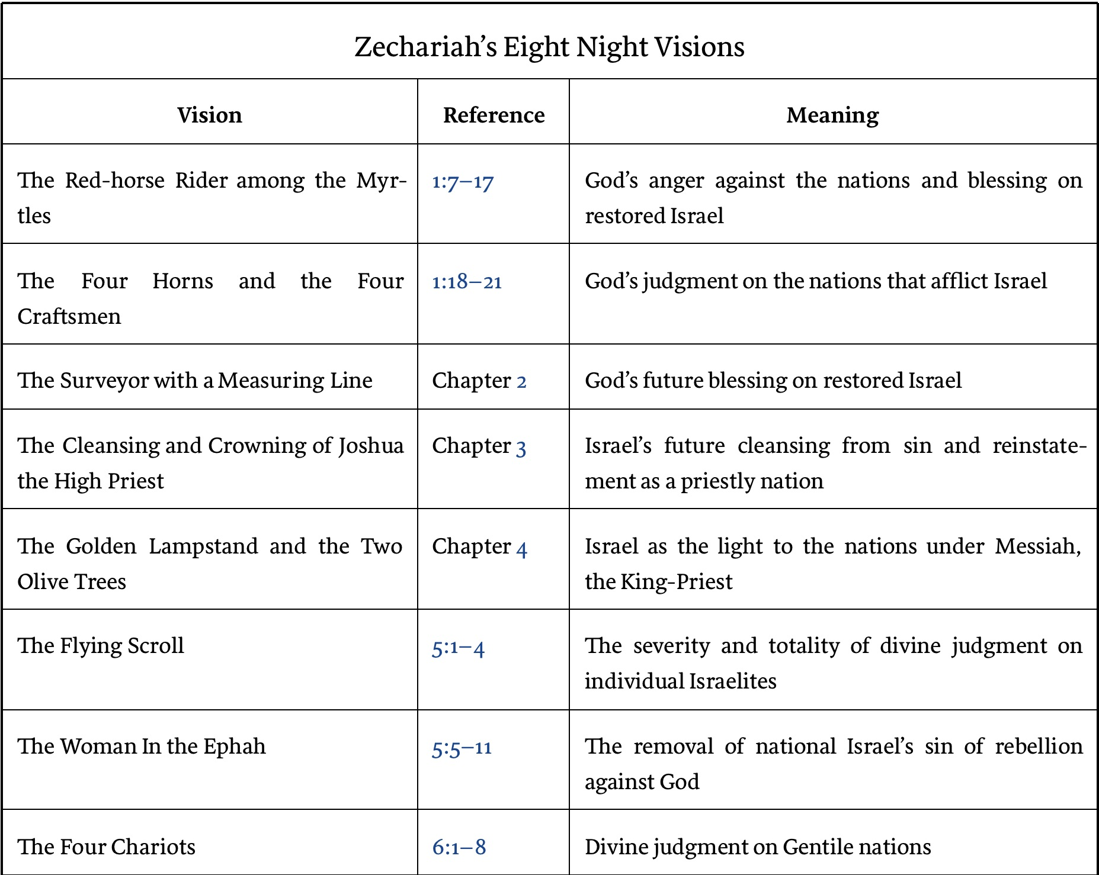

Slide 10
II. Eight Night Visions
(1:7‒6:15)
  Riders & horses among the myrtle trees (1:7-17)
  Four horns & four craftsmen (1:18-21)
  Man with the measuring line (2)
  Cleansing of the High Priest Joshua (3)
  Lampstand & olive tree (4)
  Flying scroll (5:1-4)
  Woman in the basket (5:5-11)
  Four chariots (6:1-8)
  Conclusion: crowning of Joshua (6:9-15)

Slide 11
Rider & Horses Among the Myrtle Trees
(1:7-17)
Date (1:7)
Description (1:8)
Interpretation (1:9–11)
Explanation (1:12-17)

Slide 12
Rider & Horses Among the Myrtle Trees
(1:7-17)
Date (1:7)
Description (1:8)
Interpretation (1:9–11)
Explanation (1:12-17)

Slide 13
III. Interpretation
(1:9-11)
Zechariah’s inquiry (1:9a)
Interpreting angel’s answer (1:9b)
Angel of the Lord’s answer (1:10)
Rider’s report (1:11)

Slide 14
Rider & Horses Among the Myrtle Trees
(1:7-17)
Date (1:7)
Description (1:8)
Interpretation (1:9–11)
Explanation (1:12-17)

Slide 15

IV. Explanation
(1:12-17)
God’s jealousy for Jerusalem (1:12-14)
God’s anger with the nations (1:15)
Jerusalem to be restored (1:16a)
The Temple to be restored (1:16b)
Jerusalem's prosperity to return (1:17)

Slide 16
IV. Explanation
(1:12-17)
God’s jealousy for Jerusalem (1:12-14)
God’s anger with the nations (1:15)
Jerusalem to be restored (1:16a)
The Temple to be restored (1:16b)
Jerusalem's prosperity to return (1:17)

Slide 17


Slide 18
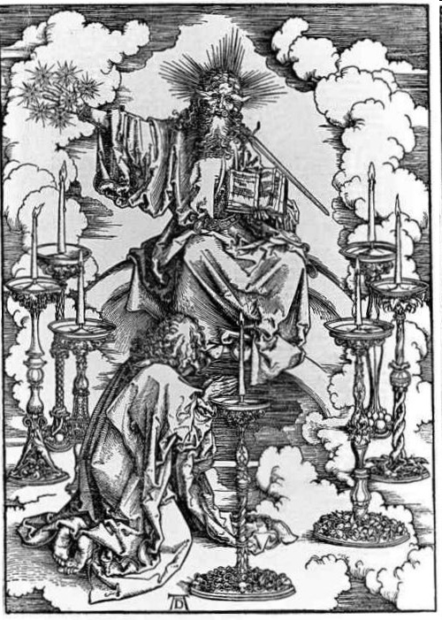

Slide 19

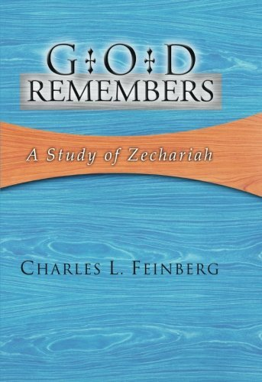
Charles L. Feinberg
God Remembers: A Study of Zechariah (Wheaton: Van Kampen, 1950, p. 34-35.
“The good comforting words, yet before us in verses 14-17, are threefold: (1) God still loves Jerusalem; (2) He is exceedingly angry with the nations that afflicted Israel; (3) He has purposes of glory, prosperity, and enlargement for Jerusalem.”

Slide 20
IV. Explanation
(1:12-17)
God’s jealousy for Jerusalem (1:12-14)
God’s anger with the nations (1:15)
Jerusalem to be restored (1:16a)
The Temple to be restored (1:16b)
Jerusalem's prosperity to return (1:17)

Slide 21
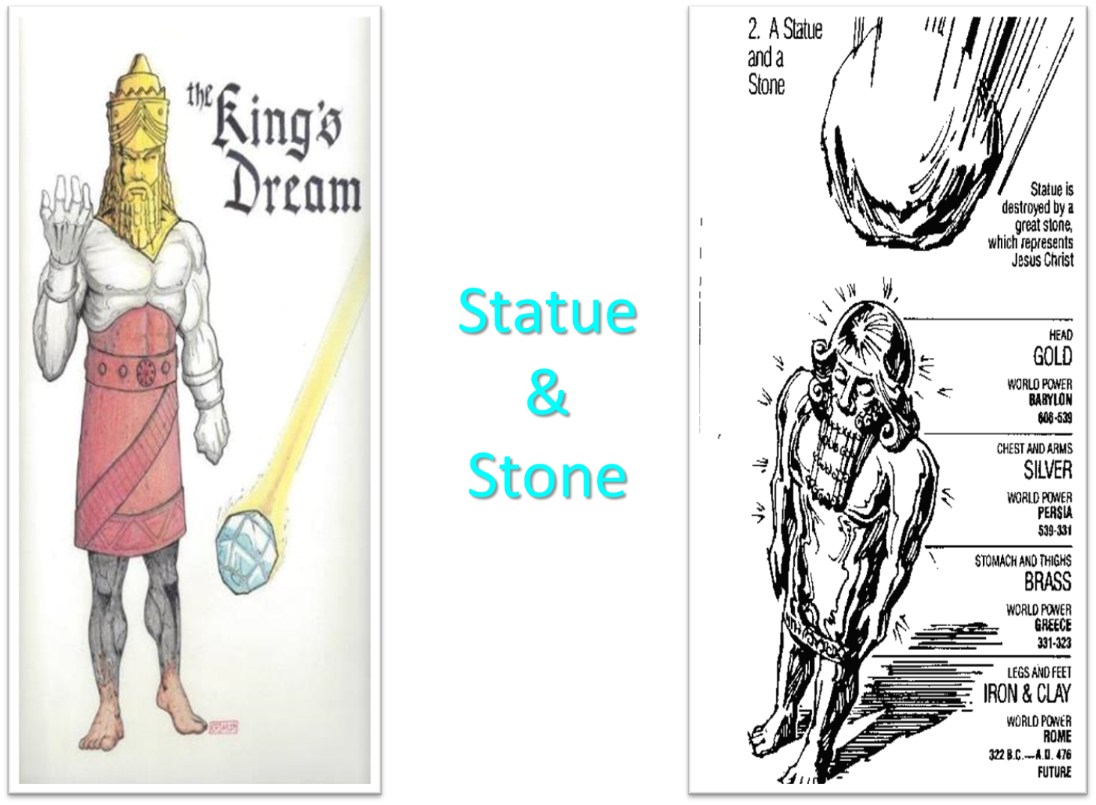

Slide 22


Slide 23

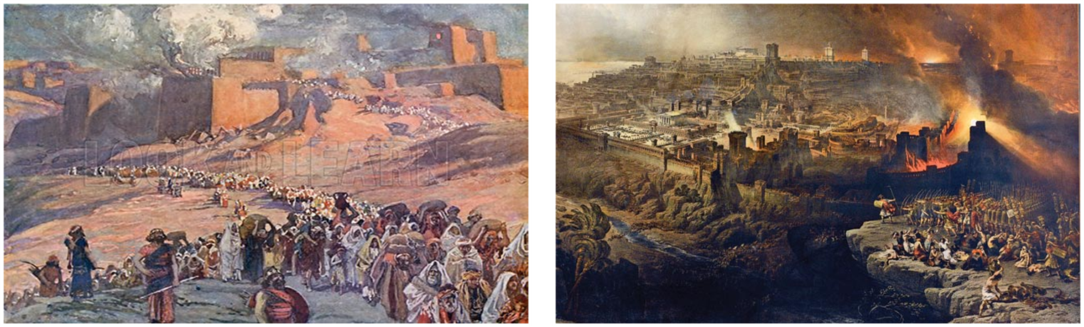
Charles Ryrie
The Ryrie Study Bible
“Zechariah 1:15 (RSB:NASB1995U): 1:15 they furthered the disaster. Lit., they helped for evil. Though the heathen nations were used of God to punish Israel, they went too far in trying to annihilate her.”

Slide 24
Charles L. Feinberg
God Remembers: A Study of Zechariah (Wheaton: Van Kampen, 1950, p. 35-36.
“They helped with evil purpose to exterminate them. God meant a moderate punishment, but the Babylonians and others reveled in the sufferings of Israel with delight in prolonging them. Babylon, like Assyria, was the rod of God‘s wrath, but their own hearts designed evil against Israel (Isa. 10:5, 7). Note it is an unfailing Scriptural principle: God’s relations to Israel are one thing and the relations of the nations to Israel are another. God is never pleased with the meddling of strangers in His relations with Israel (Isa. 47:6).”

Slide 25
Charles L. Feinberg
God Remembers: A Study of Zechariah (Wheaton: Van Kampen, 1950, p. 35-36.
“It is as though a father were chastening a child, and a stranger began to punish with an iron rod. Some take refuge in the plea that God has predicted these things before-hand. True, but the prediction of the sufferings of Christ and His betrayal at the hands of His own familiar friend mitigated not one whit the crime of the Romans and Israel or that of Judas Iscariot.”

Slide 26


Genesis 12:3
“And I will bless those who bless you, And the one who curses you I will curse. And in you all the families of the earth will be blessed.”

Slide 27
IV. Explanation
(1:12-17)
God’s jealousy for Jerusalem (1:12-14)
God’s anger with the nations (1:15)
Jerusalem to be restored (1:16a)
The Temple to be restored (1:16b)
Jerusalem's prosperity to return (1:17)

Slide 28
Charles L. Feinberg
God Remembers: A Study of Zechariah (Wheaton: Van Kampen, 1950, p. 37-38.
“But if God’s words can comfort the then present generation and speak for Messianic times to come, as in multiplied numbers of passages, who shall say this is contrary to God’s practice? We need not limit the Holy One of Israel. This is not to say that we find no fulfillment in that time…But this does not exhaust the prophecy; there awaits a fuller fulfillment...”

Slide 29
Charles L. Feinberg
God Remembers: A Study of Zechariah (Wheaton: Van Kampen, 1950, p. 37-38.
“These prophecies will be completely fulfilled in the return of Israel to her land in Messianic times, a return of which the restoration from the Babylonian captivity was a pledge and a promise. Space would forbid of bringing forth of the many passages concerning the Messianic reign which predict the presence of God‘s mercy in Jerusalem (Ezek. 48:35); the building of His temple in it (Ezek. 40-48); the rebuilding of Jerusalem (Jer. 31: 38–40); the prosperity of Judah’s cities (Isa. 60:4–9; Zech. 9:17); the comfort of Zion (Isa. 14:1). The composite picture is without a doubt Messianic.”

Slide 30

Zechariah 14:16-18
“Then it will come about that any who are left of all the nations that went against Jerusalem will go up from year to year to worship the King, the Lord of hosts, and to celebrate the Feast of Booths. ¹⁷ And it will be that whichever of the families of the earth does not go up to Jerusalem to worship the King, the Lord of hosts, there will be no rain on them. ¹⁸ If the family of Egypt does not go up or enter, then no rain will fall on them; it will be the plague with which the Lord smites the nations who do not go up to celebrate the Feast of Booths.”

Slide 31

Isaiah 2:2-3
“Now it will come about that In the last days The mountain of the house of the Lord Will be established as the chief of the mountains, And will be raised above the hills; And all the nations will stream to it.³ And many peoples will come and say, ‘Come, let us go up to the mountain of the Lord, To the house of the God of Jacob; That He may teach us concerning His ways And that we may walk in His paths.’ For the law will go forth from Zion And the word of the Lord from Jerusalem.”

Slide 32

Revelation 20:7-9
“⁷ When the thousand years are completed, Satan will be released from his prison, ⁸ and will come out to deceive the nations which are in the four corners of the earth, Gog and Magog, to gather them together for the war; the number of them is like the sand of the seashore. ⁹ And they came up on the broad plain of the earth and surrounded the camp of the saints and the beloved city, and fire came down from heaven and devoured them.

Slide 33

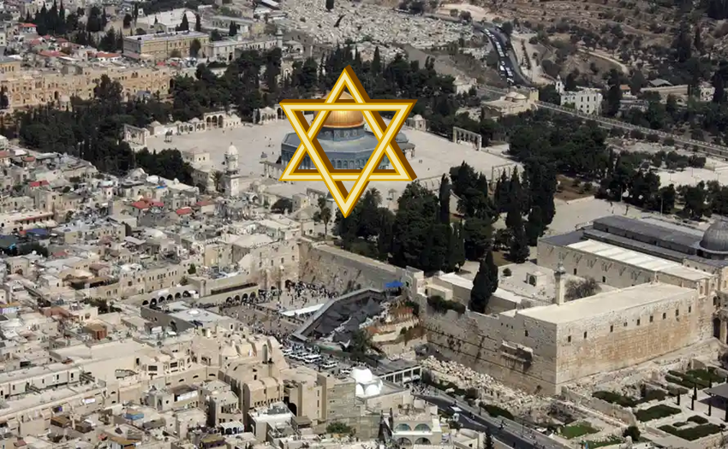
Robert Thomas
Four Views on the Book of Revelation, page 207.
“At the end of the Millennium that city will be Satan’s prime objective with his rebel army, because Israel will be a leader among the nations.”

Slide 34
IV. Explanation
(1:12-17)
God’s jealousy for Jerusalem (1:12-14)
God’s anger with the nations (1:15)
Jerusalem to be restored (1:16a)
The Temple to be restored (1:16b)
Jerusalem's prosperity to return (1:17)

Slide 35
ISRAEL’S FOUR TEMPLES
Solomon’s pre-exilic temple (Kings and Chronicles)
Zerubbabel’s post exilic temple (Ezra 1-6; John 2:20)
Antichrist's temple (Dan. 9:27; Matt. 24:15; 2 Thess. 2:4; Rev. 11:1-2)
Millennial temple (Ezek. 40-48)

Slide 36


Slide 37


Slide 38
IV. Explanation
(1:12-17)
God’s jealousy for Jerusalem (1:12-14)
God’s anger with the nations (1:15)
Jerusalem to be restored (1:16a)
The Temple to be restored (1:16b)
Jerusalem's prosperity to return (1:17)

Slide 39

Isaiah 65:21–22
²¹ “They will build houses and inhabit them; They will also plant vineyards and eat their fruit. ²² “They will not build and another inhabit, They will not plant and another eat; For as the lifetime of a tree, so will be the days of My people, And My chosen ones will wear out the work of their hands.

Slide 40


Amos 9:13
“Behold, days are coming,” declares the Lord, “When the plowman will overtake the reaper And the treader of grapes him who sows seed; When the mountains will drip sweet wine And all the hills will be dissolved.”

Slide 41

Mark Twain
The Innocents Abroad, Complete, 1st ed. (A Public Domain Book, 1869), 267, 285, 302. These quotes can be found in chapters 47, 49, 52.
“... A desolate country whose soil is rich enough, but is given over wholly to weeds…a silent mournful expanse….a desolation is here that not even imagination can grace with the pomp of life and action….we never saw a human being on the whole route….there was hardly a tree or shrub anywhere. Even the olive tree and the cactus, those fast friends of a worthless soil, had almost deserted the country.”

Slide 42
Why?
COUNTRY | GROSS DOMESTIC PRODUCT
ISRAEL | $123 BILLION
Egypt | $81 billion
Syria | $26 billion
Lebanon | $21 billion
Jordan | $12 billion
Source: CIA World Fact Book, 2005

Slide 43


Slide 44
II. Eight Night Visions
(1:7‒6:15)
  Riders & horses among the myrtle trees (1:7-17)
  Four horns & four craftsmen (1:18-21)
  Man with the measuring line (2)
  Cleansing of the High Priest Joshua (3)
  Lampstand & olive tree (4)
  Flying scroll (5:1-4)
  Woman in the basket (5:5-11)
  Four chariots (6:1-8)
  Conclusion: crowning of Joshua (6:9-15)

Slide 46
2. The Four Horses & Four Craftsmen
(1:8-21)
Four Horns (1:18-19)
    Description (1:18)
    Explanation (1:19)
Four Craftsmen (1:20-21)
    Description (1:20)
    Explanation (1:21)

Slide 47
2. The Four Horses & Four Craftsmen
(1:8-21)
Four Horns (1:18-19)
    Description (1:18)
    Explanation (1:19)
Four Craftsmen (1:20-21)
    Description (1:20)
    Explanation (1:21)

Slide 48
2. The Four Horses & Four Craftsmen
(1:8-21)
Four Horns (1:18-19)
    Description (1:18)
    Explanation (1:19)
Four Craftsmen (1:20-21)
    Description (1:20)
    Explanation (1:21)

Slide 49
2. The Four Horses & Four Craftsmen
(1:8-21)
Four Horns (1:18-19)
    Description (1:18)
    Explanation (1:19)
Four Craftsmen (1:20-21)
    Description (1:20)
    Explanation (1:21)

Slide 50


Slide 51
Six Parts of a Suzerain-Vassal Treaty in Deuteronomy
Preamble (1:1-5)
Prologue (1:6–4:40)
Covenant obligations (5–26)
Storage and reading instructions (27:2-3; 31:9, 24, 26)
Witnesses (32:1)
Blessings and curses (28)

Slide 54
Charles L. Feinberg
God Remembers: A Study of Zechariah (Wheaton: Van Kampen, 1950, p. 39-40.
“First, it is claimed that the horns are contemporaneous, whereas the position just taken would make them successive. The objection falls down completely when we consider that there were not four powers in open opposition to Judah in the time of Zechariah. Those with whom Judah had to deal at this time period were subordinate to the Persian empire.”

Slide 55
2. The Four Horses & Four Craftsmen
(1:8-21)
Four Horns (1:18-19)
    Description (1:18)
    Explanation (1:19)
Four Craftsmen (1:20-21)
    Description (1:20)
    Explanation (1:21)

Slide 56
2. The Four Horses & Four Craftsmen
(1:8-21)
Four Horns (1:18-19)
    Description (1:18)
    Explanation (1:19)
Four Craftsmen (1:20-21)
    Description (1:20)
    Explanation (1:21)

Slide 57
2. The Four Horses & Four Craftsmen
(1:8-21)
Four Horns (1:18-19)
    Description (1:18)
    Explanation (1:19)
Four Craftsmen (1:20-21)
    Description (1:20)
    Explanation (1:21)

Slide 58
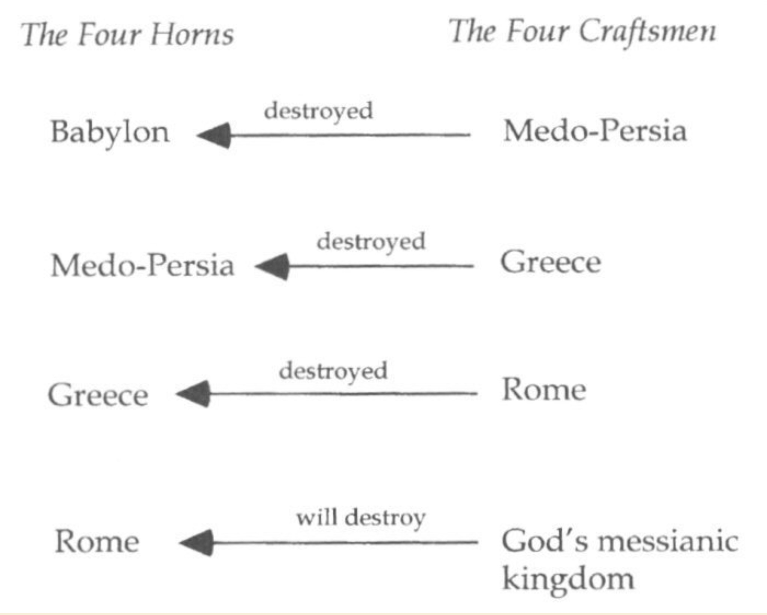

Slide 60
Charles Ryrie
The Ryrie Study Bible
“Zechariah 1:15 (RSB:NASB1995U): 1:15 they furthered the disaster. Lit., they helped for evil. Though the heathen nations were used of God to punish Israel, they went too far in trying to annihilate her.”

Slide 61
Charles L. Feinberg
God Remembers: A Study of Zechariah (Wheaton: Van Kampen, 1950, p. 42-43.
“Several features are noteworthy in this vision: (1) God takes account of everyone that lifts his hand against Israel; (2) He has complete knowledge of the dejected condition of His people and the extent of their injury; and (3) He has already provided the punishment for every foe of His chosen ones. As a definite matter of history three of the empires or kingdoms symbolized by the horns already know of the visitation of God upon them.”

Slide 62
Conclusion

Slide 63
II. Eight Night Visions
(1:7‒6:15)
  Riders & horses among the myrtle trees (1:7-17)
  Four horns & four craftsmen (1:18-21)
  Man with the measuring line (2)
  Cleansing of the High Priest Joshua (3)
  Lampstand & olive tree (4)
  Flying scroll (5:1-4)
  Woman in the basket (5:5-11)
  Four chariots (6:1-8)
  Conclusion: crowning of Joshua (6:9-15)

