Slide 1
Law and Grace: An Overview Jim McGowan, Th.D. Sugar Land Bible Church 10-17-2021
…but grace and truth were realized through Jesus Christ - John 1:17
For the Law was given through Moses…
Special thanks to Dr. Vern Peterman for access to his insights and resources.

Slide 2
Session 30 Outline
Review
Purpose, Aim, and Objective
Session 29
The Law True and Deep – Part 2
General Information
Matthew 5:21-47
Concluding Observations
Matthew 5:48

Slide 3
OUR PURPOSE, AIM AND OBJECTIVE
Law and Grace
…is to Compare and Contrast Law and Grace so as to properly understand these two important themes and how they are related to the life of the New Testament Believer.

Slide 4
C. I. Scofield, D. D.
The Grace of God, The Fundamentals Vol. 3, Chapter VII, p. 98
We have, most of us, been reared and now live under the influence of Galatianism. Protestant theology, alas, is for the most part, thoroughly Galatianized, in that neither law nor grace are given their distinct and separated places, as in the counsels of God, but are mingled together in one incoherent system.
The law is no longer, as in the Divine intent, a ministration of death (2 Cor. 3:7), of cursing (Gal. 3:10), of conviction (Rom. 3:19), because we are taught that we must try to keep it, and that by Divine help we may.
Nor, on the other hand, does grace bring us blessed deliverance from the dominion of sin, for we are kept under the law as a rule of life despite the plain declaration, “Sin shall not have dominion over you: for ye are not under the law, but under grace” (Rom. 6:14). (emphasis mine)

Slide 5
William R. Newell
Romans Verse-by-Verse (p. 274).
Grand Rapids, MI: Christian Classics Ethereal Library.
It is because Reformed theology has kept us Gentiles under the Law,—if not as a means of righteousness, then as “a rule of life,” that all the trouble has arisen. The Law is no more a rule of life than it is a means of righteousness. Walking in the Spirit has now taken the place of walking by ordinances. God has another principle under which He has put his saints: “Ye are not under law, but, under grace! (Rom. 6:14)” (italics mine)
PDF Download Here: https://archive.org/details/Romans_Verse_By_Verse-NewellWR

Slide 6
Henry Ironside
The Continual Burnt Offering: Daily Meditations on the Word of God (p. 265). Neptune, NJ: Loizeaux Brothers.
In Romans 7 we have a man renewed by the Spirit of God, but struggling under law, hoping thereby to subdue or find deliverance from the power of the old Adamic nature. In chapter 8 we have God’s way of deliverance through the death and resurrection of Christ with which the believer is identified before God. The chapter begins with “no condemnation” and ends with “no separation.” All who are in Christ Jesus are accepted in the Beloved and as free from every charge of guilt as He is Himself. He paid our penalty on the cross. Now we are linked up with Him in resurrection, not under law but under grace.

Slide 7
Matthew’s 3-Fold Purpose
Law and Grace: Review The SOM – Matthew 5:1–8:1 (Luke 6:17–49)
To explain:
that Jesus in whom they had believed was the long-awaited Jewish Messiah
why the kingdom had been postponed despite the fact that the king had arrived
the interim program of God during the kingdom’s absence

Slide 8
Matthew and the Kingdom
Law and Grace: Review The SOM – Matthew 5:1–8:1 (Luke 6:17–49)
 | offered
 | rejected
 | postponed Interim program
 | ultimately accepted

Slide 9
Matthew’s Message
Law and Grace: Review The SOM – Matthew 5:1–8:1 (Luke 6:17–49)
Jesus is the predicted Jewish king who ushered in an interim program by building the sons of the kingdom into the Church in between Israel’s past rejection and future acceptance of her king.

Slide 10
Session 30 Outline
Review
Purpose, Aim, and Objective
Session 29
The Law True and Deep – Part 2
General Information
Matthew 5:21-47
Concluding Observations
Matthew 5:48

Slide 11
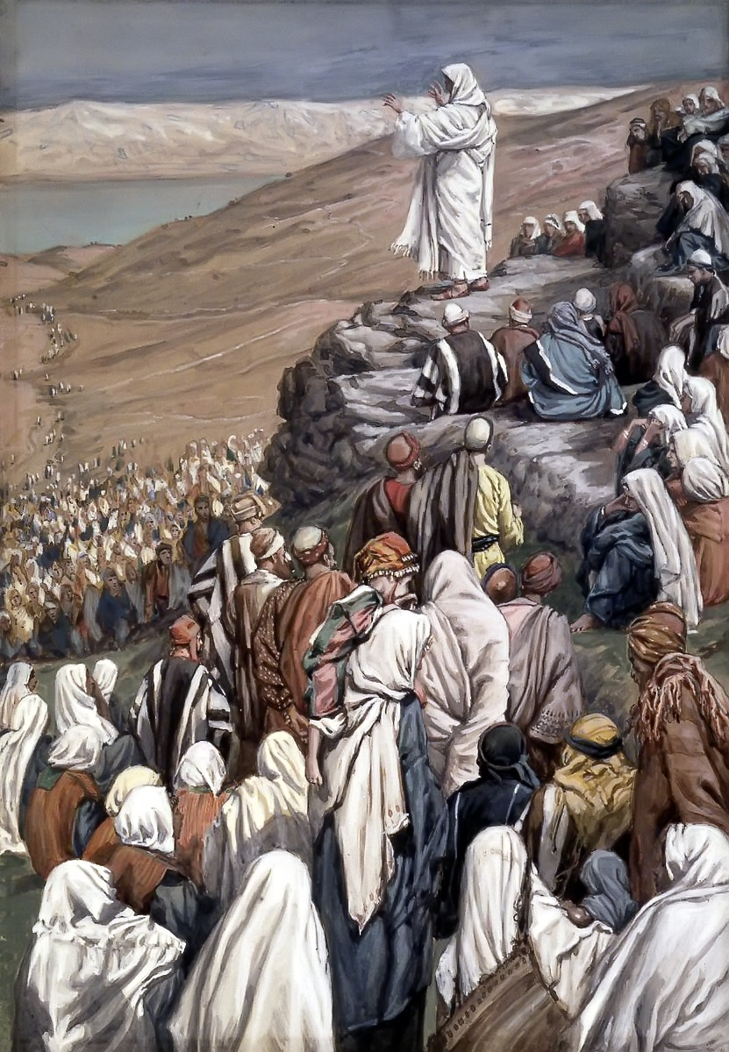
Law and Grace: Review The SOM – Matthew 5:1–8:1 (Luke 6:17–49)
To Whom is Jesus speaking in the SOM?
Rose are red
And violets are bluish
All of those listening to Jesus are Jewish!

Slide 12
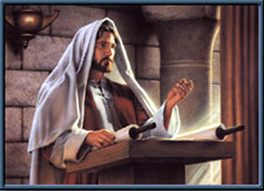
Law and Grace: Review The SOM – Matthew 5:1–8:1 (Luke 6:17–49)
Jesus contrasted with the Scribes & Pharisees
Matthew 5:20-48
Jesus made the Law of Moses apply to the whole person, all the way from the heart and thoughts, to all of the outward expressions and even in the relationships between Jews, and with God.

Slide 13
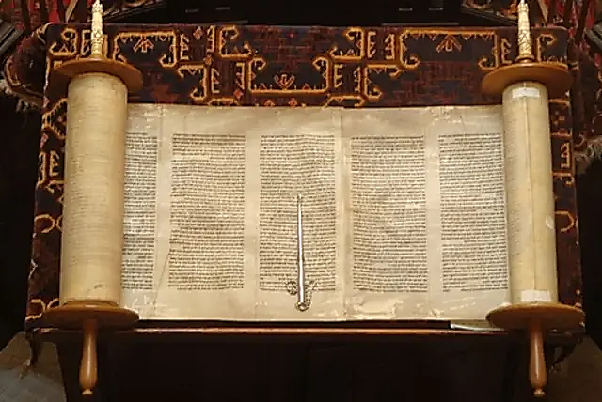
Law and Grace: Review The SOM – Matthew 5:1–8:1 (Luke 6:17–49)
Two Primary Patterns in Jesus’ Statements
Matthew 5:21-48
Jesus will quote an Old Testament passage or two and include those laws that require full heart-level and even relationship compliance.

Slide 14
Law and Grace: Review The SOM – Matthew 5:1–8:1 (Luke 6:17–49)
Two Primary Patterns in Jesus’ Statements
Matthew 5:21-48
Jesus will quote an Old Testament passage along with one of the traditions that have been added to the Law of Moses, and then correct the tradition by taking the application deeper and/or back to the original intent of the Law of Moses.

Slide 15
Law and Grace: Review The SOM – Matthew 5:1–8:1 (Luke 6:17–49)
Jesus Used Hyperbole
Matthew 5:21-26
Jesus sometimes used *hyperbole in His expressions in this passage, and elsewhere in the Sermon on the Mount, for the sake of emphasis and as an aid to memory.
* hyperbole an obvious and intentional exaggeration used for stress or emphasis; not intended to be taken literally…i.e. I’m so hungry, I could eat a horse.

Slide 16
Law and Grace: Review The SOM – Matthew 5:1–8:1 (Luke 6:17–49)
From The Inside Out – What We Covered in our last Session
Matthew 5:21-48
In Matt. 5:21-48, Jesus contrasts Pharisaic Righteousness and True Righteousness regarding 7 topics:
Murder (21-22) | Oaths (33-37)
Reconciliation (23-26) | Non-resistance (38-42)
Adultery (27-30) | Love (43-48).
Divorce (31-32)

Slide 17
Session 30 Outline
Review
Purpose, Aim, and Objective
Session 29
The Law True and Deep – Part 2
General Information
Matthew 5:21-47
Concluding Observations
Matthew 5:48

Slide 18
Law and Grace: Session 30 The SOM – Matthew 5:1–8:1 (Luke 6:17–49)
From The Inside Out – What We’ll Cover in this Session
Matthew 5:21-48
In Matt. 5:21-48, Jesus contrasts Pharisaic Righteousness and True Righteousness regarding 7 topics:
Murder (21-22) | Oaths (33-37)
Reconciliation (23-26) | Non-resistance (38-42)
Adultery (27-30) | Love (43-48).
Divorce (31-32)

Slide 19
We’ll Continue With Our Compare and Contrast Approach
Law and Grace: Session 30 The SOM – Matthew 5:1–8:1 (Luke 6:17–49)
There will be things that compare (are the same or similar) between what is directed to Israel and what is directed to us in the Church.
There will be things that contrast (are different) between what is directed to Israel and what is directed to us in the Church.
Israel was under the Law of Moses and will be under Kingdom Law in the coming Millennial Kingdom, but we in the body of Christ, live under the principle of Grace.

Slide 20
We’ll Continue With Our Compare and Contrast Approach
Law and Grace: Session 30 The SOM – Matthew 5:1–8:1 (Luke 6:17–49)
COMPARE AND CONTRAST
PEOPLE GROUP | RULING PRINCIPLE
Nation of Israel | OT / Gospels / Acts 1 The Law of Moses | 1000 Reign of Christ Kingdom Law
Church | Acts 2 – Rapture Grace | -----

Slide 21
Context, Context, Context Matthew 5:21-48
Law and Grace: Session 30 The SOM – Matthew 5:1–8:1 (Luke 6:17–49)
From the Sermon on the Mount many in various parts of Christendom have taken views against remarriage, taking oaths, participating in government or the military, etc.

Slide 22
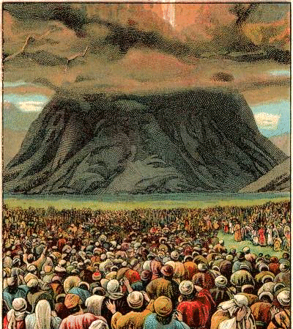
Context, Context, Context Matthew 5:21-48
Law and Grace: Session 30 The SOM – Matthew 5:1–8:1 (Luke 6:17–49)
But to understand what Christ says to these Israelites in Israel, we should keep in mind that:
the Law of Moses was given to Israel, and,
Interpretation requires identifying the cultural context.

Slide 23
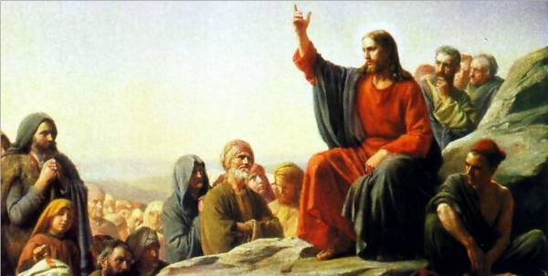
Law and Grace: Session 30 The SOM – Matthew 5:1–8:1 (Luke 6:17–49)
Context, Context, Context Matthew 5:21-48
The Sermon on the Mount was directed to Israelites, living in Israel, who were all under the Law of Moses.

Slide 24
Session 30 Outline
Review
Purpose, Aim, and Objective
Session 29
The Law True and Deep – Part 2
General Information
Matthew 5:21-47
Concluding Observations
Matthew 5:48

Slide 25
Matthew 5:33-37
³³ “Again, you have heard that the ancients were told, ‘You shall not make false vows, but shall fulfill your vows to the Lord.’ ³⁴ “But I say to you, make no oath at all, either by heaven, for it is the throne of God, ³⁵ or by the earth, for it is the footstool of His feet, or by Jerusalem, for it is the city of the great King. ³⁶ “Nor shall you make an oath by your head, for you cannot make one hair white or black. ³⁷ “But let your statement be, ‘Yes, yes’ or ‘No, no’; anything beyond these is of evil.

Slide 26
The poetic pattern in Matthew 5:34-35
Law and Grace: Session 30 The SOM – Matthew 5:1–8:1 (Luke 6:17–49)
³⁴ But I say to you,
make no oath at all,
either by heaven,
for it is the throne of God, ³⁵
or by the earth,
for it is the footstool of His feet,
or by Jerusalem,
for it is the City of the Great King.
Isaiah 66:1
Psalm 48:1-3

Slide 27
Promises, Promises Matthew 5:33-37
Law and Grace: Session 30 The SOM – Matthew 5:1–8:1 (Luke 6:17–49)
The Law of Moses required that the people of Israel simply keep their vows, whether to the Lord or to another person (Numbers 30:1-2).
However, according to the rabbis’ rules, making an oath by heaven, by earth, or by Jerusalem were all non-binding, but both Jesus and the Bible say that God is in all three places.

Slide 28
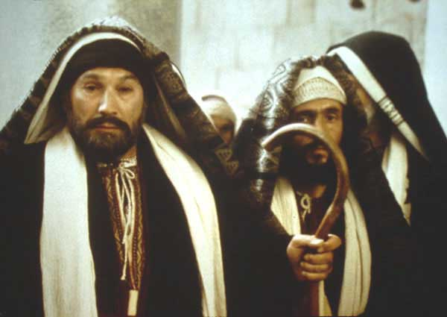
Promises, Promises Matthew 5:33-37
Law and Grace: Session 30 The SOM – Matthew 5:1–8:1 (Luke 6:17–49)
But by the time of Christ, the rabbis had developed a complex set of rules for when an oath is binding and when it is not a binding promise.
Oaths invoking God’s name were binding.

Slide 29
Numbers 30:1-2
¹ Then Moses spoke to the heads of the tribes of the sons of Israel, saying, “This is the word which the Lord has commanded. ² If a man makes a vow to the Lord*, or takes an oath to bind himself with a binding obligation, he shall not violate his word; he shall do according to all that proceeds out of his mouth.”
* Note here that the Law of Moses did not say that one could not take an oath. But the idea that one could take an oath and be excused from carrying it out because of what one swears by, was just a tricky way of lying.
1

Slide 30
Matthew 5:33-37
³³ “Again, you have heard that the ancients were told, ‘You shall not make false vows, but shall fulfill your vows to the Lord.’ ³⁴ “But I say to you, make no oath at all, either by heaven, for it is the throne of God, ³⁵ or by the earth, for it is the footstool of His feet, or by Jerusalem, for it is the city of the great King. ³⁶ “Nor shall you make an oath by your head, for you cannot make one hair white or black. ³⁷ “But let your statement be, ‘Yes, yes’ or ‘No, no’; anything beyond these is of evil.

Slide 31
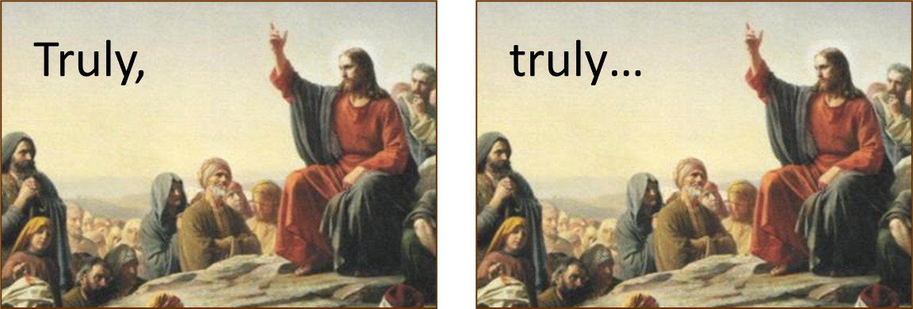
Promises, Promises Matthew 5:33-37
Law and Grace: Session 30 The SOM – Matthew 5:1–8:1 (Luke 6:17–49)
In Hebrew culture, saying something two or even three times conveyed totality or perfection: “Truly, truly”, “Holy, holy, holy”.

Slide 32
Promises, Promises Matthew 5:33-37
Law and Grace: Session 30 The SOM – Matthew 5:1–8:1 (Luke 6:17–49)
Paul expresses his grief for his fellow Israelites in Romans 9:1-2

Slide 33
Promises, Promises Matthew 5:33-37
Law and Grace: Session 30 The SOM – Matthew 5:1–8:1 (Luke 6:17–49)
Among us in the body of Christ there is to be truth: Ephesians 4:25

Slide 34
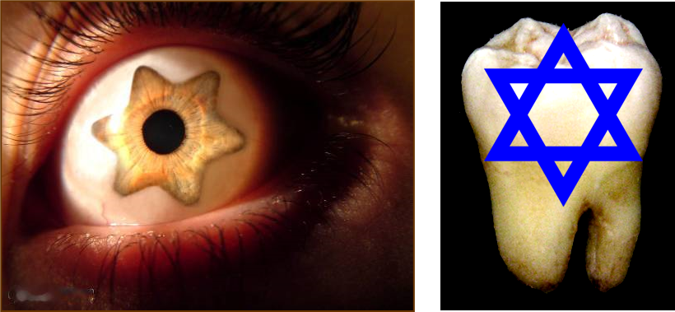
Matthew 5:38–42
³⁸ “You have heard that it was said, *‘An eye for an eye, and a tooth for a tooth.’ ³⁹ “But I say to you, do not resist an evil person; but whoever slaps you on your right cheek, turn the other to him also. ⁴⁰ “If anyone wants to sue you and take your shirt, let him have your coat also. ⁴¹ “Whoever forces you to go one mile, go with him two. ⁴² “Give to him who asks of you, and do not turn away from him who wants to borrow from you.
* Exodus 21:22-25
Leviticus 24:17-23
Deuteronomy 19:15-21

Slide 35
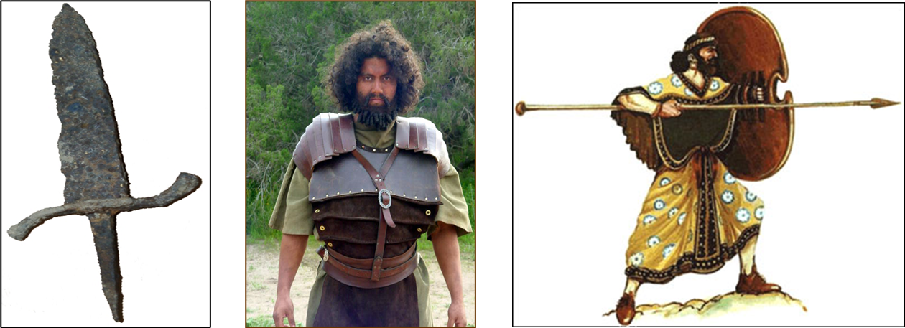
“An eye for an eye and a tooth for a tooth” Matthew 5:38-42
Law and Grace: Session 30 The SOM – Matthew 5:1–8:1 (Luke 6:17–49)
Israel was in the midst of cultures that practiced an escalating revenge, carried out privately, even to the point of ‘honor killings’.

Slide 36
“An eye for an eye and a tooth for a tooth” Matthew 5:38-42
Law and Grace: Session 30 The SOM – Matthew 5:1–8:1 (Luke 6:17–49)
The principle in the Law of Moses, ‘an eye for an eye, and a tooth for a tooth’ stopped escalating revenge and kept justice a public issue.
Israelite society was thus kept from escalating violence and the family’s ‘duty’ to carry out revenge.

Slide 37
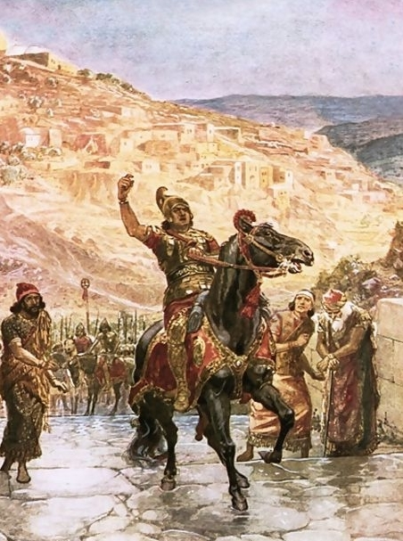
“Vengeance is mine”, says the Lord” Matthew 5:38-42
Law and Grace: Session 30 The SOM – Matthew 5:1–8:1 (Luke 6:17–49)
The Old Testament taught that Israelites were to leave room for God to take His vengeance for them (cf. Lev. 19:17-18; Deut. 32:35; Psa. 94:1; Prov. 20:22; 24:29).
The same principle applies to us who are in the body of Christ:
Romans 12:19
Hebrews 10:30

Slide 38
Romans 12:19
¹⁹ Never take your own revenge, beloved, but leave room for the wrath of God, for it is written, “Vengeance is Mine, I will repay,” says the Lord.
Hebrews 10:30a
³⁰ For we know Him who said, “Vengeance is Mine, I will repay.”

Slide 39
“Vengeance is mine”, says the Lord” Matthew 5:38-42
Law and Grace: Session 30 The SOM – Matthew 5:1–8:1 (Luke 6:17–49)
But this does not support total pacifism.

Slide 40
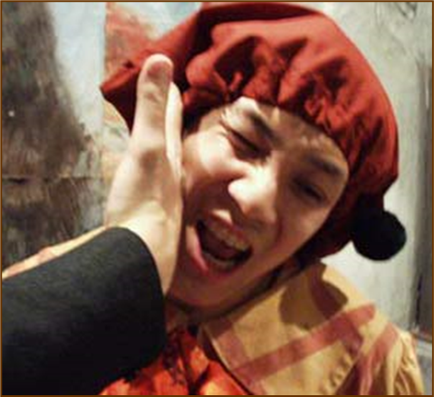
Matthew 5:38–42
³⁸ “You have heard that it was said, *‘An eye for an eye, and a tooth for a tooth.’ ³⁹ “But I say to you, do not resist an evil person; but whoever slaps you on your right cheek, turn the other to him also. ⁴⁰ “If anyone wants to sue you and take your shirt, let him have your coat also. ⁴¹ “Whoever forces you to go one mile, go with him two. ⁴² “Give to him who asks of you, and do not turn away from him who wants to borrow from you.

Slide 41
““Vengeance is mine”, says the Lord ” Matthew 5:39-42
Law and Grace: Session 30 The SOM – Matthew 5:1–8:1 (Luke 6:17–49)
A backhanded slap on the cheek was not an injurious physical threat, but an insult.
Both in the Gospels and the Epistles to the Church, one is not to respond in kind to an attack only intended to damage one’s emotions or reputation.

Slide 42
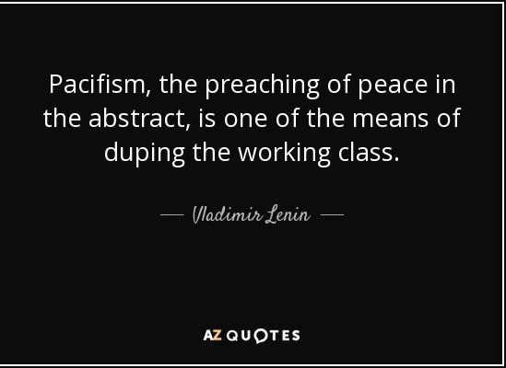
Total Pacifism Is Not Biblically Supported
Law and Grace: Session 30 The SOM – Matthew 5:1–8:1 (Luke 6:17–49)
Total Pacifism, the idea that, I don’t defend myself, I don’t defend my family, and I don’t join the military to fight, is not biblically supported.
Certainly, it may be appropriate at times to say no, I won't get involved or I won’t do something, but total pacifism is not supported.

Slide 43
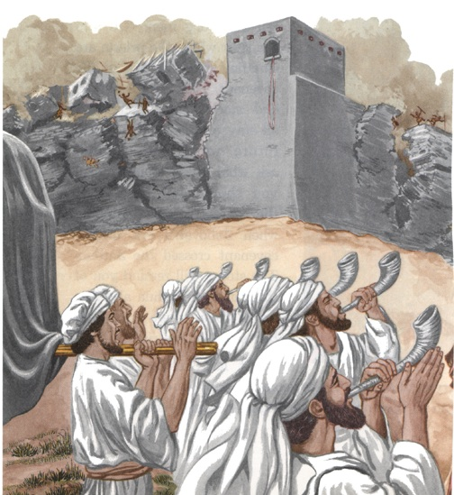
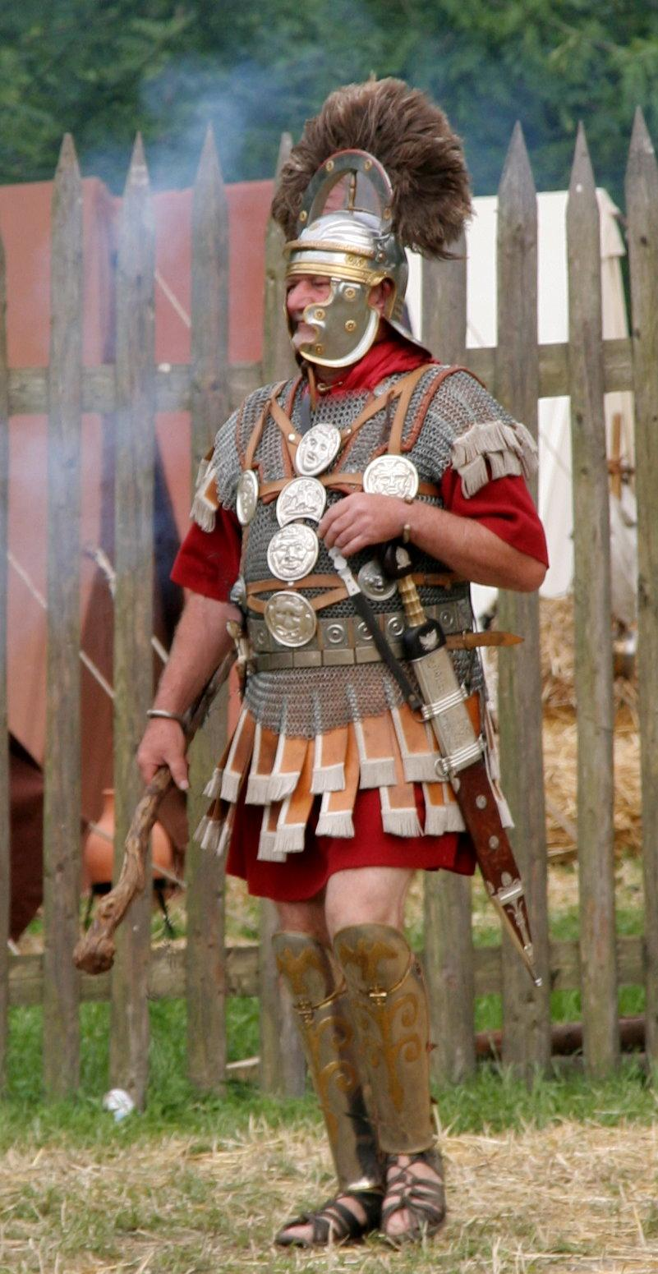
Some Reasons Why Total Pacifism Is Not Biblically Supported Matthew 5:33-37
Law and Grace: Session 30 The SOM – Matthew 5:1–8:1 (Luke 6:17–49)
Israel was to have a military, both initially and as a continuing force, and this was not incompatible with God fighting for them (cf. Ex 14:14; Deut 1:30; 3:22; Josh 23:3; 2 Chr 20:29; Neh 4:20)
In the Gospels and in the Book of Acts Roman officers are all shown in a favorable light, and neither Jesus or the apostles said to quit the military.

Slide 44
Some Reasons Why Total Pacifism Is Not Biblically Supported Matthew 5:33-37
Law and Grace: Session 30 The SOM – Matthew 5:1–8:1 (Luke 6:17–49)
In anticipation of the church (Acts 1-2) Christ tells the disciples to arm for self-defense. (cf. Luke 22:35-36).

Slide 45
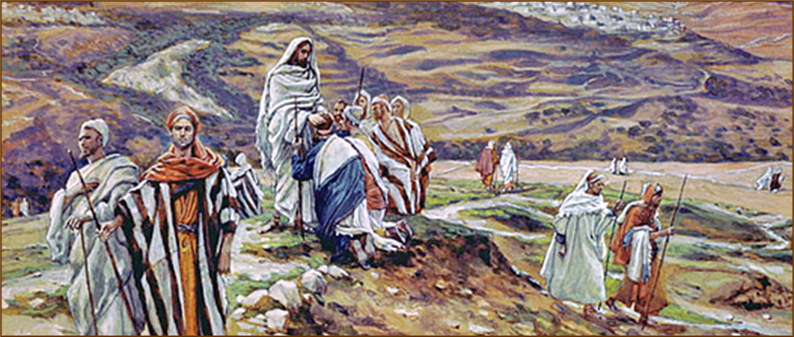
Luke 22:35-36
“³⁵ And He said to them, “When I sent you out without money belt and bag and sandals, you did not lack anything, did you?” They said, “No, nothing.” ³⁶ And He said to them, “But now, whoever has a money belt is to take it along, likewise also a bag, and whoever has no sword is to sell his coat and buy one.”

Slide 46
Some Reasons Why Total Pacifism Is Not Biblically Supported Matthew 5:33-37
Law and Grace: Session 30 The SOM – Matthew 5:1–8:1 (Luke 6:17–49)
“Some conscientious believers have taken Jesus’ instructions about resisting aggression literally and refuse to defend themselves in any situation either as pacifists or as advocates of non-resistance. However the spirit of the law, which Jesus clarified, did not advocate turning oneself into a doormat. It stressed meeting hatred with positive love rather than hatred. Though Jesus allowed His enemies to lead Him as a lamb to the slaughter, He did not cave in to every hostile attack from the scribes and Pharisees. Paul claimed his Roman citizenship rather than suffering prolonged attack by the Jews.”
Constable, T. (2003). Tom Constable’s Expository Notes on the Bible (Mt 5:39). Galaxie Software.

Slide 47
Matthew 5:38–42
³⁸ “You have heard that it was said, *‘An eye for an eye, and a tooth for a tooth.’ ³⁹ “But I say to you, do not resist an evil person; but whoever slaps you on your right cheek, turn the other to him also. ⁴⁰ “If anyone wants to sue you and take your shirt, let him have your coat also. ⁴¹ “Whoever forces you to go one mile, go with him two. ⁴² “Give to him who asks of you, and do not turn away from him who wants to borrow from you.

Slide 48
“let him have your coat also” Matthew 5:39-42
Law and Grace: Session 30 The SOM – Matthew 5:1–8:1 (Luke 6:17–49)
Jesus was using hyperbole here - modesty was not to be ignored!
This was set in a specific ‘cultural context’ where the Israelites under the Mosaic Law, in the land of Israel, were already commanded to lend to any and all of their Jewish brethren with an open hand.
But the Jews were not required to be so open-handed with their Gentile neighbors.

Slide 49
Matthew 5:38–42
³⁸ “You have heard that it was said, *‘An eye for an eye, and a tooth for a tooth.’ ³⁹ “But I say to you, do not resist an evil person; but whoever slaps you on your right cheek, turn the other to him also. ⁴⁰ “If anyone wants to sue you and take your shirt, let him have your coat also. ⁴¹ “Whoever forces you to go one mile, go with him two. ⁴² “Give to him who asks of you, and do not turn away from him who wants to borrow from you.

Slide 50
“Whoever forces you to go one mile, go with him two.” Matthew 5:39-42
Law and Grace: Session 30 The SOM – Matthew 5:1–8:1 (Luke 6:17–49)
A Roman soldier could compel anyone else by law, to carry his military equipment for one mile (cf. Matthew 27:32).
Jesus told the Israelites to carry the soldier’s equipment for another mile beyond what was required by Roman law.

Slide 51
Matthew 5:38–42
³⁸ “You have heard that it was said, *‘An eye for an eye, and a tooth for a tooth.’ ³⁹ “But I say to you, do not resist an evil person; but whoever slaps you on your right cheek, turn the other to him also. ⁴⁰ “If anyone wants to sue you and take your shirt, let him have your coat also. ⁴¹ “Whoever forces you to go one mile, go with him two. ⁴² “Give to him who asks of you, and do not turn away from him who wants to borrow from you.

Slide 52
Deuteronomy 15:7-8
⁷“If there is a poor man with you, one of your brothers, in any of your towns in your land which the Lord your God is giving you, you shall not harden your heart, nor close your hand from your poor brother; ⁸ but you shall freely open your hand to him, and shall generously lend him sufficient for his need in whatever he lacks.”

Slide 53
“Give to him who asks of you...” Matthew 5:39-42
Law and Grace: Session 30 The SOM – Matthew 5:1–8:1 (Luke 6:17–49)
Every 7th year in Israel all debts to all Israelites were to be forgiven, and no Israelite was to diminish their lending because they anticipated that year of forgiveness of debts.

Slide 54
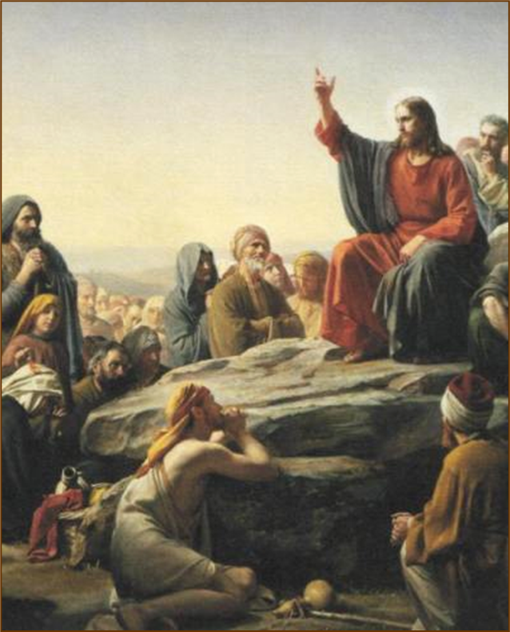
In each case in this passage… Matthew 5:39-42
Law and Grace: Session 30 The SOM – Matthew 5:1–8:1 (Luke 6:17–49)
In each case, Jesus says to go beyond the requirement of the Law of Moses.
Be gracious, full of mercy and generous from the heart – True Righteousness vs. Pharisaic Righteousness.
In these verses there is a progression from mere non-resistance to liberal giving to those who may provoke us to retaliate against them.

Slide 55
In each case in this passage… Matthew 5:39-42
Law and Grace: Session 30 The SOM – Matthew 5:1–8:1 (Luke 6:17–49)
Although, we in the Church are not under the Law of Moses, nor do we live in the land of Israel, being gracious and merciful is still what God has in mind for you and me.
Why? Because He is the same immutable God, and grace and mercy are basic to God’s character….He doesn’t change.

Slide 56
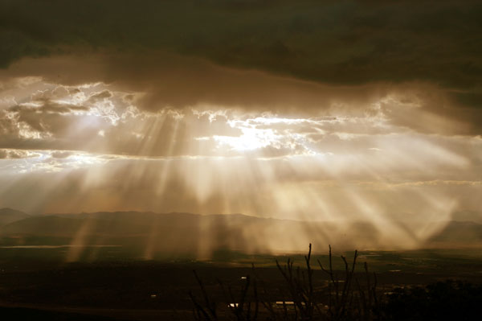
Ephesians 2:4–7
⁴ But God, being rich in mercy, because of His great love with which He loved us, ⁵ even when we were dead in our transgressions, made us alive together with Christ (by grace you have been saved), ⁶ and raised us up with Him, and seated us with Him in the heavenly places in Christ Jesus, ⁷ so that in the ages to come He might show the surpassing (ὑπερβάλλω) riches of His grace in kindness toward us in Christ Jesus.

Slide 57
In each case in this passage… Matthew 5:39-42
Law and Grace: Session 30 The SOM – Matthew 5:1–8:1 (Luke 6:17–49)
Grace and mercy, basic to God’s character, are to be lived out in and through us by the life of Christ.

Slide 58
Matthew 5:43–47
⁴³ “You have heard that it was said, ‘You shall love your neighbor and hate your enemy.’ ⁴⁴ “But I say to you, love your enemies and pray for those who persecute you, ⁴⁵ so that you may be sons of your Father who is in heaven; for He causes His sun to rise on the evil and the good, and sends rain on the righteous and the unrighteous. ⁴⁶ “For if you love those who love you, what reward do you have? Do not even the tax collectors do the same? ⁴⁷ “If you greet only your brothers, what more are you doing than others? Do not even the Gentiles do the same?

Slide 59
“Love Your Neighbor” Matthew 5:43-47
Law and Grace: Session 30 The SOM – Matthew 5:1–8:1 (Luke 6:17–49)
Love your neighbor was definitely a message from the Law of Moses (Leviticus 19:18)…

Slide 60
“Love Your Neighbor” Matthew 5:43-47
Law and Grace: Session 30 The SOM – Matthew 5:1–8:1 (Luke 6:17–49)
…but hating your enemy was primarily taught among the Essenes, who considered the Pharisees, the, Sadducees, and everyone else, enemies.

Slide 61
“Hate Your Enemy”
Law and Grace: Session 30 The SOM – Matthew 5:1–8:1 (Luke 6:17–49)
The Essenes became famous for their displays of justified indignation….But that was putting it mildly. The Qumran Community Rule scroll actually encouraged its Essene readers to show anger and hatred for all outside their sect (1QS 1.4, 5, 9–11; 4Q258 9.16, 22). In fact, it actually states that all those “chosen” by God (that is, the Essenes) should “hate all that He [God] has rejected” (1QS 1.4, 5), that is, everyone else.…According to the Community Rule, all Essenes were even expected to pledge together “Everlasting hatred in a spirit of secrecy for the men of perdition!” (4Q258 9.22). In fact, at Qumran, the Essenes prided themselves so fiercely on hating outsiders that they even composed a War Scroll. This scroll set down guidelines that Essene members were expected to honour when taking on the Romans and the rest of the world in the final eschatological battles between good and evil, light and darkness.
Qumran's "Righteous Teacher“ by Daryn Graham, https://www.hopechannel.com/au/
read/qumrans-righteous-teacher, accessed online 09-08-2021

Slide 62
“Love Your Neighbor” Matthew 5:43-47
Law and Grace: Session 30 The SOM – Matthew 5:1–8:1 (Luke 6:17–49)
Many no doubt, would have wondered where Jesus stood in the midst of these conflicting messages.

Slide 63
Matthew 5:43–47
⁴³ “You have heard that it was said, ‘You shall love your neighbor and hate your enemy.’ ⁴⁴ “But I say to you, love your enemies and pray for those who persecute you, ⁴⁵ so that you may be sons of your Father who is in heaven; for He causes His sun to rise on the evil and the good, and sends rain on the righteous and the unrighteous. ⁴⁶ “For if you love those who love you, what reward do you have? Do not even the tax collectors do the same? ⁴⁷ “If you greet only your brothers, what more are you doing than others? Do not even the Gentiles do the same?

Slide 64
Matthew 5:43–47
⁴³ “You have heard that it was said, ‘You shall love your neighbor and hate your enemy.’ ⁴⁴ “But I say to you, love your enemies and pray for those who persecute you, ⁴⁵ so that you may be sons of your Father who is in heaven; for He causes His sun to rise on the evil and the good, and sends rain on the righteous and the unrighteous. ⁴⁶ “For if you love those who love you, what reward do you have? Do not even the tax collectors do the same? ⁴⁷ “If you greet only your brothers, what more are you doing than others? Do not even the Gentiles do the same?

Slide 65
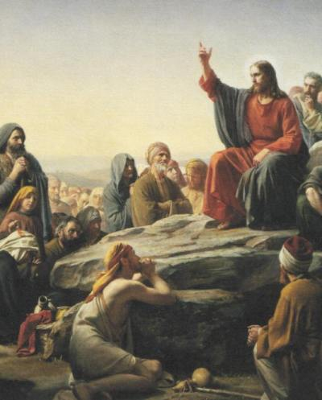
Law and Grace: Session 30 The SOM – Matthew 5:1–8:1 (Luke 6:17–49)
“Love Your Neighbor” Matthew 5:43-47
In sharp contrast to the spirit and behavior of those who would make themselves their enemies, Jesus said to love them in return. This is consistent also with what the Apostles taught.

Slide 66
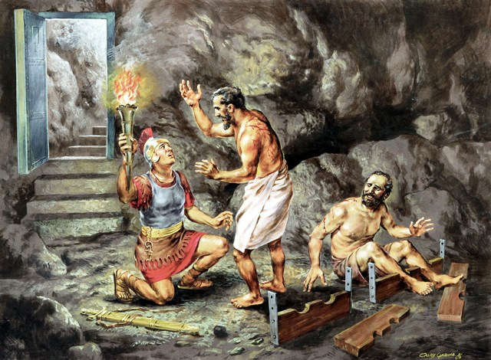
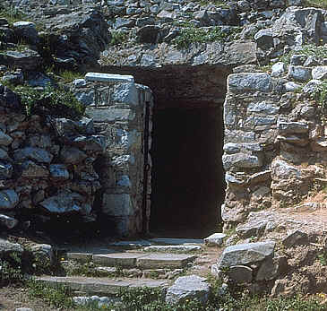
Law and Grace: Session 30 The SOM – Matthew 5:1–8:1 (Luke 6:17–49)
“Love Your Neighbor” Matthew 5:43-47
When Paul and Silas were in stocks in the worst part of the jail in Philippi, they sang songs in praise to God.
They shared the true gospel to the jailer rather than run away.

Slide 67
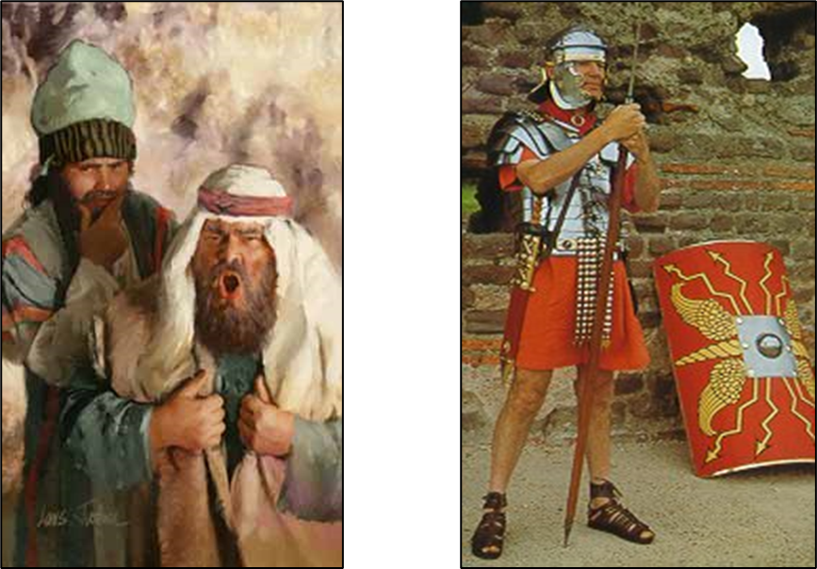
And speaking of persecutors…
Law and Grace: Session 30 The SOM – Matthew 5:1–8:1 (Luke 6:17–49)
“Love Your Neighbor” Matthew 5:43-47

Slide 68
Law and Grace: Session 30 The SOM – Matthew 5:1–8:1 (Luke 6:17–49)
“Love Your Neighbor” Matthew 5:43-47
So, whether under Law or Grace, true righteousness consists of our not responding in kind to persecutors but responding in His love!

Slide 69
Matthew 5:43–47
⁴³ “You have heard that it was said, ‘You shall love your neighbor and hate your enemy.’ ⁴⁴ “But I say to you, love your enemies and pray for those who persecute you, ⁴⁵ so that you may be sons of your Father who is in heaven; for He causes His sun to rise on the evil and the good, and sends rain on the righteous and the unrighteous. ⁴⁶ “For if you love those who love you, what reward do you have? Do not even the tax collectors do the same? ⁴⁷ “If you greet only your brothers, what more are you doing than others? Do not even the Gentiles do the same?

Slide 70
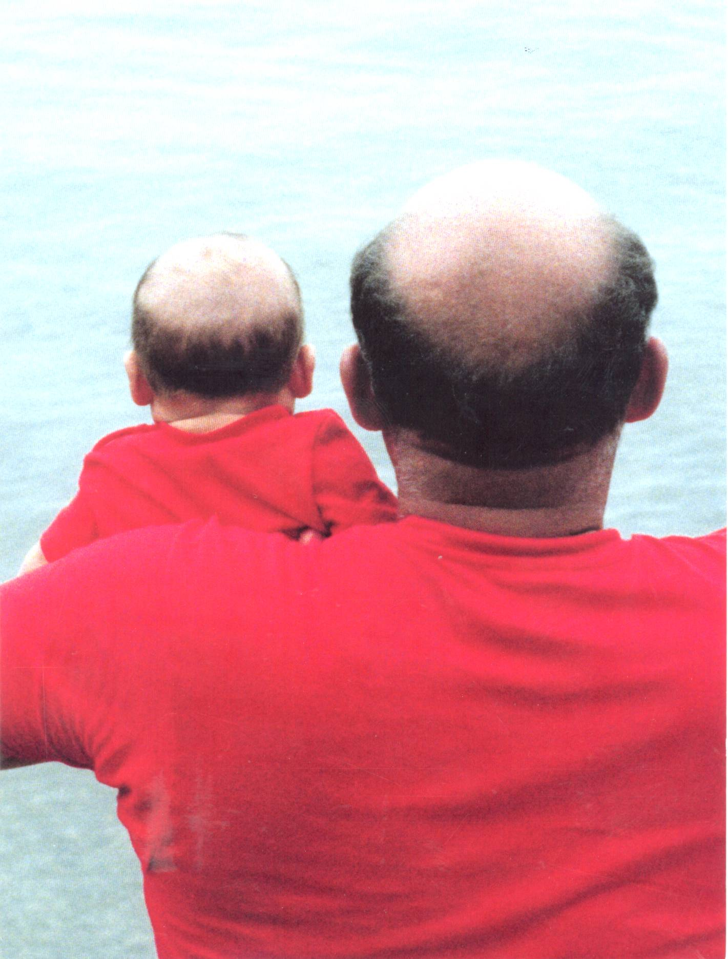
Law and Grace: Session 30 The SOM – Matthew 5:1–8:1 (Luke 6:17–49)
“Sons of your Father” Matthew 5:43-47
Jesus uses the term ‘sons of’, (‘children of’) which means:
like in character and/or
close in relationship to.
Jesus said that loving persecutors in return is ‘sonlike’.

Slide 71
Matthew 5:43–47
⁴³ “You have heard that it was said, ‘You shall love your neighbor and hate your enemy.’ ⁴⁴ “But I say to you, love your enemies and pray for those who persecute you, ⁴⁵ so that you may be sons of your Father who is in heaven; for He causes His sun to rise on the evil and the good, and sends rain on the righteous and the unrighteous. ⁴⁶ “For if you love those who love you, what reward do you have? Do not even the tax collectors do the same? ⁴⁷ “If you greet only your brothers, what more are you doing than others? Do not even the Gentiles do the same?

Slide 72
Law and Grace: Session 30 The SOM – Matthew 5:1–8:1 (Luke 6:17–49)
“Sons of your Father” Matthew 5:43-47
Jesus then tells them that God does make material blessing and provision available to all, whether they are righteous or unrighteous.
So, loving regardless of behavior is, in that way, ‘son-like’.

Slide 73
Session 30 Outline
Review
Purpose, Aim, and Objective
Session 29
The Law True and Deep – Part 2
General Information
Matthew 5:21-47
Concluding Observations
Matthew 5:48

Slide 74
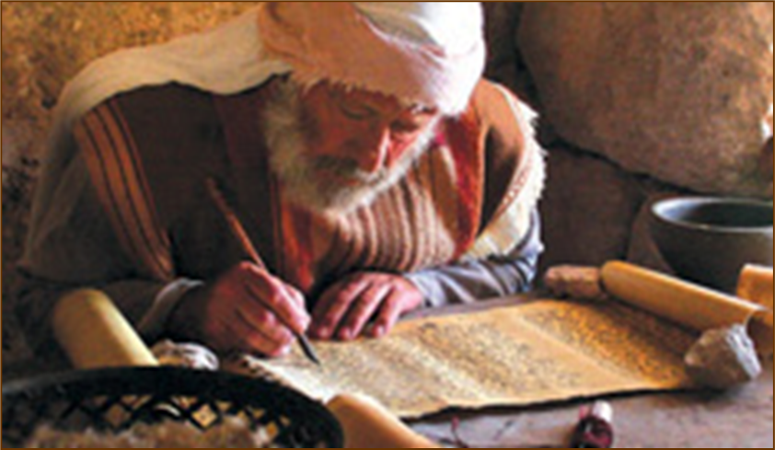
Matthew 5:48
“Therefore you are to be perfect, as your heavenly Father is perfect.

Slide 75
Law and Grace: Session 30 The SOM – Matthew 5:1–8:1 (Luke 6:17–49)
“Be Perfect…” Matthew 5:48
The Law of Moses demanded from the Israelites a holy heart that would lead to good, righteous, and holy behavior, because it’s intent, which was true righteousness as opposed to Pharisaic righteousness, perfectly expressed the very character of God (Leviticus 20:26). But the Law of Moses offered no provision for the enablement to meet its righteous demands.

Slide 76
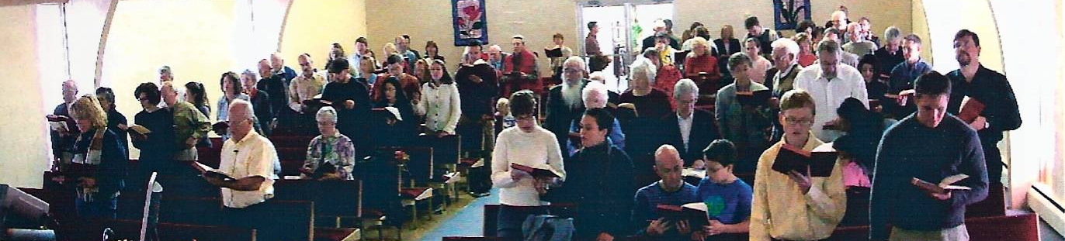
Law and Grace: Session 30 The SOM – Matthew 5:1–8:1 (Luke 6:17–49)
“Be Perfect…” Matthew 5:48
However, for believers living under Grace, the righteous demands of the Law are already fulfilled in us, through our identification with Christ, and will be fully realized experientially once we are glorified.
In the meantime, God’s design and desire is our being conformed, transformed, and growing into who we already are in Christ, daily!

Slide 77
Law and Grace: An Overview Jim McGowan, Th.D. Sugar Land Bible Church 10-17-2021
…but grace and truth were realized through Jesus Christ - John 1:17
For the Law was given through Moses…
Special thanks to Dr. Vern Peterman for access to his insights and resources.

