Slide 1
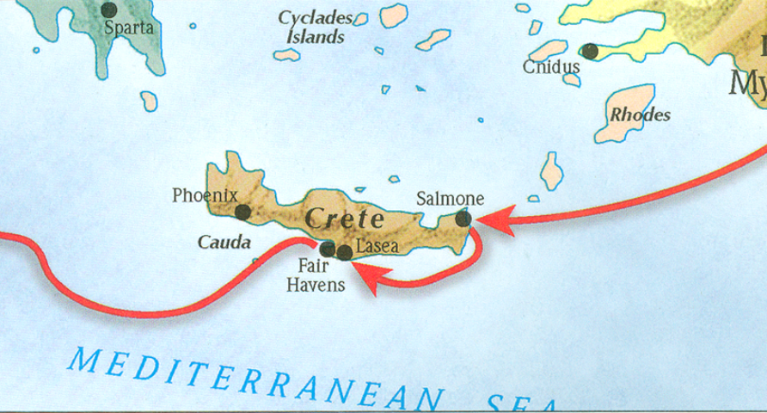
The book of Titus
Worthy of the Gospel

Slide 2
The Book of Titus
“The Role of Grace?” Part II
Titus 2:11-15

Slide 3
Titus 2:1
But as for you, speak the things which are fitting for sound doctrine.

Slide 4
Titus 2:2-10
Older men are to be temperate, dignified, sensible, sound in faith, in love, in perseverance. Older women likewise are to be reverent in their behavior, not malicious gossips nor enslaved to much wine, teaching what is good, so that they may encourage the young women to love their husbands, to love their children, to be sensible, pure, workers at home, kind, being subject to their own husbands, so that the word of God will not be dishonored. Likewise urge the young men to be sensible; in all things show yourself to be an example of good deeds, with purity in doctrine, dignified, sound in speech which is beyond reproach, so that the opponent will be put to shame, having nothing bad to say about us. Urge bondslaves to be subject to their own masters in everything, to be well-pleasing, not argumentative, not pilfering, but showing all good faith so that they will adorn the doctrine of God our Savior in every respect.

Slide 5
Titus 2:11
“For the grace of God has appeared, bringing salvation to all men..”

Slide 6
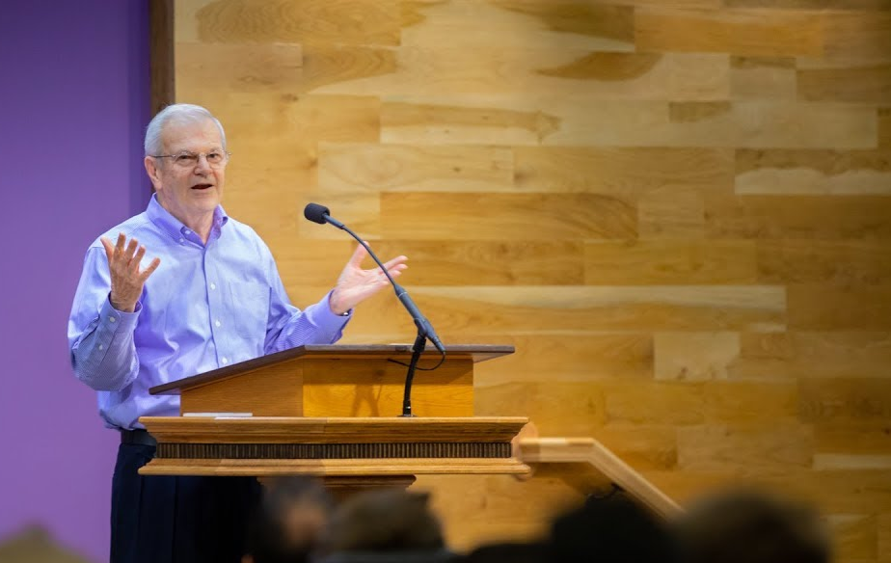
“Usually ‘grace’ refers to the principle by which God operates. Yet it also describes the sphere in which the believer lives, as here (cf. 5:2), as ‘the Law’ describes the old realm. ‘Under grace’ is not, however, a condition in which we are free from any responsibility (cf. Matt. 11:28-30; Titus 2:11-12), as Paul proceeded to clarify in verses 15-23.”
Thomas Constable, Notes on Romans – Romans 6:14, www.planobiblechapel.org.

Slide 7
Romans 5:1-2
“Therefore, having been justified by faith, we have peace with God through our Lord Jesus Christ, through whom also we have obtained our introduction by faith into this grace in which we stand; and we exult in hope of the glory of God.”

Slide 8
“Paul spoke of ‘this grace in which we stand" as the realm into which Christ's redeeming work transfers us…”
Thomas Constable, Notes on Romans – Romans 5:1-2, www.planobiblechapel.org.

Slide 9
Titus 2:11
“Χάρις, ‘grace,’ is a one-word summary of god’s saving act in Christ, given freely to sinners who believe (cf. 1 Tim 1:2).”
William D. Mounce, Pastoral Epistles, vol. 46, Word Biblical Commentary (Dallas: Word, Incorporated, 2000), 422.

Slide 10
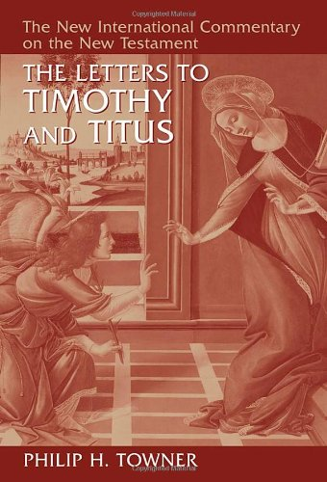
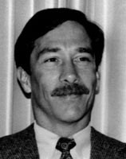
Titus 2:11
“The grace of God that offers salvation” is a roundabout way of referring to the contents of the gospel message. We know from the verb “appeared” that “grace” here means the saving act itself as that which gave full expression to “the grace of God.”
Philip H. Towner, The Letters to Timothy and Titus, The New International Commentary on the New Testament (Grand Rapids, MI: Wm. B. Eerdmans Publishing Co., 2006), 745.

Slide 11
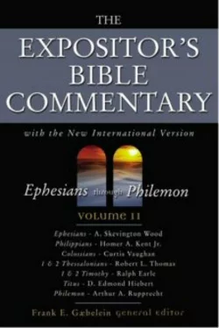
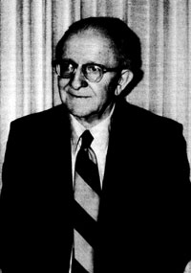
Titus 2:11
“The entire program of redemption is rooted in “the grace of God,” his free favor and spontaneous action toward needy sinners to deliver and transform them. In the Greek, “has appeared” stands emphatically at the beginning, stressing the manifestation of grace as a historical reality. The reference is to Christ’s entire earthly life—his birth, life, death, and resurrection.
D. Edmond Hiebert, “Titus,” in The Expositor’s Bible Commentary: Ephesians through Philemon, ed. Frank E. Gaebelein, vol. 11 (Grand Rapids, MI: Zondervan Publishing House, 1981), 439.

Slide 12
b. Addressing Doctrinal Issues (Titus 2:1-3:11)
The Role of Grace (2:11-15)
Supplied by God to all men (2:11)
Stimulates godly living (2:12)
Secures hope (2:13)
Substituted by Christ (2:14)
Stirred up by Titus
Outline adapted from Titus Argument, Article by Andy Woods, 2007.

Slide 13
Titus 2:11
“For the grace of God has appeared, bringing salvation to all men..”

Slide 14
b. Addressing Doctrinal Issues (Titus 2:1-3:11)
The Role of Grace (2:11-15)
Supplied by God to all men (2:11)
Stimulates godly living (2:12)
Secures hope (2:13)
Substituted by Christ (2:14)
Stirred up by Titus
Outline adapted from Titus Argument, Article by Andy Woods, 2007.

Slide 15
b. Addressing Doctrinal Issues (Titus 2:1-3:11)
The Role of Grace (2:11-15)
Supplied by God to all men (2:11)
Stimulates godly living (2:12)
Secures hope (2:13)
Substituted by Christ (2:14)
Stirred up by Titus
Outline adapted from Titus Argument, Article by Andy Woods, 2007.

Slide 16
Titus 2:13
“…looking for the blessed hope and the appearing of the glory of our great God and Savior, Christ Jesus...”

Slide 17
Isaiah 9:6-7
“For a child will be born to us, a son will be given to us; And the government will rest on His shoulders; And His name will be called Wonderful Counselor, Mighty God, Eternal Father, Prince of Peace. There will be no end to the increase of His government or of peace, On the throne of David and over his kingdom, To establish it and to uphold it with justice and righteousness From then on and forevermore. The zeal of the LORD of hosts will accomplish this.”

Slide 18
Isaiah 53:7
“He was oppressed and He was afflicted, Yet He did not open His mouth; Like a lamb that is led to slaughter, And like a sheep that is silent before its shearers, So He did not open His mouth.”

Slide 19
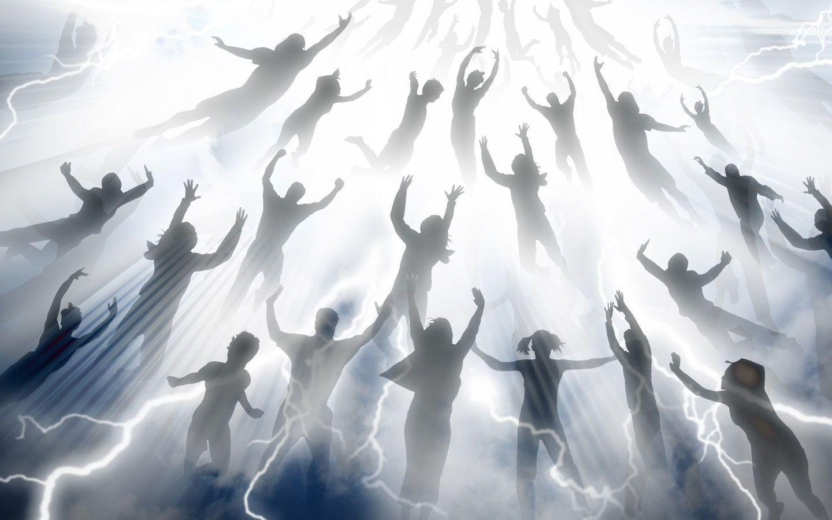
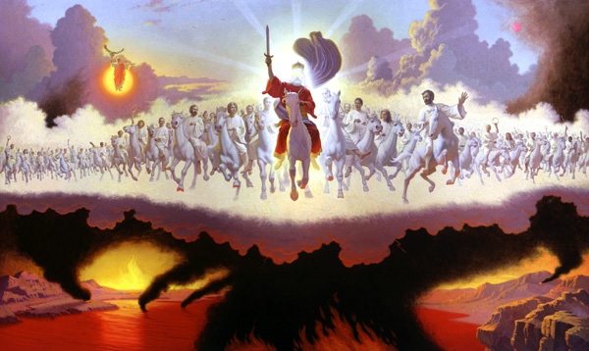
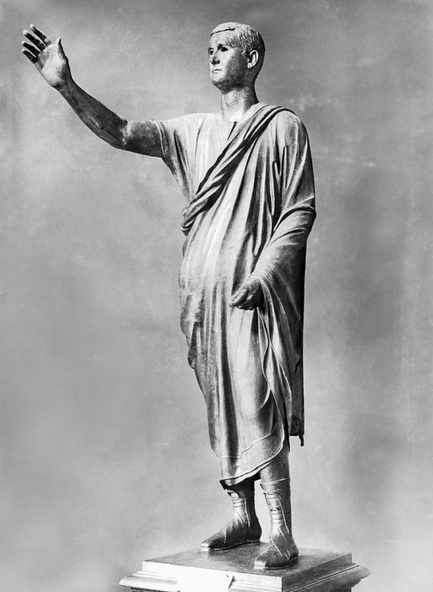
The Second Coming of Christ
Christ Raptures the Church
(1 Thess 4:16-17, 1 Cor 15:50-58)
Glorious Appearing
(Matt 24:29-31; Rev 19:11-20:10)
Antichrist (Rev 13)
Church Age
7-Year Tribulation
Millennium
Rev 6-19:21
Rev 20:1-22
Adapted from Lahaye, Ice, & Hindson, The Popular Handbook on the Rapture, 56.

Slide 20
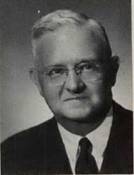
Titus 2:13-14
“The A.V. makes “that blessed hope” and “the glorious appearing” to be two different things, whereas the Greek text requires that they be construed as one. We have Granville Sharp’s rule here, which says that when there are two nouns in the same case connected by kai (και) (and), the first noun having the article, the second noun not having the article, the second noun refers to the same thing the first noun does and is a further description of it. Thus, that blessed hope is the glorious appearing of our Lord. The translation should read, “that blessed hope, even the appearing of the glory of our great God and Saviour, Jesus Christ.” The same rule applies to the words, “the great God and our Saviour Jesus Christ.” Both expressions refer to the same individual. The deity of the Lord Jesus is brought out here by a rule of Greek syntax.
Kenneth S. Wuest, Wuest’s Word Studies from the Greek New Testament: For the English Reader, vol. 9 (Grand Rapids: Eerdmans, 1997), 195.

Slide 22
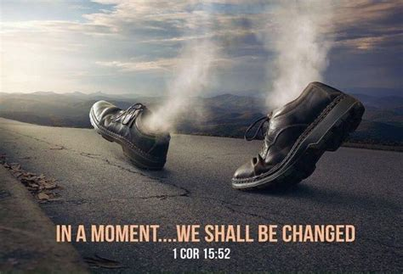
Major Rapture Passages
John 14:1-3
1 Thessalonians 4:13-18
1 Corinthians 15:50-57

Slide 23
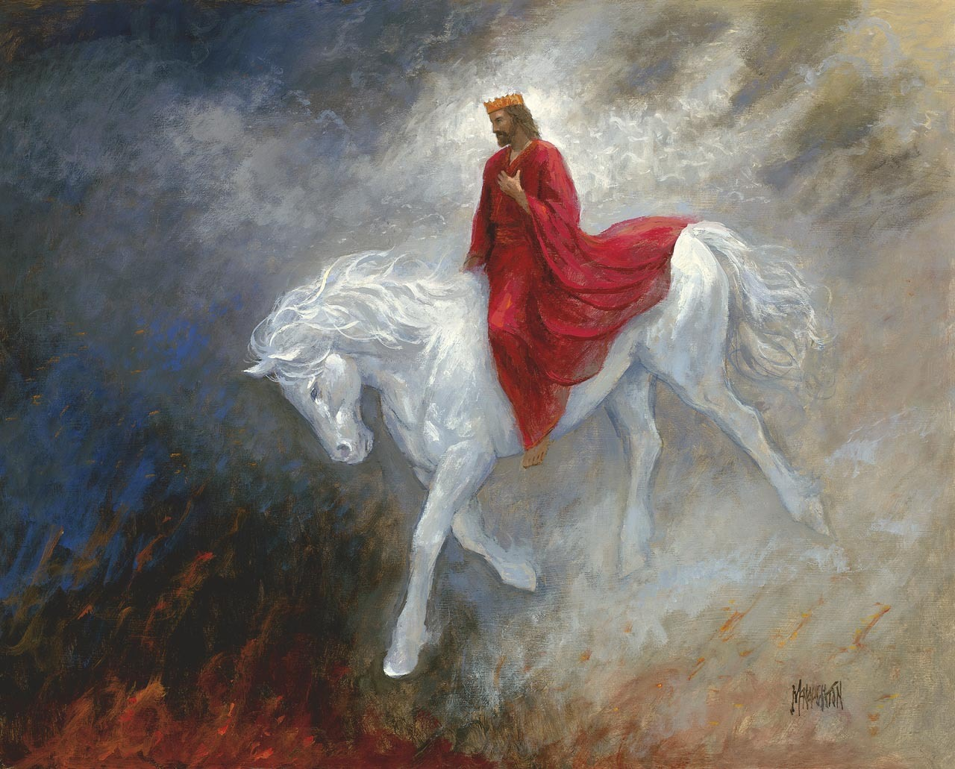

Slide 24
Matthew 24:37
“For the coming of the Son of Man will be just like the days of Noah. “For as in those days before the flood they were eating and drinking, marrying and giving in marriage, until the day that Noah entered the ark, and they did not understand until the flood came and took them all away; so will the coming of the Son of Man be.”

Slide 25
Revelation 6:17
“…for the great day of their wrath has come, and who is able to stand?”
Revelation 15:1, 7
1 Then I saw another sign in heaven, great and marvelous, seven angels who had seven plagues, which are the last, because in them the wrath of God is finished.
7 Then one of the four living creatures gave to the seven angels seven golden bowls full of the wrath of God, who lives forever and ever.”

Slide 26
1 Thessalonians 1:10
“and to wait for His Son from heaven, whom He raised from the dead, that is Jesus, who rescues us from the wrath to come.”

Slide 27
1 Thessalonians 5:9
“For God has not destined us for wrath, but for obtaining salvation through our Lord Jesus Christ…”

Slide 28
“For (hoti, “because”) introduces another reason why believers should prepare themselves. God’s intention for them is not the wrath that will come on the earth in the day of the Lord, but the full salvation that will be theirs when the Lord returns for them in the clouds. The wrath of God referred to here clearly refers to the Tribulation; the context makes this apparent. Deliverance from that wrath is God’s appointment for believers. This temporal salvation comes through the Lord Jesus Christ just as does eternal salvation.”
Thomas L. Constable, “1 Thessalonians,” in The Bible Knowledge Commentary: An Exposition of the Scriptures, ed. J. F. Walvoord and R. B. Zuck, vol. 2 (Wheaton, IL: Victor Books, 1985), 706–707.

Slide 29
Romans 5:9
“Much more then, having now been justified by His blood, we shall be saved from the wrath of God through Him.”

Slide 30
Colossians 3:4
“When Christ, who is our life, is revealed, then you also will be revealed with Him in glory.”

Slide 31
1 John 3:2
“Beloved, now we are children of God, and it has not appeared as yet what we will be. We know that when He appears, we will be like Him, because we will see Him just as He is.”

Slide 32
Hebrews 9:28
“…so Christ also, having been offered once to bear the sins of many will appear a second time for salvation without reference to sin, to those who eagerly await Him.”

Slide 33
Hebrews 9:28
“…so Christ also, having been offered once to bear the sins of many will appear a second time for salvation without reference to sin, to those who eagerly await Him.”

Slide 34
Rapture vs. 2nd Advent
Rapture | Second Coming
Comes back in the air (1 Thess 4:14-17) | Comes to the earth (Rev 19:11-16)
For His saints | With His saints
Blessing | Judgment
Believers only | All humanity (Rev 1:7)
Invisible (1 Cor 15:52) | Visible (Zech 12:10)
Adapted from Lahaye, Ice, & Hindson, The Popular Handbook on the Rapture, 55.

Slide 35
Rapture vs. 2nd Advent (cont.)
Rapture | Second Coming
Rapture/translation of all believers (1 Thess 4:16-17; 1 Cor 15:50-54) | No one Raptured
Believers taken to the Father’s House (John 14:1-3) | Resurrected saints do not see Father’s house
No judgement on earth | Christ judges inhabitants of the earth (Matt 25:31-46)
Church taken to heaven (1 Thess 4:16-17) | Christ sets up His kingdom on earth (Rev 19-20)
Imminent (1 Cor 15:51-52) | Cannot occur until 7 Trib. Concludes (Dan 9:26-29)
Adapted from Lahaye, Ice, & Hindson, The Popular Handbook on the Rapture, 55.

Slide 36
Rapture vs. 2nd Advent (cont.)
Rapture | Second Coming
No mention of Satan | Satan bound in abyss (Rev 20-20:3)
Archangel (1 Thess 4:16) | Myriad of Angels (Matt 24:31)
Resurrection | No resurrection
Rescue the Church | Rescue Israel
No signs preceding | Many signs preceding (Matt 24:29-31)
A time of joy (1 Thess 2:19-20; Tit 2:13; 4:18) | A time of mourning (Matt 24:30; Rev 1:7)
Adapted from Lahaye, Ice, & Hindson, The Popular Handbook on the Rapture, 55.

Slide 37
b. Addressing Doctrinal Issues (Titus 2:1-3:11)
The Role of Grace (2:11-15)
Supplied by God to all men (2:11)
Stimulates godly living (2:12)
Secures hope (2:13)
Substituted by Christ (2:14)
Stirred up by Titus
Outline adapted from Titus Argument, Article by Andy Woods, 2007.

Slide 38
b. Addressing Doctrinal Issues (Titus 2:1-3:11)
The Role of Grace (2:11-15)
Supplied by God to all men (2:11)
Stimulates godly living (2:12)
Secures hope (2:13)
Substituted by Christ (2:14)
Stirred up by Titus
Outline adapted from Titus Argument, Article by Andy Woods, 2007.

Slide 39
Titus 2:14
“who gave Himself for us to redeem us from every lawless deed, and to purify for Himself a people for His own possession, zealous for good deeds.

Slide 40
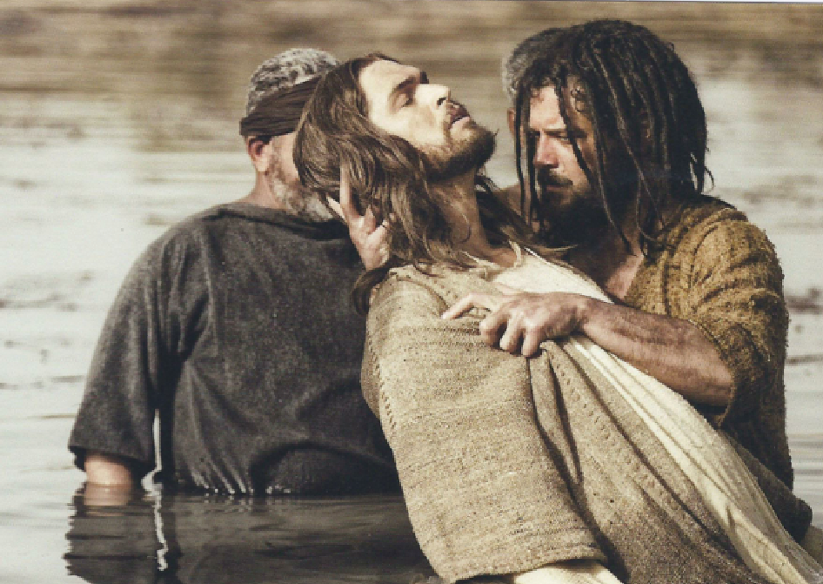

Slide 41
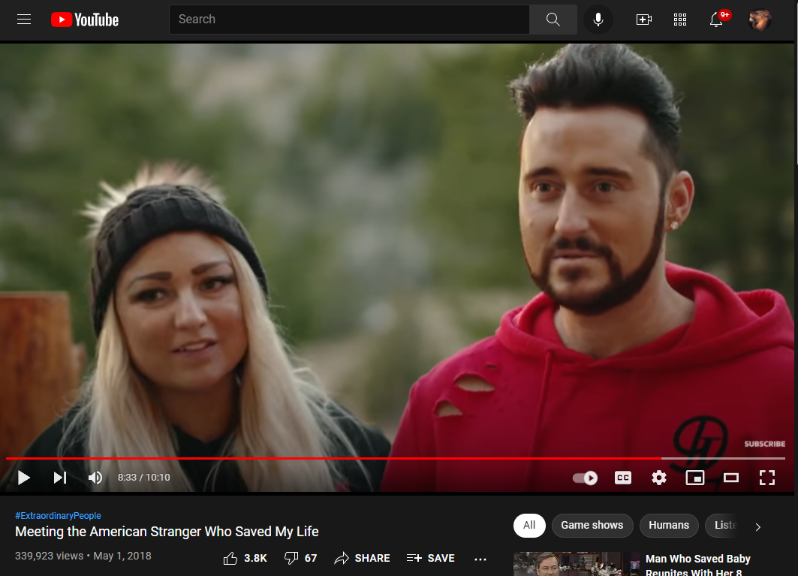

Slide 42
Titus 2:14
“who gave Himself for us to redeem us from every lawless deed, and to purify for Himself a people for His own possession, zealous for good deeds.

Slide 43
Hebrews 9:14
“…how much more will the blood of Christ, who through the eternal Spirit offered Himself without blemish to God, cleanse your conscience from dead works to serve the living God?”

Slide 44
1 John 1:7, 9
“but if we walk in the Light as He Himself is in the Light, we have fellowship with one another, and the blood of Jesus His Son cleanses us from all sin.”
“If we confess our sins, He is faithful and righteous to forgive us our sins and to cleanse us from all unrighteousness.”

Slide 45
Romans 12:1
“Therefore I urge you, brethren, by the mercies of God, to present your bodies a living and holy sacrifice, acceptable to God, which is your spiritual service of worship.”

Slide 46
b. Addressing Doctrinal Issues (Titus 2:1-3:11)
The Role of Grace (2:11-15)
Supplied by God to all men (2:11)
Stimulates godly living (2:12)
Secures hope (2:13)
Substituted by Christ (2:14)
Stirred up by Titus
Outline adapted from Titus Argument, Article by Andy Woods, 2007.

Slide 47
Romans 3:23
“…for all have sinned and fall short of the glory of God…”

Slide 48
The book of Titus
Worthy of the Gospel

Slide 49
2 Thess 2:16–17
16 “Now may our Lord Jesus Christ Himself and God our Father, who has loved us and given us eternal comfort and good hope by grace, comfort and strengthen your hearts in every good work and word.”

