Slide 1


Zechariah
Introductory Matters

Slide 2

Introductory Matters
  Title
  Authorship
  Biography
  Scope
  Date
  Audience
  Place of writing

Slide 3
Introductory Matters
  Occasion
  Structure
  Message
  Purposes
  Themes
  Unique characteristics
  Genre
  Christ in Zechariah

Slide 4

Structure
Introductory call to repentance (1:1-6)
Eight-night visions (1:7–6:15)
Question and answers about fasting (7–8)
Two burdens (9–14)

Slide 5
Structure
Introductory call to repentance (1:1-6)
Eight-night visions (1:7–6:15)
Question and answers about fasting (7–8)
Two burdens (9–14)

Slide 6

I. Introductory call to repentance
(1:1-6)
Date (1:1a)
Author (1:1b)
Call to repentance (1:2–6)

Slide 7


Deuteronomy 17:15
“you shall surely set a king over you whom the Lord your God chooses, one from among your countrymen you shall set as king over yourselves; you may not put a foreigner over yourselves who is not your countryman.”

Slide 8

Hosea 4:1-2
“Listen to the word of the Lord, O sons of Israel, For the Lord has a case against the inhabitants of the land, Because there is no faithfulness or kindness Or knowledge of God in the land.² There is swearing, deception, murder, stealing and adultery. They employ violence, so that bloodshed follows bloodshed.”

Slide 9


Slide 10
Six Parts of a Suzerain-Vassal Treaty in Deuteronomy
Preamble (1:1-5)
Prologue (1:6–4:40)
Covenant obligations (5–26)
Storage and reading instructions (27:2-3; 31:9, 24, 26)
Witnesses (32:1)
Blessings and curses (28)

Slide 11
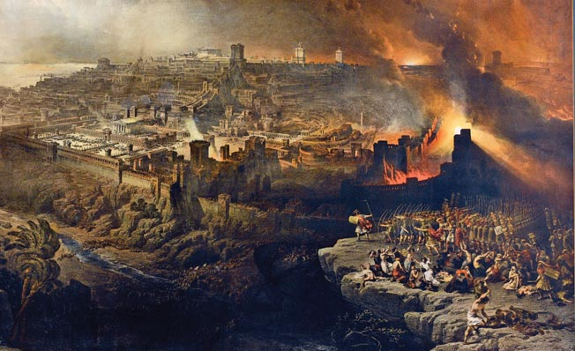
Israel's Judgments
Division of the kingdom in 931 B.C. (1 Kgs. 12)
Assyrian judgment in 722 B.C. (2 Kgs. 17)
Babylonian captivity in 586 B.C. (2 Kgs. 25)
Roman invasion in AD 70 (Luke 19:41-44)

Slide 12
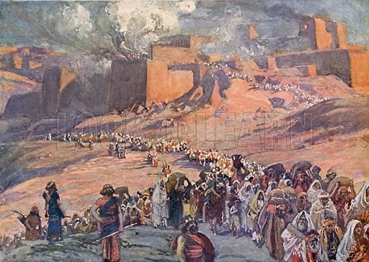
Israel's Judgments
Division of the kingdom in 931 B.C. (1 Kgs. 12)
Assyrian judgment in 722 B.C. (2 Kgs. 17)
Babylonian captivity in 586 B.C. (2 Kgs. 25)
Roman invasion in AD 70 (Luke 19:41-44)

Slide 13


Slide 14

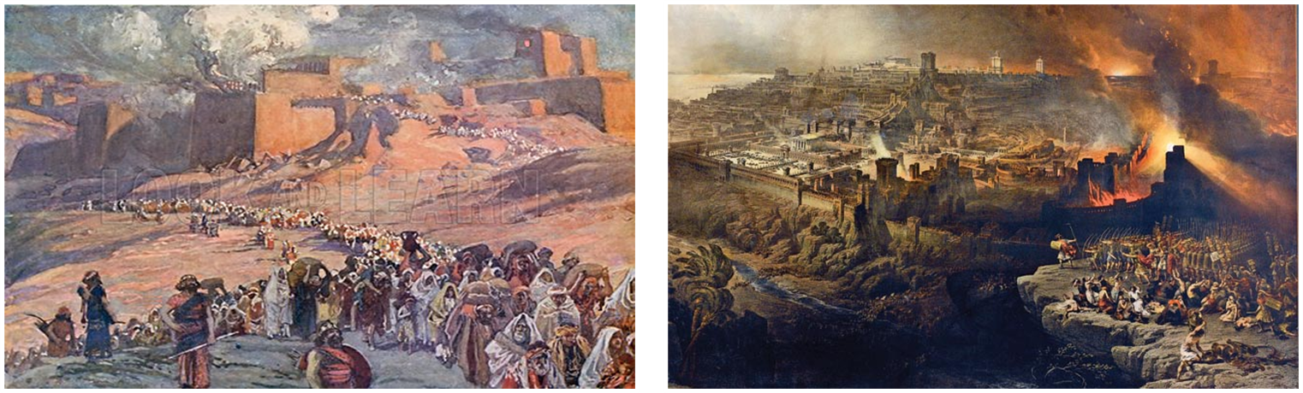
Charles Ryrie
The Ryrie Study Bible
“Zechariah 1:5–6 (RSB:NASB1995U): 1:5–6 The idea is this: Pay attention to the Word of God because, though prophets die, it endures, and the proof that it endures is that its warnings come true (overtake).”

Slide 15

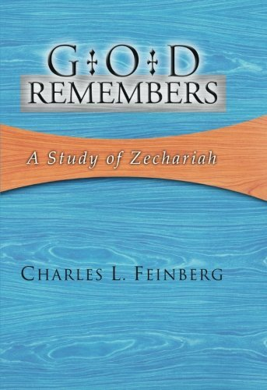
Charles L. Feinberg
God Remembers: A Study of Zechariah (Wheaton: Van Kampen, 1950, p. 20.
“God’s Word is more lasting than any messenger of His who bears it and gives utterance.”

Slide 16
Charles L. Feinberg
God Remembers: A Study of Zechariah (Wheaton: Van Kampen, 1950, p. 21.
“The fulfillment of the threatenings were so patent that Israel had to admit after consideration that God’s Word was true, even though it was to their own discomfiture. Proof that the fathers recognized the Lord‘s hand and their judgment can be found in Lamentations 2:17… Daniel 9:4ff; Ezra 9:6ff.”

Slide 17
Structure
Introductory call to repentance (1:1-6)
Eight-night visions (1:7–6:15)
Question and answers about fasting (7–8)
Two burdens (9–14)

Slide 18
II. Eight Night Visions
(1:7‒6:15)
  Riders & horses among the myrtle trees (1:7-17)
  Four horns & four craftsmen (1:18-21)
  Man with the measuring line (2)
  Cleansing of the High Priest Joshua (3)
  Lampstand & olive tree (4)
  Flying scroll (5:1-4)
  Woman in the basket (5:5-11)
  Four chariots (6:1-8)
  Conclusion: crowning of Joshua (6:9-15)

Slide 19
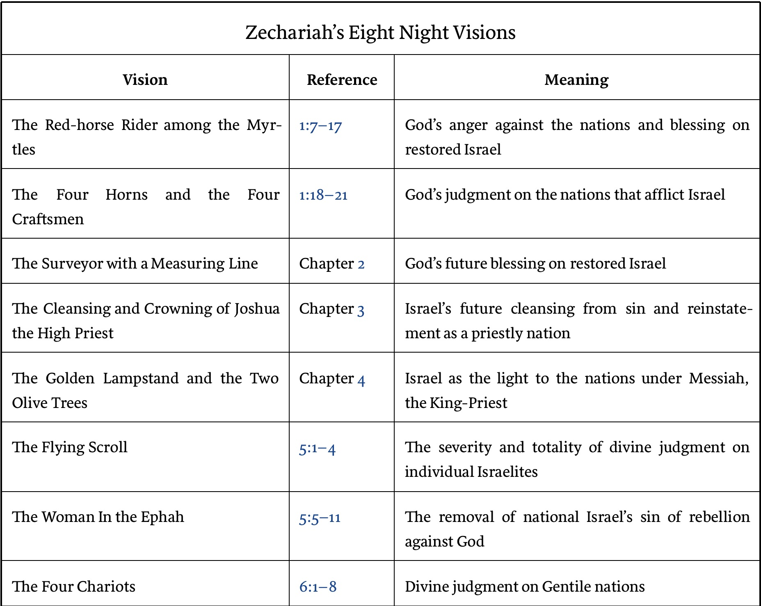

Slide 20
II. Eight Night Visions
(1:7‒6:15)
  Riders & horses among the myrtle trees (1:7-17)
  Four horns & four craftsmen (1:18-21)
  Man with the measuring line (2)
  Cleansing of the High Priest Joshua (3)
  Lampstand & olive tree (4)
  Flying scroll (5:1-4)
  Woman in the basket (5:5-11)
  Four chariots (6:1-8)
  Conclusion: crowning of Joshua (6:9-15)

Slide 21
Rider & Horses Among the Myrtle Trees
(1:7-17)
Date (1:7)
Description (1:8)
Interpretation (1:9–11)
Explanation (1:12-17)

Slide 22
Rider & Horses Among the Myrtle Trees
(1:7-17)
Date (1:7)
Description (1:8)
Interpretation (1:9–11)
Explanation (1:12-17)

Slide 23

Zechariah 1:7
On the twenty-fourth day of the eleventh month, which is the month Shebat, in the second year of Darius (519 b.c.*), the word of the Lord came to Zechariah the prophet, the son of Berechiah, the son of Iddo, as follows:
*Babylon fell in 539 b.c!

Slide 24
4. Scope
SCRIPTURE | SCRIPTURAL DATE | DATE
1:1 | 8th month, 2nd year of Darius | 10 or 11/520 B.C.
1:7 | 24th day, 11th month, 2nd year of Darius | 2/15/519 B.C.
7:1 | 4th day, 9th month, 4th year of Darius | 12/17/518 B.C.

Slide 25
Rider & Horses Among the Myrtle Trees
(1:7-17)
Date (1:7)
Description (1:8)
Interpretation (1:9–11)
Explanation (1:12-17)

Slide 26
Rider & Horses Among the Myrtle Trees
(1:7-17)
Date (1:7)
Description (1:8)
Interpretation (1:9–11)
Explanation (1:12-17)

Slide 27
III. Interpretation
(1:9-11)
Zechariah’s inquiry (1:9a)
Interpreting angel’s answer (1:9b)
Angel of the Lord’s answer (1:10)
Rider’s report (1:11)

Slide 28
III. Interpretation
(1:9-11)
Zechariah’s inquiry (1:9a)
Interpreting angel’s answer (1:9b)
Angel of the Lord’s answer (1:10)
Rider’s report (1:11)

Slide 29
III. Interpretation
(1:9-11)
Zechariah’s inquiry (1:9a)
Interpreting angel’s answer (1:9b)
Angel of the Lord’s answer (1:10)
Rider’s report (1:11)

Slide 30
III. Interpretation
(1:9-11)
Zechariah’s inquiry (1:9a)
Interpreting angel’s answer (1:9b)
Angel of the Lord’s answer (1:10)
Rider’s report (1:11)

Slide 31
III. Interpretation
(1:9-11)
Zechariah’s inquiry (1:9a)
Interpreting angel’s answer (1:9b)
Angel of the Lord’s answer (1:10)
Rider’s report (1:11)

Slide 32
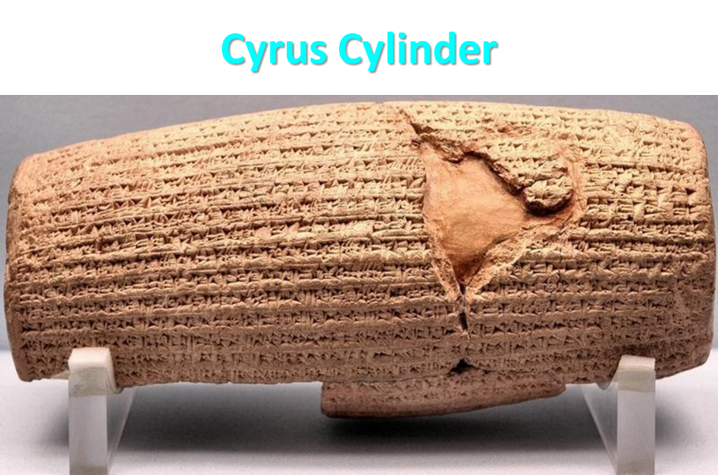

Slide 33
Three Returns
 | DATE | DURATION | PERSIAN KING | JEWISH LEADER | SCRIPTURE | PURPOSE | NUMBER OF RETURNEES
1st return | 538–515 B.C. | 23 years | Cyrus (Isa. 44:28‒45:1) | Zerubbabel | Ezra 1–6; Isaiah 44:28 | Rebuilding the temple | 50,000
2nd return | 458–457 B.C. | 2 years | Artaxerxes | Ezra | Ezra 7–10 | Adorning of the temple and reforming the people | 2,000
3rd return | 444–432 B.C. | 8 years | Artaxerxes | Nehemiah | Nehemiah | Rebuilding the wall

Slide 34
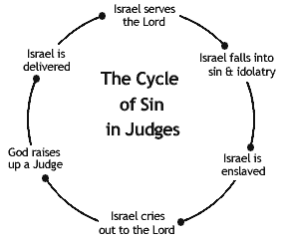

Slide 35


Slide 36

Ezekiel 38:8, 11
“⁸ After many days you will be summoned; in the latter years you will come into the land that is restored from the sword, whose inhabitants have been gathered from many nations to the mountains of Israel which had been a continual waste; but its people were brought out from the nations, and they are living securely [batach], all of them…. ¹¹ and you will say, ‘I will go up against the land of unwalled villages. I will go against those who are at rest [shacat], that live securely [batach], all of them living without walls and having no bars or gates.”

Slide 37
Charles L. Feinberg
God Remembers: A Study of Zechariah (Wheaton: Van Kampen, 1950, p. 33-34, 38.
“Let her full plight come before us; the rest promised upon return from Babylon yet unfulfilled: Israel under the yoke of the Gentile powers; hindrances in building the temple; the holy city without walls; the desolation of Jerusalem…The contrast between Israel and the nations of the earth is the occasion for the intercession now before us…Truly, God’s thoughts are not ours. When the world was busy with its own affairs, God’s eyes and the heart of the Messiah were upon the lowly estate of Israel and upon the temple in Jerusalem.”

Slide 38
Rider & Horses Among the Myrtle Trees
(1:7-17)
Date (1:7)
Description (1:8)
Interpretation (1:9–11)
Explanation (1:12-17)

Slide 39

IV. Explanation
(1:12-17)
God’s jealousy for Jerusalem (1:12-14)
God’s anger with the nations (1:15)
Jerusalem to be restored (1:16a)
The Temple to be restored (1:16b)
Jerusalem's prosperity to return (1:17)

Slide 40
IV. Explanation
(1:12-17)
God’s jealousy for Jerusalem (1:12-14)
God’s anger with the nations (1:15)
Jerusalem to be restored (1:16a)
The Temple to be restored (1:16b)
Jerusalem's prosperity to return (1:17)

Slide 42
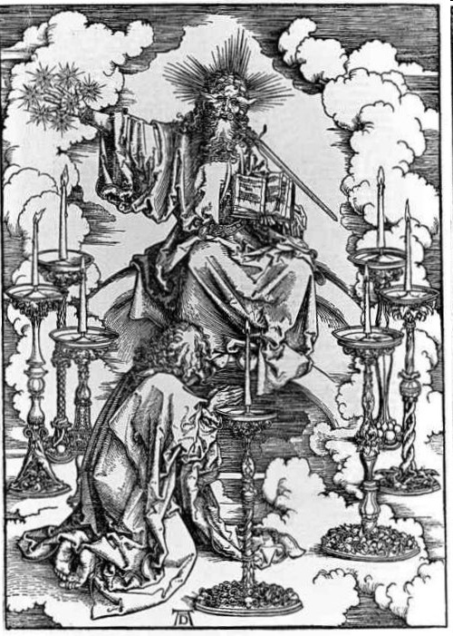

Slide 43
Charles L. Feinberg
God Remembers: A Study of Zechariah (Wheaton: Van Kampen, 1950, p. 34-35.
“The good comforting words, yet before us in verses 14-17, are threefold: (1) God still loves Jerusalem; (2) He is exceedingly angry with the nations that afflicted Israel; (3) He has purposes of glory, prosperity, and enlargement for Jerusalem.”

Slide 44
IV. Explanation
(1:12-17)
God’s jealousy for Jerusalem (1:12-14)
God’s anger with the nations (1:15)
Jerusalem to be restored (1:16a)
The Temple to be restored (1:16b)
Jerusalem's prosperity to return (1:17)

Slide 45
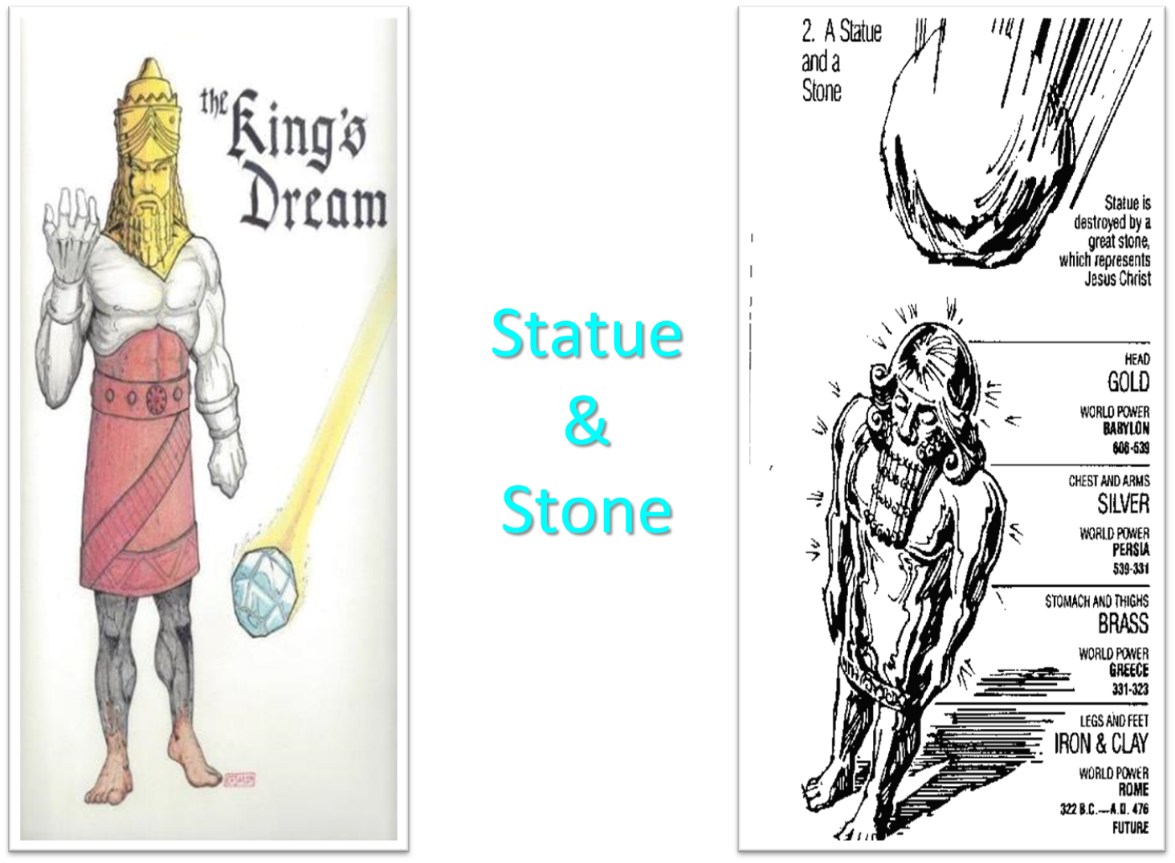

Slide 46


Slide 47
Charles Ryrie
The Ryrie Study Bible
“Zechariah 1:15 (RSB:NASB1995U): 1:15 they furthered the disaster. Lit., they helped for evil. Though the heathen nations were used of God to punish Israel, they went too far in trying to annihilate her.”

Slide 48
Charles L. Feinberg
God Remembers: A Study of Zechariah (Wheaton: Van Kampen, 1950, p. 35-36.
“They helped with evil purpose to exterminate them. God meant a moderate punishment, but the Babylonians and others reveled in the sufferings of Israel with delight in prolonging them. Babylon, like a Assyria, was the rod of God‘s wrath, but their own hearts designed evil against Israel (Isa. 10:5, 7). Note it is an unfailing Scriptural principle: God’s relations to Israel are one thing and the relations of the nations to Israel are another. God is never pleased with the meddling of strangers in His relations with Israel (Isa. 47:6).”

Slide 49
Charles L. Feinberg
God Remembers: A Study of Zechariah (Wheaton: Van Kampen, 1950, p. 35-36.
“It is as though a father were chastening a child, and a stranger began to punish with an iron rod. Some take refuge in the plea that God has predicted these things before-hand. True, but the prediction of the sufferings of Christ and His betrayal at the hands of His own familiar friend mitigated not one whit the crime of the Romans and Israel or that of Judas Iscariot.”

Slide 50


Genesis 12:3
“And I will bless those who bless you, And the one who curses you I will curse. And in you all the families of the earth will be blessed.”

Slide 51
IV. Explanation
(1:12-17)
God’s jealousy for Jerusalem (1:12-14)
God’s anger with the nations (1:15)
Jerusalem to be restored (1:16a)
The Temple to be restored (1:16b)
Jerusalem's prosperity to return (1:17)

Slide 52
Charles L. Feinberg
God Remembers: A Study of Zechariah (Wheaton: Van Kampen, 1950, p. 37-38.
“But if God’s words can comfort the then present generation and speak for Messianic times to come, as in multiplied numbers of passages, who shall say this is contrary to God’s practice? We need not limit the Holy One of Israel. This is not to say that we find no fulfillment in that time…But this does not exhaust the prophecy; there awaits a fuller fulfillment...”

Slide 53
Charles L. Feinberg
God Remembers: A Study of Zechariah (Wheaton: Van Kampen, 1950, p. 37-38.
“These prophecies will be completely fulfilled in the return of Israel to her land in Messianic times, a return of which the restoration from the Babylonian captivity was a pledge and a promise. Space would forbid of bringing forth of the many passages concerning the Messianic reign which predict the presence of God‘s mercy in Jerusalem (Ezek. 48:35); the building of His temple in it (Ezek. 40-48); the rebuilding of Jerusalem (Jer. 31: 38–40); the prosperity of Judah’s cities (Isa. 60:4–9; Zech. 9:17); the comfort of Zion (Isa. 14:1). The composite picture is without a doubt Messianic.”

Slide 54

Zechariah 14:16-18
“Then it will come about that any who are left of all the nations that went against Jerusalem will go up from year to year to worship the King, the Lord of hosts, and to celebrate the Feast of Booths. ¹⁷ And it will be that whichever of the families of the earth does not go up to Jerusalem to worship the King, the Lord of hosts, there will be no rain on them. ¹⁸ If the family of Egypt does not go up or enter, then no rain will fall on them; it will be the plague with which the Lord smites the nations who do not go up to celebrate the Feast of Booths.”

Slide 55

Isaiah 2:2-3
“Now it will come about that In the last days The mountain of the house of the Lord Will be established as the chief of the mountains, And will be raised above the hills; And all the nations will stream to it.³ And many peoples will come and say, ‘Come, let us go up to the mountain of the Lord, To the house of the God of Jacob; That He may teach us concerning His ways And that we may walk in His paths.’ For the law will go forth from Zion And the word of the Lord from Jerusalem.”

Slide 56

Revelation 20:7-9
“⁷ When the thousand years are completed, Satan will be released from his prison, ⁸ and will come out to deceive the nations which are in the four corners of the earth, Gog and Magog, to gather them together for the war; the number of them is like the sand of the seashore. ⁹ And they came up on the broad plain of the earth and surrounded the camp of the saints and the beloved city, and fire came down from heaven and devoured them.

Slide 57

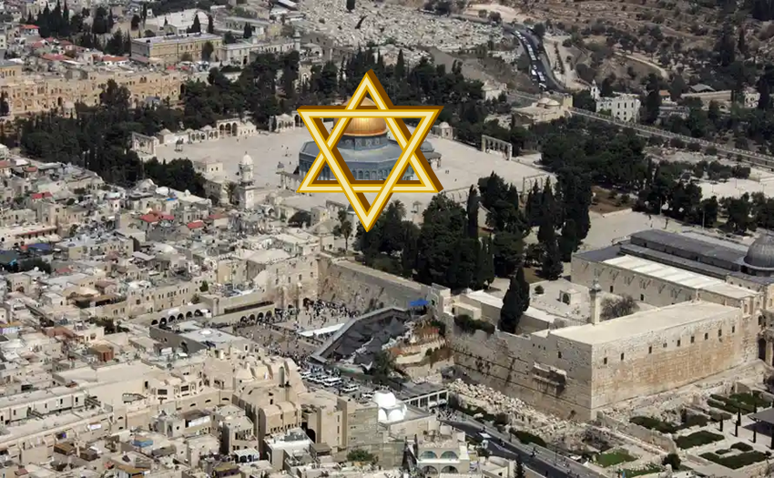
Robert Thomas
Four Views on the Book of Revelation, page 207.
“At the end of the Millennium that city will be Satan’s prime objective with his rebel army, because Israel will be a leader among the nations.”

Slide 58
IV. Explanation
(1:12-17)
God’s jealousy for Jerusalem (1:12-14)
God’s anger with the nations (1:15)
Jerusalem to be restored (1:16a)
The Temple to be restored (1:16b)
Jerusalem's prosperity to return (1:17)

Slide 59
ISRAEL’S FOUR TEMPLES
Solomon’s pre-exilic temple (Kings and Chronicles)
Zerubbabel’s post exilic temple (Ezra 1-6; John 2:20)
Antichrist's temple (Dan. 9:27; Matt. 24:15; 2 Thess. 2:4; Rev. 11:1-2)
Millennial temple (Ezek. 40-48)

Slide 60


Slide 61


Slide 62
IV. Explanation
(1:12-17)
God’s jealousy for Jerusalem (1:12-14)
God’s anger with the nations (1:15)
Jerusalem to be restored (1:16a)
The Temple to be restored (1:16b)
Jerusalem's prosperity to return (1:17)

Slide 63

Isaiah 65:21–22
²¹ “They will build houses and inhabit them; They will also plant vineyards and eat their fruit. ²² “They will not build and another inhabit, They will not plant and another eat; For as the lifetime of a tree, so will be the days of My people, And My chosen ones will wear out the work of their hands.

Slide 64

Amos 9:13
“Behold, days are coming,” declares the Lord, “When the plowman will overtake the reaper And the treader of grapes him who sows seed; When the mountains will drip sweet wine And all the hills will be dissolved.”

Slide 65

Mark Twain
The Innocents Abroad, Complete, 1st ed. (A Public Domain Book, 1869), 267, 285, 302. These quotes can be found in chapters 47, 49, 52.
“... A desolate country whose soil is rich enough, but is given over wholly to weeds…a silent mournful expanse….a desolation is here that not even imagination can grace with the pomp of life and action….we never saw a human being on the whole route….there was hardly a tree or shrub anywhere. Even the olive tree and the cactus, those fast friends of a worthless soil, had almost deserted the country.”

Slide 66
Why?
COUNTRY | GROSS DOMESTIC PRODUCT
ISRAEL | $123 BILLION
Egypt | $81 billion
Syria | $26 billion
Lebanon | $21 billion
Jordan | $12 billion
Source: CIA World Fact Book, 2005

Slide 67


Slide 68
II. Eight Night Visions
(1:7‒6:15)
  Riders & horses among the myrtle trees (1:7-17)
  Four horns & four craftsmen (1:18-21)
  Man with the measuring line (2)
  Cleansing of the High Priest Joshua (3)
  Lampstand & olive tree (4)
  Flying scroll (5:1-4)
  Woman in the basket (5:5-11)
  Four chariots (6:1-8)
  Conclusion: crowning of Joshua (6:9-15)

Slide 70
2. The Four Horses & Four Craftsmen
(1:8-21)
Four Horns (1:18-19)
    Description (1:18)
    Explanation (1:19)
Four Craftsmen (1:20-21)
    Description (1:20)
    Explanation (1:21)

Slide 71
2. The Four Horses & Four Craftsmen
(1:8-21)
Four Horns (1:18-19)
    Description (1:18)
    Explanation (1:19)
Four Craftsmen (1:20-21)
    Description (1:20)
    Explanation (1:21)

Slide 72
2. The Four Horses & Four Craftsmen
(1:8-21)
Four Horns (1:18-19)
    Description (1:18)
    Explanation (1:19)
Four Craftsmen (1:20-21)
    Description (1:20)
    Explanation (1:21)

Slide 73
2. The Four Horses & Four Craftsmen
(1:8-21)
Four Horns (1:18-19)
    Description (1:18)
    Explanation (1:19)
Four Craftsmen (1:20-21)
    Description (1:20)
    Explanation (1:21)

Slide 75
Six Parts of a Suzerain-Vassal Treaty in Deuteronomy
Preamble (1:1-5)
Prologue (1:6–4:40)
Covenant obligations (5–26)
Storage and reading instructions (27:2-3; 31:9, 24, 26)
Witnesses (32:1)
Blessings and curses (28)

Slide 78
Charles L. Feinberg
God Remembers: A Study of Zechariah (Wheaton: Van Kampen, 1950, p. 39-40.
“First, it is claimed that the horns are contemporaneous, whereas the position just taken would make them successive. The objection falls down completely when we consider that there were not four powers in open opposition to Judah in the time of Zechariah. Those with whom Judah had to deal at this time period were subordinate to the Persian empire.”

Slide 79
2. The Four Horses & Four Craftsmen
(1:8-21)
Four Horns (1:18-19)
    Description (1:18)
    Explanation (1:19)
Four Craftsmen (1:20-21)
    Description (1:20)
    Explanation (1:21)

Slide 80
2. The Four Horses & Four Craftsmen
(1:8-21)
Four Horns (1:18-19)
    Description (1:18)
    Explanation (1:19)
Four Craftsmen (1:20-21)
    Description (1:20)
    Explanation (1:21)

Slide 81
2. The Four Horses & Four Craftsmen
(1:8-21)
Four Horns (1:18-19)
    Description (1:18)
    Explanation (1:19)
Four Craftsmen (1:20-21)
    Description (1:20)
    Explanation (1:21)

Slide 82
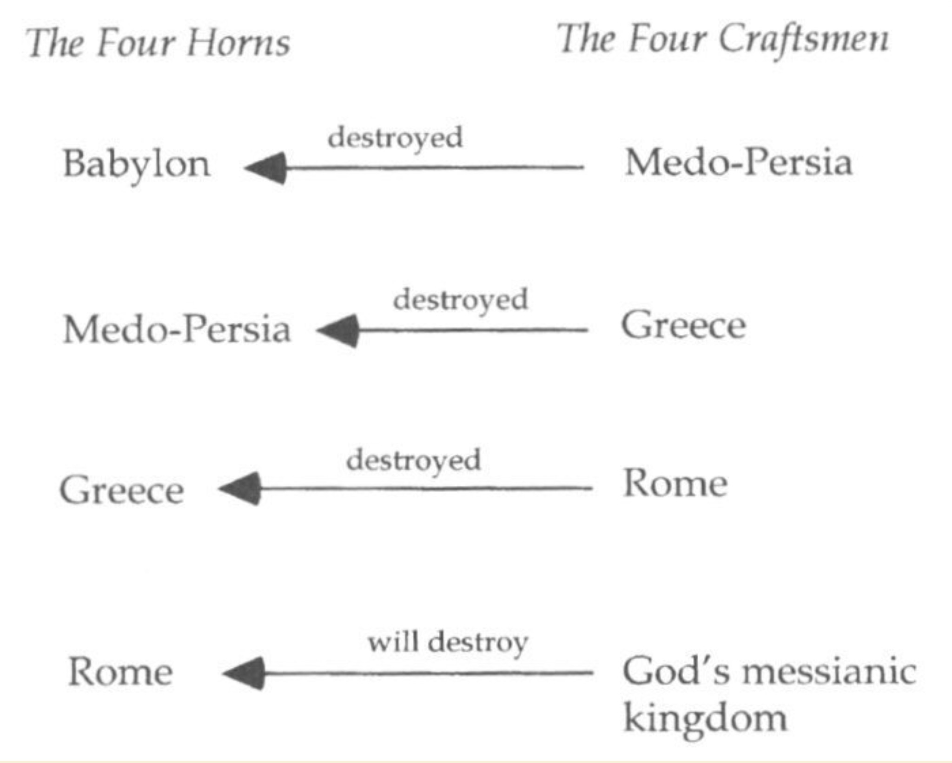

Slide 84
Charles Ryrie
The Ryrie Study Bible
“Zechariah 1:15 (RSB:NASB1995U): 1:15 they furthered the disaster. Lit., they helped for evil. Though the heathen nations were used of God to punish Israel, they went too far in trying to annihilate her.”

Slide 85
Charles L. Feinberg
God Remembers: A Study of Zechariah (Wheaton: Van Kampen, 1950, p. 42-43.
“Several features are noteworthy in this vision: (1) God takes account of everyone that lifts his hand against Israel; (2) He has complete knowledge of the dejected condition of His people and the extent of their injury; and (3) He has already provided the punishment for every foe of His chosen ones. As a definite matter of history three of the empires or kingdoms symbolized by the horns already know of the visitation of God upon them.”

Slide 86
Conclusion

Slide 87
II. Eight Night Visions
(1:7‒6:15)
  Riders & horses among the myrtle trees (1:7-17)
  Four horns & four craftsmen (1:18-21)
  Man with the measuring line (2)
  Cleansing of the High Priest Joshua (3)
  Lampstand & olive tree (4)
  Flying scroll (5:1-4)
  Woman in the basket (5:5-11)
  Four chariots (6:1-8)
  Conclusion: crowning of Joshua (6:9-15)

