Slide 1


Genesis 12‒50
Israel’s Birth & Preservation

Slide 2


GENESIS STRUCTURE
  Beginning of the Human race (Gen. 1‒11)
  Beginning of the Hebrew race (Gen. 12‒50)

Slide 3

GENESIS STRUCTURE
  Genesis 1-11 (four events)
    Creation (1-2)
    Fall (3-5)
    Flood (6-9)
    National dispersion (10-11)

Slide 4


Genesis 3:15
“And I will put enmity Between you and the woman, And between your seed and her seed; He shall bruise you on the head, And you shall bruise him on the heel.”

Slide 5
GENESIS STRUCTURE
  Beginning of the Human race (Gen. 1‒11)
  Beginning of the Hebrew race (Gen. 12‒50)

Slide 6

GENESIS STRUCTURE
  Genesis 12-50 (four people)
    Abraham (12:1–25:11)
    Isaac (25:12–26:35)
    Jacob (27–36)
    Joseph (37–50)

Slide 7


Isaiah 43:1
“But now, thus says the Lord, your Creator, O Jacob, And He who formed you, O Israel, 'Do not fear, for I have redeemed you; I have called you by name; you are Mine!'”

Slide 8
GENESIS STRUCTURE
  Genesis 12-50 (four people)
    Abraham (12:1–25:11)
    Isaac (25:12–26:35)
    Jacob (27–36)
    Joseph (37–50)

Slide 9
Genesis 11:27‒12:3
A New Nation
  A new record (Gen. 11:27a)
  A new family (Gen. 11:27b-29)
  A new crisis (Gen. 11:30)
  A new journey (Gen. 11:31)
  A death (Gen. 11:32)
  New promises (Gen. 12:1-3)

Slide 10
Genesis 11:27‒12:3
A New Nation
  A new record (Gen. 11:27a)
  A new family (Gen. 11:27b-29)
  A new crisis (Gen. 11:30)
  A new journey (Gen. 11:31)
  A death (Gen. 11:32)
  New promises (Gen. 12:1-3)

Slide 11


Slide 12


Proverbs 3:5-6
“Trust in the Lord with all your heart And do not lean on your own understanding. In all your ways acknowledge Him, And He will make your paths straight.”

Slide 14

Jeremiah 31:35-37
Thus says the Lord, Who gives the sun for light by day And the fixed order of the moon and the stars for light by night, Who stirs up the sea so that its waves roar; The Lord of hosts is His name:³⁶ “If this fixed order departs From before Me,” declares the Lord, “Then the offspring of Israel also will cease From being a nation before Me forever.”³⁷ Thus says the Lord, “If the heavens above can be measured And the foundations of the earth searched out below, Then I will also cast off all the offspring of Israel For all that they have done,” declares the Lord.

Slide 15
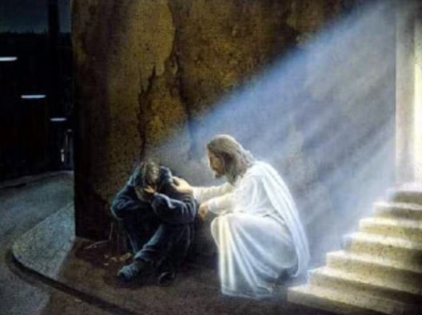
2 Timothy 2:11, 13
“The statement is trustworthy:…If we are faithless, He remains faithful, for He cannot deny Himself.”

Slide 16

2 Timothy 2:13
“If we are faithless, He remains faithful, for He cannot deny Himself.”

Slide 17
VI. New Promises
Genesis 12:1-3
    Land (Gen. 12:1b)
    Great nation (Gen. 12:2a)
    Personal blessing (Gen. 12:2b)
    Great name (Gen. 12:2c)
    Blessing to others (Gen. 12:2d)
    Blessing to blessers (Gen. 12:3a)
    Cursing to cursers (Gen. 12:3b)
    Blessing to the world (Gen. 12:3c)

Slide 18
VI. New Promises
Genesis 12:1-3
    Land (Gen. 12:1b)
    Great nation (Gen. 12:2a)
    Personal blessing (Gen. 12:2b)
    Great name (Gen. 12:2c)
    Blessing to others (Gen. 12:2d)
    Blessing to blessers (Gen. 12:3a)
    Cursing to cursers (Gen. 12:3b)
    Blessing to the world (Gen. 12:3c)

Slide 19


Slide 20
VI. New Promises
Genesis 12:1-3
    Land (Gen. 12:1b)
    Great nation (Gen. 12:2a)
    Personal blessing (Gen. 12:2b)
    Great name (Gen. 12:2c)
    Blessing to others (Gen. 12:2d)
    Blessing to blessers (Gen. 12:3a)
    Cursing to cursers (Gen. 12:3b)
    Blessing to the world (Gen. 12:3c)

Slide 21
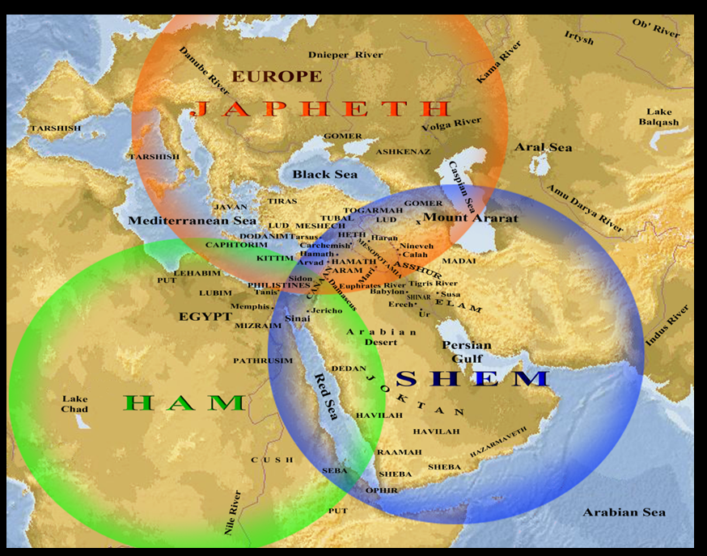

Slide 22
VI. New Promises
Genesis 12:1-3
    Land (Gen. 12:1b)
    Great nation (Gen. 12:2a)
    Personal blessing (Gen. 12:2b)
    Great name (Gen. 12:2c)
    Blessing to others (Gen. 12:2d)
    Blessing to blessers (Gen. 12:3a)
    Cursing to cursers (Gen. 12:3b)
    Blessing to the world (Gen. 12:3c)

Slide 23
VI. New Promises
Genesis 12:1-3
    Land (Gen. 12:1b)
    Great nation (Gen. 12:2a)
    Personal blessing (Gen. 12:2b)
    Great name (Gen. 12:2c)
    Blessing to others (Gen. 12:2d)
    Blessing to blessers (Gen. 12:3a)
    Cursing to cursers (Gen. 12:3b)
    Blessing to the world (Gen. 12:3c)

Slide 24
Genesis 11:1-4
¹ Now the whole earth used the same language and the same words. ² It came about as they journeyed east, that they found a plain in the land of Shinar and settled there. ³ They said to one another, “Come, let us make bricks and burn them thoroughly.” And they used brick for stone, and they used tar for mortar. ⁴ They said, “Come, let us build for ourselves a city, and a tower whose top will reach into heaven, and let us make for ourselves a name, otherwise we will be scattered abroad over the face of the whole earth.”

Slide 25
VI. New Promises
Genesis 12:1-3
    Land (Gen. 12:1b)
    Great nation (Gen. 12:2a)
    Personal blessing (Gen. 12:2b)
    Great name (Gen. 12:2c)
    Blessing to others (Gen. 12:2d)
    Blessing to blessers (Gen. 12:3a)
    Cursing to cursers (Gen. 12:3b)
    Blessing to the world (Gen. 12:3c)

Slide 26
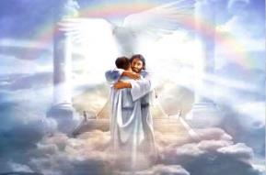
Ephesians 1:3
“Blessed be the God and Father of our Lord Jesus Christ, who has blessed us with every spiritual blessing in the heavenly places in Christ.”

Slide 27


Genesis 12:3
“And I will bless those who bless you, And the one who curses you I will curse. And in you all the families of the earth will be blessed.”

Slide 28
VI. New Promises
Genesis 12:1-3
    Land (Gen. 12:1b)
    Great nation (Gen. 12:2a)
    Personal blessing (Gen. 12:2b)
    Great name (Gen. 12:2c)
    Blessing to others (Gen. 12:2d)
    Blessing to blessers (Gen. 12:3a)
    Cursing to cursers (Gen. 12:3b)
    Blessing to the world (Gen. 12:3c)

Slide 29
Genesis 12:3
“And I will bless those who bless you, And the one who curses you I will curse. And in you all the families of the earth will be blessed.”

Slide 30

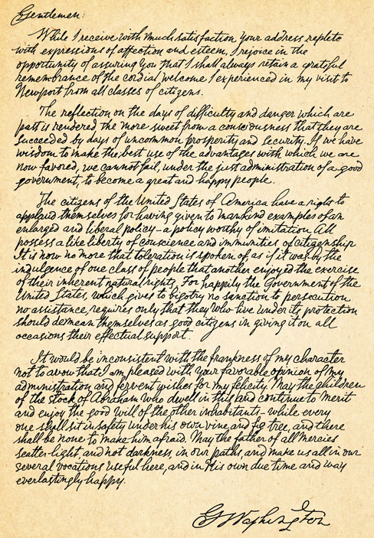
George Washington’s Letter to the Hebrew Congregation of Newport, Rhode Island, August 18, 1790
"I rejoice in the opportunity of assuring you, that I shall always retain a grateful remembrance of the cordial welcome I experienced in my visit to Newport...the Government of the United States, which gives to bigotry no sanction, to persecution no assistance...May the Children of the Stock of Abraham, who dwell in this land, continue to merit and enjoy the good will of the other Inhabitants; while every one shall sit in safety under his own vine and fig tree, and there shall be none to make him afraid."

Slide 31
VI. New Promises
Genesis 12:1-3
    Land (Gen. 12:1b)
    Great nation (Gen. 12:2a)
    Personal blessing (Gen. 12:2b)
    Great name (Gen. 12:2c)
    Blessing to others (Gen. 12:2d)
    Blessing to blessers (Gen. 12:3a)
    Cursing to cursers (Gen. 12:3b)
    Blessing to the world (Gen. 12:3c)

Slide 32
Genesis 12:3
“And I will bless those who bless you, And the one who curses you I will curse. And in you all the families of the earth will be blessed.”

Slide 33
Genesis 12:3
“And I will bless those who bless you, And the one who curses [kalal] you I will curse [aor]. And in you all the families of the earth will be blessed.”

Slide 34

Dr. Arnold G. Fruchtenbaum
The Book of Genesis, 242
“The first word for curse is kalal, which means ‘to treat lightly,’ ‘to hold in contempt,’ or ‘to curse.’ To merely treat Abram and the Jews lightly is to incur the curse of God. The second word for curse used in this phrase (him that curses you will I curse) is aor, from the Hebrew root arah, which means ‘to impose a barrier,’ ‘to ban.’ This is a much stronger word for curse than the first one in the phrase…Therefore, even a light curse against Abram or against the Jews will bring a heavier curse from God.”

Slide 35


Slide 36
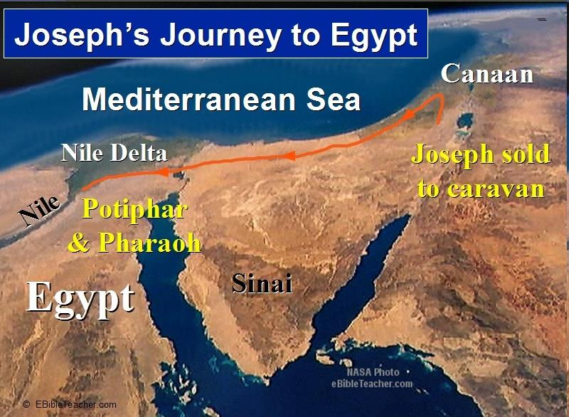

Slide 38
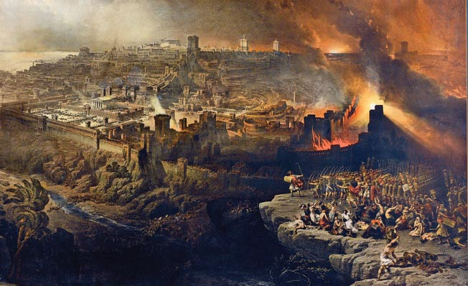
Israel's Judgments
Division of the kingdom in 931 B.C. (1 Kgs. 12)
Assyrian judgment in 722 B.C. (2 Kgs. 17)
Babylonian captivity in 586 B.C. (2 Kgs. 25)
Roman invasion in AD 70 (Luke 19:41-44)

Slide 39
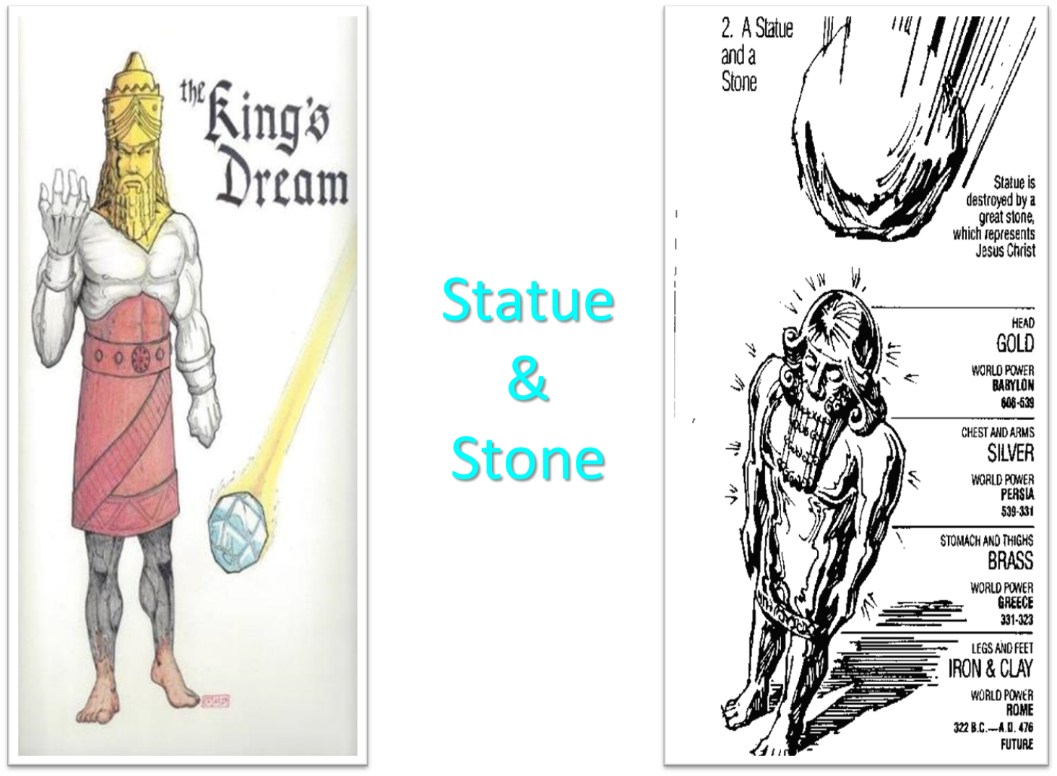

Slide 40


Slide 41
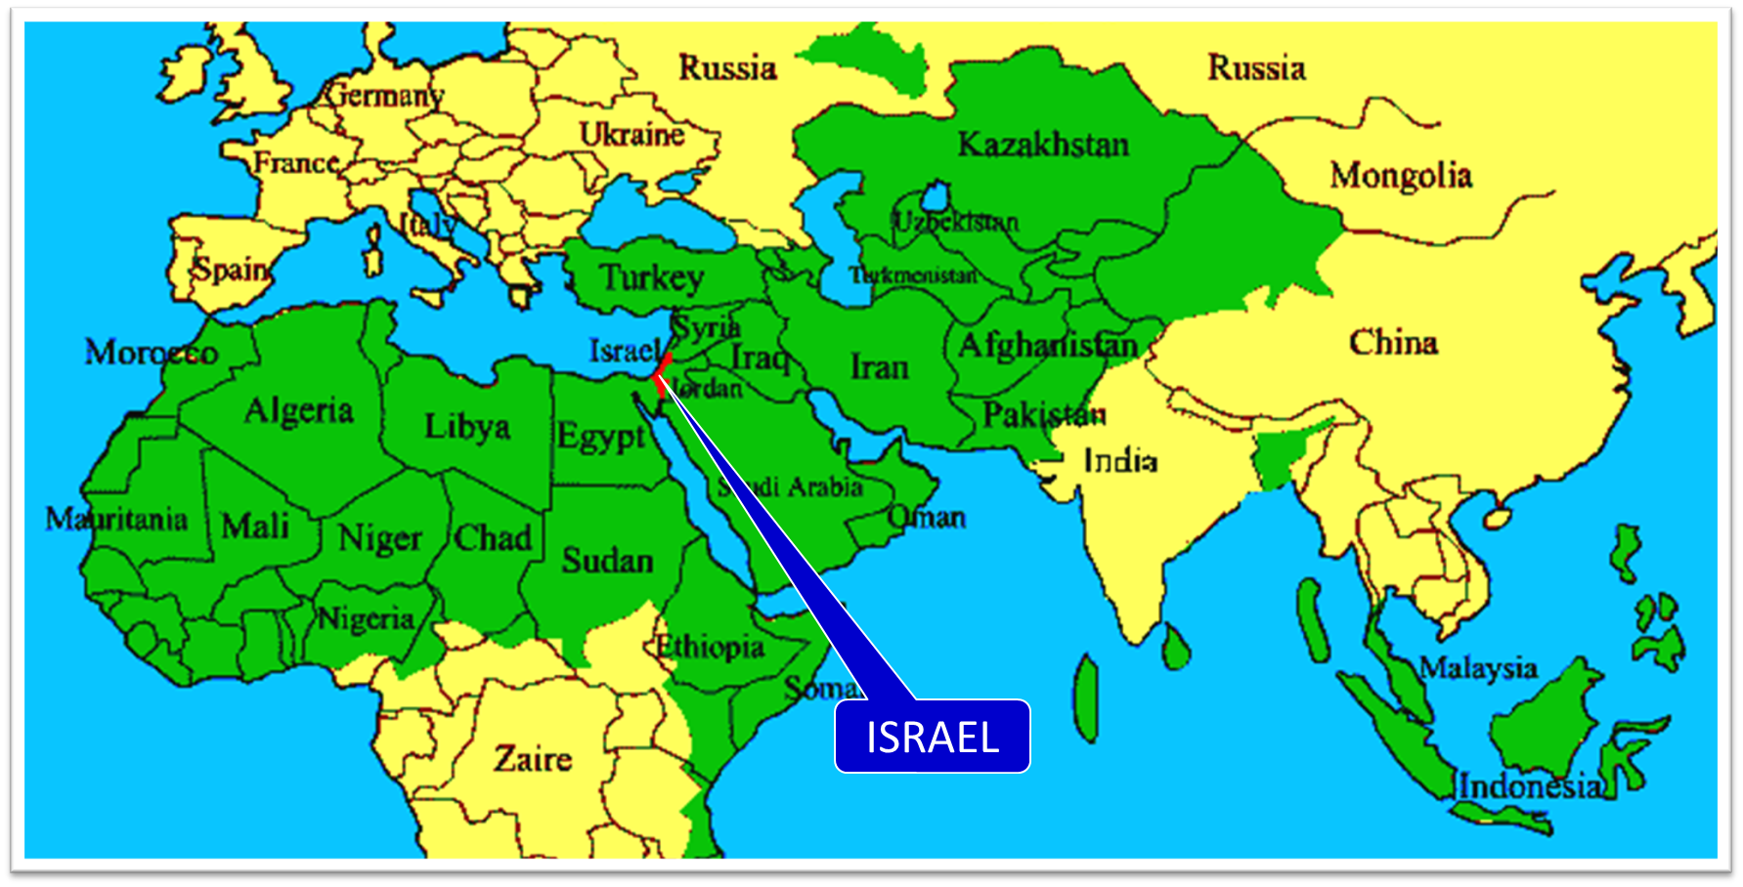

Slide 42
VI. New Promises
Genesis 12:1-3
    Land (Gen. 12:1b)
    Great nation (Gen. 12:2a)
    Personal blessing (Gen. 12:2b)
    Great name (Gen. 12:2c)
    Blessing to others (Gen. 12:2d)
    Blessing to blessers (Gen. 12:3a)
    Cursing to cursers (Gen. 12:3b)
    Blessing to the world (Gen. 12:3c)

Slide 43
Genesis 12:3
“And I will bless those who bless you, And the one who curses you I will curse. And in you all the families of the earth will be blessed.”

Slide 44
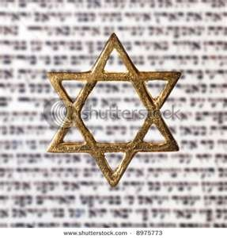
Israel’s Three Blessings to the World
(Gen 12:3b)
Scripture (Rom 3:2)
Savior (John 4:22)
Kingdom (Isa 2:2-3)

Slide 45
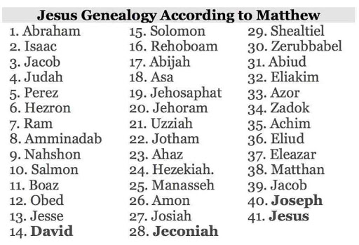

Slide 46
Genesis 3:15
“And I will put enmity Between you and the woman, And between your seed and her seed; He shall bruise you on the head, And you shall bruise him on the heel.”

Slide 47

Isaiah 2:2-3
“Now it will come about that In the last days The mountain of the house of the Lord Will be established as the chief of the mountains, And will be raised above the hills; And all the nations will stream to it.³ And many peoples will come and say, ‘Come, let us go up to the mountain of the Lord, To the house of the God of Jacob; That He may teach us concerning His ways And that we may walk in His paths.’ For the law will go forth from Zion And the word of the Lord from Jerusalem.”

Slide 48

Zechariah 14:16-18
“Then it will come about that any who are left of all the nations that went against Jerusalem will go up from year to year to worship the King, the Lord of hosts, and to celebrate the Feast of Booths. ¹⁷ And it will be that whichever of the families of the earth does not go up to Jerusalem to worship the King, the Lord of hosts, there will be no rain on them. ¹⁸ If the family of Egypt does not go up or enter, then no rain will fall on them; it will be the plague with which the Lord smites the nations who do not go up to celebrate the Feast of Booths.”

Slide 49

Revelation 20:7-9
“⁷ When the thousand years are completed, Satan will be released from his prison, ⁸ and will come out to deceive the nations which are in the four corners of the earth, Gog and Magog, to gather them together for the war; the number of them is like the sand of the seashore. ⁹ And they came up on the broad plain of the earth and surrounded the camp of the saints and the beloved city, and fire came down from heaven and devoured them.

Slide 50

Robert Thomas
Four Views on the Book of Revelation, page 207.
“At the end of the Millennium that city will be Satan’s prime objective with his rebel army, because Israel will be a leader among the nations.”

Slide 51
Conclusion

Slide 52
Genesis 11:27‒12:3
A New Nation
  A new record (Gen. 11:27a)
  A new family (Gen. 11:27b-29)
  A new crisis (Gen. 11:30)
  A new journey (Gen. 11:31)
  A death (Gen. 11:32)
  New promises (Gen. 12:1-3)

Slide 53
VI. New Promises
Genesis 12:1-3
    Land (Gen. 12:1b)
    Great nation (Gen. 12:2a)
    Personal blessing (Gen. 12:2b)
    Great name (Gen. 12:2c)
    Blessing to others (Gen. 12:2d)
    Blessing to blessers (Gen. 12:3a)
    Cursing to cursers (Gen. 12:3b)
    Blessing to the world (Gen. 12:3c)

Slide 54

“The Lord bless you and keep you; the Lord make his face shine on you and be gracious to you; the Lord turn his face toward you and give you peace.” (NIV)

