Slide 1
Genesis 12‒50
Israel’s Birth & Preservation

Slide 2
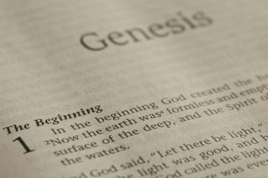
GENESIS STRUCTURE
Beginning of the Human race (Gen. 1‒11)
Beginning of the Hebrew race (Gen. 12‒50)

Slide 3
GENESIS STRUCTURE
Genesis 1-11 (four events)
Creation (1-2)
Fall (3-5)
Flood (6-9)
National dispersion (10-11)

Slide 4
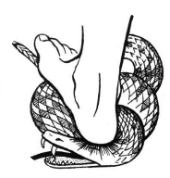
Genesis 3:15
“And I will put enmity Between you and the woman, And between your seed and her seed; He shall bruise you on the head, And you shall bruise him on the heel.”

Slide 5
GENESIS STRUCTURE
Beginning of the Human race (Gen. 1‒11)
Beginning of the Hebrew race (Gen. 12‒50)

Slide 6
GENESIS STRUCTURE
Genesis 12-50 (four people)
Abraham (12:1–25:11)
Isaac (25:12–26:35)
Jacob (27–36)
Joseph (37–50)

Slide 7
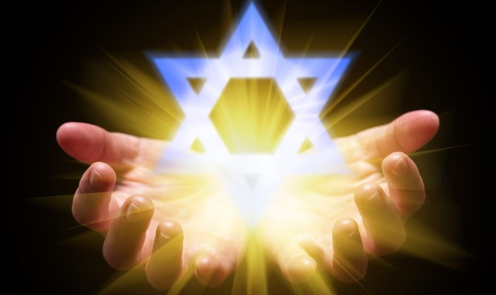
Isaiah 43:1
“But now, thus says the Lord, your Creator, O Jacob, And He who formed you, O Israel, 'Do not fear, for I have redeemed you; I have called you by name; you are Mine!'”

Slide 8
GENESIS STRUCTURE
Genesis 12-50 (four people)
Abraham (12:1–25:11)
Isaac (25:12–26:35)
Jacob (27–36)
Joseph (37–50)

Slide 9
Genesis 11:27‒12:3 A New Nation
A new record (Gen. 11:27a)
A new family (Gen. 11:27b-29)
A new crisis (Gen. 11:30)
A new journey (Gen. 11:31)
A death (Gen. 11:32)
New promises (Gen. 12:1-3)

Slide 10
Genesis 11:27‒12:3 A New Nation
A new record (Gen. 11:27a)
A new family (Gen. 11:27b-29)
A new crisis (Gen. 11:30)
A new journey (Gen. 11:31)
A death (Gen. 11:32)
New promises (Gen. 12:1-3)

Slide 11
Toledoth “And These Are the Generations of…”
Introduction to the generations (1:1–2:3)
Generations of the heaven and earth (2:4–4:26)
Generations of Adam (5:1–6:8)
Generations of Noah (6:9–9:29)
Generations of the sons of Noah (10:1–11:9)
Generations of Shem (11:10–26)
Generations of Terah (11:27–25:11)
Generations of Ishmael (25:12-18)
Generations of Isaac (25:19–35:29)
Generations of Esau (36:1–37:1)
Generations of Jacob (37:2–50:26)
Notes:
Oral & Written records were passed down…

Slide 12
Toledoth “And These Are the Generations of…”
Introduction to the generations (1:1–2:3)
Generations of the heaven and earth (2:4–4:26)
Generations of Adam (5:1–6:8)
Generations of Noah (6:9–9:29)
Generations of the sons of Noah (10:1–11:9)
Generations of Shem (11:10–26)
Generations of Terah (11:27–25:11)
Generations of Ishmael (25:12-18)
Generations of Isaac (25:19–35:29)
Generations of Esau (36:1–37:1)
Generations of Jacob (37:2–50:26)

Slide 14
Luke 1:1–4
¹ Inasmuch as many have undertaken to compile an account of the things accomplished among us, ² just as they were handed down to us by those who from the beginning were eyewitnesses and servants of the word, ³ it seemed fitting for me as well, having investigated everything carefully from the beginning, to write it out for you in consecutive order, most excellent Theophilus; ⁴ so that you may know the exact truth about the things you have been taught.

Slide 15
Genesis 11:27‒12:3 A New Nation
A new record (Gen. 11:27a)
A new family (Gen. 11:27b-29)
A new crisis (Gen. 11:30)
A new journey (Gen. 11:31)
A death (Gen. 11:32)
New promises (Gen. 12:1-3)

Slide 16
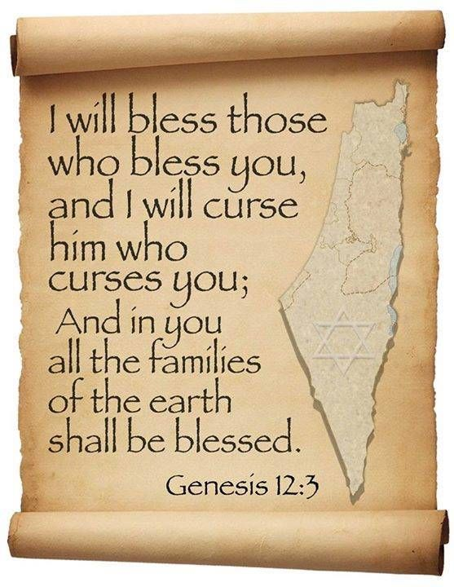
Genesis 12:3
“And I will bless those who bless you, And the one who curses you I will curse. And in you all the families of the earth will be blessed.”

Slide 17
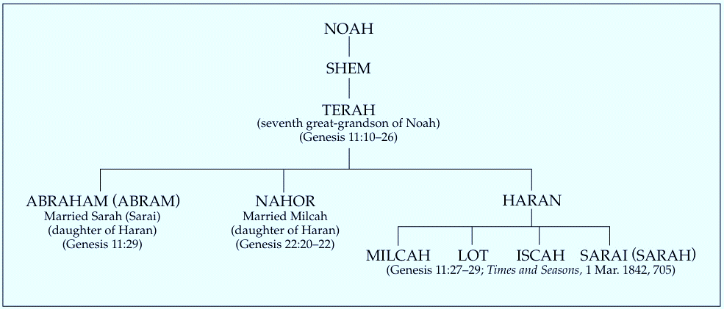

Slide 18
Charles Ryrie
The Ryrie Study Bible
“Genesis 11:28–31 (RSB:NASB1995U): 11:28 Ur of the Chaldeans. A wealthy, populous, and sophisticated pagan center of southern Mesopotamia (220 mi., or 354 km, SE of Baghdad). Its most prosperous and literate era was during the time of Abraham. A great ziggurat was built there, and Abraham must have seen it.”

Slide 19
Joshua 24:2
“Joshua said to all the people, “This is what the Lord, the God of Israel says: ‘From ancient times your fathers lived beyond the Euphrates River, namely, Terah, the father of Abraham and the father of Nahor, and they served other gods.”

Slide 20
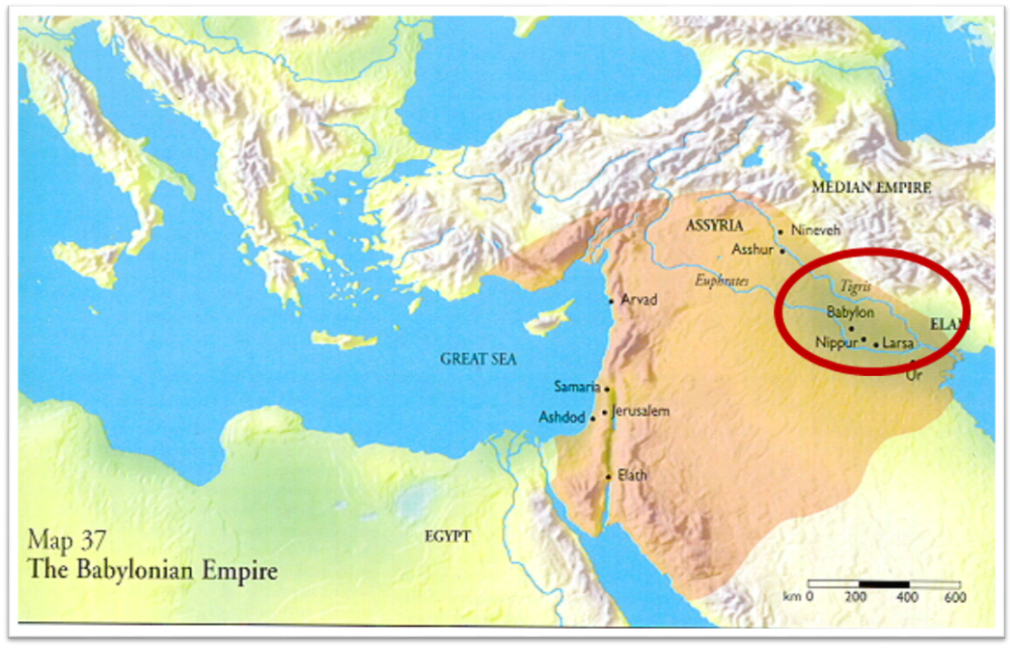

Slide 21
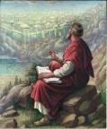
Ecclesiastes 1:9
“That which has been is that which will be, And that which has been done is that which will be done. So there is nothing new under the sun.”

Slide 23
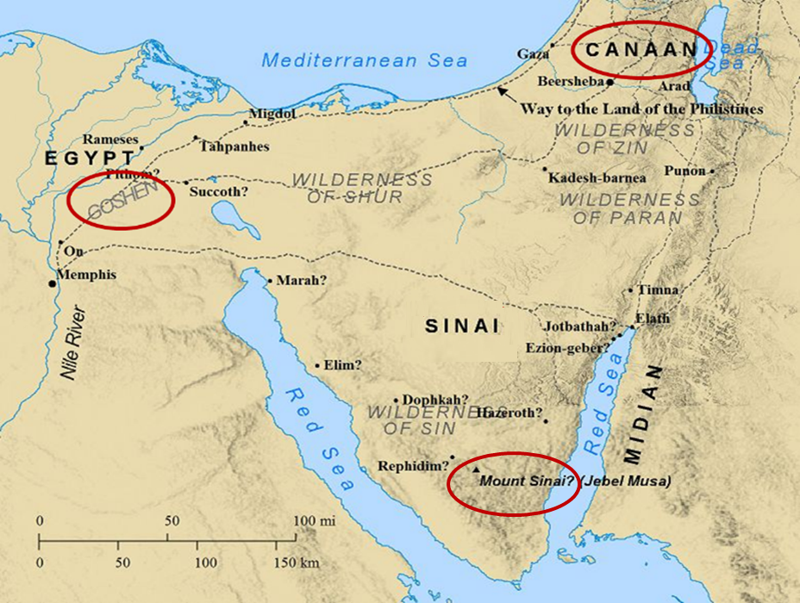

Slide 24
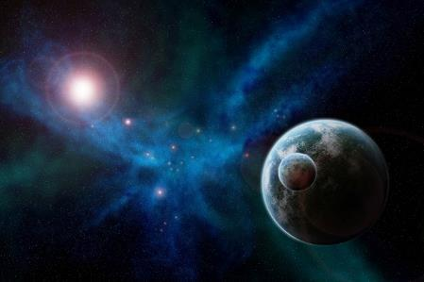
Genesis 1:31
“God saw all that He had made, and behold, it was very good. And there was evening and there was morning, the sixth day.”

Slide 25
Genesis 11:27‒12:3 A New Nation
A new record (Gen. 11:27a)
A new family (Gen. 11:27b-29)
A new crisis (Gen. 11:30)
A new journey (Gen. 11:31)
A death (Gen. 11:32)
New promises (Gen. 12:1-3)

Slide 26
Genesis 3:15
“And I will put enmity Between you and the woman, And between your seed and her seed; He shall bruise you on the head, And you shall bruise him on the heel.”

Slide 28
Genesis 11:27‒12:3 A New Nation
A new record (Gen. 11:27a)
A new family (Gen. 11:27b-29)
A new crisis (Gen. 11:30)
A new journey (Gen. 11:31)
A death (Gen. 11:32)
New promises (Gen. 12:1-3)

Slide 30
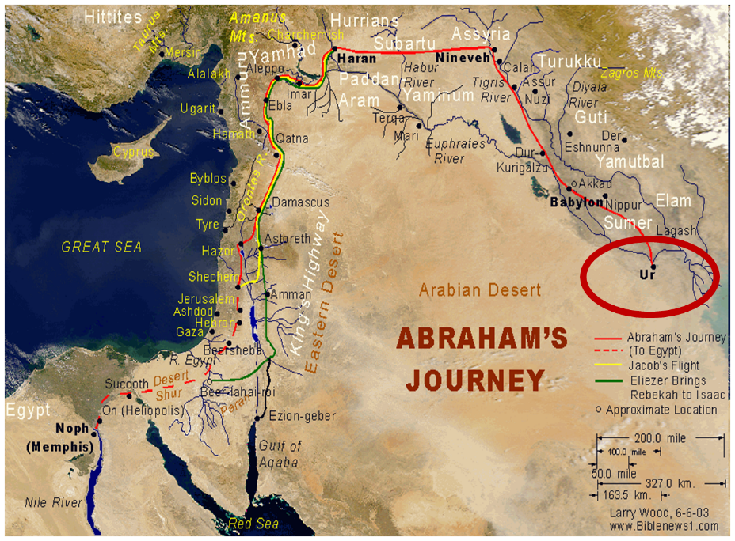

Slide 31
Ham’s Sons (vs. 6)
Cush
Mizraim
Put
Canaan

Slide 32
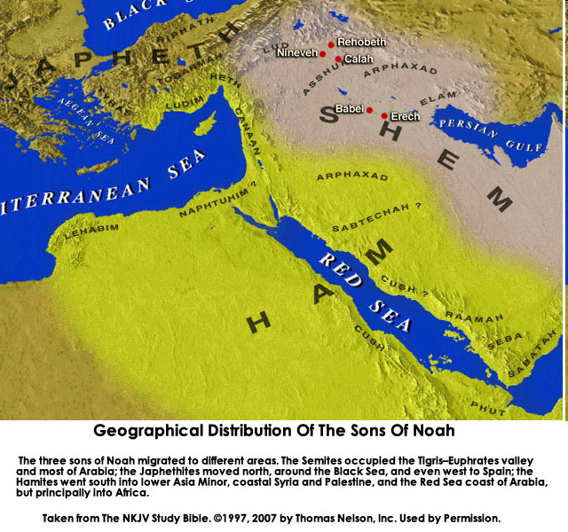

Slide 34
Charles Ryrie
The Ryrie Study Bible
“Genesis 11:31 God called Abraham while he was in Ur (Acts 7:2–3). Only two routes to Canaan were available: one across the Arabian desert (impossible for transporting large herds), and the other along the Euphrates to Haran, in Syria, then down to Canaan, a 1,500 mi. (2,400 km) journey.”

Slide 35
Genesis 11:27‒12:3 A New Nation
A new record (Gen. 11:27a)
A new family (Gen. 11:27b-29)
A new crisis (Gen. 11:30)
A new journey (Gen. 11:31)
A death (Gen. 11:32)
New promises (Gen. 12:1-3)

Slide 38
Jeremiah 31:35-37
Thus says the Lord, Who gives the sun for light by day And the fixed order of the moon and the stars for light by night, Who stirs up the sea so that its waves roar; The Lord of hosts is His name:³⁶ “If this fixed order departs From before Me,” declares the Lord, “Then the offspring of Israel also will cease From being a nation before Me forever.”³⁷ Thus says the Lord, “If the heavens above can be measured And the foundations of the earth searched out below, Then I will also cast off all the offspring of Israel For all that they have done,” declares the Lord.

Slide 39
Genesis 11:27‒12:3 A New Nation
A new record (Gen. 11:27a)
A new family (Gen. 11:27b-29)
A new crisis (Gen. 11:30)
A new journey (Gen. 11:31)
A death (Gen. 11:32)
New promises (Gen. 12:1-3)

Slide 41
VI. New Promises Genesis 12:1-3
Land (Gen. 12:1b)
Great nation (Gen. 12:2a)
Personal blessing (Gen. 12:2b)
Great name (Gen. 12:2c)
Blessing to others (Gen. 12:2d)
Blessing to blessers (Gen. 12:3a)
Cursing to cursers (Gen. 12:3b)
Blessing to the world (Gen. 12:3c)

Slide 42
VI. New Promises Genesis 12:1-3
Land (Gen. 12:1b)
Great nation (Gen. 12:2a)
Personal blessing (Gen. 12:2b)
Great name (Gen. 12:2c)
Blessing to others (Gen. 12:2d)
Blessing to blessers (Gen. 12:3a)
Cursing to cursers (Gen. 12:3b)
Blessing to the world (Gen. 12:3c)

Slide 43
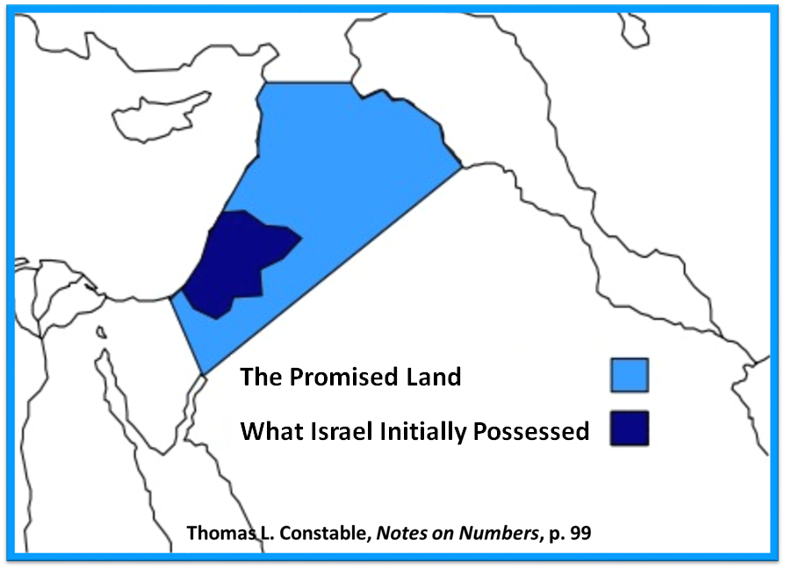

Slide 44
VI. New Promises Genesis 12:1-3
Land (Gen. 12:1b)
Great nation (Gen. 12:2a)
Personal blessing (Gen. 12:2b)
Great name (Gen. 12:2c)
Blessing to others (Gen. 12:2d)
Blessing to blessers (Gen. 12:3a)
Cursing to cursers (Gen. 12:3b)
Blessing to the world (Gen. 12:3c)

Slide 45
VI. New Promises Genesis 12:1-3
Land (Gen. 12:1b)
Great nation (Gen. 12:2a)
Personal blessing (Gen. 12:2b)
Great name (Gen. 12:2c)
Blessing to others (Gen. 12:2d)
Blessing to blessers (Gen. 12:3a)
Cursing to cursers (Gen. 12:3b)
Blessing to the world (Gen. 12:3c)

Slide 46
VI. New Promises Genesis 12:1-3
Land (Gen. 12:1b)
Great nation (Gen. 12:2a)
Personal blessing (Gen. 12:2b)
Great name (Gen. 12:2c)
Blessing to others (Gen. 12:2d)
Blessing to blessers (Gen. 12:3a)
Cursing to cursers (Gen. 12:3b)
Blessing to the world (Gen. 12:3c)

Slide 47
VI. New Promises Genesis 12:1-3
Land (Gen. 12:1b)
Great nation (Gen. 12:2a)
Personal blessing (Gen. 12:2b)
Great name (Gen. 12:2c)
Blessing to others (Gen. 12:2d)
Blessing to blessers (Gen. 12:3a)
Cursing to cursers (Gen. 12:3b)
Blessing to the world (Gen. 12:3c)

Slide 48
Genesis 12:3
“And I will bless those who bless you, And the one who curses you I will curse. And in you all the families of the earth will be blessed.”

Slide 49
VI. New Promises Genesis 12:1-3
Land (Gen. 12:1b)
Great nation (Gen. 12:2a)
Personal blessing (Gen. 12:2b)
Great name (Gen. 12:2c)
Blessing to others (Gen. 12:2d)
Blessing to blessers (Gen. 12:3a)
Cursing to cursers (Gen. 12:3b)
Blessing to the world (Gen. 12:3c)

Slide 50
Genesis 12:3
“And I will bless those who bless you, And the one who curses you I will curse. And in you all the families of the earth will be blessed.”

Slide 51
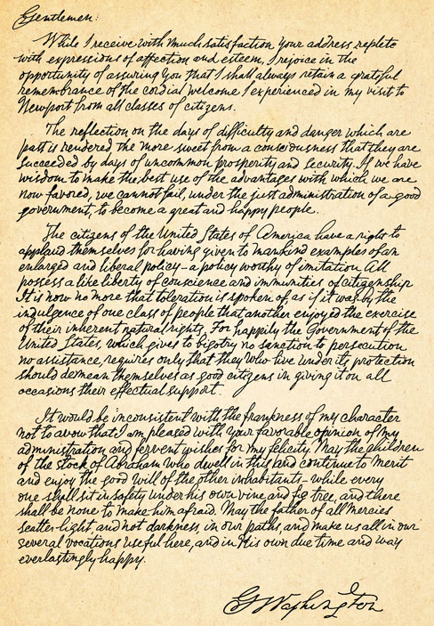
George Washington’s Letter to the Hebrew Congregation of Newport, Rhode Island, August 18, 1790
"I rejoice in the opportunity of assuring you, that I shall always retain a grateful remembrance of the cordial welcome I experienced in my visit to Newport...the Government of the United States, which gives to bigotry no sanction, to persecution no assistance...May the Children of the Stock of Abraham, who dwell in this land, continue to merit and enjoy the good will of the other Inhabitants; while every one shall sit in safety under his own vine and fig tree, and there shall be none to make him afraid."

Slide 52
VI. New Promises Genesis 12:1-3
Land (Gen. 12:1b)
Great nation (Gen. 12:2a)
Personal blessing (Gen. 12:2b)
Great name (Gen. 12:2c)
Blessing to others (Gen. 12:2d)
Blessing to blessers (Gen. 12:3a)
Cursing to cursers (Gen. 12:3b)
Blessing to the world (Gen. 12:3c)

Slide 53
Genesis 12:3
“And I will bless those who bless you, And the one who curses you I will curse. And in you all the families of the earth will be blessed.”

Slide 56
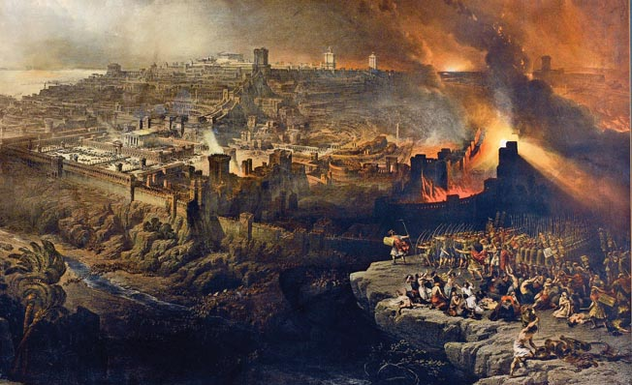
Israel's Judgments
Division of the kingdom in 931 B.C. (1 Kgs. 12)
Assyrian judgment in 722 B.C. (2 Kgs. 17)
Babylonian captivity in 586 B.C. (2 Kgs. 25)
Roman invasion in AD 70 (Luke 19:41-44)

Slide 57
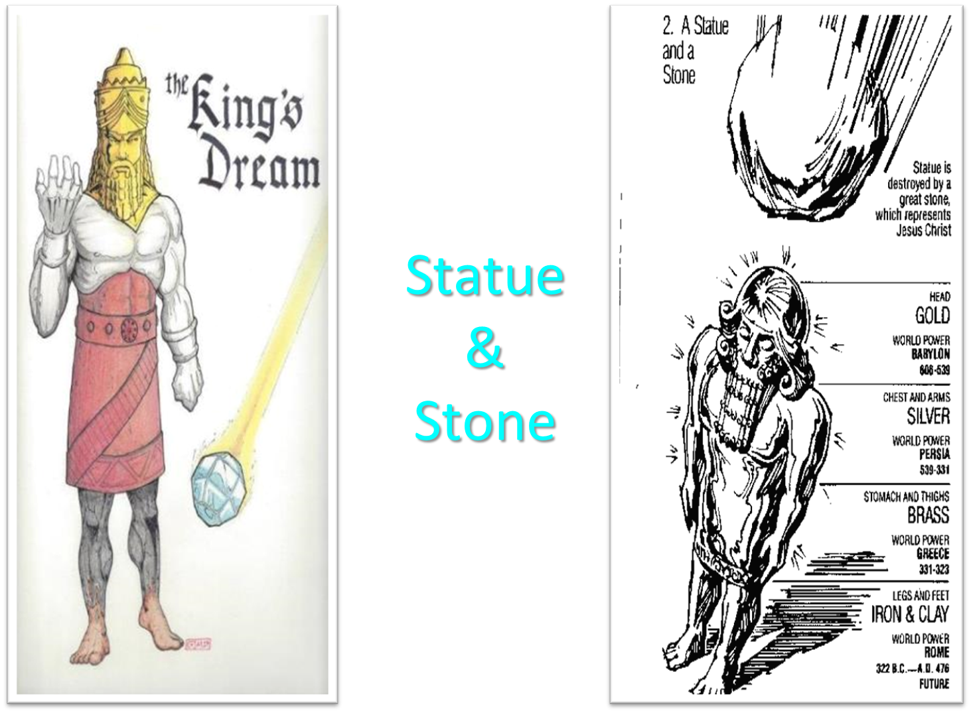

Slide 58
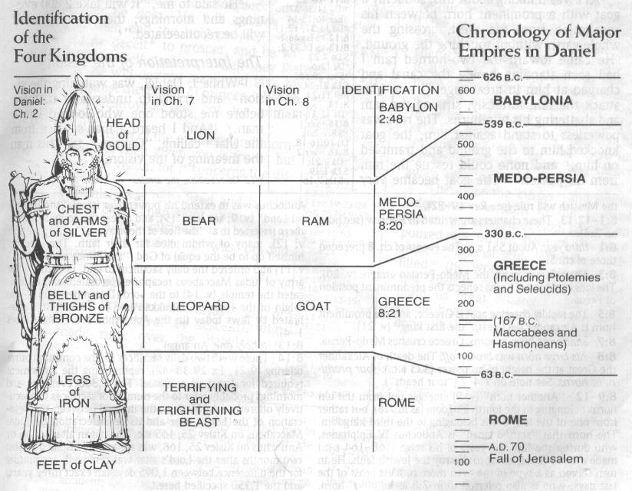

Slide 59
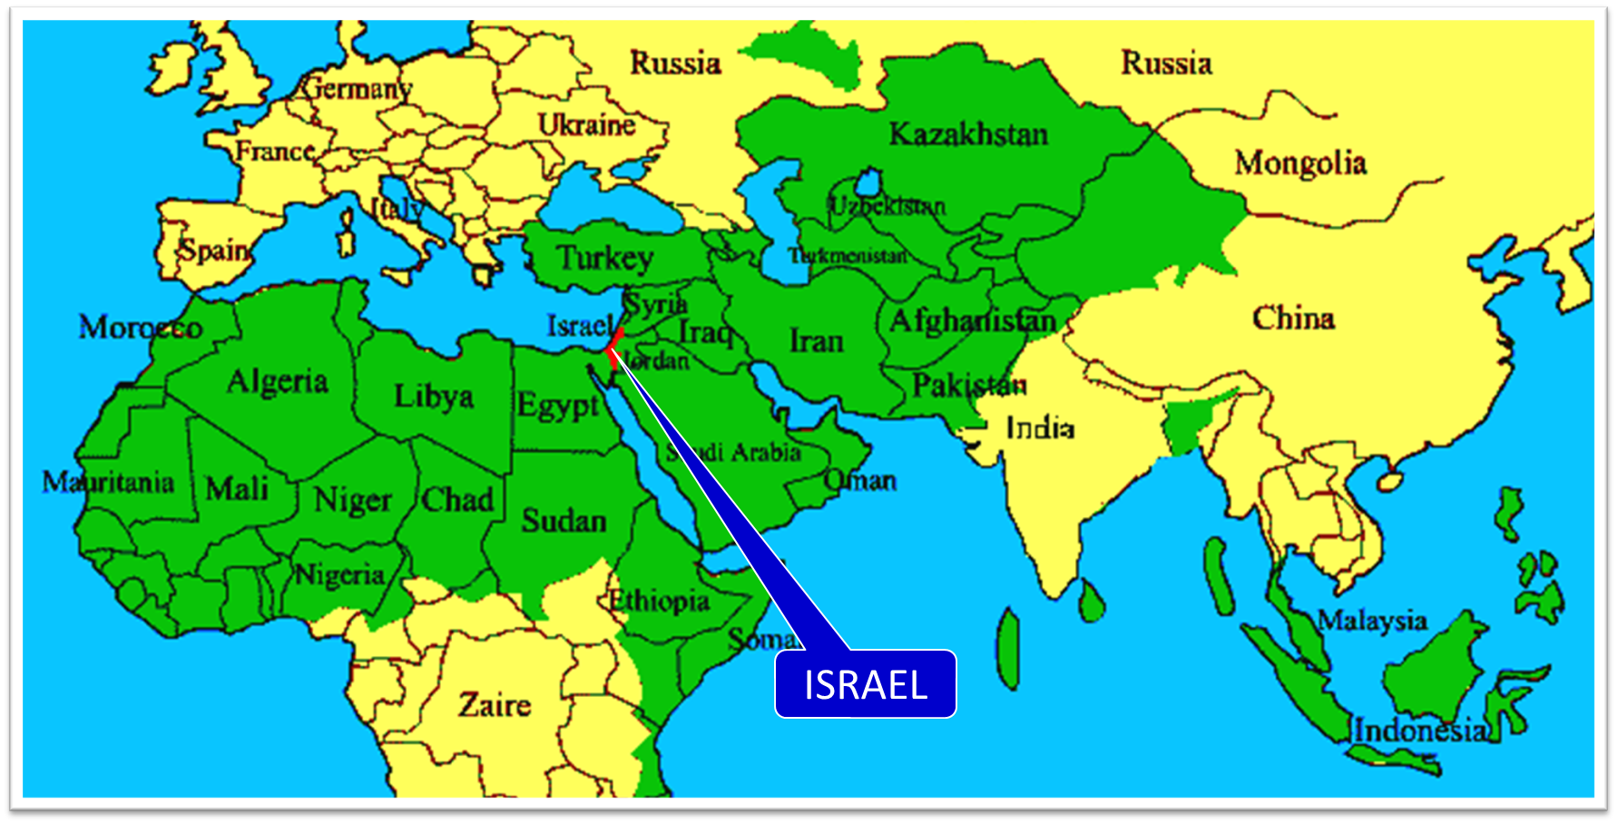

Slide 60
VI. New Promises Genesis 12:1-3
Land (Gen. 12:1b)
Great nation (Gen. 12:2a)
Personal blessing (Gen. 12:2b)
Great name (Gen. 12:2c)
Blessing to others (Gen. 12:2d)
Blessing to blessers (Gen. 12:3a)
Cursing to cursers (Gen. 12:3b)
Blessing to the world (Gen. 12:3c)

Slide 61
Genesis 12:3
“And I will bless those who bless you, And the one who curses you I will curse. And in you all the families of the earth will be blessed.”

Slide 62
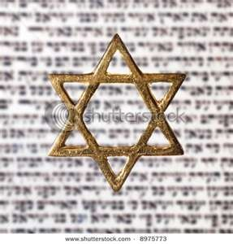
Israel’s Three Blessings to the World (Gen 12:3b)
Scripture (Rom 3:2)
Savior (John 4:22)
Kingdom (Isa 2:2-3)

Slide 63
Genesis 3:15
“And I will put enmity Between you and the woman, And between your seed and her seed; He shall bruise you on the head, And you shall bruise him on the heel.”

Slide 64
Conclusion

Slide 65
Genesis 11:27‒12:3 A New Nation
A new record (Gen. 11:27a)
A new family (Gen. 11:27b-29)
A new crisis (Gen. 11:30)
A new journey (Gen. 11:31)
A death (Gen. 11:32)
New promises (Gen. 12:1-3)

Slide 66
“The Lord bless you and keep you; the Lord make his face shine on you and be gracious to you; the Lord turn his face toward you and give you peace.” (NIV)

