Slide 1
THE RAPTURE
What and When? – Part 64
Andrew Marshall Woods, Th.M., JD., PhD.
Sr. Pastor, Sugar Land Bible Church

Slide 2
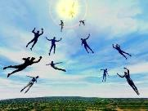
The Rapture Course Overview
What is the Rapture?
When is the Rapture?
Strengthening the Pre-Tribulational case
The opposing views
One second after the Rapture

Slide 3
MAIL BAG
Will we see the Antichrist?
Date for the Rapture?
Believers protected during Tribulation?
Return to the earth?
Demons during the millennium?
Darby got it from McDonald?
Raise up at the Last Day (John 6:39, 40, 44)
Application of Olivet Discourse to the Church?
This generation?
No rapture?

Slide 4
MAIL BAG
Will we see the Antichrist?
Date for the Rapture?
Believers protected during Tribulation?
Return to the earth?
Demons during the millennium?
Darby got it from McDonald?
Raise up at the Last Day (John 6:39, 40, 44)
Application of Olivet Discourse to the Church?
This generation?
No rapture?

Slide 5
Revelation 13:17-18
“¹⁷ and he provides that no one will be able to buy or to sell, except the one who has the mark, either the name of the beast or the number of his name. ¹⁸ Here is wisdom. Let him who has understanding calculate the number of the beast, for the number is that of a man [anthrōpos]; and his number is six hundred and sixty-six.”

Slide 6
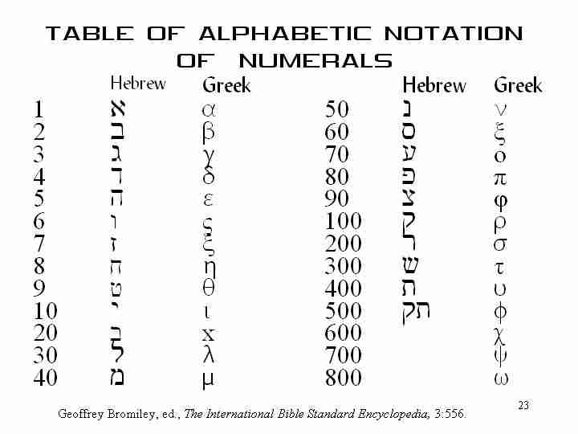

Slide 7
2 Thessalonians 2:6-7
⁶And you know what restrains [katechon; neuter] him now, so that in his time he will be revealed. ⁷For the mystery of lawlessness is already at work; only he who now restrains [katechōn; masculine] will do so until he is taken out of the way.

Slide 8
MAIL BAG
Will we see the Antichrist?
Date for the Rapture?
Believers protected during Tribulation?
Return to the earth?
Demons during the millennium?
Darby got it from McDonald?
Raise up at the Last Day (John 6:39, 40, 44)
Application of Olivet Discourse to the Church?
This generation?
No rapture?

Slide 11
Levitical Feasts (23)
Feast | Season | Purpose | Type
Passover | Spring | Redemption | 1 Cor 5:7
Unleavened Bread | Spring | Separation | John 6:35
1st fruits | Spring | Praise | 1 Cor 15:20
Pentecost | Spring | Praise | Acts 2:1-4
Trumpets | Fall | New Year | Matt 24:31
Atonement | Fall | Lev 16 | Zech 12:10
Booths | Fall | Wilderness provision | Zech 14:16-18

Slide 12
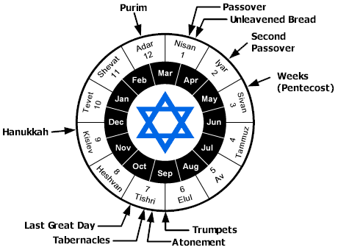

Slide 13
MAIL BAG
Will we see the Antichrist?
Date for the Rapture?
Believers protected during Tribulation?
Return to the earth?
Demons during the millennium?
Darby got it from McDonald?
Raise up at the Last Day (John 6:39, 40, 44)
Application of Olivet Discourse to the Church?
This generation?
No rapture?

Slide 14
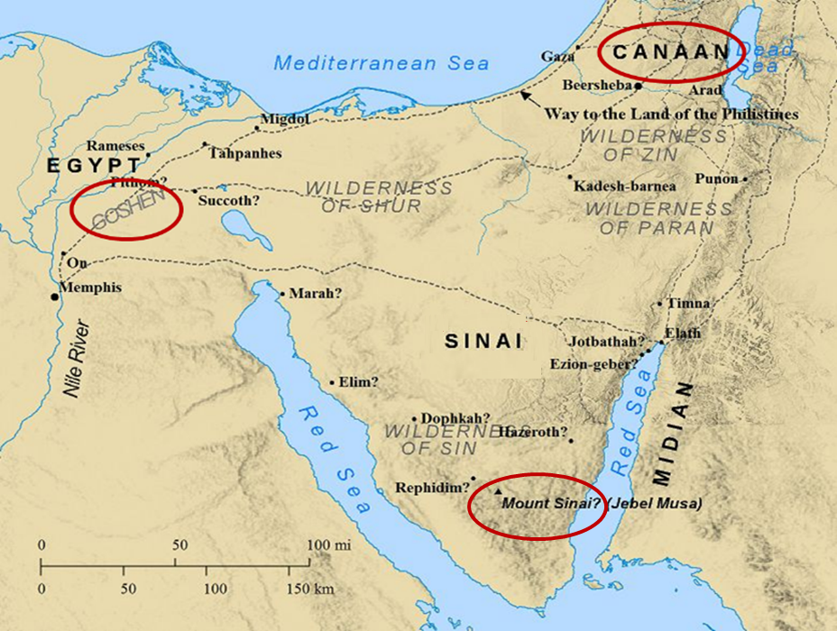

Slide 15
2. Protection Through the Tribulation?
(Revelation 3:10)
Like the protection in Goshen (Exod. 8:22, 24; 9;4, 6; 11:4-7; Rev. 9;4; 16:2)
Effective? Rev. 6:9-11; 7:13-14; 13:10, 15; 17:6; 18:24; 20:4
Comfort? John 14:1; 1 Thess. 4:18; Titus 2:13

Slide 16
MAIL BAG
Will we see the Antichrist?
Date for the Rapture?
Believers protected during Tribulation?
Return to the earth?
Demons during the millennium?
Darby got it from McDonald?
Raise up at the Last Day (John 6:39, 40, 44)
Application of Olivet Discourse to the Church?
This generation?
No rapture?

Slide 17
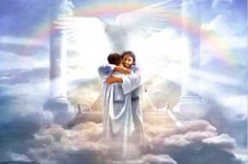
Ephesians 1:3
“Blessed be the God and Father of our Lord Jesus Christ, who has blessed us with every spiritual blessing in the heavenly places in Christ.”

Slide 18
John 14:1–4
¹ “Do not let your heart be troubled; believe in God, believe also in Me. ² “In My Father’s house are many dwelling places; if it were not so, I would have told you; for I go to prepare a place for you. ³ “If I go and prepare a place for you, I will come again and receive you to Myself, that where I am, there you may be also. ⁴ “And you know the way where I am going.”

Slide 19
Revelation 1:6; 5:10
“and He has made us to be a kingdom, priests to His God and Father—to Him be the glory and the dominion forever and ever. Amen…You have made them to be a kingdom and priests to our God; and they will reign [basileuō] upon the earth [gē].”

Slide 20
John 14:1–4
¹ “Do not let your heart be troubled; believe in God, believe also in Me. ² “In My Father’s house are many dwelling places; if it were not so, I would have told you; for I go to prepare a place for you. ³ “If I go and prepare a place for you, I will come again and receive you to Myself, that where I am, there you may be also. ⁴ “And you know the way where I am going.”

Slide 21
1 Thessalonians 4:13-18
. . . have fallen asleep. ¹⁶ For the Lord Himself will descend from heaven with a shout, with the voice of the archangel and with the trumpet of God, and the dead in Christ will rise first. ¹⁷ Then we who are alive and remain will be caught up together with them in the clouds to meet the Lord in the air, and so we shall always be with the Lord. ¹⁸ Therefore comfort one another with these words."

Slide 22
Jewish Marriage Analogy
STEP | JEWISH MARRIAGE | CHURCH ANALOGY
1. Marriage covenant | Groom initiated; Covenant established upon payment for bride; drank same cup | Christ initiated; Christ’s sacrificial death (1 Cor. 6:19-20; 11:25)
2. Bride set apart | Bride set apart exclusively for groom | Church’s positionally sanctified (1 Cor. 1:2; 6:9-11)
3. Bridal chamber prepared | Groom separates from bride and returns to his father’s house to prepare bridal chamber | Christ’s 2000 year separation from church; Ascension; return to heaven to prepare dwellings (John 14:2; Acts 1:9-11)
4. Betrothal period | Loyalty test | Reward determined by orthodoxy and orthopraxy (Jas. 4:4)
5. Bride retrieved | Groom returns at unknown time preceded by a shout with escorts to retrieve bride | Rapture at unknown time (John 14:3; 1 Thess. 4:16-17)
Showers, Maranatha Our Lord, Come!, 164-69.

Slide 23
Jewish Marriage Analogy
STEP | JEWISH MARRIAGE | CHURCH ANALOGY
6. Bride and groom hidden in Father’s house for seven days | Hidden in the Father’s house for seven days: three events transpire | Church hidden from world during Daniel’s 70th Week
7. Bride cleansed | Bride undergoes ritual cleansing prior to wedding ceremony | Bema Seat Judgment (1 Cor 3:10-15; 2 Cor 5:10)
8. Wedding ceremony | Meeting with the Father’s assembled wedding guests; Private wedding ceremony | Meeting with OT saints; Rev 19:7
9. Consummation | Bride and groom consummate the marriage | Eph 5:27
10. Marriage feast | Public presentation; Bride unveiled; marriage feast | Col 3:3-4; Rev 19:9
Showers, Maranatha Our Lord, Come!, 164-69.

Slide 25
MAIL BAG
Will we see the Antichrist?
Date for the Rapture?
Believers protected during Tribulation?
Return to the earth?
Demons during the millennium?
Darby got it from McDonald?
Raise up at the Last Day (John 6:39, 40, 44)
Application of Olivet Discourse to the Church?
This generation?
No rapture?

Slide 27
Revelation 20:1-3
“¹ Then I saw an angel coming down from heaven, holding the key of the abyss and a great chain in his hand. ² And he laid hold of the dragon, the serpent of old, who is the devil and Satan, and bound him for a thousand years; ³ and he threw him into the abyss, and shut it and sealed it over him, so that he would not deceive the nations any longer, until the thousand years were completed; after these things he must be released for a short time.”

Slide 28
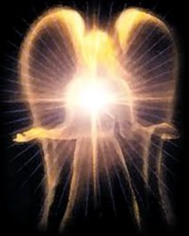
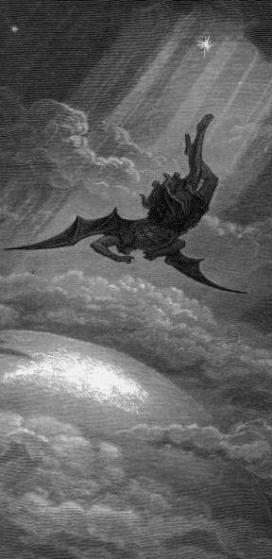
Satan’s Progressive Defeat
Initial eviction from heaven (Isa 14:12-15; Ezek 28:12-17)
Eden (Gen 3:15)
Pre-diluvian world (1 Pet 3:19-20)
Cross (John 12:31; 16:11; Col 2:15; Heb 2:14; 1 John 3:8)
Mid point of the Tribulation (Rev 12:9)
Beginning of millennium (Rev 20:2-3)
End of millennium (Rev 20:10)

Slide 29
MAIL BAG
Will we see the Antichrist?
Date for the Rapture?
Believers protected during Tribulation?
Return to the earth?
Demons during the millennium?
Darby got it from McDonald?
Raise up at the Last Day (John 6:39, 40, 44)
Application of Olivet Discourse to the Church?
This generation?
No rapture?

Slide 30
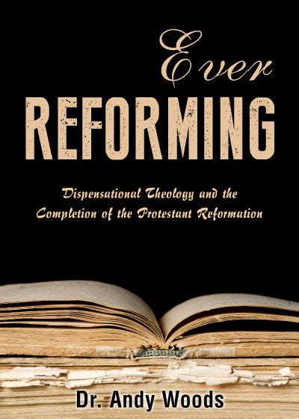

Slide 31
Pseudo Ephraem (4th-6th century A.D.)
“Why therefore do we not reject every care of earthly actions and prepare ourselves for the meeting of the Lord Christ, so that he may draw us from the confusion, which overwhelms all the world…For all the saints and the elect of God are gathered, prior to the tribulation that is to come, and are taken to the Lord lest they see the confusion that is to overwhelm the world because of our sins.”

Slide 33
MAIL BAG
Will we see the Antichrist?
Date for the Rapture?
Believers protected during Tribulation?
Return to the earth?
Demons during the millennium?
Darby got it from McDonald?
Raise up at the Last Day (John 6:39, 40, 44)
Application of Olivet Discourse to the Church?
This generation?
No rapture?

Slide 35
Outline of John
1:1-18 | HEAVENLY GENEALOGY (Explains who Jesus is)
1:19-11:57 | PUBLIC MINISTRY ( 7 signs & discourses)
12:1-50 | TRIUMPHAL ENTRY (public national rejection of Christ-12:37)
13-17 | UPPER ROOM DISCOURSE (new dispensation)
18-21 | PASSION NARRATIVES (crucifixion to resurrection)

Slide 36
Daniel 12:2
“Many of those who sleep in the dust of the ground will awake, these to everlasting (olam) life, but the others to disgrace and everlasting (olam) contempt.”

Slide 37
John 14:1–4
¹ “Do not let your heart be troubled; believe in God, believe also in Me. ² “In My Father’s house are many dwelling places; if it were not so, I would have told you; for I go to prepare a place for you. ³ “If I go and prepare a place for you, I will come again and receive you to Myself, that where I am, there you may be also. ⁴ “And you know the way where I am going.”

Slide 38
New Mystery Truth
“But here in John 14 the Lord gives a new and unique revelation; He speaks of something which no prophet had promised, or even could promise. Where is it written that this Messiah would come and instead of gathering His saints into an earthly Jerusalem, would take them to the Father's house, to the very place where He is? It is something new.”
Arno C. Gaebelein, The Gospel of John, 268.

Slide 39
Ephesians 3:3-6
“³ that by revelation there was made known to me the mystery, as I wrote before in brief. ⁴ By referring to this, when you read you can understand my insight into the mystery of Christ, ⁵ which in other generations was not made known to the sons of men, as it has now been revealed to His holy apostles and prophets in the Spirit; ⁶ to be specific, that the Gentiles are fellow heirs and fellow members of the body, and fellow partakers of the promise in Christ Jesus through the gospel”.

Slide 40
Colossians 1:26
“that is, the mystery which has been hidden from the past ages and generations, but has now been manifested to His saints.”

Slide 41
“Mystery” Defined
“In the N.T, it [mystērion] denotes, not the mysterious (as with the Eng. word), but that which, being outside the range of unassisted natural apprehension, can be made known only by Divine revelation, and is made known in a manner and at a time appointed by God, and to those who are illumined by His Spirit.”
W. E. Vine, Merrill F. Unger, and William White, Vine's Complete Expository Dictionary of the Old and New Testament Words (Nashville: Nelson, 1996), 424.

Slide 42
1 Corinthians 15:51
“Behold, I tell you a mystery [mystērion]; we will not all sleep, but we will all be changed.”

Slide 43
1 Corinthians 15:20-23
“²⁰ But now Christ has been raised from the dead, the first fruits of those who are asleep. ²¹-For since by a man came death, by a man also came the resurrection of the dead. ²² For as in Adam all die, so also in Christ all will be made alive. ²³ But each in his own order (tagma): Christ the first fruits, after that those who are Christ’s at His coming.”

Slide 44
Matthew 16:18
I also say to you that you are Peter, and upon this rock I will build [oikodomeō] My church; and the gates of Hades will not overpower it.

Slide 45
MAIL BAG
Will we see the Antichrist?
Date for the Rapture?
Believers protected during Tribulation?
Return to the earth?
Demons during the millennium?
Darby got it from McDonald?
Raise up at the Last Day (John 6:39, 40, 44)
Application of Olivet Discourse to the Church?
This generation?
No rapture?

Slide 46
MAIL BAG
Will we see the Antichrist?
Date for the Rapture?
Believers protected during Tribulation?
Return to the earth?
Demons during the millennium?
Darby got it from McDonald?
Raise up at the Last Day (John 6:39, 40, 44)
Application of Olivet Discourse to the Church?
This generation?
No rapture?

Slide 47
Psalm 90:10
“As for the days of our life, they contain seventy years, Or if due to strength, eighty years, Yet their pride is but labor and sorrow; For soon it is gone and we fly away.”

Slide 48
Matthew 24:15-16, 20
“¹⁵ Therefore when you see the abomination of desolation which was spoken of through Daniel the prophet, standing in the holy place (let the reader understand) ¹⁶ then those who are in Judea must flee to the mountains…²⁰ But pray that your flight will not be in the winter, or on a Sabbath.”

Slide 50
MAIL BAG
Will we see the Antichrist?
Date for the Rapture?
Believers protected during Tribulation?
Return to the earth?
Demons during the millennium?
Darby got it from McDonald?
Raise up at the Last Day (John 6:39, 40, 44)
Application of Olivet Discourse to the Church?
This generation?
No rapture?

Slide 51
John 14:1–4
¹ “Do not let your heart be troubled; believe in God, believe also in Me. ² “In My Father’s house are many dwelling places; if it were not so, I would have told you; for I go to prepare a place for you. ³ “If I go and prepare a place for you, I will come again and receive you to Myself, that where I am, there you may be also. ⁴ “And you know the way where I am going.”

Slide 52
New Mystery Truth
“But here in John 14 the Lord gives a new and unique revelation; He speaks of something which no prophet had promised, or even could promise. Where is it written that this Messiah would come and instead of gathering His saints into an earthly Jerusalem, would take them to the Father's house, to the very place where He is? It is something new.”
Arno C. Gaebelein, The Gospel of John, 268.

Slide 53
1 Thessalonians 4:13-18
. . . have fallen asleep. ¹⁶ For the Lord Himself will descend from heaven with a shout, with the voice of the archangel and with the trumpet of God, and the dead in Christ will rise first. ¹⁷ Then we who are alive and remain will be caught up [harpazō] together with them in the clouds to meet the Lord in the air, and so we shall always be with the Lord. ¹⁸ Therefore comfort one another with these words."

Slide 54
Rapture Distinct from Second Advent
RAPTURE (1 Thess 4:13-18; 1 Cor 15:51-58) | SECOND COMING (Rev 19:11-16)
Christ comes in the air (1 Thess 4:16-17) | Christ comes to the earth (Zech 14:4)
For His saints (1 Thess 4:15-17) | With His saints (Rev 19:14)
Blessing (1 Thess 4:18) | Judgment (Rev 19:15)
Effects only believers (1 Thess 4:16) | Effects both believers & unbelievers (Rev 19:15)

Slide 55
Rapture Distinct from Second Advent
RAPTURE (1 Thess 4:13-18; 1 Cor 15:51-58) | SECOND COMING (Rev 19:11-16)
Invisible (1 Thess 4:16) | Visible to all (Rev 1:7)
Announced only by an archangel (1 Thess 4:16) | Involves myriads of angels (Jude 14)
Resurrection (1 Cor 15: 51) | No resurrection
Rescue of the Church (1 Thess 1:10) | Rescue of Israel (Matt 23:37-39)

Slide 56
CONCLUSION

Slide 57
MAIL BAG
Will we see the Antichrist?
Date for the Rapture?
Believers protected during Tribulation?
Return to the earth?
Demons during the millennium?
Darby got it from McDonald?
Raise up at the Last Day (John 6:39, 40, 44)
Application of Olivet Discourse to the Church?
This generation?
No rapture?

