Slide 1


Zechariah
Introductory Matters

Slide 2

Introductory Matters
  Title
  Authorship
  Biography
  Scope
  Date
  Audience
  Place of writing

Slide 3
Introductory Matters
  Occasion
  Structure
  Message
  Purposes
  Themes
  Unique characteristics
  Genre
  Christ in Zechariah

Slide 4
Introductory Matters
  Occasion
  Structure
  Message
  Purposes
  Themes
  Unique characteristics
  Genre
  Christ in Zechariah

Slide 5
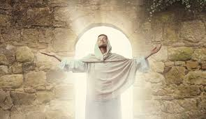
The Uniqueness of Jesus Christ
A man of verifiable history
A man of fulfilled prophecy
A man of predictive prophecy
A man of unimpeachable morality
A man of profound teaching
A man of authentic miracles
A man of bodily resurrection

Slide 6
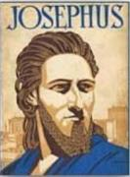
Josephus
Antiquities 18.3.3
“About this time there lived Jesus, a wise man, if indeed one ought to call him a man. For he was one who performed surprising deeds and was a teacher of such people as accept the truth gladly. He won over many Jews and many of the Greeks. He was the Christ. And when, upon the accusation of the principal men among us, Pilate had condemned him to a cross, those who had first come to love him did not cease. He appeared to them spending a third day restored to life, for the prophets of God had foretold these things and a thousand other marvels about him. And the tribe of the Christians, so called after him, has still to this day not disappeared.”

Slide 7
OT Prophecies About Christ
Prophecy | Scripture | Years in Advance
Manner of Birth | Isaiah 7:14 | 700 years
Place of Birth | Micah 5:2 | 700 years
Nationality | Numbers 24:17 | 1400 years
Tribe | Genesis 49:10 | 1800 years
Time of & Response to His Messiahship | Dan. 9:25-26 | 600 years

Slide 8
OT Prophecies About Christ
Prophecy | Scripture | Years in Advance
Crucified Between Thieves | Isaiah 53:9 | 700 years
Pierced | Isaiah 53:5 | 700 years
No Broken Bones | Psalm 22:17 | 1000 years
Gamble for His Clothing | Psalm 22:18 | 1000 years
Buried in Rich Man’s Tomb | Isaiah 53:9 | 700 years
Notes:
109 prophecies…
Peter Stoner – SCIENCE SPEAKS, An Evaluation of Certain Christian Evidences
To fulfill just 8 prophecies =1 X 10 to the twenty-eighth power!
Can we visualize this with an illustration? Suppose we took an atheistic professor, blindfolded him and covered the state of Texas two feet deep with silver dollars. Then we put a check on one of those silver dollars and mixed them up. The odds of one person fulfilling just these eight prophecies would be the same as this atheistic professor selecting the silver dollar upon which we have placed a check, in his first try.
https://www.bereanpublishers.com/the-odds-of-eight-messianic-prophecies-coming-true/

Slide 9

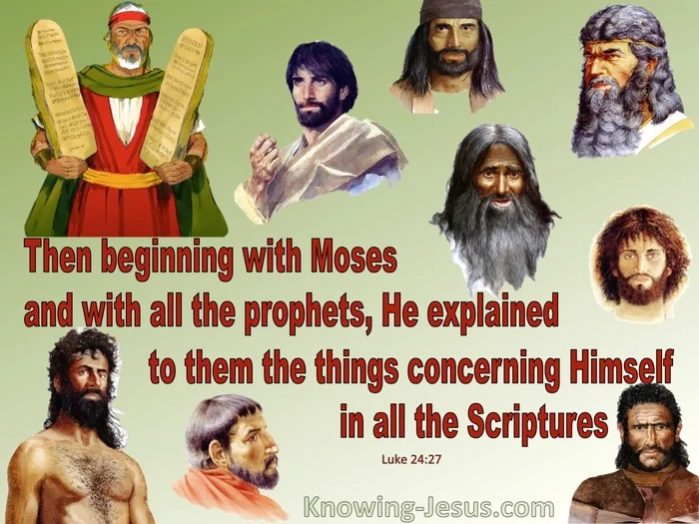
Luke 24:27, 44
“²⁷ Then beginning with Moses and with all the prophets, He explained to them the things concerning Himself in all the Scriptures…⁴⁴ Now He said to them, ‘These are My words which I spoke to you while I was still with you, that all things which are written about Me in the Law of Moses and the Prophets and the Psalms must be fulfilled.’”

Slide 10

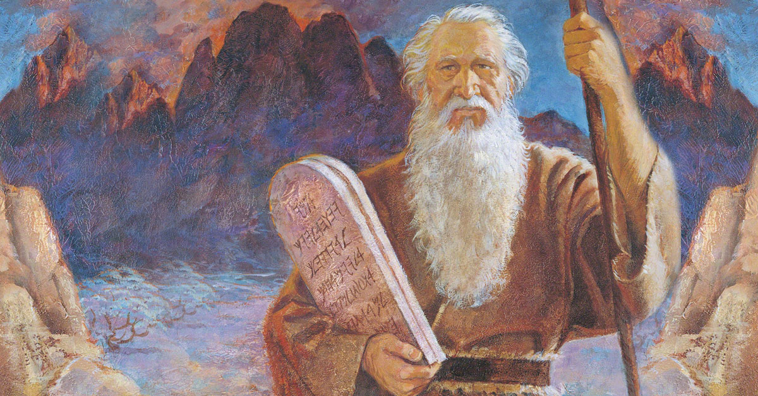
John 5:39, 46
“³⁹ You search the Scriptures because you think that in them you have eternal life; it is these that testify about Me…⁴⁶ For if you believed Moses, you would believe Me, for he wrote about Me.”

Slide 11

Acts 17:1–3
¹ Now when they had traveled through Amphipolis and Apollonia, they came to Thessalonica, where there was a synagogue of the Jews. ² And according to Paul’s custom, he went to them, and for three Sabbaths reasoned with them from the Scriptures, ³ explaining and giving evidence that the Christ had to suffer and rise again from the dead, and saying, “This Jesus whom I am proclaiming to you is the Christ.”

Slide 12
1 Corinthians 15:3-4
“³ For I handed down to you as of first importance what I also received, that Christ died for our sins according to the Scriptures, ⁴ and that He was buried, and that He was raised on the third day according to the Scriptures.”

Slide 13

Christ in Zechariah general
the angel of the Lord (3:1-2)
the righteous branch (3:8; 6:12-13)
the servant (3:8)
the stone with seven eyes (3:9)
the King-Priest (6:13)
the cornerstone, tent peg, and the bow of battle (10:4)

Slide 14
Christ in Zechariah first advent
the humble king riding on a donkey (9:9-10; Matt 21:1-8; John 12:14-16)
the rejected good shepherd sold for thirty pieces of silver (11:4-13; Matt 26:14-16; 27:9-10)
the one the Jews pierced (12:10; John 19:37; 20:24-27)
the smitten good shepherd (13:7)

Slide 15
Christ in Zechariah second advent
the one who will be accepted by Israel (12:10–13:1; Rom 11:26)
the one who cleanses Israel (13:1)
the coming judge (14)
the destroyer of Israel’s enemies (14:3, 12-15; Rev 19:11-16)
the one who will split the Mount of Olives (14:4)
the one who will reign from Jerusalem (14:9, 16; Rev 20:4-6)

Slide 16

Romans 11:25-26
“²⁵ For I do not want you, brethren, to be uninformed of this mystery—so that you will not be wise in your own estimation—that a partial hardening has happened to Israel until the fullness of the Gentiles has come in; ²⁶ and so all Israel will be saved; just as it is written, ‘The Deliverer will come from Zion, He will remove ungodliness from Jacob.’”

Slide 17

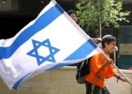
Zechariah 14:2-3
“² For I will gather all the nations against Jerusalem to battle, and the city will be captured, the houses plundered, the women ravished and half of the city exiled, but the rest of the people will not be cut off from the city. ³ Then the Lord will go forth and fight against those nations, as when He fights on a day of battle.”

Slide 18

Zechariah 14:16-18
“Then it will come about that any who are left of all the nations that went against Jerusalem will go up from year to year to worship the King, the Lord of hosts, and to celebrate the Feast of Booths. ¹⁷ And it will be that whichever of the families of the earth does not go up to Jerusalem to worship the King, the Lord of hosts, there will be no rain on them. ¹⁸ If the family of Egypt does not go up or enter, then no rain will fall on them; it will be the plague with which the Lord smites the nations who do not go up to celebrate the Feast of Booths.”

Slide 19

Isaiah 2:2-3
“Now it will come about that In the last days The mountain of the house of the Lord Will be established as the chief of the mountains, And will be raised above the hills; And all the nations will stream to it.³ And many peoples will come and say, ‘Come, let us go up to the mountain of the Lord, To the house of the God of Jacob; That He may teach us concerning His ways And that we may walk in His paths.’ For the law will go forth from Zion And the word of the Lord from Jerusalem.”

Slide 20

Revelation 20:7-9
“⁷ When the thousand years are completed, Satan will be released from his prison, ⁸ and will come out to deceive the nations which are in the four corners of the earth, Gog and Magog, to gather them together for the war; the number of them is like the sand of the seashore. ⁹ And they came up on the broad plain of the earth and surrounded the camp of the saints and the beloved city, and fire came down from heaven and devoured them.

Slide 21

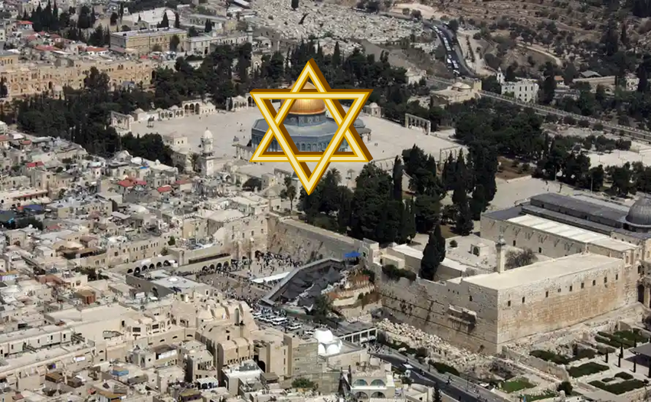
Robert Thomas
Four Views on the Book of Revelation, page 207.
“At the end of the Millennium that city will be Satan’s prime objective with his rebel army, because Israel will be a leader among the nations.”

Slide 22

Structure
Introductory call to repentance (1:1-6)
Eight-night visions (1:7–6:15)
Question and answers about fasting (7–8)
Two burdens (9–14)

Slide 23
Structure
Introductory call to repentance (1:1-6)
Eight-night visions (1:7–6:15)
Question and answers about fasting (7–8)
Two burdens (9–14)

Slide 24
I. Introductory call to repentance
(1:1-6)
Date (1:1a)
Author (1:1b)
Call to repentance (1:2–6)

Slide 25
I. Introductory call to repentance
(1:1-6)
Date (1:1a)
Author (1:1b)
Call to repentance (1:2–6)

Slide 26
4. Scope
SCRIPTURE | SCRIPTURAL DATE | DATE
1:1 | 8th month, 2nd year of Darius | 10 or 11/520 B.C.
1:7 | 24th day, 11th month, 2nd year of Darius | 2/15/519 B.C.
7:1 | 4th day, 9th month, 4th year of Darius | 12/17/518 B.C.

Slide 27
4. Scope
SCRIPTURE | SCRIPTURAL DATE | DATE
1:1 | 8th month, 2nd year of Darius | 10 or 11/520 B.C.
1:7 | 24th day, 11th month, 2nd year of Darius | 2/15/519 B.C.
7:1 | 4th day, 9th month, 4th year of Darius | 12/17/518 B.C.

Slide 28
I. Introductory call to repentance
(1:1-6)
Date (1:1a)
Author (1:1b)
Call to repentance (1:2–6)

Slide 29
1. Title
Named after the book’s spokesman
Hebrew: Zekar-yah
LXX: Zecharias
Latin: Zecharias
English: Zechariah
“Yahweh Remembers”

Slide 30
3. Biography
Common name
Son of Berechiah (1:1)
Called into ministry as a youth (2:4)
Born during Babylonian Captivity
Taken to Israel in first return
A priest
Member of the Great Synagogue

Slide 31
Three Returns
 | DATE | DURATION | PERSIAN KING | JEWISH LEADER | SCRIPTURE | PURPOSE | NUMBER OF RETURNEES
1st return | 538–515 B.C. | 23 years | Cyrus (Isa. 44:28‒45:1) | Zerubbabel | Ezra 1–6; Isaiah 44:28 | Rebuilding the temple | 50,000
2nd return | 458–457 B.C. | 2 years | Artaxerxes | Ezra | Ezra 7–10 | Adorning of the temple and reforming the people | 2,000
3rd return | 444–432 B.C. | 8 years | Artaxerxes | Nehemiah | Nehemiah | Rebuilding the wall

Slide 32

Ezekiel 1:1-3
¹ “Now it came about in the thirtieth year, on the fifth day of the fourth month, while I was by the river Chebar among the exiles, the heavens were opened and I saw visions of God. ² (On the fifth of the month in the fifth year of King Jehoiachin’s exile, ³ the word of the Lord came expressly to Ezekiel the priest, son of Buzi, in the land of the Chaldeans by the river Chebar; and there the hand of the Lord came upon him.).”

Slide 33
I. Introductory call to repentance
(1:1-6)
Date (1:1a)
Author (1:1b)
Call to repentance (1:2–6)

Slide 34


Slide 35


Slide 36


Slide 38
Six Parts of a Suzerain-Vassal Treaty in Deuteronomy
Preamble (1:1-5)
Prologue (1:6–4:40)
Covenant obligations (5–26)
Storage and reading instructions (27:2-3; 31:9, 24, 26)
Witnesses (32:1)
Blessings and curses (28)

Slide 39


Charles L. Feinberg
God Remembers: A Study of Zechariah (Wheaton: Van Kampen, 1950, p. 18.
“Positionally, we have been made nigh (Eph. 2:13), but experimentally we need to be ever more near.”

Slide 40
Charles L. Feinberg
God Remembers: A Study of Zechariah (Wheaton: Van Kampen, 1950, p. 15.
“Since the book is mainly one of consolation and hope, some may be inclined to ask: Why does it begin with a charge to repent? The purpose, no doubt, is to preclude any false security on the part of the ungodly in Israel who might think themselves to be the recipients of the blessings and promises of God regardless of their spiritual condition.”

Slide 41
Messengers of the Kingdom In Matthew
John the Baptist – 3:2
Jesus Christ – 4:17
12 Apostles – 10:5-7
Seventy – Luke 10:1, 9
Toussaint, Behold the King, 18-20

Slide 42

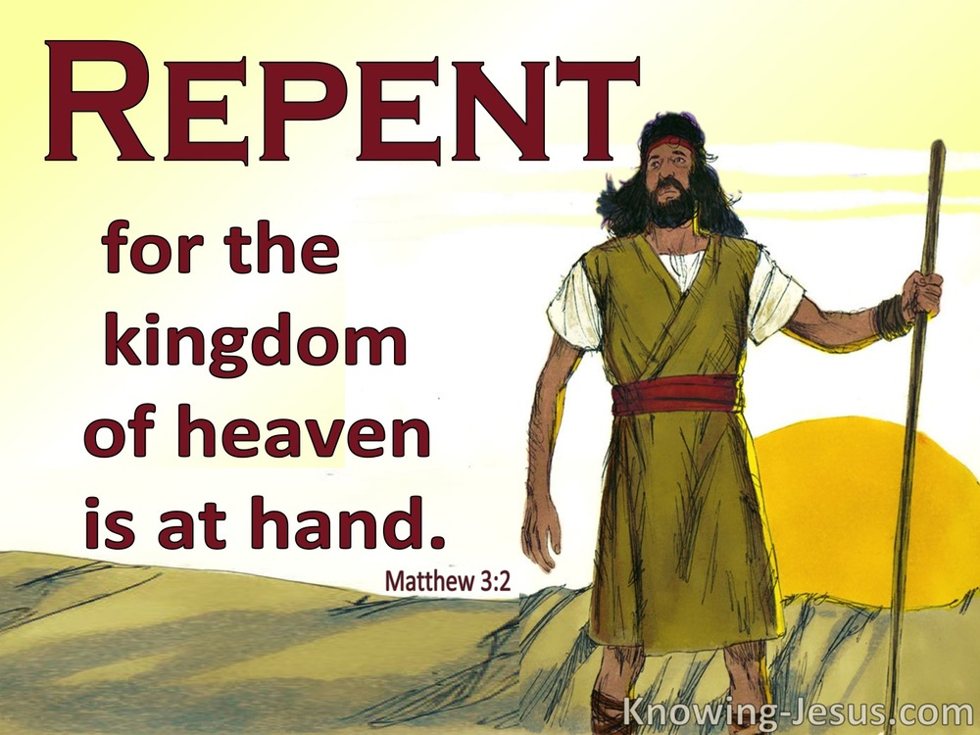
Matthew 3:1-2
“¹Now in those days John the Baptist came, preaching in the wilderness of Judea, saying, ²‘Repent, for the kingdom of heaven is at hand.”

Slide 43

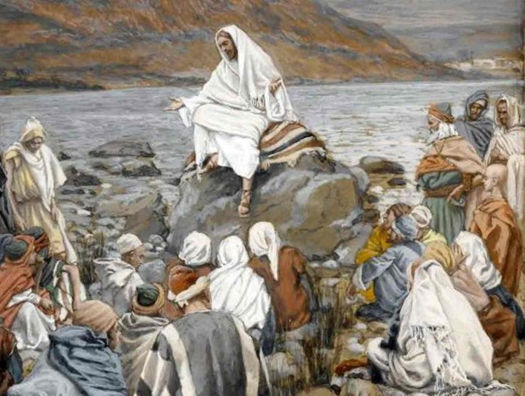
Matthew 4:17
“From that time Jesus began to preach and say, ‘Repent, for the kingdom of heaven is at hand.’”

Slide 44



Slide 45
Conclusion

Slide 46
I. Introductory call to repentance
(1:1-6)
Date (1:1a)
Author (1:1b)
Call to repentance (1:2–6)

Slide 47
Structure
Introductory call to repentance (1:1-6)
Eight-night visions (1:7–6:15)
Question and answers about fasting (7–8)
Two burdens (9–14)

Slide 48
II. Eight Night Visions
(1:7‒6:15)
  Riders & horses among the myrtle trees (1:7-17)
  Four horns & four craftsmen (1:18-21)
  Man with the measuring line (2)
  Cleansing of the High Priest Joshua (3)
  Lampstand & olive tree (4)
  Flying scroll (5:1-4)
  Woman in the basket (5:5-11)
  Four chariots (6:1-8)
  Conclusion: crowning of Joshua (6:9-15)

