Slide 1


Genesis 10‒11
National Dispersion

Slide 2


GENESIS STRUCTURE
  Beginning of the Human race (Gen. 1‒11)
  Beginning of the Hebrew race (Gen. 12‒50)

Slide 3

GENESIS STRUCTURE
  Genesis 1-11 (four events)
    Creation (1-2)
    Fall (3-5)
    Flood (6-9)
    National dispersion (10-11)

Slide 4
GENESIS STRUCTURE
  Genesis 1-11 (four events)
    Creation (1-2)
    Fall (3-5)
    Flood (6-9)
    National dispersion (10-11)

Slide 5


Genesis 3:15
“And I will put enmity Between you and the woman, And between your seed and her seed; He shall bruise you on the head, And you shall bruise him on the heel.”

Slide 6
GENESIS STRUCTURE
  Genesis 1-11 (four events)
    Creation (1-2)
    Fall (3-5)
    Flood (6-9)
    National dispersion (10-11)

Slide 7
GENESIS STRUCTURE
  Genesis 1-11 (four events)
    Creation (1-2)
    Fall (3-5)
    Flood (6-9)
    National dispersion (10-11)

Slide 8
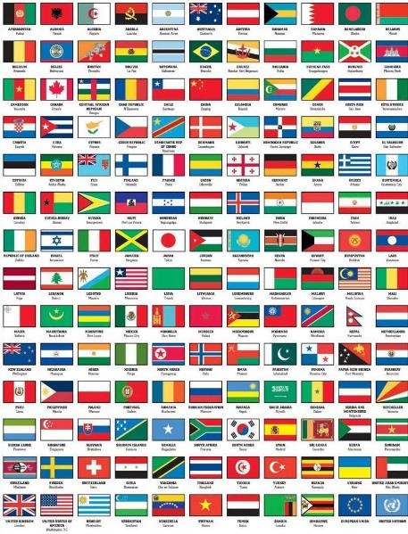
Outline
  Table of nations (Gen 10)
  Tower of Babel (Gen 11:1-9)
  Genealogy from Shem to Terah (Gen 11:10-32)

Slide 9
Outline
  Table of nations (Gen 10)
  Tower of Babel (Gen 11:1-9)
  Genealogy from Shem to Terah (Gen 11:10-32)

Slide 10
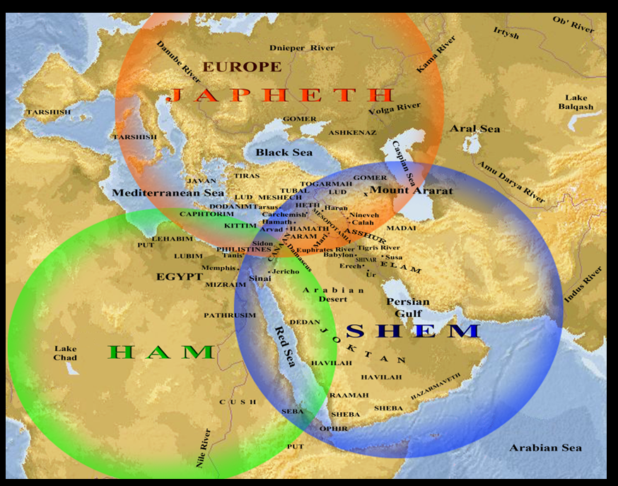

Slide 11
Genesis 10–11 Questions & Answers
  Origin of the nations?
  Dispersal of the nations?
  Corruption of the nations?
  What happened in the days of Peleg? (Gen. 10:25)
  Nimrod’s empire in Shinar? (Gen. 10:10)
  How did Nimrod get to Assyria? (Gen. 10:11-12)

Slide 12
Outline
  Table of nations (Gen 10)
  Tower of Babel (Gen 11:1-9)
  Genealogy from Shem to Terah (Gen 11:10-32)

Slide 13
GENESIS 11:1-9
Outline
  The Former World (1-2)
  The Rebellion (3-4)
  God’s Condescension (5)
  God’s Observations (6)
  God’s Intervention (7-8a)
  The Results (8b-9)

Slide 14
Outline
  Table of nations (Gen 10)
  Tower of Babel (Gen 11:1-9)
  Genealogy from Shem to Terah (Gen 11:10-32)

Slide 15
Genesis 9:26
“He also said, ‘Blessed be the Lord, The God of Shem; And let Canaan be his servant.’”

Slide 16

God’s Messianic Purposes Beginning in Genesis
Proto-evangelium from Adam & Eve (3:15)
Seth (4:25)
Noah (Gen 5:29)
Shem (9:26)
Abraham (12:3)
Isaac (21:12)
Jacob (25:23)
Judah (49:10)

Slide 17
God’s Messianic Purposes Beginning in Genesis
Proto-evangelium from Adam & Eve (3:15)
Seth (4:25)
Noah (Gen 5:29)
Shem (9:26)
Abraham (12:3)
Isaac (21:12)
Jacob (25:23)
Judah (49:10)

Slide 18

Genesis 11:10-26 Outline
  Shem (11:10-11)
  Arphachshad (11:12-13)
  Shelah (11:14-15)
  Eber (11:16-17)
  Peleg (11:18-19)
  Reu (11:20-21)
  Serug (11:22-23)
  Nahor (11:24-25)
  Terah (11:26)

Slide 19
Genesis 11:10-26 Outline
  Shem (11:10-11)
  Arphachshad (11:12-13)
  Shelah (11:14-15)
  Eber (11:16-17)
  Peleg (11:18-19)
  Reu (11:20-21)
  Serug (11:22-23)
  Nahor (11:24-25)
  Terah (11:26)

Slide 20
Three Concluding Observations
(Gen 11:10-26)
    Age of patriarch at birth of seed-son demonstrate no genealogical gaps
    Antediluvian and Patriarchal overlap
    Shorter patriarchal ages indicate changed world conditions

Slide 21
Three Concluding Observations
(Gen 11:10-26)
    Age of patriarch at birth of seed-son demonstrate no genealogical gaps
    Antediluvian and Patriarchal overlap
    Shorter patriarchal ages indicate changed world conditions

Slide 22
Three Concluding Observations
(Gen 11:10-26)
    Age of patriarch at birth of seed-son demonstrate no genealogical gaps
    Antediluvian and Patriarchal overlap
    Shorter patriarchal ages indicate changed world conditions

Slide 23

Dr. Arnold G. Fruchtenbaum
The Book of Genesis, 232
“…only four life spans link together the continuity of tradition from Adam to Jacob, and these make three links. The four life spans are Adam, Lamech, Shem and Jacob. The three links are from Adam to Lamech, since Adam was living when Lamech was born; from Lamech to Shem, since Lamech was living when Shem was born; and from Shem to Isaac and Jacob, since Shem was still living when both Isaac and Jacob were born. Therefore, there are not many gaps in the tradition to retain the history.”

Slide 24
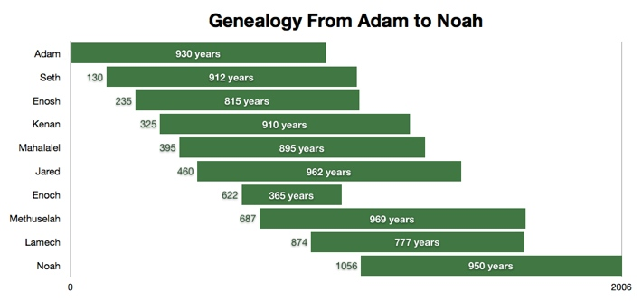

Slide 25
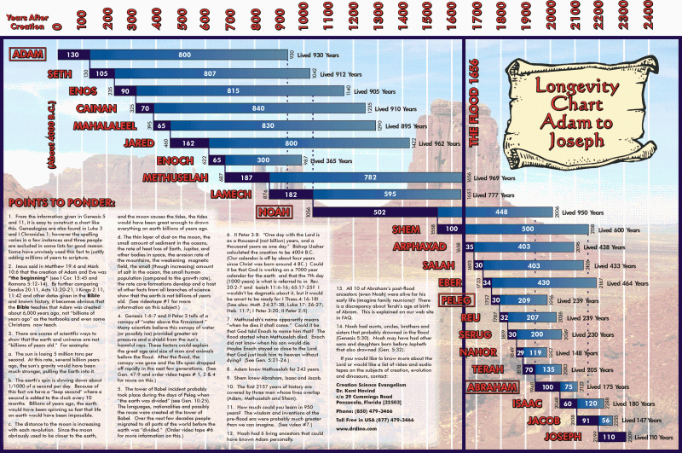

Slide 26
Dr. Arnold G. Fruchtenbaum
The Book of Genesis, 232
“Along this line, the following points should be made: Noah lived until Terah, the father of Abraham, was 128 years old; Shem and Eber outlived Terah; Eber outlived Abraham; and, based upon when Terah died, Shem died when Isaac or Jacob was 48 years old…So as to the question of how history was maintained and how the tradition was kept, there is really no problem here because quite a bit of overlapping occurs within these genealogies.”

Slide 27
Three Concluding Observations
(Gen 11:10-26)
    Age of patriarch at birth of seed-son demonstrate no genealogical gaps
    Antediluvian and Patriarchal overlap
    Shorter patriarchal ages indicate changed world conditions

Slide 28
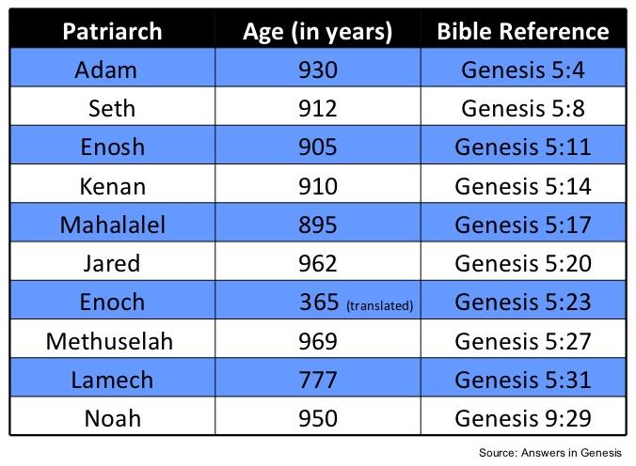

Slide 30
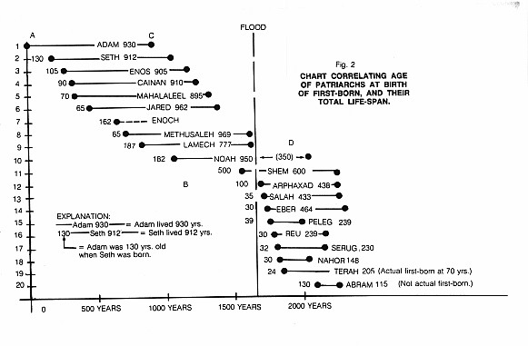

Slide 31
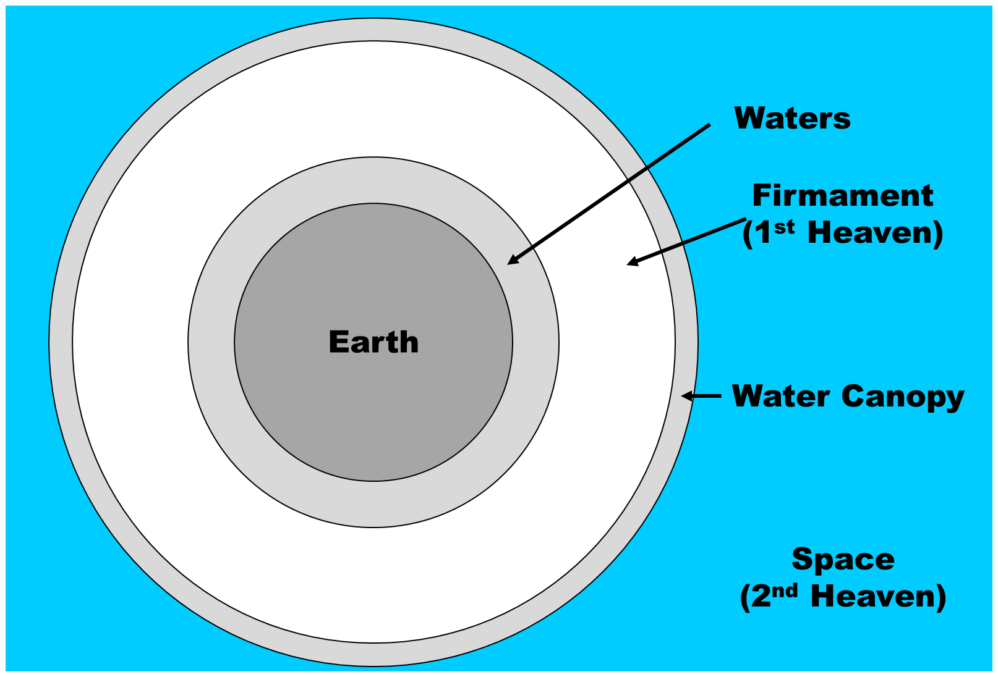

Slide 32
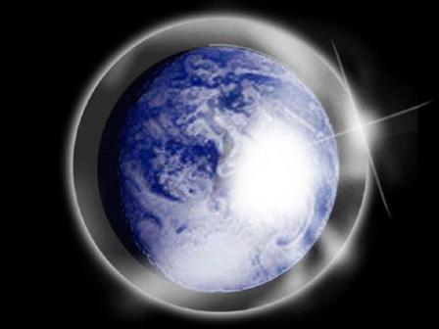

Slide 33
Day 2 Canopy Theory
(Gen 1:6-8)
Implied – Gen. 1:6-7; Ps. 148:4
Explains
  Long life spans of early man – Gen. 5:5, 27
  Strange beasts – (Gen. 1:24-25; Job 40‒41)
  Where the flood waters came from – (Gen. 2:5-6)
  Why man’s post-flood life span cut short – (Gen. 11:24-25)

Slide 34
Eight-Fold Pattern
Genesis 11:10-11
  Generation of Shem: First
  Name: Shem
  Meaning: Name
  Name of seed son: Arphachshad
  Age at birth of seed-son: 100 years
  Additional years lived: 500 years
  Total years lived: 600 years
  Begat other sons & daughters: Yes

Slide 35
Eight-Fold Pattern
Genesis 11:12-13
  Generation of Shem: Second
  Name: Arphachshad
  Meaning: Unclear
  Name of seed son: Shelah
  Age at birth of seed-son: 35 years
  Additional years lived: 403 years
  Total years lived: 438 years
  Begat other sons & daughters: Yes

Slide 36
Dr. Arnold G. Fruchtenbaum
The Book of Genesis, 231
“…there is a gradual decrease in the age of man. A sharp drop occurs between Shem and Arpachshad, between the first and second generation, during which time the Flood occurred. What probably caused the sudden decrease was the Flood. This was part of God’s divine judgment on humanity.”

Slide 37
Eight-Fold Pattern
Genesis 11:16-17
  Generation of Shem: Fourth
  Name: Eber
  Meaning: Cross over
  Name of seed son: Peleg
  Age at birth of seed-son: 34 years
  Additional years lived: 430 years
  Total years lived: 464 years
  Begat other sons & daughters: Yes

Slide 38
Eight-Fold Pattern
Genesis 11:18-19
  Generation of Shem: Fifth
  Name: Peleg
  Meaning: Division
  Name of seed son: Reu
  Age at birth of seed-son: 30 years
  Additional years lived: 209 years
  Total years lived: 239 years
  Begat other sons & daughters: Yes

Slide 39
Dr. Arnold G. Fruchtenbaum
The Book of Genesis Record, 231-32
“A second sharp drop occurs between Eber and Peleg, which are the fourth and fifth generations. It was between the fourth and fifth generation that the Tower of Babel event occurred. Therefore, with these two divine judgments, a sharp drop in the longevity of man occurs. If the canopy theory is correct, that might account for it. However, even without the canopy theory, divine judgment will easily account for this decrease, because it is following the divine judgments that the sharp drops occurred.”

Slide 40
UNIFORMITARIANISM IS NOT BIBLICISM
 | ERA | SCRIPTURE | DISTINCTIVES
1. | CREATION | Genesis 1-2 | No death
2. | FALL | Genesis 3-6 | Death, painful pregnancy & toil, long life spans, no human government
3. | FLOOD | Genesis 7-10 | Shorter life spans, human government, one language, no nations
4. | BABEL | Genesis 11-present | No global government, multiple languages, nations, ethnicities
5. | ANTICHRIST | Rapture to 2nd Advent | Global government, restrainer removed
6. | KINGDOM | Rev. 20:1-10 | Long life spans, kingdom conditions, reality of death, renovated earth
7. | ETERNAL STATE | Rev. 21-22 | No death, new earth

Slide 41

Psalm 90:10
“As for the days of our life, they contain seventy years, Or if due to strength, eighty years, Yet their pride is but labor and sorrow; For soon it is gone and we fly away.”

Slide 42
Romans 6:23
“For the wages of sin is death, but the free gift of God is eternal life in Christ Jesus our Lord.”

Slide 43

Genesis 2:16-17
“¹⁶ The Lord God commanded the man, saying, ‘From any tree of the garden you may eat freely; ¹⁷ but from the tree of the knowledge of good and evil you shall not eat, for in the day that you eat from it you will surely die (muwth).’”

Slide 44
Genesis 3:19
“By the sweat of your face You will eat bread, Till you return to the ground, Because from it you were taken; For you are dust, And to dust you shall return.”

Slide 45
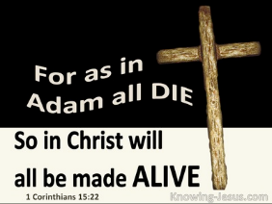
1 Corinthians 15:21-22
“²¹ For since by a man came death, by a man also came the resurrection of the dead. ²² For as in Adam all die, so also in Christ all will be made alive.”

Slide 46
Romans 5:12
“Therefore, just as through one man sin entered into the world, and death through sin, and so death spread to all men, because all sinned—.”

Slide 47
Why God Became Man
(Heb. 2:5-18)
To restore God’s original purpose for man (5-8)
To taste death for every man (9)
To bring many to glory (10-13)
To break Satan’s rule over humanity (14)
To remove the fear of death (15)
To become our merciful high priest (16-17a)
To make a complete purification for sin (17b)
To sympathize with those tested (18)
Adapted from J. Dwight Pentecost, Faith that Endures (Grand Rapids, MI: Kregel, 2000), 60-71.

Slide 48
Why God Became Man
(Heb. 2:5-18)
To restore God’s original purpose for man (5-8)
To taste death for every man (9)
To bring many to glory (10-13)
To break Satan’s rule over humanity (14)
To remove the fear of death (15)
To become our merciful high priest (16-17a)
To make a complete purification for sin (17b)
To sympathize with those tested (18)
Adapted from J. Dwight Pentecost, Faith that Endures (Grand Rapids, MI: Kregel, 2000), 60-71.

Slide 49
Hebrews 2:15
“and might free those who through fear of death were subject to slavery all their lives.”

Slide 50


Slide 51

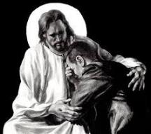
Revelation 21:4
“and He will wipe away every tear from their eyes; and there will no longer be any death; there will no longer be any mourning, or crying, or pain; the first things have passed away.”

Slide 52
Psalm 90:10
“As for the days of our life, they contain seventy years, Or if due to strength, eighty years, Yet their pride is but labor and sorrow; For soon it is gone and we fly away.”

Slide 53
Conclusion

Slide 54
Genesis 11:10-26 Outline
  Shem (11:10-11)
  Arphachshad (11:12-13)
  Shelah (11:14-15)
  Eber (11:16-17)
  Peleg (11:18-19)
  Reu (11:20-21)
  Serug (11:22-23)
  Nahor (11:24-25)
  Terah (11:26)

Slide 55
GENESIS STRUCTURE
  Beginning of the Human race (Gen. 1‒11)
  Beginning of the Hebrew race (Gen. 12‒50)

Slide 56

GENESIS STRUCTURE
  Genesis 12-50 (four people)
  Abraham (12:1–25:11)
  Isaac (25:12–26:35)
  Jacob (27–36)
  Joseph (37–50)

Slide 57


Isaiah 43:1
“But now, thus says the Lord, your Creator, O Jacob, And He who formed you, O Israel, 'Do not fear, for I have redeemed you; I have called you by name; you are Mine!'”

Slide 58


Slide 59

“The Lord bless you and keep you; the Lord make his face shine on you and be gracious to you; the Lord turn his face toward you and give you peace.” (NIV)

