Slide 1
THE RAPTURE
What and When? – Part 63
Andrew Marshall Woods, Th.M., JD., PhD.
Sr. Pastor, Sugar Land Bible Church

Slide 2
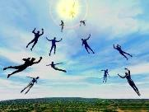
The Rapture Course Overview
What is the Rapture?
When is the Rapture?
Strengthening the Pre-Tribulational case
The opposing views
One second after the Rapture

Slide 3
MAIL BAG
Wrath to come (1 Thess. 1:10)?
Day = 1000 years (2 Pet. 3:8)?
Hastening the Lord’s return (2 Pet. 3:12)?
2 witnesses (Rev. 11) born before the Rapture?
Holy Spirit’s role in the Tribulation?
Israel focus in the Tribulation?
Will we see the Antichrist?
Date for the Rapture?
Believers protected during Tribulation?
Return to the earth?

Slide 4
MAIL BAG
Wrath to come (1 Thess. 1:10)?
Day = 1000 years (2 Pet. 3:8)?
Hastening the Lord’s return (2 Pet. 3:12)?
2 witnesses (Rev. 11) born before the Rapture?
Holy Spirit’s role in the Tribulation?
Israel focus in the Tribulation?
Will we see the Antichrist?
Date for the Rapture?
Believers protected during Tribulation?
Return to the earth?

Slide 6
Promised Exemption from Divine Wrath
The promise (1 Thess 1:10; 5:9; Rom 5:9; 8:1; Rev 3:10)
Tribulation = divine wrath/anger (Rev 6:16-17; 11:18; 14:10; 15:1, 7; 16:1, 19; 19:15)

Slide 7
MAIL BAG
Wrath to come (1 Thess. 1:10)?
Day = 1000 years (2 Pet. 3:8)?
Hastening the Lord’s return (2 Pet. 3:12)?
2 witnesses (Rev. 11) born before the Rapture?
Holy Spirit’s role in the Tribulation?
Israel focus in the Tribulation?
Will we see the Antichrist?
Date for the Rapture?
Believers protected during Tribulation?
Return to the earth?

Slide 8
Shaping and Populating (Gen 1:1)
Day 1: | Light | Day 4: | Luminaries
Day 2: | Water, sky | Day 5: | Sea animals, birds
Day 3: | Land, vegetation | Day 6: | Land animals, man

Slide 9
MAIL BAG
Wrath to come (1 Thess. 1:10)?
Day = 1000 years (2 Pet. 3:8)?
Hastening the Lord’s return (2 Pet. 3:12)?
2 witnesses (Rev. 11) born before the Rapture?
Holy Spirit’s role in the Tribulation?
Israel focus in the Tribulation?
Will we see the Antichrist?
Date for the Rapture?
Believers protected during Tribulation?
Return to the earth?

Slide 10
2 Peter 3:12
“looking for and hastening [speudō] the coming of the day of God, because of which the heavens will be destroyed by burning, and the elements will melt with intense heat!.”

Slide 11
2 Peter 3:9
“The Lord is not slow about His promise, as some count slowness, but is patient toward you, not wishing for any to perish but for all to come to repentance.”

Slide 12
Romans 11:25-26
“²⁵ For I do not want you, brethren, to be uninformed of this mystery—so that you will not be wise in your own estimation—that a partial hardening has happened to Israel until the fullness of the Gentiles has come in; ²⁶ and so all Israel will be saved; just as it is written, ‘The Deliverer will come from Zion, He will remove ungodliness from Jacob.’”

Slide 13
MAIL BAG
Wrath to come (1 Thess. 1:10)?
Day = 1000 years (2 Pet. 3:8)?
Hastening the Lord’s return (2 Pet. 3:12)?
2 witnesses (Rev. 11) born before the Rapture?
Holy Spirit’s role in the Tribulation?
Israel focus in the Tribulation?
Will we see the Antichrist?
Date for the Rapture?
Believers protected during Tribulation?
Return to the earth?

Slide 14
MAIL BAG
Wrath to come (1 Thess. 1:10)?
Day = 1000 years (2 Pet. 3:8)?
Hastening the Lord’s return (2 Pet. 3:12)?
2 witnesses (Rev. 11) born before the Rapture?
Holy Spirit’s role in the Tribulation?
Israel focus in the Tribulation?
Will we see the Antichrist?
Date for the Rapture?
Believers protected during Tribulation?
Return to the earth?

Slide 15
Daniel 9:24
Seventy weeks have been decreed for your people and your holy city, to finish the transgression, to make an end of sin, to make atonement for iniquity, to bring in everlasting righteousness, to seal up vision and prophecy and to anoint the most holy place.

Slide 17
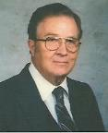
Robert Culver Daniel and the Latter Days (Chicago, IL: Moody Press, 1977), p. 149
“Let the postmillennial and amillennial commentators look long and steadily at this fact. This prophecy is a prophecy for Daniel’s people and Daniel’s city. No alchemy of Origenistic spiritualizing interpretation can change that.”

Slide 18
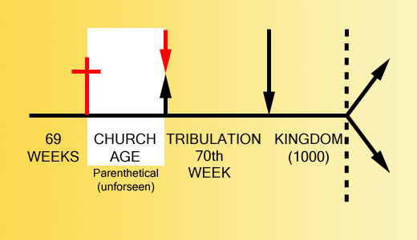

Slide 19
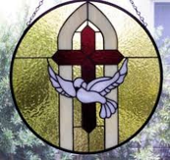
1 Samuel 16:13-14
¹³ Then Samuel took the horn of oil and anointed him in the midst of his brothers; and the Spirit of the Lord came mightily upon David from that day forward. And Samuel arose and went to Ramah. ¹⁴ Now the Spirit of the Lord departed from Saul, and an evil spirit from the Lord terrorized him.

Slide 20
John 14:16-17
¹⁶ I will ask the Father, and He will give you another Helper, that He may be with you forever; ¹⁷ that is the Spirit of truth, whom the world cannot receive, because it does not see Him or know Him, but you know Him because He abides with you and will be in you.

Slide 21
WORK OF THE SPIRIT IN THE OT
 | OT/GOSPELS/ACTS 1 | ACTS 2/TODAY
External vs. Internal | Upon (1 Sam. 16:13) | Within (John 14:17)
Reception of all of the Spirit at the moment of salvation? | Subsequent to salvation (Exod 31:3) | At moment of salvation (Rom 8:9)
How long is the indwelling? | Temporary indwelling (1 Sam 16:14; Ps 51:11) | Permanent indwelling (John 14:16)
Who is indwelt? | Selective indwelling (Joel 2:28) | Universal indwelling (1 Cor 12:13)

Slide 22
MAIL BAG
Wrath to come (1 Thess. 1:10)?
Day = 1000 years (2 Pet. 3:8)?
Hastening the Lord’s return (2 Pet. 3:12)?
2 witnesses (Rev. 11) born before the Rapture?
Holy Spirit’s role in the Tribulation?
Israel focus in the Tribulation?
Will we see the Antichrist?
Date for the Rapture?
Believers protected during Tribulation?
Return to the earth?

Slide 23
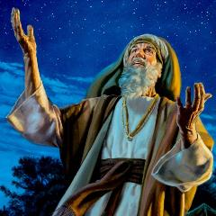
Genesis 12:3
“And I will bless those who bless you, And the one who curses you I will curse. And in you all the families of the earth will be blessed.”

Slide 25
Distinctions Between 144,000 & Multitude
144,000 | MULTITUDE
Revelation 7:1-8 | Revelation 7:9-17
Numbered | Innumerable
Jews | All nations
Sealed (First Fruits) | Slain (Martyrs)
Sealed before the Tribulation | Converted out of the Tribulation
Hitchcock and Ice, The Truth Behind Left Behind, 77

Slide 26
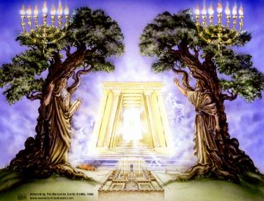
God’s Work Through Israel
Rev 7 – 144,000 Jews
Rev 11 – Two Jewish witnesses
Rev 12 – Israel flees

Slide 27
MAIL BAG
Wrath to come (1 Thess. 1:10)?
Day = 1000 years (2 Pet. 3:8)?
Hastening the Lord’s return (2 Pet. 3:12)?
2 witnesses (Rev. 11) born before the Rapture?
Holy Spirit’s role in the Tribulation?
Israel focus in the Tribulation?
Will we see the Antichrist?
Date for the Rapture?
Believers protected during Tribulation?
Return to the earth?

Slide 28
Revelation 13:17-18
“¹⁷ and he provides that no one will be able to buy or to sell, except the one who has the mark, either the name of the beast or the number of his name. ¹⁸ Here is wisdom. Let him who has understanding calculate the number of the beast, for the number is that of a man [anthrōpos]; and his number is six hundred and sixty-six.”

Slide 29
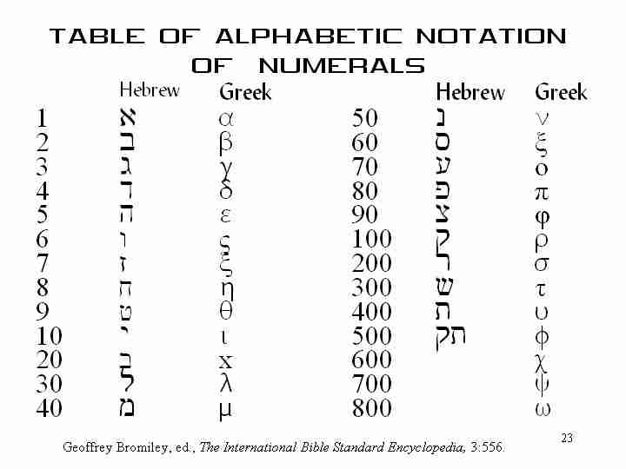

Slide 30
2 Thessalonians 2:6-7
⁶And you know what restrains [katechon; neuter] him now, so that in his time he will be revealed. ⁷For the mystery of lawlessness is already at work; only he who now restrains [katechōn; masculine] will do so until he is taken out of the way.

Slide 31
MAIL BAG
Wrath to come (1 Thess. 1:10)?
Day = 1000 years (2 Pet. 3:8)?
Hastening the Lord’s return (2 Pet. 3:12)?
2 witnesses (Rev. 11) born before the Rapture?
Holy Spirit’s role in the Tribulation?
Israel focus in the Tribulation?
Will we see the Antichrist?
Date for the Rapture?
Believers protected during Tribulation?
Return to the earth?

Slide 34
Levitical Feasts (23)
Feast | Season | Purpose | Type
Passover | Spring | Redemption | 1 Cor 5:7
Unleavened Bread | Spring | Separation | John 6:35
1st fruits | Spring | Praise | 1 Cor 15:20
Pentecost | Spring | Praise | Acts 2:1-4
Trumpets | Fall | New Year | Matt 24:31
Atonement | Fall | Lev 16 | Zech 12:10
Booths | Fall | Wilderness provision | Zech 14:16-18

Slide 35
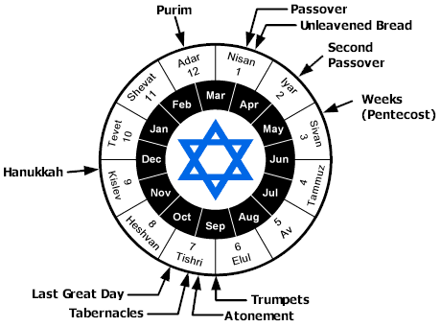

Slide 36
MAIL BAG
Wrath to come (1 Thess. 1:10)?
Day = 1000 years (2 Pet. 3:8)?
Hastening the Lord’s return (2 Pet. 3:12)?
2 witnesses (Rev. 11) born before the Rapture?
Holy Spirit’s role in the Tribulation?
Israel focus in the Tribulation?
Will we see the Antichrist?
Date for the Rapture?
Believers protected during Tribulation?
Return to the earth?

Slide 37
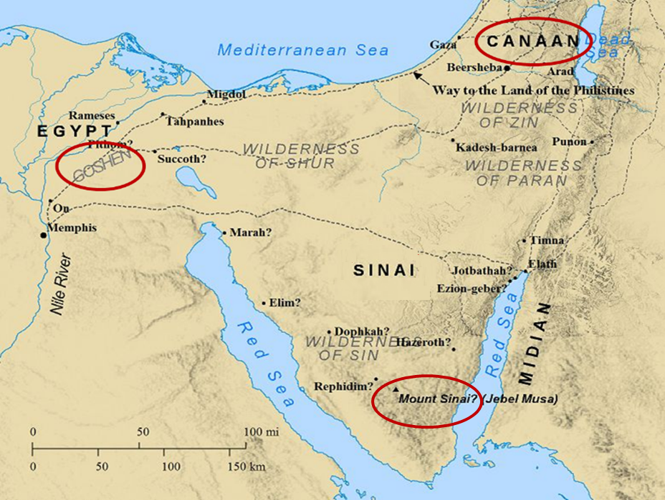

Slide 38
2. Protection Through the Tribulation?
(Revelation 3:10)
Like the protection in Goshen (Exod. 8:22, 24; 9;4, 6; 11:4-7; Rev. 9;4; 16:2)
Effective? Rev. 6:9-11; 7:13-14; 13:10, 15; 17:6; 18:24; 20:4
Comfort? John 14:1; 1 Thess. 4:18; Titus 2:13

Slide 39
MAIL BAG
Wrath to come (1 Thess. 1:10)?
Day = 1000 years (2 Pet. 3:8)?
Hastening the Lord’s return (2 Pet. 3:12)?
2 witnesses (Rev. 11) born before the Rapture?
Holy Spirit’s role in the Tribulation?
Israel focus in the Tribulation?
Will we see the Antichrist?
Date for the Rapture?
Believers protected during Tribulation?
Return to the earth?

Slide 40
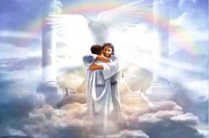
Ephesians 1:3
“Blessed be the God and Father of our Lord Jesus Christ, who has blessed us with every spiritual blessing in the heavenly places in Christ.”

Slide 41
John 14:1–4
¹ “Do not let your heart be troubled; believe in God, believe also in Me. ² “In My Father’s house are many dwelling places; if it were not so, I would have told you; for I go to prepare a place for you. ³ “If I go and prepare a place for you, I will come again and receive you to Myself, that where I am, there you may be also. ⁴ “And you know the way where I am going.”

Slide 42
Revelation 1:6; 5:10
“and He has made us to be a kingdom, priests to His God and Father—to Him be the glory and the dominion forever and ever. Amen…You have made them to be a kingdom and priests to our God; and they will reign [basileuō] upon the earth [gē].”

Slide 43
John 14:1–4
¹ “Do not let your heart be troubled; believe in God, believe also in Me. ² “In My Father’s house are many dwelling places; if it were not so, I would have told you; for I go to prepare a place for you. ³ “If I go and prepare a place for you, I will come again and receive you to Myself, that where I am, there you may be also. ⁴ “And you know the way where I am going.”

Slide 44
1 Thessalonians 4:13-18
. . . have fallen asleep. ¹⁶ For the Lord Himself will descend from heaven with a shout, with the voice of the archangel and with the trumpet of God, and the dead in Christ will rise first. ¹⁷ Then we who are alive and remain will be caught up together with them in the clouds to meet the Lord in the air, and so we shall always be with the Lord. ¹⁸ Therefore comfort one another with these words."

Slide 45
Jewish Marriage Analogy
STEP | JEWISH MARRIAGE | CHURCH ANALOGY
1. Marriage covenant | Groom initiated; Covenant established upon payment for bride; drank same cup | Christ initiated; Christ’s sacrificial death (1 Cor. 6:19-20; 11:25)
2. Bride set apart | Bride set apart exclusively for groom | Church’s positionally sanctified (1 Cor. 1:2; 6:9-11)
3. Bridal chamber prepared | Groom separates from bride and returns to his father’s house to prepare bridal chamber | Christ’s 2000 year separation from church; Ascension; return to heaven to prepare dwellings (John 14:2; Acts 1:9-11)
4. Betrothal period | Loyalty test | Reward determined by orthodoxy and orthopraxy (Jas. 4:4)
5. Bride retrieved | Groom returns at unknown time preceded by a shout with escorts to retrieve bride | Rapture at unknown time (John 14:3; 1 Thess. 4:16-17)
Showers, Maranatha Our Lord, Come!, 164-69.

Slide 46
Jewish Marriage Analogy
STEP | JEWISH MARRIAGE | CHURCH ANALOGY
6. Bride and groom hidden in Father’s house for seven days | Hidden in the Father’s house for seven days: three events transpire | Church hidden from world during Daniel’s 70th Week
7. Bride cleansed | Bride undergoes ritual cleansing prior to wedding ceremony | Bema Seat Judgment (1 Cor 3:10-15; 2 Cor 5:10)
8. Wedding ceremony | Meeting with the Father’s assembled wedding guests; Private wedding ceremony | Meeting with OT saints; Rev 19:7
9. Consummation | Bride and groom consummate the marriage | Eph 5:27
10. Marriage feast | Public presentation; Bride unveiled; marriage feast | Col 3:3-4; Rev 19:9
Showers, Maranatha Our Lord, Come!, 164-69.

